Slide 1

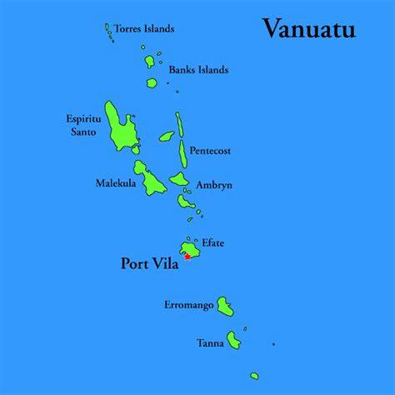
UPDATE OF THE VANUATU PROJECT
“The End Malaria in Vanuatu –For Good”
Campaign
RAM National Conference 2022

Slide 2
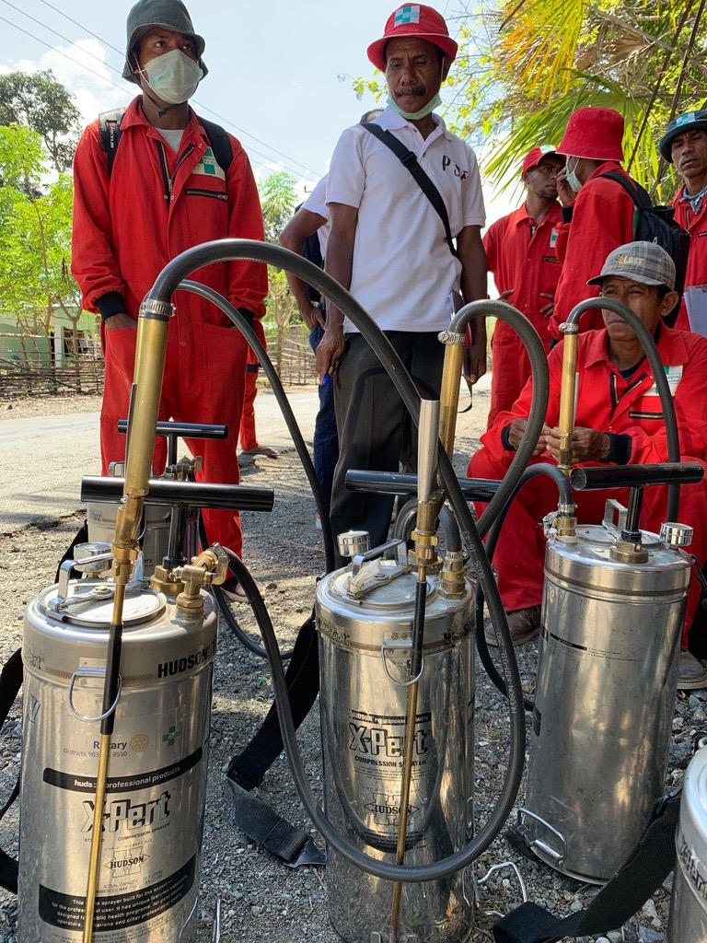
The First Tier of Financial Support to Vanuatu
A Rotary Global Grant
Submission
Objective
Progress

Slide 3
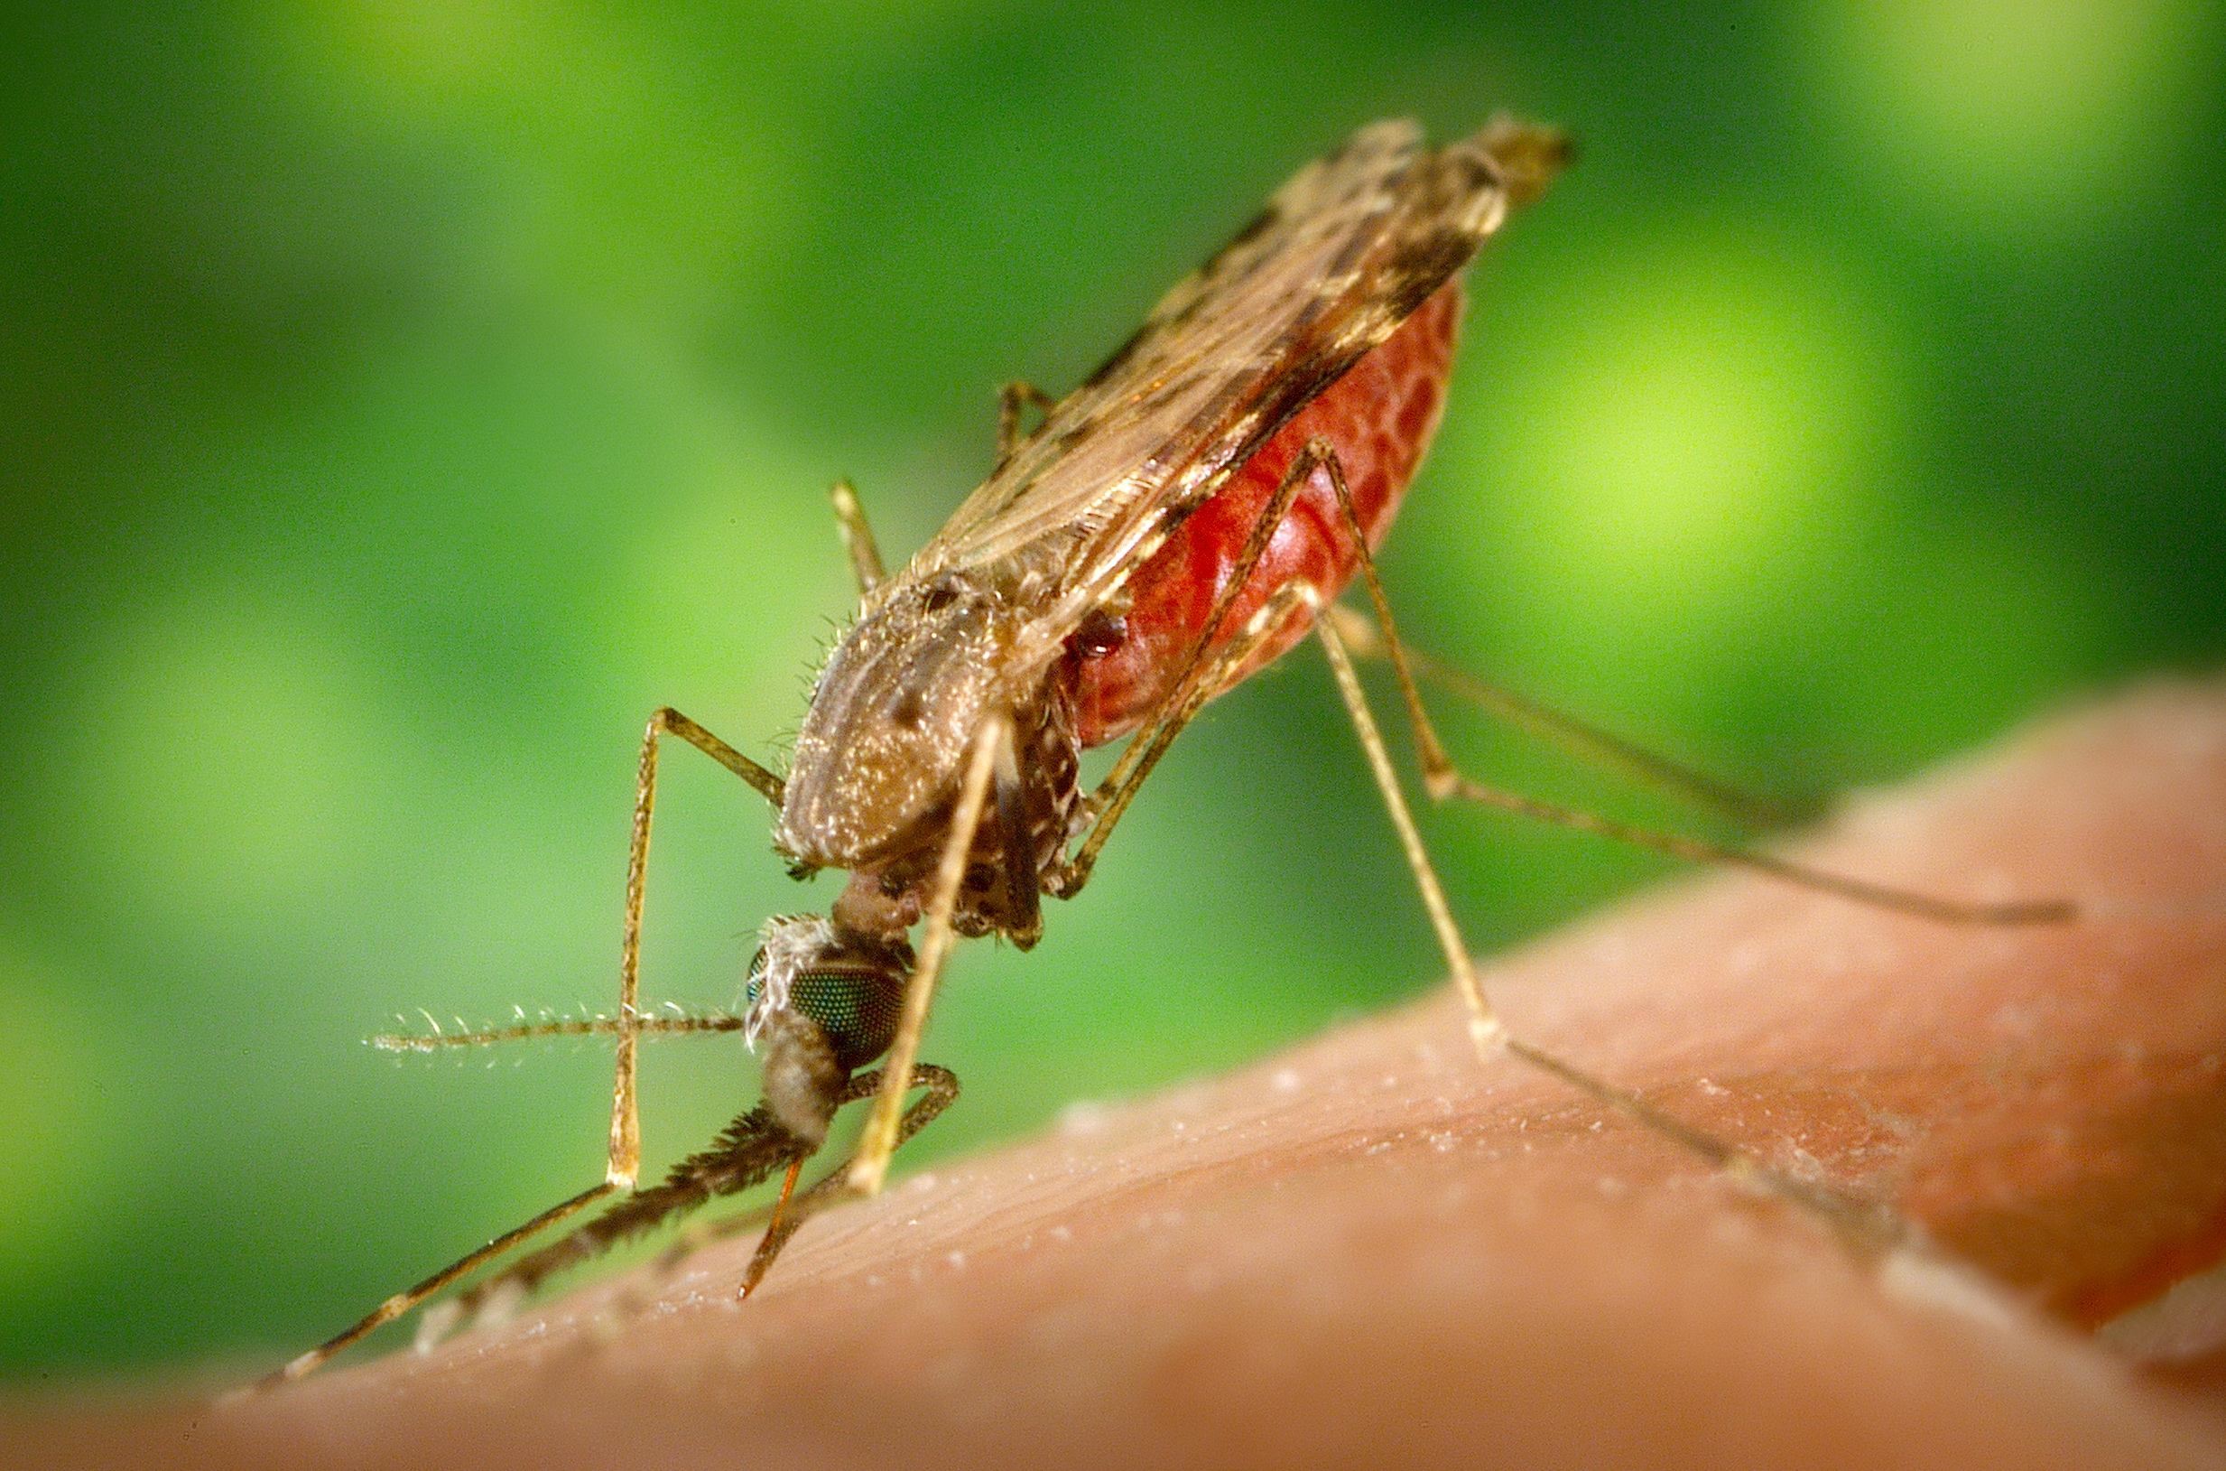
The Second Tier of Financial Support to Vanuatu
Why was the RAWCS/RAM Fundraising Account initiated?
How did COVID
intervene?
Why are there upsurges
in cases?

Slide 4
What is Happening Now?
A shift back to normal operations for malaria programs
An urgent response to areas with malaria resurgence
Address malaria staffing gaps
Targeted indoor residual spraying (IRS)
Development of key malaria awareness materials
Distribution of mosquito nets to
fill gaps
Community awareness and
education

Slide 5
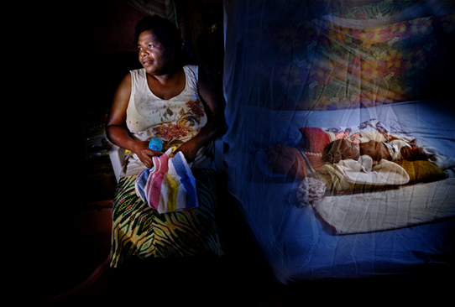
What is Happening Now?
A Rapid Response has been instigated through the National Health Emergency Centre

Slide 6
Data Management to determine Hotspots
This Report was completed for the Island of Epi in July
Reports such as this are done in the Outbreak Areas to ascertain where priority activities should take place

