Slide 1
An update on the Malaria Vaccine Project Dr Danielle Stanisic
A Good Group technology
CONFIDENTIAL

Slide 3
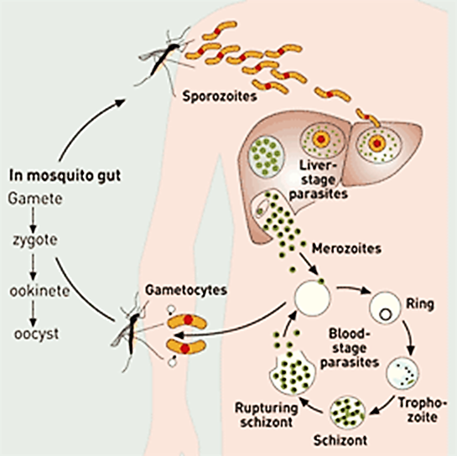
Global malaria vaccine development
Multiple vaccine approaches in development
  e.g. sub-unit and whole parasite
Multiple types of vaccines targeting different parasite life-cycle stages
  Liver-stage
  Blood-stage
  Transmission-blocking
The malaria parasite has significant protein diversity
Liver-stage vaccines require 100% efficacy

Slide 4
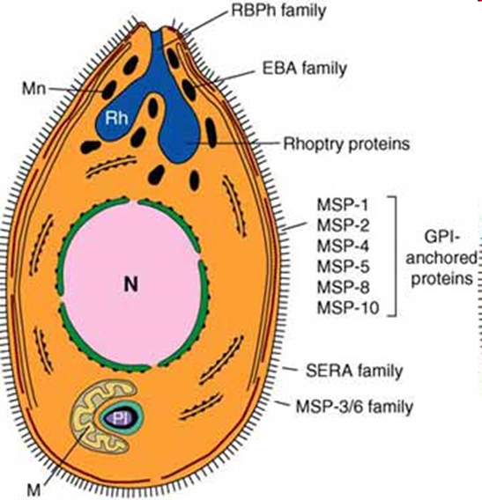
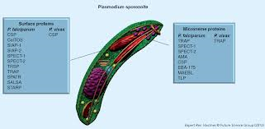
Two Broad Malaria Vaccine Approaches
Sub-unit vaccines
Contain a small part of the parasite eg a single protein
Require adjuvants (substance that enhances immune response)
Proteins that are targeted are often variable between different parasite strains
Immune responses often not long-lived
Low and variable protection

Slide 5
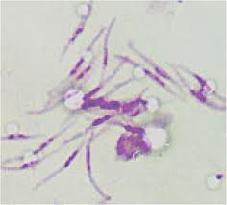
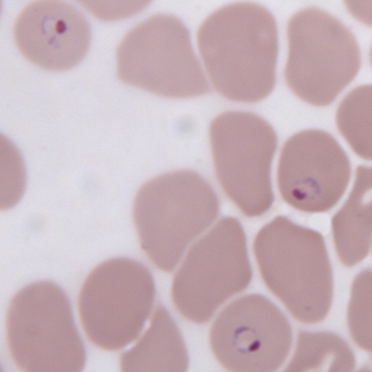
Whole Parasite Vaccines
-Many different protein targets including proteins that are the same (conserved) between parasite strains.
-May overcome issues associated with protein variation.
Approaches:
Liver-stage:
-Irradiated sporozoite vaccine
-Sporozoites + Chemoprophylaxis
-Genetically attenuated sporozoite vaccine
Blood-stage:
-Controlled Infection Immunisation (blood-stage parasites + drug treatment)
-Chemically attenuated blood-stage vaccine
-Killed parasite blood-stage vaccine (liposomes)
-Genetically attenuated blood-stage vaccine

Slide 6
Leading malaria vaccine candidates
Duffy et al, npj Vaccines, 2020, 5:48.

Slide 7
Mosquirix (RTS,S)
MosquirixTM – Sub-unit, liver-stage vaccine has been recommended by the WHO for children in Africa at high risk of contracting malaria. It is only partially effective against severe disease (30%) and there is no evidence of protection against death.
Prof. Dyann Wirth, Professor of Infectious Diseases at Harvard University, and the Chair of the WHO Malaria Policy Advisory Group (MPAG):
“And so, I think this is one of those situations where we have a tool (referring to the RTS,S vaccine), it’s demonstrated through, both the clinical trial, and now through the implementation trials, to have a measurable and significant impact. And that’s the reason we’re approving it. We’re not saying this is the end, and in fact, I’m hoping this is the beginning, a renaissance, of vaccine development in the malaria field. I think in fact that now we have an approved vaccine, means it may actually spur the field to use some of the great new innovations in vaccines that have occurred since this vaccine was first developed over 30 years ago.”
Malaria Vaccine Technology Roadmap
-Developing malaria vaccines with protective efficacy of at least 75 percent against clinical malaria by 2030
-Developing malaria vaccines that reduce transmission of the parasite in order to substantially reduce the incidence of human malaria infection by 2030.

Slide 8
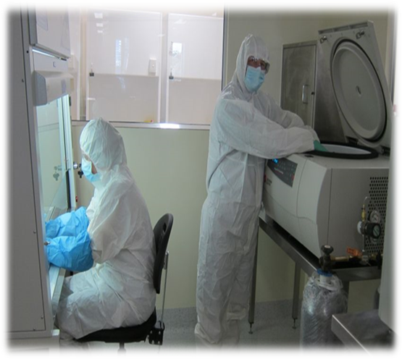
Griffith University’s Malaria Vaccine Programme
Pre-clinical development of whole parasite blood-stage vaccine candidates using animal models.
Developed 2 novel and distinct culture-based P. falciparum blood-stage cell banks for clinical studies.
Developed experimental human blood-stage challenge model for cultured malaria parasites.
GMP-compliant vaccine manufacture on-site at Griffith University.
Human clinical trials at Griffith University.
Whole parasite blood-stage vaccine candidates in the development pipeline.

Slide 9
A chemically attenuated P. yoelii 17X blood-stage vaccine induces broad protective immunity against different parasite strains
Compound used to treat malaria parasite: Tafuramycin A
Tafuramycin-A binds irreversibly to malaria parasite DNA and inhibits replication.
Vaccine consists of chemically treated pRBC. Red cell membranes must be intact.
In rodent models of malaria, chemically treated parasites can protect mice from challenge (P. chabaudi and P. yoelii). (Good et al 2013 J. Clin. Invest. 123(8): 3353-3362; Raja et al 2016 Infect. Immun. 84(8): 2274-2288).

Slide 10
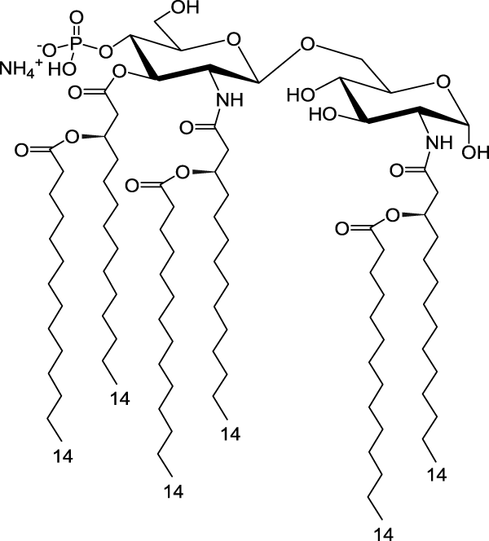
Our field-deployable whole parasite malaria vaccine
Lipids
Parasite
3D(6-acyl)PHAD
3D(6-acyl)PHAD helps to improve the immune response stimulated by the vaccine

Slide 11
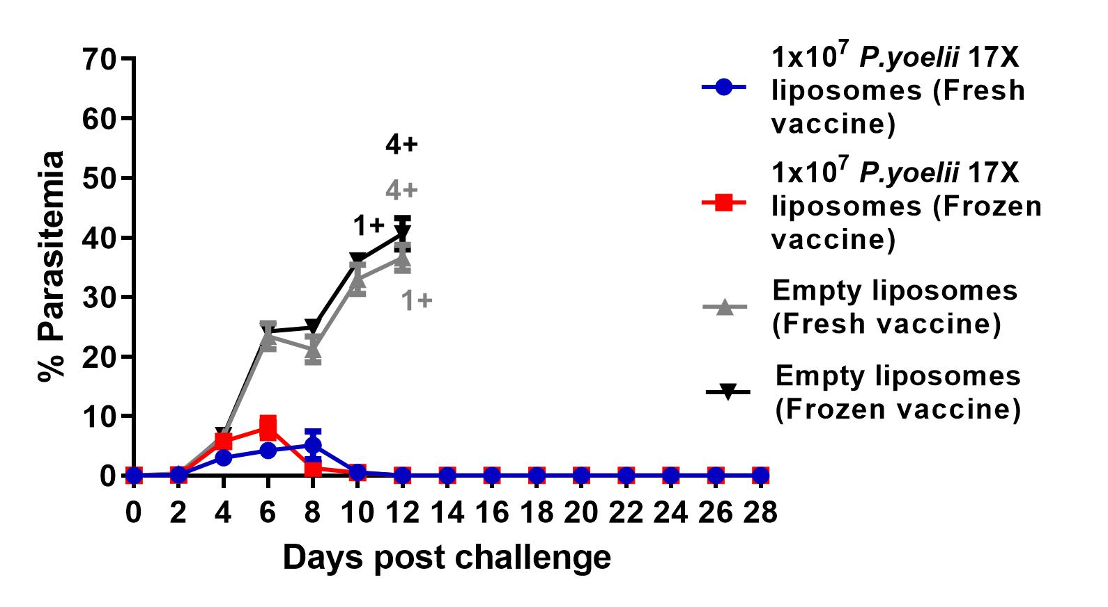
Efficacy of the P. yoelii 17X field-deployable vaccine in pre-clinical studies is maintained following freezing
Stanisic et al 2021 mBio 12(5):e0265721.

Slide 13

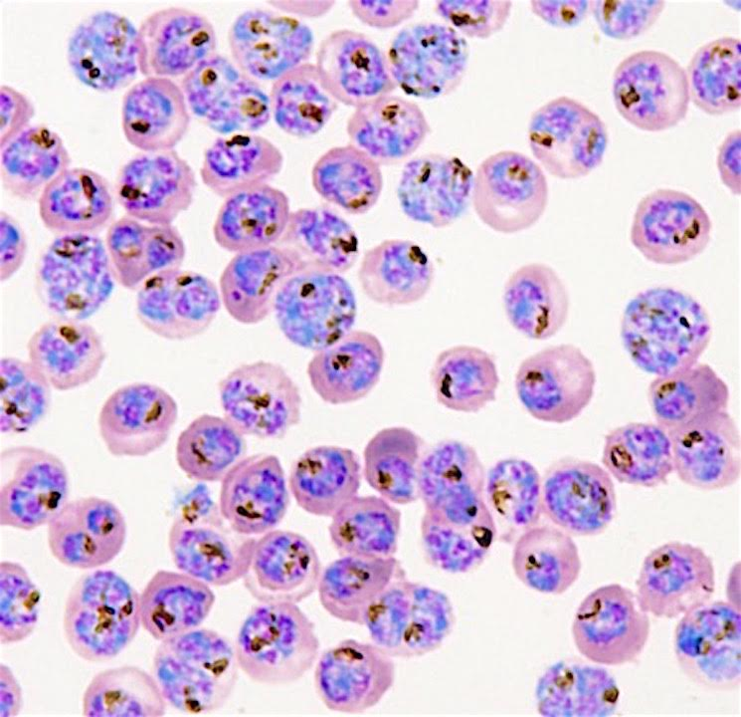
Next steps
The next key steps to progress our whole blood-stage parasite field-deployable vaccine candidate are:
GMP-compliant manufacture of a P. falciparum vaccine.
Formal toxicological evaluation of the P. falciparum vaccine.
A Phase I trial to assess safety and stimulation of an immune response in a dose-ranging sentinel-based study of malaria-naïve, healthy adult human volunteers.
Following the demonstration of safety and stimulation of an immune response, further clinical studies will be undertaken to assess the protective efficacy of the vaccine.

Slide 14
Acknowledgements
Gold Coast University Hospital
John Gerrard
James Fink
Kylie Alcorn
Johanna Mayer
Lana Sundac
Letitia Gore
Sarah Coghill
Kevin O’Callaghan
Andrew Slack
Hashim Abdeen
Mayur Raniga
Lee Forman
Charisma Dhaliwal
Tim Badrick
Prue Gramp
Dineshki Silva
Ezaam Fraz
Peter Simos
Georgia State University
Moses Lee
Burnet Institute
James Beeson
Jo-Anne Chan
Institute for Glycomics
Michael Good
Mei-Fong Ho
Emily Cooper
Reshma Nevagi
Maddie Walton
Amber Raja
Aloysious Ssemaganda
Xue Liu
Bibiana Rodriguez
Jolien Pingnet
Jessica Powell
Sai Lata De
Nicole Willemsen
Ibrahim El-Deeb
Judy Coote (CTU)
Maryna Brown (CTU)
Melanie Aikebuse (CTU)
Sanaria
Steve Hoffman
Kim Lee Sim
Tao Li
University of Queensland
Istvan Toth
Mariusz Skwarczynski
Waleed Hussein
Md. Tanjir Islam
The Study Participants
Funding
Rotary
Private Trust
Ray James
Zarraffas Coffee
Medical Research Future Fund
NFMRI
NHMRC
Perpetual
Merchant Foundation
Atlantic Philanthropies
QIMRB Institute for
Medical Research
James McCarthy
Silvana Sekuloski
Katharine Trenholme
Australian Army Malaria Institute
Dennis Shanks
Qin Cheng
Marina Chavchich
Mike Edstein
Fiona McCallum
Mater Hospital
Paul Griffin

Slide 15
