Slide 1

Loop-mediated isothermal amplification (LAMP):
Applicability in resource limited settings
Dr Leanna Isam
ADFMIDI

Slide 2
Overview
Introduction to LAMP
LAMP compared to other diagnostic tools
Commercial kits:
  Experience with Eiken kit in field settings
  Experience with Meridian Alethia kits
Future of LAMP

Slide 3
LAMP: an introduction

Slide 4
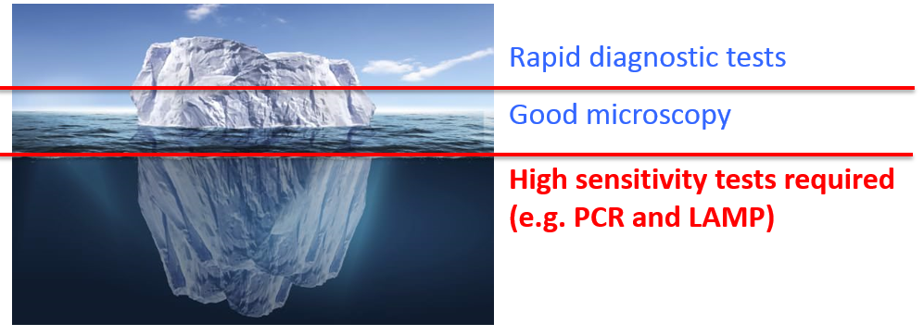
Loop-mediated isothermal amplification
Nucleic acid amplification test (replicates target DNA fragment)
Polymerase action
Constant temperature: 60-65° C
Duration: 15-60 minutes
DNA extraction > LAMP incubation > Result

Slide 5
LAMP compared to microscopy, RDTs, and PCR
Attribute | RDTs | Microscopy | PCR | LAMP
Sensitivity | ≥ 200 p/µL | ≥ 50 p/µL | ≥ 2-5 p/µL | ≥ 2-5 p/µL
Specificity | Ok | Good | Very good | Very good
Time to result | 15 min | ~ 1 hr | 1-2 hr | 15-60 min
Ease of use | No training required | Training required | Complex- training required | Simple- training required
Cost | $1-2 per test | $5-10 per test | $30-40 per test | $15-30 per test
RDTs and microscopy = case management, cold chain not required
PCR and LAMP = elimination settings, cold chain required

Slide 6
Commercial LAMP kits: Eiken

Slide 7
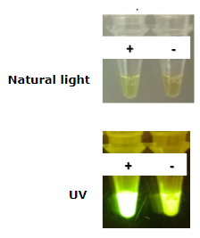
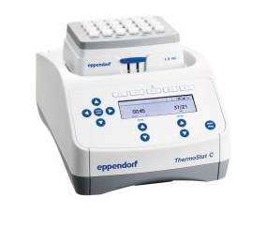
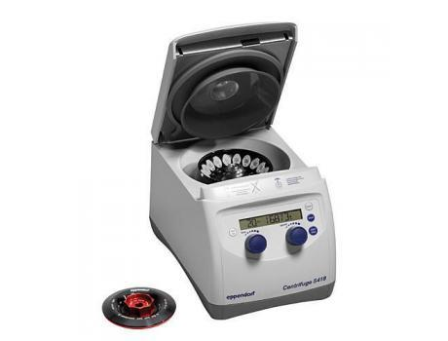
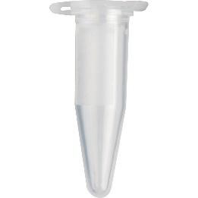

Eiken commercial LAMP kits
Founded LAMP technology
Made the first commercial kits
Pan and Pf specific
Visual result – instrumentation not required

Slide 8
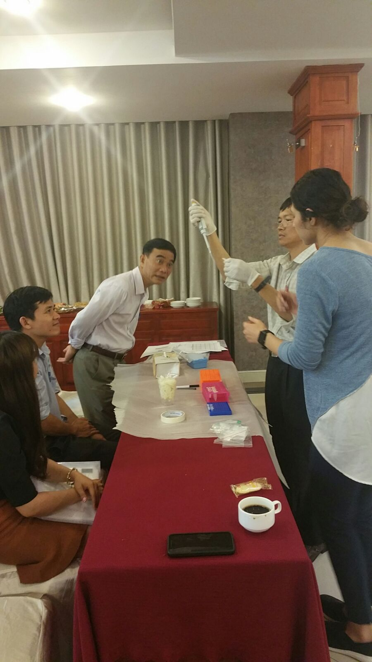
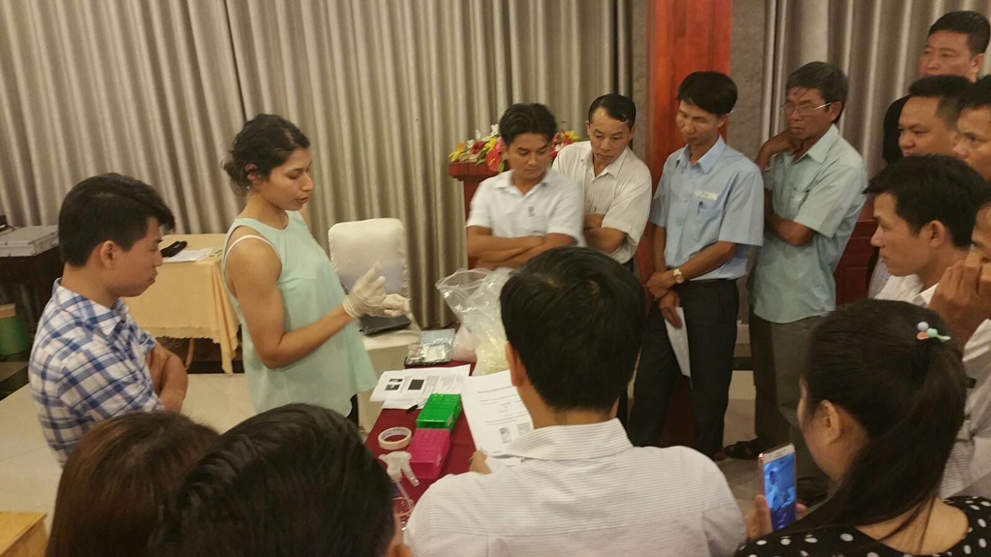
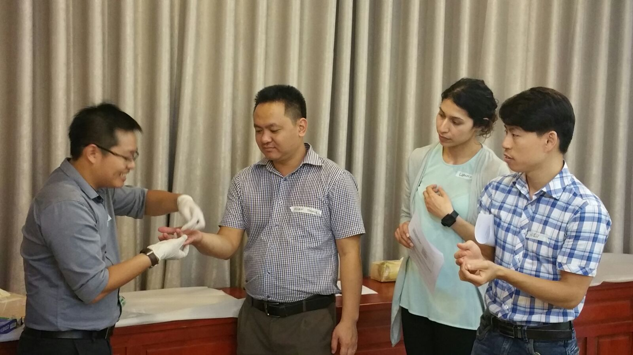
Using the Eiken kit in Vietnam
Training

Slide 9
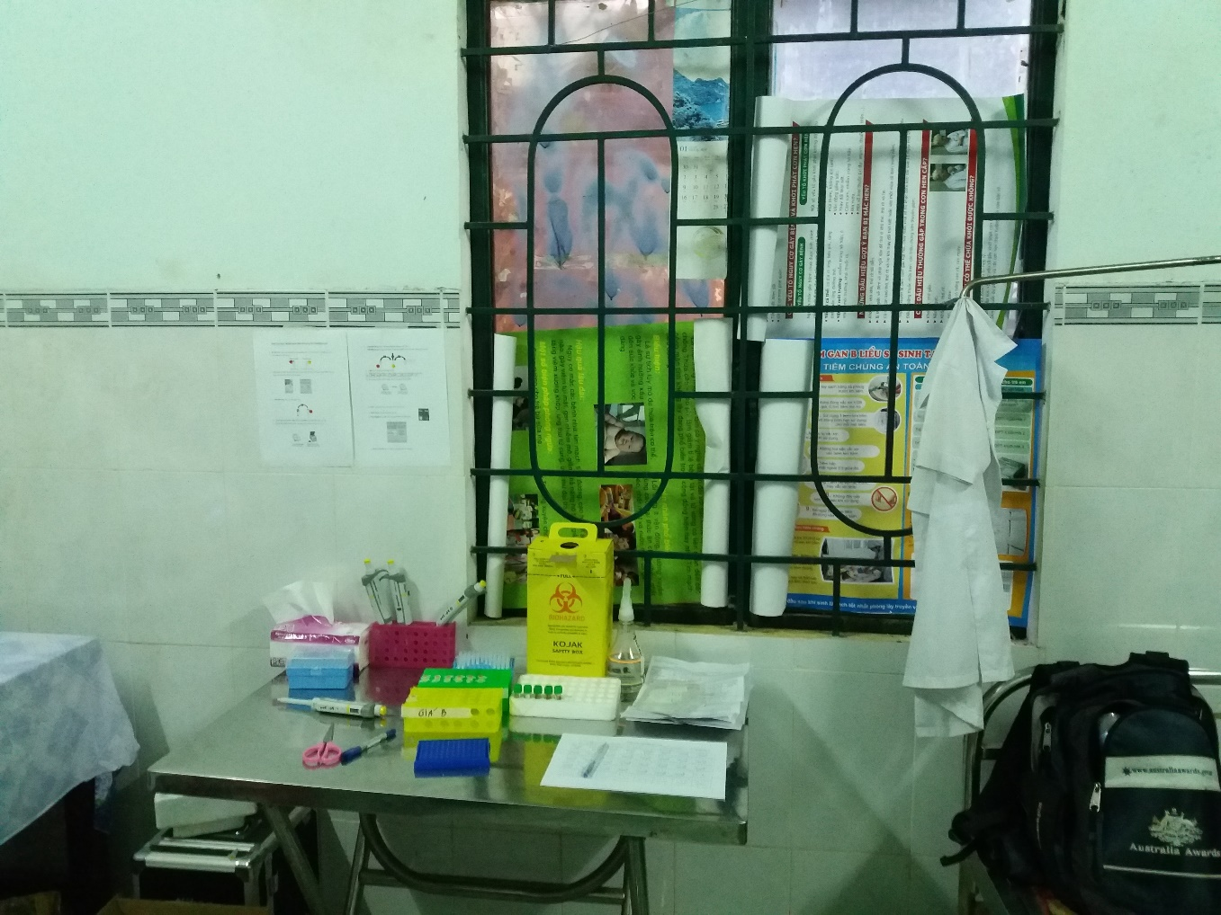
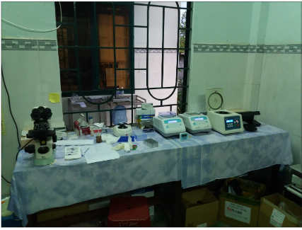
Using the Eiken kit in Vietnam
Set up workstations in health care centres

Slide 10
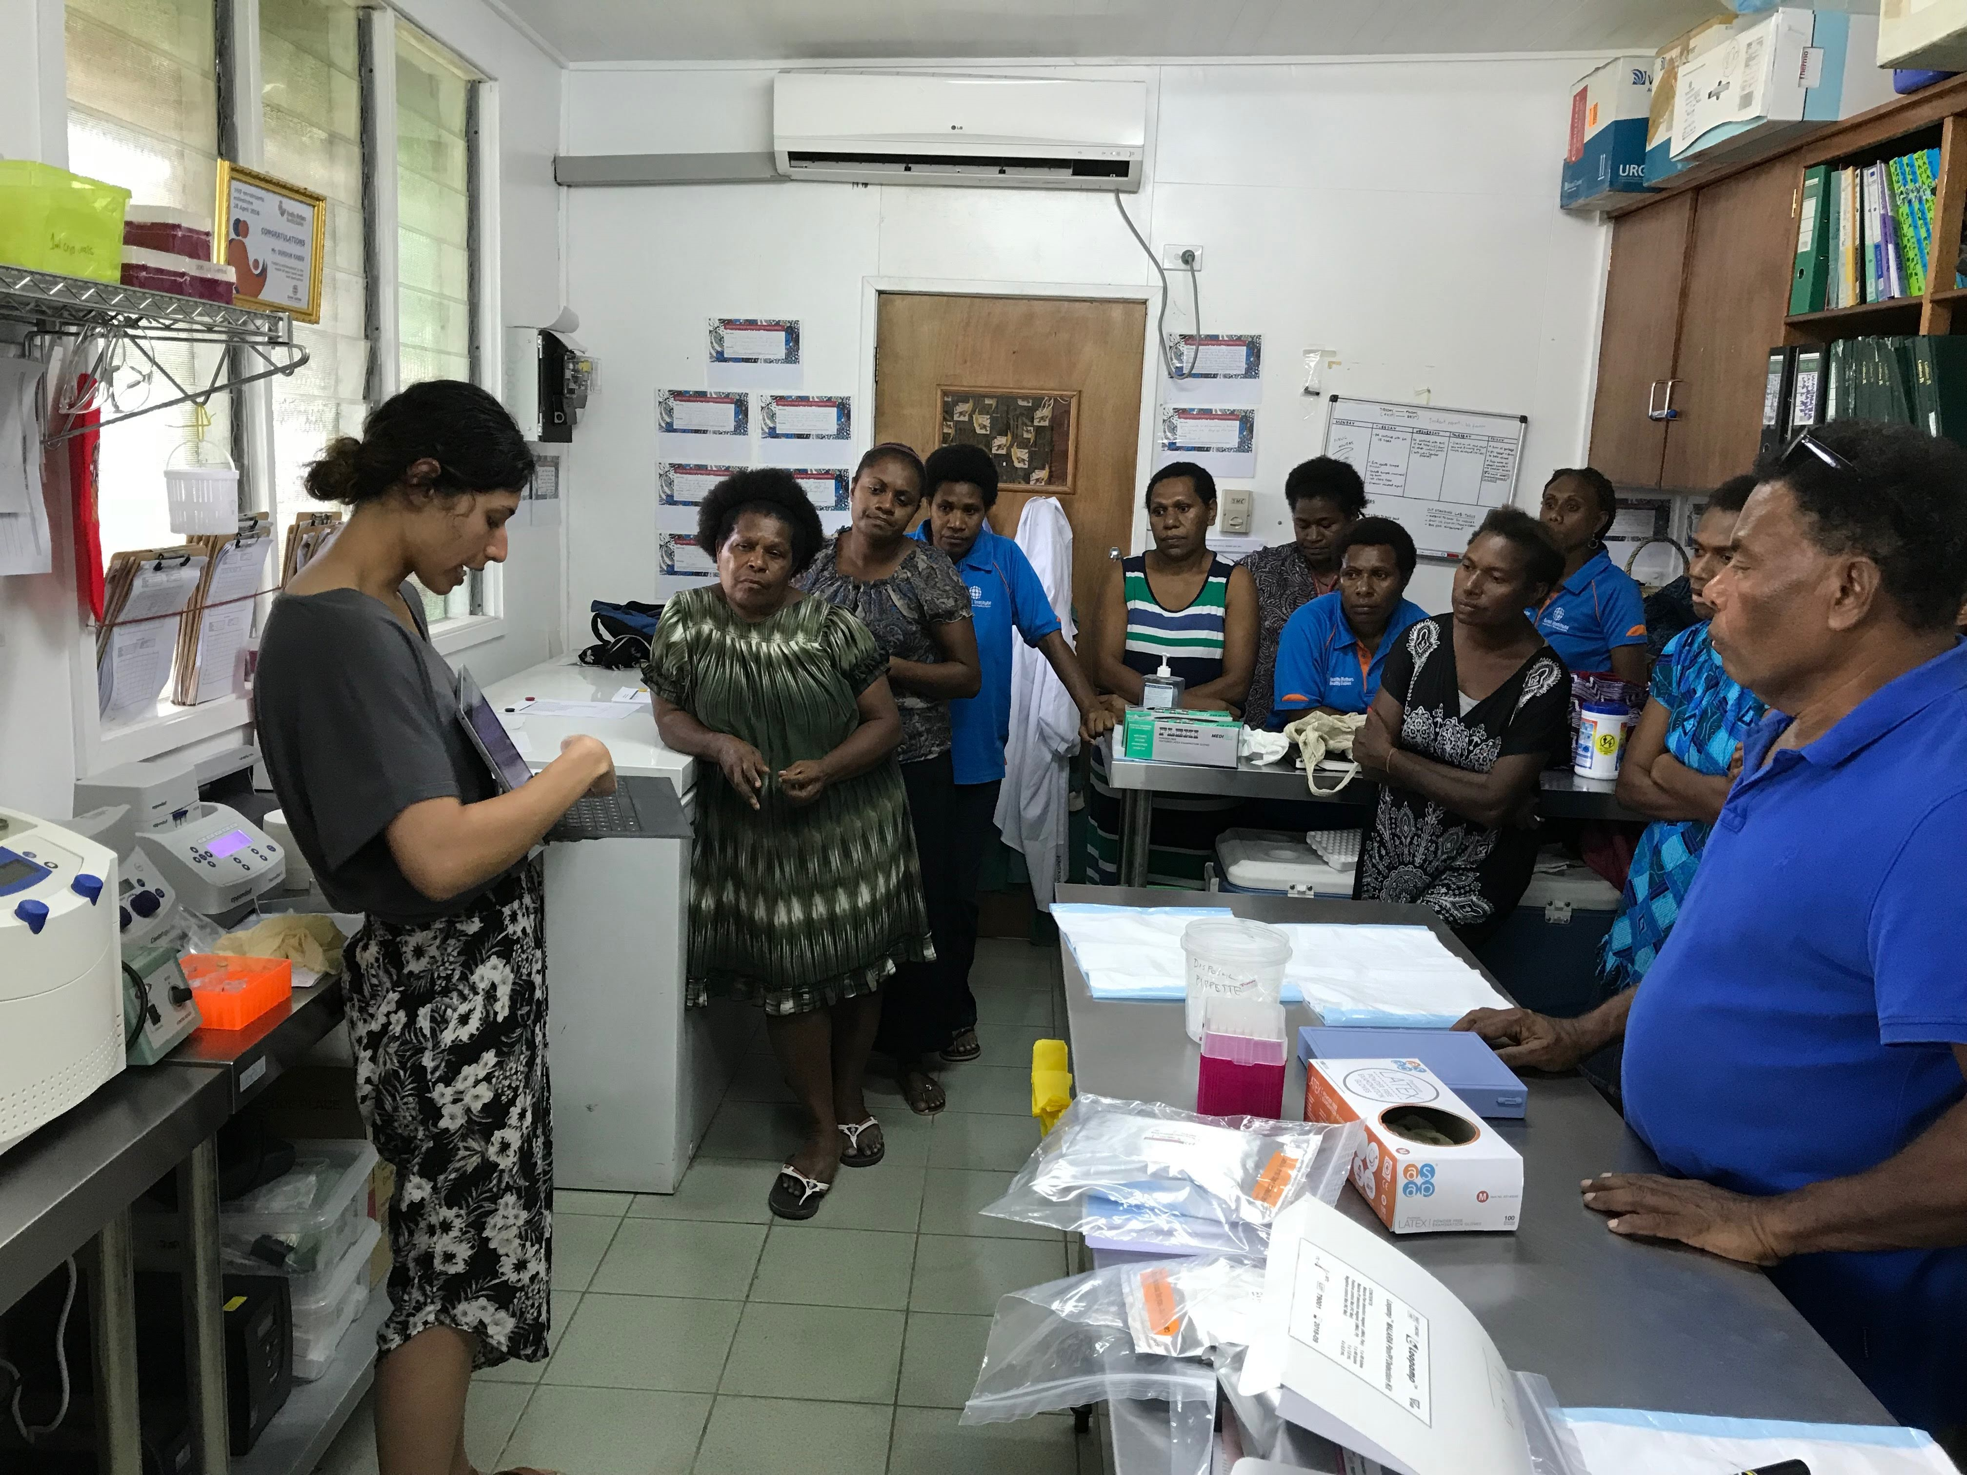
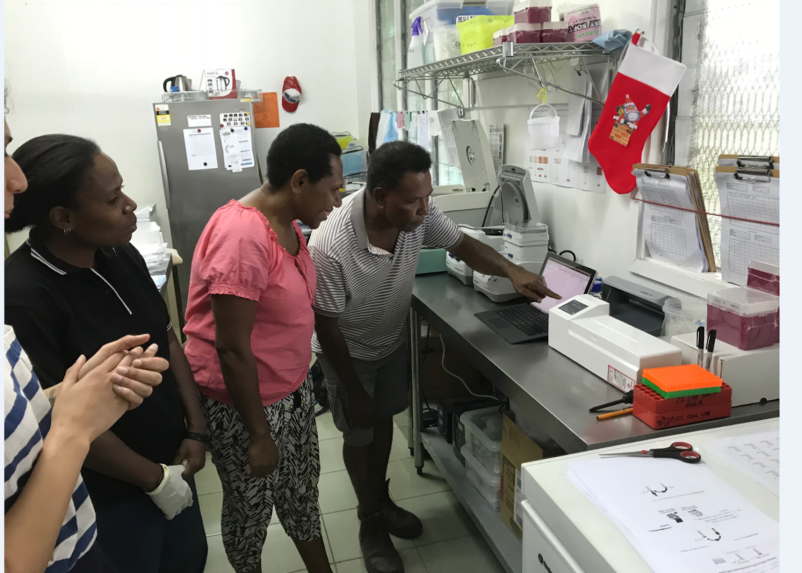
Using the Eiken kit in PNG

Slide 11
Eiken kit field performance
High acceptability
Easy to set up and maintain
Undiagnosed asymptomatic reservoir present

Slide 12
Limitations of Eiken kits
Power
Space
Cleanliness
Lighting issues for visual detection

Slide 13
Commercial LAMP kits: Meridian

Slide 14
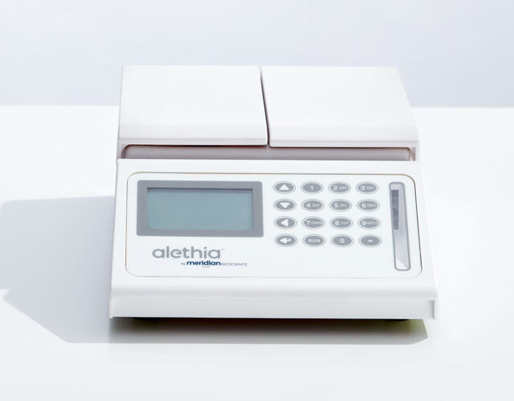
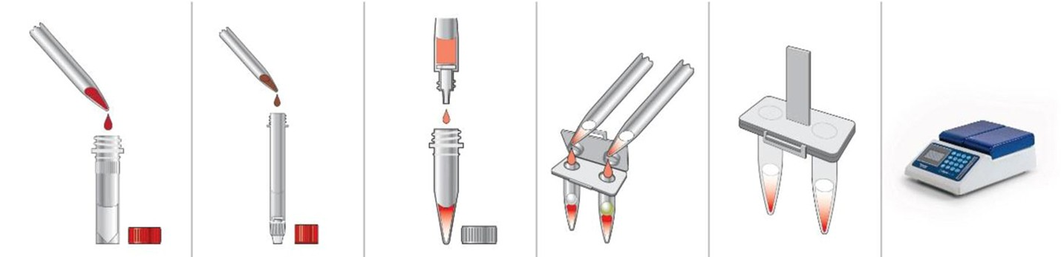
Meridian’s Alethia LAMP platform

Slide 15
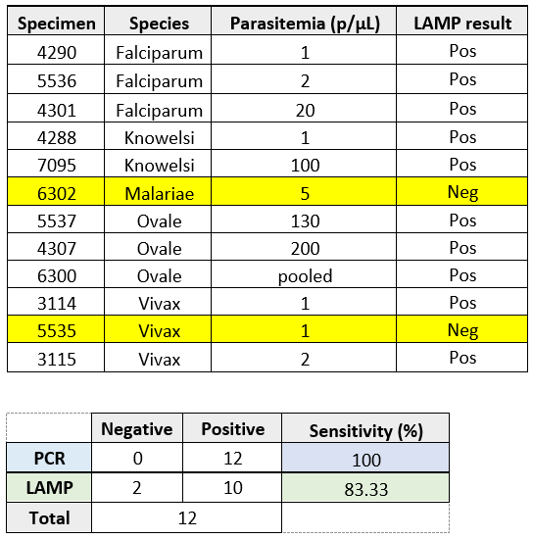
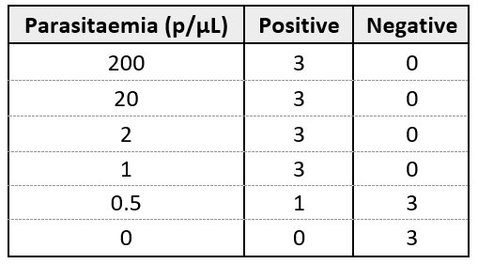
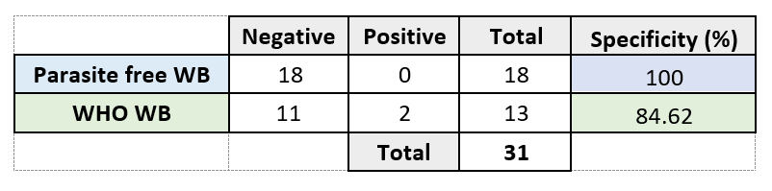
Performance of Alethia instrument at ADFMIDI
LOD of Pf samples
False positive rate
Compared to PCR
Pilot field study in PNG on DF and families

Slide 16
Future of LAMP

Slide 17
Scenarios most suitable for LAMP
Highly sensitive and specific
Can’t replace RDTs and microscopy for management in endemic areas
Use at hospital level for screening of returned travellers
During intensified surveillance in elimination settings

Slide 18
Questions?

