Slide 1



How to think about malaria control and elimination like a health economist
Angela Devine
Rotarians Against Malaria Conference – 22 October 2021
@devinefy

Slide 2
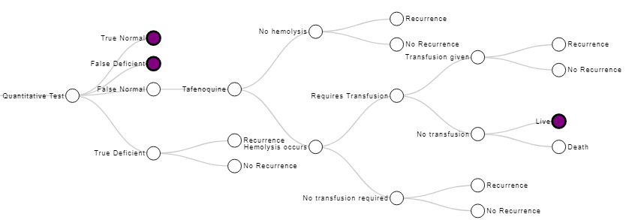
Seeing science through an economic and operational lens
  What will be the impact? (e.g., long-term health outcomes & cost savings)
Notes:
Longer-term costs of anemia & malnutrition for those with repeated Pv episodes

Slide 3
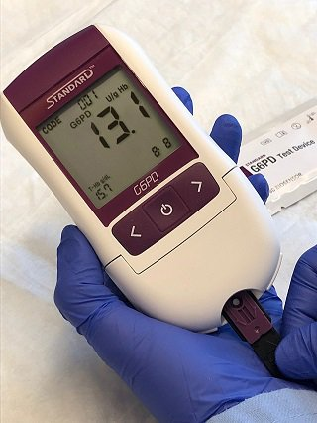
Seeing science through an economic and operational lens
  What will be the impact? (e.g., long-term health outcomes & cost savings)
  How will it work (in the field)?
Notes:
Motorbikes, high likelihood of being swiped

Slide 4
Seeing science through an economic and operational lens
  What will be the impact? (e.g., long-term health outcomes & cost savings)
  How will it work (in the field)?
  How much will it cost? (And who will pay for it?)
Spatial emanators
Notes:
Willingness to pay for it by households & malaria control program
Usually assumed that HH will pay for emanators
But ITNs usually paid for by NMCPs (needed more frequently than ITNs)

Slide 5
Seeing science through an economic and operational lens
  What will be the impact? (e.g., long-term health outcomes & cost savings)
  How will it work (in the field)?
  How much will it cost? (And who will pay for it?)
  What are the wider economic consequences of disease?
Notes:
This is what I’ll focus on for the first part of my talk…but a quick example…

Slide 6
The economic and social burden of malaria
Review by Sachs & Malaney (2002) Nature
Argue that the correlation between malaria and poverty runs both ways
  Poverty promotes malaria transmission
  Malaria causes poverty by impeding economic growth
Notes:
Similar studies have been done for HIV in Africa (lost productivity due to early deaths)
improved housing & Increased urbanization can reduce transmission (US, Greece, Italy),
--But not always enough (wealthy countries like Oman & UAE hadn’t been able to eliminate malaria)
Point to AJTMH study on economic growth and malaria

Slide 7
Funding for malaria treatment & control
Suggested that malaria control would be a valuable way to increase economic growth
  But point to huge funding shortfalls
  Still have a shortfall today
  But we have a higher % of the funding needed
Notes:
US$100m vs US$2.5b needed in 2007 (Sachs 2002)
2019 funding = US$3.0b for 91 countries vs $5.6b “to stay on track” (WMR 2020)
Current funding is a drop from 2017 (US$3.2b, WMR 2020)
US$600m spent on malaria R&D (WMR 2020)

Slide 8
Global burden of vivax malaria = US$359m
Only includes treatment costs & foregone productivity in 2017
Devine 2021 Plos Med

Slide 9
Vivax malaria global cost scenarios
Devine 2021 Plos Med

Slide 10
Types of Economic Evaluation
Type of analysis | Cost measure | Consequence measure | Results reported
Cost minimisation | Money | Identical outcomes | Lower cost
Cost consequence | Money | List of separate outcomes (no comparable valuation) | Summary table of costs and consequences
Cost benefit | Money | Money | Maximize the difference between benefits and costs
Cost effectiveness | Money | Natural units (ie infections averted) | Cost per unit (ie cost per infection averted)
Cost utility | Money | Multiple effects valued as a common unit (ie DALY or QALY) | Cost per QALY gained or DALY averted

Slide 11
Incremental cost-effectiveness ratios
Total costs (B) - Total costs (A)
ICER =
Outcomes (B) - Outcomes (A)
Incremental Costs
ICER =
Incremental Outcomes
ICER = Cost per QALY gained
ICER = Cost per DALY averted
ICER = Cost per infection averted

Slide 12
New frontiers for vivax malaria CEAs
Single-dose tafenoquine for radical cure
Quantitative G6PD testing
Simple interventions to improve effectiveness of primaquine
  Short course primaquine regimens
  Day 3 review to improve adherence & prevent haemolytic events
  Directly observed therapy for primaquine
  Patient, provider & community education
SD Biosensor

Slide 13
Pv global burden scenario analysis
Devine 2021 Plos Med

Slide 14
Question for malaria control programs
Do we invest in developing and implementing new tools?
Or do we focus on making sure that things like bednets and effective treatment are operating well?
Funding something new requires a disinvestment is something old…unless the budget is increased
Notes:
Insect repellent

Slide 15
Funding challenges
WMR 2020
  Paulden 2016
Malaria funding comes from a range of sources
  But do they all have the same priorities?
  Budget for malaria vs budget for the whole healthcare system
Notes:
Goal is to maximize health gains for the available budget

Slide 16
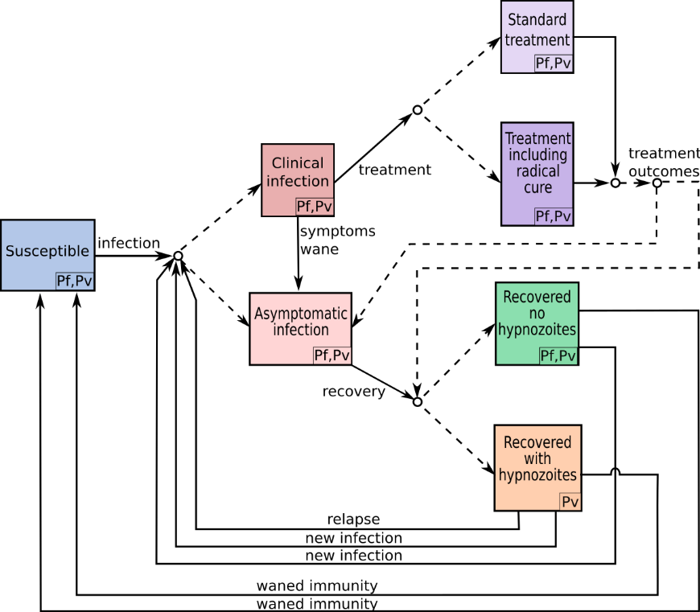
Getting the intervention mix right
Malaria control requires packages of complementary measures, but economic evaluations consider single interventions (Goodman 1999 Health Policy Plan)
  Economic evaluation using transmission models
Interventions differ in impact on malaria species
  Multi-species malaria models to incorporate impact on both Pf and Pv
Heterogeneity in malaria epidemiology
  Geographic resource allocation by district rather than country (Drake 2017Appl Health Econ Health Policy)
  Online interactive models give decision makers a chance to see the impact of parameters on outcomes (Devine 2017 Plos NTDs, Devine 2021 Plos Med)
Multi-species malaria model (in preparation)
Notes:
Heterogeneity: incidence, time to first relapse, G6PD deficiency
Geographic resource allocation: ITNs, CHWs or both in Myanmar

Slide 17

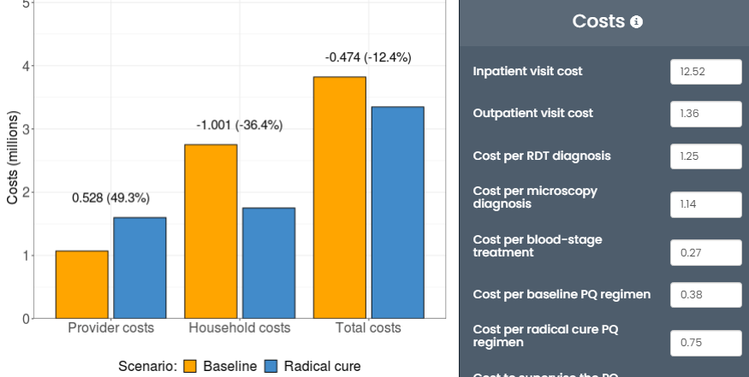
Online interactive models
Estimates provider and household costs of national policies for the treatment of vivax malaria management
Radical cure scenario: 14-day supervised PQ treatment provided to all who are eligible and test G6PD normal
Global cost app
Devine 2021 Plos Med

Slide 18
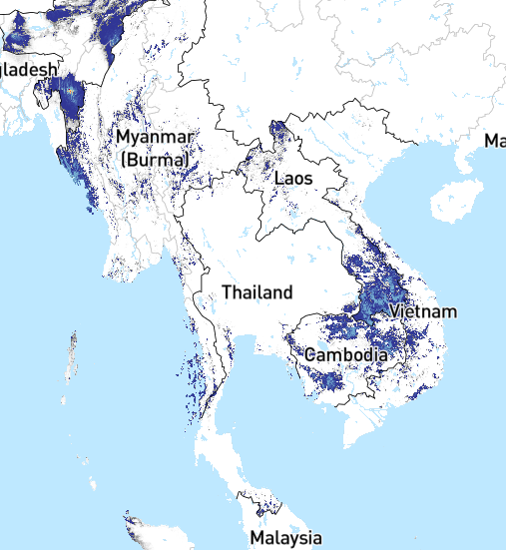
Elimination challenges
Countries are unlikely to achieve elimination without regional cooperation
As cases drop:
  The cost per case increases (economies of scale)
  Community health workers will become less effective (economies of scope)
We need to replace short-term thinking with long-term vision for malaria elimination
  Investment case (tourism, workforce productivity)
Notes:
Global fund allocations
A malaria episode usually lasts a few days but the long-term consequences are massive

Slide 19
Start thinking like a health economist
What will be the impact? (e.g., long-term health outcomes & cost savings)
  How is what you’re doing now going to impact malaria in the future?
How will it work (in the field)?
  Is it practical for a setting without electricity or A/C?
  Will people be willing to travel for this treatment?
How much will it cost? (And who will pay for it?)
  Involve a health economist early to collect appropriate data alongside clinical trials
What are the wider economic consequences of the disease?
  Greater awareness of the economic burden of malaria to bring context as to why what you’re working on is important
Notes:
Presentations, papers, grant applications, implementation studies…

Slide 20
Thank you!
Menzies
Ric N. Price
Kamala Thriemer
UniMelb
Julie A. Simpson
Niamh Meagher
Saber Dini
MORU
Yoel Lubell
Burnet Institute
Win Han Oo
Freya Fowkes
Paul Agius
Julia Cutts
Leanne Robinson
Telethon Kids + Curtin
Pete Gething
Institute for Disease Modelling
Katherine Battle
FIND
Rosalind E. Howes

