Slide 1
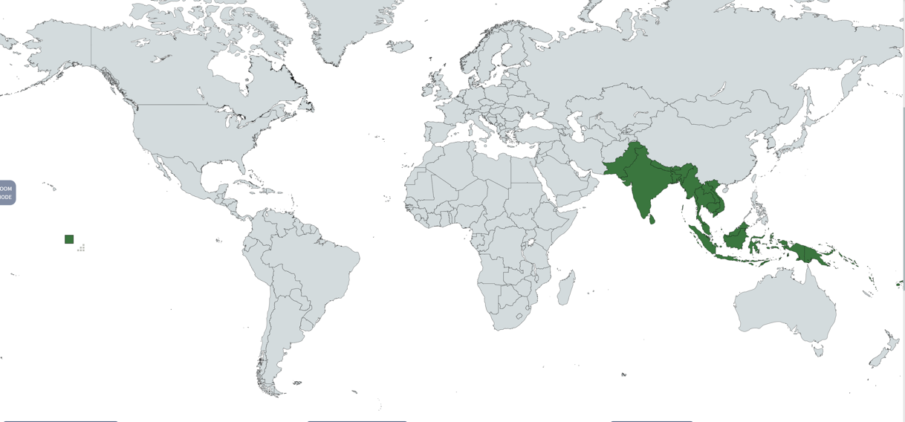
Cross Sector Development Partnerships Initiative (XSPI)
RAM Australia 2022 Conference
Progress Report - T-L & NTT Malaria Elimination Project
Dr. Dan Evans, Founding Chair – XSPI
Dr. Jenny Kerrison, RAM Australia & Chair, T-L & NTT Malaria Elimination Project
Jeff Smith, Lead Convenor, XSPI Indonesia Working Group

Slide 2
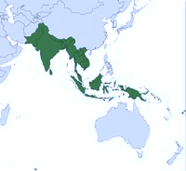
Presentation Outline
Timor- Leste & NTT Malaria Context
Project Co-Creation
Forward Program & Resourcing
Project Challenges & Key Learnings

Slide 3
Timor-Leste & NTT Malaria Context

Slide 4
Malaria in Timor-Leste
1.3 million estimated population (2021)
Global Fund key malaria program donor
2017 - 2020 all confirmed malaria cases were imported
Border transmission key challenge; porous West Timor borders: Oecusse, Bobonaro, Covalima
Late 2020 three local transmissions (sourced West Timor?) were reported, none since
Government to government cross border malaria intervention MOU requires urgent renewal
WHO Malaria Elimination Certification target 2025
7

Slide 5
Malaria in NTT
Estimated 5.54 million population (2021), including estimated West Timor 1.97 million
May 2017 NTT Governor commitment to malaria free status by 2023 – was changed to 2028
West Timor: Pop about 1.97m; 5 districts confirmed 413 cases in 2020 (vs 4,220 in 2017); only API 0.21/ 1,000 pop in 2020; 181 cases in 2021 and API 0.09/ 1,000 pop
In 2021, entire NTT avg 1.7 per 1,000 pop; very close to elimination excluding Sumba
5

Slide 6
Malaria in Sumba Districts
Has 95% of all malaria cases in NTT (2021, 8,901 cases); districts to API 10.8 /1,000 pop
Estimated population about 900,000
Sumba Foundation: West Sumba impact area 176 sq. km. offers microscopy training, manages dedicated malaria clinics, reduced malaria 93%
Key priority for GF – LLINs, and training of village malaria cadres to test and treat malaria, NTT DoH funding
6

Slide 7
Project Co-Creation

Slide 8
XSPI Partnership Pilot Project Framework
Objective: By Dec 2021 create at least 2 cross sector partnership pilot projects in each of XSPI’s Melanesia, Southeast and South Asia regions
Phase
1 - Stakeholder Mapping
2 - Country Working Groups (Bangladesh, Indonesia, PNG)
3 – Project Qualification
4 – Partnership Creation
Aus Business Strength | N/A | Many companies | Full range | Full range
Project Stage Range | N/A | Concept, design, feasibility, implementation (pilot), optimisation, sustaining, scaling or closure stage projects
Description | Map Australian stakeholder activity 19 Asia Pacific countries, (Melanesia, Southeast Asia and South Asia) | Hybrid team of Advisory Council & Expert Network & Co-opted members; create XSPI & host country networks required to define project leads | Qualify project concept, including partner roles & value propositions | Creation of cross sector partnership required for project feasibility study or implementation
Objectives | Define where sector entities active, identify cross sector partnerships | Define range of potential partnership pilots; identify business partners | Scope initial project proposal, identify partner options (ensure business sector role), qualify key inputs | Establish partnership/partnering framework covering both AUS & national partners; complete full due diligence
Outcomes | Identification of potential project partners by country and development themes | Each WG identify required quality project leads/partners to successfully qualify & create >/= 2 pilot projects | Qualified project proposal | Full partnership project proposal completed, due diligence completed, project MOU executed
Manager | XSPI Project Director | Working Group Convenors | Project Proponents | Project Proponents
Timing/Status | Completed | In progress: Jan - Dec 2021 | In progress: Jan - Dec 2021 | In progress: July - Dec 2021
Costs/Funder | Analysts pro bono, Project Director donor funded | Working Groups pro bono; Project Proponents absorb costs | Project Proponents | Project Proponents
XSPI Roles
Stakeholder Sector Entities | N/A | Potential Project Proponents | Potential Project Partners | Potential Project Partners
Expert Network | N/A | Advocacy, identify potential projects/partners, ad hoc inputs/specialist advice
Advisory Council | N/A | Confirm guidelines, develop/qualify project options, identify potential partners | Strategic oversight, guidance, advocacy (as required) | Strategic oversight, guidance, advocacy (as required)
Development Project | Conduct internal project | Support consortium development | Support consortium, as required | Support consortium, as required
Steering Committee | Manage XSPI internal Development Project
B4D | Host XSPI internal Development Project

Slide 9
XSPI Partners & Network
Advisory Council
Indonesia Partners & Network
PNG Partners & Network
Research Agenda
Bangladesh Partners & Network
DFAT New Colombo Plan
Momentum Series 2021
“Creating an integrated cross sector approach to Asia Pacific Development”.

Slide 10
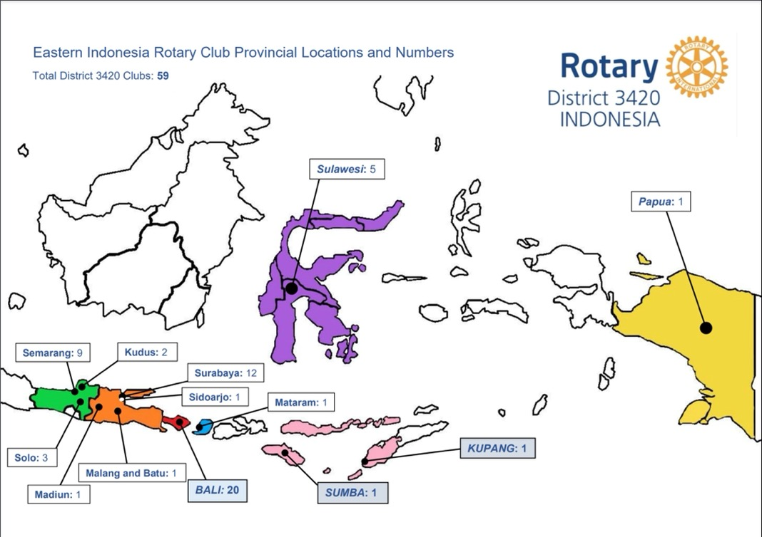

Slide 11
Project Taskforce Members
XSPI & RAM Australia
Dr. Dan Evans: XSPI Founding Chair, Chair New Ireland Provincial Malaria Alliance; former roles: Deputy Chair, B4D; Deputy Chair, Monash Medical Foundation; MMV Consultant; former VP Exploration WMC & Accenture partner
Ross Hutton: Principle, Public Health Solutions; Consultant, PNG National Department of Health (NDoH), Senior Manager & Founder, Oil Search Health Foundation; Project Manager, NIPMA Malaria Elimination Project
Dr. Jenny Kerrison (Taskforce Chair): National Manager, Rotarians Against Malaria (RAM) Australia; Maternal & neonatal health specialist
Jeff Smith (Taskforce Co-chair): Public Health Advisor & former Chief Operating Officer, APLMA
Co-opted Subject Matter Experts & Industry Partners
Dr. Claus Bogh, Malaria entomologist, Chair, Sumba Foundation, manages 5 malaria clinics on Sumba Island
Dr. Josh Francis: Senior Research Fellow, Menzies School of Health Research; Paediatrician & paediatric infectious disease physician
Professor Ric Price: Professor of Tropical Medicine, Menzies School of Heath Research; Infectious disease & general physician, Royal Darwin Hospital
Dr. Manel Yapabandara: WHO Consultant, Sri Lanka and Timor-Leste malaria elimination specialist
Dr. Flora Tanudyaya: APLMA Consultant seconded to Dr.Guntur, Malaria Subdirectorate, MoH
Arthur Tadudjaja: President & Director, PT Cheetham

Slide 12
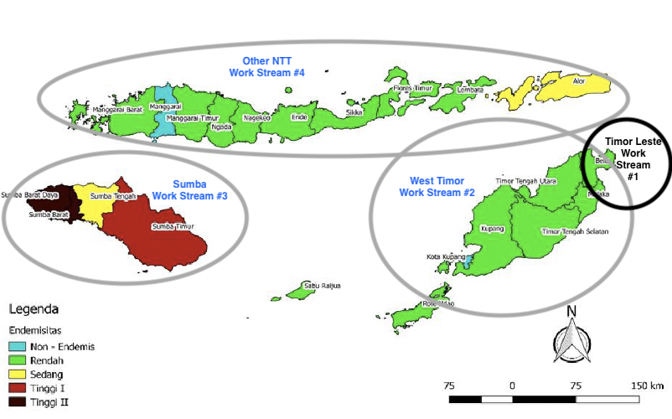
Timor Leste & NTT malaria status – late 2020
& 4 Project Work Streams

Slide 13
XSPI-RAM Taskforce Goals
RAM -XSPI Project Goals
2025 Timor-Leste WHO certified malaria free
Strengthen cross-border collaboration with West Timor to prevent re-establishment
2026 NTT Province malaria free
Advocate for sustainable domestic financing to support continued malaria free status
West Timor: malaria free in 2024
Sumba Island: malaria free in 2026
Other 12 districts: malaria free in 2026

Slide 14
XSPI-RAM Taskforce Goals
Project Description (2022 – 2026)
Gap Analyses & Implementation Plan
Data collection & analyses: Nov ‘21 – Jan ‘22
Draft Scoping Report & costed 3-year Implementation Plan: 28 Feb ‘22
Final Scoping Report & costed 3-year Implementation Plan: 31 Mar ‘22
Identify key Australian & International Partners
Partners: RAM-Australia; Menzies School of Health Research; APLMA; Govts of Timor-Leste, Indonesia, NTT Province
Potential partners: GF, WHO, Indonesian & international foundations; Australian & Indonesian businesses (Cheatam Salt; Gulf Manganese)
Project Implementation
Implement 3-year plan through a coalition of partners from Q3 2022
Propose mid-term project review
Modified project plan and budget to secure funding for Years 4-5
Goal of Timor-Leste and NTT Province attaining elimination by end of 2026

Slide 15
XSPI-RAM Taskforce Goals
RAM – XSPI Project Approach
Explore
Undertake T-L & NTT scoping study and gap analysis against WHO Global Malaria Elimination Strategy
Develop
Develop 3 year (2023-2026) costed work plan to accelerate malaria elimination
Strengthen
Strengthen cross border collaboration between two countries
Dedicated Work Stream consulting teams recruited
Secure MoH & NT DOH endorsement of recommended implementation plan

Slide 16
XSPI-RAM Taskforce Goals
Proposed Project Benefits
Timor-Leste
WHO Malaria Free Certification (2025)
Strengthened and uniform cross-border disease surveillance and response systems
West Timor
Malaria eliminated in 2024
Strengthened and uniform cross-border disease surveillance and response systems
Sumba Island & Other 12 Districts
Malaria eliminated in 2026
Strengthened surveillance and response systems in all districts
For All
Reach malaria free status four years ahead of 2030 regional goal
Strengthened disease surveillance and response systems in all areas
Enhanced information sharing and knowledge exchange
Established platform for future health sector cooperation

Slide 17
Forward Program & Resourcing

Slide 18
WS #1 – Timor Leste
Forward Program – prevent reintroduction
Diagnosis & Treatment: Training & refresher training of staff on microscopy and RDT; including maintaining quality standards; training for early Dx & Tx; point-of-care test kits to detect G6PD deficiency & radical cure for Pv; robust supply chain system
Surveillance, Monitoring & Evaluation: continue to strengthen border area community health volunteers; response teams, access to real-time data. Case and foci investigation formats revised by RAM in 2018 by USD251k Rotary GG.
Entomology & Vector Control: develop risk maps; border areas LLIN distribution; train vector control staff; monitor insecticide resistance. Annual IRS (at borders) and focal spraying. Rotary GG provided 80 Hudson sprayers in 2019.
Information, Education & Communications: public awareness campaign; promote community participation
Cross-Border Collaboration: establish inter-country (West Timor & Timor Leste) task force; establish 2-5 km epidemiological zone and coordinate activities. Screening posts at border crossings and ports of entry will be strengthened.
Human Resources: establish staff training programs; develop & update manuals for malaria prevention & response
Research: audit diagnosis, treatment, & surveillance activities to optimize prevention-of-reintroduction activities
Resourcing
2023 – 2025 estimated required budget USD $1.6m (US$0.7m, US$ 0.5m, US$0.4m)
Financial support from GF & Govt of Timor-Leste, private sector unlikely
Current technical support from RAM-Australia, Menzies School of Health Research, WHO

Slide 19
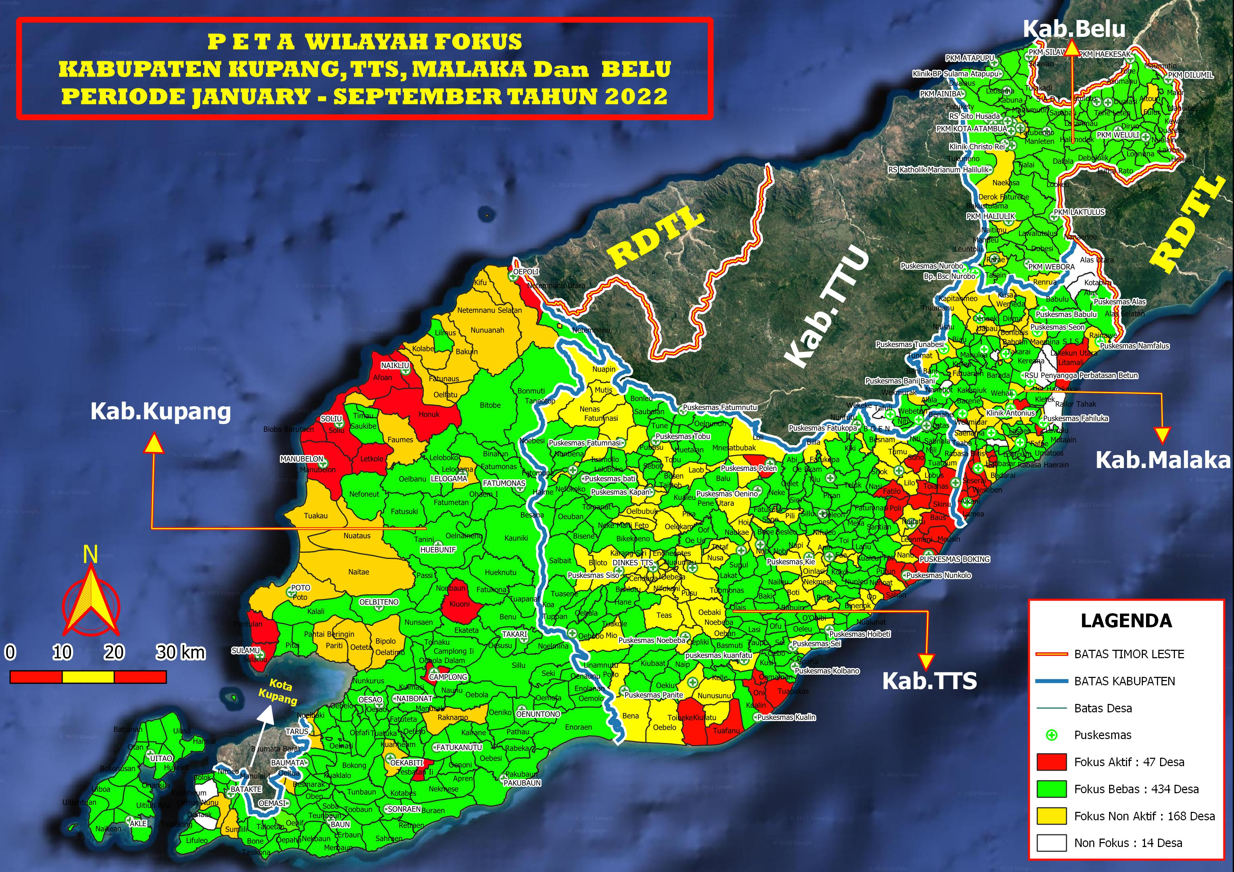
Rotary Global Grant 1 & 2 Goal: break transmission in 47 red villages Resources: CHW, District Malaria Assts Need: expert entomology support
Map of local malaria transmissions in Districts Kupang, Central Timor, Malaka and Belu. Period: Jan – Sept 2022
Timor Leste border
Inter-District border
Village border
Community Health Centre
Active focus – 47 villages
Free focus – 434
Non Active focus – 168
Non Focus – 14

Slide 20
WS #2 – West Timor
Forward Program – Malaria free by end 2024
Diagnosis & Treatment: training for early Dx & Tx; develop SOPs & QA system; implement for use & training for RDTs
Surveillance, Monitoring & Evaluation: timely reporting of cases into national E-SISMAL data base; establish & train district rapid response team
Entomology & Vector Control: appoint & train district entomology officers; develop risk maps; LLIN distribution; develop SOPs; mobilize community support for VC; establish sentinel sites in each district to monitor insecticide resistance
Information, Education & Communications: revise & update current educational materials; tailor materials to local contexts; train staff on advocacy
Cross-Border Collaboration: establish inter-country task force; establish 2 -5 km epidemiological zone & coordinate activities
Human Resources: establish staff training materials; support national HR & capacity planning for 2023-2027
Resourcing
2023 – 2025 estimated budget required: US$ 5.7m (US$3.0m, US$1.5m, US$1.2m); Note: Yr 1 high, includes establishing PMO
Financial support from GF, Govt of Indonesia, NTT Provincial Govt, other donors & private sector
Oct 2022 funding proposal: Gulf Manganese (Owner: Fofo Sariaatmadja): US$50,000 support 52 Village Volunteers 2023, annual renewal)
Technical support from RAM-Australia, Menzies School of Health Research, WHO, AVI (potential)

Slide 21
WS #3 – Sumba Island
Forward Program – Malaria free by end 2026
Diagnosis and treatment: training for early Dx & Tx; develop SOPs & QA system; implement RDTs training & use
Surveillance, Monitoring & Evaluation: timely reporting of cases into national E-SISMAL data base; establish and train district rapid response team
Entomology & vector control: appoint & train district entomology officers; develop risk maps; LLIN distribution; develop SOPs; mobilize community support for VC; establish sentinel sites in each district to monitor insecticide resistance
Information, Education & Communications: revise and update current educational materials; tailor materials to local contexts; train staff on advocacy
Human Resources: establish staff training materials; support national HR & capacity planning for 2023-2027
Resourcing
2023 – 2025 estimated budget required: US$4.7m (US$1.1m, US$ 0.7m, US$ 2.9m)
Sumba Foundation continues support 4 Sumba Island districts with malaria testing, treatment, follow-up, malaria microscopy training & proficiency testing; scope to expand for NTT wide training

Slide 22
WS #4 – Other Districts (Flores/other islands)
Forward Program – Malaria Free by end 2026
Diagnosis and treatment: training for early Dx & Tx; develop SOPs & QA system; implement RTDs training & use
Surveillance, Monitoring & Evaluation: timely reporting of cases into national E-SISMAL data base; establish & train district rapid response team
Entomology and vector control: appoint & train district entomology officers; develop risk maps; LLIN distribution; develop SOPs; mobilize community support for VC; establish sentinel sites in each district to monitor insecticide resistance
Information, Education, and Communications: revise & update current educational materials; tailor materials to local contexts; train staff on advocacy
Human Resources: establish staff training materials; support national HR & capacity planning for 2023-2027
Resourcing
2023 – 2025 estimated budget required: US$ 5.2m (US$3.5m, US$ 0.9m, US$ 0.8m)
Financial support from GF, Govt of Indonesia, NTT Provincial Govt, other donors & private sector
PT Cheetham Salt will support project with technical support from WHO & other organizations

Slide 23
Project Challenges & Key Learnings

Slide 24
Project Challenges
Scoping project funding: substantial gap beyond initial APLMA AUD $62K funding & and final required AUD$242 resourcing secured (40% cash, 60% pro bono by Jenny Kerrison, Jeff Smith)
Work plan: data acquisition & compilation significantly more complex than anticipated; some staff turnover
Current: identify & secure potential implementation partners: financing; technical assistance; private sector engagement; in kind support
24

Slide 25
Key Learnings
Role of advocacy: this whole-of-society approach requires advocacy efforts to develop a shared vision for all partners
Collaboration: private sector and other non-traditional partners are required to support the government agencies in accelerating elimination
Government: officials are not always open to engaging private sector to support existing health programs
Border approach: fully eliminating malaria in border areas requires effective collaboration and alignment of activities between two governments
Funding: existing financing mechanisms for malaria elimination are inadequate to significantly accelerate elimination efforts
25

Slide 26
Timor-Leste & NTT Malaria Elimination Project – RAM Australia led XSPI Indonesia Working Group
Scope: & Status | Scope: Malaria Elimination in Timor-Leste and NTT Province, Indonesia Status: Completed scoping study/gap analysis/implementation plan development; working to resolve post scoping study/elimination plan implementation mechanism and financing gap; working to secure project partners, complete consortium enabling XSPI transitioned exit.
XSPI Required Support | Funding: Financial (40%) AUD$62k APLMA funded; AUD$33k funded by Malaria Partners International (MPI), RAM-Australia, RAM-Global, and Evans5 Fund. Pro Bono (60%); Additional AUD $ 147k pro bono (Dr. Jenny Kerrison, Jeff Smith, Dr. Krisna Hort) Partnership consortium: identify cross sector project partners (business sector priority)
Approved
Funding Completed (AUD $241.6k Scoping Study) | Financial: AUD$ 95k (40%) Pro Bono: AUD$147k (60%) Implementation funding TBA | Period funding required: | Oct 2021 – May 2022 | Location: | Timor-Leste & NTT Province, Indonesia
Business Partners | Cheetham Salt Gulf Manganese (proposed) Indonesia partners required | Government Partners: | ID MoH, NTT Dept of Health | NGO/NFP Partners: | RAM Australia, APLMA, Woolgoolga RC, RAM Global, Malaria Partners International Dr. Jenny Kerrison (pro bono)
Academia / Health / Medical Research Partners | Menzies School of Health Research Jeff Smith, Public Health Adviser (pro bono) Dr. Krishna Hort (pro bono) | Philanthropy / Private Capital Partners: | Evans5 Fund Others required | Other Partners: | TBA
Taskforce Lead | Chair - Dr. Jenny Kerrison, Co- Chair: Jeffery Smith
Taskforce Team | RAM (1) Dr. Jenny Kerrison; XSPI (3): Dr. Dan Evans, Ross Hutton, Jeffery Smith; Co-Opted Experts (5): Dr. Josh Francis, Prof. Ric Price; Dr. Manel Yapabandara; Dr. Claus Bogh; Dr. Ellya Dewi; Business partner (1): Arthur Tanudjaja, President & Director, Cheetham Salt
Timor -Leste
&
NTT Malaria Elimination
Project description:
Scoping study/gap analysis/implementation plan development Oct 2021 – May 2022 using RAM recruited consultant team. 4 Work Streams covering: (1) Timor-Leste, (2) West Timor, (3)Sumba Island, (4) Other 12 NTT district,s mainly Flores Island.
Gap analysis was against WHO Global Technical Strategy for Malaria Elimination. Project fully endorsed by Timor-Leste and Indonesia governments

Slide 27
Cross Sector Development Partnerships Initiative (XSPI)
For more information, please contact:
Dr Dan Evans
Founding Chair - XSPI
evansaus@bigpond.com
Jeff Smith
Lead Convenor, XSPI Indonesia Working Group
jefferyjsmith17@gmail.com

Slide 28
Extra Slides

Slide 29
THE OPPORTUNITY: Create new integrated cross sector approach
A new approach chasing the “holy grail” of effective partnering
Business Sector Role
Cross Sector International
Partnerships Initiative
(XSPI)
Position Australia
Aims to unleash cross sector potential
Hub for cross sector networking to open new opportunities
Creating synergies across five sectors with established international development roles:
Business
Government
Philanthropy/ private capital
Academia/ health/ medical research
NGO/NFP
Leads international development in Asia Pacific
Significant hidden potential exists to increase development impact by harnessing the power of cross sector partnerships
Presents the greatest challenge and opportunity to enhance international development outcomes
Position into current and new emerging markets
Business sector as a driver to develop cross sectoral partnerships

Slide 30
Market Gap, Value Proposition, Point of Difference, Unique Structure
Market Gap – Development Sector
XSPI’s Global Cross Sector Partnership (XSP) Leaders empirical research project (total 23 entities: 9 OECD countries, 8 international foundations, 6 multinational organisations) demonstrated a definite “market gap”. None focus on cross sector partnerships spanning XSPI’s five stakeholder sectors.
Value Proposition
XSPI's unique value proposition is to incubate, seed or accelerate cross-sector partnerships across Asia Pacific providing solid, long-term, future platforms to create diverse development projects in close partnership with national partners and aligned with SDG’s.
Point of Difference
XSPI’s “5 C’s” approach comprises being a catalyst, convenor, collaborator, co-developer and coalition builder” for partnerships across Australia’s Business, NGO/NFP, Philanthropy/Private Capital, Government and Academia/Health/Medical Research sectors. XSPI’s “collective impact” approach to supporting expanded Asia Pacific SDG aligned development and increased impact should increase sector confidence stimulating increased financial commitments. XSPI is NOT a project funder or project manager; both roles are responsibility of individual project consortium.
Unique Structure
Advisory Council: Executives from selected entities across five stakeholder sector provides strategic oversight. Expert Network: 36 strong, diverse group of Asia Pacific development and business experts. Steering Committee: 7 members: Chair, Advisory Councillors & Working Group Convenors providing governance. Bangladesh, Indonesia and PNG Working Groups: Country expert groups, hybrid mix of XSPI Advisory Councillors, Expert Network members & Co-Opted Experts) identify “proof of concept” partnership pilot projects, qualify, endorse & construct partnership consortia.

Slide 31
Structure, Scope, Partners & Network ….2
19 Asia Pacific countries comprise our focus where greatest impact possible through alignment with Australia’s regional business and development priorities
Melanesia (5): Priority PNG, Fiji, Timor Leste, Solomon Islands, Vanuatu
South East Asia (8): Priority Indonesia, Cambodia, Lao DR, Malaysia Myanmar, Philippines, Thailand, Vietnam
South Asia (6): Priority Bangladesh, Bhutan, India, Nepal, Pakistan, Sri Lanka
Initial Priority Countries for Partnership Pilot Projects:
Bangladesh (South Asia), PNG (Melanesia), Indonesia (Southeast Asia)

Slide 32
XSPI OBJECTIVES
XSPI has defined an 18 month Horizon One set of integrated organisation research and actions
ORGANISATION
Create Steering Committee to govern internal XSPI Development Project
Create Advisory Council: key executives from leading cross sector entities
Establish Expert Network: key Asia Pacific development sector/regional experts
Create Bangladesh, Indonesia and PNG Working Groups
Stakeholder sector activity mapping across 18 target Asia Pacific countries within Melanesia, Southeast Asia and South Asia regions
Status of private capital activity in Asia Pacific development sector
Sustainable NGO business models and role of cross sector partnerships
Global cross sector development partnership leaders (countries, foundations, multinationals)
RESEARCH
Create partnership strategies to increase development impact
Convene PNG, Indonesia and Bangladesh Working Groups to identify project leads
Start at least two partnership pilot project consortia AND at least two strategic partnership platforms for Bangladesh (South Asia), Indonesia (Southeast Asia) and PNG (Melanesia)
Qualify & Plan Asia Pacific Development Partnership Knowledge Platform: case studies, thought leadership, key references, frameworks & tools
ACTION

Slide 33
XSPI Structure, Partners Network Comprises Australia’s first cross sector executive group of development & business experienced, strategic thinkers
Host Entity
Business for Development (B4D)
XSPI has access to DGR Type 1 (tax deductible) through B4D
B4D helps business achieve sustainable development for enhanced outcomes
Advisory Council (17)
Business (5): Peter Botten (Chair Accel, former Oil Search CEO), Andrew Parker (PwC), Julianne Rose (Social Economy Group); Morgana Ryan (Infoxchange, CARE, ex-Accenture); Dr. Dan Evans (ex-WMC, ex-Accenture,)
Government (2): Claire Moore (Former Senator); Howard Hall (ACIAR)
Philanthropy/Private Capital (2): Julie Rosenburg (AIDN), Farhad Reza (Build Bangladesh Impact Fund)
Academia/Health/Medical Research (4): Prof. Glenn Hoetker (MBS); Prof. Abid Khan (Monash University) Brendan Allen (Burnet Institute); Geoff Scahill (Abt Associates)
NGO/NFP (3): Karen James(B4D); Shane Nichols (ACFID), Mat Tinkler (Save the Children)
Secretariat (1): Laiza Garcia, Project Director; Consultant DPI Mining (ex-Accenture)
SteerCo (7)
(Chair, 2 Councilors, 3 Working Group Convenors, Project Director)
XSPI Terms of Reference
Business (12): Ron Brew, Ray Hughes-Odgers, Kristie Laird, Kymberley Kepore, Prerana Mehta, Gavin Murray, Akun Novriani, Jeff Parker, Jen Ross, Dr. Nia Sarinastiti, Alex Schultz, Dr. Tim Siegenbeek van Heukelom
Government (5): Brian Borgonha, Jeff Bost, Kevin Evans, Ben Giles, Ian Porter
Philanthropy/Private Capital (3): Rob Dunn, Mark Ingram, Renee Martin
Academia/Health/Medical Research (8): Zoey Diaz,, Ross Hutton, Prof. Brett Inder, Dr. Jenny Kerrison, Rumana Parveen, Jeff Smith, Dr. Russ Stephenson, Dr. Jodi York
NGO/NFP (8): Dr. Yasmin Ahmed, Jess Carter, Robert Dunn, Kevin Evans, Peter Falvey, Steve Goudswaard, Dr. Ana Klincic Andrews, Ash Rogers
Expert Network (36)
Country Working Groups
Bangladesh WG
11 Members
Local Expert: Dr. Yasmin Ahmed
PNG WG
11 Members
Local Expert: Kymberley Kapore
Indonesia WG 11 Members, including
2 local members (Akun Novriani, Dr. Nia Sarinastiti); also 7 member Taskforce

Slide 34
Research Agenda & Progress
August 2021 status of 18-month research agenda supporting XSPI Development Project
Sustainable NGO Business Models
Examine status of emerging, sustainable business models for NGO’s replacing or augmenting traditional donor funded models
Key focus is International and regional NGO’s operating from Australia & ACFID members
Provide insight into current NGO business models, sustainable options and transitioning status
Knowledge Platform Creation
Case studies, thought leadership, key foundation references, partnering frameworks & toolkits
Unique cross sector partnering knowledge centre aligned with XSPI objectives
Case studies; other components support scoping, implementing, sustaining partnerships
Global XSP Leaders
Map recent country based experiences, identify effective practices, key challenges
Nordics, Germany, Netherlands, UK, USA, Canada; last 3-5 years history
Well informed insight into cross sector partnerships global status/learnings
Private Capital Sector Status
Development sector currently lacks clear insight into private capital status & investment criteria
Phase 1: “snapshot” of Australia’s private capital/impact investing/philanthropic sector’s current status related to Asia Pacific development
Conduct survey of leading 10-15 Australian private capital entities
Provide late 2021 insight into status quo of private capital approach to Asia Pacific development funding
XSPI Website
Provide a reference point for XSPI networks, projects and supporters
Provide updated information of What is XSPI, Scope and Mission.
Update on current partnerships and initiatives in key countries
Maintained informed the wider community and XSPI network
Grind Labs
Stakeholder Sector Activity Mapping
Map 5 sectors activity reach & partnering history since 2017
Melanesia, Southeast Asia & South Asia
140 entities across 5 stakeholder entities across 19 Asia Pacific countries
Inform potential priorities for country, theme and XSPI partnering pilot project options
In progress
Completed

