Slide 1
Threat of Monkey Malaria? (Plasmodium knowlesi)
Prof G Dennis Shanks
Director Australian Defence Force Malaria and Infectious Disease Institute
COL, US Army Medical Corps (retired)

Slide 2
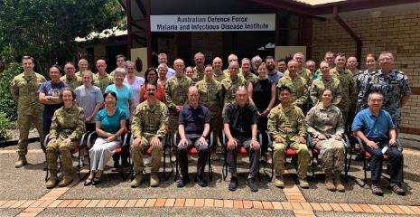

ADF Malaria Infectious Disease Institute (ADFMIDI)
Joint specialist medical unit to prevent infectious diseases in Defence members
Currently in its sixth name / iteration since 1915, located in current laboratories at Gallipoli Barracks, Brisbane since 1997
Staff is divided equally into active duty uniformed military, reserve military and civilian scientific members

Slide 3
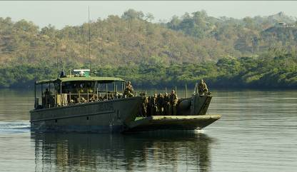
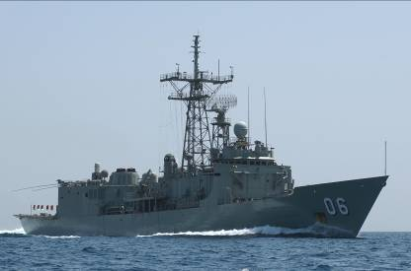
Little Recent Malaria Experience in ADF
ADF soldier returns from family visit to Sierra Leone with falciparum malaria 2019
Feb 2018 case of P knowlesi or monkey malaria from jungle warfare training in Johor Bauru, Malaysia
Four falciparum malaria cases on HMAS Newcastle while on anti-piracy patrol in Indian Ocean following shore leave at beach resort in Tanzania 2015
Notes:
More recently malaria has been a problem for the SAS in Afghanistan, the Royal Australian Army in Papua New Guinea and the Royal Australian Navy during piracy operations in the Indian Ocean.

Slide 4
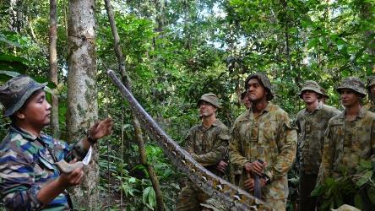
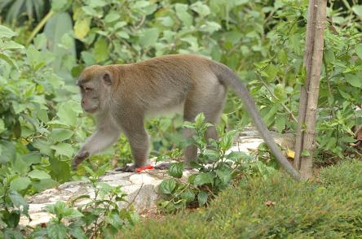
Plasmodium knowlesi (Pk or monkey malaria)
First known Pk case in ADF in Feb 2018 following jungle warfare / survival training in Johor Bauru, Malaysia
Only modestly ill due to having taken partial doxycycline prophylaxis
Exposure it depends on the amount of monkey contact in jungle

Slide 5
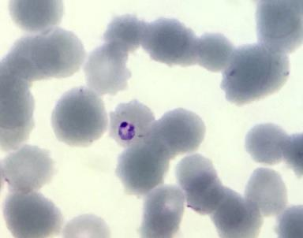
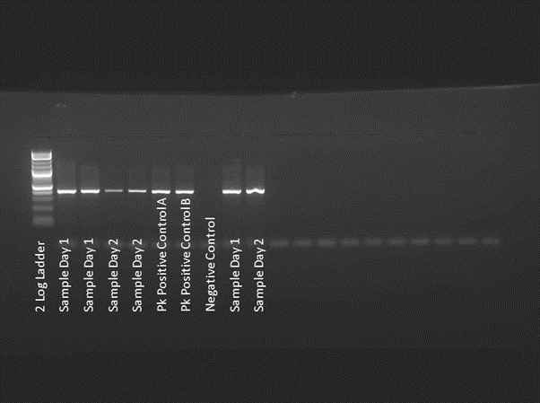
Monkey Malaria Is Distinctly Unusual
Most people do not live near monkeys, so risk of infection through mosquitoes is very limited
P knowlesi is often mistaken for P malariae on microscope smears
Genomic (PCR) confirmation of diagnosis is recommended

Slide 6
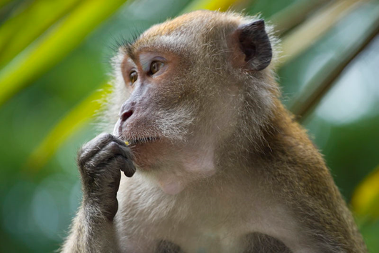
Treatment of Plasmodium knowlesi Is Different
Although severe malaria can occur, it is usually from anemia, not cerebral malaria
As there has been no drug treatment of monkeys, parasites are still chloroquine sensitive
Pk does not relapse so there is no need for primaquine afterwards

Slide 7
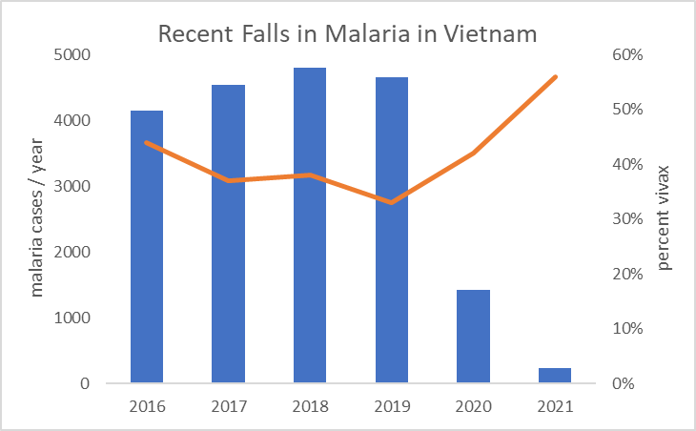
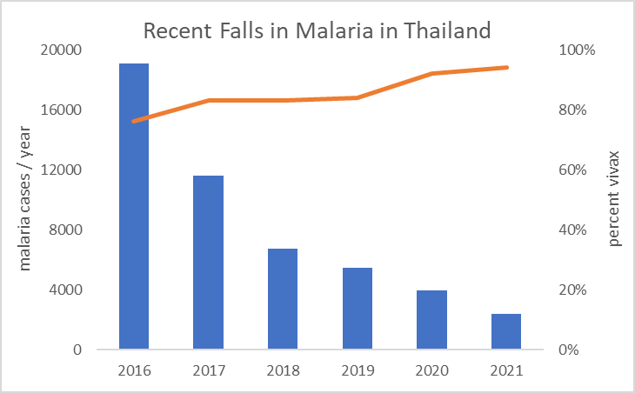
Malaria Decreasing in Much of SE Asia
Predominately Relapsing Malaria P vivax

Slide 8
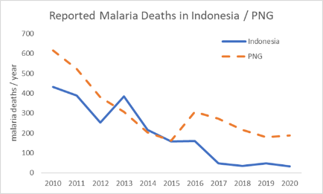
> 90% of Indonesian Malaria is in Papua 2021

Slide 9
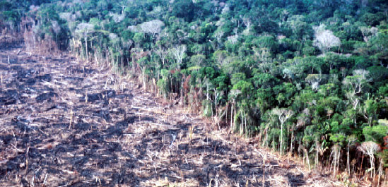
Changes Promoting P knowlesi in SE Asia
Jungle habitat of macaques being taken for housing developments, palm oil plantations etc.
Monkeys forced into peri-urban environments closer to humans
Malaria elimination efforts have made human malaria very rare in some places (e.g. Malaysia)

Slide 10
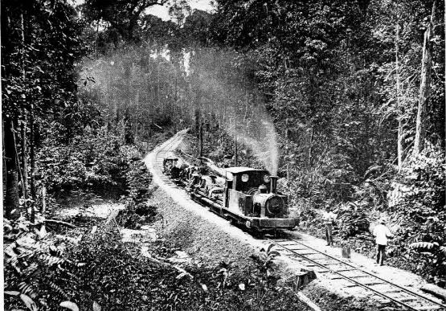
Historical Interface between Man and Jungle
Malaria in North Borneo (Sabah) was likely always due to Pk
Very limited medical facilities available to highest risk populations living in forest such as Dayaks, Oran Osli
Microscopic diagnosis rarely picked up outliers as different

Slide 11
Most P knowlesi Likely on Island of Borneo
Distribution of Pk largely matches the primate host with many species of macaque
Habitat is mostly jungles on islands of SE Asia
Elimination of macaques or jungle drastically lowers malaria infection risk; no monkeys past the Wallace Line in New Guinea

Slide 12
Malaria Is Spread by Anopheles Mosquitoes
Mosquito vectors are most likely living in canopy with monkeys
Very hard to implicate specific Anopheles due to rarity of infection
Disturbance of the jungle (logging) is likely an important interface between man and these rare malaria vectors

Slide 13
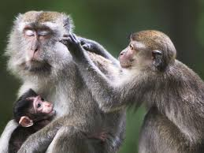
Difference in Long and Short Tailed Macaques
Pk is a natural infection of long tailed monkeys and causes little disease in M nemestrina
In short tailed Indian monkeys, it is rapidly lethal infection
Genetic difference explaining this observation must be small as the monkeys can on occasion inter-breed showing close relationship

Slide 14
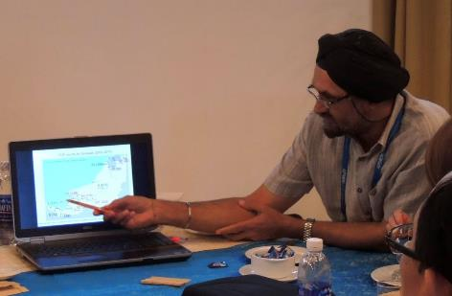
Does Pk Threaten Regional Malaria Elimination?
P knowlesi is the main species of malaria in some parts of SE Asia (Malaysia)
Unlikely that we will ever get such parasites out of native primate population
Smallpox is still considered eliminated even though its close primate relative monkey pox still causes human infection; this is a direct analogy to monkey malaria

Slide 15



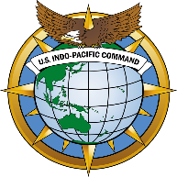


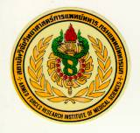








Acknowledgements
Queensland Institute of Medical Research / Berghofer
Universities of Queensland and Sunshine Coast
US Armed Forces Research Institute of the
Medical Sciences, Bangkok, Thailand
Walter Reed Army Institute of Research, Washington DC
Notes:
We work with a wide variety of military and civilian partners only some of which are noted in these acknowledgements.

