Slide 1


International engagements by ADFMIDI in drug resistant malaria surveillance and elimination in Vietnam
Dr Mike Edstein (PhD)
Department of Drug Evaluation
Australian Defence Force Malaria and Infectious Disease Institute (ADFMIDI)
22 October 2022
RAM Conference, Brisbane, 2022

Slide 2
Presentation Overview
Historical overview of drug-resistant malaria in the Greater Mekong Subregion (GMS)
Malaria cases in Vietnam over the last several years
3. Partnership with the Vietnam Ministry of Health (MoH), the Ministry of Defense (MoD), the U.S. Navy and ADFMIDI in researching malaria in Central Vietnam with a focus on:
  Therapeutic efficacy studies of antimalarials
  Monitoring for drug resistant malaria using validated molecular biomarkers and in vitro drug susceptibility studies
  Determining the prevalence of asymptomatic malaria to support strategies towards malaria elimination
  4. Current projects in Vietnam

Slide 3
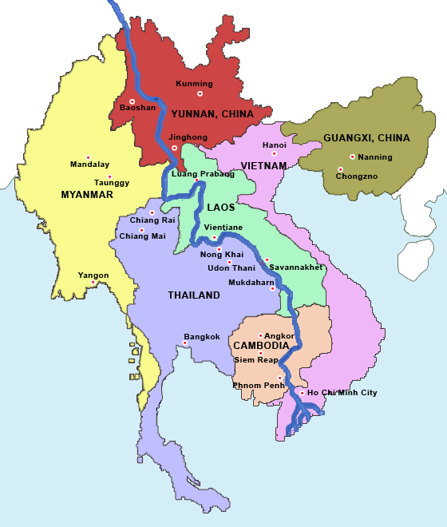
Greater Mekong Subregion the epicenter for drug resistant malaria
Greater Mekong Subregion (GMS) comprises six countries (Cambodia, China, Laos, Myanmar, Thailand and Vietnam)
Time lines of drug resistance
Chloroquine-resistant malaria was first reported in Thailand in 1957 and then spread through South and Southeast Asia
1960s - antifolate (proguanil and sulphadoxine-pyrimethamine) resistance became widespread
1980s - mefloquine-resistance occurred
1990s - Artemisinin based combination therapies (ACTs) introduced due to the imminent prospect of untreatable malaria in Southeast Asia
2006-2008 – Artemisinin and ACT resistance occurred in Cambodia

Slide 4
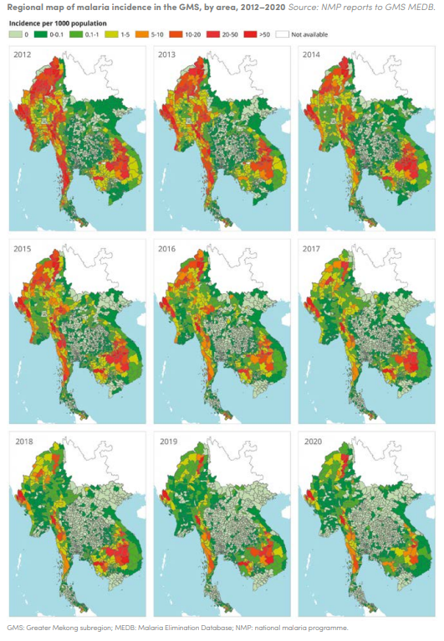
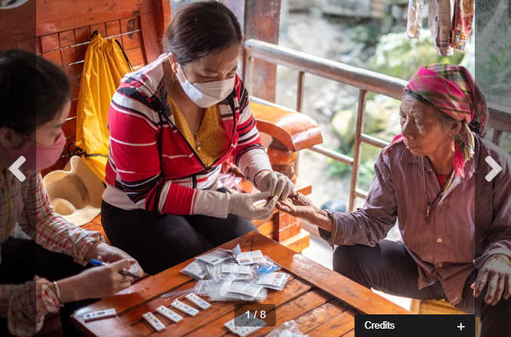
Malaria elimination in Greater Mekong Subregion (GMS)
Significant progress in malaria control in GMS, with marked decline in malaria cases between 2012 and 2020:
93% decline in malaria cases from 2.16m to 162k subjects
Goal ; Malaria elimination in GMS by 2030
WHO, 18 Nov 2021: Balancing act: managing malaria elimination and antimalarial resistance in Viet Nam
Data source: World Malaria Report 2021

Slide 5
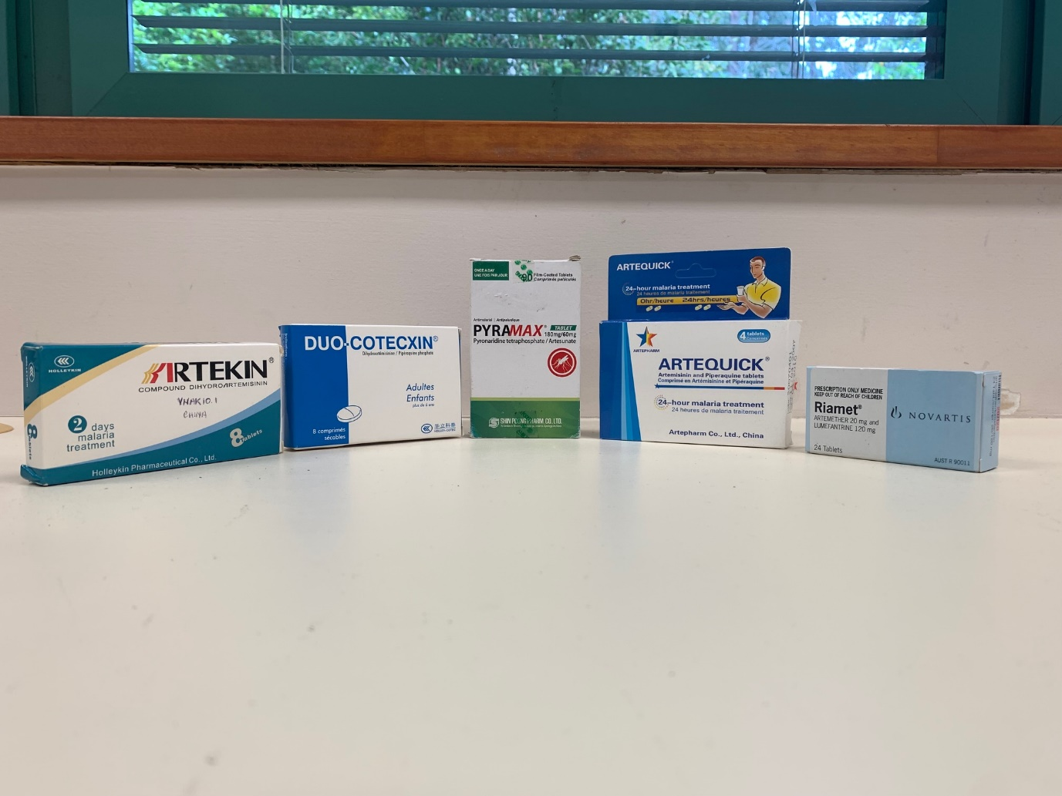
Measures contributing to the reduction in malaria cases in the GMS
Improved assess to early diagnosis with rapid diagnostic testing (RDTs)
Rapid case notification, case investigation, and targeted interventions
to reduce the spread of Plasmodium spp.
Wide distribution of long lasting insecticidal nets (LLINs)
Expanded networks of village health workers
Prompt effective treatment with ACTs
Challenge ahead towards malaria elimination
To reach the last malaria cases mostly present along international borders, in remote and forested areas in forest-goers and mobile migrant populations
ACT resistance in the GMS

Slide 6
Vietnam’s monthly malaria incidence - past 5 years
Number of malaria cases
Number of tests
Estimated malaria cases in Vietnam
2017 5485
2018 4525
2019 3134
2020 818
Total No. of malaria cases decreased by 85% from 2017 to 2020
Data source: World Malaria Report 2021

Slide 7

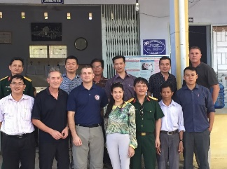


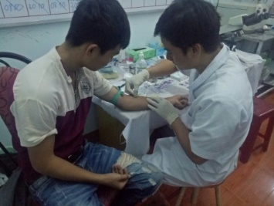
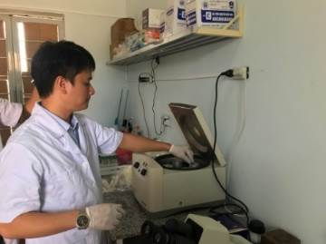
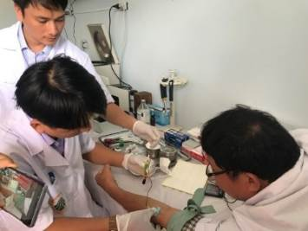
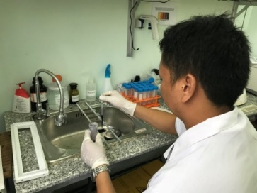
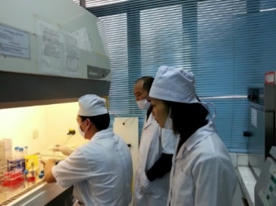
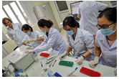
International Partnership in Vietnam with ADFMIDI
Vietnam MoH Institute of Malariology, Parasitology and Entomology
Vietnam MoD Military Institute of Preventive Medicine
U.S. Naval Medical Research Unit Number TWO
Pyramax® TES in Dak Nong Province, Vietnam
Symptomatic malaria survey-monitoring drug resistant parasites in Central Vietnam
Asymptomatic Malaria Survey in Central Vietnam Highlands

Slide 8
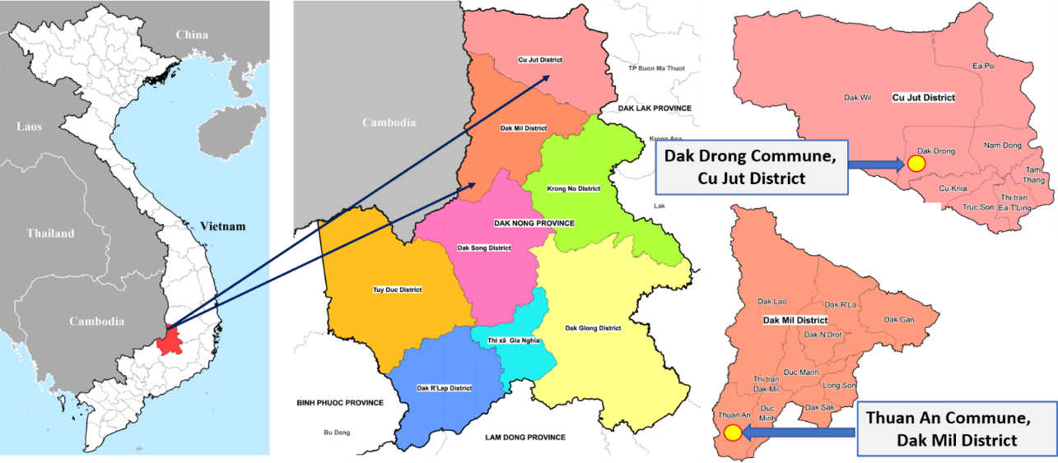
Therapeutic Efficacy Study (TES) of Pyramax
Evaluation of the efficacy of pyronaridine-artesunate (Pyramax®) for the treatment of artemisinin- and piperaquine- resistant falciparum and vivax malaria in Dak Nong province in the Central Highlands of Vietnam
Single arm, open label, prospective observational study was conducted between July 2018 and October 2019
Major inclusion criteria
  Adults and children ≥ 20 kg
  Symptomatic of malaria infection: history of fever within 24 h and/or presence of fever >38.0°C
  Microscopic confirmation of asexual stages of P. falciparum and P. vivax: parasitemia between 250/µL and <100,000/µL
  Target sample size: 60 Pf and 60 Pv
Manh ND, et al., 2021. AAC. “Pyronaridine-Artesunate (Pyramax) for Treatment of Artemisinin- and Piperaquine-Resistant Plasmodium falciparum in the Central Highlands of Vietnam”.

Slide 9
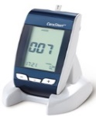
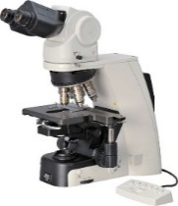
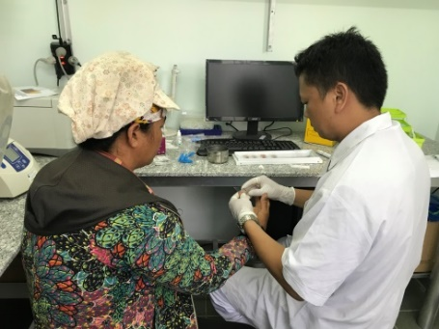

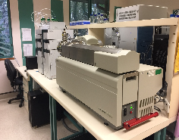
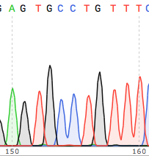


Methodologies for TES of Pyramax
Malaria diagnosis
Informed consent Recruitment
Case Report Forms
Blood Film Microscopy
Pf/Pv Ag-RDTs
Hb, G6PD deficiency testing
Blood sample collection
Day 0 Sample Collection
Clinical data analysis.
PCR confirmation of speciation
ACPR PCR confirmation
Drug concentration measurement (Day 7)
Analysis of drug resistance markers
In vitro drug susceptibility testing
Observed drug administration
Publications
Clinical monitoring,
up to 42 day follow-up
Sample collection

Slide 10
Patients Demographics/Clinical Characteristic

Slide 11
Efficacy Parameters after Pyramax treatment
 | Plasmodium falciparum | Plasmodium vivax
Median Parasite Clearance Time (h) | 72 (range 12-132) (n=49) | 24 (range: 12-36) (n=59)
Median Fever Clearance Time (h) | 36 (range: 12-72) (n=35) | 24 (range: 12-60) (n=59)
Time to 50% Parasite Clearance (PC₅₀) (h) | 6.9 (IQR: 4.2-11.3) (n=49) | 0.9 (IQR: 0.6-1.8) (n=38)
Parasite Clearance Half-Life (h) | 6.7 (IQR: 4.8-7.7) (n=49) | 2.7 (IQR: 2.5-3.0) (n=38)
Parasites on day 3 (%) | 45% (22/49) | Nil (0/59)
Late treatment failures | 4.8% (2/42) | 4.0% (2/50)
Kaplan-Meier estimates of PCR-corrected efficacy on day 42 for Pf (95% CI) | Kaplan-Meier estimates of recurrent Pv on day 42 (95% CI)
95.2% (82.3-98.8%) | 96.0% (84.9-99.0%)

Slide 12
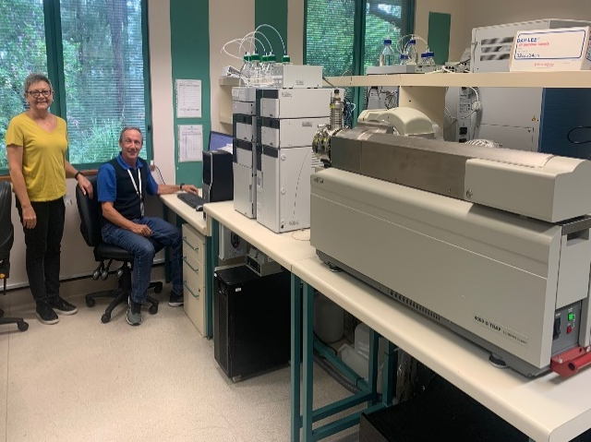
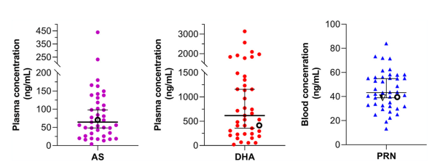
Drug exposure of Pyramax Components
Artesunate (AS), dihydroartemisinin (DHA) and pyronaridine (PRN) concentrations in blood/plasma samples collected after Pyramax® administration
Two recrudescent patients (hollow circles) had adequate drug exposure to AS/DHA and PRN

Slide 13
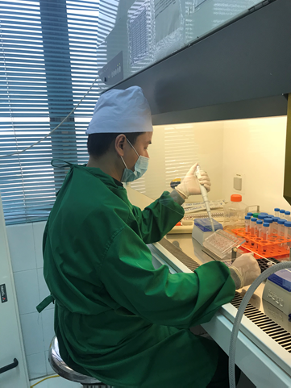
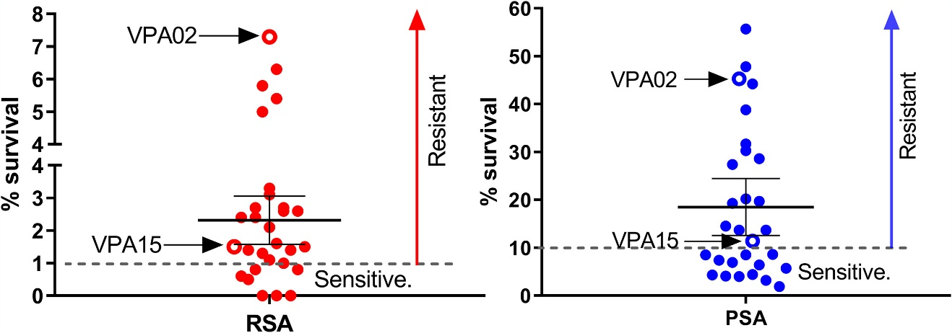
In Vitro Drug Susceptibility Testing and Ring-Stage Survival Assay
Drug | Mean IC₅₀ (nM) | SEM | No. Pf isolates
DHA | 2.2 | 0.2 | 26
PRN | 5.8 | 0.4 | 26
LUM | 66.9 | 8.4 | 23
MEF | 27.5 | 3.4 | 25
MB | 3.2 | 0.3 | 26
PPQ | 46.1 | 9.2 | 23
CQ | 116.5 | 41.1 | 26
dAQ | 47.9 | 4.9 | 19
  Decreased susceptibility to PPQ
  Elevated IC₅₀s to MEF and LUM
  High IC₅₀s to CQ
  ~76% of isolates resistant to DHA
  ~59% of isolates resistant to PPQ
DHA, 700 nM, 6 h
PPQ, 200 nM, 48 h
DHA-resistance cut-off:
Survival rate >1% 75.9% (22/29) isolates
PPQ-resistance cut-off:
Survival rate >10% 58.6% (17/29) isolates

Slide 14
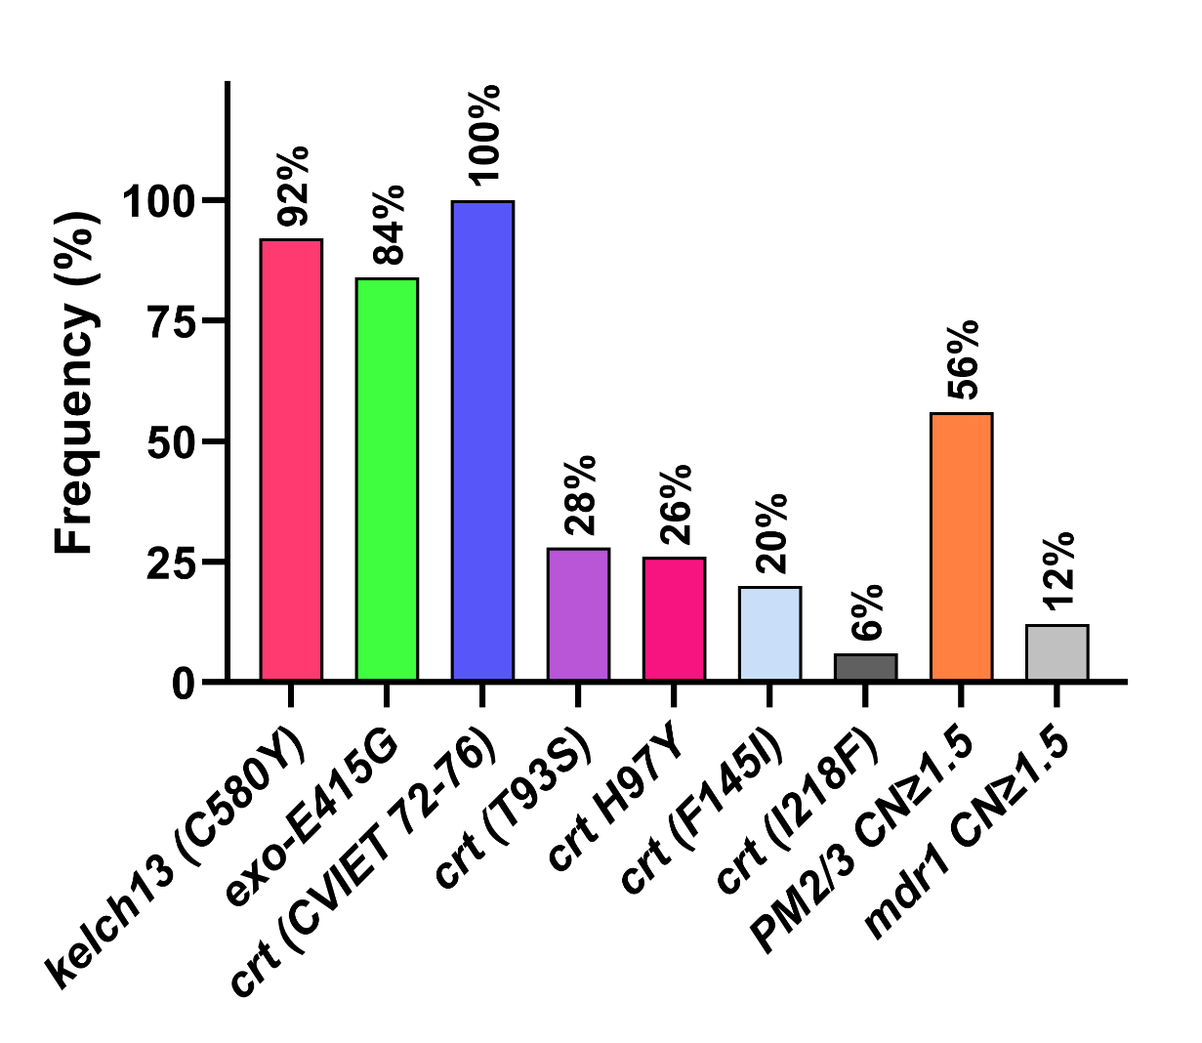
Prevalence of mutations for drug resistance in P. falciparum
parasites collected in TES Pyramax study
Polymorphisms/Amplifications in P. falciparum genes associated with resistance to antimalarial drugs
pfkelch13 - artemisinin resistance (92%)
plasmepsin 2/3 – piperaquine resistance (56%)
pfcrt – chloroquine resistance (100%)
pfmdr1 – mefloquine resistance (12%)
56% of P. falciparum isolates had both Pfkelch13 C580Y mutation and PM2/3 CN amplification (KEL1/PLA1)
Confirmed high level of resistance to DHA-PPQ and chloroquine

Slide 15
Asymptomatic malaria in the Central Highlands of Vietnam for the Malaria Elimination Roadmap
In Vietnam the goal is to eliminate malaria by 2030
For malaria elimination it is important to identify asymptomatic malaria carriers because asymptomatic infections are:
  a) hidden reservoir for malaria transmission and responsible for persistent malaria in the community
  b) responsible for chronic malaria infection & anemia, especially in vulnerable groups
  c) responsible for the spread of resistant strains
  Different approaches to malaria elimination need to be evaluated, including targetting asymptomatic malaria
Quang H.H. et al., 2021, PLOS ONE “Cross-sectional survey of asymptomatic malaria in Dak Nong province in the Central Highlands of Vietnam for the malaria elimination roadmap”
Notes:
15

Slide 16
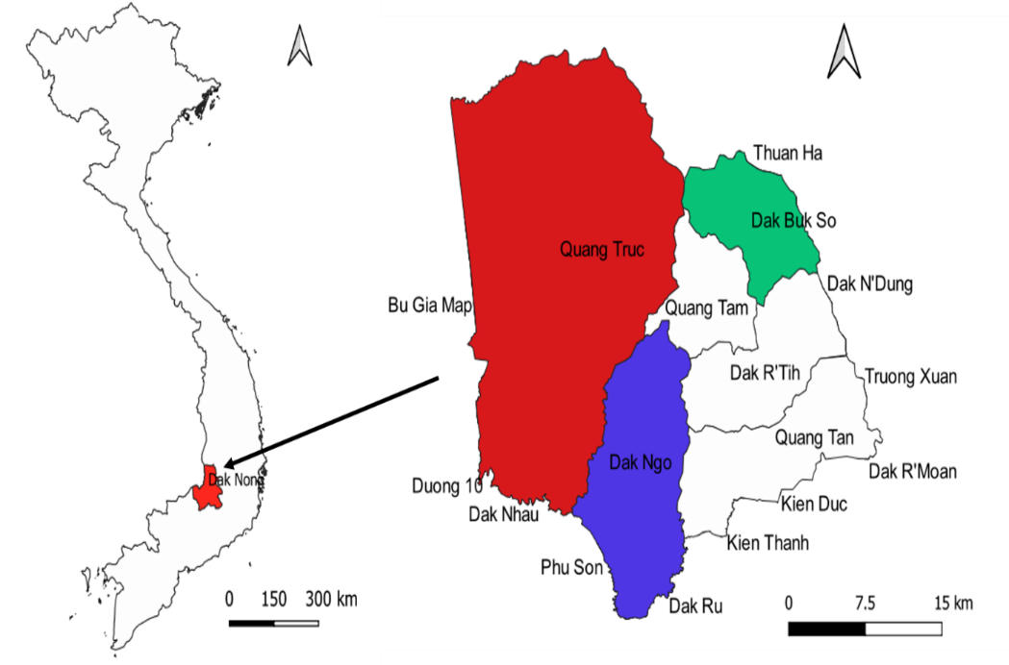
Survey of asymptomatic malaria in the Central Highlands of Vietnam
Study sites:
Central Highlands of Vietnam, Tuy Duc district, Dak Nong province
Three communes: Quang Truc, Dak Ngo and Dak Buk So of high, moderate and mild malaria risks, respectively
Total of N = 2,809 people without malaria symptoms
Children:10 to <18 yrs; Adults:≥ 18 yrs
Timeframe: Sep 2018 – May 2019
Detection of asymptomatic malaria infections by highly sensitive RT-qPCR
Analysis of risk factors such as working in forest areas and not sleeping under a bed net for asymptomatic malaria infections
Notes:
16

Slide 17
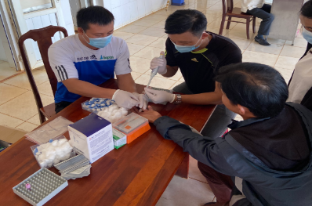
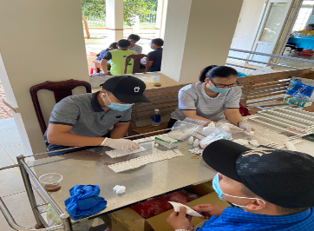
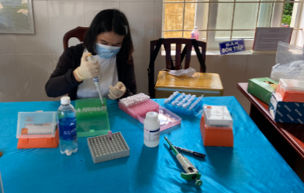
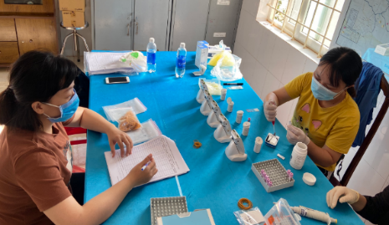
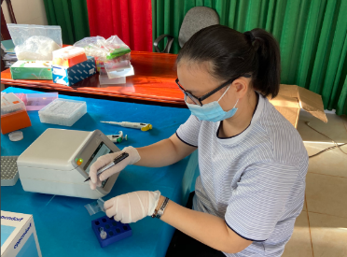
Prevalence of asymptomatic malaria cases in Dak Buk So, Dak Ngo and Quang Truc communes
Commune | Malaria risk area stratification | Symptomatic malaria (confirmed blood film microscopy) in 2018 | No. of Asymptomatic Participants Screened | Positive samples by RT-qPCR
Dak Buk So | Low | 0.1% (1/883; 1Pf) | 1328 | 1.7% (22/1328)
Dak Ngo | Moderate | 0.6% (14/2272; 8Pf, 6Pv) | 890 | 3.5% (31/890)
Quang Truc | High | 3.0% (57/1903, 29Pf, 27Pv,1Pf/Pv) | 591 | 12.2% (72/591)
Notes:
17

Slide 18
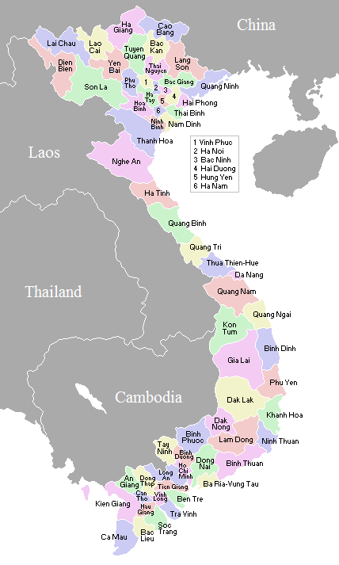
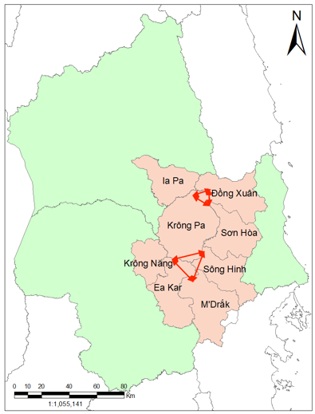
Current projects with IMPE-QN, MIPM, NAMRU-2 and ADFMIDI
Therapeutic efficacy surveillance of malaria treatment and drug resistance monitoring in Gia Lai and Phu Yen provinces of Central Vietnam (VDCP01)
Asymptomatic malaria survey in malaria hotspots in the same provinces (VDCP02)
VDCP01 (started 8 Jun 2022):
Monitor the therapeutic efficacy of:
Pyramax® plus primaquine for the treatment of patients with Plasmodium falciparum malaria
Chloroquine plus primaquine for the treatment of patients with P. vivax malaria
Characertization of drug resistance by in vitro phenotypic and molecular testing
VDCP02 (started 13 Jun 2022):
Detection of asymptomatic malaria carriers in malaria “hotspots” identified under VDCP01 study
Treatment of asymptomatic malaria positive individuals with first-line antimalarial treatments.
 | )
Field sites: Two communes in Krong Pa district, Gia Lai province and two communes in Song Hinh district, Phu Yen province in Central Vietnam

Slide 19




A long roadmap forward to Malaria elimination by 2030 in Vietnam

