Slide 1

ROTARY ACTION TO ELIMINATE MALARIA
Presentation to RAM Information Sessions
20 & 27 September 2021
Andrea Grosvenor PP PHF
Governor Nominee District 9705
Rotarians Against Malaria Eastern Region Supervisor

Slide 2


World Malaria Statistics 2019
The bad news…
229 million new malaria infections
in 2019
409 000 people died of malaria
in 2019
The good news…
1.5 billion malaria cases averted
since 2000
7.6 million malaria-related deaths
averted since 2000
WHO World Malaria Report 2020

Slide 3


Slide 4
Rotarians Against Malaria (RAM)
A stand-alone project of all of the Australian Rotary Districts under Rotary Australia World Community Service (RAWCS) Ltd
A network of Rotarians with a RAM representative in each Rotary District in Australia
Funded by donations from Rotary clubs, Rotarians and individuals
www.ram.rawcs.com.au

Slide 5
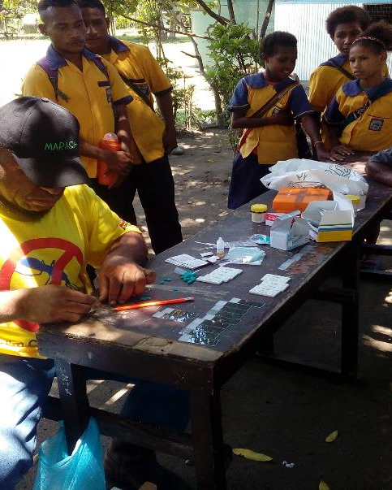
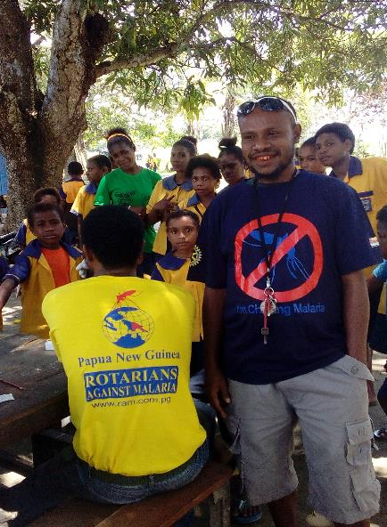
Papua New Guinea “Chasing Malaria”

Slide 6
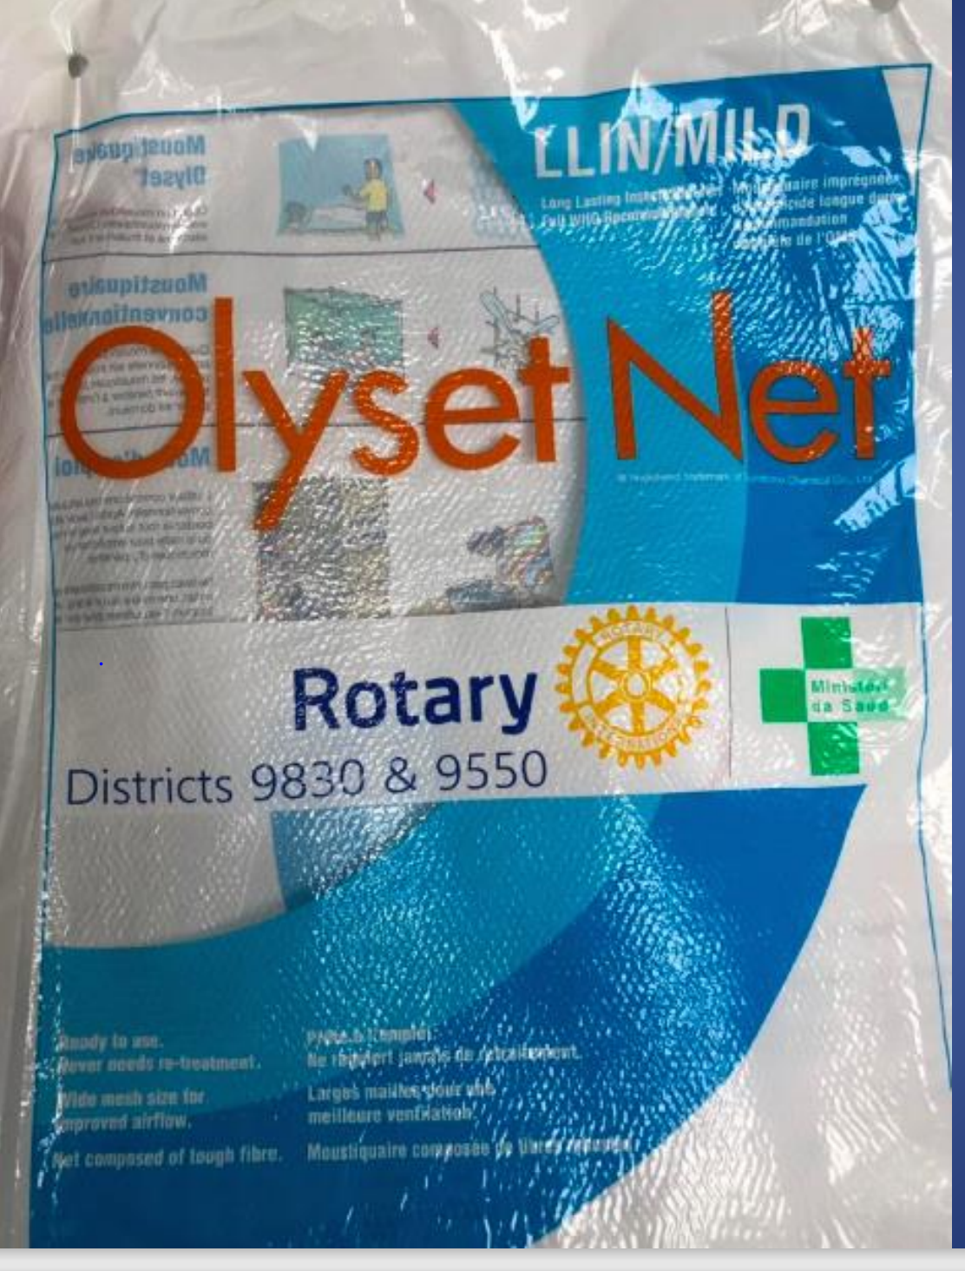
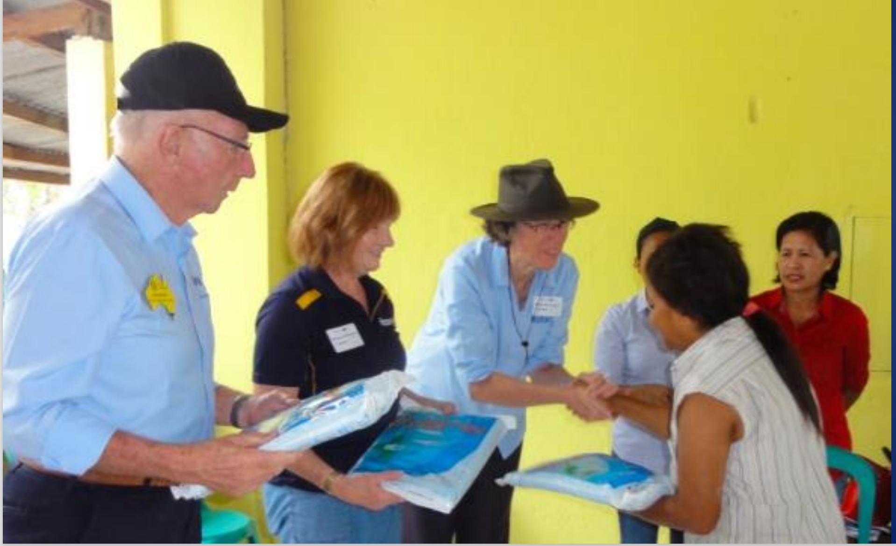
Timor Leste – So close to malaria elimination!

Slide 7
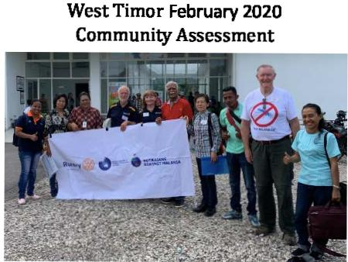
West Timor
Community Assessment team

Slide 8
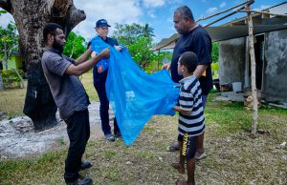
“End Malaria in Vanuatu – For Good!”

Slide 9
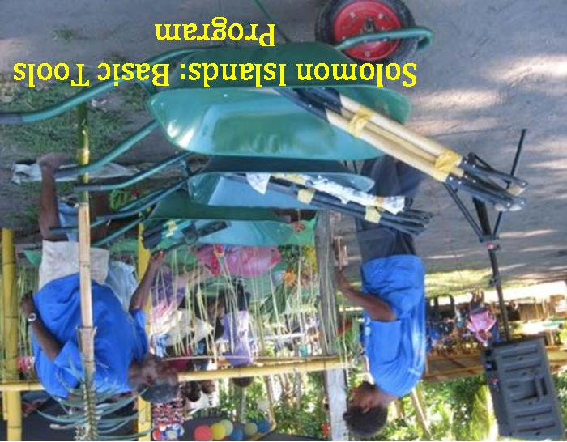

Slide 10

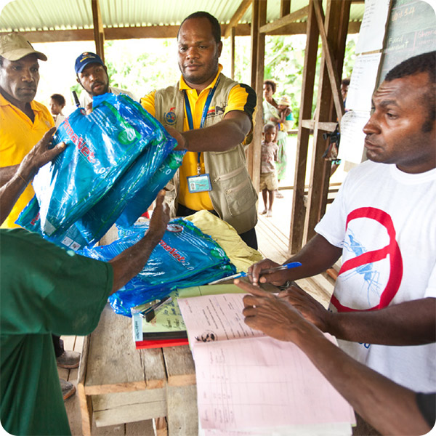
Finish the Fight
As People of Action, we are committed to raising USD12M towards finishing the fight against malaria in the Western Pacific Rim region.
The lives of children, pregnant women, and the elderly are most at risk, and RAM is dedicated to our humanitarian mission of eliminating this risk from the communities in this region.
www.finish-the-fight.org

Slide 11
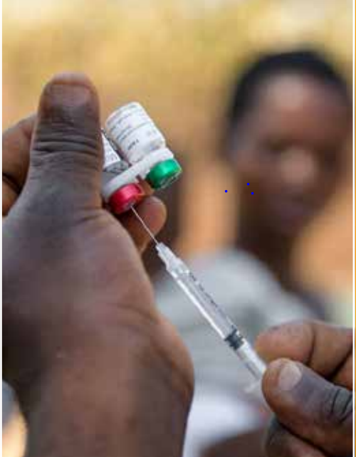
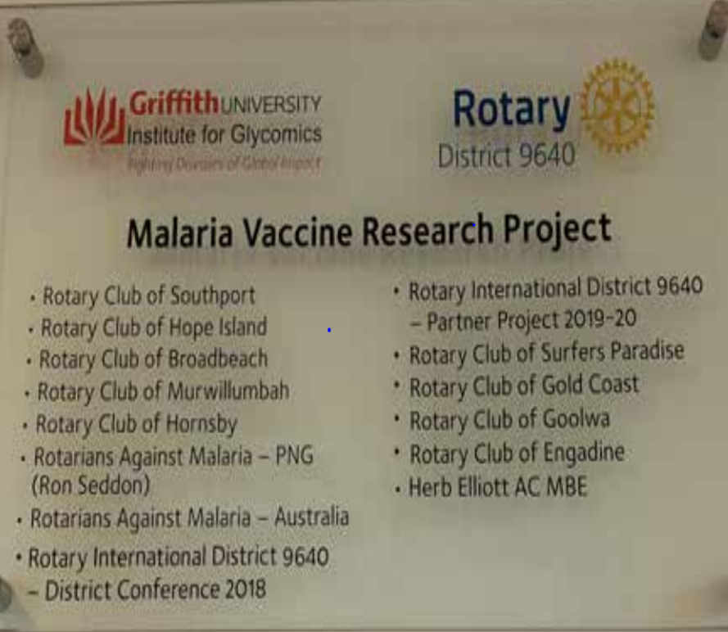
The search for a malaria vaccine

Slide 12

13-14 November 2021
Register at the RAM website:
ram.rawcs.com.au/2021conference/

