Slide 1
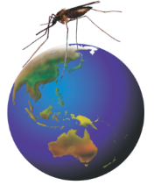

Rotarians Against Malaria
RAM - working to eliminate malaria
The KISS Principle - KEEP IT SIMPLE
Rotary Talk, 1 slide/min, MAX 20 SLIDES
Don’t try to cram too much in!! Don’t rush it!!
On Header slide only – distraction!
Notes:
Rotarians Against Malaria, or RAM,is a volunteer organisation working to eliminate malaria, one of the World’s most devastating diseases.

Slide 2
Presentation Outline
Introduction – malaria causes devastation
About RAM
      RAM - A project of RAWCS
      One Goal
      Actions to achieve goal
Timelines
      The fight against malaria
      Where we want to be
A vaccine
Challenges
Conclusion
Maximum 36 words/slide, 6 words/line, 6 lines/slide
Notes:
In this presentation, I will give a brief introduction that highlights why we need to eliminate malaria. I will then provide an overview of RAM, its goal and the actions RAM is taking to achieve this goal. The relevance of RAM’s work is highlighted in the history of the fight against malaria and an example is given of where RAM wants to be in each of our malaria-affected, partner countries. I will briefly mention the search for a vaccine and the challenges RAM faces in its quest to eliminate malaria and, in conclusion, I will issue a call to action for you to help RAM achieve its worthy goal of malaria elimination.

Slide 3
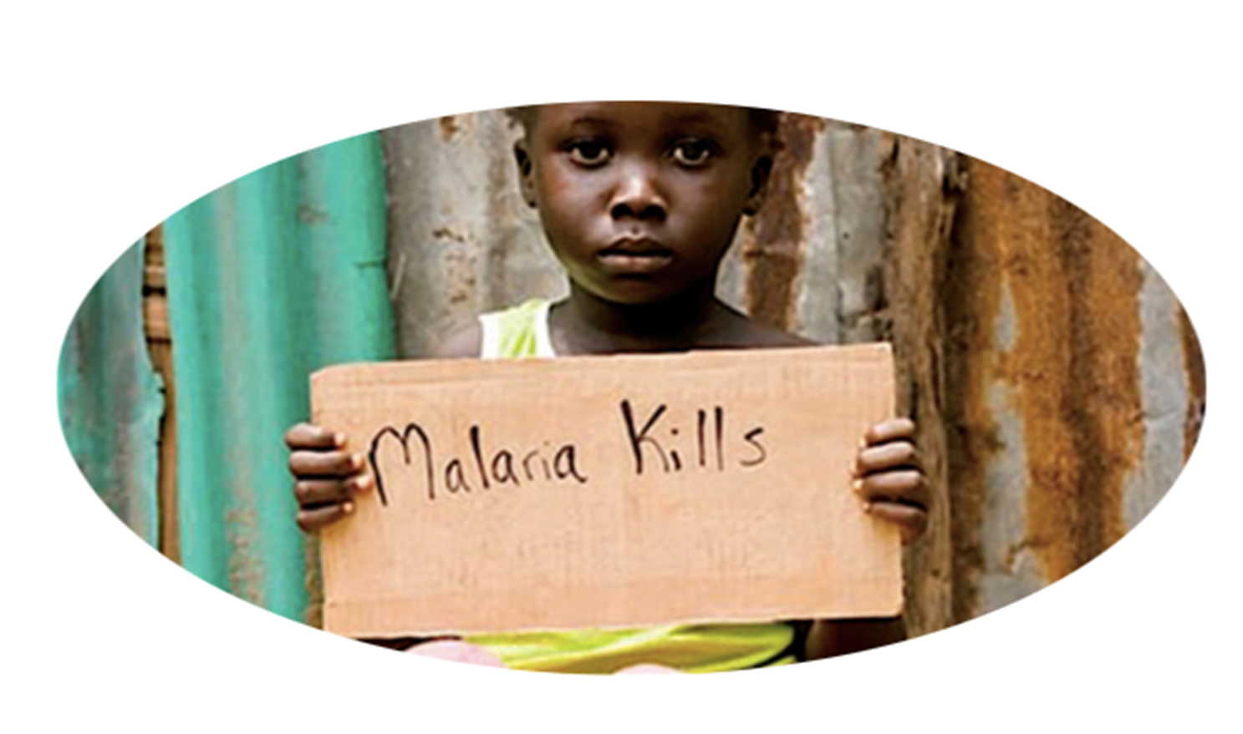
1. Introduction – Malaria causes devastation
Keep messages simple! and VISUAL - ppt is a visual aid
One child < 5 dies every 2 minutes of every day
Notes:
The powerful message here is that malaria kills. It kills too many children under 5. In fact, one child under 5 dies every 2 minutes of every day, every year!

Slide 4
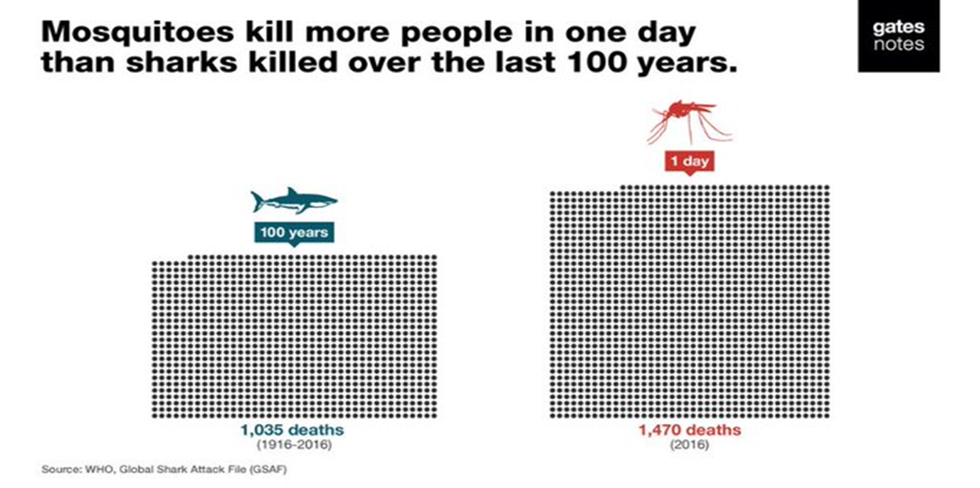
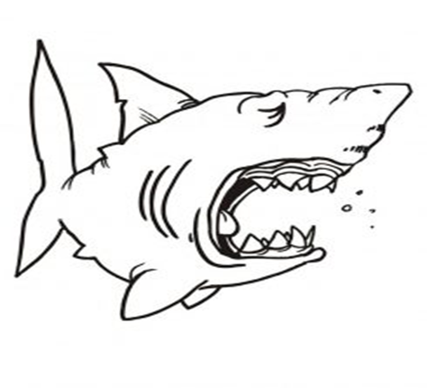
Malaria - World’s most deadly Disease
Bill Gates:
World Malaria (2018) 228 million cases pa
405,000 deaths pa mainly children < 5 years old
A picture - worth a thousand words!
Notes:
Malaria is indeed one of the World’s most serious and deadly diseases. Bill Gates put into perspective nicely when he reminded us that mosquitos kill more people in one day than sharks killed over the last 100 years. Mosquitos do transmit other deadly diseases like Denge and but malaria is by far the most important of these. In fact, in 2018, there were 228 milion cases of malaria causing 405,000 deaths. Many of these deaths are children under 5 years old. Importantly, this level of devastation will continue every year unless we do something about it. Note, the number of malaria cases each year is over 10 times that of Covid 19 in 2020. Covid 19 could reverse the gains against malaria achieved over the last 2 decades. It could result in double the malaria deaths.

Slide 5
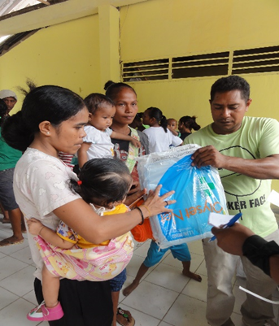
Consistent funding over more than a decade from the Global Fund.
High level of government commitment and a stable political climate.
Consistent technical support from WHO Malaria Consultant.
A well organised NMCP with a network of trained malaria staff.
Rural outreach services by active Community Health Volunteers.
Test kits available in the hard to reach places where there are no microscopy facilities.
Diagnostic facilities & treatment available in all health institutions.
Good surveillance and case response systems.
Ongoing training for clinicians and nurses to carry out treatment.
Ongoing visits by teams to villages
Reasons For the Malaria Reductions
DO NOT use small fonts to cram in more words!
Headings 32 Font
Body text 24 Font – not 18 font!

Slide 6
Consistent long term Global Funds funding over more than a decade from the Global Fund
High level of Government commitment and a stable political climate.
Consistent WHO Malaria Consultant technical support from WHO Malaria Consultant
A well organised health services , NMCP with a network of trained malaria staff
Rural outreach services by active Community Health Volunteers
Test kits available in the hard to reach remote places where there are no microscopy facilities. institutions.
Good surveillance and case response systems
Ongoing treatment training for clinicians and nurses to carry out treatment. to villages
Cull excess words
Reasons For the Malaria Reductions
Successful Malaria control

Slide 7

Successful Malaria control
Consistent, long term Global Funds
Government commitment
WHO Malaria Consultant support
Well organised health services, trained malaria staff
Community Health Volunteers
Test kits in remote places
Diagnostics & treatment in all health centres
Good surveillance and case response systems
Ongoing treatment training
Regular malaria team visits
Words reduced by half – double clarity
Never write sentences! – PHRASES ONLY

Slide 8
RAM District Champion’s Information Package
Resources for the job!
https://ram.rawcs.com.au/members/members-only/
Letter templates
PowerPoint Presentation KISS
Malaria Fact Sheet – Present selected facts only!
Remember, less is more! ……….or the 80:20 rule
Roles and Responsibilities
RAM logo, poster (RAM Letterhead!)
Others: eg Shared resources - avoid reinventing the wheel,

Slide 9

In Conclusion
KISS!!!!!
No flashy animation –they distract!
Maximise VISUAL impact! – Minimise words
Never copy graphs/tables from other docs – hard to read – make your own in ppt
Face the audience, not the screen!
10 minute talk - 10 slides!!!
Questions ?
Always leave some time for questions!
Notes:
1. When we look at the impact of malaria, we find that it affects nearly half of the World’s population, most of whom live in poor, developing countries, particularly in sub-Saharian Africa but also in our region of the World. 2. The general symptoms of malaria are a a debilitating fever, headache and chills, aand they can result in death. 3. In addition, symptoms in children include anaemia, breathing difficulties, in some cases cerebral malaria, and seizures that may result in learning and behavioural impairment, and in death. 4. The impact of malaria is magnified as people can get malaria up to 3 times a year. 5. Malaria is truly debilitating so affected people are unable to work and children are unable to attend school and study. All this contributes to adverse economic and social impacts. For example, the direct costs of malaria alone amount to US$12 Billion each year, let alone the indirect costs on peoples lives and livelihoods. Malaria is one of the World’s most serious diseases!

Slide 10
