Slide 1
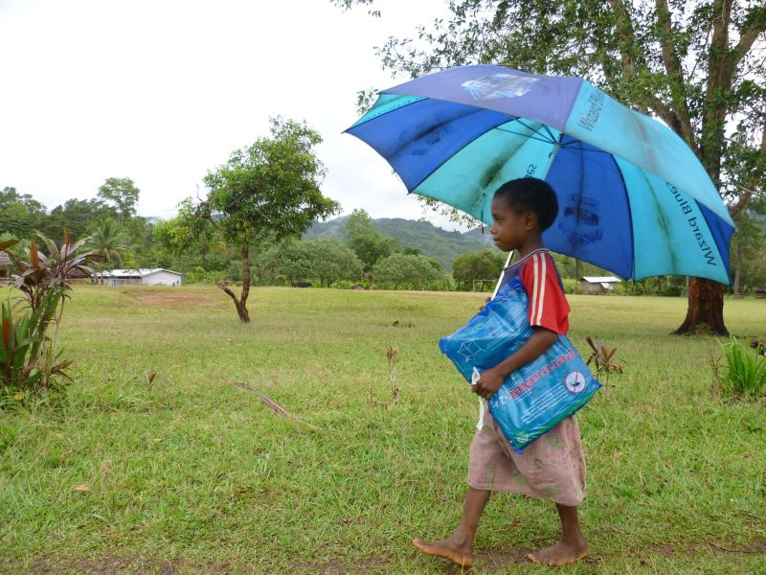
Rotarians Against Malaria
Malaria Elimination:
A Work in Progress

Slide 2
What is RAM?
2
Rotarians Against Malaria is a volunteer-run organisation working to eliminate malaria
RAM is represented in all Rotary Districts and is governed by Rotary Australia World Community Service (RAWCS) Ltd
Notes:
“The prevention of mortality

Slide 3

3
Rotary Australia World Community Service
National
Activities
Communications
Rotarians Against Malaria
Projects and Volunteers
In Kind Donations
Regional Committees
District Committees
Notes:
Slide 10 RAWCS National Activities
The projects that I have just described are all RABS projects and are facilitated through our Projects and Volunteers National activity. In addition, RAWCS has three other National Activities: RAM, In-kind Donations and Communications. These activities are all represented on the Board of RAWCS, on the five Regional RAWCS Committees and in most District RAWCS Committees. The following slides describe how the Activities contribute to Rotary.

Slide 4
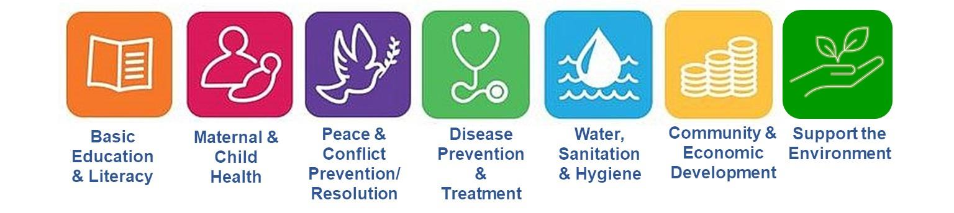
RAWCS Mission
4
“Within the areas of focus of Rotary International, to enhance support services to Australian Rotarians and Rotary Clubs to assist disadvantaged communities and individuals with humanitarian aid projects”
Notes:
Slide 3 Mission Statement
Provide support to Australian Rotarian’s Humanitarian aid projects; within RI areas of focus.

Slide 5
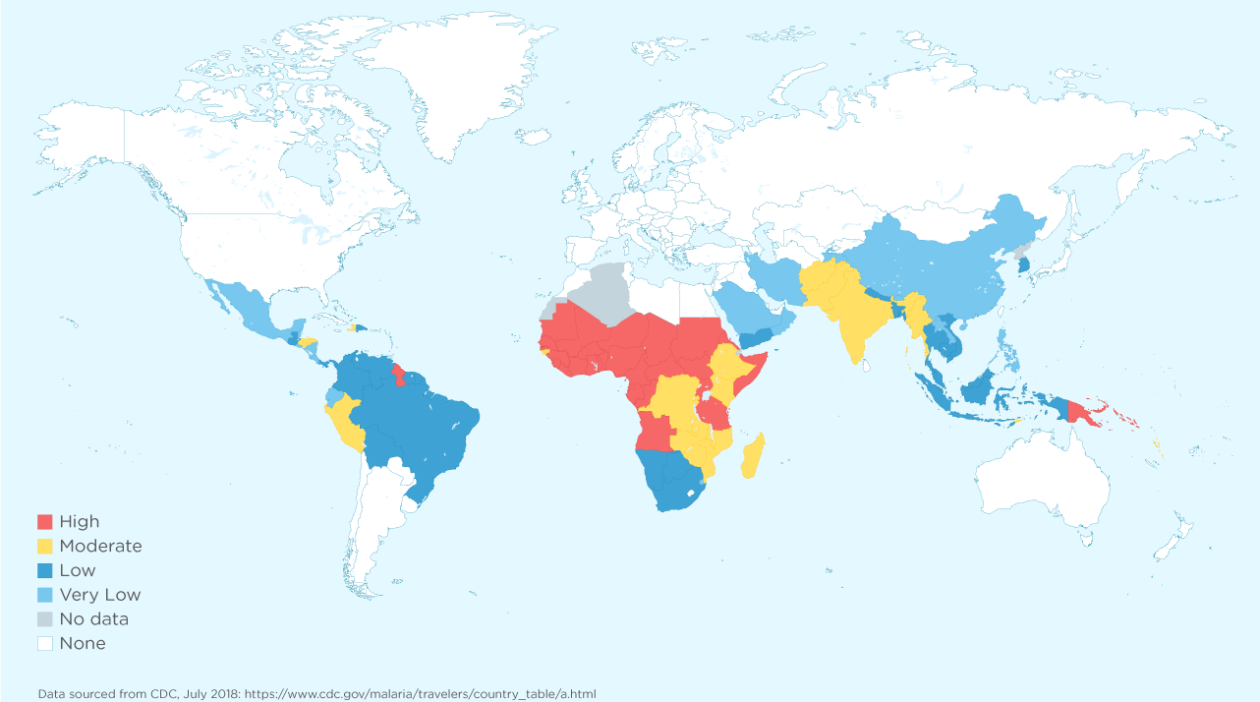
50% of the World was affected by Malaria in 2019

Slide 6
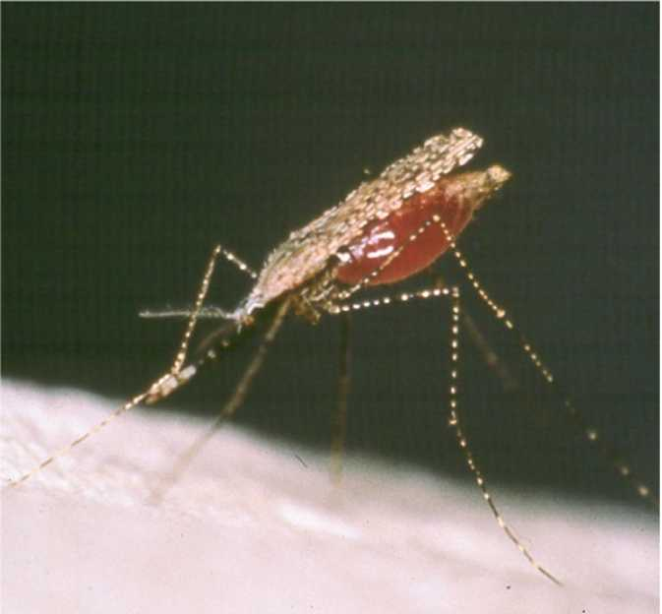
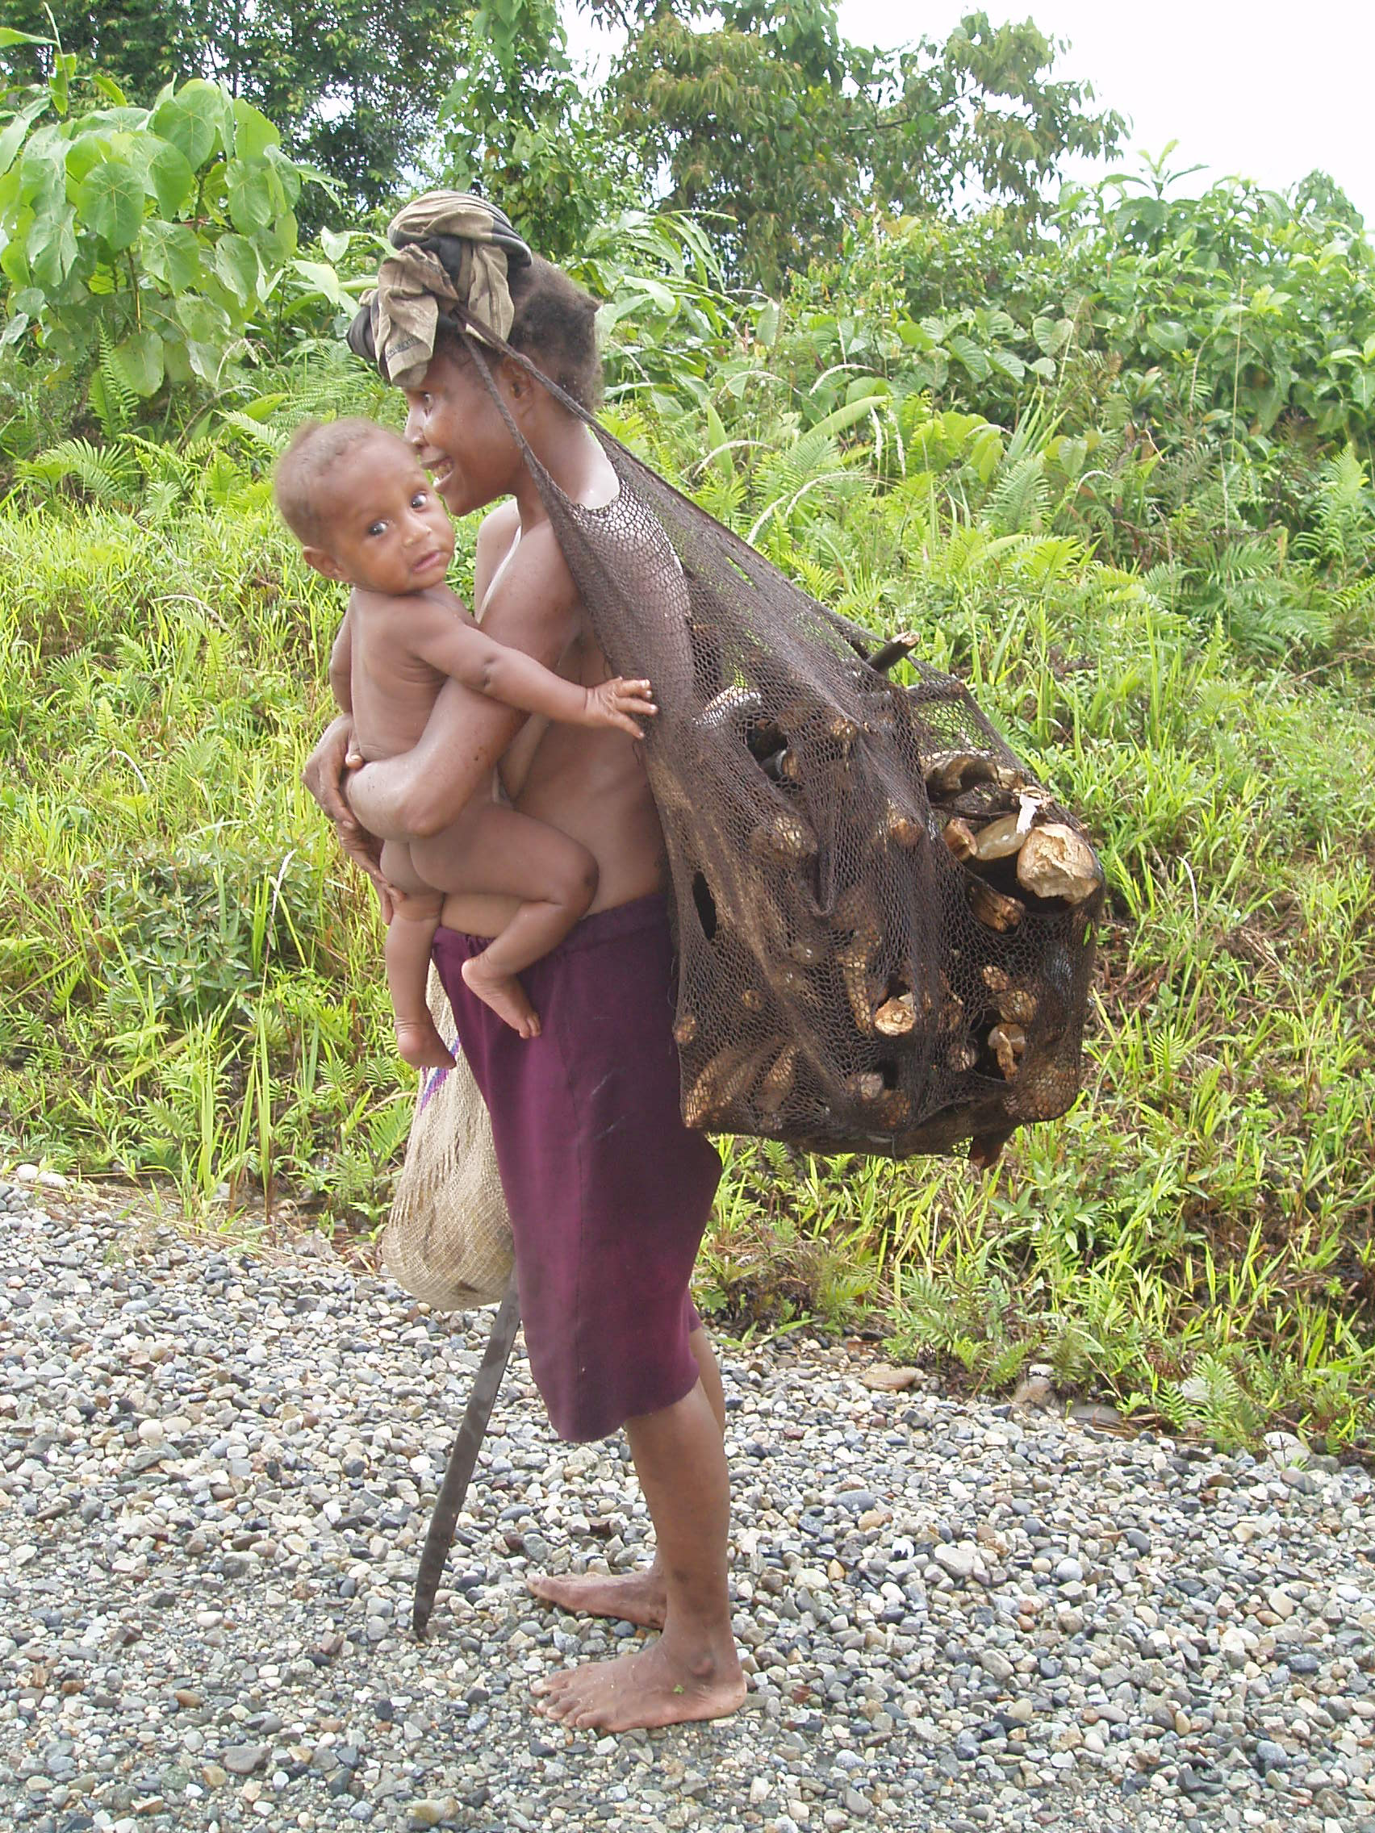
The Enemy: Female Anopheles Mosquito
6
In 2019, annual global infection rate: 229 million cases
Annual deaths: 409,000
67% of deaths are children under 5
(Humans at risk: 3 billion)
The challenge:

Slide 7
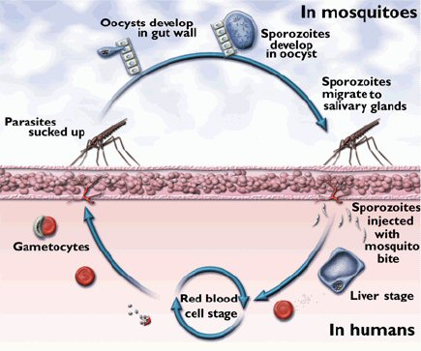
The Malaria Cycle
7

Slide 8
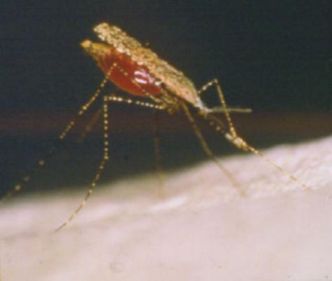
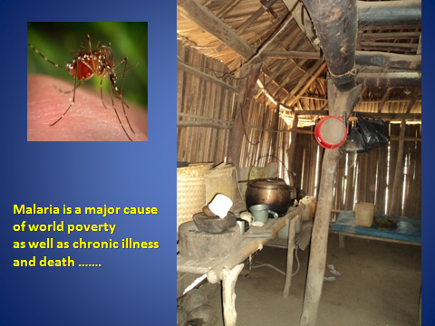

Slide 9
About RAM
9
RAM was an Australian initiative founded in the early 1990s
It was launched in 1995
RAM works:
through the Governments in
our partner countries
with some Global organisations
& research institutions in
Australia

Slide 10
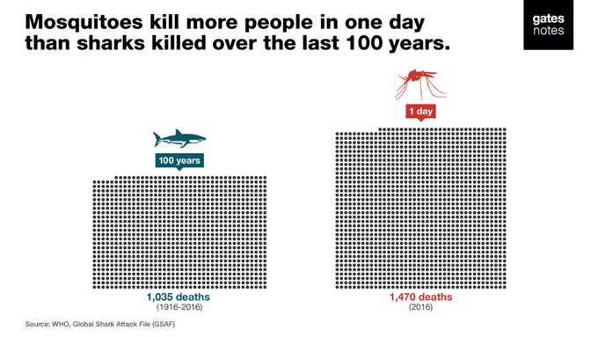

Bill Gates Quote
10
Malaria is deadly.
Early treatment prevents the parasite entering the liver resulting in a lifetime of suffering

Slide 11
Search for a Vaccine
11
RTS,S – Mosquirix
Has had limited success
Why?

Slide 12
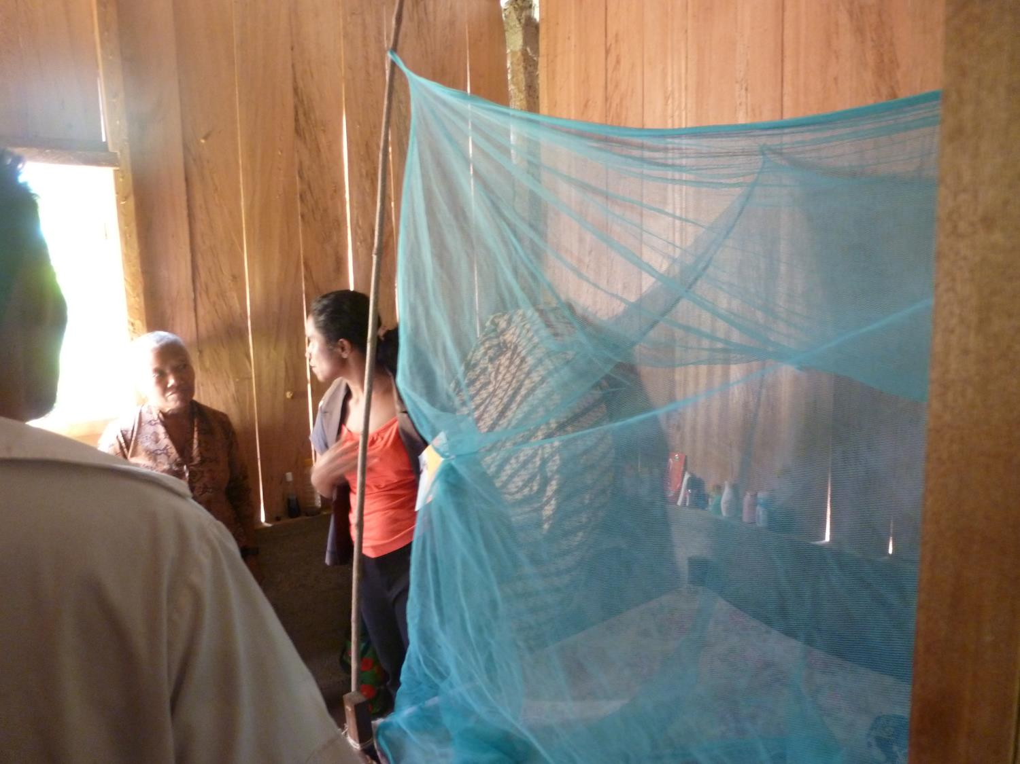
RTS,S Mosquirix
12
Needs 4 doses to be given
It’s short lived
Only gives about 30% -40% protection
Has to be administered in conjunction with the use of treated nets (LLINs)

Slide 13

HOPED FOR OUTCOMES
13
A large drop in reported malaria cases and deaths
A drop in the number of premature child births and increase in average birth weight
Huge reduction of anaemia in pregnant women and newborn children
A reduction in the number of miscarriages
Improved economy, employment & education

Slide 14
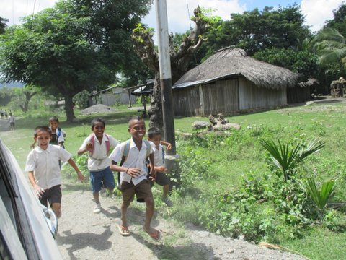
An Important goal of RAM
Happy healthy kids eager to get an education

Slide 15
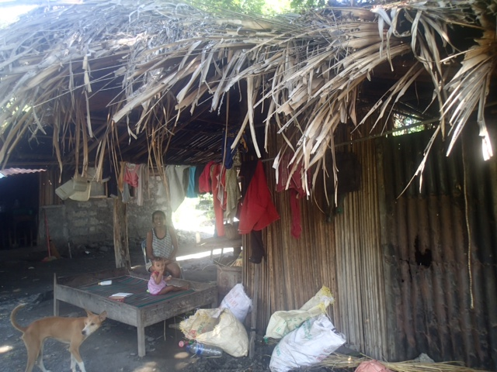

Slide 16
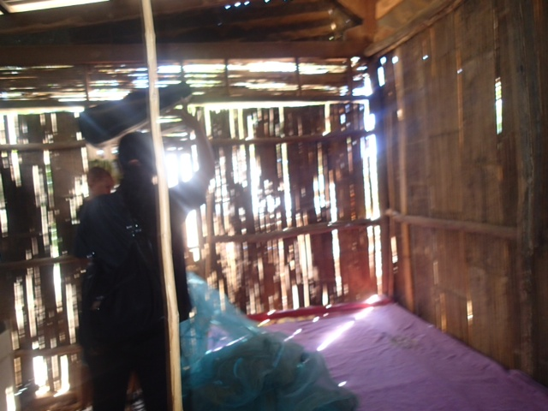

Slide 17
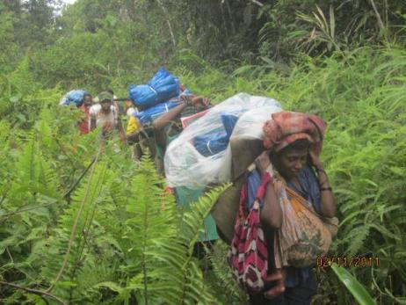
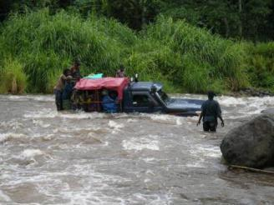
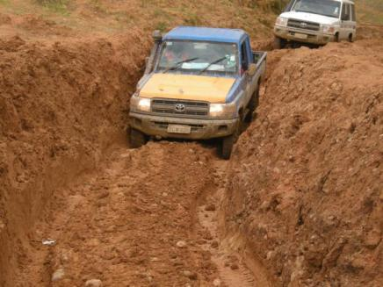
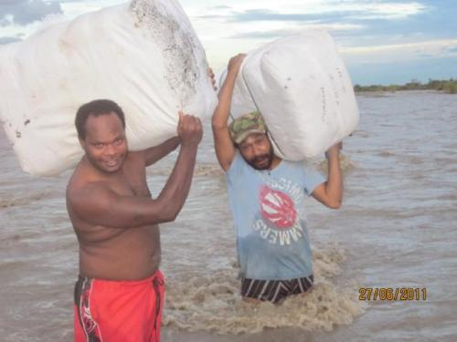
Difficulties
17
Notes:
The challenges for net distributors are huge

Slide 18
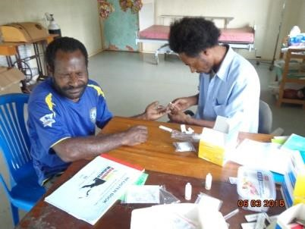
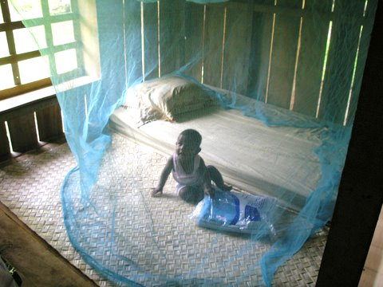
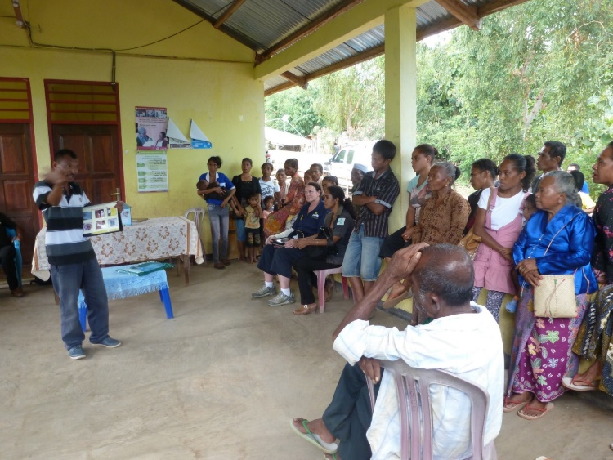
RAM Programs: Breaking the cycle of infection
18
It’s a very grass roots approach:
Collaboration: Other NGOs & Governments
LLIN bed nets
Residual insecticidal spraying (IRS)
Education
Engineering environments
Controlling larvicide in breeding grounds
Rapid accurate diagnosis, surveillance
Effective treatment (Logistics)
Research: PhD Scholarship, vaccines?
Notes:
ACT (Artemisinin – based combination treatment)

Slide 19
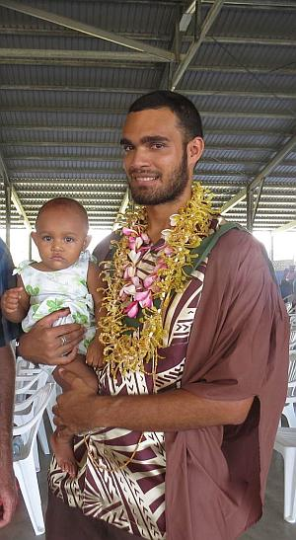
Successful First Recipient of the RAM Scholarship
Edgar Pollard PhD from the Solomon Islands
Research topic:
Understanding mosquito flight to maximise malaria and dengue control by insecticide impregnated barriers

Slide 20
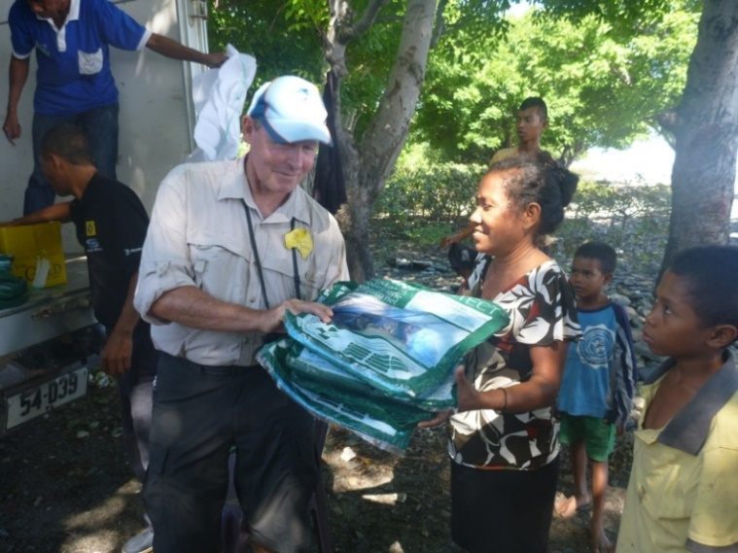
RAM Focus Countries
20
Papua New Guinea, the Solomon Islands and Timor Leste have received active and financial support from RAM for a number of years.
West Timor and Vanuatu have also requested support from RAM and this began in the 2019-20 Rotary Year
Distributing nets in Timor Leste

Slide 21
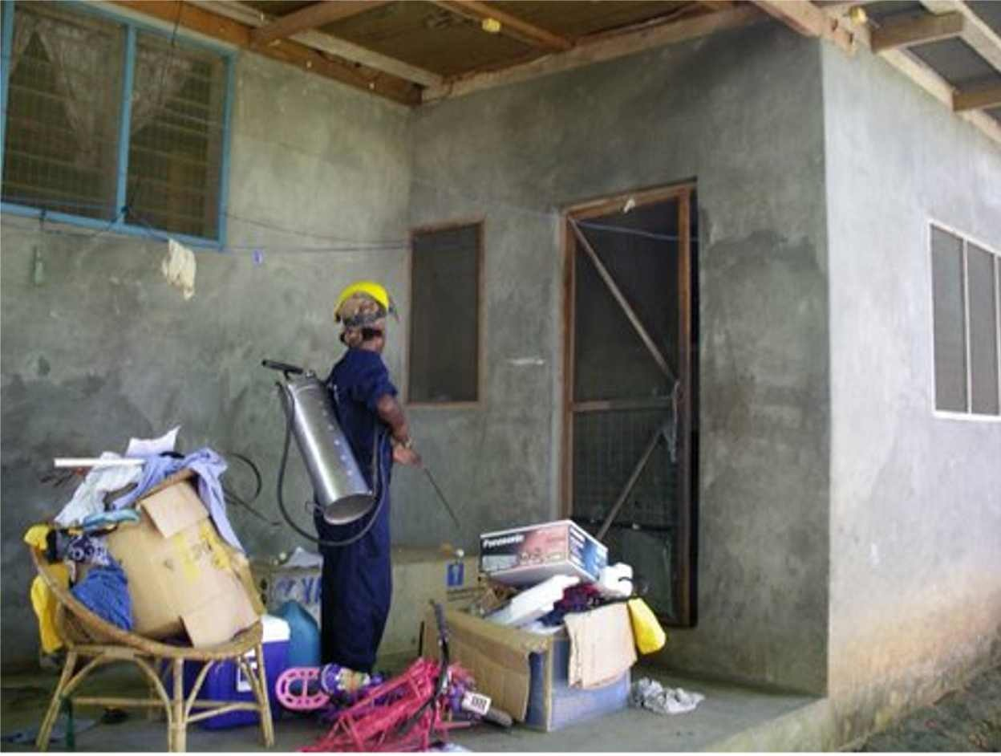
Adopt–A–RAM–Project
21
Southern Region has adopted the ‘End Malaria in Vanuatu-for Good’ Program
A RAWCS Fundraising Account was set up by D9810 and D9820 – (RAWCS 104-2019-20)
Money raised was used in an application for a Global Grant which was
submitted in June 2020
and led by D9910 NZ.
Success!!

Slide 22
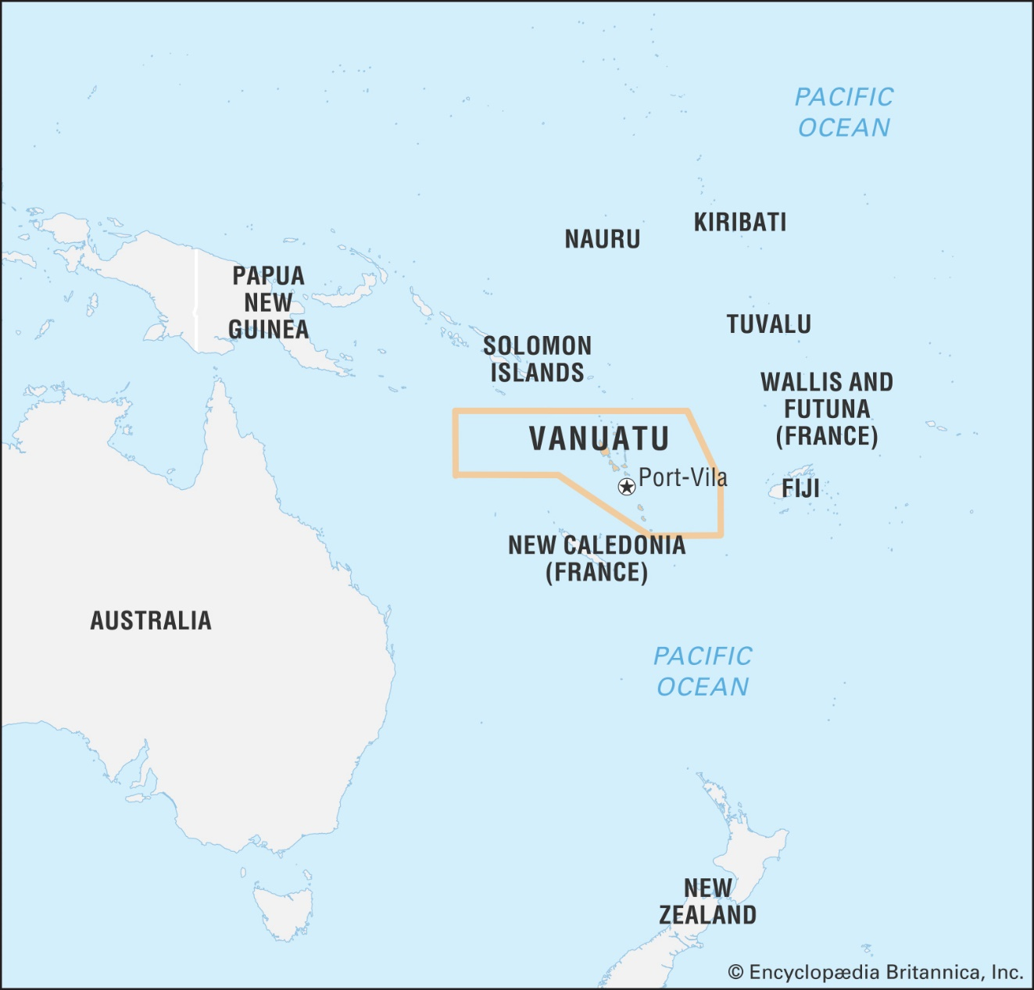
END MALARIA IN VANUATU - FOR GOOD
The objective of this Rotary Global Grant is to train and equip a National Indoor Residual Spraying team in Vanuatu
Help save lives …
Please continue to donate to help Vanuatu …

Slide 23
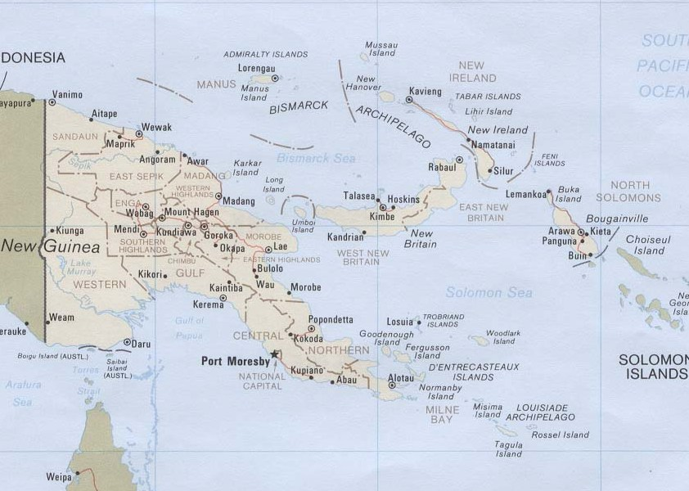
In Papua New Guinea
23
2005, 2009 & 2012 large Global Funds awarded
By June 2020,
more than 12 million
nets were distributed

Slide 24
RAM in Papua New Guinea
Global Fund’s funding has decreased, so a new initiative has been implemented:
In Port Moresby and Central Province, RAM has funded a program called “Chasing Malaria” to track and investigate case clusters in schools and communities

Slide 25
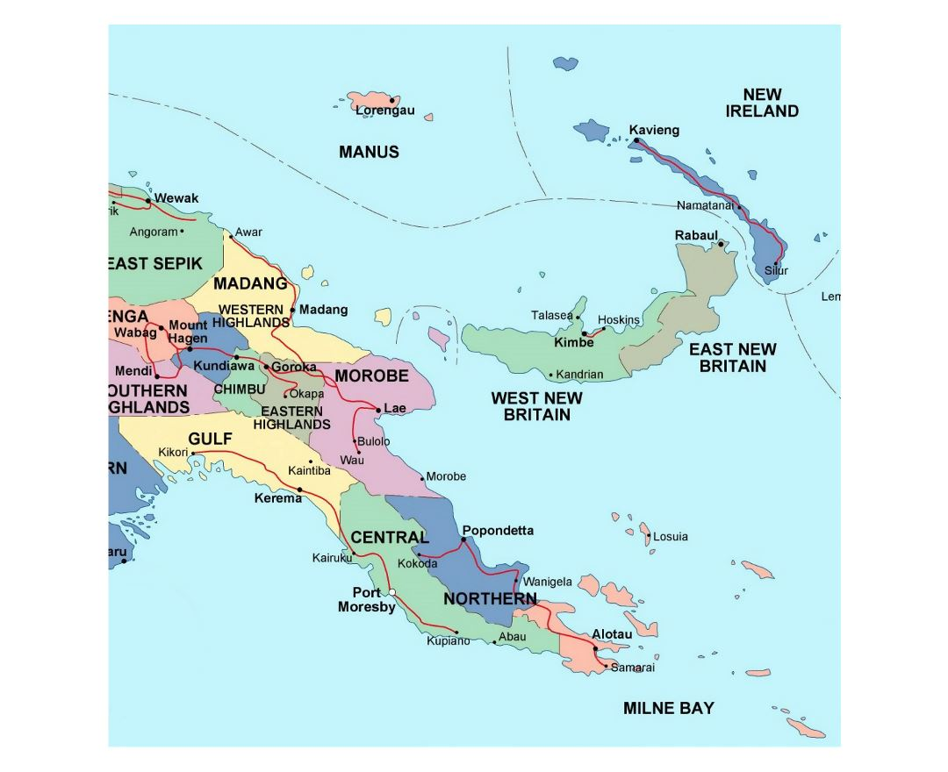
Resurgence of Malaria in PNG:
25
Drug and insecticide resistance
Diagnostic failure
Human behaviour
Mosquitoes biting earlier
Sub-optimal level of Insecticide on bed nets – lasting only 18 months instead of 3 years
Drugs and test kits not being available at hospitals and health centres

Slide 26
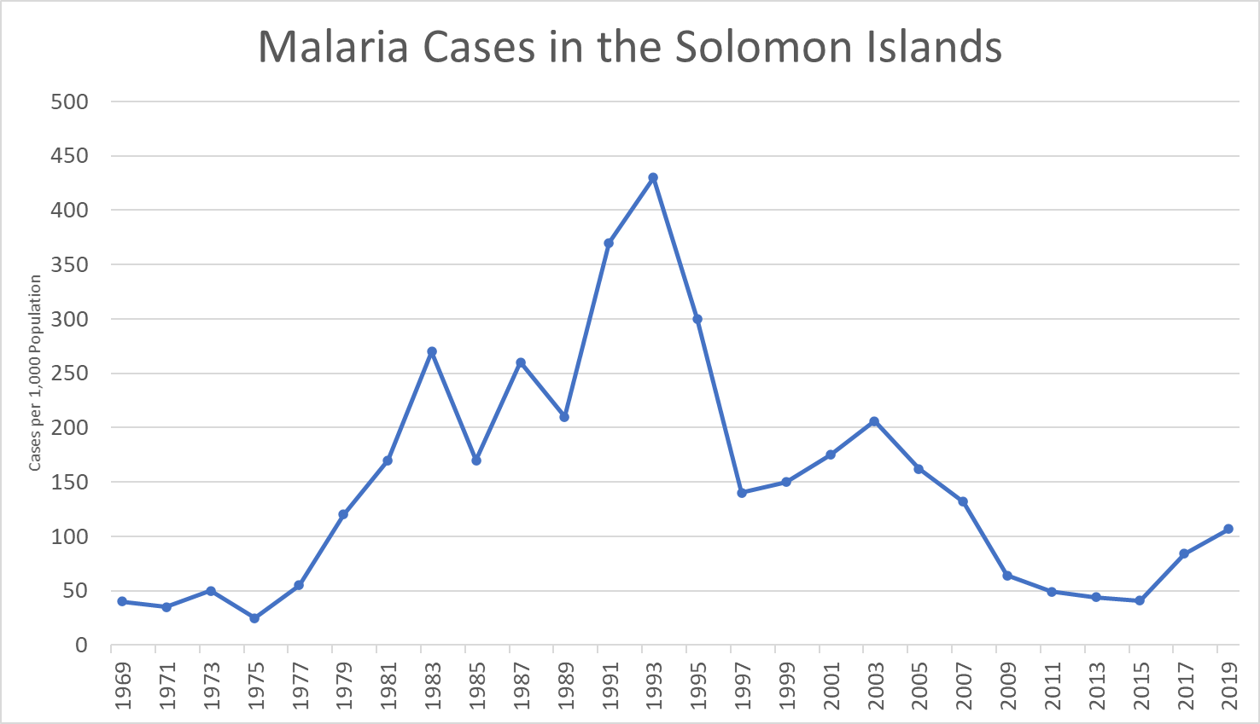

RAM
launched
Less RAM
surveillance
Intensified control & elimination program
Original MEP
DDT spraying

Slide 27
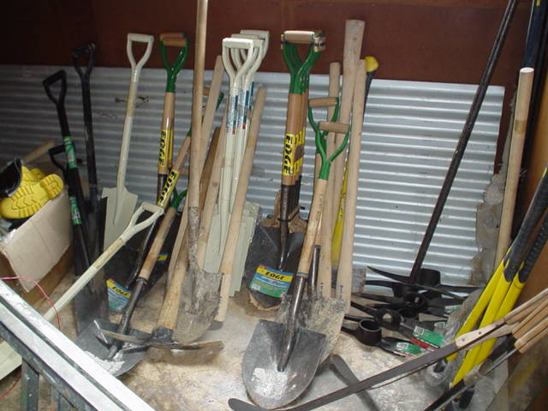
27
RAM in the Solomon Islands
2012 - 2017 RAM ran the Basic Tools Healthy Villages Program, in conjunction with the Ministry of Health
For $1,750, a village received bush knives, axes, flat files, spades, mattocks, crow bars, and wheelbarrows.
  These tools were used to remove mosquito breeding sites and improve general drainage

Slide 28
TIMOR LESTE
28
Reduction in malaria incidence
220 per 1,000 in 2006
0.9 per 1,000 in 2013
0.01 per 1,000 in 2019
Timor Leste is very close
to achieving their objective of zero
indigenous malaria cases in 2021
and WHO malaria free certification
in 2024

Slide 29
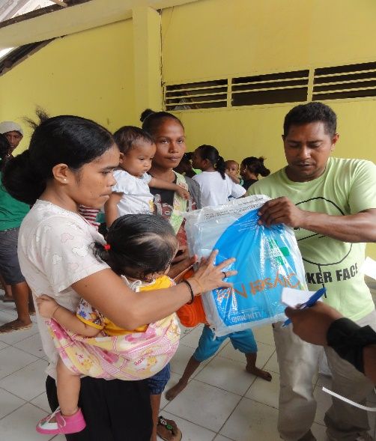
Reasons For the Malaria Reductions
29
Consistent funding over more than a decade from the Global Fund
High level of government commitment and a stable political climate.
Consistent technical support from WHO Malaria Consultant
A well organised NMCP with a network of trained malaria staff
Rural outreach services by active Community Health Volunteers
Test kits available in the hard to reach places where there are no microscopy facilities.
Diagnostic facilities & treatment available in all health institutions.
Good surveillance and case response systems
Ongoing training for clinicians and
nurses to carry out treatment.
Ongoing visits by teams to villages

Slide 30
RAM Long-term Goals
30
Increase awareness of malaria and support for our work through the following activities:
  (i) Establish a RAM District Committee in each Rotary District
  (ii) Conduct biannual RAM volunteer team visits to partner countries,
Provide strategic financial assistance, to the Government in our five (5) partner countries, in areas not funded by Global Fund
Offer a PhD scholarship every 5 years
Join RAM-Global in the global campaign to eradicate malaria

