Slide 1
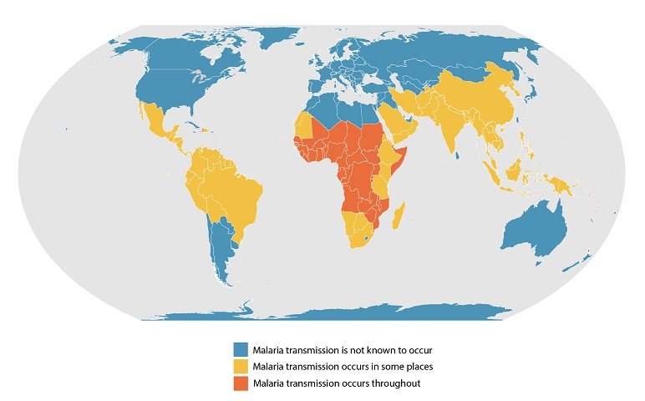
ZERO MALARIA STARTS WITH ME!
Malaria is a life-threatening disease caused by Plasmodium parasites that are transmitted to people through the bites of infected female Anopheles mosquitoes. It is preventable and curable
In 2019, there were an estimated 229 million cases of malaria worldwide estimated number of malaria deaths stood at 409 000 in 2019
Who are most vulnerable?
Children aged under 5 years! In 2019, they accounted for 67% of all malaria deaths worldwide
The WHO African Region carries a disproportionately high share of the global malaria burden. In 2019, the region was home to 94% of malaria cases and deaths.
Total funding for malaria control and elimination reached an estimated US$ 3 billion in 2019
We are Rotarians against Malaria (RAM)
RAM is managed by a network of Rotarians with a RAM representative in each of the 19 Rotary districts in Australia
We help our partner countries in their mission of eliminating Malaria disease
Among Australia’s neighbours, malaria has almost been eliminated in Timor Leste and Vanuatu is aiming for elimination in the next few years. Malaria remains a significant problem in PNG, Eastern Indonesia and the Solomon Islands
What do we do?
We support vector control i.e reducing the mosquito population and the opportunity for mosquitoes to bite humans. For example:
Provide and distribute Long Lasting Insecticide-treated Nets (LLINs)
Indoor Residual Spraying (IRS)
Environmental improvements such as through the Chasing Malaria Program in PNG.
Train community health volunteers to participate in mass LLINs distribution and malaria education
How can you help?
DONATE via http://ram.rawcs.com.au
Let Zero Malaria start with you!
Developed in 2021 by: Rotaractor Thisarani Jayasinghe D9830

