Slide 1
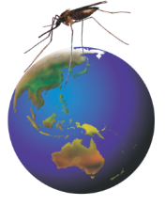

Rotarians Against Malaria
Russ Stephenson
Rotary Club of Nambour
RAM - working to eliminate malaria
Notes:
Rotarians Against Malaria, or RAM,is a volunteer organisation working to eliminate malaria, one of the World’s most devastating diseases.

Slide 2
Presentation Outline
Introduction – devastation caused by malaria
About RAM
      One Goal
      Actions to achieve goal
Timelines
      The fight against malaria
      Where we want to be
A vaccine
Challenges
Conclusion
Notes:
In this presentation, I will give a brief introduction that highlights why we need to eliminate malaria. I will then provide an overview of RAM, its goal and the actions RAM is taking to achieve this goal. The relevance of RAM’s work is highlighted in the history of the fight against malaria and an example is given of where RAM wants to be in each of our malaria-affected, partner countries. I will briefly mention the search for a vaccine and the challenges RAM faces in its quest to eliminate malaria and, in conclusion, I will issue a call to action for you to help RAM achieve its worthy goal of malaria elimination.

Slide 3
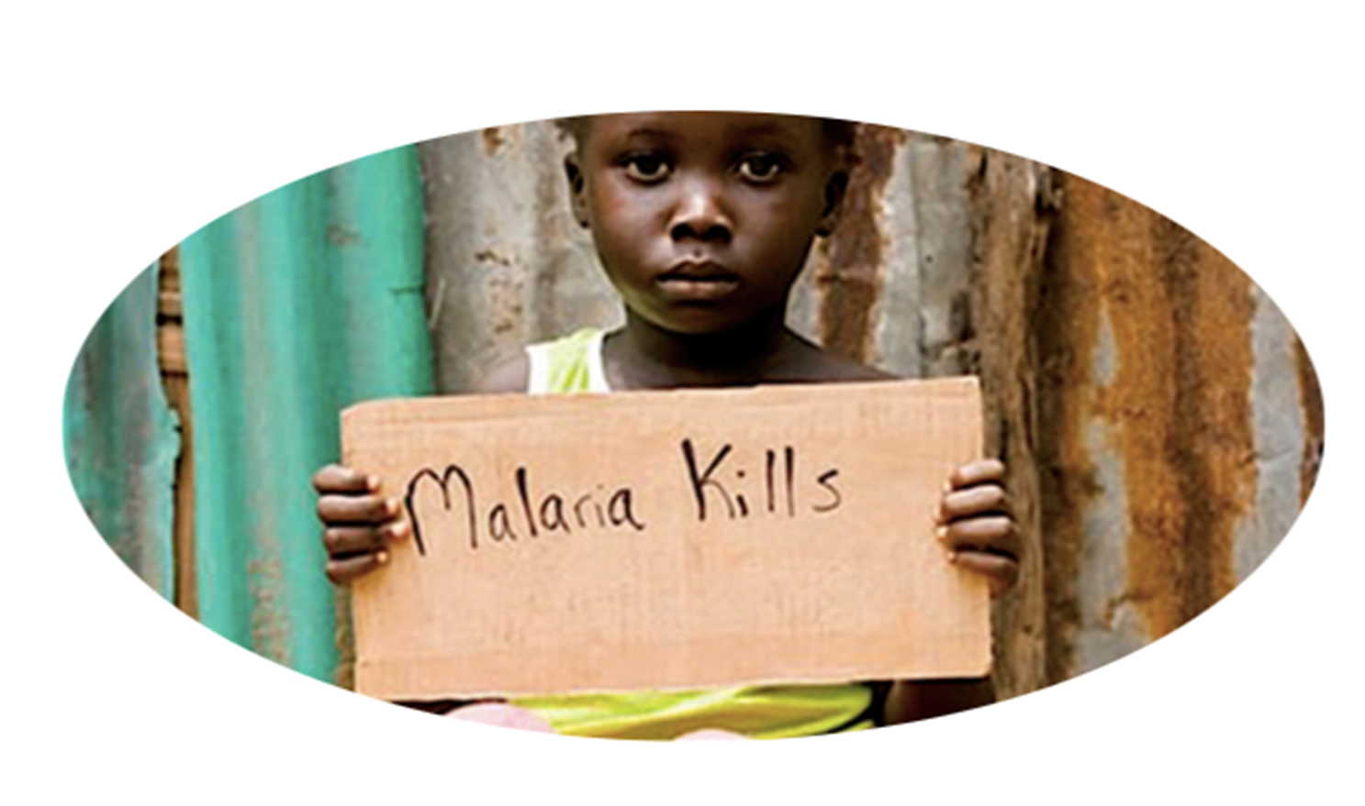
One child < 5 dies every 2 minutes of every day
Notes:
The powerful message here is that malaria kills. It kills too many children under 5. In fact, one child under 5 dies every 2 minutes of every day, every year!

Slide 4
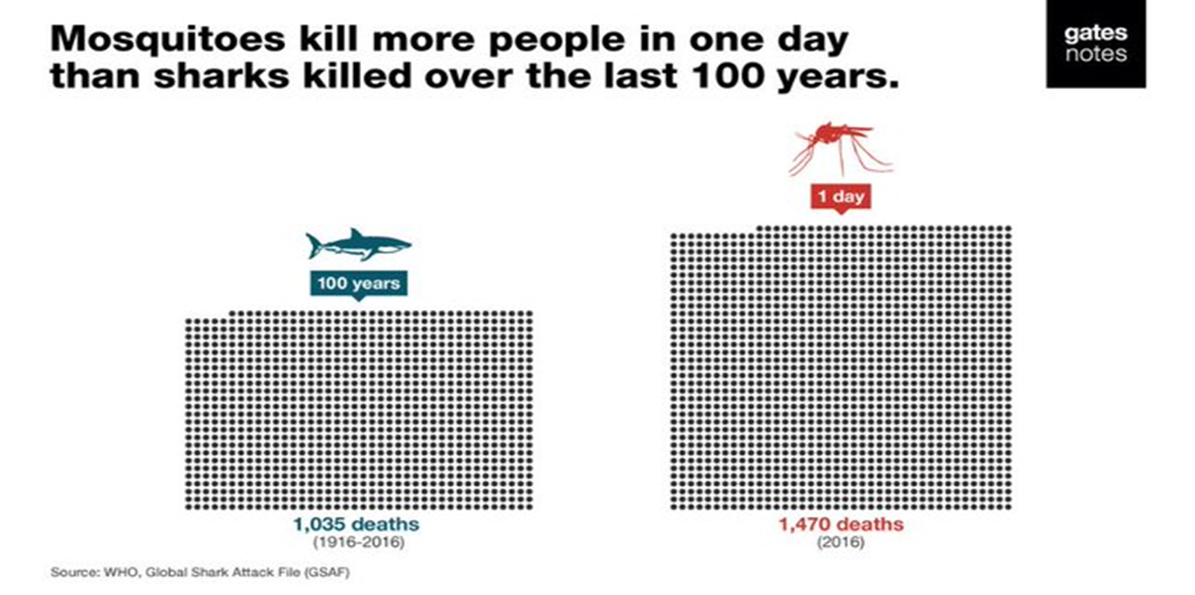
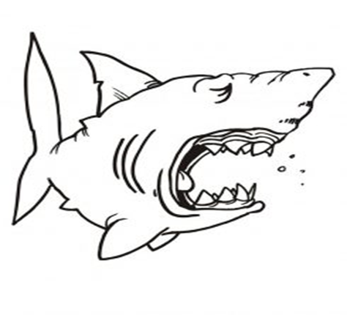
Malaria - The World’s most serious Disease
Bill Gates:
World Malaria (2018)
228 million cases pa
405,000 deaths pa mainly children < 5 years old
Notes:
Malaria is indeed one of the World’s most serious and deadly diseases. Bill Gates put into perspective nicely when he reminded us that mosquitos kill more people in one day than sharks killed over the last 100 years. Mosquitos do transmit other deadly diseases like Denge and but malaria is by far the most important of these. In fact, in 2018, there were 228 milion cases of malaria causing 405,000 deaths. Many of these deaths are children under 5 years old. Importantly, this level of devastation will continue every year unless we do something about it. Note, the number of malaria cases each year is over 10 times that of Covid 19 in 2020.

Slide 5
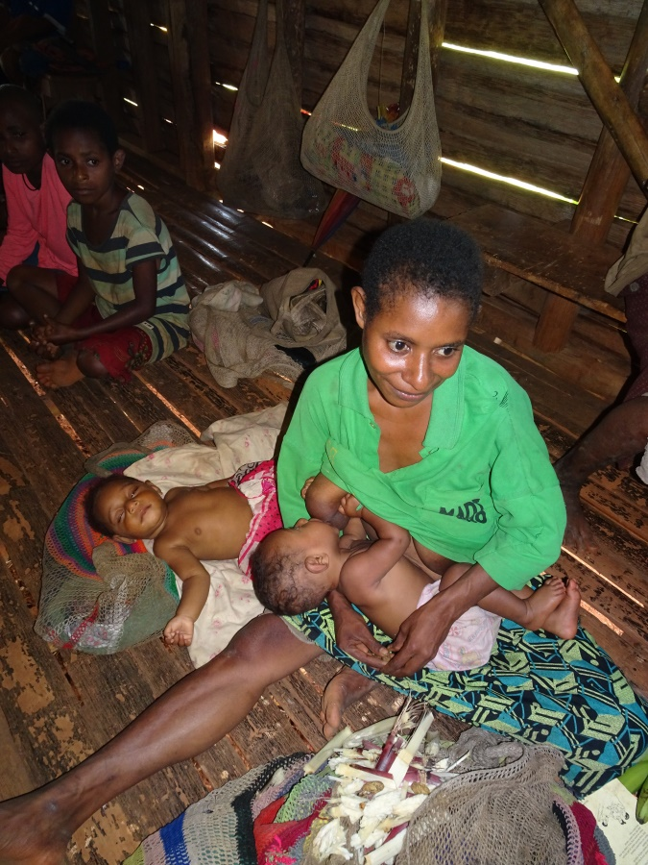
Impact of Malaria
    Half world’s population at risk – poor countries
Symptoms – fever, headache, chills
Child symptoms - anaemia, breathing
  problems, cerebral malaria, seizures,
  learning impairment, death
    May get malaria 3 times/year
    Debilitating - unable to work or attend school
    Economic and social impacts
      direct costs alone US$12 Billion/year
Notes:
1. When we look at the impact of malaria, we find that it affects nearly half of the World’s population, most of whom live in poor, developing countries, particularly in sub-Saharian Africa but also in our region of the World. 2. The general symptoms of malaria are a a debilitating fever, headache and chills, aand they can result in death. 3. In addition, symptoms in children include anaemia, breathing difficulties, in some cases cerebral malaria, and seizures that may result in learning and behavioural impairment, and in death. 4. The impact of malaria is magnified as people can get malaria up to 3 times a year. 5. Malaria is truly debilitating so affected people are unable to work and children are unable to attend school and study. All this contributes to adverse economic and social impacts. For example, the direct costs of malaria alone amount to US$12 Billion each year, let alone the indirect costs on peoples lives and livelihoods. Malaria is one of the World’s most serious diseases!

Slide 6
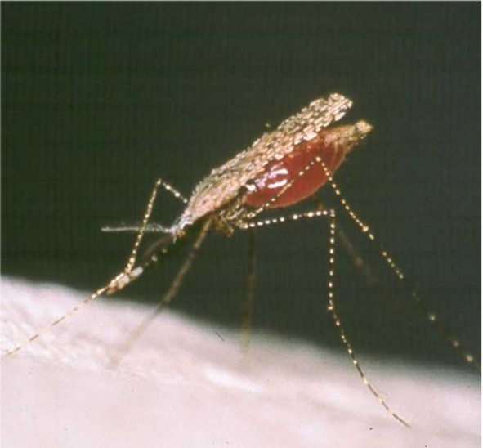
RAM
Established in 1990s
Goal: to eliminate malaria
in PNG, Timor, Solomon Islands, Vanuatu
How?
Control mosquitos – The Enemy
      Distribution of bed nets
      Healthy Villages – drainage and cleanliness
      Insecticide and lavacide sprays
Diagnosis and Treatment
Village malaria volunteers
Surveillance and targeted intervention – Chasing Malaria
Malaria Education
Notes:
What ia RAM? It was established in the mid 1990’s, firstly in the Solomon Islands and in PNG and then in Australia. RAM is run by volunteers and has the one goal of eliminating malaria in partner countries in our part of the world. These partner countries are PNG, The Solomon Islands, Timor Leste, West Timor Because of cross-border transmission) and Vanuatu.
How does RAM achieve its goal? 1. Firstly, it helps control the ENEMY, the female Anopholie mosquito that transmits the malaria parasite in blood. The first, and still most important way in which mosquitos are controlled is be providing people with insecticide-impregnated bed nets. Other strategies include drainage of surface water and village cleanliness promoted by the Healthy Villages program. Finally, RAM helps control mosquitos by chemical sprays. Internal Residual Spraying of houses is carried out twice a year to repel mosquitos from inside houses. In some cases, lavicides are sprayed on surface water where mosquitos breed. 2. Diagnosis and treatment of malaria is another vital function supported by RAM 3. As is the appoinment and training of Village Malaria Volunteers. 4. The fight against malaria is now more sophisticated by careful surveillance, mapping, and targetted interventions such as those used in the Chasing Malaria project in PNG. 5. Finally, education about malaria and how it can be controlled is a vital element of the malaria-elimination “tool chest”

Slide 7

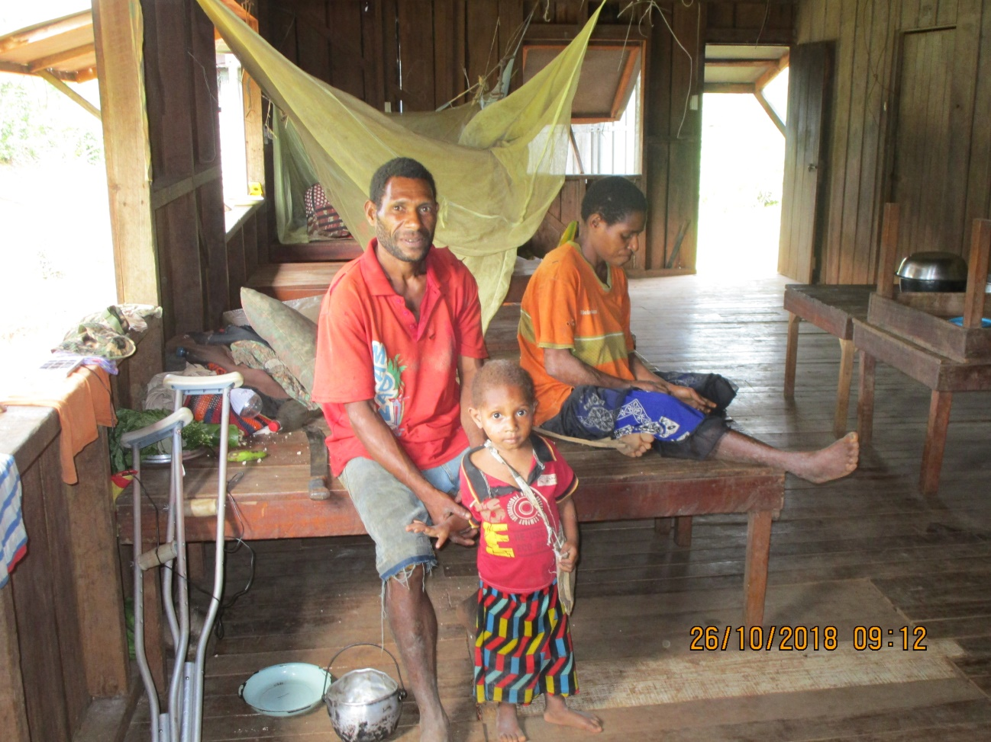
Control mosquitos - bed nets
12 million bed nets distributed by RAM PNG
3 generations appreciate the protection of RAM bed nets
Notes:
In PNG, every household receives at least one insecticide-impregnated bed net every 3 years. Over 12 million bed nets have been distributed by RAM and 3 generations of Papua New Guineans appreciate the protection RAM bed nets give them.

Slide 8

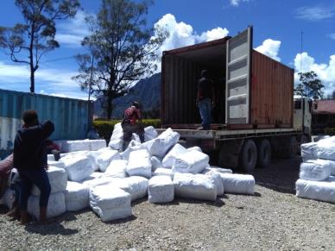
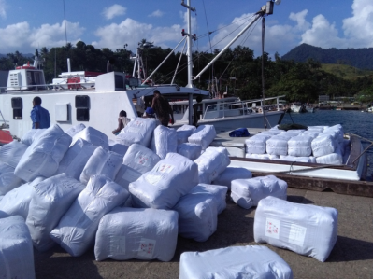
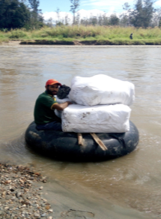
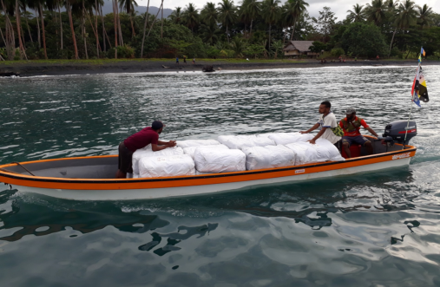
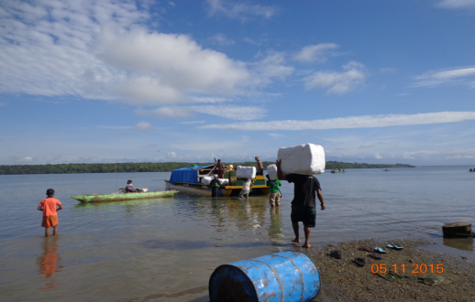
Bed net distribution – a big job
Notes:
The logistics of distributing bednets to millions of villagers is an enormous task, including warehousing, shipping and distribution by whatever means are available.

Slide 9
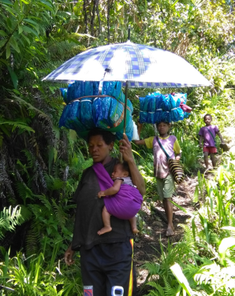
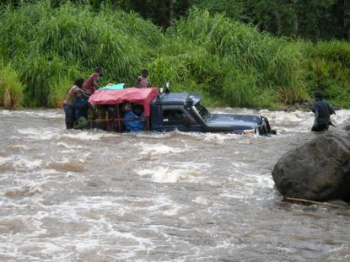
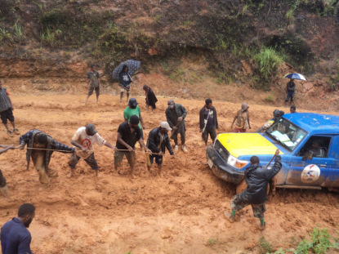
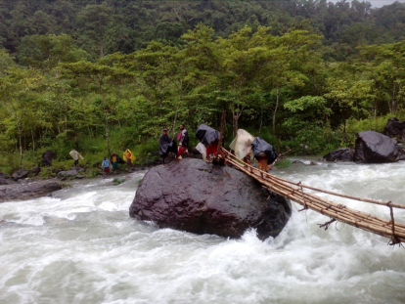
Challenges distributing bed nets
Notes:
In a rugged country like PNG, the RAM bed net distribution teams often face extreme challenges.

Slide 10

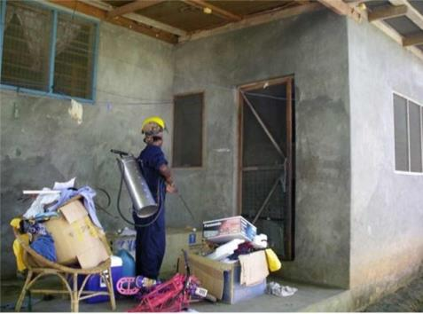
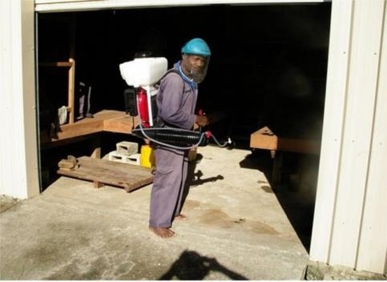
Control mosquitos - Indoor Residual Spraying (IRS)
Spray insecticide inside each house twice a year
Notes:
Indoor Residual Spraying (IRS) is an effective way of repelling mosquitos from inside houses. Two or more insecticide sprays per year are applied to the internal walls of houses by trained operators with specialised sprayers to protect the inhabitants.

Slide 11
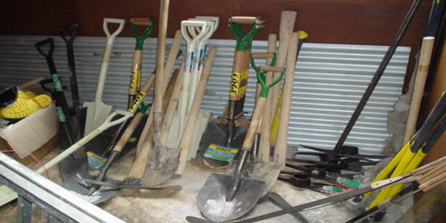
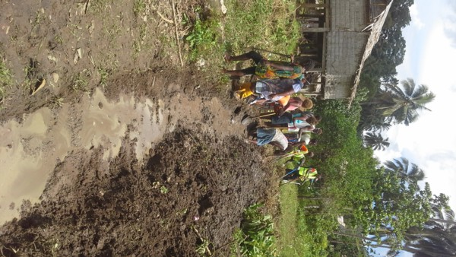
Control mosquitos - Healthy Villages
Self help, clean up, drain surface water
Notes:
The Healthy Villages project in the Solomon Islands provided tools, education and encouragement for villagers to drain surface water away from the village and to maintain a clean village environment to remove mosquito breeding habitats, thus reducing mosquito numbers, and hence reducing malaria.

Slide 12
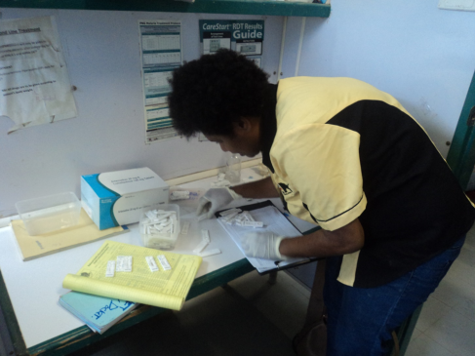
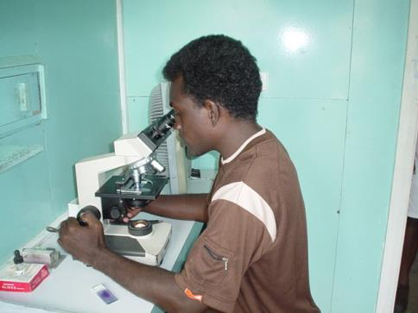
Diagnosis and Treatment
Fever Symptoms – inaccurate, many other causes
Rapid Diagnostic Tests (RDT)– slightly inaccurate
Microscopy – accurate, slow, limited availability
Need better, quicker, accurate tests and better drugs
Notes:
Diagnosis and treatment of patients suffereing from malaria is an important function supported by RAM. 1. The most common means of diagnosis is clinical, based on symptoms of fever. This diagnosis is often inaccurate, largely because many other diseases cause fever. 2. The most important means of diagnosis facilitated by RAM are Rapid Diagnostic Tests. These are widely used but may be slightly inaccurate. 3. The most accurate diagnosois of malaria is microscopy but it is slow. Moreover, and microscopes and trained microscope operators are seldom available in more remote small towns and villages. 4. There is a need for better, quicker, more accurate diagnostic tests and better, more effective drugs to treat malaria.

Slide 13
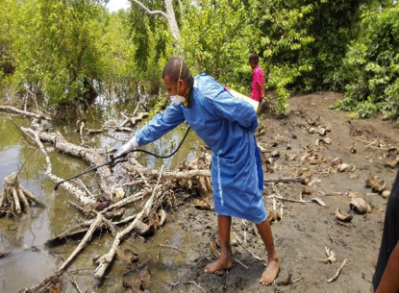
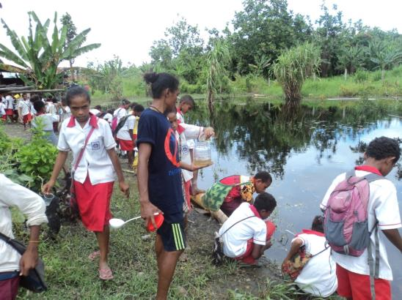
Surveillance and targeted intervention - Chasing Malaria
RDTs & clinical records
all + ve cases get a new bed net
volunteer, local student surveillance
Notes:
An increasingly important strategy for elimination of malaria is careful surveillance, diagnosis and targetted interventions such as those used in Chasing Malaria (and also those currently being used throughout the World to control the spread of the Covd 19 virus). The intervention might include spraying lavicide on water breeding grounds. Teams of trained mobile and village health workers respond promptly to malaria cases and trace to source of the disease - Whether it is local transmission or imported from other villages, towns or regions. Rapid Diagnostic Tests are carried out to confirm that the symptoms are caused by the plasmodium parasite and the patients are treated with antimalarial drugs. All people who are diagnosed with malaria receive a new insecticide impregnated mosquito net to provide ongoing protection, particularly for pregnant women and mothers. from the disease.
Because this effective malaria elimination strategy is labour-intensive, volunteers including school teachers are oftem given some training on diagnosis and treatment, supplied with Rapid Diagnostic Test kits and drugs so patients receive prompt treatment. School children can play a useful role in surveying waterways for mosquito larvae to identify buildup of mosquito populations, this prompting effective interventions to reduce these populations

Slide 14


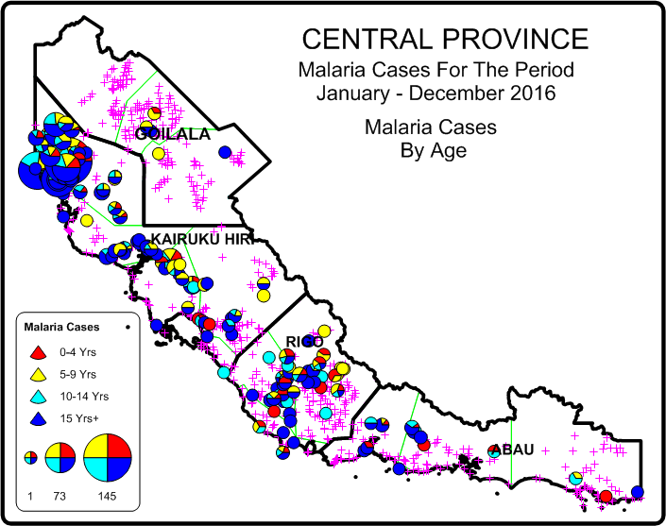
RAM PNG Chasing Malaria
Elimination
Notes:
This is the sort of detailed surveillance and mapping done by RAM PNG in identifying cases and the ages of those suffering from malaria. These data provide a lot of intelligence to guide effective interventions. Combined with a GPS capability, It is now possible to identify he actual house in a village where malaria has been reported so even more precise, targetted interventions can be given.

Slide 15
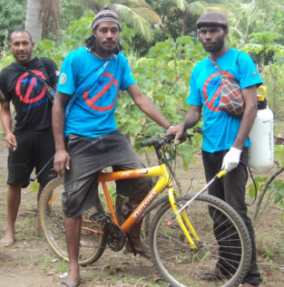
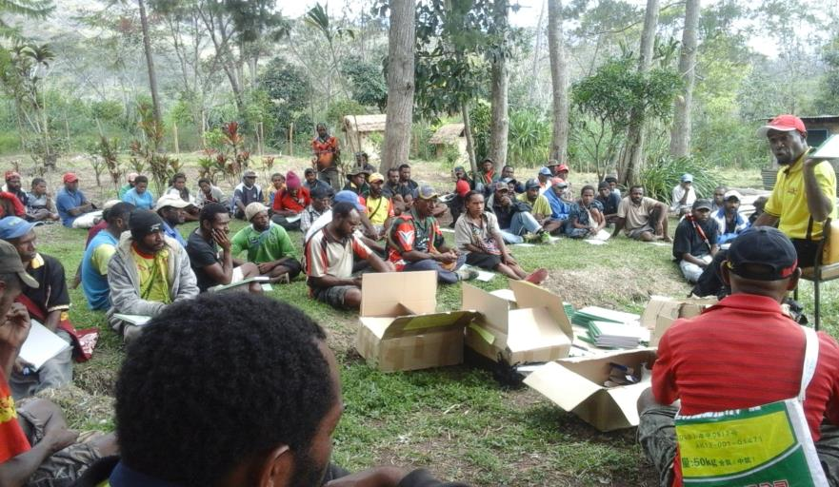
Village Malaria Volunteers
Diagnosis and treatment training
Supply bed nets, RDT and drugs
Prompt diagnosis and treatment
Notes:
Village Malaria Volunteers, proudly identified by their RAM shirts, are used extensively to ensure that every household within their area receives a bed net. In addition, selected village volunteers receive training in diagnosis and treatment for malaria, and resources such as spare bed nets, Rapid Diagnostic Test kits and drugs to provide prompt diagnosis and treatment.

Slide 16
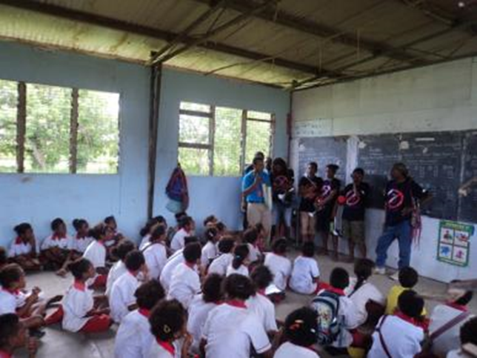
Malaria Education
for:
Children
Community Health Workers
Village Malaria Volunteers
Villagers
Notes:
Knowledge is power! Education about malaria and its treatment empowers children, Community Health Workers, Village Malaria Volunteers and villagers to protect themselves from this dreaded disease.

Slide 17
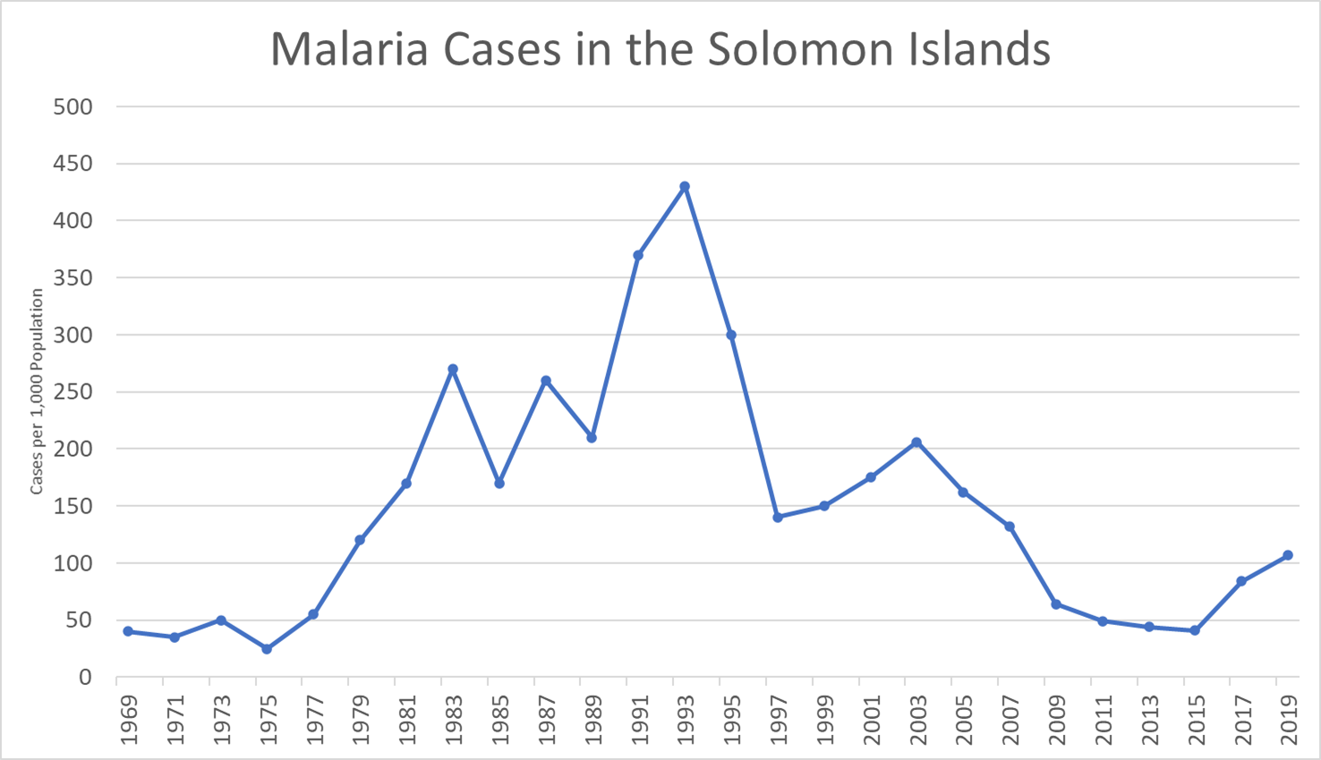





Timeline – The Fight against malaria
Elimination Phase
?
A similar pattern for PNG and The Solomon Islands

Slide 18
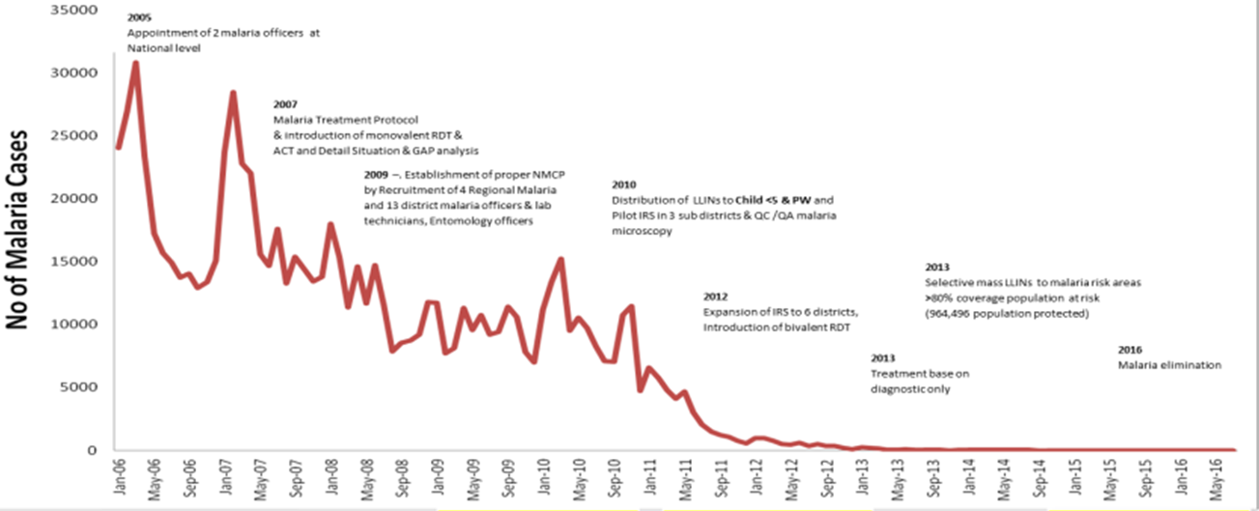
Timeline – Where we want to be
Elimination
Timor Leste 2018
Notes:
This graph is the timeline of where RAM would like to be in all partner countries – zero malaria cases. For WHO to certify a country as malaria-free ie malaria has been eliminated, it is necessary to show zero cases of local malaria over 3 years. RAM is assisting Timor Leste and Vanautu, both of which are close to that goal of elimination. The situation in PNG and the Solomon Islands will require a concerted effort over a much longer timeframe before the goal of elimination is achieved.

Slide 19

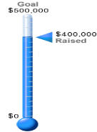

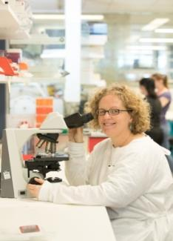
Malaria Vaccine – Griffith University
Notes:
An effective vaccine has proved to reduce the incidence of malaria (Plasmodium falciparum) in African children but efficacy is only about 30%. A new, whole parasite vaccine developed at Griffith University is currently undergoing human clinical trials.

Slide 20
Elimination of Malaria – Challenges
The ongoing work of RAM
Maintain control measures – vector and parasite
Accurate surveillance and mapping
A reliable field test for asymptomatic carriers
New affordable drugs for reliable treatment
Multi valent vaccine
&
Focus and Persistence
Notes:
RAM Faces significant challenges to achieving its goal of malaria elimination in partner countries. 1. For its on-going work, RAM needs to keep the foot on the pedal to maintain gains from vector and parasite control measures. 2. RAM needs to help fund the staff and resources needed for accurate and timely surveillance and mapping of the disease. 3. There is a need for a more reliable, but simple, field test for asymptomatic carriers and, 4. the need for a new, affordable and reliable antimalarial drug and 5. for a multi-valent vaccine. All these things are needed, together with focus and persistence, to eliminate malaria.

Slide 21
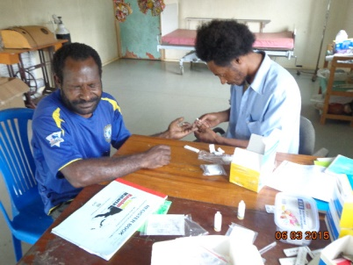


RAM will help eliminate malaria !
BUT……..A Call for action
We need financial support from Rotarians to finish the job
Notes:
In conclusion, RAM will succeed! It will help eliminate malaria! But—, and here we have ”A call for action” RAM needs financial support from Rotarians to finish the job!

