Slide 1
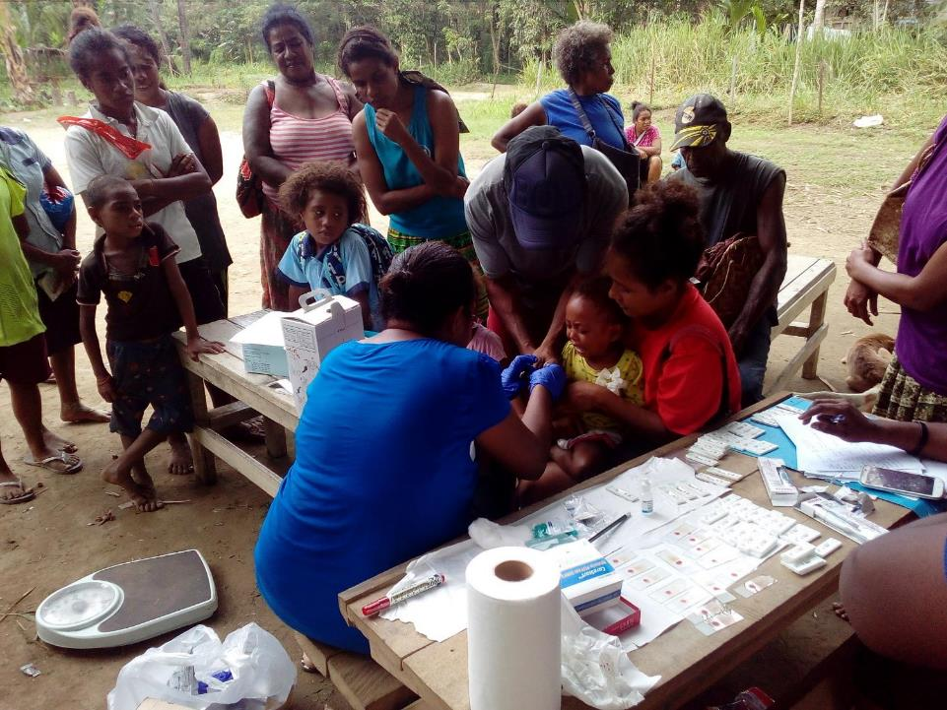


ROTARIANS AGAINST MALARIA
PAPUA NEW GUINEA
RAMs Role In Malaria Control In PNG
RAM Meeting
12 September 2020
Tim Freeman

Slide 2

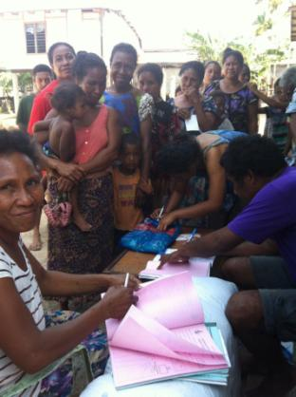
PNG – MALARIA PROGRAMME
RAM/NDOH PROGRAMME
RAM/NDOH PROGRAMME
Net Distribution
Health Facility Supervision Visits
Drug Distribution
HMM (2020)
Finance IMR and NDOH for research
Chasing Malaria

Slide 3
PNG – MALARIA PROGRAMME
RAM PROGRAMME
RAMs Funding
Global Fund
  77.6% of funding
  Nets over 1600 metres, drugs, HF supervision, IMR
Against Malaria Foundation
  19.3% of funding
  All nets under 1600 metres
PNG Sustainable
  2.4% of funding
  Western Province nets and drug distribution
RAM (PNG and Australia)
  0.6% of funding
  Chasing Malaria
Exxon Mobil

Slide 4
PNG – MALARIA PROGRAMME
RAM PROGRAMME
Funding Sources And Amounts
It is expected that RAM will expend all funds budgeted before the end of 2020

Slide 5
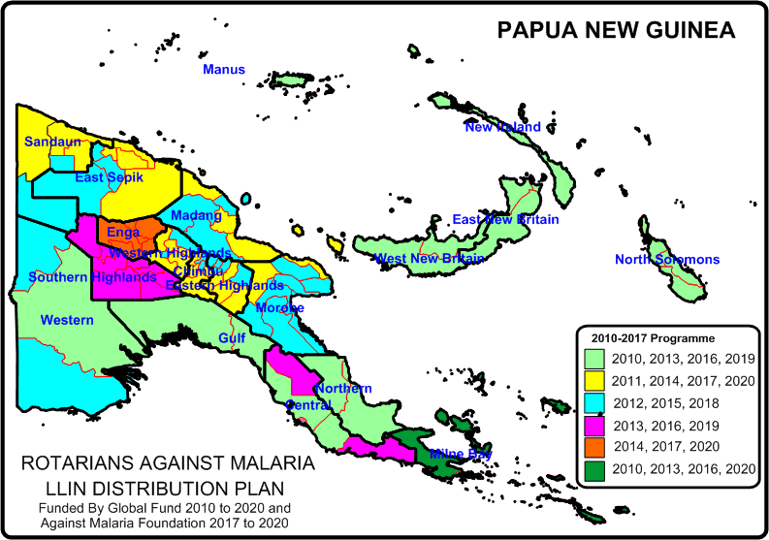
PNG - MALARIA PROGRAMME
LLIN DISTRIBUTION
RAM Distributes LLINs On A Three Year Basis To All Areas Of PNG
Presently in Southern Highlands and Central Province and moving shortly to Gulf

Slide 6
PNG - MALARIA PROGRAMME
LLIN DISTRIBUTION
Distribution Of LLINs To Household Level
103% of target achieved for 2019 and 97.2% for first six months of 2020

Slide 7
PNG - MALARIA PROGRAMME
LLIN DISTRIBUTION
Distribution Of LLINs To Vulnerable Groups
No Targets For Antenatal Nets As No Nets Supplied By GF In 2018 and 2019

Slide 8
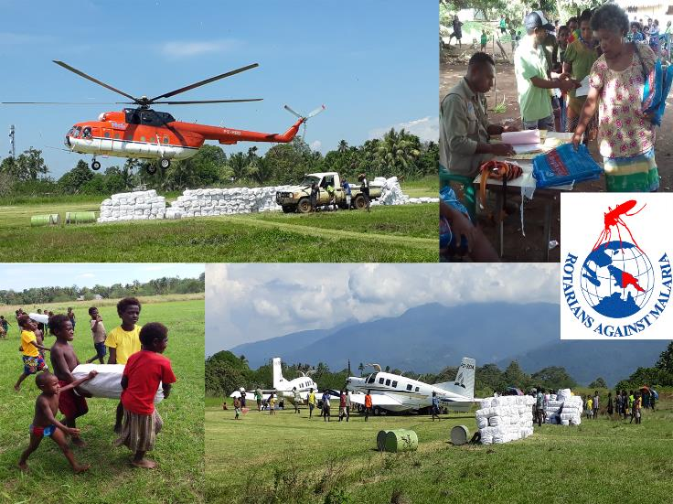
PNG - MALARIA PROGRAMME
LLIN DISTRIBUTION

Slide 9
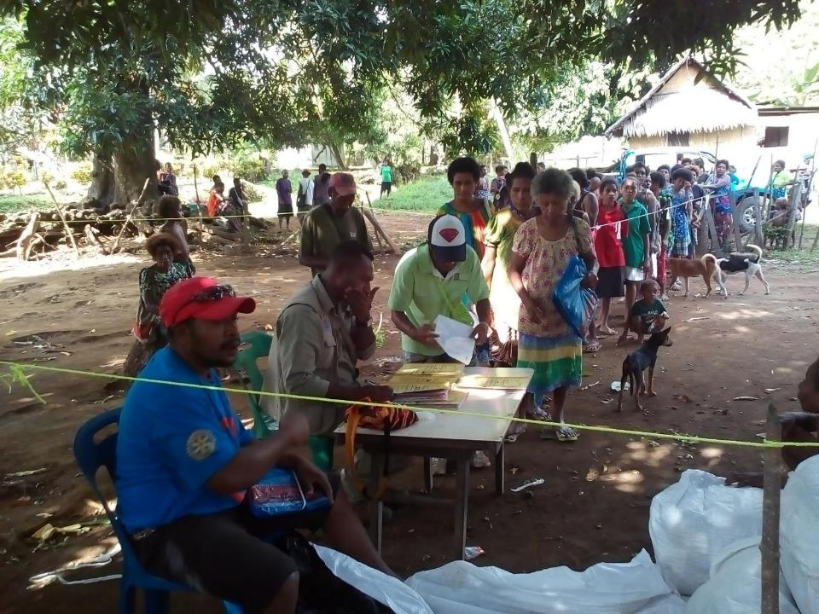
PNG - MALARIA PROGRAMME
LLIN DISTRIBUTION

Slide 10
PNG - MALARIA PROGRAMME
LLIN DISTRIBUTION
CONSTRAINTS
  Tribal Fights
    Unable to do one complete district (Dei in Western Highlands) and several other areas.
    Had to evacuate a RAM team from one fly in area in Enga due to disputes between local health staff an communities.
    Aircraft compnies closed down as pilots have evacuated the country.
  Covid 19 – has delayed operations in some places with flights not available when you need them and quarantine in Enga Province.

Slide 11
PNG - MALARIA PROGRAMME
HEALTH CENTRE SUPERVISION
RAM programme now employs eleven Regional Malaria Coordinators (RMCs) and seven Provincial Malaria Supervisors (PMS)
RMCs visit all accessible health facilities (not Aid Posts) on a quarterly basis. At each health facility the RMCs carry out the following:
  Supply RDTs, ACTs and Antenatal LLINs to a predetermined level.
  Ensure that RDTs, ACTS are fully accounted for.
  Monitor testing and treatment of malaria and train where necessary.
  Ensure that all cases of malaria are recorded and data submitted to the NHIS on time.

Slide 12
PNG - MALARIA PROGRAMME
HEALTH CENTRE ISSUES
  Reporting to the National Health Information System (NHIS) is very slow.
  Communication with remote health centres extremely difficult and supplying commodities to these locations problematic.
  However, an electronic National Health Information System (ENHIS) will be installed in all health centres in the coming year and hopefully this will allow health data to be available more quickly.
  RAM will work with ENHIS to ensure that it is used properly.

Slide 13
PNG - MALARIA PROGRAMME
HEALTH CENTRE ISSUES
  Estimated that 40-50% cases of malaria are not recorded. This has made quantification of ACTs and RDTs very difficult. It is estimated that
    Negative cases are often not recorded.
    Clinically diagnosed malaria cases often not recorded.
    Treatment from AID posts not included in many cases but Aid Post Kit Drugs also not included in the above

Slide 14
PNG - MALARIA PROGRAMME
DRUG DISTRIBUTION
Since January 2019, RMCs have visited all provinces at least four times.
14 out of 22 provinces already visited six times.
RAM is working very closely with the National Department of Health Supply Division. RAM is filling in stock shortages of ACTs and RDTs throughout PNG and has distributed both RDTs and ACTs from Global Fund and from government of PNG in a combined distribution.

Slide 15
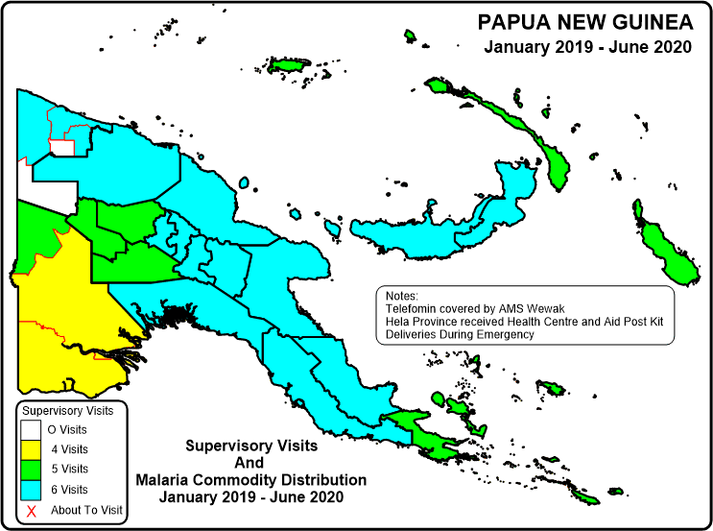
PNG - MALARIA PROGRAMME
DRUG DISTRIBUTION

Slide 16
PNG - MALARIA PROGRAMME
DRUG DISTRIBUTION
2019
Logistics Team and RMC distribute malaria commodities from both Global Fund and NDoH.
Drugs procured through Global Fund.
Distribution in coordination with RMCs and AMSs.
In 2020 all RDTs and ACTs for PNG procured through Global Fund using Global Fund funds.

Slide 17
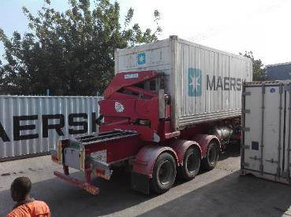
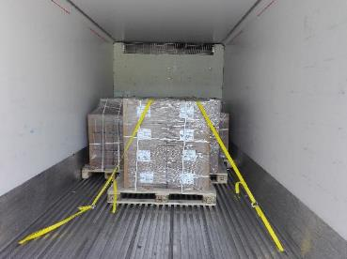
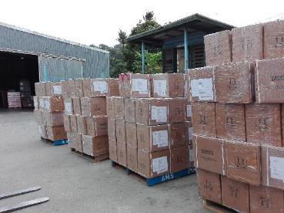
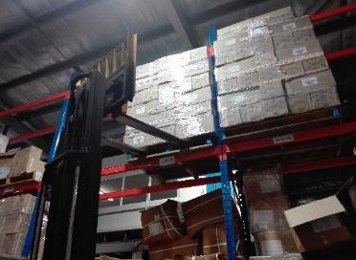
PNG - MALARIA PROGRAMME
DRUG DISTRIBUTION

Slide 18
PNG - MALARIA PROGRAMME
RESEARCH
  RAM is managing finances of IMR and NDoH in five studies being supported by the Global Fund.
  IMR
  Stratification of malaria in PNG in 2018.
  Insecticide Resistance in 2018 and 2020.
  Net quality
  Malaria Indicator Survey in 2019 – 2020.
  NDoH
  Therapeutic Efficacy Studies of ACTs

Slide 19
PNG - MALARIA LLIN PROGRAMME
Net Quality
Bednets supplied before 2013 not as good as those supplied 2012 activity.
This is believed to have had massive impacts on malaria in PNG

Slide 20
PNG - MALARIA PROGRAMME
HOME MANAGEMENT OF MALARIA
  Program involved training Community Volunteers in remote areas in the testing and treatment of malaria.
  Home Management of Malaria (HMM) previously carried out in Sandaun (PSI), East Sepik (Save the Children) and East New Britain (Burnet Institute) from 2015 to 2017.
  Program abandoned in 2017 due to high cost. However continued in Sandaun by PHA which RAM supports.
  PHA HMM program like the one in Sandaun now being rolled out in 2020 Morobe, Madang, East Sepik, New Ireland, Central, Gulf and Milne Bay.
  Training already carried out in East Sepik (6), Madang (3), NIP (4), Morobe (6) and Central (5), Gulf (1), Milne Bay (4).
  To date 531 volunteers around the country trained

Slide 21
PNG - MALARIA PROGRAMME
CHASING MALARIA PROGRAM
  Working closely alongside the NCD, Gulf and Central PHAs. Activities include:
  Giving out nets to all malaria positive patients.
  Map all positive cases.
  Work with schools and communities for malaria education and create school clubs to destroy mosquito breeding sites.
  Training school teachers in test and treating malaria and keeping them supplied with drugs
  Support World Malaria Day
  School malaria prevalence surveys

Slide 22
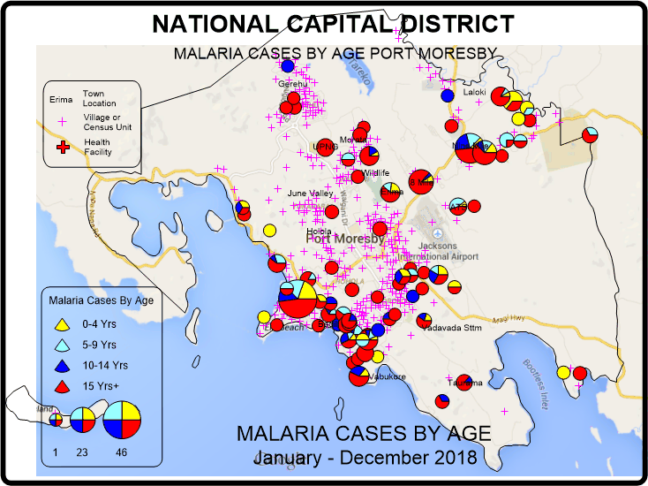
PNG - MALARIA LLIN PROGRAMME
CHASING MALARIA
MAPPING IN NCD
This map shows malaria cases in children in NCD. This suggests that malaria is still being transmitted in Kaugere.

Slide 23
PNG - MALARIA LLIN PROGRAMME
SCHOOL PROGRAM
RAM PNG started the first Community Program in 2012. Has worked in several areas but now works mainly in a high malaria area known as Kuriva.
The objective of the programs is to involve communities and school children in malaria control activities. At this moment, the program concentrates on eleven schools, six of which are in Kuriva.
Involves training teachers and school children in malaria and it control.
School Malaria Clubs are created and children in the clubs are expected to go our once a week and look for mosquito breeding sites.
Once the mosquito breeding sites are identified, mosquito breeding sites should be destroyed or controlled.

Slide 24
PNG - MALARIA LLIN PROGRAMME
SCHOOL PROGRAM
Problems include
  Schools tend to relax when RAM team is not there
  Snakes so buying gum boots
Major problem is that community and school response are very good when RAM teams were around but tended to drop off when RAM staff were not there. Despite this, generally malaria in this area has reduced in the last two years.
Chasing Malaria is also Supporting Home Management Of Malaria HMM to train community members and teachers in other parts of the province.

Slide 25
PNG - MALARIA LLIN PROGRAMME
SCHOOL PROGRAM
To strengthen the school program we are not jointly working with a NGO called the Skillz program which comes under the YWCA and works in schools.
Skills has a good but limited school malaria program and we are jointly creating a new curriculum for Skills to carry out the same type of work which Chasing Malaria has developed.
We are hoping this approach will give more sustainability into the school program so that it will continue in schools whether RAM of Skillz program is there/

Slide 26
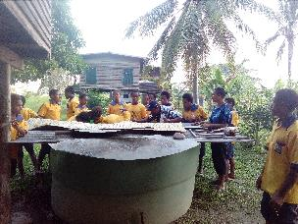
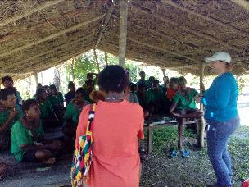
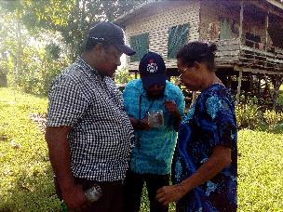
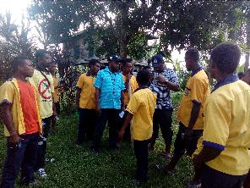
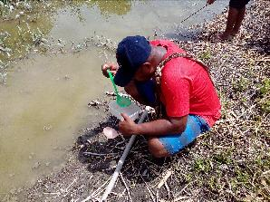
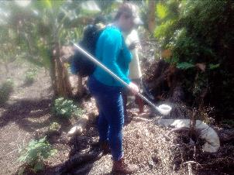
PNG - MALARIA LLIN PROGRAMME
CHASING MALARIA
School And Community Involvement

Slide 27
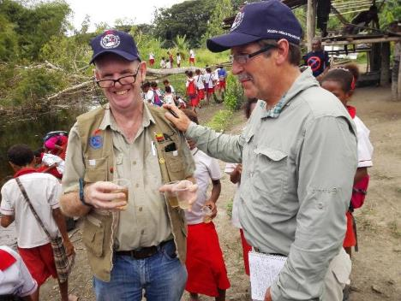
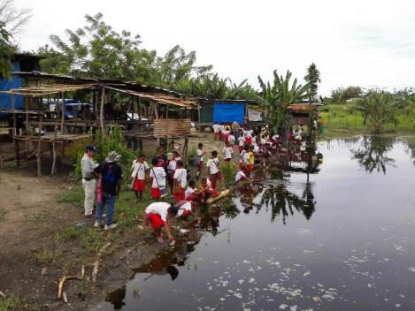
PNG - MALARIA LLIN PROGRAMME
CHASING MALARIA
Community Involvement

Slide 28
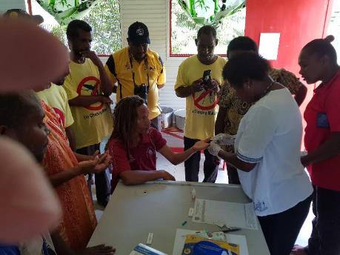
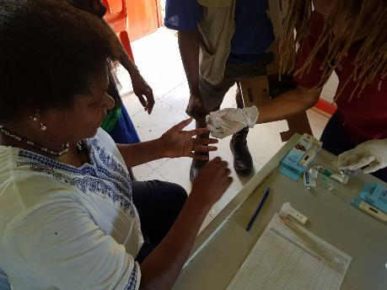
PNG - MALARIA LLIN PROGRAMME
CHASING MALARIA
School Program
TRAINING PRIMARYSCHOOL TEACHERS IN KURIVA CENTRAL PROVINCE IN APRIL 2019
April 2019 - 13 teachers trained in testing and treating malaria.

Slide 29
PNG - MALARIA LLIN PROGRAMME
WORLD MALARIA DAY
PREVALENCE SURVEYS
School Prevalence Surveys Initiated On
World Malaria Day in Kuriva in 2018 Central Province showed very high prevalence rates

Slide 30
PNG - MALARIA LLIN PROGRAMME
CHASING MALARIA
Private Sector Sale Of Nets
RAM had engaged a salesman in 2014 and 2015 to sell nets around Port Moresby.
Revenue from his sales supported his salary.
Salesman left and as nets in supply chain were few this project was abandoned.
It is hoped that this will now be resurrected. We would like to have a target of LLINs being sold in every district capital in PNG so that people can replace their nets when they wear out early.
New nets just arriving shortly in PNG

Slide 31
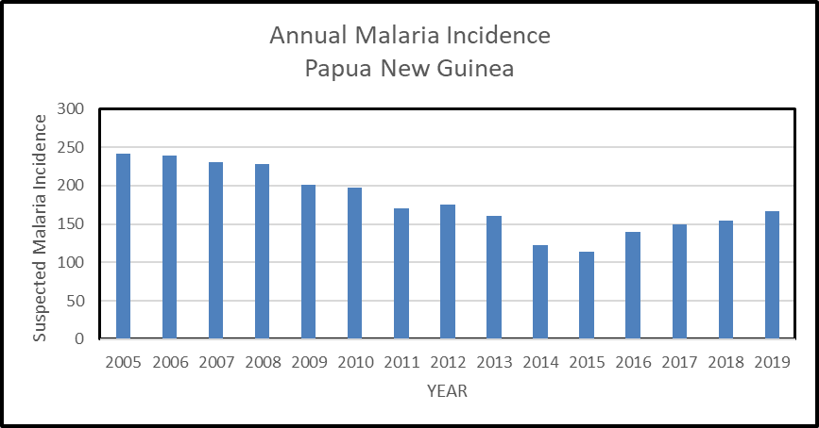
PNG - MALARIA PROGRAMME
The Malaria Challenge
Annual Malaria Incidence Of Suspected Malaria – Cases Clinical Diagnosed And Those Tested

Slide 32
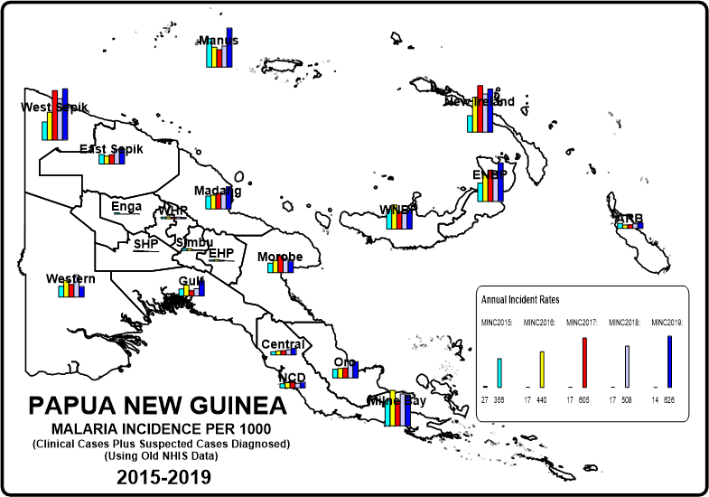
PNG - MALARIA PROGRAMME
MALARIA INCIDENCE
Malaria increasing in some parts of PNG but not in all areas

Slide 33
PNG - MALARIA PROGRAMME
FUTURE CHALLENGES
OUR MAJOR CHALLENGE IS TO REVERSE THE PRESENT MALARIA TREND
Need to find a good LLIN. It seems that the quality is very variable despite they all being categorized as equal.
Other challenge is to improve all aspects of malaria program. It is hoped that we can at least eliminate malaria from one part of PNG such as Bougainville

Slide 34
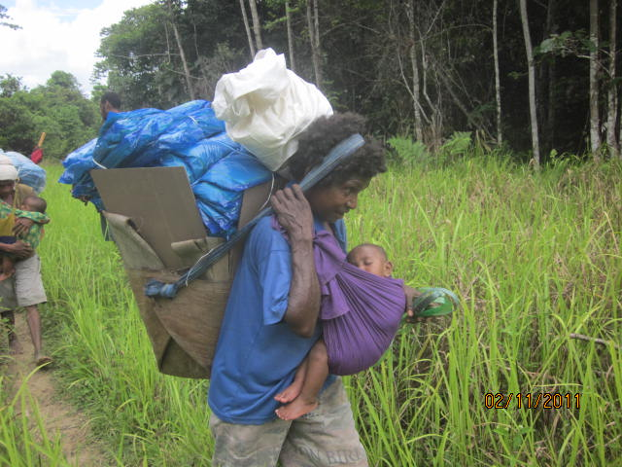
PNG - MALARIA LLIN PROGRAMME
Next Steps (3)
Initial Data From Chasing Malaria Project Showing Malaria Cases Recorded In NCD and Hiri and Kairuku District Of Central Province
The Realities Of Distributing Nets In PMG

Slide 35
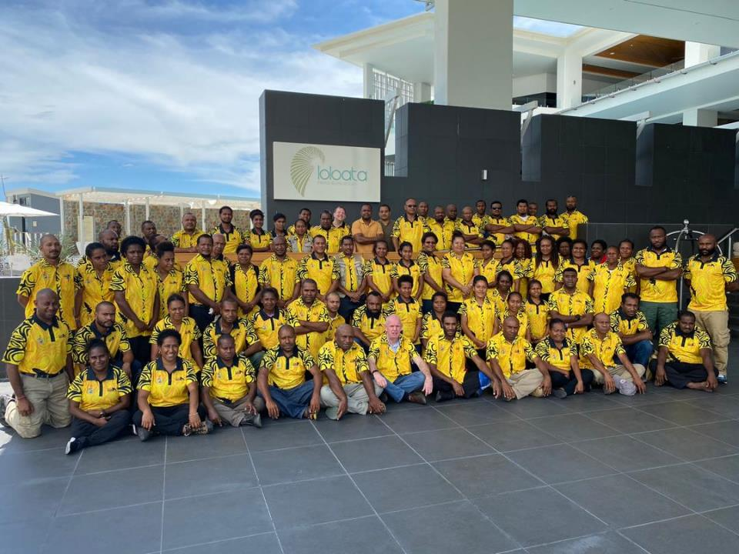
RAM TEAM
2020
PNG - MALARIA LLIN PROGRAMME

Slide 36
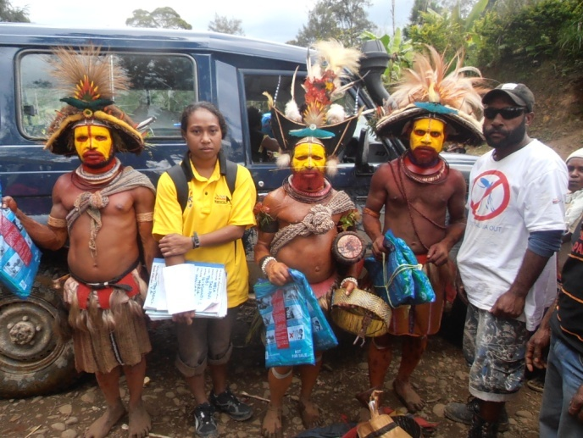
Thank You Very Much
Tenk Yu Tru
Tanikiu Bada Herea
PNG - MALARIA LLIN PROGRAMME

