Slide 1




Tafenoquine Use for Elimination of Relapsing Malaria in Asia Pacific
Prof G Dennis Shanks
Director ADF Malaria and Infectious Disease Institute COL US Army (retired)
Identification of specific products are not to be considered a commercial endorsement The opinions expressed are those of the author and are not necessarily those of the ADF

Slide 2






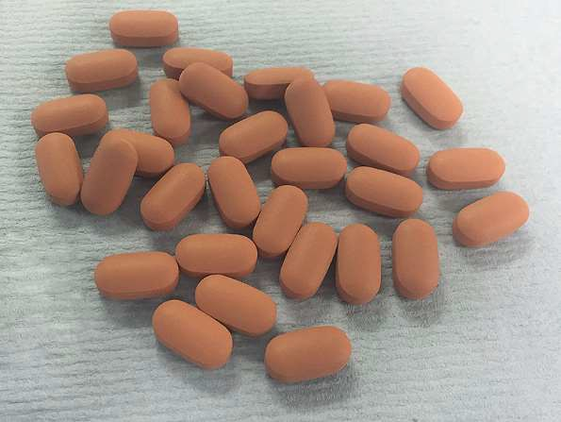







Tafenoquine: Long-Acting Primaquine-Like Drug
Weekly dosing likely to partially fix compliance problems
Has same G6PD liability as primaquine so need to have measured G6PD status once
Other wise well tolerated and most appropriate for very high risk travellers
Krintafel GSK

Slide 3
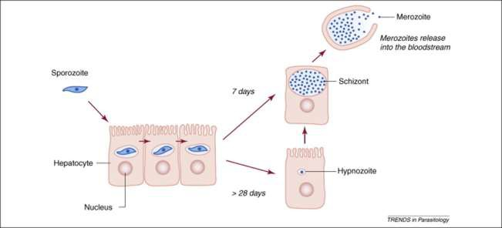
Killing Residual Hepatic Parasites (Hypnozoites)
Quiescent post-sporozoite parasite in hepatocyte able to reactivate months after infection
Wells et al TIP Volume 26, Issue 3, p145–151, March 2010
8-aminoquinolines only class of drug known to kill hypnozoites; primaquine only drug currently available for clinical use
Destruction of hypnozoites necessary for malaria elimination

Slide 4
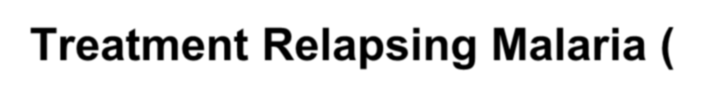




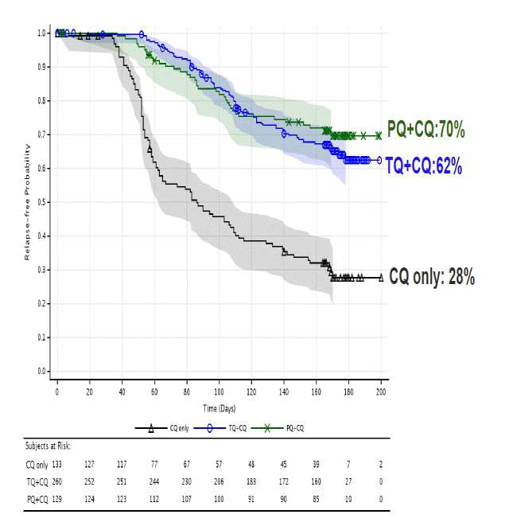







Treatment Relapsing Malaria ( P vivax, P ovale)
Other treatment needed to clear blood phase (chloroquine, ACT etc.)
300 mg single dose tafenoquine when G6PD status has been tested
Not superior to primaquine, just a great deal easier to give
GSK registration file

Slide 5



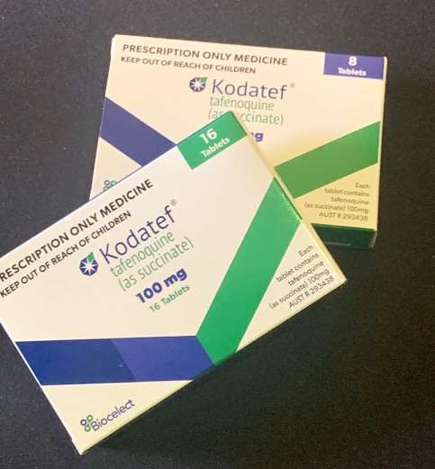






Directions to Use Prophylactic Tafenoquine
Loading regimen of 200mg x3 OD followed by 200mg weekly for adults
Best taken with food for improved absorption
Working on pediatric formulation / indication

Slide 6



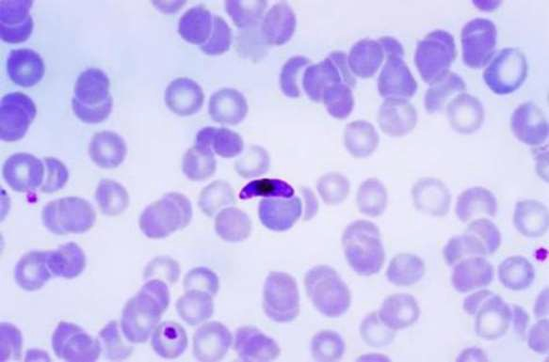







Other Aspects of Tafenoquine Being Tested
Extend prevention from 6m to 12m
Monthly dosing regimens (600- 800mg) or single dose short-term protection in Vietnam
Pediatric formulations
Public health indications

Slide 7


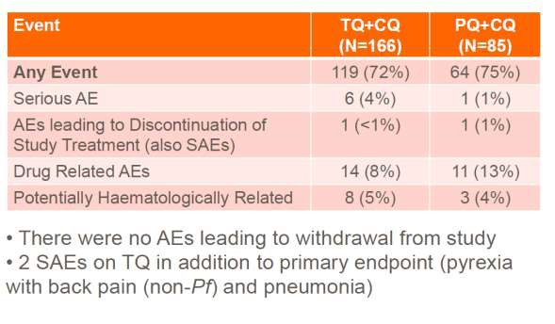






Tafenoquine Tolerance Similar to Primaquine
All 8-AQ cause some hemolysis, but both PQ and TQ tolerated in G6PD normal
Adverse events roughly equal between groups
GSK registration file
TQ is at least as well tolerated as PQ in terms of GI upset

Slide 8
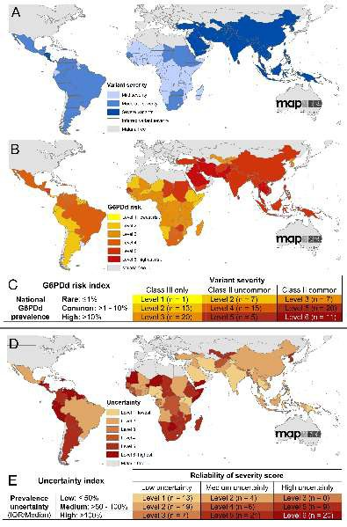














G6PD Deficiency Very Common in Vivax Areas
Hemolysis from G6PDd must have evolutionary importance in malarious areas (primarily with P vivax)
Lower parasitemia with Pv not seen with Pf in G6PD deficient Mahidol variant
Earlier hemolysis may limit number of relapses as very few G6PD deficient people have vivax
http://dx.doi.org/10.1371/journal.pmed.1001339.

Slide 9
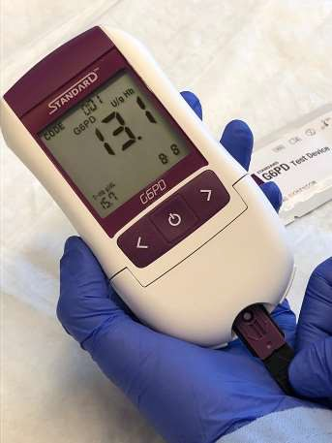
Increased Safety Margin for P vivax Treatment
Regardless of quality of G6PD testing some deficient individuals will mistakenly receive tafenoquine
If tafenoquine dose could be reduced to 100mg, then it may be possible to treat without G6PD test
Will not eliminate all hemolysis but should stop any massive reactions (blackwater fever like)
PATH

Slide 10

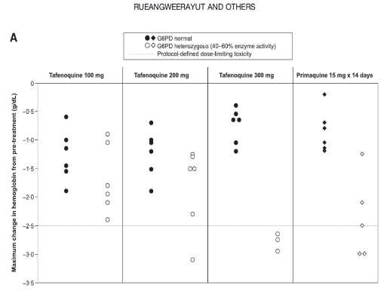

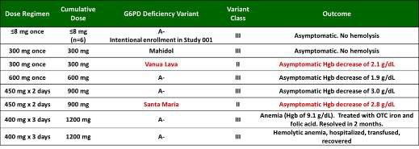
What Is a “Safe” Dose of Tafenoquine?
G6PD testing every individual in a large population is not feasible for public health purposes
Even in clinical trials of PQ or TQ mistakes happen with G6PD testing and hemolytic episodes occur
Single dose 100mg TQ is likely equivalent to 15mg PQ and possibly could be used without G6PD testing

Slide 11
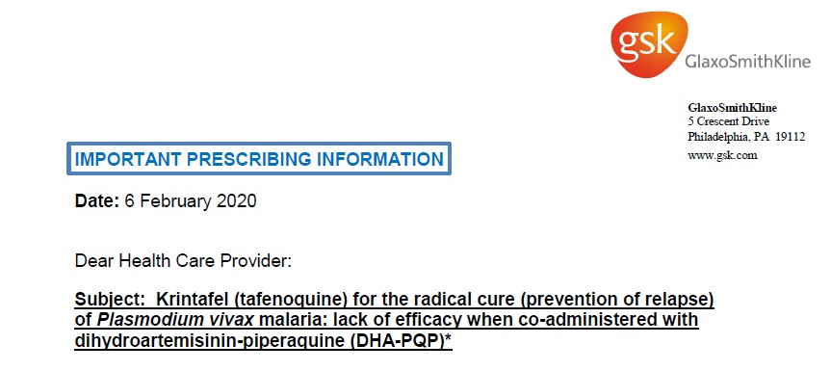
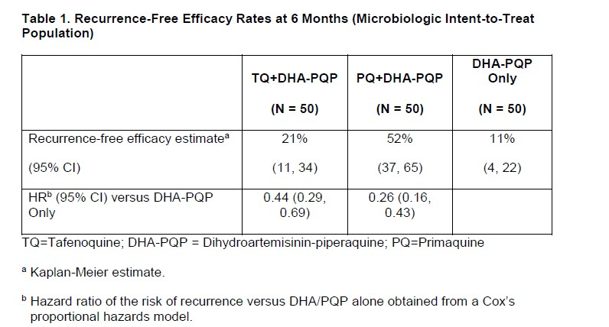
Tafenoquine + DHA-Pip Did Not Stop Vivax Relapses
Tafenoquine when used with ACT (DHA-Pip) did not stop relapses
Companion drug chloroquine vs. piperaquine (two chloroquine molecules connected) did not seem to be an obvious difference
Dihydro-Artemisinin (DHA) did not seem an obvious difference either as the drug would have largely been cleared before tafenoquine given

Slide 12

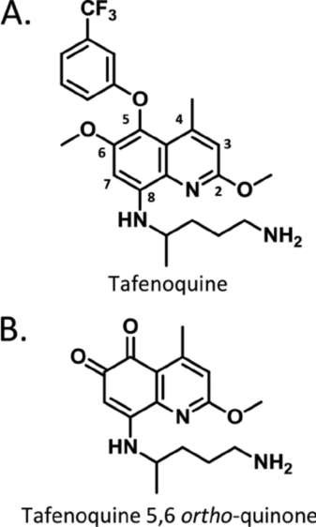
REDOX Boosted Tafenoquine to Kill Hypnozoites?
Persons who do not metabolize primaquine due to cytochrome P450 polymorphism (2D6) are not cured of relapses
Active form of tafenoquine is a redox active quinoneimine which rapidly forms tafenoquine 5,6 ortho-quinone
Redox activity inside hepatocyte is key from tafenoquine does not appear to be as dependant on cytochromes as primaquine

Slide 13
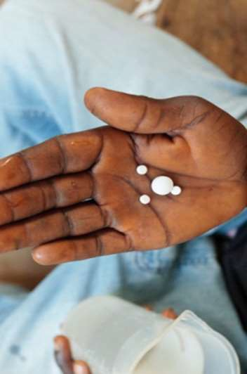








Possible Tafenoquine Scenario for Elimination?
Pulse of drug into a defined area to stop transmission
Mass drug administration in order to eliminate relapses
Stopping an on-going epidemic with tafenoquine

Slide 14
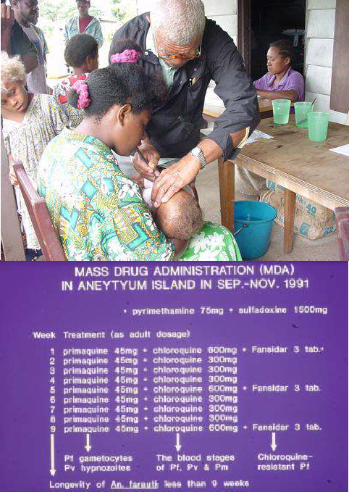
MDA on Aneityum, Vanuatu 1991 and 2002
Commercial pressure to eliminate malaria from small tourist island in south Vanuatu
8 weeks of chloroquine + primaquine + SULFA / PYR (Fansidar) combined in 800 persons
Successfully eliminated malaria but had scattered re-introductions despite good surveillance largely due to inter-island exchanges including religious meeting and high school boarding students on holidays

Slide 15
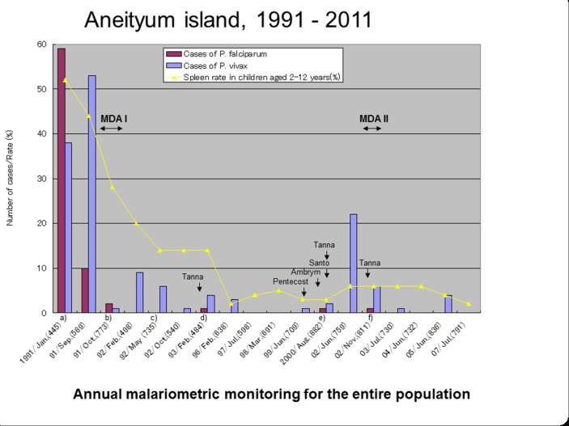
Elimination of Malaria Possible but Difficult
Vivax is always the most difficult to eliminate and the one most easily re-introduced due to relapses from latent liver parasites
All of southern Vanuatu is now free of malaria but required long program of case finding and treatment of residual parasites
Data from Dr Akira Kaneko, Karolinska Institute

Slide 16
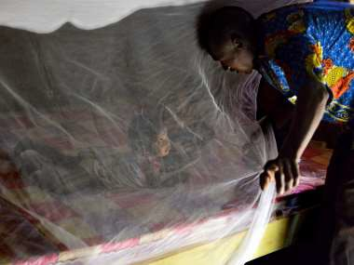
Malaria Transmission Blocking
Anti vector measures are key to malaria control but are usually insufficient to eliminate parasites from a region
Not all malaria transmission occurs indoors at night; no clear means to tackle outdoor transmission
IVCC
8-aminoquinolines are the best drugs for transmission blocking effects and tafenoquine can maintain effect for weeks

Slide 17
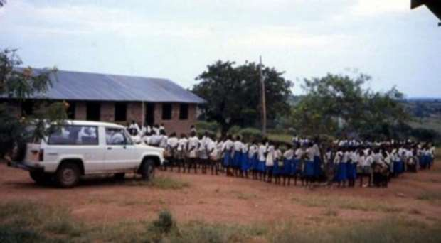
Pulse Tafenoquine Through a Population?
Likely a single dose sufficient for a month of transmission blocking
Less than perfect participation rates may not be essential
Infected mosquitoes die out while drug blocks formation of any sporozoites in newly infected Anopheles mosquitoes

Slide 18
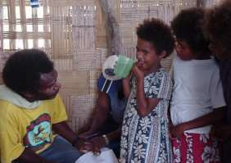

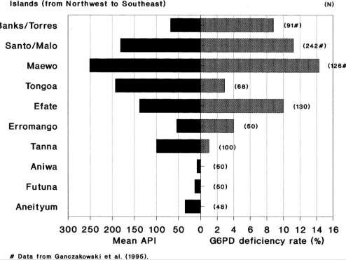
Future MDA Projects to Eliminate Island Malaria?
New possibilities with long-acting primaquine drug, tafenoquine (TQ) for monthly usage (e.g. 3-4 months MDA)
Must work around G6PD deficiency but 100mg TQ is safe even in G6PD deficient
Islands for consideration: Manus and New Ireland on PNG, Isabella, Pentecost
Kaneko 1998 ActaTrop

Slide 19
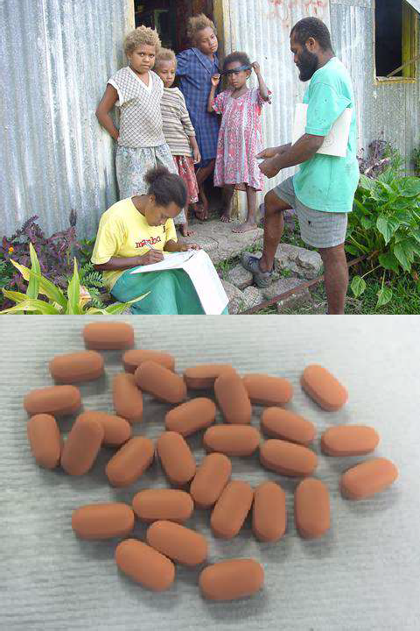
Progression Towards MDA for Pacific Islands
Clinical trial of single dose tafenoquine in G6PDd males; need escalating (from 100mg) challenge to establish safe dose without G6PD screening
Completion of on-going 1 year safety studies in volunteers along with Pf challenge trial at QIMR
Proof of concept in small controlled Melanesian population willing to cooperate fully with mass drug administration (e.g. Manus?)
Krintafel GSK

Slide 20



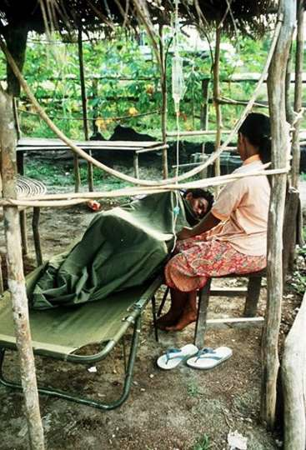







Conclusions for Eliminating Vivax Malaria
Have to kill the hypnozoites in the liver in order to stop relapses
Must find a better way to use 8- aminoquinoline drugs as they are the only ones stopping relapses
Tafenoquine in combination with chloroquine is near to approval in several Asia Pacific countries

Slide 21




















Acknowledgements
US Armed Forces Research Institute of the Medical Sciences, Bangkok, Thailand
Vietnam People’s Army Military Institute of Preventive Medicine (MIPM), Hanoi, Vietnam
United States Pacific Command (US INDOPACOM) Photos by Dr Akira Kaneko, Karloinska Institute

