Slide 1
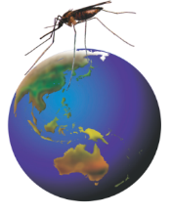

Rotarians Against Malaria
A volunteer run organisation working to eliminate malaria

Slide 2
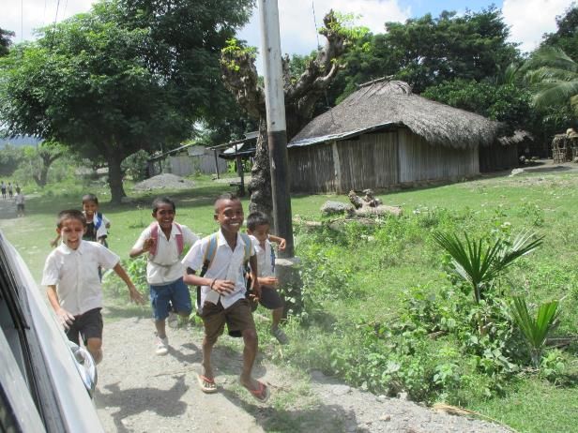
An important goal of RAM
Happy healthy kids eager to get an education

Slide 3

Recent History of Malaria
RAM
launched
Original MEP
DDT spraying
Intensified control & elimination program
Malaria in the Solomon Islands
Incidence of confirmed cases per 1000 population (MHMS, Solomon Islands)
Notes:
Nets require humans to sleep inside them. IRS is less behaviour dependent but the mosquitoes still need to enter the houses to contact the insecticide and be killed. We are presently at the same level of control as when DDT was used in indoor residual spraying in the 1970s in the Solomon Islands

Slide 4
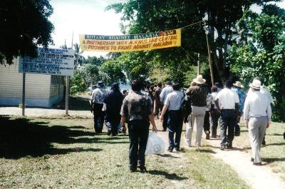
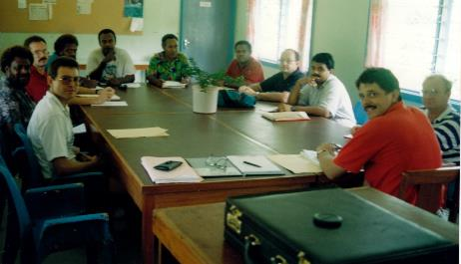
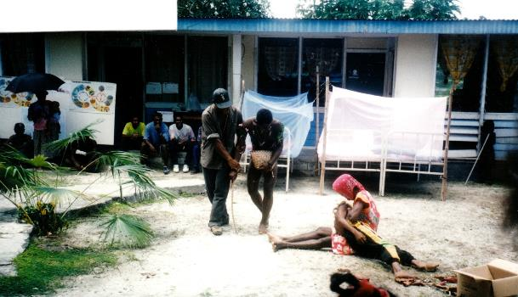
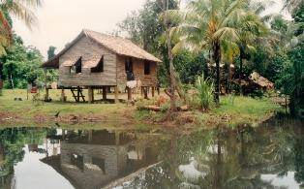
RAM Beginnings 1995
Tulagi Solomon Islands

Slide 5
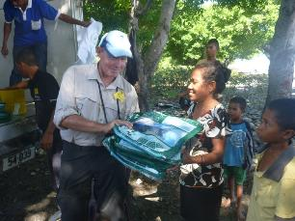
RAM Focus Countries – Progress
Solomon Islands 87% reduction, 2 provinces at pre-elimination stage.
PNG 65% (to 90%) reduction; elimination programs planned.
Timor Leste >99% reduction working toward malaria free status by 2022.

Slide 6
Solomon Islands
RAM Record of Service:
>200,000 Bed nets, Flip charts and brochures, larvacide & IRS.
LLIN procurement for the Global fund.
21 Houses constructed for MoH malaria staff and microscope diagnosis.
13 Storage sheds for LLINs.
20 boats and several vehicles to assist LLIN distribution.
160 villages provided with tools ($250,000).

Slide 7

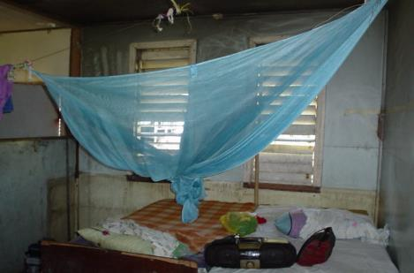
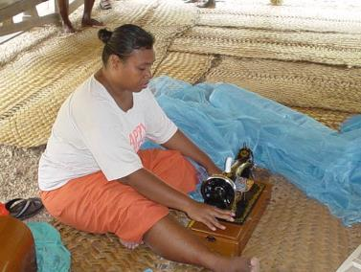
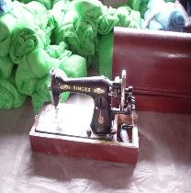
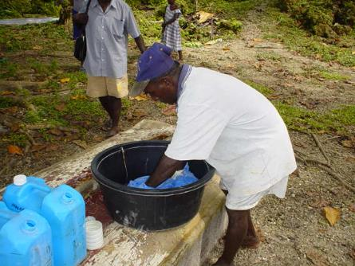
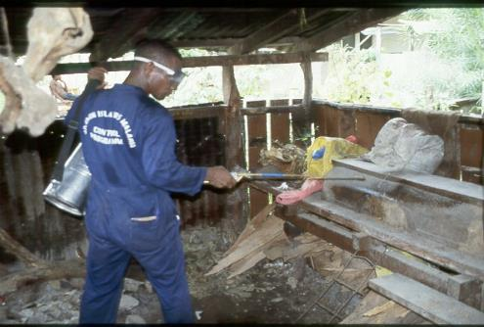
Early days - Bed nets and Chemicals

Slide 8
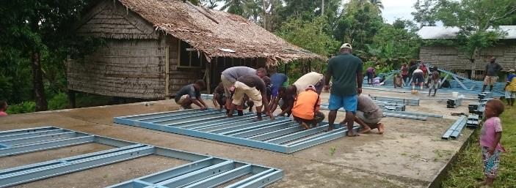
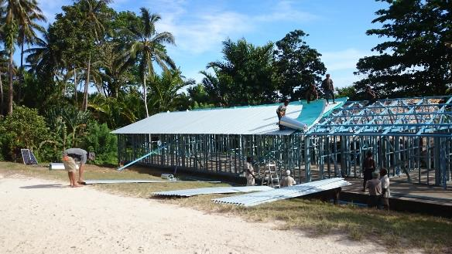
Rotary Molotabi Clinic build

Slide 9
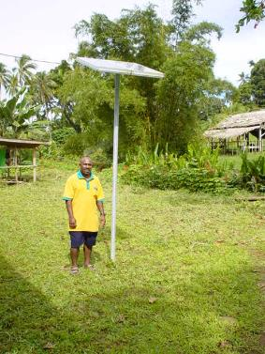
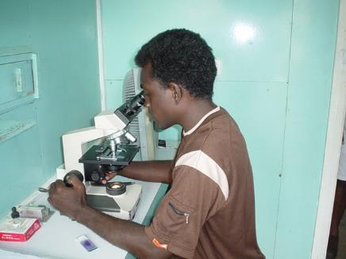
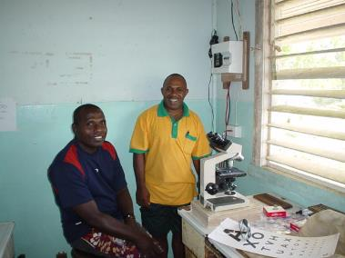
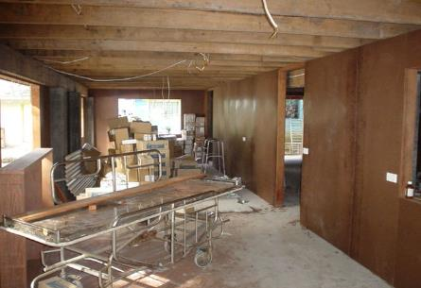
Equipment and Repairs

Slide 10
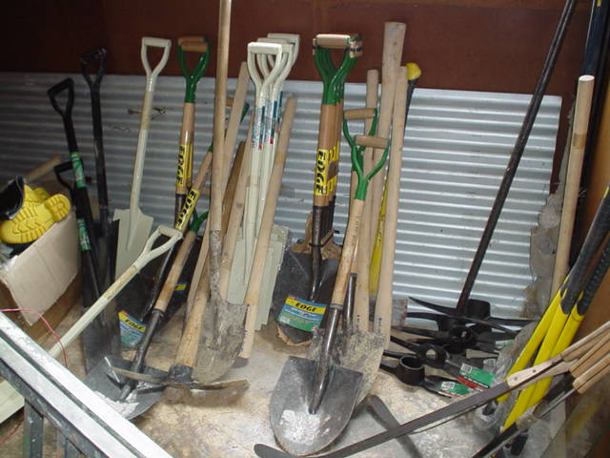
Tools for Villages
Project Planning / Training / Tools / Work – self help
HEALTHY VILLAGES PROJECT
Notes:
Some of the tools lined up for distribution. Clubs and individuals supply the funds, RAM acquires the tools and Ministry of Health workers arrange distribution.

Slide 11
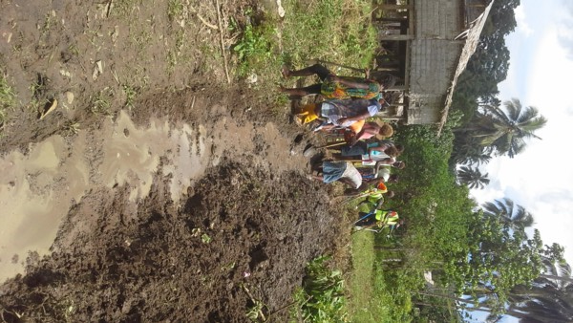
RAM tools help villagers

Slide 12
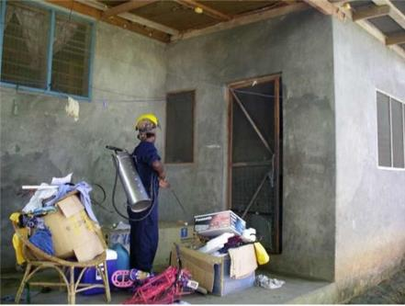
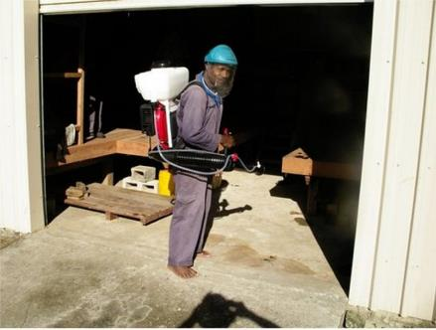
RAM Sponsored IRS

Slide 13
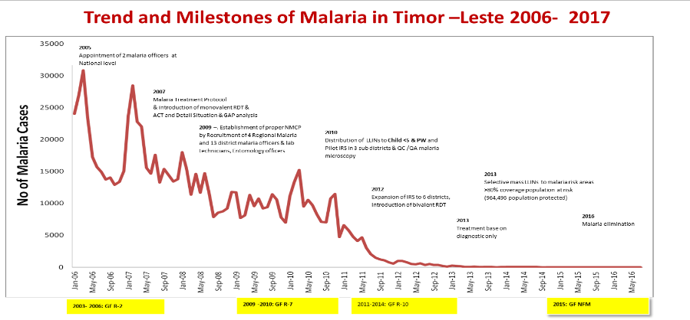
National Malaria Programme Success Story:
Control to Elimination Phase in 10 years
Timor Leste 2018

Slide 14
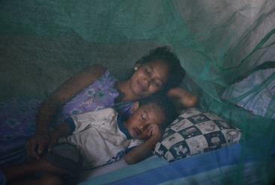
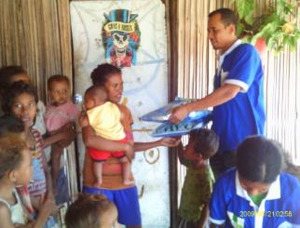
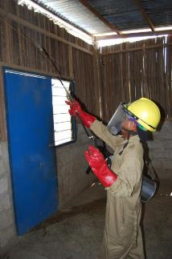
Use of Long Lasting Insecticide treated Nets (LLIN) and Indoor Residual Spraying (IRS) in malaria risk areas
>80% people in risk areas sleep under a LLIN.
LLIN being distributed in the community.
IRS : >80% houses fully sprayed with susceptible insecticide in risk areas.

Slide 15
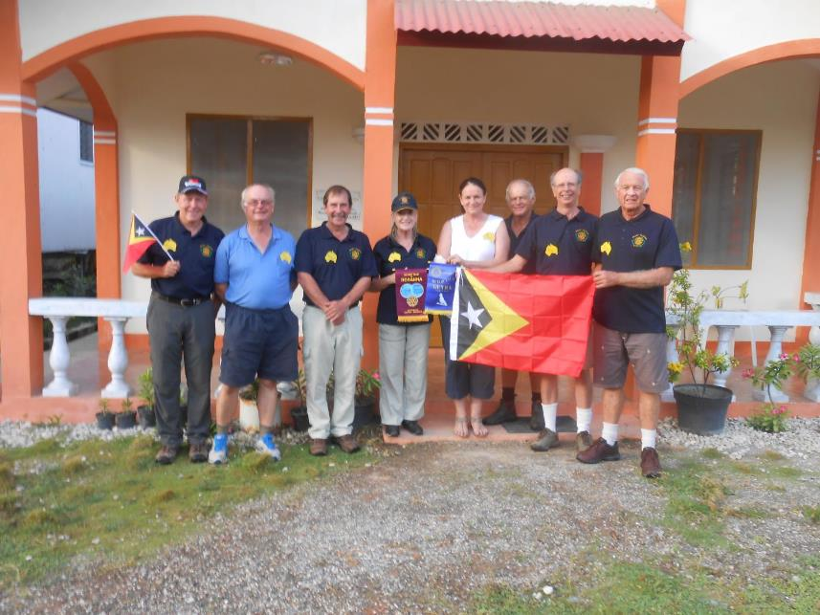
RAM Volunteer Team 2014

Slide 16
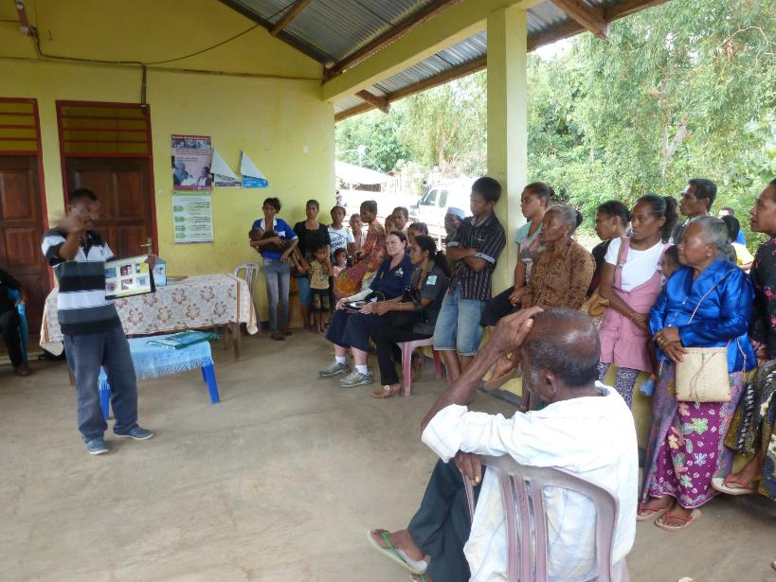
Timor Leste LLIN, community training

Slide 17
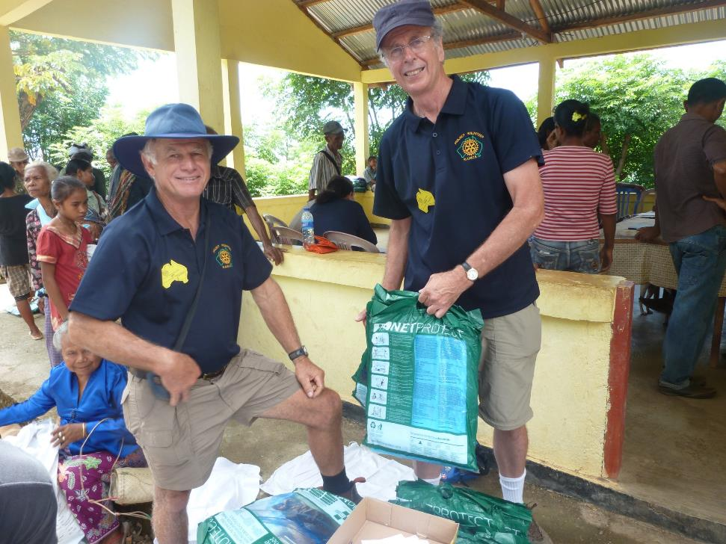

Slide 18
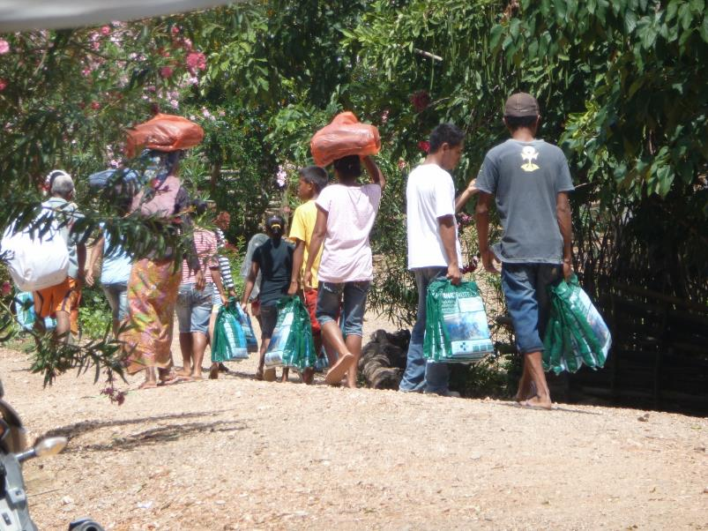
Precious bed nets go home

Slide 19
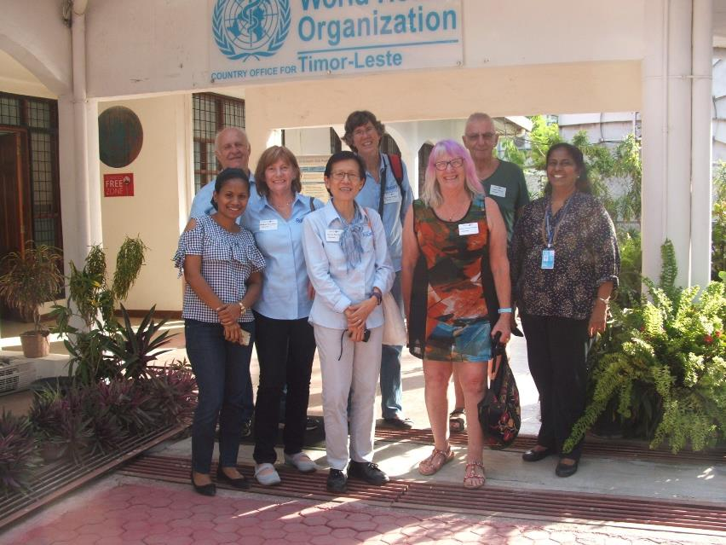
RAM Volunteer Team 2017

Slide 20
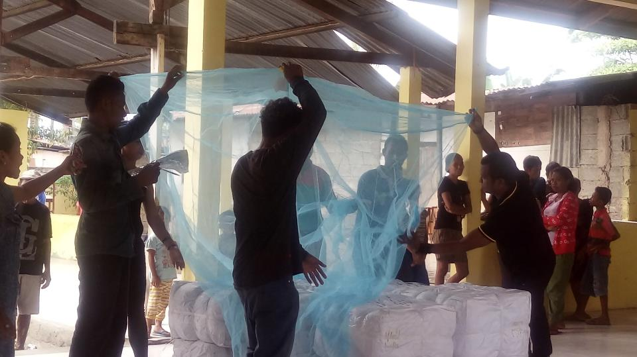
Timor Leste LLIN, community training

Slide 21
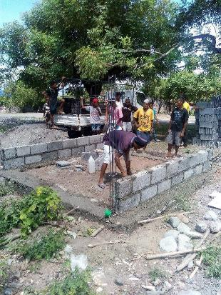
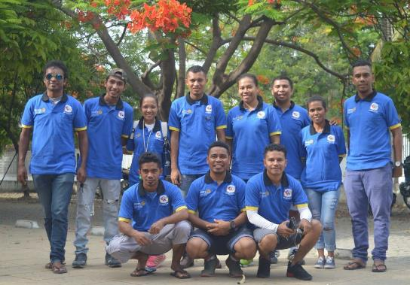
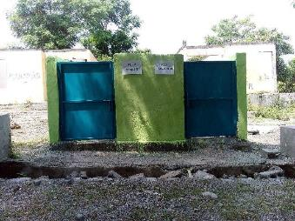
ROTARY CLUB of
Dili Lafaek
Covered rubbish disposal
reduces mosquito breeding

Slide 22
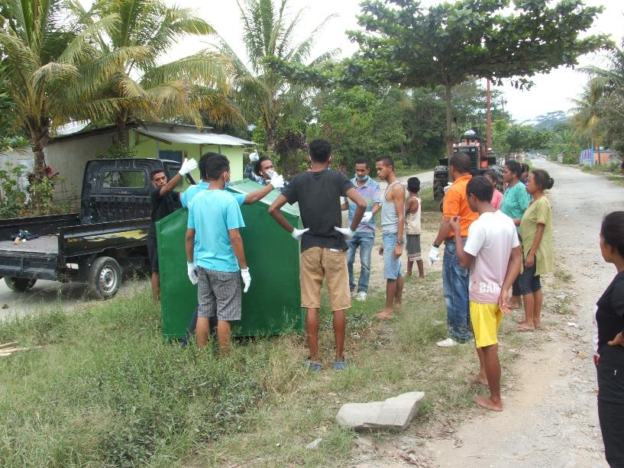
Timor Leste Healthy Villages project

Slide 23

RAM Papua New Guinea

Slide 24
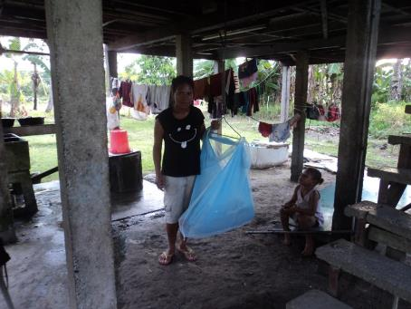
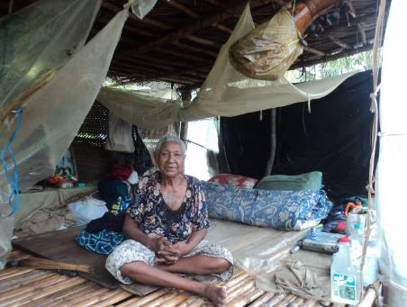
In PNG RAM has distributed more than
12 million bed nets
Two generations appreciate the protection of RAM bed nets

Slide 25


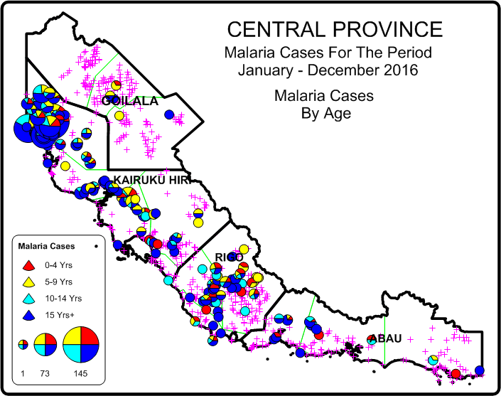
RAM PNG Chasing Malaria Results
Data From Chasing Malaria Project Showing Relative Malaria Incidence Recorded In Central Province

Slide 26

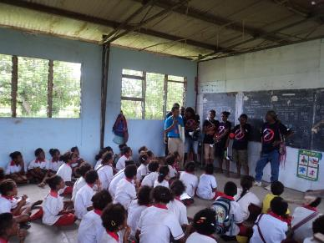
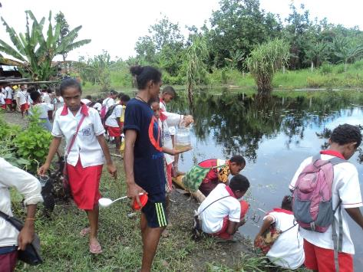
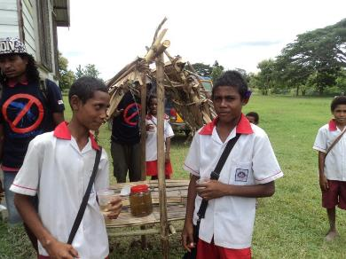
Chasing Malaria volunteers and local school student surveillance recruits

Slide 27
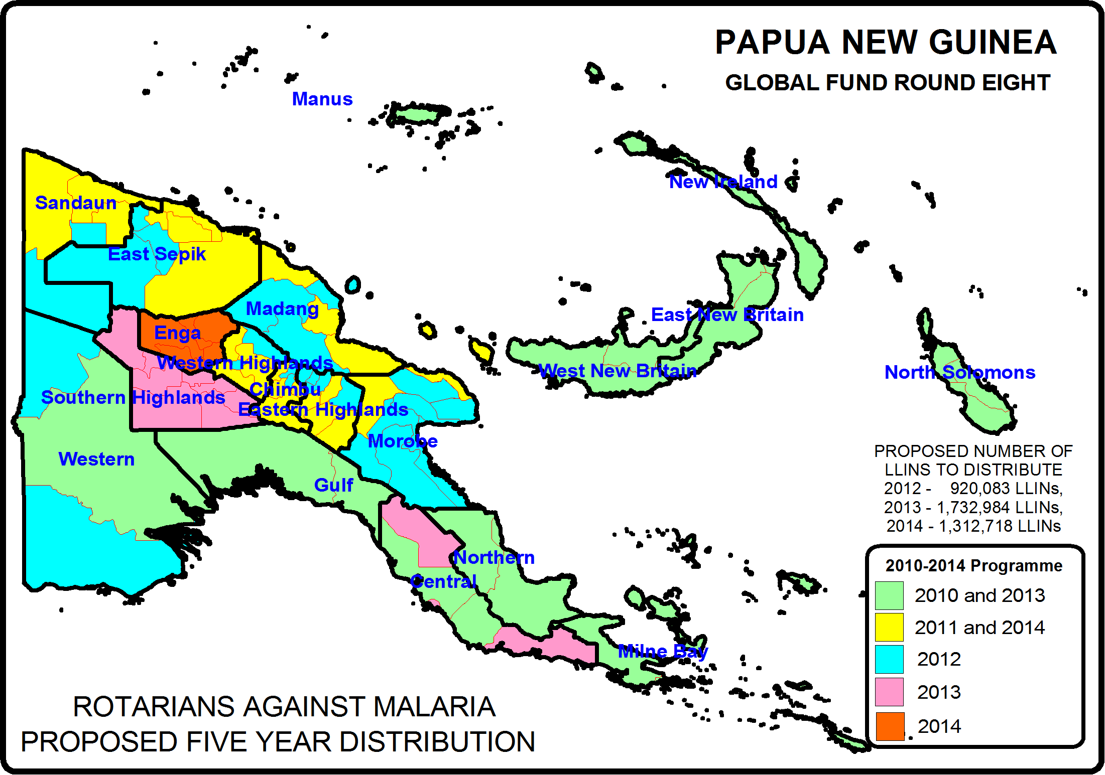
PNG - MALARIA LLIN PROGRAMME
RAM has Distributed Nets in all
22 Provinces and 89 Districts

Slide 28
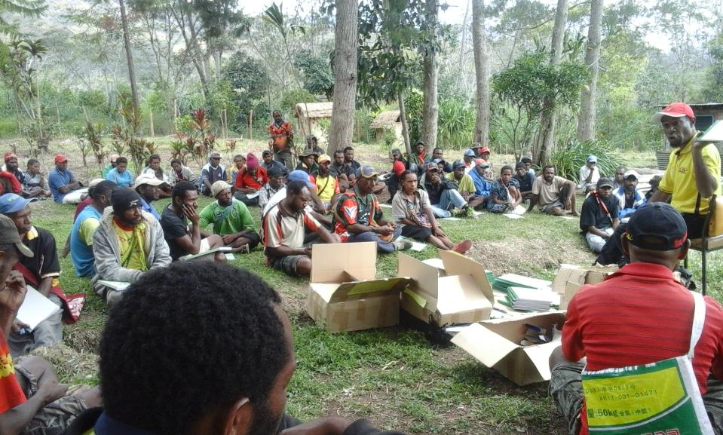
LLIN HOUSEHOLD DISTRIBUTION
Training Volunteers

Slide 29
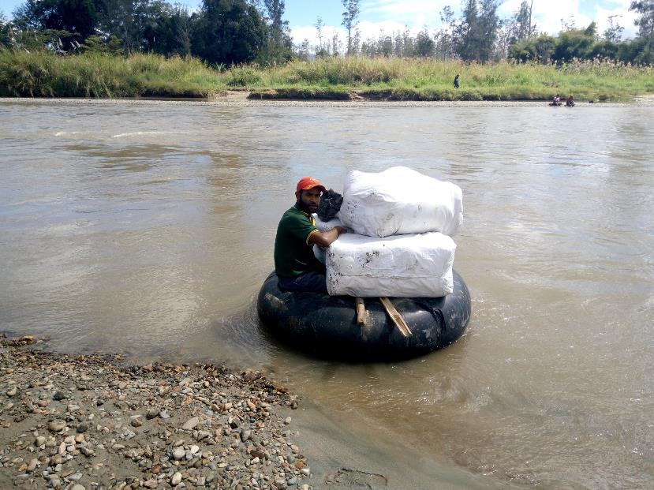
LLIN HOUSEHOLD DISTRIBUTION
Moving LLINs to distribution site

Slide 30
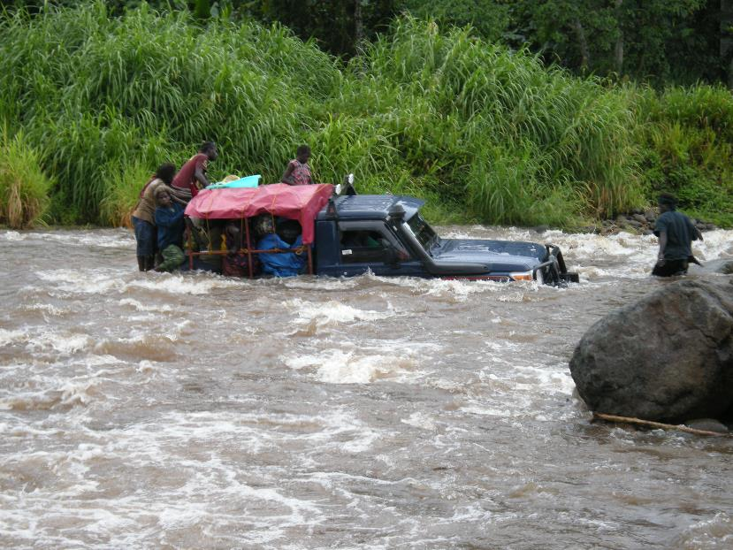
LLIN HOUSEHOLD DISTRIBUTION
Moving LLINs to distribution site

Slide 31
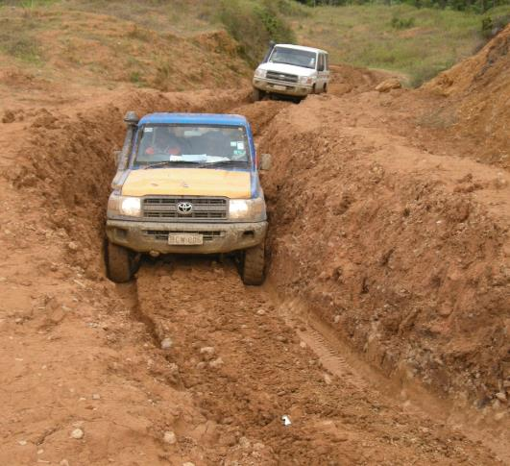
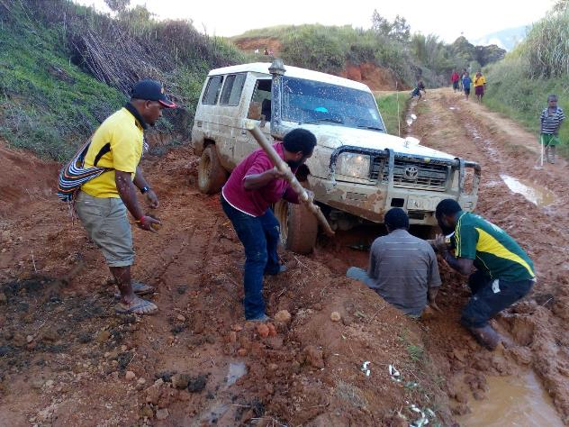

Slide 32
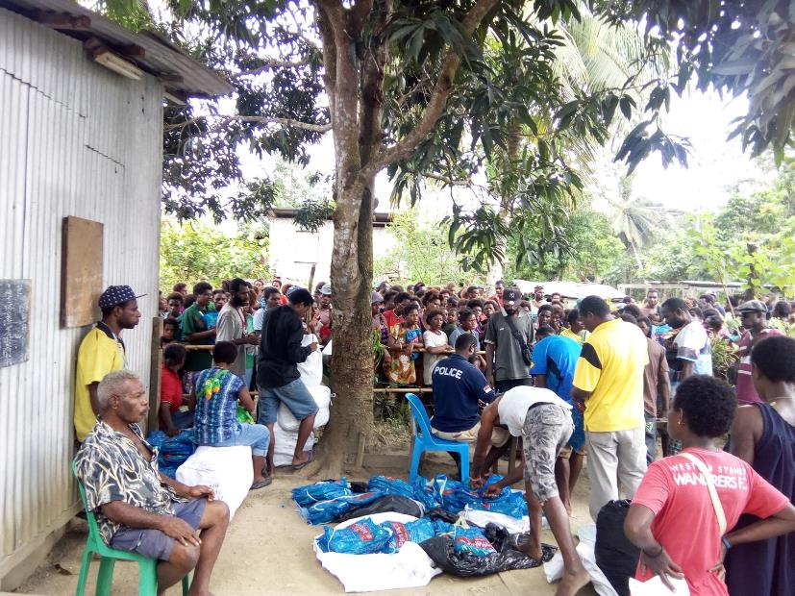
LLIN HOUSEHOLD DISTRIBUTION
Distribution day

Slide 33
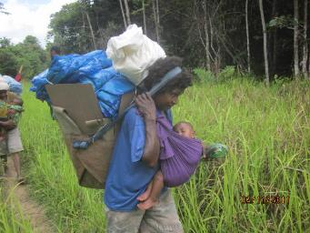

LLIN HOUSEHOLD DISTRIBUTION
Going home with precious nets

Slide 34



LLIN HOUSEHOLD DISTRIBUTION
Going home with precious nets

Slide 35

PNG - MALARIA DRUG PROGRAM
Diagnostics and Treatment

Slide 36





Awareness Raising
Malaria advocacy in Australia
Malaria Awareness Day April 30

Slide 37


Rotary District projects like…..

Slide 38


Australian Rotaractors

Slide 39




Malaria Vaccine Fund raising project

Slide 40
Elimination will require:-
Accurate surveillance and mapping
Maintenance of control measures
A reliable field test for asymptomatic carriers
New affordable drug as a reliable treatment
Multi valent vaccine
&
Focus and Persistence to Complete

Slide 41


RAM will do the hard yards !!
RAM will be there at the end !!

Slide 42


