Slide 1
Progress Against Malaria in Vanuatu and beyond: lessons from history
Dr Tessa Knox
Technical Advisor Malaria and Other Vector-Borne and Parasitic Diseases
WHO Country Liaison Office, Vanuatu

Slide 2
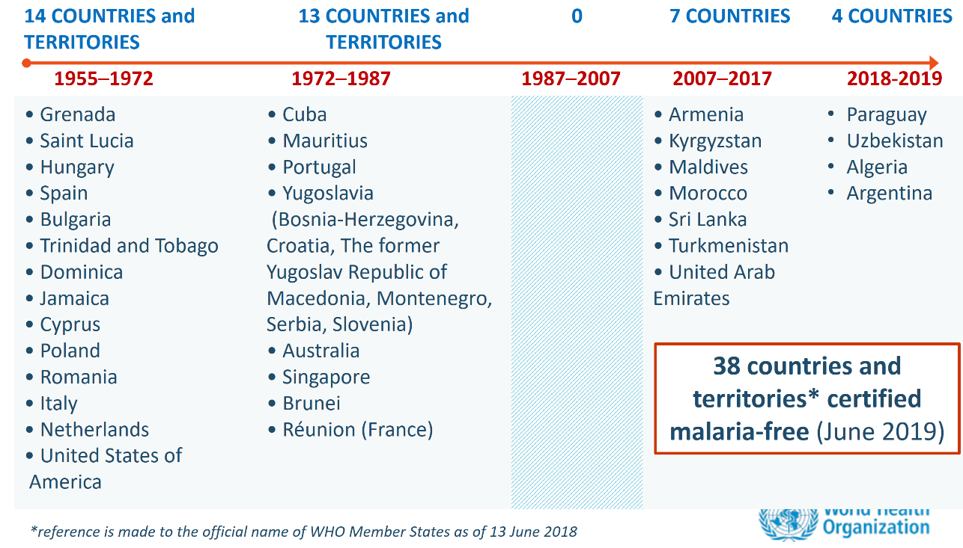
Elimination is possible

Slide 3
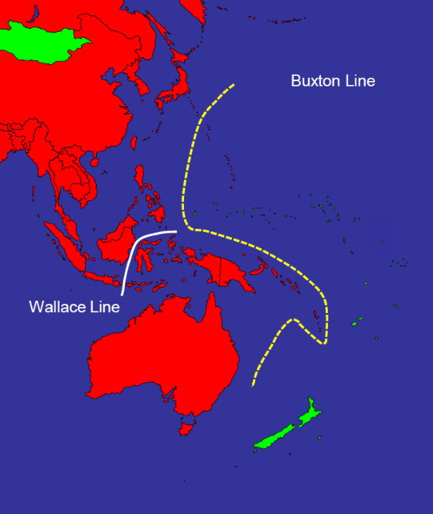
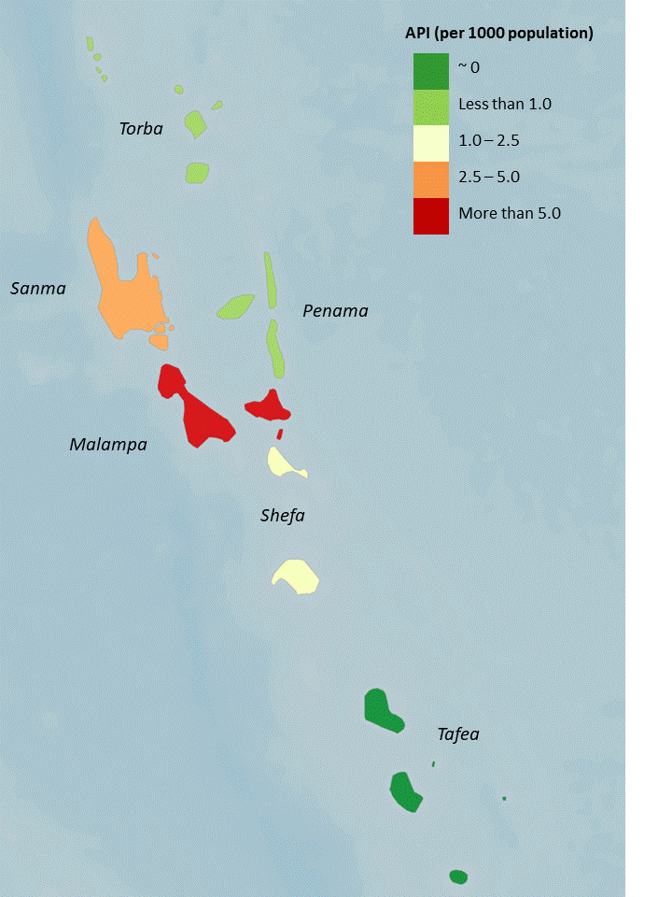
Pick the low hanging fruit
- and learn by doing
Source: Feachem, 2014
2018 API: annual parasite incidence

Slide 4
A “whatever it takes” approach is needed
TAFEA approach
Indoor residual spraying
Increased mosquito net coverage
Selective larval breeding site management
Universal access to diagnosis and treatment
Enhanced surveillance and rapid response
  case finding, case investigation, directly observed treatment, household screen, follow-up
Large team: Elimination Officers, volunteers

Slide 5
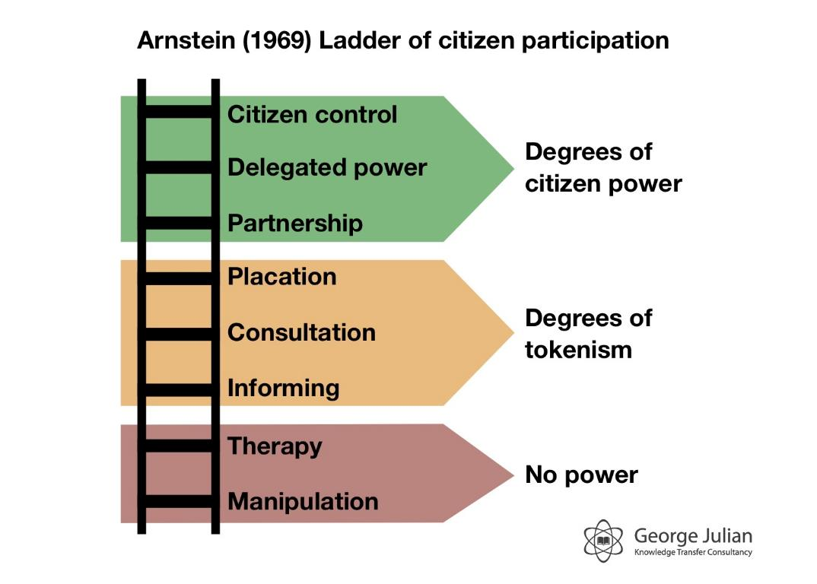
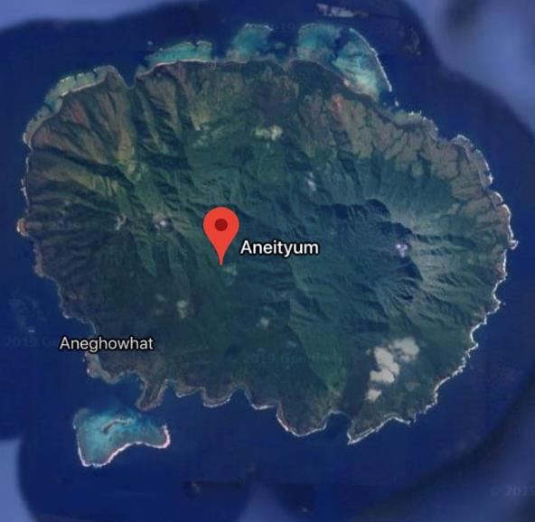
True community participation is essential

Slide 6
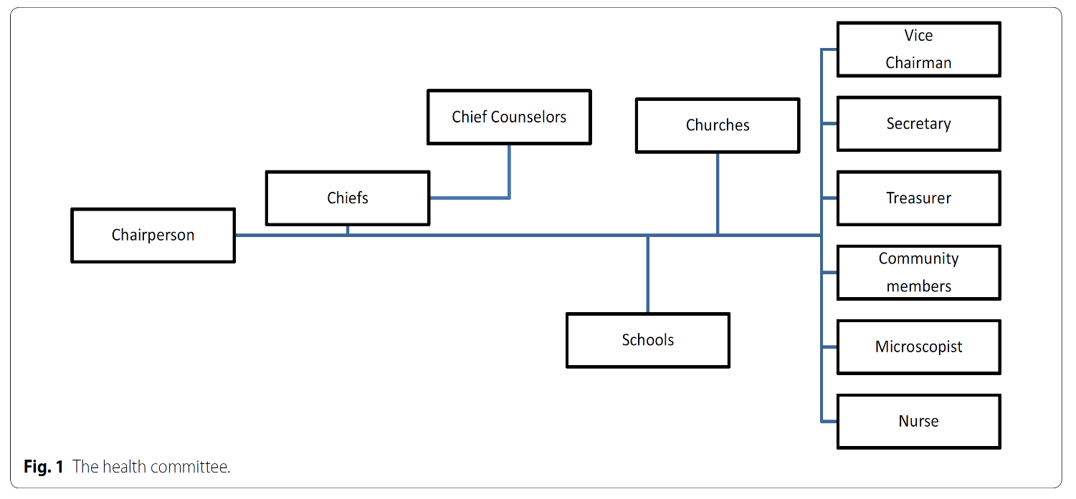
True community participation is essential
Watanabe et al. Malaria Journal 2015

Slide 7
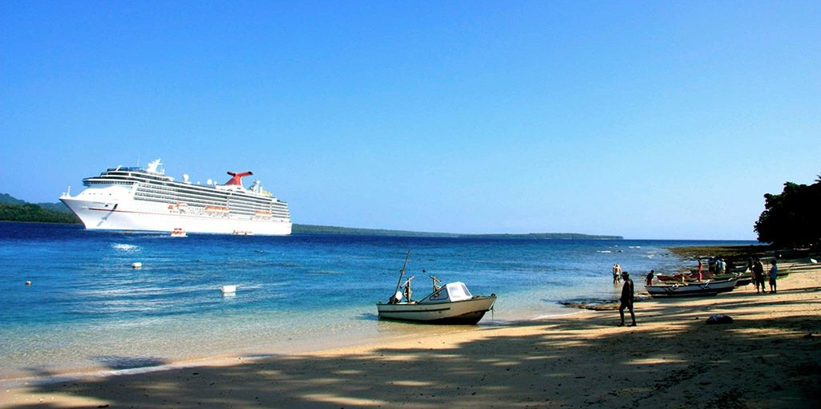

True community participation is essential

Slide 8
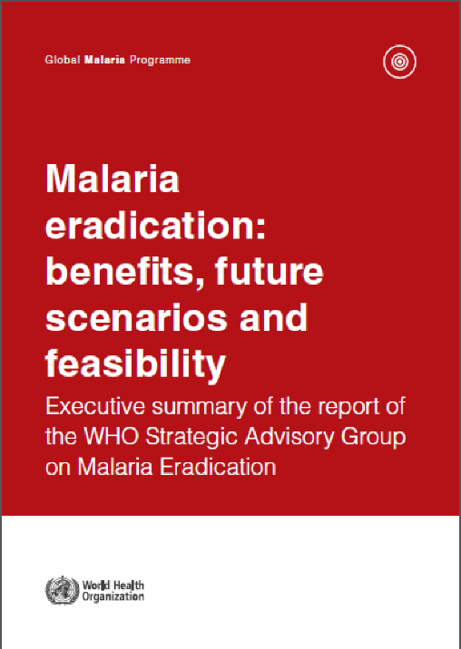
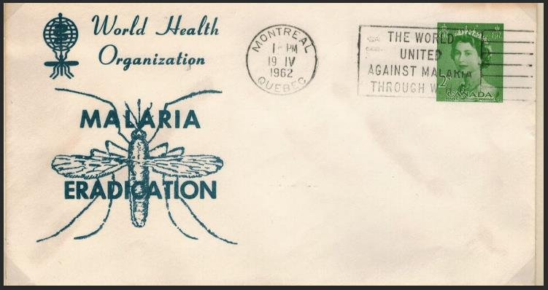
Set goals – and expectations – carefully

Slide 9
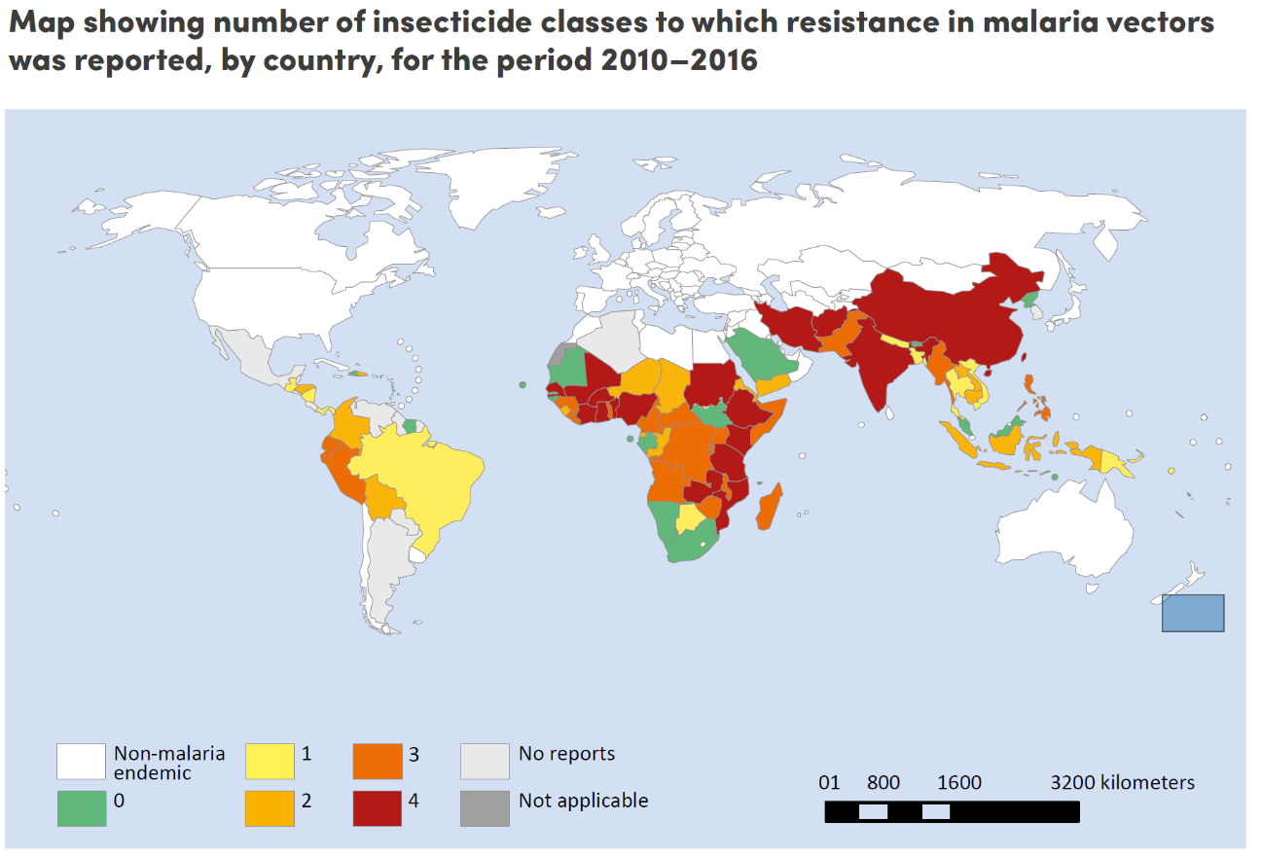
Identify and mitigate against threats
WHO 2018

Slide 10
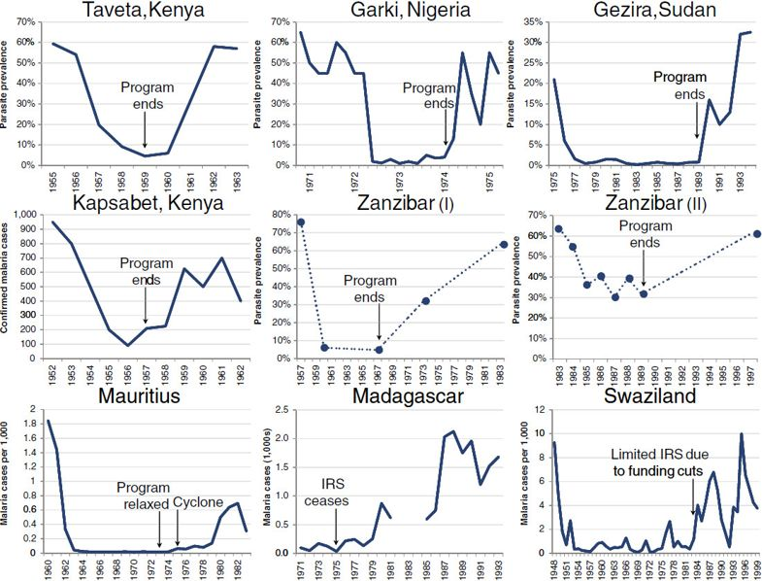
Sustained effort is essential
Malaria easily roars back after control efforts are reduced
Populations with little to no immunity can suffer serious outbreaks
Cohen et al. Malaria Journal 2012

Slide 11
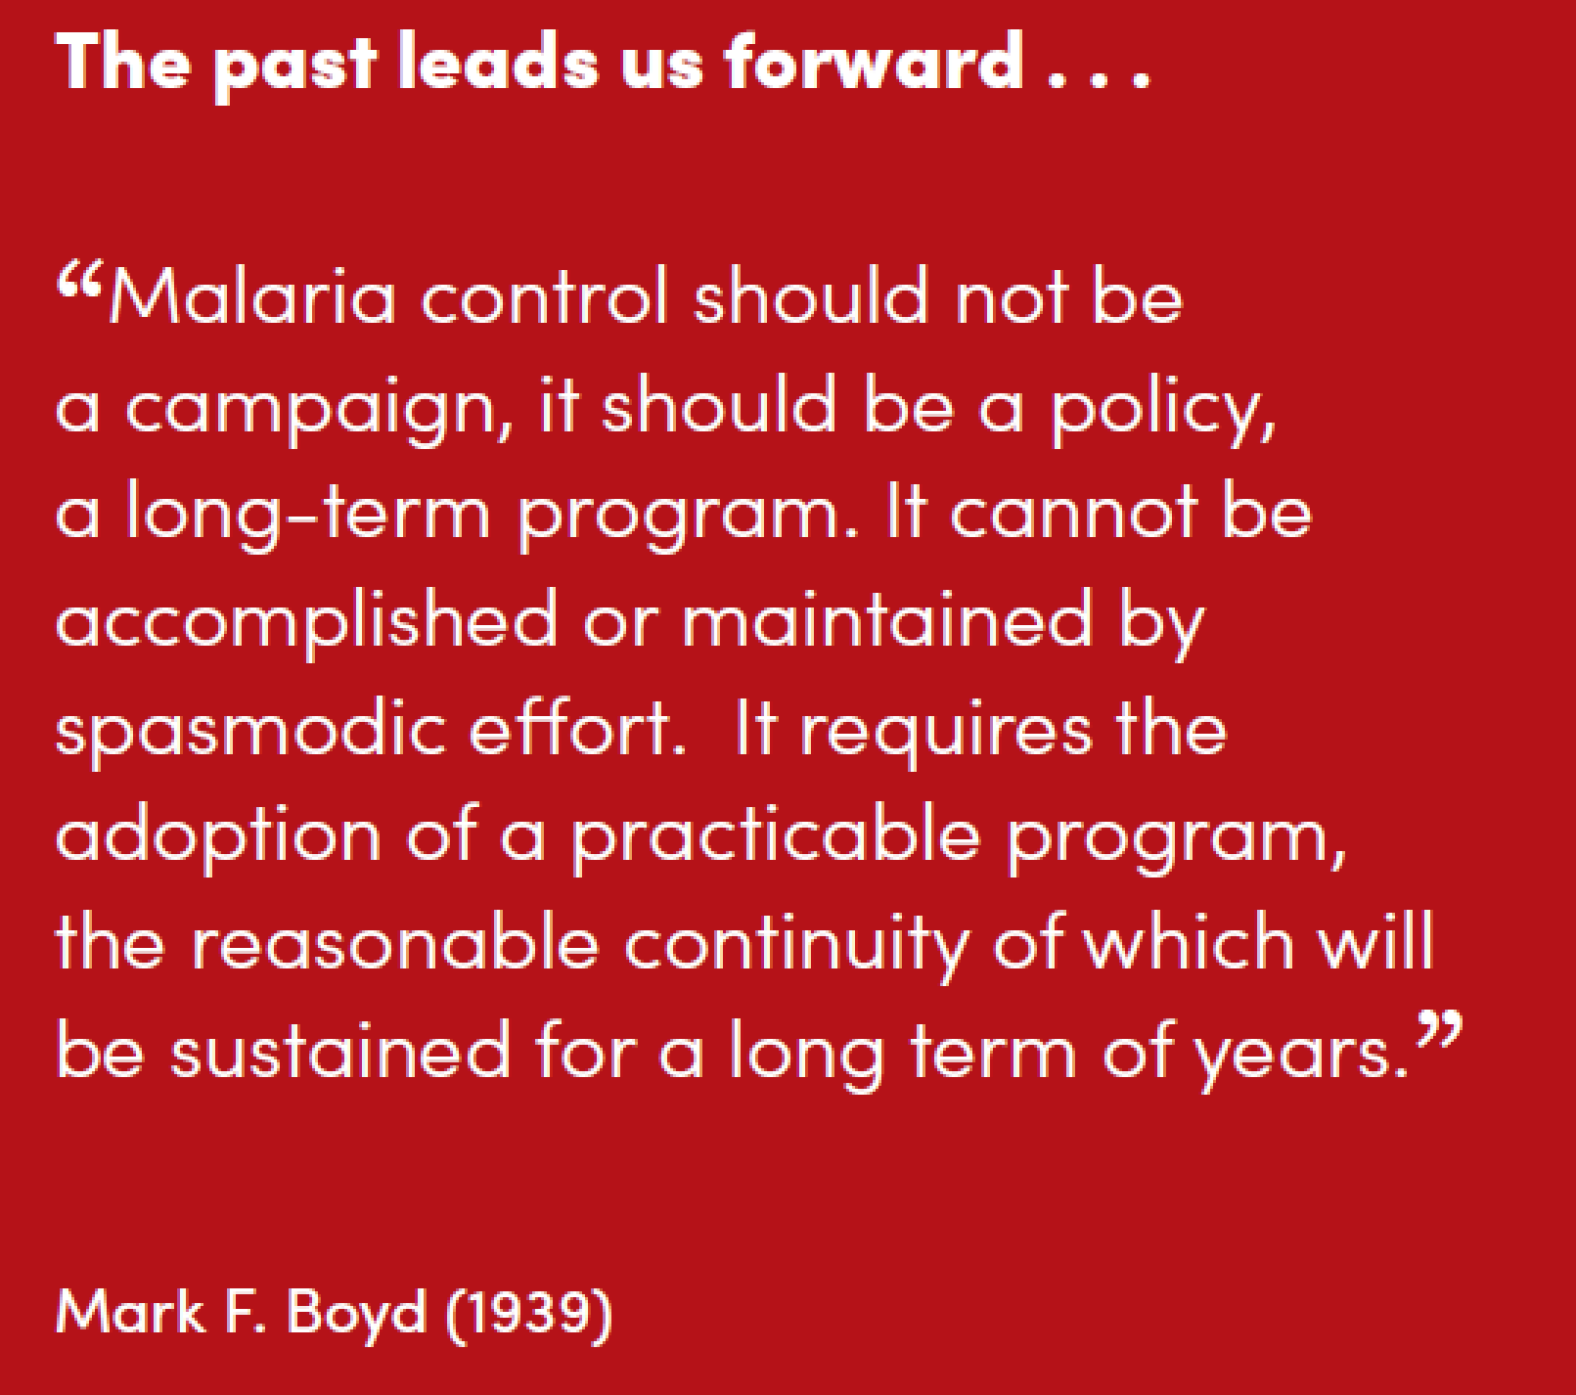
Content

Slide 12
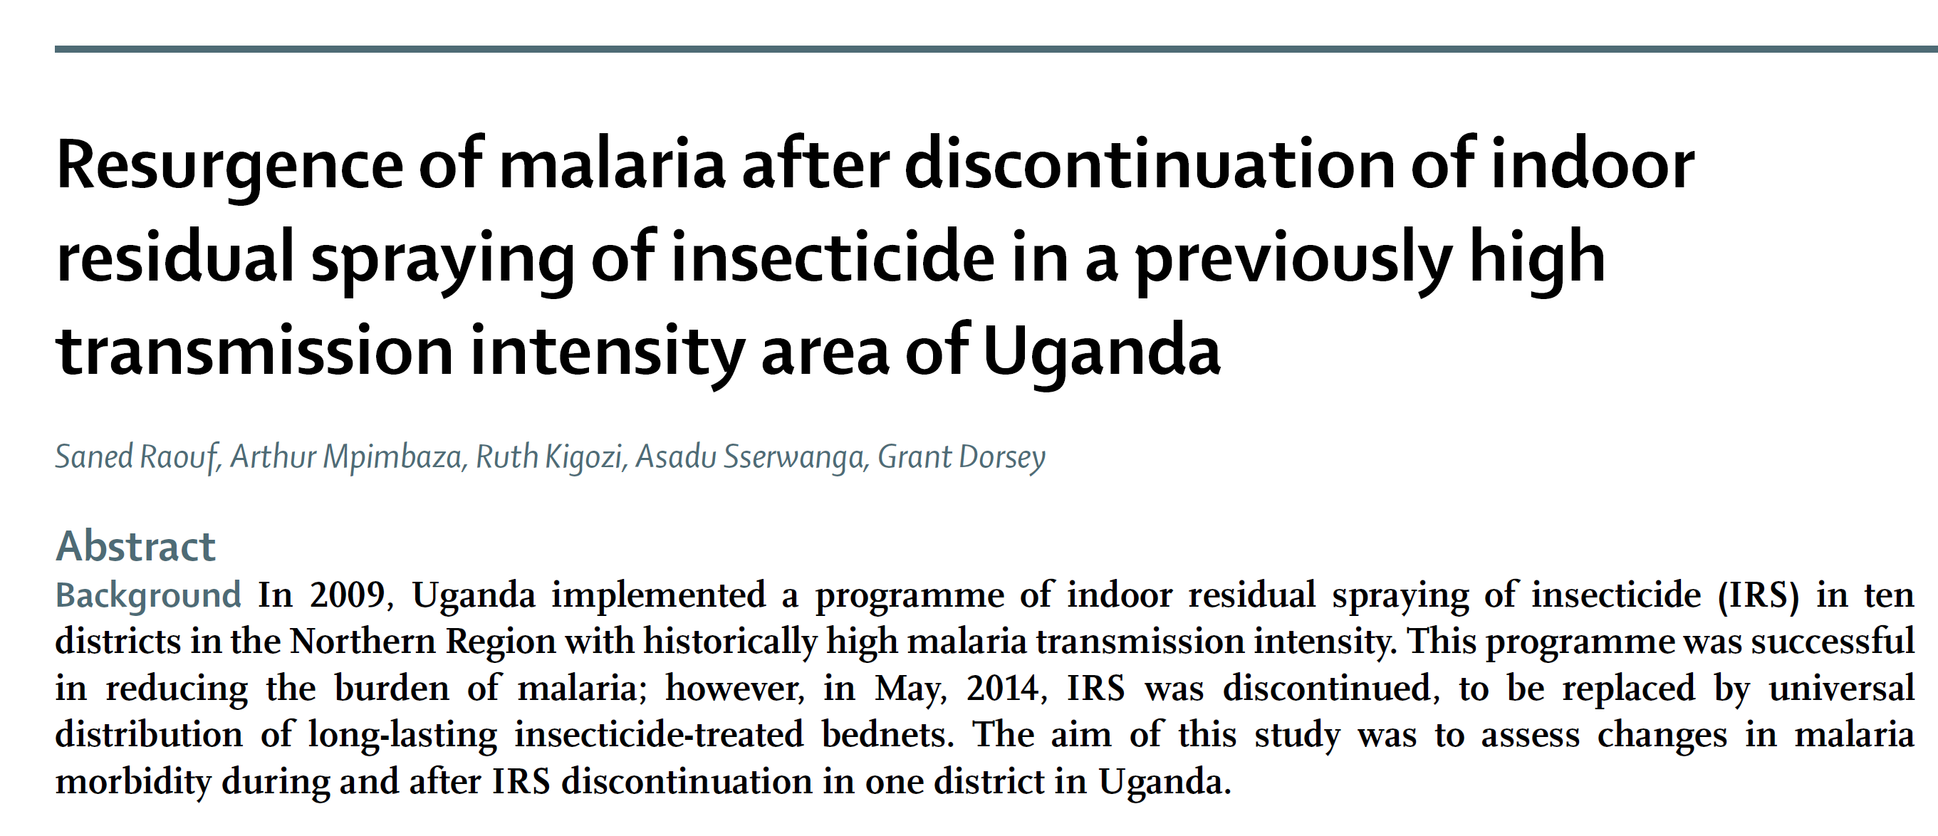
We must not stop too soon
Gains can be lost rapidly
Raouf et al. Clin Infect Dis 2017

Slide 13
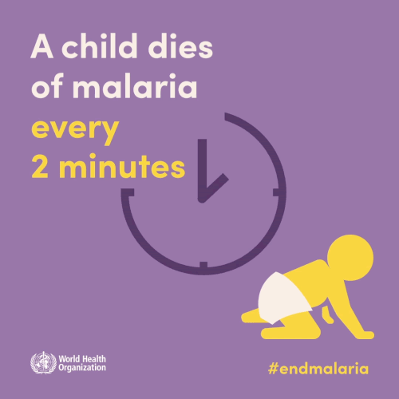
Overall progress is cause for positivity

Slide 14
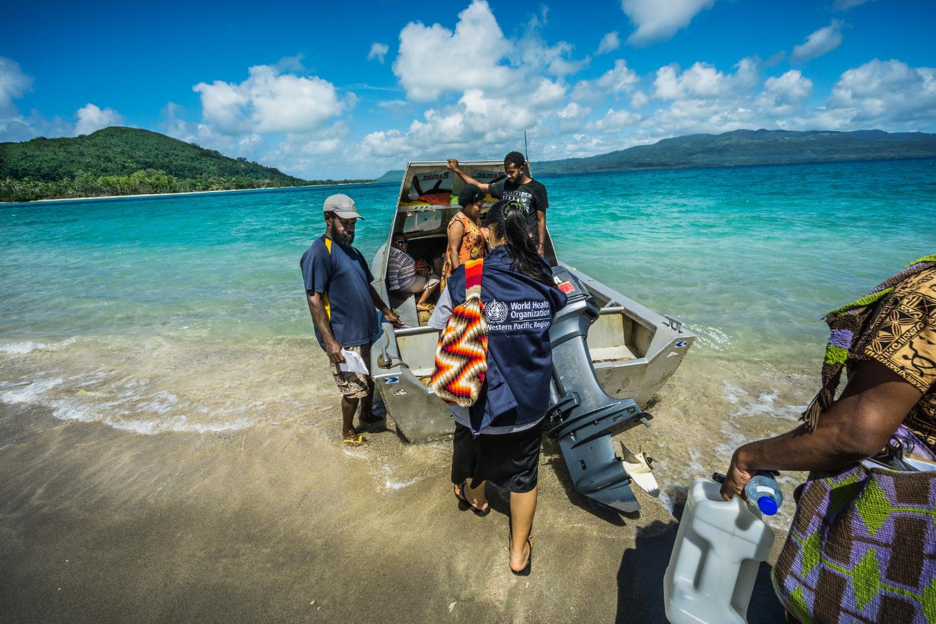
Effective partnerships are essential
“If you want to go fast, go alone.
If you want to go far, go together.”

Slide 15
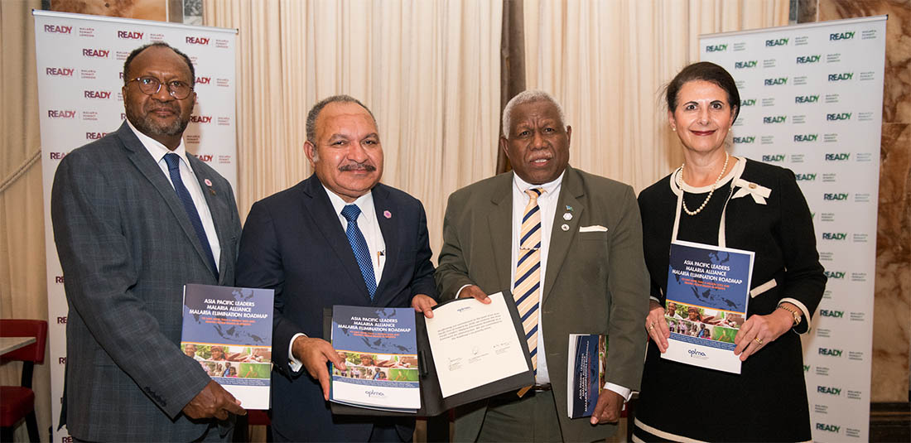
High level commitment is critical
The Prime Ministers of the Republic of Vanuatu, Papua New Guinea, and Solomon Islands with the Australian Minister for International Development and the Pacific, Malaria Summit London, April 2018 (© APMEN)

Slide 16
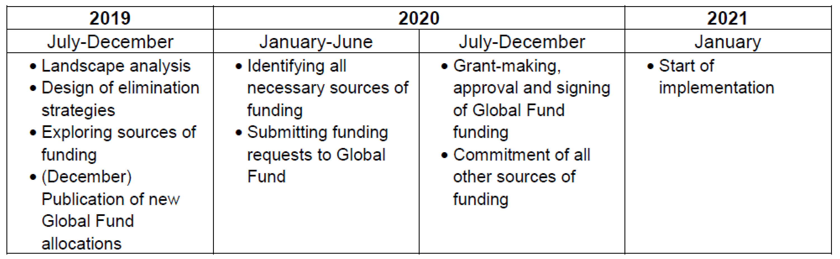
Good news for malaria elimination in our region
Global Fund have committed to a Malaria Elimination in Melanesia and Timor-Leste Initiative - “MEMTI”
Up to US$25 million for 2021-2023 in 4 countries
Additional to country grants
Expected to leverage other support (Asia Development Bank, World Bank)

Slide 17
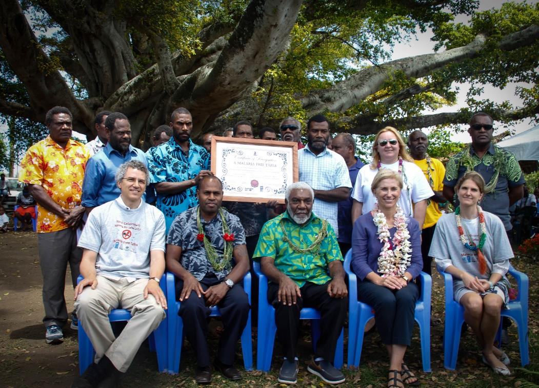
Celebrate the gains!
Celebration of declaration of elimination of malaria from Tafea Province, November 2017
(© UNDP/Donald Wouloseje)

Slide 18
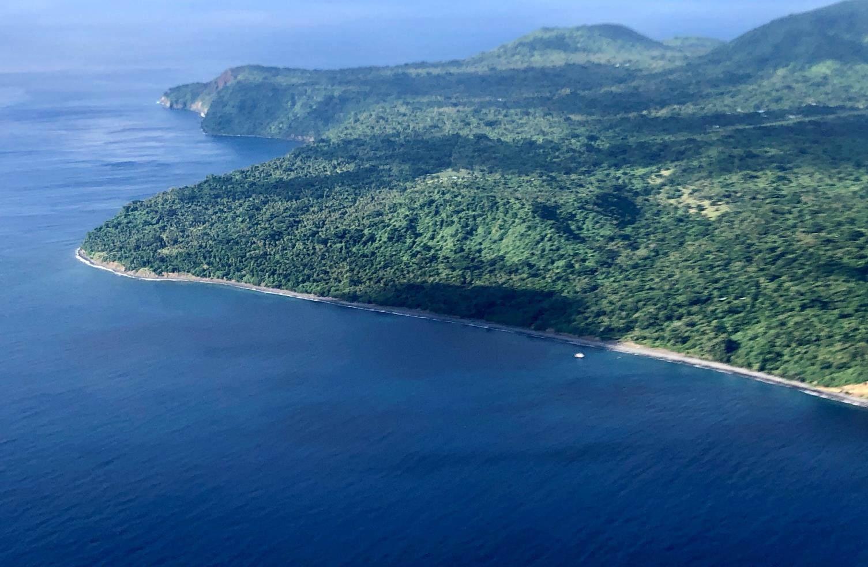
Thank you for your attention
“Malaria is not just a task to be performed; it is a problem to be solved”.

