Slide 1
Update on studies of primaquine for vivax malaria in the Solomon Islands Harin Karunajeewa
Rotary Against Malaria Annual Conference, Melbourne, 2019
Notes:
Thanks Rob and good morning,

Slide 2
Overview
Recap of study rationale and objectives
Update on progress
Preliminary results
G6PD issues
Discussion of implications
Photographed with permission

Slide 3
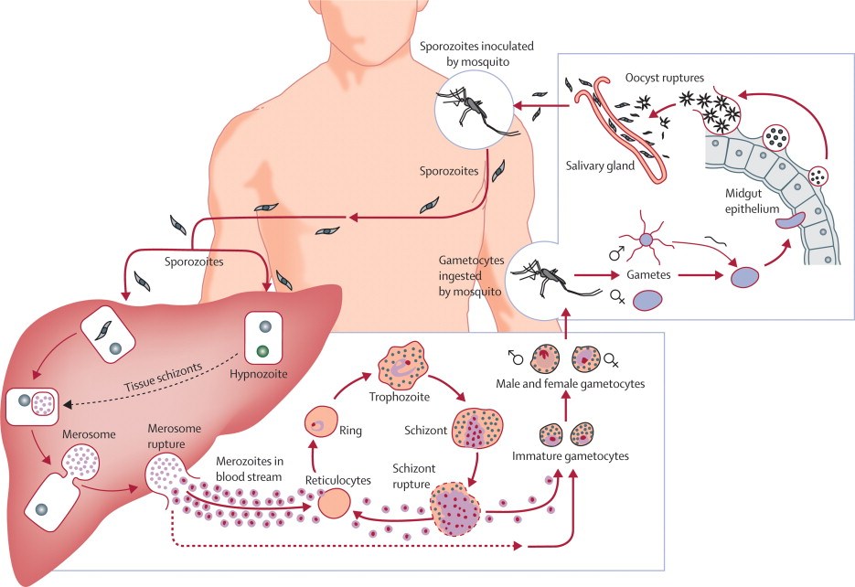
The challenge of P. vivax
Fact:
In Southwest Pacific, 4 out of every 5 episodes of P.vivax are due to hypnozoite relapse.
Robinson et al. PLoS Medicine 2015

Slide 4
A comparison of two artemisinin combination therapies (ACTs) in combination with primaquine for radical cure of Plasmodium vivax malaria in the Solomon Islands: the “ACT-radical” study.
PIs: Karunajeewa H, Baird J.K & Mueller I
Photographed with permission

Slide 5
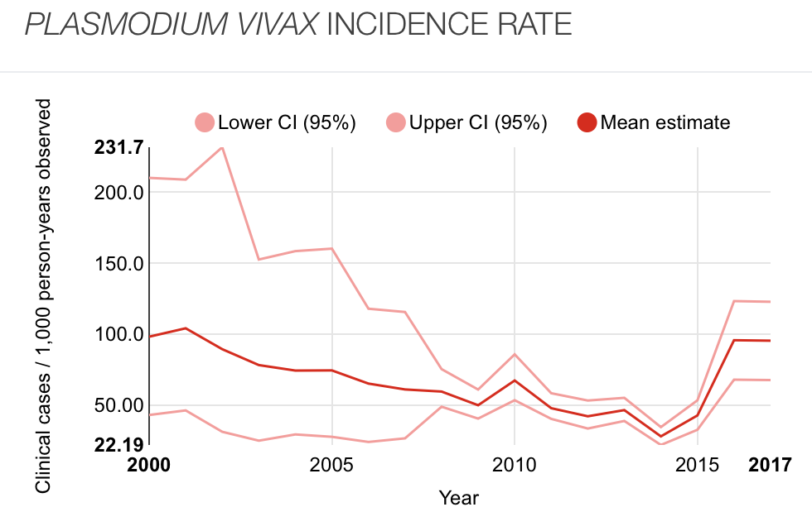
Malaria incidence rates Solomon Islands 2000-2017
Malaria Atlas Project: https://map.ox.ac.uk
Notes:
So the context here as that although we have seen enormous improvements in malaria control since the 90’s, these achievements have faltered in recent years, especially for vivax which has now become the dominant malaria species.

Slide 6
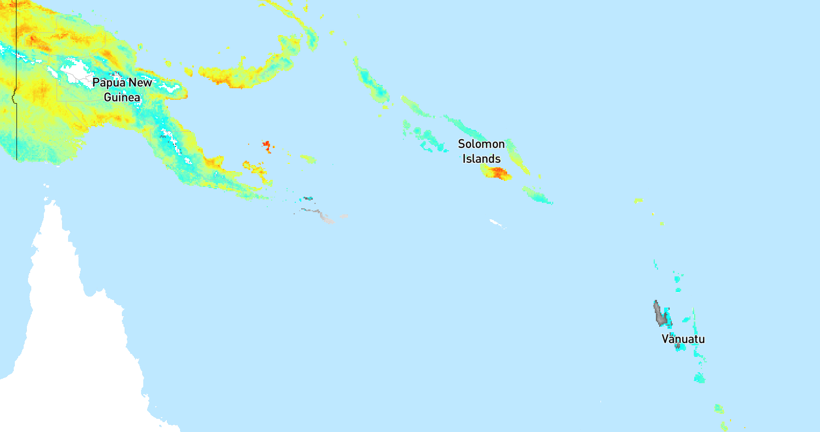
Malaria Atlas Project: https://map.ox.ac.uk
Notes:
So Rob has given the global overview, I’m now going to concentrate specifically on the situation in the South Pacific where we deal with the Chesson strain of vivax.
And I’m presenting a study conducted here on the Island of Guadalcanal in the Solomon Islands which has amongst the region’s highest P.vivax transmission.

Slide 7
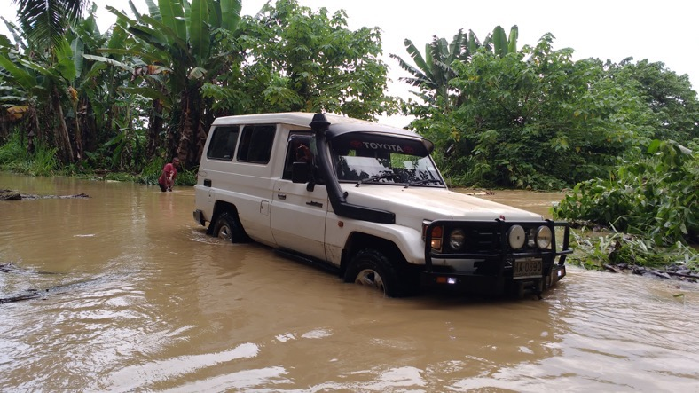
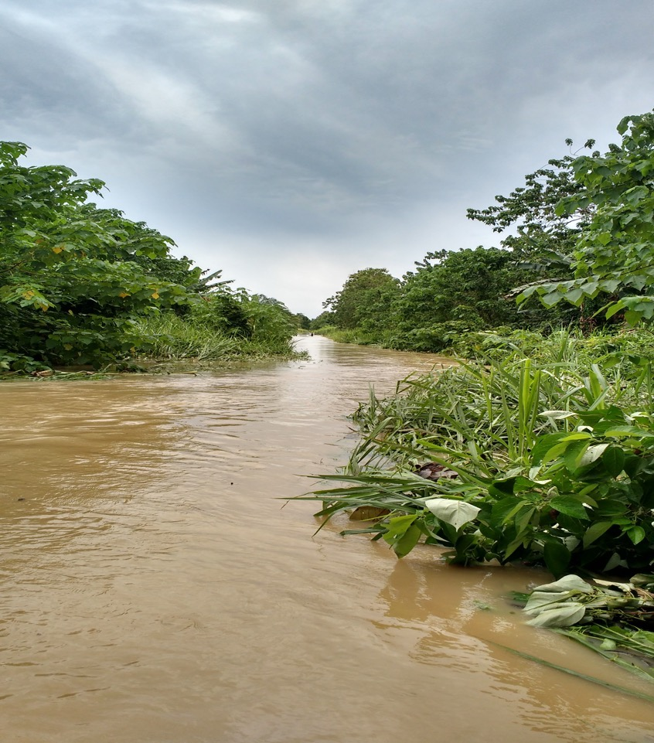

Slide 8
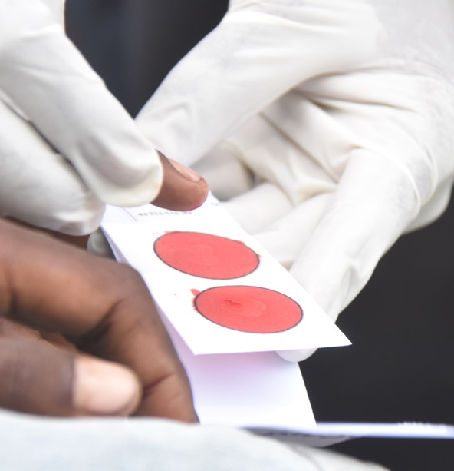
Where are we now? Progress report
Enrolments complete (n=383 = 100% pre-specified sample size)
Full 6 months follow-up completed (>4300 individual visits)
Preliminary microscopy endpoint (field microscopy, verified by 2nd +/- 3rd level 2 microscropist).
Pending:
PCR-correction of microscopy results (baseline and follow-up)
CYP-2D6 genotyping
Genotyping baseline-recurrent sample pairs (re-infection vs recrudescence/relapse)
Alternative PCR endpoint (PCR on all follow-up samples)

Slide 9
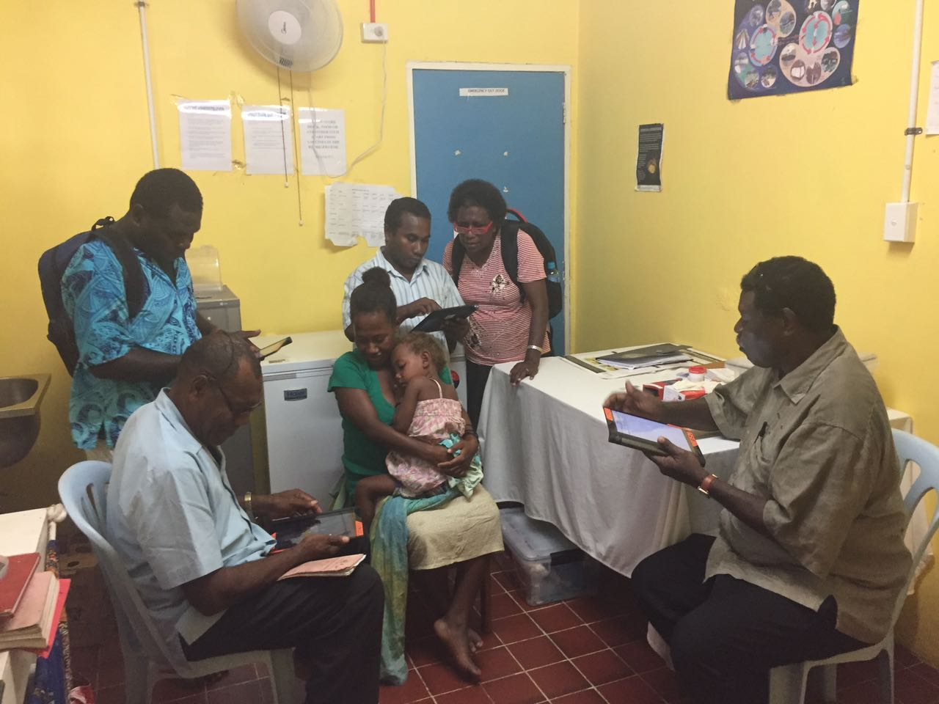
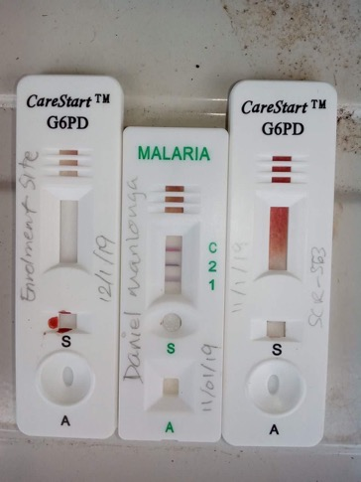
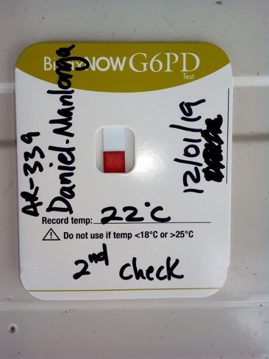
G6PD testing: Risk mitigation measures

Slide 10
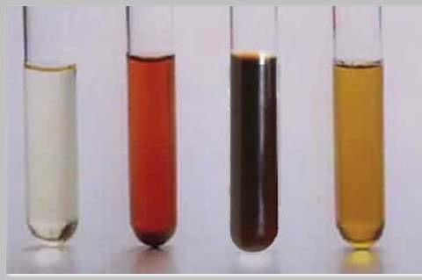
G6PD testing: Pharmacovigilance

Slide 11
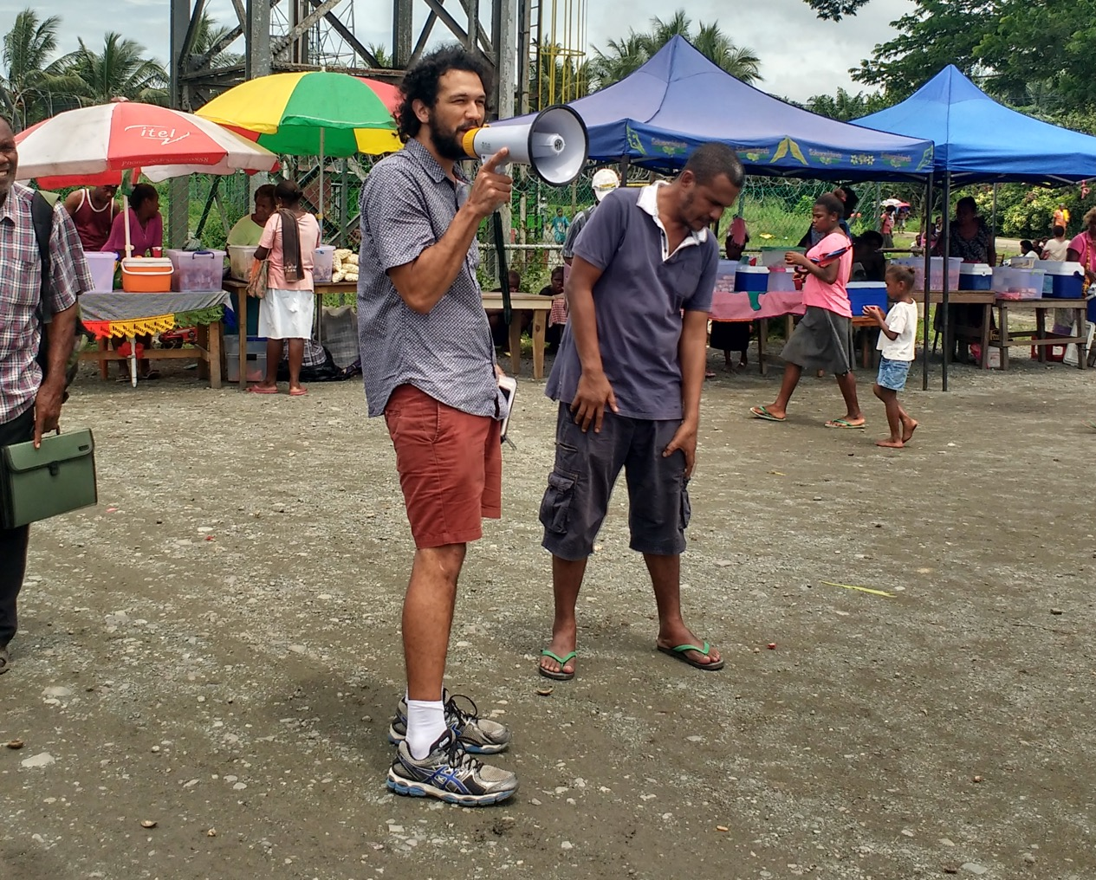

Slide 12
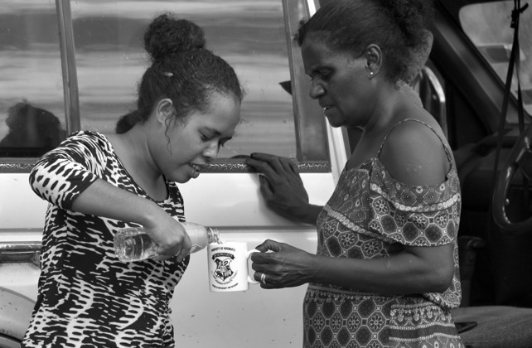

Slide 13
