Slide 1
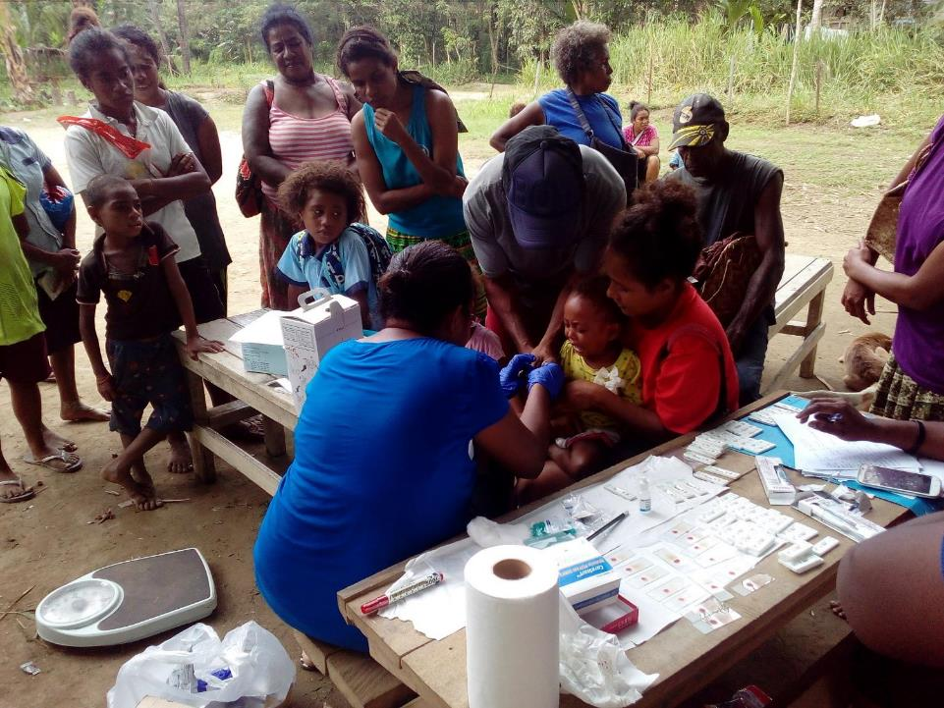


ROTARIANS AGAINST MALARIA
PAPUA NEW GUINEA
RAMs Role In Malaria Control In PNG
RAM Conference Melbourne
25 August 2019
Tim Freeman

Slide 2

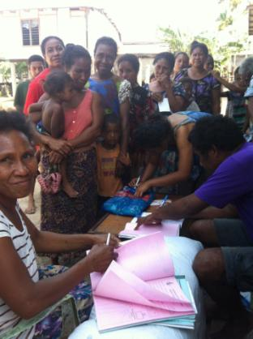
PNG – MALARIA PROGRAMME
RAM PROGRAMME
RAM PROGRAMME
Net Distribution
Health Facility Visits
Drug Distribution
Management Of Finances For IMR and NDOH
Chasing Malaria

Slide 3
PNG – MALARIA PROGRAMME
RAM PROGRAMME
RAMs Funding
Global Fund
  74.9% of funding
  Nets over 1600 metres, drugs, HF supervision, IMR
Against Malaria Foundation
  20.9% of funding
  All nets under 1600 metres
PNG Sustainable
  2.9% of funding
  Western Province nets and drug distribution
RAM (PNG and Australia)
  1.3% of funding
  Chasing Malaria
Exxon Mobil

Slide 4
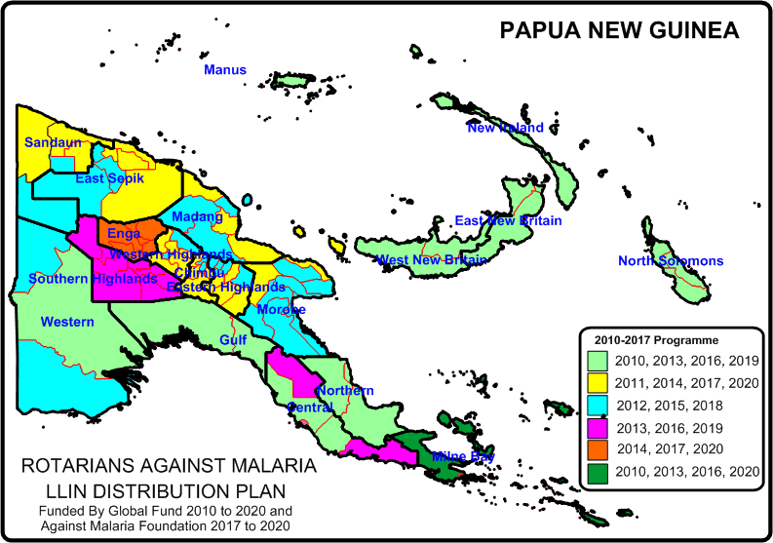
PNG - MALARIA PROGRAMME
LLIN DISTRIBUTION
RAM Distributes LLINs On A Three Year Basis To All Areas Of PNG
Presently in Southern Highlands and Central Province and moving shortly to Gulf

Slide 5
PNG - MALARIA PROGRAMME
LLIN DISTRIBUTION
Distribution Of LLINs To Household Level

Slide 6
PNG - MALARIA PROGRAMME
LLIN DISTRIBUTION
Distribution Of LLINs To Vulnerable Groups
Antenatal Net Distribution Now Very Low 2019 as the programme no longer has nets to delivery

Slide 7
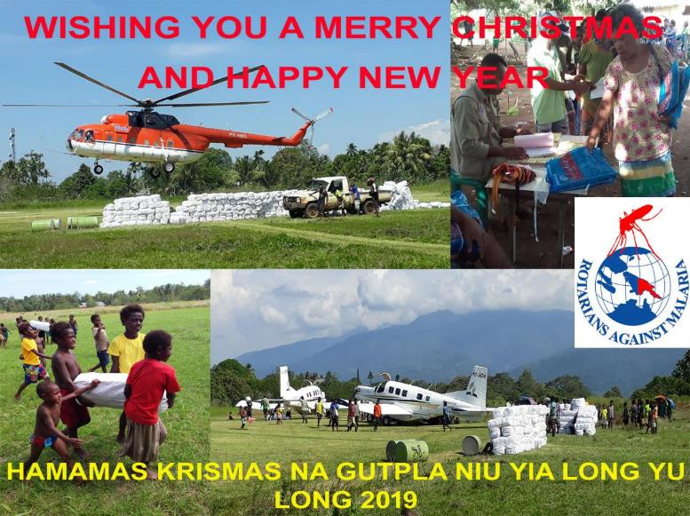
PNG - MALARIA PROGRAMME
LLIN DISTRIBUTION

Slide 8
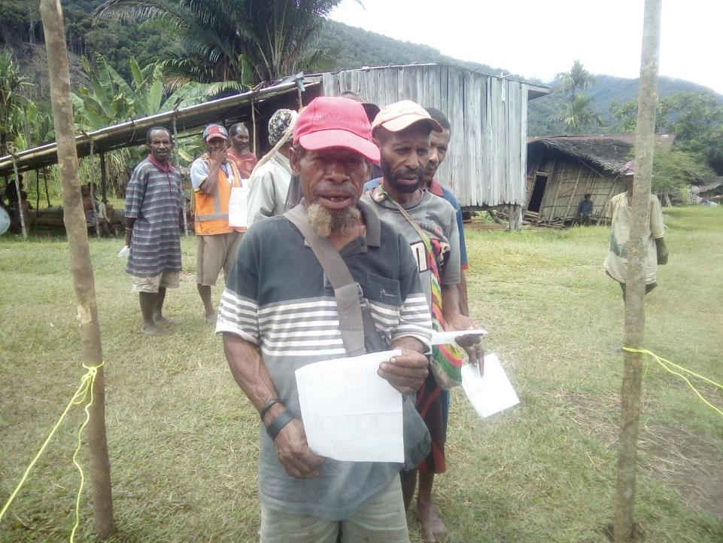
PNG - MALARIA PROGRAMME
LLIN DISTRIBUTION

Slide 9
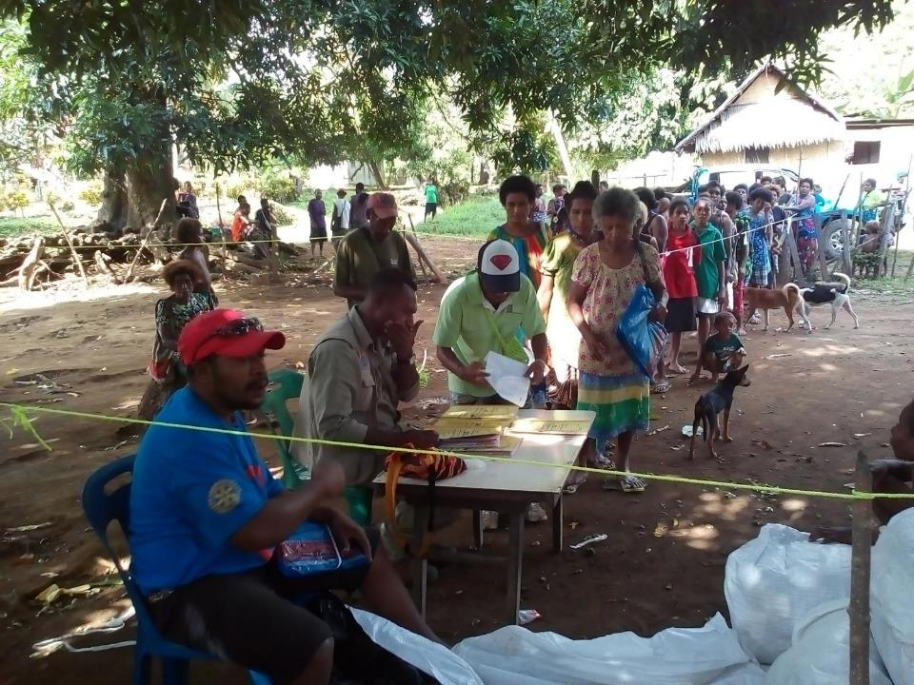
PNG - MALARIA PROGRAMME
LLIN DISTRIBUTION

Slide 10
PNG - MALARIA PROGRAMME
HEALTH CENTRE SUPERVISION
RAM programme now employs nine Regional Malaria Coordinators (RMCs) and five Provincial Malaria Supervisors (PMS)
RMCs visit all accessible health facilities (not Aid Posts) on a quarterly basis. At each health facility the RMCs carry out the following:
  Supply RDTs, ACTs and Antenatal LLINs to a predetermined level.
  Ensure that RDTs, ACTS are fully accounted for.
  Monitor testing and treatment of malaria.
  Ensure that all cases of malaria are recorded and data submitted to the NHIS on time.

Slide 11
PNG - MALARIA PROGRAMME
HEALTH CENTRE SUPERVISION
  Estimated that 30-40% cases of malaria are not recorded. This has made quantification of ACTs and RDTs very difficult.
  Negative cases are often not recorded.
  Many other malaria cases still not recorded, particularly clinically diagnosed malaria cases. This results in RDTs being better reconciled than ACTs.
  Reporting to the National Health Information System (NHIS) is very slow. For this reason RAM has send two teams to two provinces to resolve problems in reporting.

Slide 12
PNG - MALARIA PROGRAMME
DRUG DISTRIBUTION
Since January 2018, RMCs have visited all provinces at least three times.
17 out of 22 provinces already visited four times.
RAM is working very closely with the National Department of Health Supply Division. RAM is filling in stock shortages of ACTs and RDTs throughout PNG and has distributed both RDTs and ACTs from Global Fund and from government of PNG in a combined distribution.

Slide 13
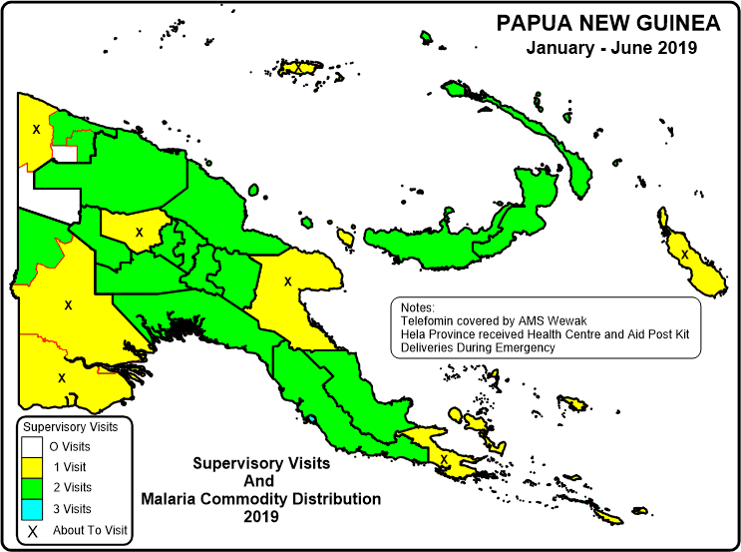
PNG - MALARIA PROGRAMME
DRUG DISTRIBUTION

Slide 14
PNG - MALARIA PROGRAMME
DRUG DISTRIBUTION
2018
RDTs and ACTs stored in Government Store
In total, from January to December 2018, RAM has distributed:
  about 2,000,000 RDTs (1,100,000 from GF stocks and about 900,000 from NDoH stocks)
  About 930,000 ACTs (about 750,000 from GF stocks and about 180,000 from NDoH stocks).
  A further 200,000 RDTs and 400,000 ACTs delivered by NDoH giving total of 2.2 million RDTs and 1.3 million ACTs.

Slide 15
PNG - MALARIA PROGRAMME
DRUG DISTRIBUTION
2019
In total, from January to June 2019, RAM has been involved in the distribution:
  1.136 million RDTs (364,000 from GF stocks and 772,000 from NDoH stocks)
  680,000 ACTs (230,880 from GF stocks and 230,000 from NDoH stocks)
  Now assisting with the distribution of Primaquine and with Dihydropiperazine Phosphate (DP).

Slide 16
PNG - MALARIA PROGRAMME
DRUG DISTRIBUTION
With 300,000 RDTs and ACTs delivered through Aid Post Kits gives a total of 2.5 million RDTs and about 1.6 million ACTs delivered in 2018.
Since July 2017 there have been no significant shortages of malaria commodities to this time.
Only problem to date is that two cartoon of drugs has been lost in transit through Air Niugini.
Biggest problem is getting health centres to report usage of ACTs (35%) and RDTs (40%). This is a major challenge for RMCs.

Slide 17
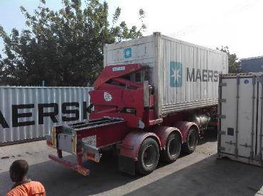
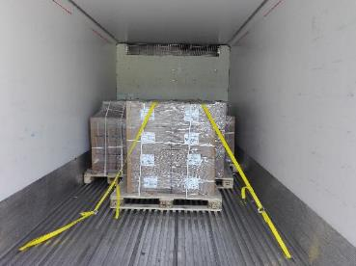
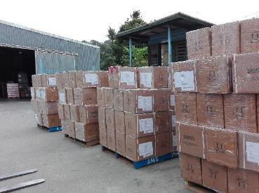
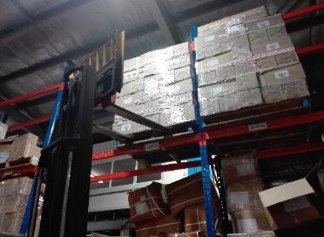
PNG - MALARIA PROGRAMME
DRUG DISTRIBUTION

Slide 18
PNG - MALARIA PROGRAMME
INSTITUTE OF MEDICAL RESEARCH
  RAM is managing finances of IMR in three studies being supported by the Global Fund.
  Stratification of malaria in PNG in 2018.
  Insecticide Resistance in 2018 and 2020.
  Malaria Indicator Survey in 2019 – 2020.

Slide 19
PNG - MALARIA PROGRAMME
INSTITUTE OF MEDICAL RESEARCH
  STRATIFICATION
  It is presently assumed that the stratification of malaria in PNG is as follows:
  0-1200m Malaria is endemic
  1200-1600m Malaria is epidemic
  1600-2000m Only P. vivax is transmitted
  2000m and over No malaria transmission.
  This study is to determine if these limits are still good in the environment of Global Warming

Slide 20
PNG - MALARIA PROGRAMME
INSTITUTE OF MEDICAL RESEARCH
  Malaria Indicator Survey
  This is a national malaria survey which covers all provinces. It looks primarily at three things,
  LLIN Coverage and Usage
  Treatment seeking practices
  National Prevalence
  (Note LLIN Coverage has remained consistent for seven years)

Slide 21
PNG - MALARIA PROGRAMME
NATIONAL DEPARTMENT OF HEALTH
  Working Closely Alongside the National Malaria Control Program (MCP) Including
  Coordination of all malaria activities in the country
  Therapeutic Efficacy Studies of Anti Malaria Drugs carried out by MCP
  Community Based Malaria Programs including Home Management of Malaria

Slide 22
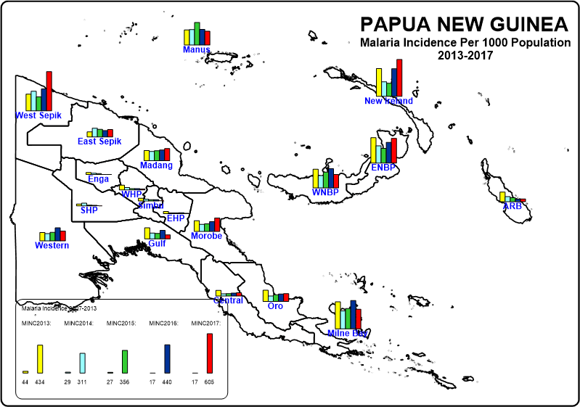
PNG - MALARIA PROGRAMME
MALARIA INCIDENCE
Malaria increasing in some parts of PNG but not in all areas

Slide 23
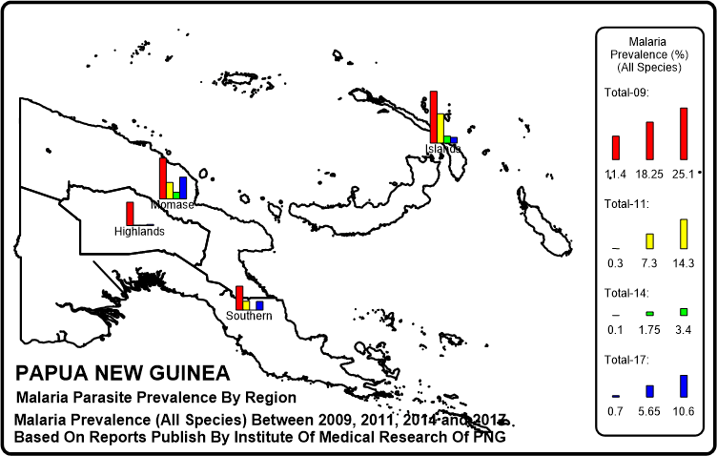
PNG - MALARIA PROGRAMME
MALARIA PREVALENCE
Malaria Prevalence Reduced From 2009 To 2014 By More Than 90% In Highlands And Southern Region and 80% In Momase And Niugini Islands. However, malaria increase greatly in 2017 in many places

Slide 24
PNG - MALARIA PROGRAMME
INCREASED
MALARIA CASES
Apart from the maps, the following has been noted in the last two years which has not been seen before.
Very high increases in malaria prior to RAM distributing new nets i.e. great increases in malaria 2.5 years after previous distribution.
A number of malaria outbreaks have been recorded in a number of places in the country.
More worryingly is that in some provinces, no decrease of malaria was noted after the distribution of mosquito nets.

Slide 25
PNG - MALARIA LLIN PROGRAMME
POSSIBLE PROBLEMS
POSSIBLE REASONS FOR INCREASES IN MALARIA
Treatment failure
  Drugs resistance
  Substandard medicine
  Non compliance of taking full course or sub optimal doses
  Expired drugs
  Health Staff giving wrong doses
  Diagnostic Test (RDTs) problems
  Treatment seeking behaviour
  Health Staff behaviour
Shortage of antimlaria commodities

Slide 26
PNG - MALARIA LLIN PROGRAMME
POSSIBLE PROBLEMS
POSSIBLE REASONS FOR INCREASES IN MALARIA
People not going for treatment due to access (Kuriva Population spread out)
Human behaviour
  Not sleeping under nets, not repairing nets
Mosquitoes biting earlier so increasing contact with mosquitoes.
People staying up late e.g. watching village cinema
LLINs no longer working
  not treated properly.
  Insecticide resistance
  Nets not being repaired

Slide 27
PNG - MALARIA LLIN PROGRAMME
PNG RESPONCE
Verify Cause Of Problems. Carry out the following investigations.
  Therapeutic Efficacy Studies (TES) (NDoH)
  Insecticide Resistance Studies (IMR)
  Test bednets for efficacy (IMR)
  Entomological studies include speciation and when mosquitoes are biting (IMR).
  Study of people night time behaviour (RAM to lead).

Slide 28
PNG - MALARIA LLIN PROGRAMME
RAM RESPONCE
RAM PNG started the first Chasing Malaria Programme in 2012 in Central Province with a Community Malaria Programme.
Program was well accepted but did not survive as the area chosen for RAM to work in by the Central Province Authorities has practically no malaria.
Since late 2014, RAM has been giving nets away for all RDT positive cases. This has encouraged people to get tested while allowing health staff to collect data on malaria cases throughout the two provinces.
We also collect data on the travel history of the patients.

Slide 29
PNG - MALARIA LLIN PROGRAMME
CHASING MALARIA
LLINs Given Out For Positive Cases Of Malaria In Central, NCD and Gulf Provinces

Slide 30
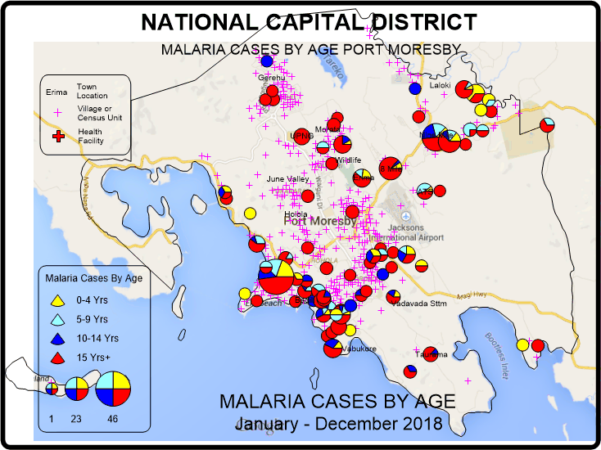
PNG - MALARIA LLIN PROGRAMME
CHASING MALARIA
MAPPING IN NCD
This map shows malaria cases in children in NCD. This suggests that malaria is still being transmitted in Kaugere.

Slide 31
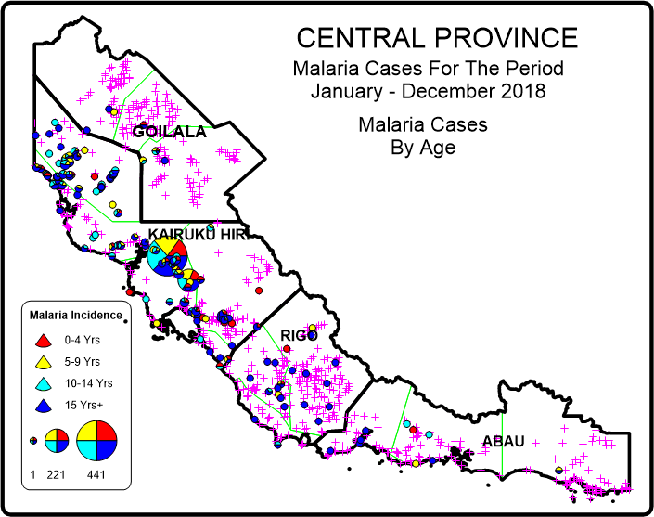
PNG - MALARIA LLIN PROGRAMME
CHASING MALARIA
MAPPING IN CENTRAL PROVINCE
Based on this map, Chasing Malaria has concentrated its activities in the Waima and Bereina areas of Kairuku

Slide 32
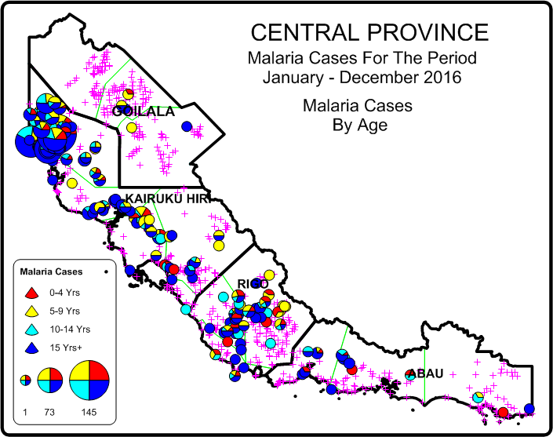
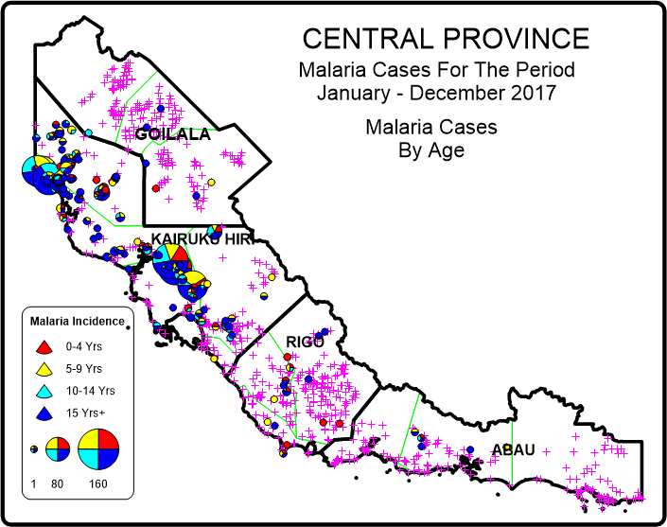
PNG - MALARIA LLIN PROGRAMME
CHASING MALARIA
MAPPING IN CENTRAL PROVINCE
Based on this map, Chasing Malaria has concentrated its activities in the Waima and Bereina and then Kuriva areas of Kairuku

Slide 33
PNG - MALARIA LLIN PROGRAMME
RAM RESPONSE (2)
When starting to plot malaria in 2015, the worst malaria cases were coming from an area known as Waima. This initiated a Community Based Malaria Project in this area starting in 2016.
The objective was to involve communities and school children in malaria control activities. Community and school response was very good when RAM teams were around but tended to drop off when RAM staff were not there. Despite this, generally malaria in this area has reduced in the last two years.
Following World Malaria Day 2018 and a school survey carried out, RAM teams moved to Kuriva.

Slide 34
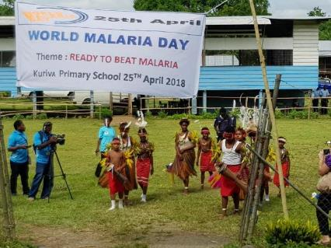
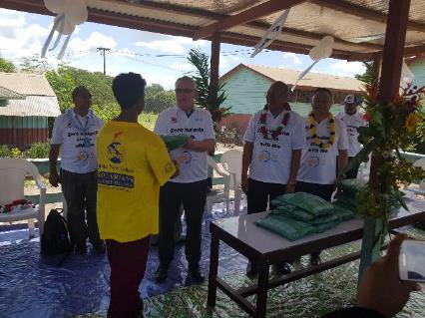
PNG - MALARIA PROGRAMME
WORLD MALRIA DAY
Working now in collaboration with WHO, NDoH Malaria Programme, CPHL and Central Province PHA
World Malaria Day 2018 Kuriva Central Province
World Malaria Day 2019 – NCD – Ron Seddon (Chairman of RAM together with Minister of Health giving prizes)

Slide 35
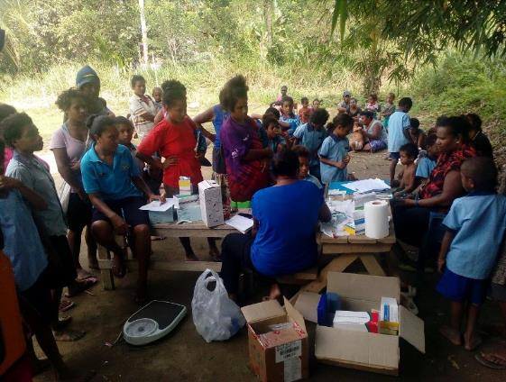
PNG - MALARIA PROGRAMME
CHASING MALARIA
As a result of World Malaria Day it was decided to carry out malaria prevalence surveys in primary schools through out the country

Slide 36
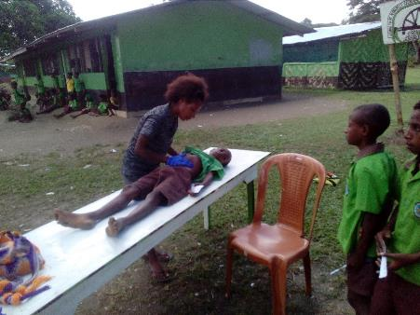
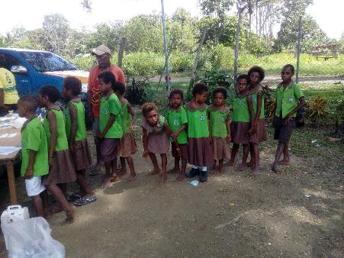
PNG - MALARIA LLIN PROGRAMME
CHASING MALARIA
SCHOOL PREVALENCE SURVEYS
School Prevalence Survey In Brown River

Slide 37
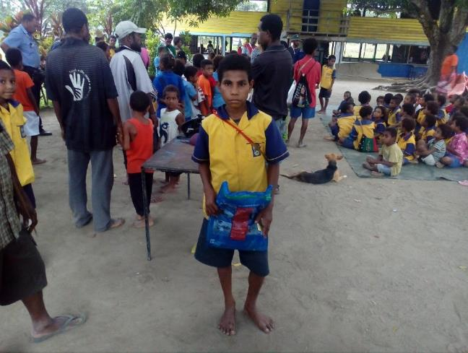
PNG - MALARIA PROGRAMME
CHASING MALARIA
Nets were given to RDT Positive Cases through the Chasing Malaria Programme

Slide 38
PNG - MALARIA LLIN PROGRAMME
WORLD MALARIA DAY
PREVALENCE SURVEYS
School Prevalence Surveys Initiated On
World Malaria Day in Kuriva in 2018 Central Province showed very high prevalence rates

Slide 39
PNG - MALARIA LLIN PROGRAMME
ELEMENTARY SCHOOL
PREVALENCE SURVEYS
School Prevalence Surveys Now carried out throughout PNG in Elementary Schools.
Results have shown very high prevalence rates in many parts of the country.
The area big differences between provinces but also within the same province.
Results from Central Province at least show reductions of malaria from 2018.

Slide 40
PNG - MALARIA LLIN PROGRAMME
CHASING MALARIA INTERVENTIONS
Mapping of area to show villages in relationship to health centres and schools.
Look for other partners or organisations working in the area
Introduce School Health Master and possible Village Volunteers for testing and treatment of malaria in remote locations.
Ensure that health centre does not run out of malaria commodities (RAM).
Health education of schools and villages
School Projects to carry out health education and larval control – this can be extended to villages where volunteers are willing.
Training teachers to test and treat malaria in Elementary Schools in Kuriva catchment areas.
School surveys carried out every six months

Slide 41
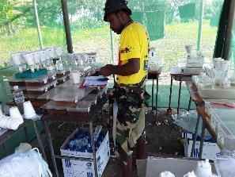
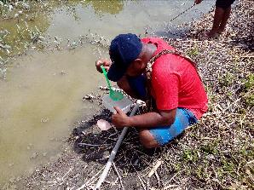
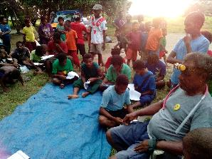
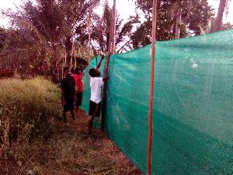
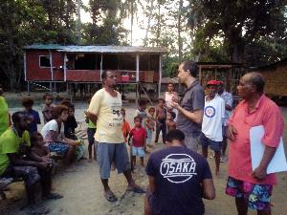
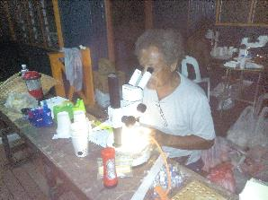
PNG - MALARIA LLIN PROGRAMME
CHASING MALARIA
RESEARCH BY INSTITUTE OF MEDICAL RESEARCH (IMR)
To try and understand malaria in the area, the IMR was invited to come to Kuriva in Central Province in November 2018

Slide 42
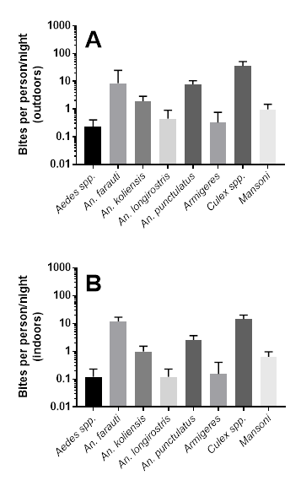
PNG - MALARIA LLIN PROGRAMME
IMR RESEARCH
Findings
Many species of anophelines biting both inside and outside

Slide 43
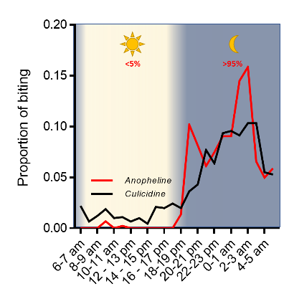
PNG - MALARIA LLIN PROGRAMME
IMR RESEARCH
Findings (2)
Most biting occurring at night but significant biting early hours of the evening before people go to bed.
Good news is that mosquitoes are still biting late at night so likely to come into contact with LLIN

Slide 44
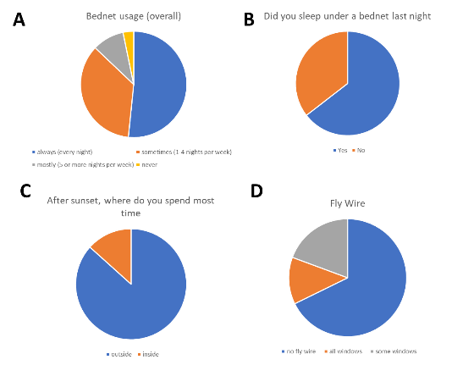
PNG - MALARIA LLIN PROGRAMME
IMR RESEARCH
Findings (3)
Many people still not sleeping under mosquito nets and spending a lot of time outside. Most windows have not protection against mosquitoes.

Slide 45
PNG - MALARIA LLIN PROGRAMME
IMR RESEARCH
Findings (4)
Bednets not holding their insecticidal activity

Slide 46
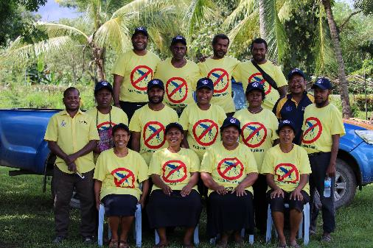
PNG - MALARIA LLIN PROGRAMME
CHASING MALARIA
TRAINING ELEMENTARY TEACHERS IN KURIVA CENTRAL PROVINCE IN APRIL 2019
April 2019 - 13 teachers trained in testing and treating malaria.
Teachers came from six schools plus one village volunteer trained at Kuriva Primary School.
Teachers now all testing and treating malaria

Slide 47
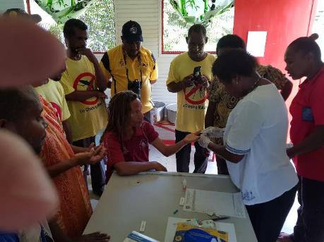
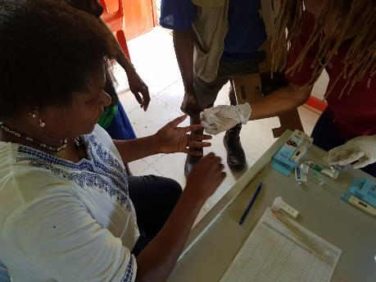
PNG - MALARIA LLIN PROGRAMME
CHASING MALARIA
TRAINING ELEMENTARY TEACHERS IN KURIVA CENTRAL PROVINCE IN APRIL 2019

Slide 48
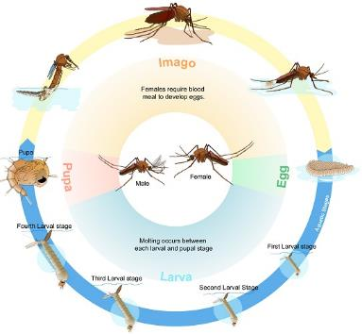
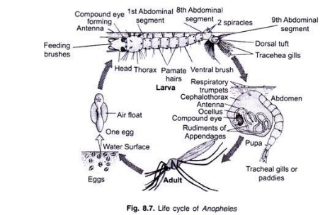
PNG - MALARIA LLIN PROGRAMME
CHASING MALARIA
SCHOOL EDUCATION POSTERS
This is an area we need to develop as poster come from the internet only

Slide 49
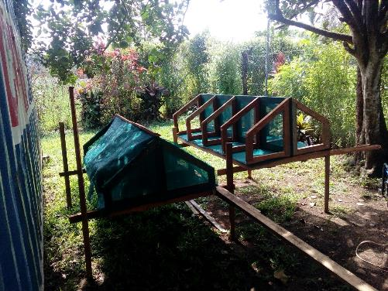
PNG - MALARIA LLIN PROGRAMME
CHASING MALARIA
LARVAE HOUSES
Four compartments built to represent North, East South And West for children to put collected larvae

Slide 50
PNG - MALARIA LLIN PROGRAMME
CHASING MALARIA
Community Involvement
RAM has been working since 2018 with communities in the Kairuku area of Central Province where malaria is considered very bad, particularly in the Waima area.
Working closely with four health centres.
Presently working with 11 schools and many communities to encourage looking for breeding sites of malaria on a weekly basis.
School teachers and children are educated in malaria and asked to form school clubs which should look for larvae on a weekly basis.

Slide 51
PNG - MALARIA LLIN PROGRAMME
CHASING MALARIA
Community Involvement
Ensuring that all health centres are recording malaria on a regular basis.
We work with schools and communities trying to destroy breeding sites through filling in puddles of water, larviciding, covering water places, fish.
Also set up barrier of old mosquito nets to see if this would stop malaria.

Slide 52
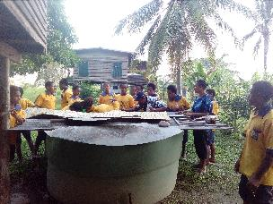
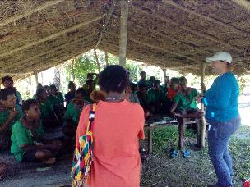
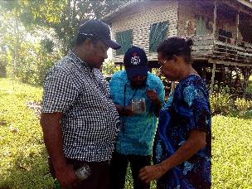
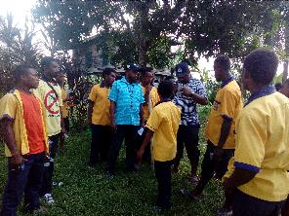
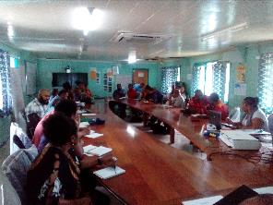
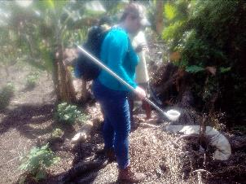
PNG - MALARIA LLIN PROGRAMME
CHASING MALARIA
School And Community Involvement

Slide 53
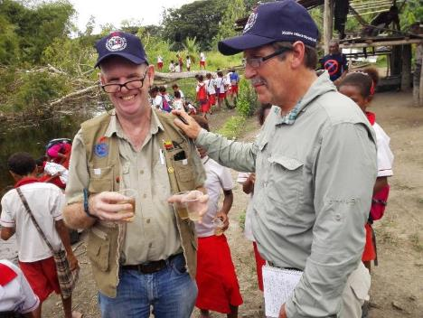
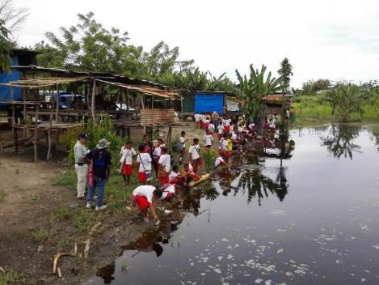
PNG - MALARIA LLIN PROGRAMME
CHASING MALARIA
Community Involvement

Slide 54
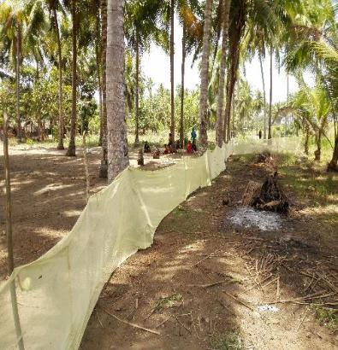
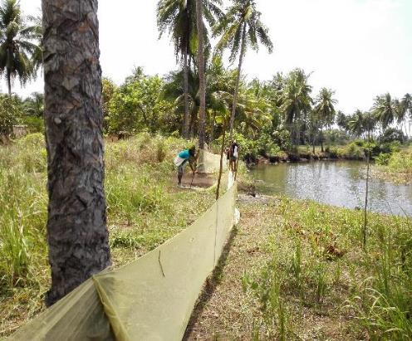
PNG - MALARIA LLIN PROGRAMME
OTHER ACTIVITIES
Intervention Failure
Net barrier had no measurable impact on malaria and was continually destroyed by pigs

Slide 55
PNG - MALARIA LLIN PROGRAMME
FUTURE
RAM will continue to work in Waima but will now concentrate on Kuriva.
However ownership remains a big problem – communities happy to work when RAM staff are present and but do nothing when RAM staff are away. In this respect trying to identify any strong local groups (e.g. Church or women’s groups) working in the area with whom RAM Chasing Malaria Team can overcome this problem.
However, it is good to report that teachers are now testing and treating malaria on a regular basis in schools.

Slide 56
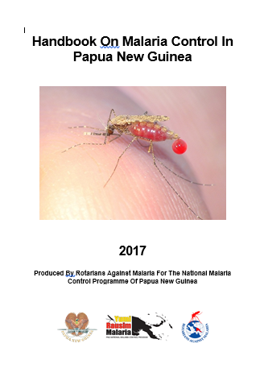
PNG - MALARIA LLIN PROGRAMME
CHASING MALARIA
Manual On Malaria Control
RAM has printed a practical guide to malaria control at national and community level.
5000 copies in A5 size to be distributed to all health centres and schools in the country.
Written by RAM in collaboration with WHO staff and NDoH.

Slide 57
PNG - MALARIA LLIN PROGRAMME
CHASING MALARIA
Private Sector Sale Of Nets
RAM had engaged a salesman in 2014 and 2015 to sell nets around Port Moresby.
Revenue from his sales supported his salary.
Salesman left and as nets in supply chain were few this project was abandoned.
It is hoped that this will now be resurrected. We would like to have a target of LLINs being sold in every district capital in PNG so that people can replace their nets when they wear out early.

Slide 58
PNG - MALARIA LLIN PROGRAMME
2020
LLIN
Nets Distribution In Highlands and Morobe
Health Centre Supervision
Supply all malaria drugs to PNG for 2020
Visit all accessible health facilities on a quarterly basis and try and reach the unreachable at least once a year.
Continue with drug distribution and improving diagnosis, treatment and NHIS.
NDOH and IMR
TES by NDoH
Household Survey and Entomology

Slide 59
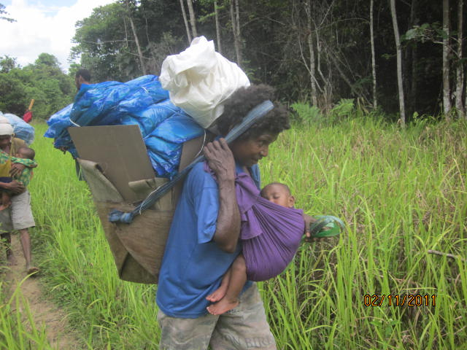
PNG - MALARIA LLIN PROGRAMME
Next Steps (3)
Initial Data From Chasing Malaria Project Showing Malaria Cases Recorded In NCD and Hiri and Kairuku District Of Central Province
The Realities Of Distributing Nets In PMG

Slide 60

RAM TEAM
2019
PNG - MALARIA LLIN PROGRAMME

Slide 61

Thank You Very Much
Tenk Yu Tru
Tanikiu Bada Herea
PNG - MALARIA LLIN PROGRAMME

