Slide 1
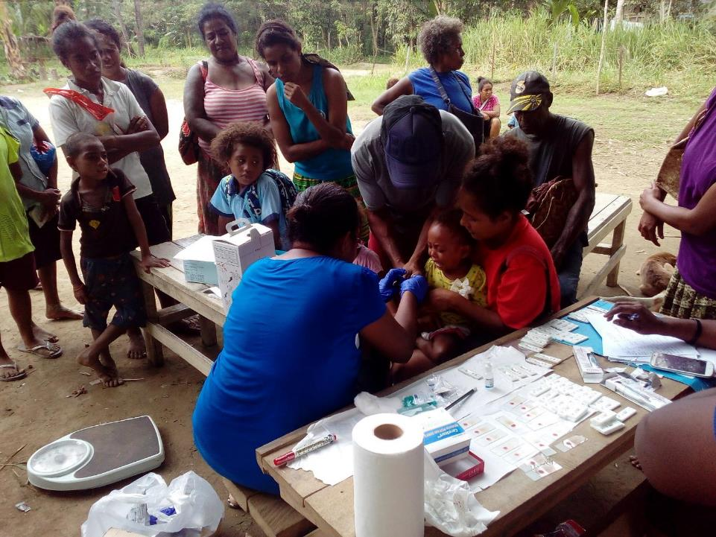


ROTARIANS AGAINST MALARIA
PAPUA NEW GUINEA
Community Based Malaria Control Program
Lessons From PNG
RAM Meeting Melbourne
24 August 2019
Tim Freeman

Slide 2

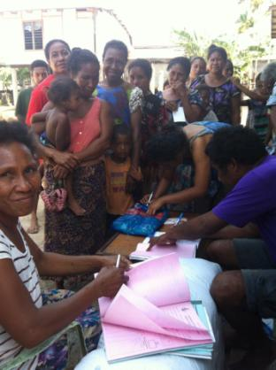
PNG – MALARIA PROGRAMME
PRESENTATION PURPOSE
Can the Papua New Guinea Chasing Malaria Project be replicated in other RAM Partner Countries.

Slide 3
PNG – MALARIA PROGRAMME
CHASING MALARIA
Ingredients For Community Malaria Control Program
You need to have levels of malaria to which the community feels that there is a problem.
No or little malaria or mosquitoes – little likelihood of community by in.
Best to identify hot spots of malaria. This can be done in three ways:
  National Health Information System
  School prevalence surveys
  Active surveillance using nets.

Slide 4
PNG - MALARIA LLIN PROGRAMME
CHASING MALARIA
Using Long Lasting Insecticidal Nets (LLINs) To Locate Malaria Hotspots.
LLINs Given Out For Positive Cases Of Malaria In Health Centres In Central, NCD and Gulf Provinces
Locations of all cases recorded and put into data base.
This data is mapped.
Table below shows nets given out in PNG for this purpose in the last few years.

Slide 5
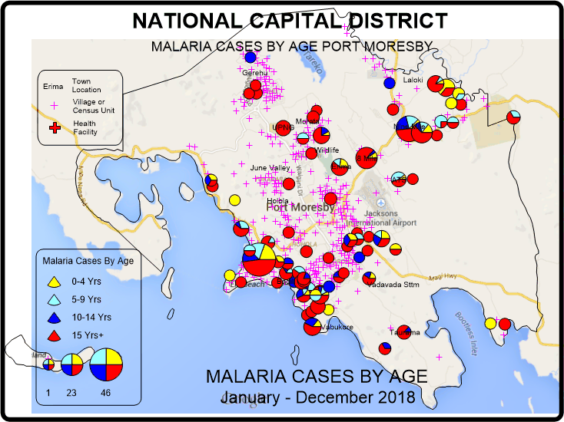
PNG - MALARIA LLIN PROGRAMME
CHASING MALARIA
MAPPING IN NCD
This map shows malaria cases in children in NCD. This suggests that malaria is still being transmitted in Kaugere.

Slide 6
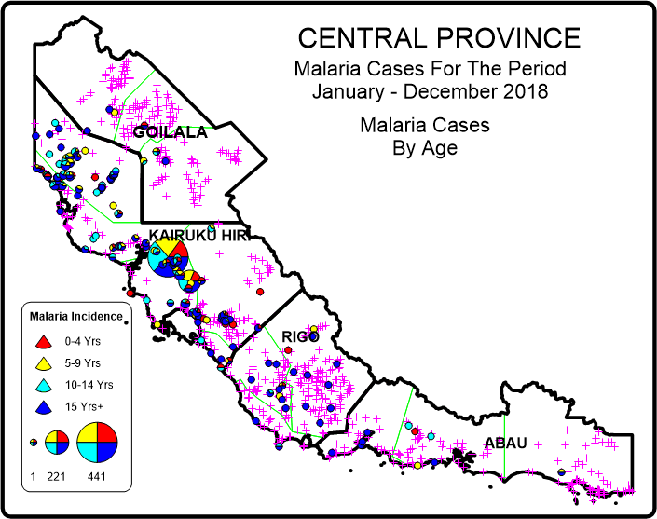
PNG - MALARIA LLIN PROGRAMME
CHASING MALARIA
MAPPING IN CENTRAL PROVINCE
Based on this map, Chasing Malaria has concentrated its activities in the Waima and Bereina areas of Kairuku

Slide 7
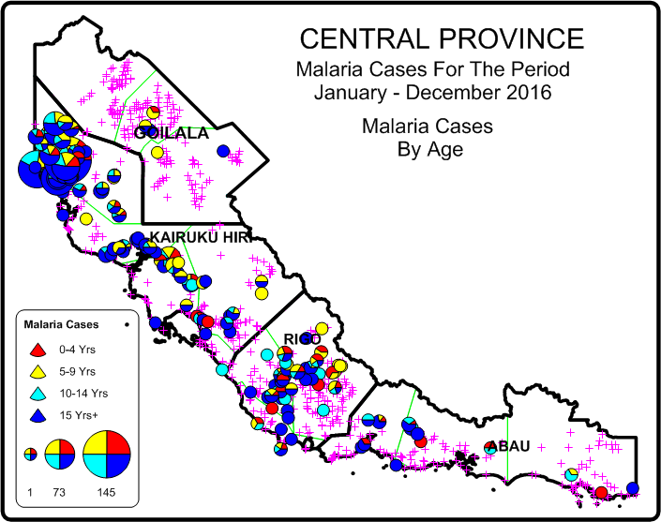
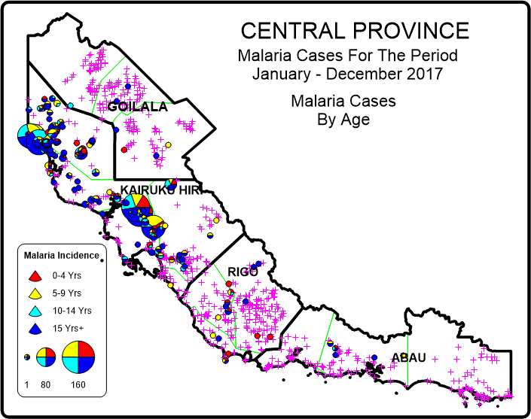
PNG - MALARIA LLIN PROGRAMME
CHASING MALARIA
MAPPING IN CENTRAL PROVINCE
Based on this map, Chasing Malaria has concentrated its activities in the Waima and Bereina and then Kuriva areas of Kairuku

Slide 8
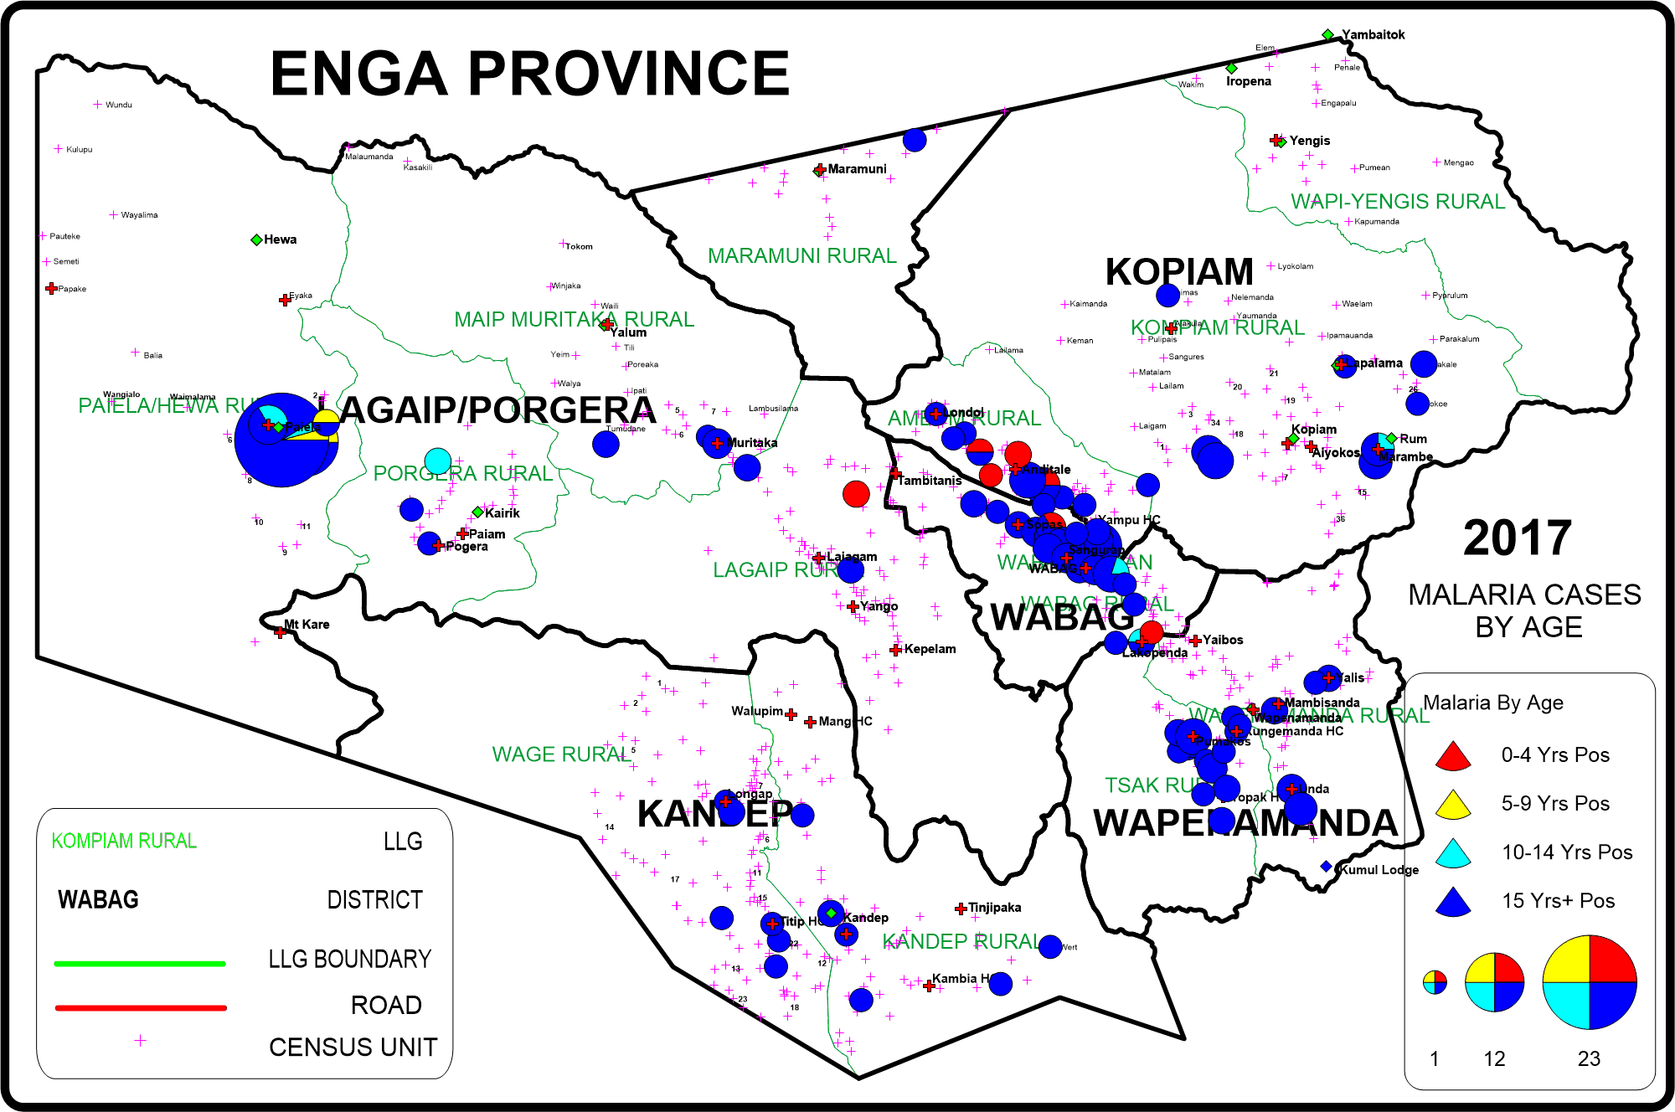
PNG - MALARIA LLIN PROGRAMME
CHASING MALARIA
MAPPING IN ENGA FROM ENHIS

Slide 9
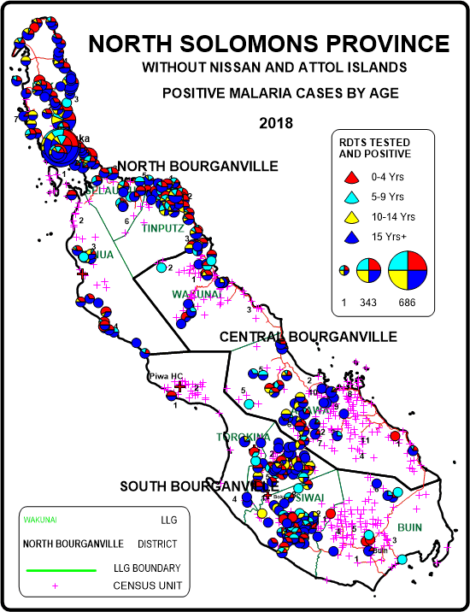
PNG - MALARIA LLIN PROGRAMME
CHASING MALARIA
MAPPING IN BOUGAINVILLE FROM ENHIS

Slide 10
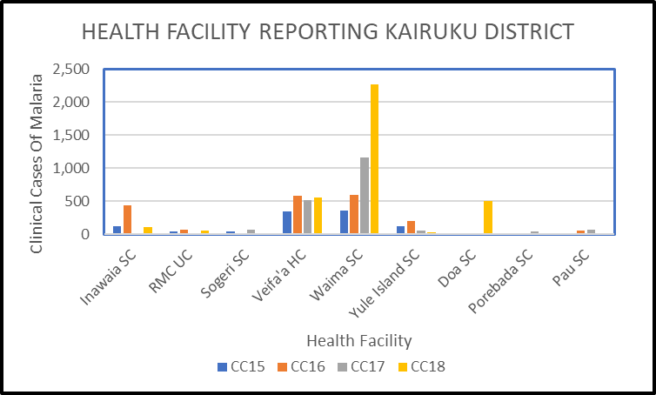
PNG – MALARIA PROGRAMME
RAM PROGRAMME
Ingredients For Community Malaria Control Program – Checking Local Data

Slide 11
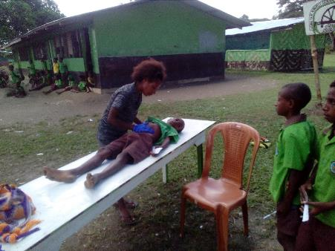
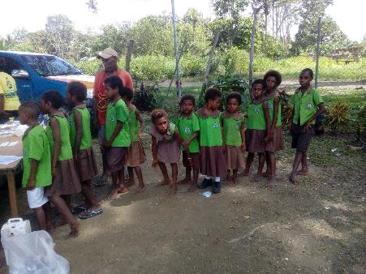
PNG - MALARIA LLIN PROGRAMME
CHASING MALARIA
SCHOOL PREVALENCE SURVEYS
School Prevalence Survey In Brown River

Slide 12
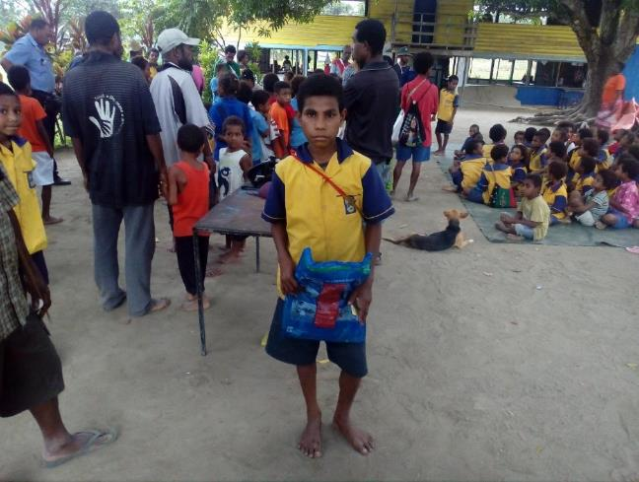
PNG - MALARIA PROGRAMME
CHASING MALARIA
Nets were given to RDT Positive Cases through the Chasing Malaria Programme

Slide 13
PNG - MALARIA LLIN PROGRAMME
WORLD MALARIA DAY
PREVALENCE SURVEYS
School Prevalence Surveys Initiated On
World Malaria Day in Kuriva in 2018 Central Province showed very high prevalence rates

Slide 14
PNG - MALARIA LLIN PROGRAMME
ELEMENTARY SCHOOL
PREVALENCE SURVEYS
School Prevalence Surveys Now carried out throughout PNG in Elementary Schools.
Results have shown very high prevalence rates in many parts of the country.
The area big differences between provinces but also within the same province.
Results from Central Province at least show reductions of malaria from 2018.

Slide 15
PNG – MALARIA PROGRAMME
CHASING MALARIA
Once areas of high incidence or prevalence are identified, it is then important to hold consultations with local leadership at provincial, district, health centre, school and village level. This is to ascertain the following:
  Is malaria in the areas identified considered to be a malaria problem at all levels
  Is there a political willingness to be involved at all levels
  Is there any social cohesion at community level i.e. clear community leadership or strong community based organisations?

Slide 16
PNG – MALARIA PROGRAMME
RAM PROGRAMME
Ingredients For Community Malaria Control Program
You need to have levels of malaria to which the community feels that there is a problem.
No or little malaria or mosquitoes – little likelihood of community by in.
Greatest danger is that communities will not fully participate when project is not there.

Slide 17
PNG – MALARIA PROGRAMME
RAM PROGRAMME
Ingredients For Community Malaria Control Program
Challenge is buy in?
Issues that can help – research on mosquitoes, biting times, usage of nets can all help focus community on issues.
Do they have strong leaders and or local Community Groups such as Church or women's group.

Slide 18
PNG – MALARIA PROGRAMME
RAM PROGRAMME
Ingredients For Community Malaria Control Program
Possible Activities
Health education at all levels
School and community surveys
School clubs or village clubs where leadership is found to destroy breeding sites.
Ensuring that the local health centre reports all cases of malaria and that all cases are treated correctly.

Slide 19
PNG – MALARIA PROGRAMME
RAM PROGRAMME
Ingredients For Community Malaria Control Program
EDUCATION MESSAGES
Sleep under bednets every night – can local leaders assist in this.
Use nets all night – don’t leave them in cupboards – hang them up on the walls when not used, cover windows and doors, make old nets into sarongs, hand around your shoulders when sitting outside.
Destroy mosquito breeding sites
If sick, seek early treatment!!

Slide 20
PNG – MALARIA PROGRAMME
RAM PROGRAMME
Ingredients For Community Malaria Control Program – Checking Local Data
Spending a lot of time with the community at first and then weaning them off for longer and longer period.
Activities include – school clubs – looking for breeding sites weekly.
In remote areas train volunteers and teachers in testing and treatment of malaria
Be involved with National Program and World Malaria Day

Slide 21
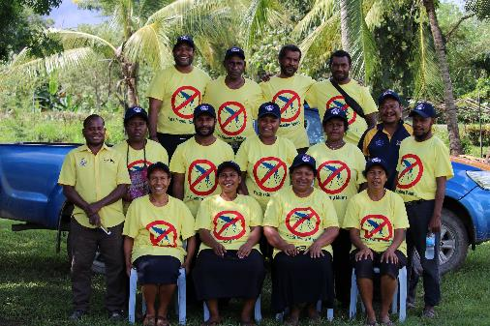
PNG - MALARIA LLIN PROGRAMME
CHASING MALARIA
TRAINING ELEMENTARY TEACHERS IN KURIVA CENTRAL PROVINCE IN APRIL 2019
April 2019 - 13 teachers trained in testing and treating malaria.
Teachers came from six schools plus one village volunteer trained at Kuriva Primary School.
Teachers now all testing and treating malaria

Slide 22
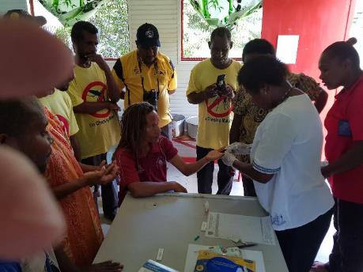
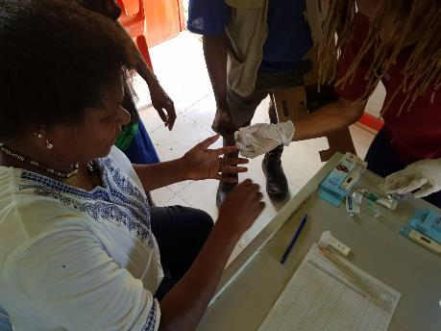
PNG - MALARIA LLIN PROGRAMME
CHASING MALARIA
TRAINING ELEMENTARY TEACHERS IN KURIVA CENTRAL PROVINCE IN APRIL 2019

Slide 23
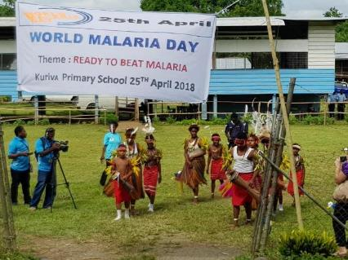
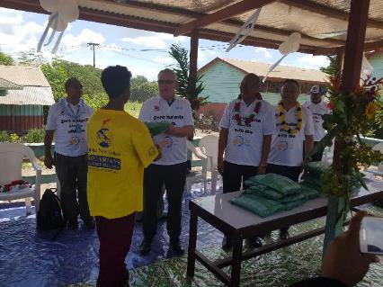
PNG - MALARIA PROGRAMME
WORLD MALRIA DAY
Working now in collaboration with WHO, NDoH Malaria Programme, CPHL and Central Province PHA
World Malaria Day 2018 Kuriva Central Province
World Malaria Day 2019 – NCD – Ron Seddon (Chairman of RAM together with Minister of Health giving prizes)

Slide 24
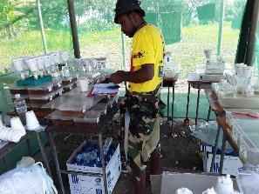
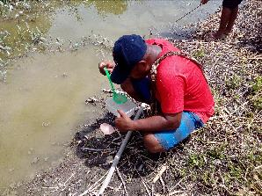
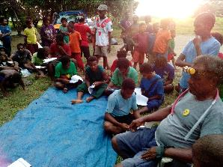
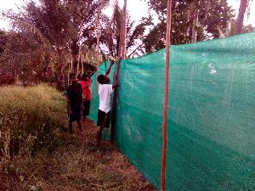
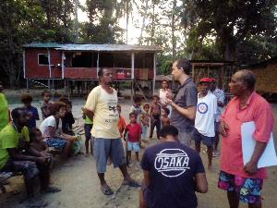
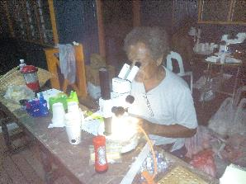
PNG - MALARIA LLIN PROGRAMME
CHASING MALARIA
RESEARCH BY INSTITUTE OF MEDICAL RESEARCH (IMR)
To try and understand malaria in the area, the IMR was invited to come to Kuriva in Central Province in November 2018

Slide 25
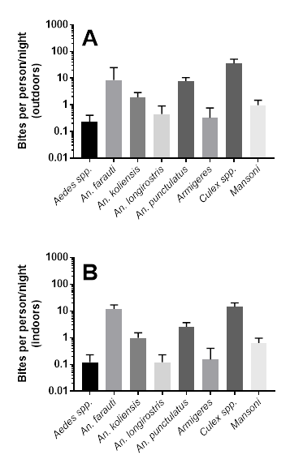
PNG - MALARIA LLIN PROGRAMME
IMR RESEARCH
Findings
Many species of anophelines biting both inside and outside

Slide 26
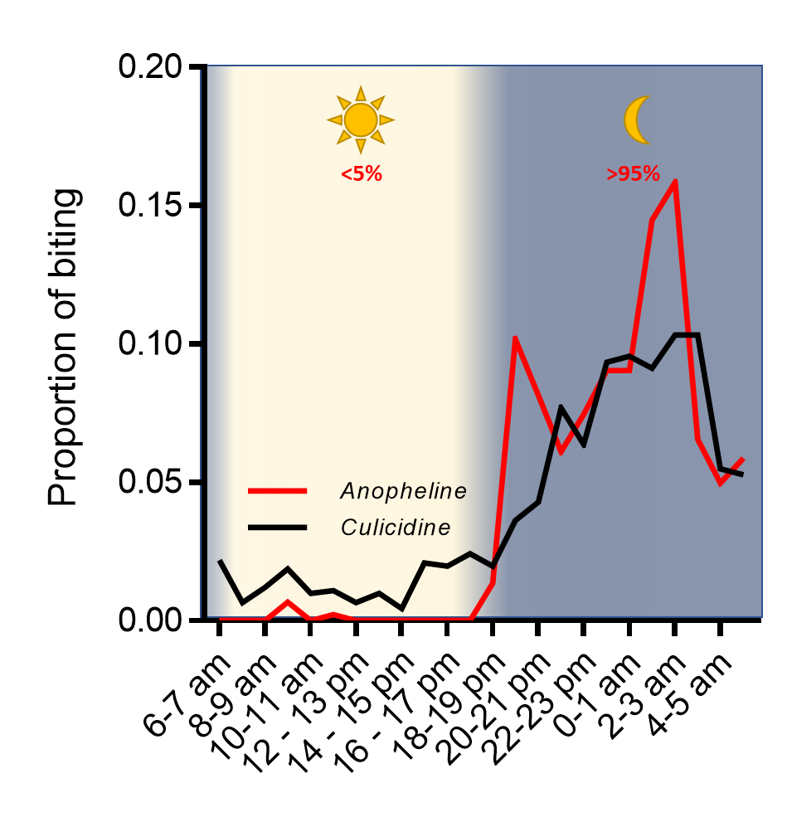
PNG - MALARIA LLIN PROGRAMME
IMR RESEARCH
Findings
Much biting at early hours of the evening and only at night

Slide 27
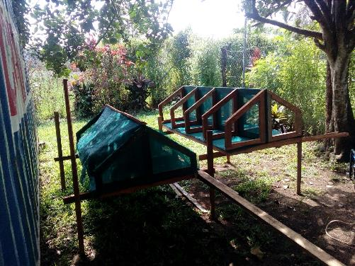
PNG - MALARIA LLIN PROGRAMME
CHASING MALARIA
LARVAE HOUSES
Four compartments built to represent North, East South And West for children to put collected larvae

Slide 28
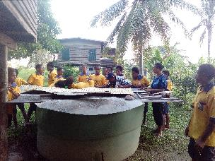
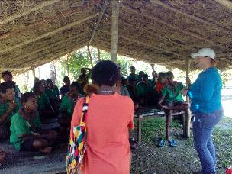
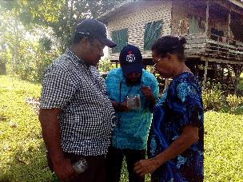
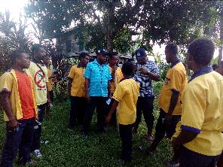
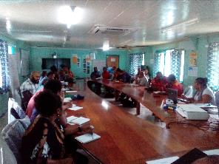
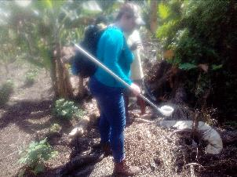
PNG - MALARIA LLIN PROGRAMME
CHASING MALARIA
School And Community Involvement

Slide 29
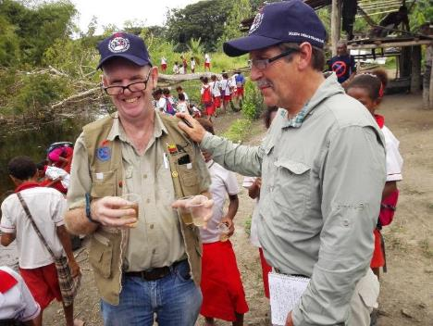
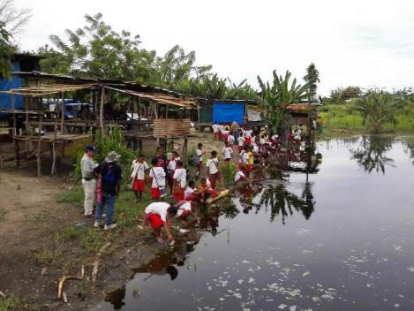
PNG - MALARIA LLIN PROGRAMME
CHASING MALARIA
Community Involvement

Slide 30
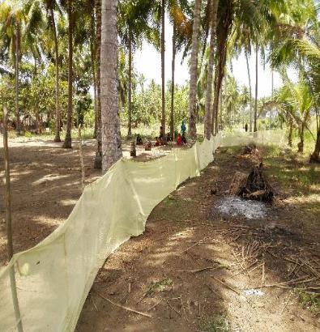
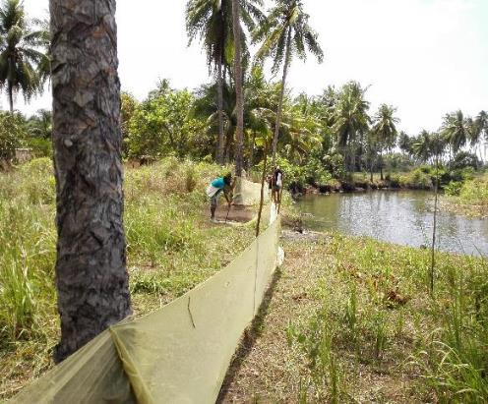
PNG - MALARIA LLIN PROGRAMME
OTHER ACTIVITIES
Intervention Failure
Net barrier had no measurable impact on malaria and was continually destroyed by pigs

Slide 31
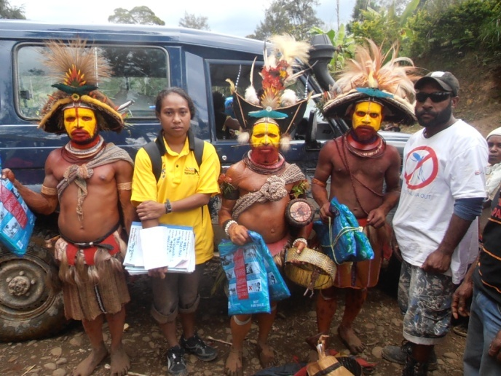
Thank You Very Much
Tenk Yu Tru
Tanikiu Bada Herea
PNG - MALARIA LLIN PROGRAMME

