Slide 1
Preventing malaria in pregnancy – with a focus on PNG
Prof Stephen Rogerson
Department of Medicine at the Doherty Institute,
University of Melbourne

Slide 2
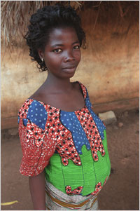
Burden of malaria in pregnancy
>100 million women at risk
Worst in first pregnancies
10,000 maternal anaemia deaths
1-200,000 infant deaths from LBW due to malaria
Leading preventable cause of LBW in Africa

Slide 3
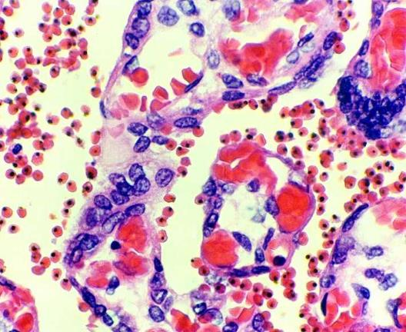
Placental malaria and pregnant women’s susceptibility to malaria
P. falciparum can sequester in the maternal blood space of the placenta
Parasite protein VAR2CSA binds to placental receptor
Women in first pregnancy lack immunity to VAR2CSA
Parity-specific antibody may control infection
Vaccine in development

Slide 4
WHO’s three pronged approach to malaria in pregnancy
Prompt diagnosis and treatment with effective drugs (ACT, quinine)
Intermittent preventive treatment in areas of stable malaria transmission in Africa
Long-lasting insecticidal bed nets

Slide 5
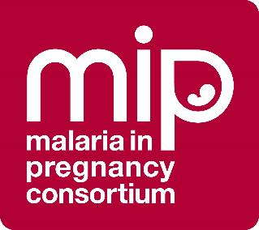
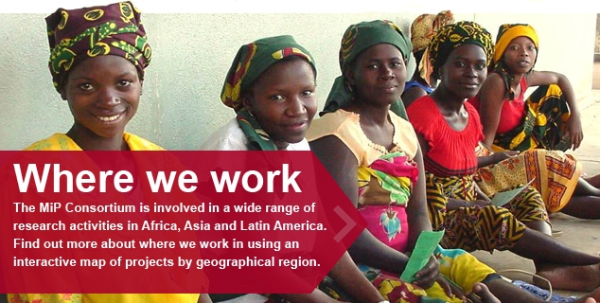

Slide 6
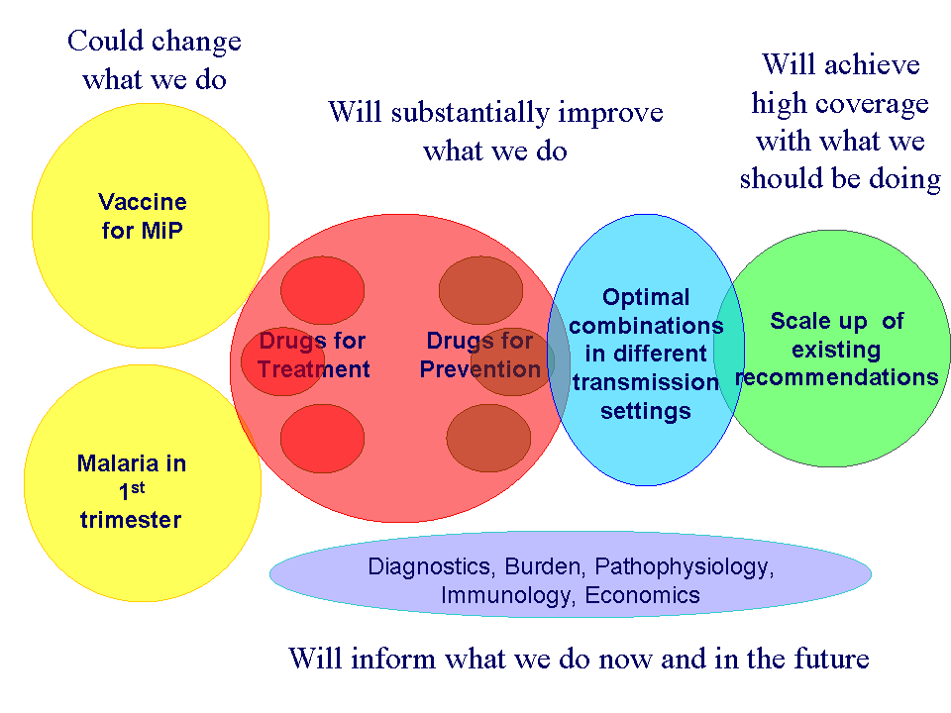

Slide 7
Treating malaria in pregnancy
Severe disease: IV/IM artesunate (or quinine): saving mother’s life
Uncomplicated disease: depends on trimester.
First: quinine & clindamycin or artemether lumefantrine (Coartem); chloroquine (vivax).
Second & third: artemisinin combination treatments: Coartem, dihydroartemisinin piperaquine, artesunate-mefloquine, artesunate-amodiaquine

Slide 8
Prevention: Intermittent preventive treatment in pregnancy (IPTp)
The delivery of a treatment dose of an antimalarial at pre-specified times, regardless of the presence of symptoms or infection
WHO policy for Africa: Three or more doses of appropriate drug, at least a month apart, after quickening
≥4 ANC visits recommended
Ideal drug combines clearance with prophylaxis
Presently SP is the only proven safe effective drug.
Dihydroartemisinin piperaquine promising alternative

Slide 9
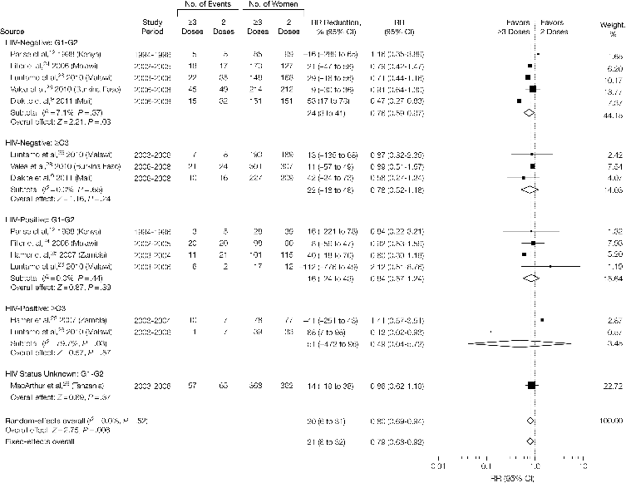
Efficacy of SP IPTp for LBW
Three + SP doses better than two
Irrespective of HIV status and gravidity

Slide 10

…but SP resistance is common in East Africa

Slide 11
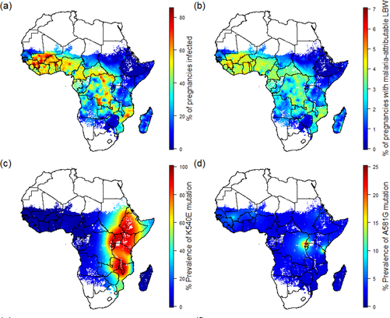
Malaria infection in pregnancy and SP resistance in Africa
Walker PGT et al 2017.PLOS Medicine 14(2)

Slide 12
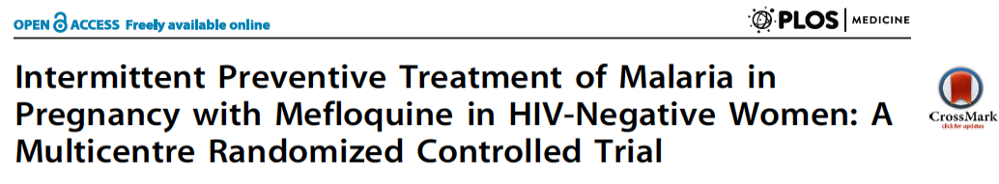
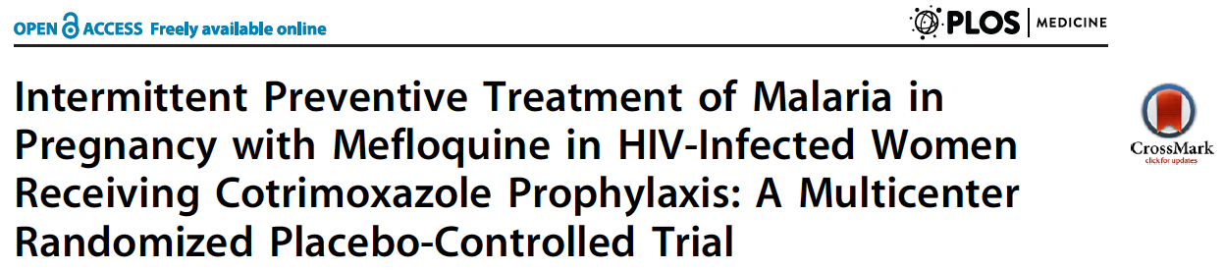
Alternatives to SP: mefloquine?
Gonzalez et al PLoS Medicine 2014 11(9): e1001735, e1001733
Decrease in parasitaemia and (HIV-) anaemia
No effect on pregnancy outcomes, poor tolerability
In HIV+ possible association with MTCT.
No indication to change current policy

Slide 13
Alternatives to SP: chloroquine and azithromycin
In parts of Africa, chloroquine sensitivity has returned.
Azithromycin increases effectiveness, and may treat STIs etc
Multicentre study. 2891 of 4500 enrolled
Stopped early: preplanned analysis showed no benefit over SP for pregnancy outcomes.
No benefit, not well tolerated (vomiting, dizziness, weakness)

Slide 14
Alternatives to SP: dihydroartemisinin-piperaquine
Three relatively small studies
All show decrease in placental and/or maternal malaria
None show benefit for birth outcomes such as LBW, preterm birth, growth restriction
IMPROVE study in Malawi, Kenya and Tanzania recruiting 4800 women to SP, DP or DP plus azithromycin
Results available next year.

Slide 15
Lancet Infectious Diseases 2019
Used dihydroartemisinin-piperaquine
Single dose at booking; screening at monthly intervals; or monthly IPTp
At delivery malaria prevalence was reduced by 40% in the IPTp arm vs single dose
Pregnancy outcomes were not different.

Slide 16
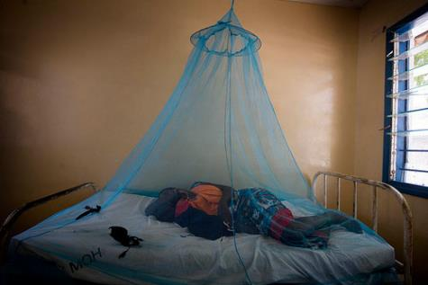
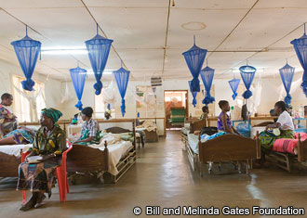
Long lasting insecticidal nets
In African studies:
Increase birth weight 55g
Decrease LBW 23%
Decrease miscarriages and stillbirths 33%
Decrease placental malaria 23%
Effect on anaemia in Asia (1 trial) but not Africa

Slide 17
ITN coverage, pregnant women, Africa, 2000-2014
In 2017 61% of pregnant women slept under an ITN
Summarized 114 surveys 2000-2014, median 2.5, range 0-6, per country
Total number of estimated births in 45 countries with an ITN policy: 26.6 million in 2000, 34 million in 2014

Slide 18
IPTp coverage in Africa, 2003-2014
In 2017, 54% of pregnant women received 1 IPTp dose, 42% received 2 doses and 22% received 3 doses of IPTp
Summarized: 79 surveys 2003-2014, median 2, range 1-5, surveys per country
Total number of estimated births in 37 countries with an IPTp policy: 2003: 25.5 million; 2014: 31 million

Slide 19
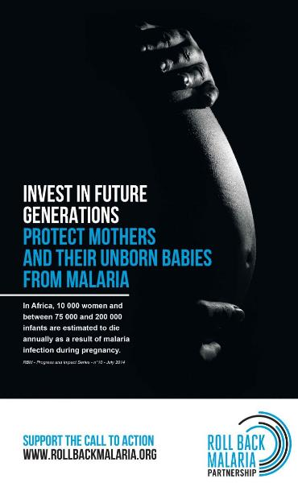
Improving coverage with IPTp
Of 35 M pregnant women in sub-Saharan Africa 15 M did not receive any IPTp in 2013.
200,000 excess neonatal deaths 2009- 2012.
Better dialogue between MCP and RCH programs

Slide 20
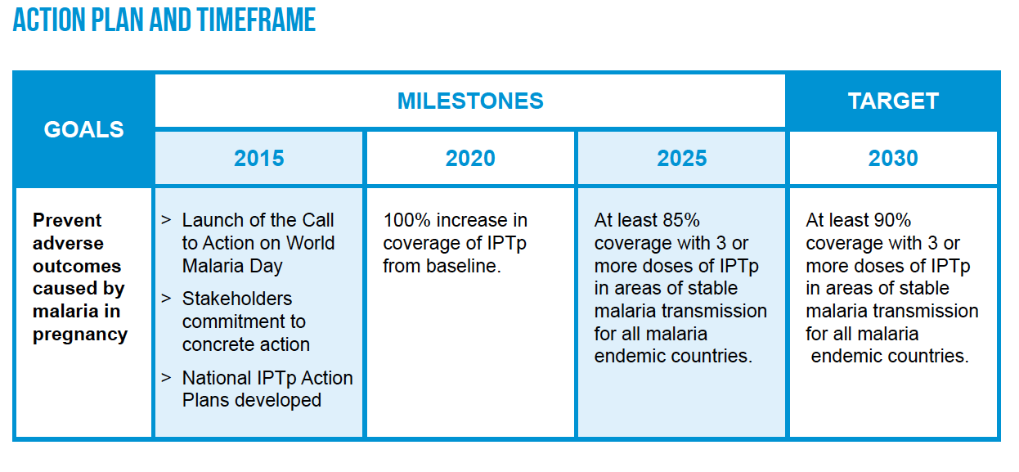

Slide 21
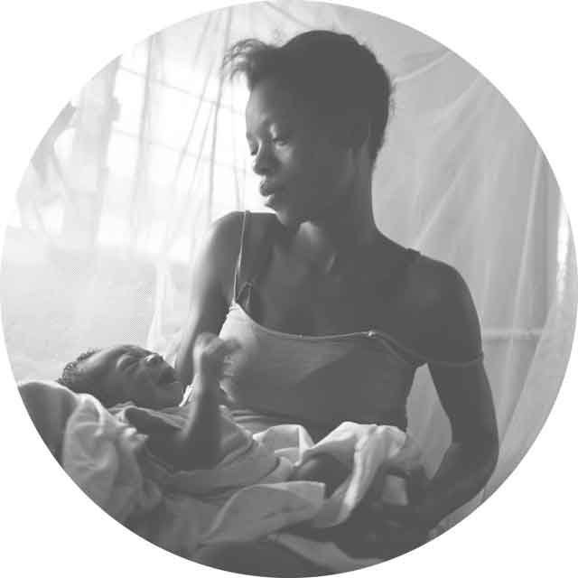
Community based scale up of IPTP: TIPTOP
Transforming Intermittent Preventive Treatment for Optimal Pregnancy (TIPTOP)
Community-based approach to increase uptake of IPTp in sub-Saharan Africa
Focus on DRC, Nigeria, Mozambique and Madagascar
Partnership between Jhpiego, ISGlobal, Medicines for Malaria Venture, World Health Organization, funded by UNITAID

Slide 22
How can we better engage communities to increase IPTp and ITN coverage?

Slide 23
Preventing malaria in pregnancy and improving birth outcomes in PNG

Slide 24

SP + azithromycin in PNG
Additive effects on malaria
AZ also effective against chlamydia, gonorrhoea, syphilis
Both have antibiotic effects
Decreased PTD by 30% in Malawi
“Packaged” intervention
Funded through the Malaria in Pregnancy Consortium
Recruited from 2009-2012

Slide 25
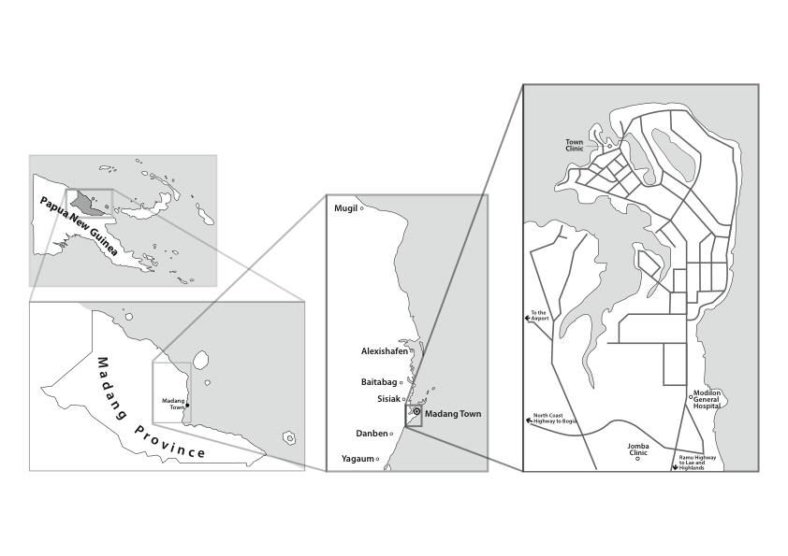
Madang Province and Madang town

Slide 26
Banisim Bel Mama long Malaria
Screening and recruitment
<27 weeks
No twins
Healthy
In study area
IPTp
control
intervention
SP+CQ
SP+AZI
Azithromycin 1 g
twice daily
for two days
enrollment
Placebo
SP+AZI
2nd visit
Safety monitoring
Placebo
SP+AZI
3rd visit
Delivery
2793 women recruited
2021 with birth outcome
Notes:
1391 and 1402 pregnant women below 27 weeks gestational age were randomised to control and intervention arms after careful screening. Women were blinded to treatment, and ITN were provided at enrollment when available. In the control arm women received S/P and CQ at enrollment and placebo at subsequent monthly visits. The control arm was designed to match the PNG protocol for prevention of malaria in pregnancy in place at the time of trial implementation. Women assigned to the intervention arm received 3 monthly doses of S/P+AZI. Women were followed up until delivery and safety monitoring was maintained throughout.

Slide 27
Notes:
Baseline characteristics of women in each arm were very similar. Of note, most 80 % of women were anaemic, only few had syphillis, half were primigravid, about 7% had microscopy-detected malaria at enrollment and two-thirds were residing in rural areas.

Slide 28
Notes:
On crude analysis, female infant gender, primigravidity, maternal undernutrition as assessed by MUAC, maternal height <150cm, the mother not having highlander parentage and the mother not having an income generating husband were associated with increased odds of delivering a LBW baby, amongst others

Slide 29
Side effects differed little between treatments
Notes:
Adverse events were analysed for all women who received a minimum of one treatment, and was assessed by actual treatment received.
Overall, the number of adverse events was similar between groups. None of the SEVERE adverse events, whether maternal or neonatal, were judged drug related. The number of drug-related adverse events were also similar between groups.

Slide 30
Decreased malaria but not anaemia at delivery
Outcome | Control |  | Intervention |  | Risk ratio (95% CI) | P
Peripheral blood, by LM | 40/1016 | (3·9) | 23/1018 | (2·3) | 0·57 (0·35 – 0·95) | 0·03
Placental blood, by LM | 29/843 | (3·4) | 15/837 | (1·8) | 0·52 (0·28 – 0·97) | 0·03
Placental histology, all stages | 148/733 | (20·2) | 127/732 | (17·4) | 0·86 (0·69 – 1·06) | 0·16
Placental histology, acute & chronic infection | 65/733 | (8·9) | 44/732 | (6·0) | 0·68 (0·47 – 0·98) | 0·04
Anaemia (Hb <11 g/dL) | 686/931 | (73·7) | 697/929 | (75·0) | 1·02 (0·97 – 1·07) | 0·51
Hb, mean ± SD, g/dL | 10·1 | (1·7) | 10·0 | (1·7) | - | 0·66

Slide 31
ARR: 4.4%, 95% CI 1.2, 7.5, NNT 22. PTB OR 0.62 (0.43-0.89)
Notes:
Compared to control, S/P+AZI reduced the risk of delivering a LBW infant by 25%, and this was statistically significant. When adjusted for confounders in a multivariable Poisson regression model with robust error variance this observation persisted. Women who received the intervention also had a higher mean birthweight in both crude – 42.7g, and adjusted analyses52.7g.

Slide 32
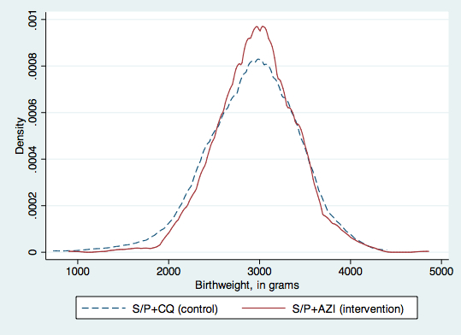
Distribution of birth weights by treatment arm
Notes:
When birthweights are charted by treatment arm using a kernel density plot a similar picture emerges. Here, the area under the curve represents the probability of having a specific birthweight value between a range of birthweight values. Of note, there is a lower probability of having a baby born with birthweights of 1500-2500 gs, and babies in the intervention are not becoming macrosomic.

Slide 33
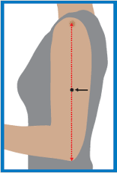
Undernutrition and pregnancy outcomes in PNG IPTp study
Both associated with poverty, common in LMICs
Seasonality- “wet” season = “hungry” season
Malaria affects placental nutrient transport
Does malaria worsen nutrition?
Can we target women for combined interventions?
MUAC <23 cm (28%)
BMI <19.8 kg/m² (12%)
GWG <226 g/wk (25%)

Slide 34
Gestational weight gain
Major predictor of birth outcomes
Documented in ~1/2 study participants
IOM recommends weight gain of 350-500 g/wk
One quarter of study participants had GWG<226 g/wk
 | <226 g/wk | ≥226 g/wk | aRR or MD (CI) | P
Bwt | 2874 (2795, 2952) | 2994 (2953, 3034) | -88 (-173, -3) | 0.043
LBW | 21.2 (48/226) | 11.8 (81/689) | 1.63 (1.19, 2.23) | 0.002
PTD | 9.3 (21/226) | 6.1 (42/689) | 1.38 (0.83, 2.28) | 0.22
Unger HW et al, Matern Child Nutr. 2016 Oct;12(4):699-712.

Slide 35
MUAC and outcomes
 | <23 cm | ≥23 cm | aRR or MD (CI) | P
Bwt | 2833 (2794, 2873) | 2983 (2958, 3008) | -111 (-157, -65) | <0.001
LBW | 20.5 (111/541) | 12.9 (182/1,406) | 1.46 (1.18, 1.80) | <0.001
PTD | 12.6 (45/357) | 7.1 (65/919) | 1.75 (1.21, 2.52) | 0.003
BMI and outcomes
 | < 19.8 kg/m² | ≥19.8 kg/m² | aRR or MD (CI) | P
Bwt | 2819 (2760, 2879) | 2957 (2934, 2980) | -139 (-204, -74) | <0.001
LBW | 20.5 (45/220) | 14.4 (248/1727) | 1.41 (1.07, 1.86) | 0.014
PTD | 12.9 (20/155) | 8.0 (90/1,121) | 1.59 (1.01, 2.50) | 0.043

Slide 36
SPAZ improves maternal and infant nutritional outcomes
Maternal | n | SPCQ | SPAZ | aRR/MD | P
Weight gain | 948 | 364 (341, 387) | 419 (398, 441) | 58 (26, 90) | <0.001
Postnatal BMI | 811 | 21.9 (21.6, 22.2) | 22.3 (21.9, 22.6) | 0.4 (0.0, 0.9) | 0.043
Infant
underweight | 828 | 49 (11.6) | 29 (7.1) | 0.6 (0.4, 0.9) | 0.025
stunted | 788 | 167 (42.2) | 166 (42.4) | 1.0 (0.8, 1.2) | 0.99
wasted | 779 | 33 (8.4) | 13 (3.4) | 0.4 (0.2, 0.7) | 0.003
No Increase in maternal obesity after delivery on SPAZ.

Slide 37
In summary, SPAZ was associated with:
A reduction in LBW and increased mean birthweight
A reduction in preterm delivery
A reduction in malaria at delivery
An increase in mean weekly GWG
A reduction in the proportion of underweight mothers at 1 month
A higher mean maternal MUAC at 1 month
A reduced risk for wasting and underweight in infants.
Question: are these effects due to SP, AZ, or both?

Slide 38
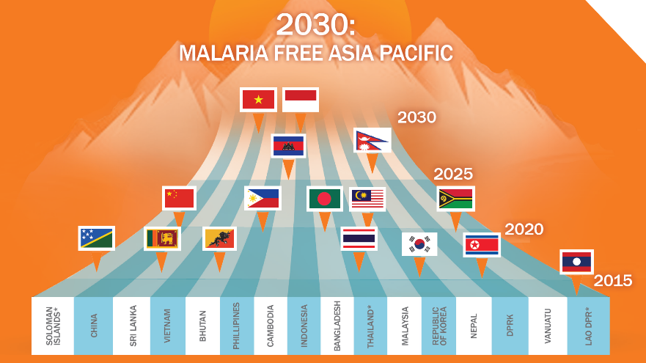
East Asia leaders commit to eliminate malaria from Asia Pacific by 2030
13th November 2014

Slide 39
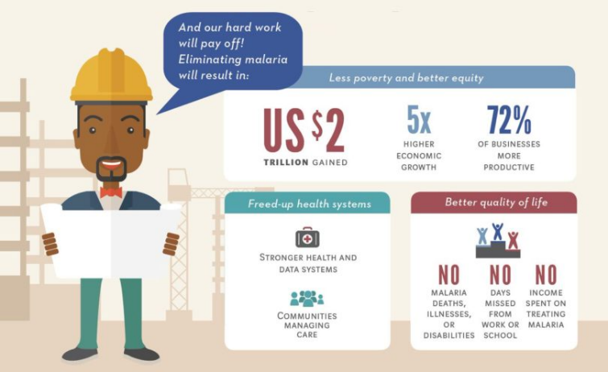
What would be the benefits of malaria elimination?

Slide 40

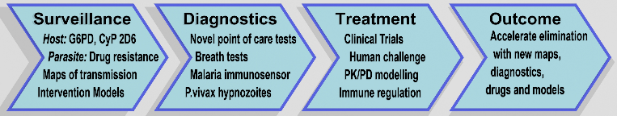
www.acreme.org.au

Slide 41
Points to think about
What is the current ITN coverage amongst pregnant women in PNG?
What is the availability of SP IPTp?
Is there resistance to SP? In falciparum or vivax?
How can coverage with ITNs and IPTp be improved?
What “package” of antenatal interventions would offer most benefit?
What further evidence is needed to optimize care for pregnant women?

Slide 42
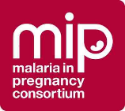

Acknowledgements
Banisim Bel Mama long Malaria
IPTp
University of Melbourne
Holger Unger, Sarah Hanieh, Alex Umbers, Honor Rose, Lisa Lansfield, Wina Hasang, Annjaleen Hansa
PNG IMR, health services Peter Siba, Maria Ome-Kaius, Regina Wangnapi, Celine Aho, Andrew Greenhill, Anna Rosanas-Urgell, Elvin Lufele, all members of study team, local antenatal services, John Bolnga
CRESIB, University of Barcelona
Clara Menendez, Azucena Bardaji, Mireia Piqueras
Liverpool School of Tropical Medicine
Feiko ter Kuile, Jenny Hill
Walter and Eliza Hall Institute
Ivo Mueller, Leanne Robinson, Connie Li Wa Suen, Stephan Karl
Funding
Bill and Melinda Gates Foundation, EU FP7 for funding, Pfizer Inc for azithromycin
Finally… all the study participants

