Slide 1

Reflections on Community engagement in malaria elimination: the why and the how?
Maxine Whittaker
Dean, College of Public Health, Medical and Veterinary Sciences,
Co-Director WHO Collaborating Centre for Vector Borne and Neglected Tropical Diseases
James Cook University, Townsville, Australia
2019 Annual RAM Conference, Melbourne
24 - 25 August 2019

Slide 2
Order of Presentation
Brief introduction to the concept of community engagement.
  Principles for community engagement including those elaborated by the Civil Society for Malaria Elimination.
Lessons learnt on community engagement activities in infectious diseases especially elimination
  Specific examples of community engagement in malaria elimination will explored,
Possibilities of strengthening community involvement in existing Rotary projects in the Asia Pacific region.

Slide 3
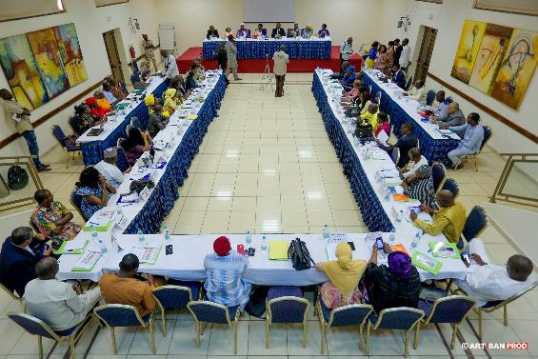
What’s the fuss…….?

Slide 4
The Promise of Community
Participation
‘The rise of community participation is premised on perceived benefits that participation brings to community programs in terms of added efficiency, sustainability and the collective community power.’
Xu 2007
Notes:
Obtaining community enthusiasm and participation in strategies to eliminate malaria in the context of disappearing disease and maintaining it during the pre-elimination and surveillance phases of a program will be significantly more challenging than eliciting participation in an endemic or hyper-endemic context. In a low disease context, health education initiatives that attempt to elicit participation only through increasing malaria knowledge and by encouraging individuals to take responsibility for their own health will be ultimately ineffective. Complementary strategies are therefore required to provide the motivation for communities to participate actively in preventative, curative and screening practices for elimination, particularly where malaria is no longer a perceived risk or social or cultural belief systems hinder participation. Strategies aimed at engaging and motivating communities to participate need to be integrated into the planning, implementation and monitoring and evaluation stages of elimination programs in order to maintain community commitment despite low levels of disease.

Slide 5
Cornerstone of Primary Health Care
COMMMUNITY PARTICIPATION
Enabling environment
Health behaviour
Health services
Community capacity and resources
Notes:
The cornerstone of Primary Health Care is community participation, the popularity of which is premised on the perceived benefits of:
• the creation of an enabling environment for public health interventions;
• health behaviour modification and reasoned action as a by-product of augmented community empowerment and resilience;
• improved efficiency, utilisation and sustainability of health services; and
• the harnessing of community capacity and resources to supplement limited allocations for health care [12].

Slide 6
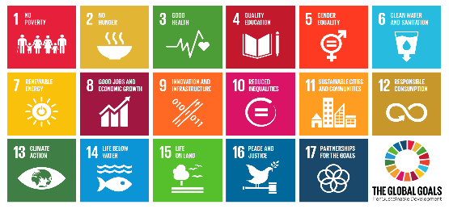

G20 Policy brief : SDGs and Health
“We believe that engaging communities in decision making, planning and implementing programmes and policies that are about their own health and wellbeing can lead to sustainable change"
“Regular dialogue and relationship building between health system actors and service users central to addressing tensions, changing mindsets, and fostering culturally acceptable and respectful health care practices”
Strong evidence that “Effective and inclusive citizen engagement supports positive social outcomes”
Boutilier, Z. 2017 SDGs and health : a vision for public policy G20 policy brief www.G20-insights.org May 19, 2017

Slide 8
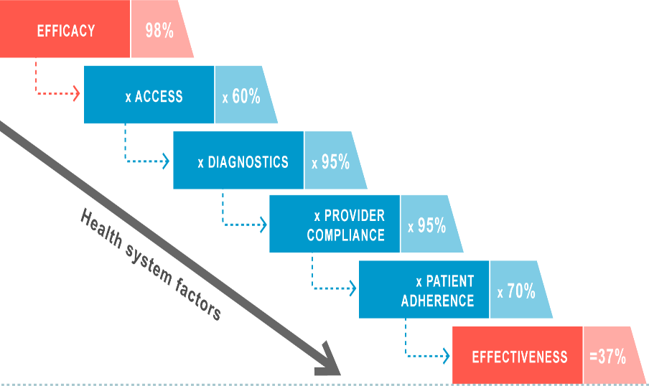
Physical
Cultural
Gender
Affordability
Discrimination
Health beliefs
Community & personal values
Experience
Peer pressure
Role models
Job satisfaction and motivation
Affordability
Empowerment
Comprehension
Health beliefs
Peer pressure
The malERA Refresh Consultative Panel on Health Systems and Policy Research (2017) malERA: An updated research agenda for health systems and policy research in malaria elimination and eradication.

Slide 9
A way forward –
A global civil society movement

Slide 10

CS4ME
2 day Global Malaria Civil Society Strategizing and Advocacy Pre-meeting held in conjunction with, and as part of the 1st World Malaria Congress July 2018 in Melbourne
Provide orientation to civil society partners on the Congress
Facilitate partnership building between CS partners, Congress Organsiers and key stakeholders
Update CS partners of 6th replenishment of GFATM efforts and identify CS efforts to support
Develop a shared vision and roadmap for building a global malaria civil society movement
CS4ME

Slide 11
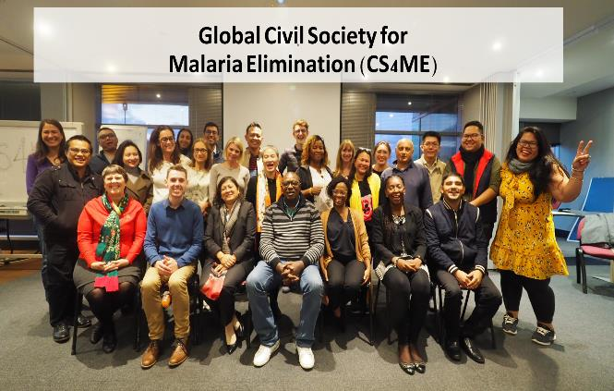
Firm in the belief that empowered community and civil society are game-changers in health responses, we, ​representatives of national, regional and global malaria communities and civil society, have come together and formed the Global Civil Society for Malaria Elimination (CS4ME), ​as part of our commitment to jointly advocate for more effective, sustainable, people-centered, rights-based, equitable, and inclusive malaria programmes​.

Slide 12
CS4ME actions:
Connect civil society organizations and communities affected by/at risk of malaria on a single platform and build & strengthen their capacities and enable South-South collaboration and coordination;
Promote the involvement of local civil society organizations and communities beyond service delivery as actors taking part in decision-making processes, strategy & programme development, monitoring and evaluation, research, to complement and strengthen malaria control/elimination and contribute to Sustainable Development Goals (SDGs);
Champion & secure community-based programmes and reinforce the sense of urgency for malaria elimination;
Advocate for sufficient and sustained resource mobilization for malaria control/elimination and prioritize appropriate allocations for civil society & communities;
Promote universal access to & effective use of existing tools and demand innovative tools & responses that serve the needs of communities and local conditions;
Solicit an effective multisectoral response for malaria elimination with empowered civil society & communities as key stakeholders.

Slide 13
Steering Committee
The Steering Committee constitute the principal decision-making body for the activities of CS4ME and be responsible for giving guidance and strategic directions to the implementation of the work plan and objectives. The committee also reviews the progress of its implementation.
Governance
Members
Membership in CS4ME is open to any representative of civil society or community-based organization with experience in malaria-based programming. Members are active representatives of Civil Society Organizations and actors of change at their different level.
Secretariat
The Secretariat is responsible for planning, coordinating, executing activities, and providing administrative support to CS4ME.
ObserversI
Parties that are not eligible for CS4ME membership may participate as Observers at CS4ME Steering Committee meetings, Working Group meetings, events and other activities, by invitation only. These parties may consist of organizations, companies, government officials, institutions and individuals or other interested parties.
Working groups
Members have the opportunity to join working groups on selected topic and actively contribute to design and implement CS4ME actions, positions, statement, campaigns and other key activities. We have global, regional and countries working groups to advance the fight and ensure greater committees engagement.

Slide 14
Frame malaria responses in the context of social justice and human rights and within equitable universal health coverage systems
Make malaria decision making spaces more inclusive and support malaria civil society mobilisation
Fully meeting the funding needs for malaria responses and for health and community systems strengthening
Partner with civil society and community actor for effective malaria surveillance and response systems

Slide 15
Partners of CS4ME

Slide 16
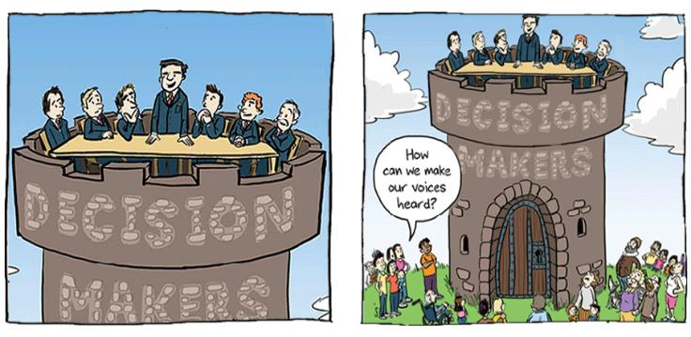
What is community?
What is participation?

Slide 17
Community is…
Location/Place
based
Identity based
Shared History/ culture
Organizational based
Projected

Slide 18

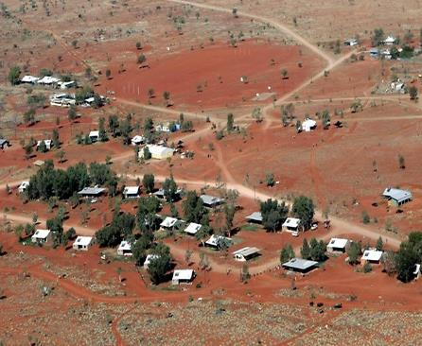

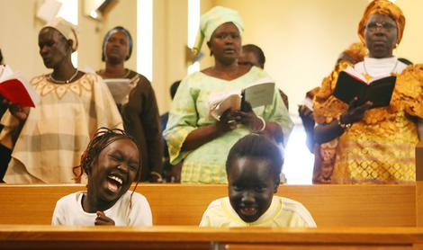

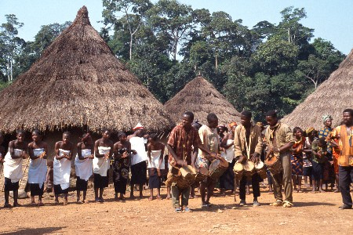
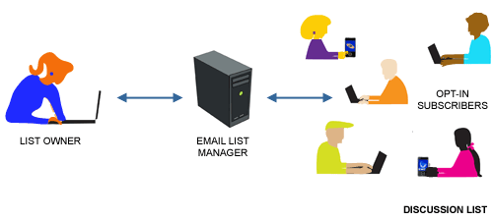
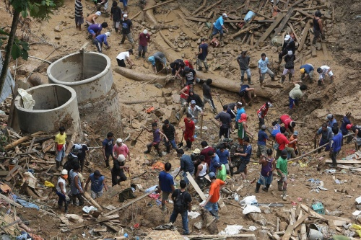

Community is:

Slide 19
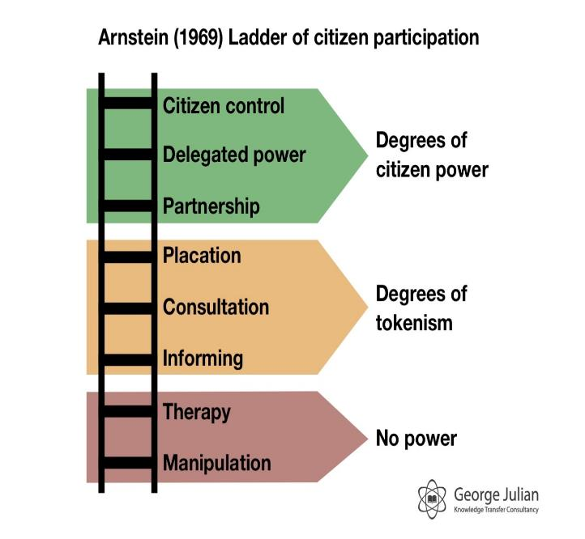
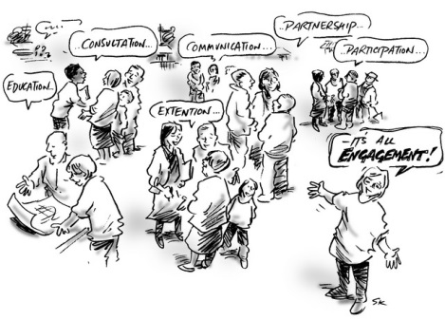
Participation is:
Increasing levels of empowerment
http://www.georgejulian.co.uk/wp-content/uploads/2013/01/Arnsteins-ladder-1969-cropped.jpg

Slide 20

Health
Declaration of Alma Ata (International Conference on Primary Health Care, Alma-Ata, USSR, 6-12 September 1978)
The Conference strongly reaffirms that health, which is a state of complete physical, mental and social wellbeing, and not merely the absence of disease or infirmity, is a fundamental human right and that the attainment of the highest possible level of health is a most important world-wide social goal

Slide 21
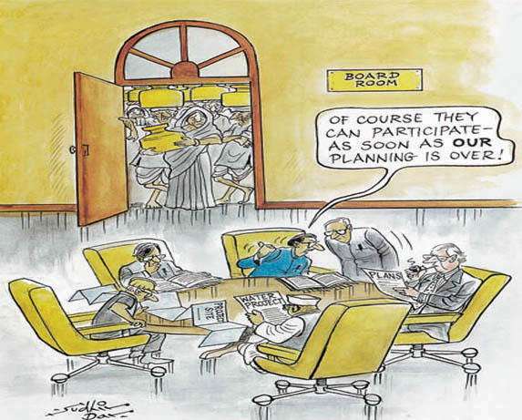
Common debates
Means to an end OR End in it’s own right
What is a Community?
Measuring success
Maintaining representativeness
Whose voice is not heard?
Somethings are too urgent/critical/ to have community participation

Slide 22
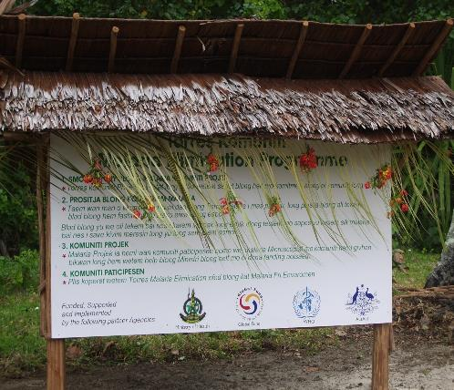
Examples of CP in infectious disease elimination

Slide 23
Onchocerciasis: community directed treatment in charge of drug distribution and administration in a manner suited them
Smallpox: support from community members to identify smallpox foci for containment
Polio: engaged leaders and role models to gain endorsement or program for public confidence and credibility of programme
How described in disease eradication
Taiwan malaria elimination: during “attack” phase meeting and health education to sensitive and alleviate fears ad elicit full co-operation
Aneytium, Vanuatu malaria elimination: community meetings to respond to concerns, seek feedback for tailoring interventions : aggressive health education for high compliance”
Notes:
Previous global malaria elimination attempt in mid 1950s
Significant political and financial support (WHO, UNICEF, USAID, The Rockefeller Foundation)
Primary strategy was vector control
Malaria eliminated from US, Japan, Korea, Taiwan, Spain, Italy, the Balkans, Greece, northern Africa & parts of the South Pacific
Emergence of resistance, DDT shortages, human-behavioural factors led to waning political and financial support and eradication was abandoned.
Realisation of limitations of one-size-fits-all strategy led to shift in focus to a Primary Health Care strategy (Alma Ata Conference 1978)

Slide 24
Case 1
Health seeking behaviour

Slide 25
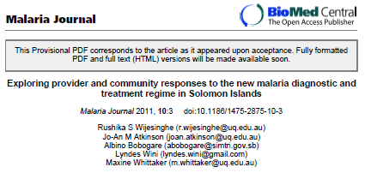
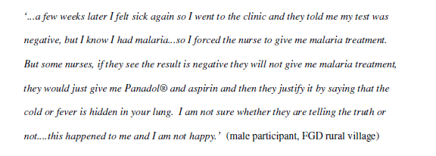
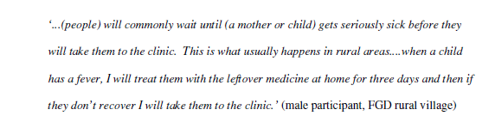
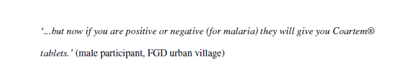
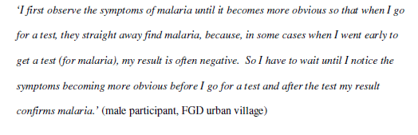
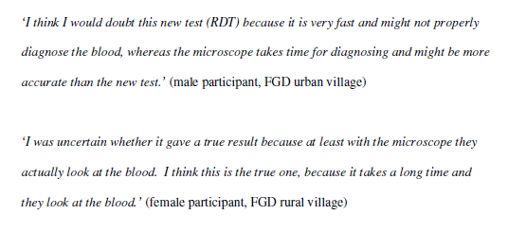
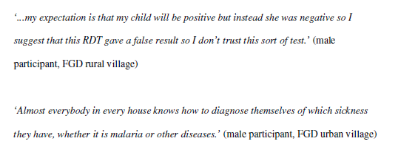
Health seeking behaviours

Slide 26
Responses
Community based treatment support for people who are using malaria treatment (vivax or falciparum) (early recognition of fever, active case detection, directly observed treatment and adherence, community based distribution support, test before treatment behaviour)

Slide 27
Case 2
Community surveillance
Receptivity
vulnerability

Slide 28
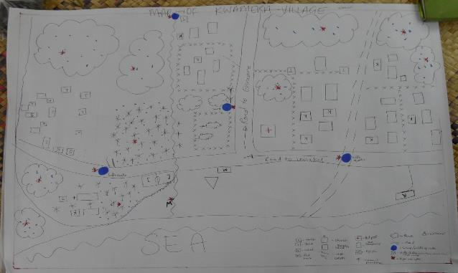
Community Based Surveillance
Objective: Develop and strengthen community self monitoring of community level surveillance indicators.
Foci:
Cases
Entomology
Quality
Access
Notes:
Community Based Surveillance
Develop and strengthen community self monitoring of community level surveillance indicators.
Cases:
VHWs reporting to Provincial staff and to own Area Health Committee
Survey reports
Promote active case detection
Linking of malaria cases to spatial maps for Health Centre / Aid Post output on monthly basis
Entomology:
Quality:
Training of CMOs, VHWs, Health Promotion Officers re: maintenance of LLINs
Community level monitoring of LLINs (i.e. transect walks to access LLIN coverage and use)
Gender disaggregation of monitoring and surveillance to assist analysis of interventions
Access:

Slide 29
Case 3
Mobility

Slide 30
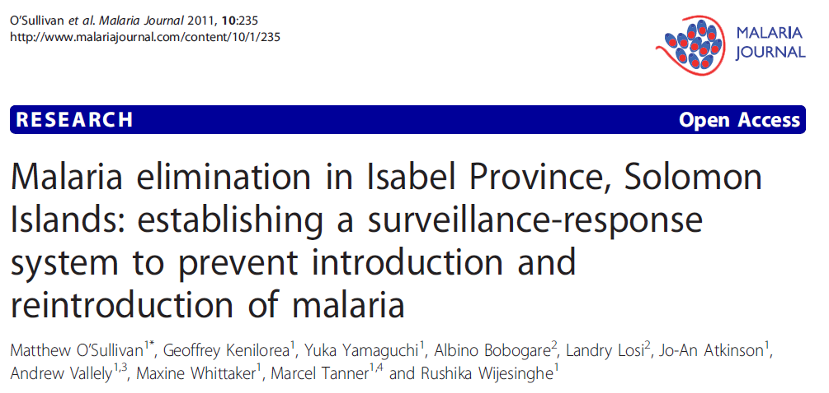
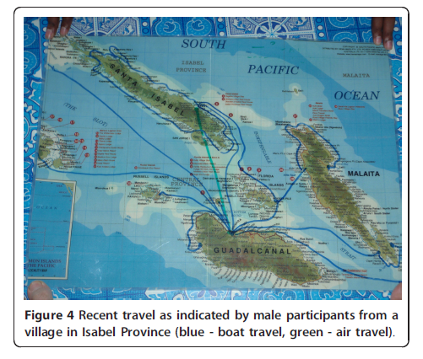

Slide 31
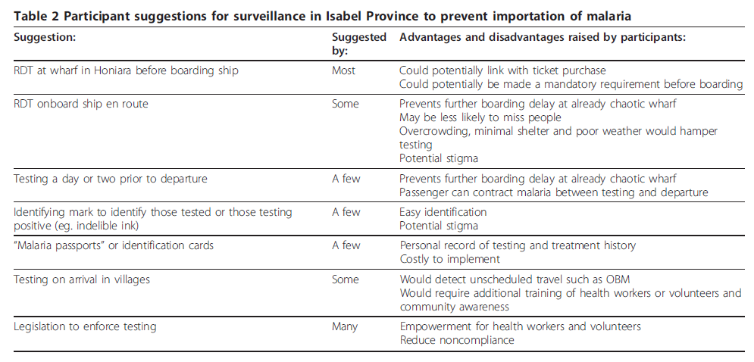
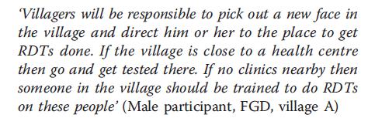

Slide 32
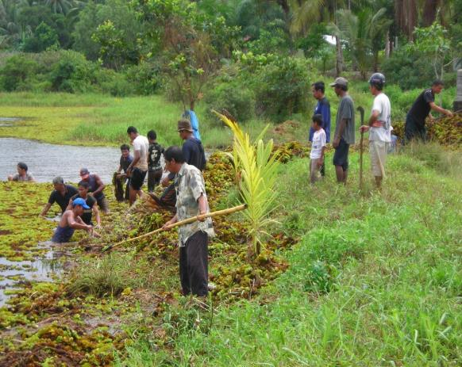
Case 4
Vector control

Slide 33
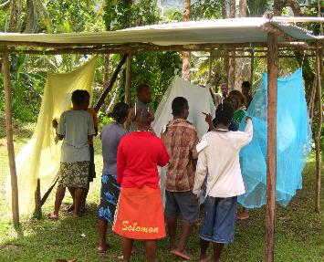
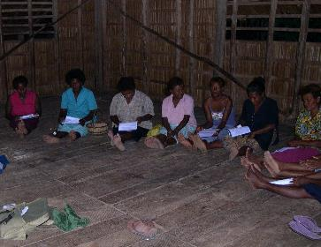


Slide 34
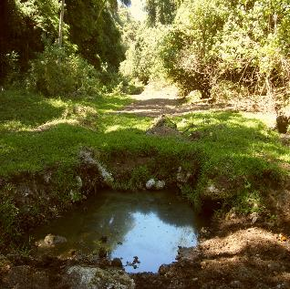
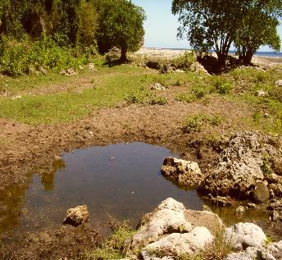
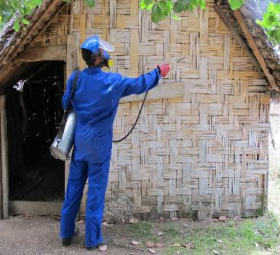
Larviciding and IRS

Slide 35
Case study 5
Community Competence/ Social Capital/Resilence

Slide 36

The Tripod Strategy
Community participation
ANGLICAN
MOTHERS UNION
CHURCH
VBDCP
Health promotion
Rotary
PACMIS
PROVINCIAL GOVERNMENT
TIDY VILLAGE COMMITTE
CHIEFLY CULTURE
CULTURE

Slide 37
The how….

Slide 38
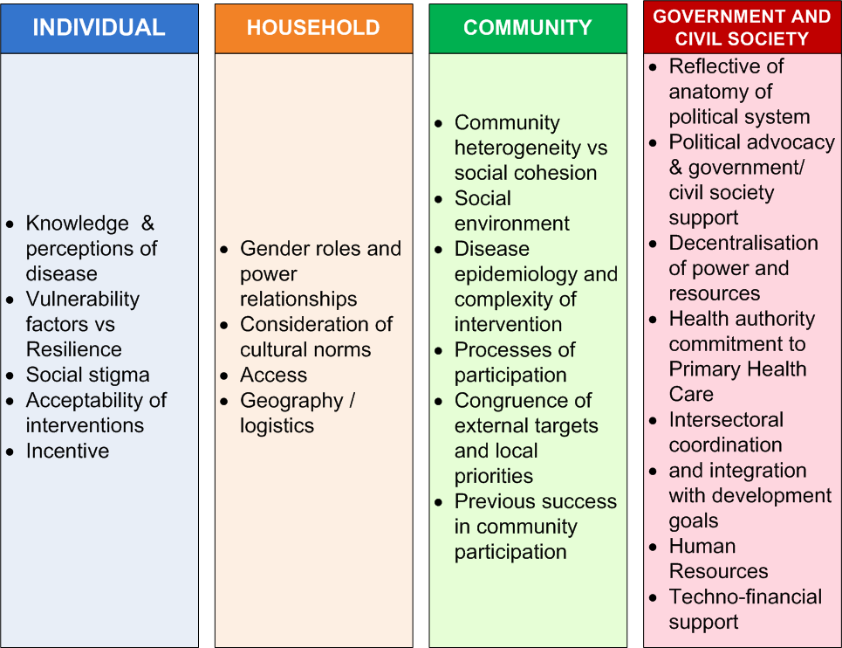
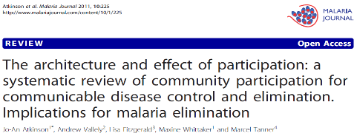
Determinants of Community Participation
Atkinson et al 2011
Notes:
Based on this review the following themes emerged.
The determinants of community participation at the INDIVIDUAL level are:
Knowledge and perceptions of disease, its causality, prevention & treatment
Vulnerability factors (internal & external) vs Resilience (social identity, self efficacy/empowerment and mitigation of risk)
Social stigma
Acceptability of interventions
Incentive
- Need to consider what are the incentives / disincentives for participation at the household level. Potential disincentives can include –opportunity costs (e.g. time), direct participation costs (monetary, physical or psychological costs), personal constraints (availability to participate) and countervailing social norms and organisational barriers (e.g. gender roles / expectations). These are weighed against the incentives that can be both individual and collective (material or symbolic capital). Participation influenced by ‘incentive determinants’ and community characteristics [6]
HOUSEHOLD
Gender roles and power relationships
There were gender differences in those willing to volunteer without incentive (majority were women). Kironde & Kahirimbanyi (2002)
Consideration of cultural norms (traditions, values and status)
Access (household access to interventions)
Geography / logistics (urban vs rural)
COMMUNITY
Community heterogeneity (economic, ethnic, religious or other divisions) vs social cohesion (social capital)
Social environment (leadership structure, power relations and availability / monopolisation of resources, population movement)
Disease epidemiology and complexity of intervention
Processes by which communities are engaged / empowered to participate
Congruence of external targets and local priorities
GOVERNMENT AND CIVIL SOCIETY
Implementation of program reflective of anatomy of political system (socialist, dictatorship, military, communist, democratic).
Political advocacy & government / civil society support for genuine participation (and/or a social tradition supportive of participation
Decentralisation of power and resources to the local level and identification / use of community assets
Health authority committment to Primary Health Care
Intersectoral coordination and integration of program in broader development goals
Human Resources (adequate recruitment, training, supervision and incentives)
Techno-financial support of locally embedded development agencies (selective participation)

Slide 39
A package
A package for community participation in malaria elimination programmes will need to be tailored to local contexts but should broadly include:
Advocacy
Supportive environment including community structures
Identifying and mobilising local stakeholders
Intersectoral collaboration
Local-level action-orientated community participatory research
Integration of malaria interventions (Primary Health Care approach);
Targeted implementation of locally-appropriate, multi-level behaviour change communication
Reporting systems that support community feedback to decision makers and the flow of information on program progress to communities;
Monitoring and evaluation of community participation activities.
Community volunteers (education, drug distribution, treatment, surveillance)
Notes:
A package for community participation in malaria elimination will need to be tailored to local contexts but should broadly include:
Advocacy (Government, private sector, civil society, local level stakeholders and communities) to increase awareness and commitment to the elimination program
Supportive environment - decentralisation of resources and local decision making. Adequate human resources (adequate recruitment, training, supervision and incentive to facilitate and maintain community participation)
Identifying and mobilising local stakeholders and social networks through consensus building processes (see Appendix C for potential stakeholders);
Intersectoral collaboration (Health Dept., Agriculture, Education Dept., Health Promotion, private sector, development agencies etc.);
Local-level action-orientated research (where there are gaps) as part of an initial scoping mission that will build community partnerships and inform community mobilisation and behaviour change communication strategies. This research should seek to understand:
Community perceptions / misconceptions about malaria;
The socio-cultural, behavioural and practical issues that impact community participation in interventions for malaria prevention and treatment (see Appendix B for multi-level influences on participation);
Influences on these practices including social mechanisms and how malaria is contextualised within broader community health and disease priorities; and
Local-level resources and the most effective avenues for channelling health information.
The acceptability of interventions and models for implementation
Integration of malaria interventions with activities addressing other community health and disease priorities (Primary Health Care approach);
Targeted implementation of locally-appropriate, multi-level behaviour change communication to maintain attention and motivation for participation in malaria elimination;
Reporting systems that support community feedback to decision makers and the flow of information on program progress to communities;
Monitoring and evaluation of community participation activities.

Slide 40
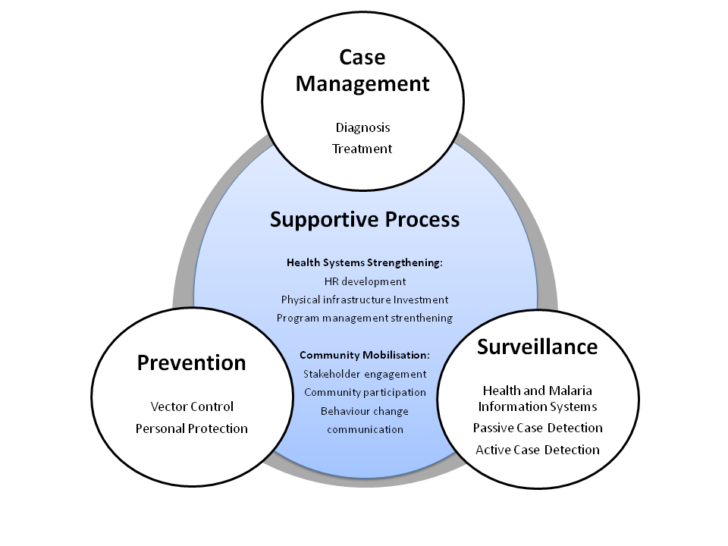
Outcomes:
Commitment to the goal of zero transmission
Motivated to maintain interventions to the point of zero transmission and sustain
Highest possible coverage
Highest possible quality of application
Need to specify exactly what we expect families to do?
Joint decision making re interventions?
The overall aim of community participation to support elimination is to develop sustainable engagement by communities in the targeted locations to maintain and support malaria control activities and be engaged in the identification of malaria cases, and protection of borders. as defined in the national malaria elimination strategy.
Experienced people to support CP
Notes:
The overall aim of community participation to support elimination is to develop sustainable engagement by communities in the targeted locations to maintain and support malaria control activities and be engaged in the identification of malaria cases, and protection of borders. as defined in the national malaria elimination strategy.
This will include:
Community participation to reduce transmission and reservoir of infection (including IRS, source reduction, LLINs)
Community based treatment support for people who are using malaria treatment (vivax or falciparum) (early recognition of fever, active case detection, directly observed treatment and adherence, community based distribution support, test before treatment behaviour)
Develop and strengthen community self monitoring of community level surveillance

Slide 41
Leadership
Needs assessment
Management
1. Narrow
2. Restricted
3. Mean
4. Open
5. Wide
Organization
Resource
mobilization
Rifkin S et al .1988
Notes:
Using a “spidergram” (Rifkin, et. al ( 1988)
• Factors are
• Needs Assessment-Who made the Assessment?
• Leadership-personal or community interests?
• Management-who manages—community or professionals
• Organization-linking with existing program?
• Resource Mobilization-outside or community?
1. Narrow; 2. Restricted; 3. Mean; 4. Open; 5. Wide
Draper, A.K. et al redefine the continuum by placing mobilization define new critical factors for participation based on program
We can use it as baseline to map participation.
• We can compare the baseline with a period afterwards to see changes in
participation to allow us to analyze possible causes for these changes.
• We also can compare participation in different areas and analyze causes.
• We can ask community people to assess participation in the program and
together put it to the uses identified above.
• And we can identify different indicators depending on the context of the
program and on how we see empowerment

Slide 42
Lessons learnt
Tools available

Slide 43
Key Preliminary Messages
Community participation should:
Be instigated at the outset of a program
Requires structure and capacity.
Where possible, uses existing organisations’ / volunteers’ structures
Establishes communication channels and engage functioning administrative hierarchy if exists
Builds capacity for community participation and health promotion at the grassroots
Not be restricted to labour-intensive and non-technical activities : often perceived communities as low-cost and poor-quality substitutes for services, Must be meaningful and visible
Consider role of “volunteer health workers” to increase access remote communities – need supervision;
Not be hindered by inadequacies in health system
Be supported by acceptable, available affordable and accessible health services
Notes:
Some key preliminary messages so far:
- Community participation should be instigated at the outset of a program rather that used as an ad hoc approach to fixing barriers to program implementation or sustainability. Set up a framework for community participation including allocation of sufficient funding & resources for long-term maintenance of the CP program.
- CP requires structure and capacity. Creating large scale cooperative and collective action for the purpose of malaria elimination will require an appropriate organisational framework to support it and this should be adequately budgeted for.
-Where possible, use existing organisations / volunteers structures rather than creating new ones.
-Establish communication channels and consider whether villages / communities have a well-established functioning administrative hierarchy that can be engaged to develop these communication channels at the micro-level also.
-Build capacity for community participation and BCC work at the grass roots including adequate training (which should include management training) and ongoing supervision.
- The restriction of community participation to labour-intensive and non-technical activities such as clean-up campaigns act to reduce the viability of participatory strategies as they are perceived communities as low-cost and poor-quality substitutes for services such as insecticide spraying. Non-technical activities generally have a low perceived efficacy (i.e. immediate results can be seen with insecticide spraying i.e. dead mosquitoes on their floor, however, source reduction activities do not demonstrate such immediate effects).

Slide 44

Lessons… (G20 Policy Brief)
Beyond broad involvement of groups.
Key stakeholders include women and vulnerable and agents of change crucial in solving health inequities.
Citizen knowledge.
When spaces are created and voices heard citizens and communities cam mobilise to bring about transformative change.
Facilitate citizen engagement in data collection monitoring and feedback mechanisms in order to increase public accountability and help make progress in addressing complex health problems.
Spaces for different social actors to engage in debates in an informed equitable and inclusive way.
Boutilier, Z. 2017

Slide 45
Challenges for Maintaining Community Engagement moving towards Elimination
Don’t have the disease anymore – not perceived as a risk
Why continue behaviours like sleeping under a net when no longer a problem?
Why support IRS when mosquitoes no longer a nuisance?
Need to actively manage fevers (any cause)
Need to “protect borders” – risk of re-introduction and capacity of transmission maintained
A generation who don’t remember malaria

Slide 46
Other Challenges
Social inclusion
Groups who existing services do not reach
Minorities
Mobile and migrants
Accountability
  Whom to whom;
  Groups who are not reached;
  whose perspective; empowered voices?
Human rights:
  Stigmatisation
  Surveillance
  Groups being considered to support e.g. military
  Public good and personal rights
  Public good and community rights

Slide 47
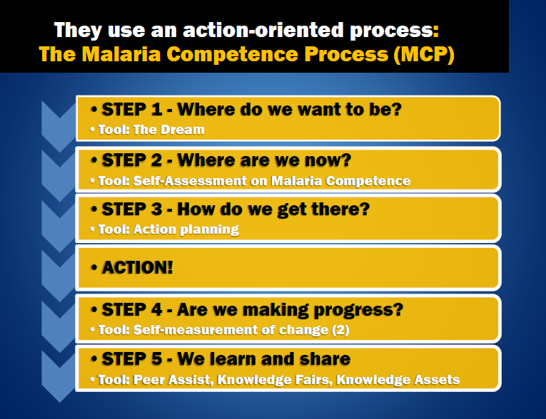
Tools available
Community coalitions,
Quality improvement teams,
Participatory Appraisal (Participatory rural appraisals, participatory rapid appraisals, participatory learning and action),
Care Group Model and
Community-directed interventions (CDI)

Slide 48
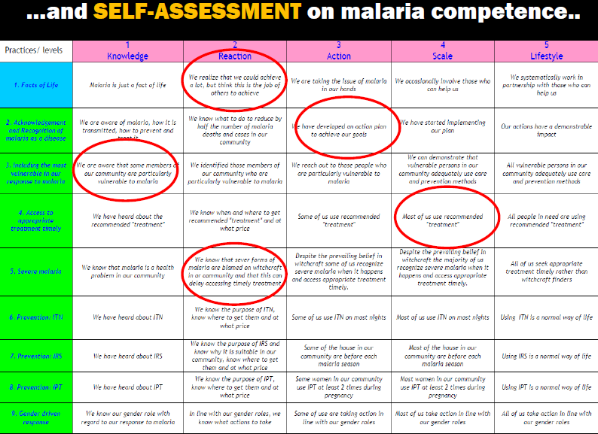

Slide 49
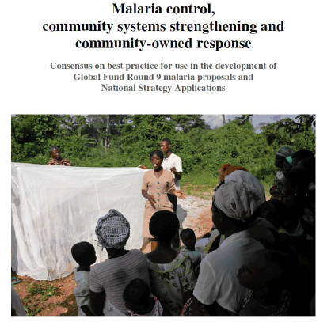
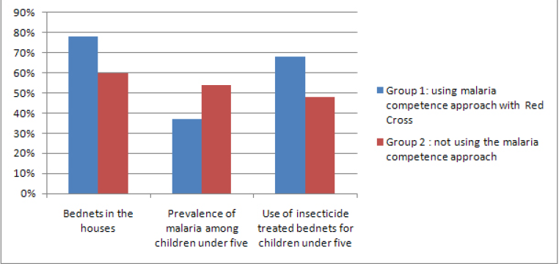

Slide 50
Rotary examples
Adopt a village
Chasing malaria
Health promoting villages

Slide 51
RAM Adopt A Village (AAV) Program
Developed in PNG (2002) ->Solomon Islands
  Main form of fund raising to support RAM’s distribution of LLINs.
  After several years taken up by Global Fund to fight Aids Tuberculosis and Malaria
  PNG, RAM initially provided a procurement service for LLINs funded by the Global Fund, then appointed to manage the net distribution programs.
  RAM employs permanent staff through the Rotary Club of Port Moresby to administer and deliver the programs; LLINs to nearly every household in the country twice.
-> Solomon Islands RAM provide solid practical advice and facilities such as storage sheds and staff accommodation to support the Global Fund program.
Funds used for strategic distribution of LLINs funded by AAV complement and support the work of the Global Fund.
  E.g. cover gaps and short-falls in the Global Fund distributions in PNG, Solomon Islands and Timor Leste (2012) working closely with the National Health organisations in each country;
Notes:
Distribution of LLINs funded by RAM in Timor Leste commenced in 2012 and so far 74,000 nets have been supplied including 40,000 nets to ensure that all expectant mothers and their babies were protected from mosquitoes and 1000 special conical nets for hospitals.

Slide 52
Reflection?

Slide 53
Chasing Malaria’
Pilot program in National Capital District (NCD) and Central Provinces of Papua New Guinea (2014)
Goal is to map malaria within these Provinces and supply LLINs where malaria remains a problem.
  Provide every RDT malaria positive case an LLIN.
  From the data collected identify the worst affected villages and commence programs to eliminate malaria altogether.
Works closely with the Central and NCD Provincial Health Authorities -> full coverage (LLIN and RDTs) of all health centres in these Provinces.
Notes:
The project is now delivering nets through 19 Health Centres in NCD and 21 Health Centres in Central Province (1 Goilala, 11 Kairuku, 6 Rigo and 3 Abau).
Between December 2014 and June 2015, the project has recorded 1,814 cases of malaria with LLINs distributed to them. This is about 260 malaria cases a month between the two provinces. This would give approximate incidence rates of 2 per 1000 in NCD and about 11 per thousand in Central Province.
When the project started, many cases of malaria were being diagnosed clinically without using RDTs. Now all clinics are regularly using RDTs – NCD now tests 99% of all cases of malaria and Central 96% -The records show that some of the Aid Posts of the programme are still not utilising RDTs properly but this is being addressed.
Between December 2014 to June 2015 NCD Clinics tested 17,457 cases of which 644 were positive (3.6% in NCD ). Interestingly the records show that most cases where in adults suggesting that much of the malaria is NCD is imported.
In Central Province, from 8,932 patients tested with RDTs, 1,170 (12.1%) were positive. Unlike NCD, malaria cases in Central are not scattered but appear focused in certain locations. The two worst villages identifies are Kuriva Blocks near Kuriva Health Centre and Adio near Kabuna Health Centre. This identification means that the project can now start to look at other interventions that can be applied to these villages to reduce malaria.
The data shows that malaria cases recorded in the period of April to June are greater than January to March. It is not yet clear why but the data supports deeper analysis.

Slide 54
Reflection?

Slide 55
Healthy Villages Solomon Islands
AAV funds provide tools to villages to enable them to keep their villages free of mosquito breeding areas.
  Each village is provided with the following tools at an average cost of $1,750:-Bush knives, brush knives, axes, flat files, spades, mattocks, metal rakes, crow bars and wheelbarrows.
Villages develop plan of work, apply to the Health Promotion Director (Solomons Ministry of Health); sign an agreement to look after the tools. Once approved and tools purchased, collected by a representative of the village and transported to the village.
The first tools were provided to 30 villages in 2013, a further 38 villages have been provided with tools in 2014/15 at a cost to RAM of AUD$ 106,000.
Notes:
We have received a request from a further 81 villages for tools at an estimated cost of $142,000.
Although further monitoring and evaluation needs to be done on the success of the program the feedback from the villages has been good with comments that they do not need to use bed nets as there are no mosquitos. We also know the program has been very successful in Isabel province where the incident of malaria is very minimal and malaria elimination programs are now underway.
Healthy Villages is supervised by PDG Wayne Morris OBE of the Rotary Club of Honiara. RAM hopes to introduce this program into other countries where we work as another tool in the strategy to eliminate malaria.

Slide 56
Reflection?

Slide 57
Conclusion

Slide 58

The Promise of Community
Participation
Acceptability
Access
Effectiveness
Efficiency
Sustainability
Empowerment

Slide 59
Frame malaria responses in the context of social justice and human rights and within equitable universal health coverage systems
Make malaria decision making spaces more inclusive and support malaria civil society mobilisation
Fully meeting the funding needs for malaria responses and for health and community systems strengthening
Partner with civil society and community actor for effective malaria surveillance and response systems
Reflection

Slide 60
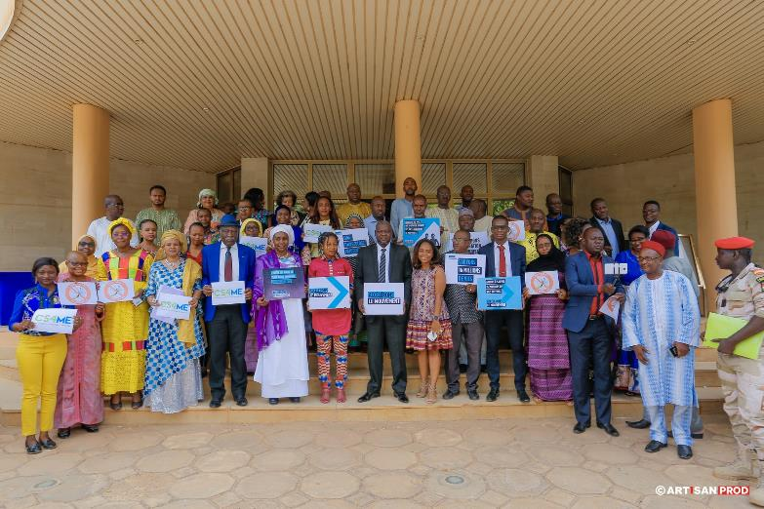
Thank you

Slide 61
References

Slide 62
Atkinson, J et al 2011 The architecture and effect of participation: a systematic review of community participation for communicable disease control and elimination. Implications for malaria elimination Malaria journal 10:225
Boutilier, Z. 2017 SDGS and health : a vision for public policy G20 policy brief www.G20-insights.org May 19, 2017
Guyant, P. et al 2015 Malaria and the obile and migrant population in Cambodia: a population movement framework to inform stratgeies for malaria control and elimination Malaria Journal 14:252 doi:10.1186/s12936-015-0773-5
IOM 2017 World Migration Report 2018 Geneva: IOM
Research for development network 2017 From evidence to impact: development contributions of Australian aid funded research Oct 2017 www.rdinetwork.org
Rifkin, S., Muller, F., Bichmann, W 188 Primary health Care: on measuring community participation Social Science and Medicine 26(9): 931-940
The malERA Refresh Consultative Panel on Health Systems and Policy Research (2017) malERA: An updated research agenda for health systems and policy research in malaria elimination and eradication. PLoS Med 14(11): e1002454. https://doi.org/10.1371/journal.pmed.1002454
Xu, Q 2007 Community Participation in Urban China: Identifying Mobilization Factors Nonprofit and Voluntary Sector Quarterly, vol. 36, no. 4, December 2007 622-642 DOI: 10.1177/0899764006297675

