Slide 3
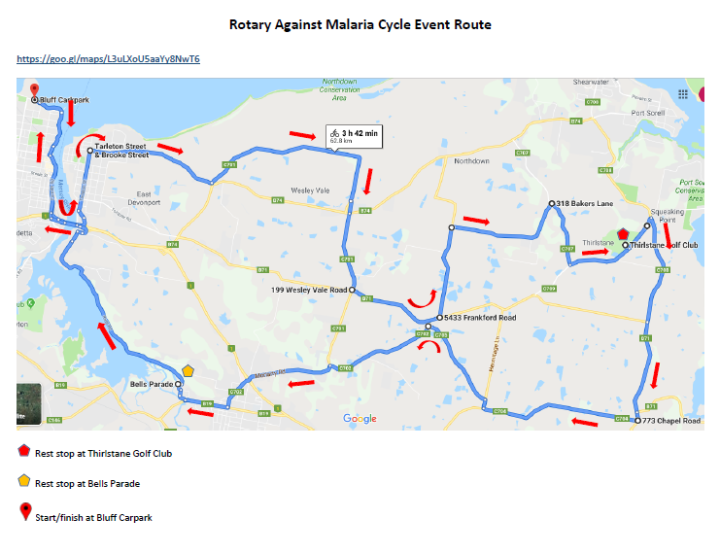

Slide 4
Ben Milbourne

Slide 5
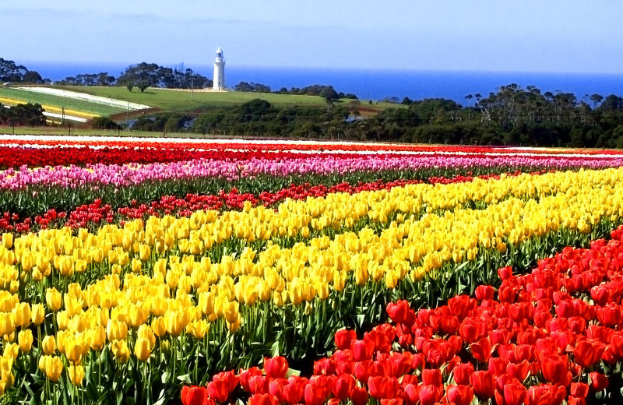
Table Cape Tulip Festival

