Slide 1


August 2019

Slide 2

What is Aquatain AMF?
Unique silicone-based liquid
Self-spreads across water surface
Non-toxic: physical action, reducing surface tension
Effective for 4 weeks on the surface
Environmentally friendly - degrades into silicate
- does not affect fauna and flora
Mosquitoes can’t become resistant to it

Slide 3




Slide 4
The Global Picture
Approved for sale in 60 countries
Exempted from registration in many countries (eg the European Union) due to its physical action
Several other approvals in the pipeline

Slide 5
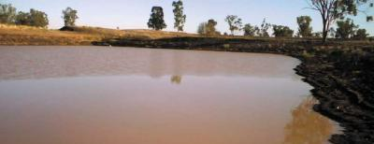
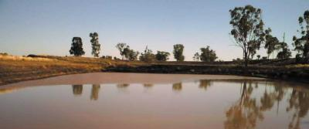
Self-Spreading Film
AMF spreading across the surface
A few minutes later

Slide 6
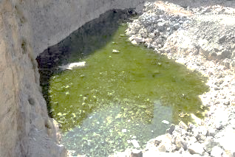
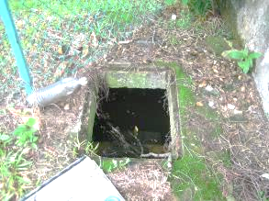
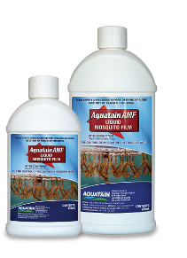
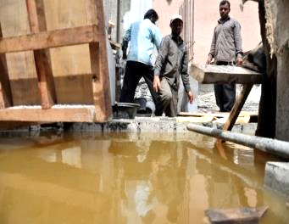
How To Apply Aquatain AMF (1)

Slide 7
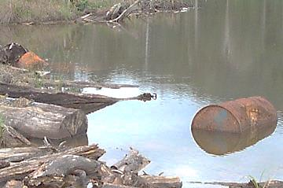
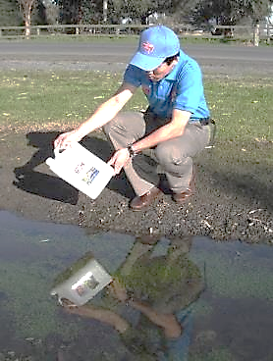
How To Apply Aquatain AMF (2)

Slide 8
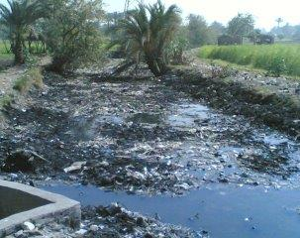
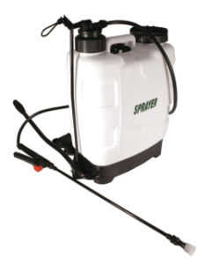
How To Apply Aquatain AMF (3)

Slide 9
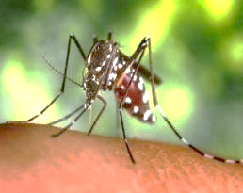
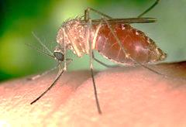
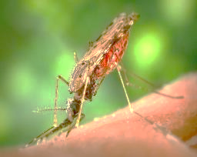
Aquatain AMF Trials On …
Aedes aegypti
Dengue vector
Culex quinquefasciatus
West Nile Virus vector
Anopheles
Malaria vector
Photo: James Gathany

Slide 10
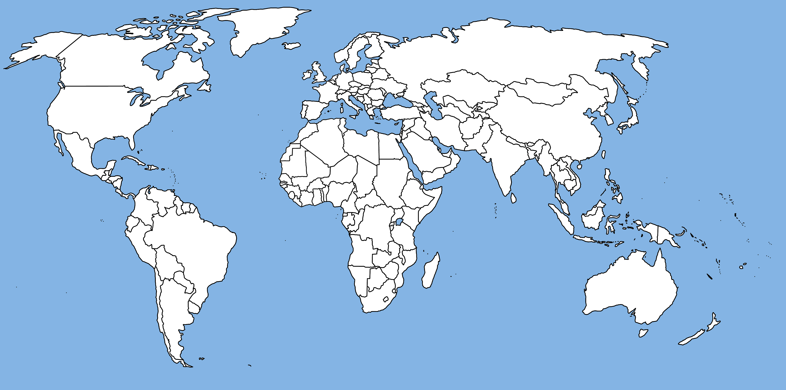
Aquatain AMF Trials
Australia
Singapore
Cambodia
Sri Lanka
India
Uganda
Kenya
Sudan
Greece
France
Netherlands
Argentina
Venezuela
Jamaica
Cuba
UAE

Slide 11
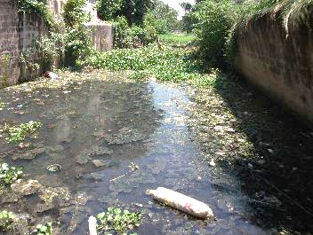
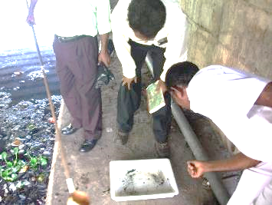
Sri Lanka Medical Research Institute
100% reduction in larvae after 1 day
98% reduction after 2 weeks
91% reduction after 4 weeks (control showed 60% increase)

Slide 12
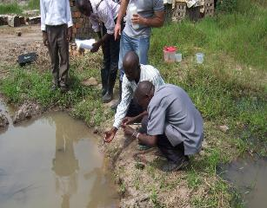
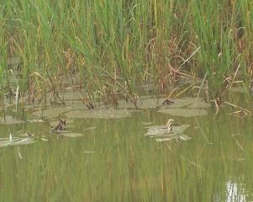
Uganda Ministry of Health
Applying Aquatain AMF
to an infested swamp.
Aquatain AMF spreading between the grass
100% reduction in larvae after 12 hours
no mortality in control group

Slide 13

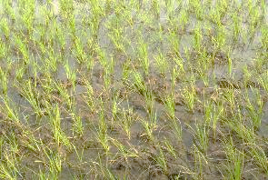
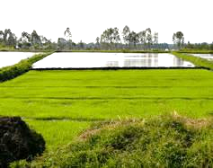
Kenya Medical Research Institute
Effective agent for the control of mosquitoes in irrigated paddy fields
No negative impact on non-target organisms
No impact on rice yield

Slide 14
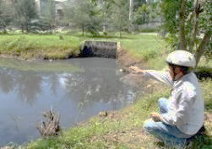
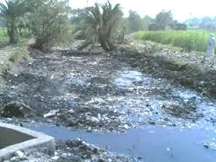
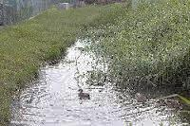
Cuba Directorate Of Surveillance,
Sancti Spiritus
Five polluted sites where other larvicides had been ineffective
Almost 100% mortality after 24 hours; maintained for 15 days
“Aquatain AMF highly effective in very difficult conditions”

Slide 15
Pupal Mortality Over Time

Slide 16
Larval Mortality Over Time

Slide 17
Other Impacts…
No emergence of adults
No eggs laid on the film
Many females drown

Slide 18
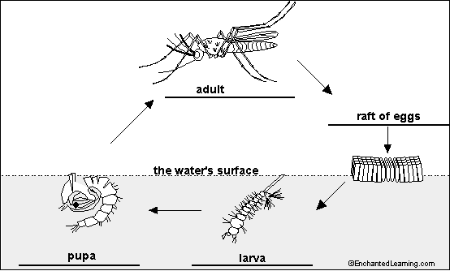
Aquatain AMF – how it works

Slide 19
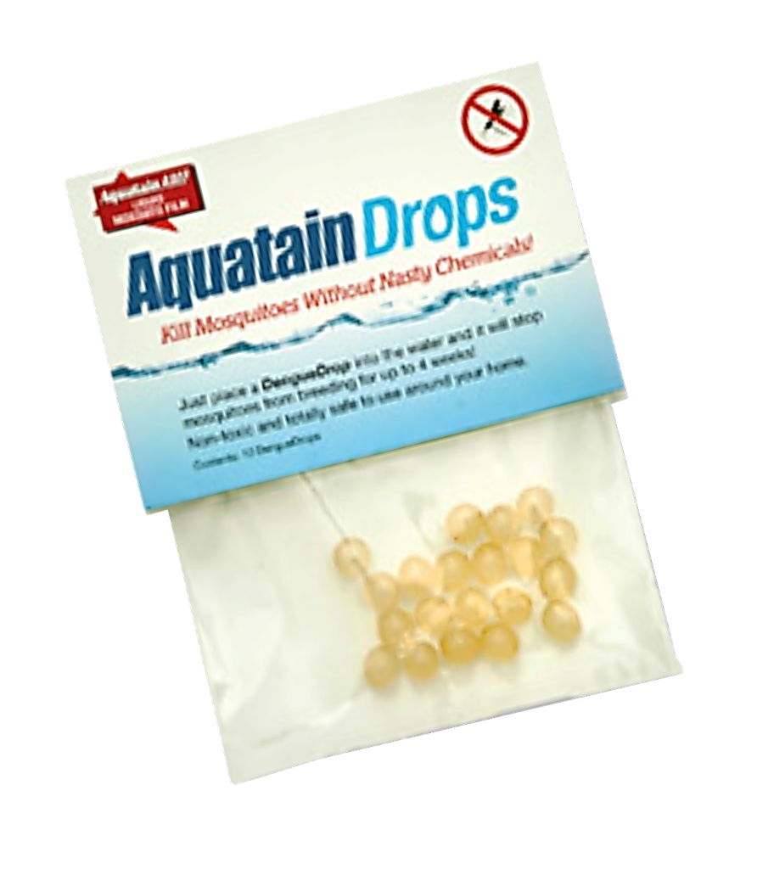
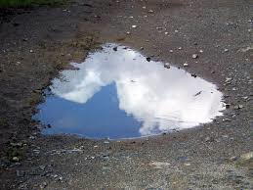
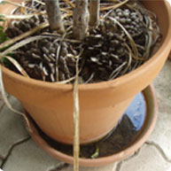
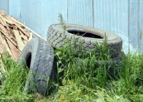
New Product

Slide 20
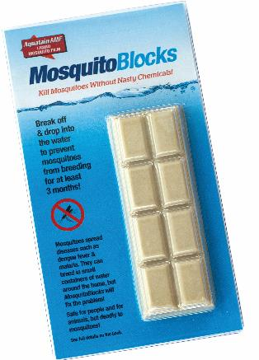
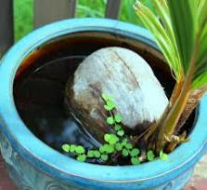
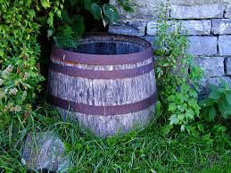
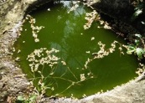
New Product

Slide 21

South Sudan Proposal
2019
Proposal To The South Sudan Government
Malaria Action Package
For Schools

Slide 22
Unique Advantages
Can be safely used by the general public
No need for precision in dosage
No possibility of mosquito resistance
Can access difficult-to-reach sites
Not affected by changes in biting patterns
Long-lasting

Slide 23
In a Few Words …
Aquatain AMF
is an ideal complement to
LLINs and IRS

Slide 24
August 2019

Slide 25
Pricing To RAM
Aquatain AMF | 250 ml Bottles | $5.00 per Bottle
 | 1 Litre Bottles | $11 per Bottle
 | 5 Litre Jerry Cans | $50 per Jerry Can
MosquitoBlocks | Block of 8 Segments | $1.20 per Block
Malaria Drops | Pack of 20 Drops | $1.10 per Pack
Prices are ex-Melbourne and exclude GST.

