Slide 1
Rotarians Against Malaria (RAM) Australia A volunteer run organisation working to eliminate malaria
Jenny Kerrison PhD, D.Ed
National RAM Manager
July 2019 – June 2022

Slide 2
RAM’s Purpose
The prevention of mortality, and the reduction in morbidity and social and economic loss caused by malaria through a progressive improvement and strengthening of local and national capabilities in malaria control.

Slide 3
Organisational structure
Rotary Australia World Community Service
(RAWCS)
National RAM Australia Executive Committee
21 District Chairs

Slide 4
RAM Areas of Work
^{Encourage} Rotary clubs to support anti-malaria projects
Raise awareness of risks for malaria in Australia
^{Networking with the partner} Government’s malaria program; and key leaders in malaria field e.g. WHO, Australian Health organisations.
^{Support} students and health workers in partner countries to develop knowledge and skills e.g. PhD scholarship
Support medical research activities in Australia

Slide 5
RAM Projects
Long-lasting insecticidal nets (LLINs)
Indoor residual spraying (IRS)
Community-based activities
Healthy Village Tools project (Solomon Islands)
Chasing Malaria project (Papua New Guinea)
Community Health Volunteers training

Slide 6
RAM Malaria Vaccine Project
Separate entity
Griffith University
Since 2018 - AUD$1.05 million raised
Further $1 million required for Phase 1 - test the efficacy of PlasProtecT®
Next step: Phase 2 trials outside Australia

Slide 7
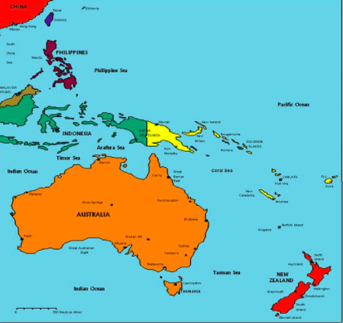
RAM Partners

Slide 8
RAM PNG launched mid-1990s
Papua New Guinea (PNG) Population 8.5 M (2019)
600 small islands , ~ 5,150 km of coastline
13 per cent of people live in urban areas
More than 800 indigenous languages,
Major funder: Global Fund, PNG Gov. and, Against Malaria Foundation

Slide 9
Chasing Malaria PNG
Funded by RAM Australia
Locations Waima, Bereina and Kairuka in Central Province
Students in 15 schools - track mosquito breeding areas to identify and control local malaria transmission sites.
Malaria prevalence screening and treatment of positive malaria cases.
All positive cases are provided with a new LLIN and their home details recorded

Slide 10
Solomon Islands RAM launched in1995
Population 634,133 (2019)
Hundreds of islands in the South Pacific
RAM and Rotary Club of Honiara
2018- 2019:
AUD 60,000 for tools for Healthy Villages with Health Promotions Division
AUD 1 Million DFAT application submitted
RAM PhD Scholarship recipient - final 4th year

Slide 11
Timor Leste launched 2004
Population 1.3M
For WHO malaria elimination certification in 2021
RC North Hobart & RAM: Rotary Global Grant USD251,334 Dec 2018 – 2021 (18 months)
40,000 nets for pregnant women
80 Hudson Sprayers
Training

Slide 12
Thank you

