Slide 1
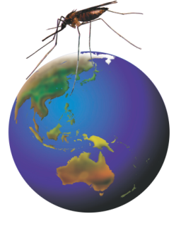
Rotarians Against Malaria
A volunteer run organisation working to eliminate malaria

Slide 2
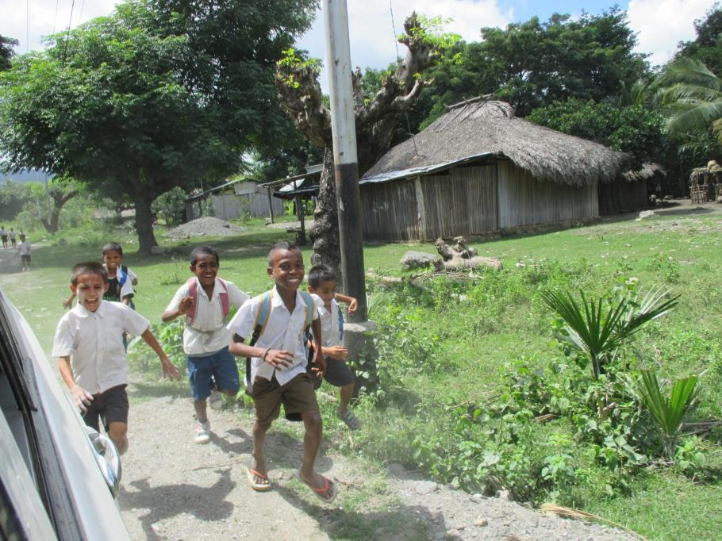
An important goal of RAM
Happy healthy kids eager to get an education

Slide 3
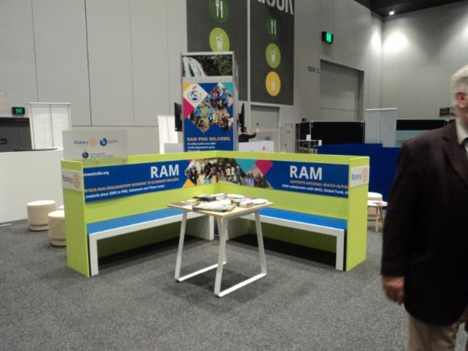
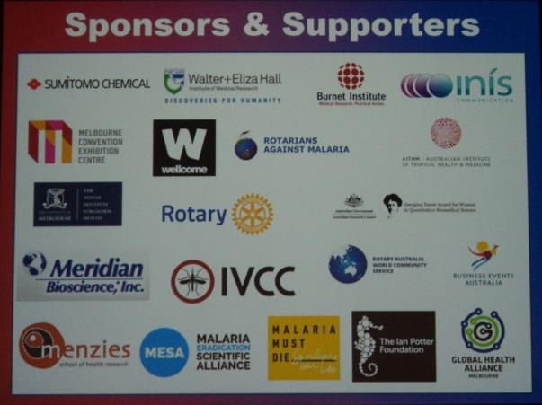
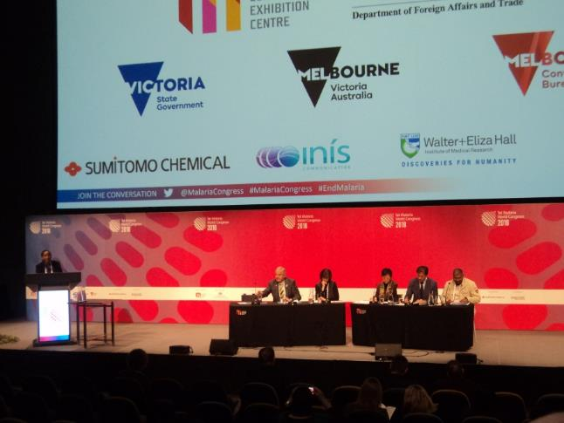
World Malaria Congress

Slide 4
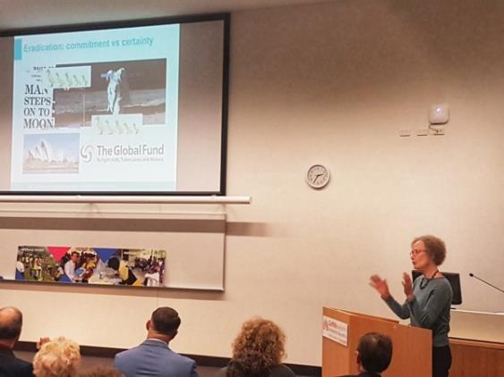
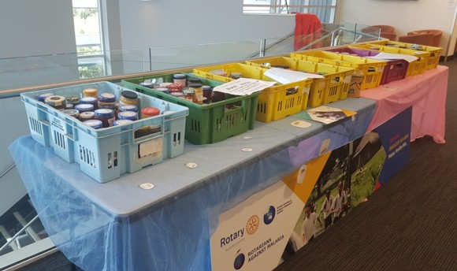
RAM Conference 2018, Gold Coast

Slide 5
RAM at RI Convention
Jenny meets with Rotarian Malaria Partners and REMARAG

Slide 6
RAM PNG

Slide 7
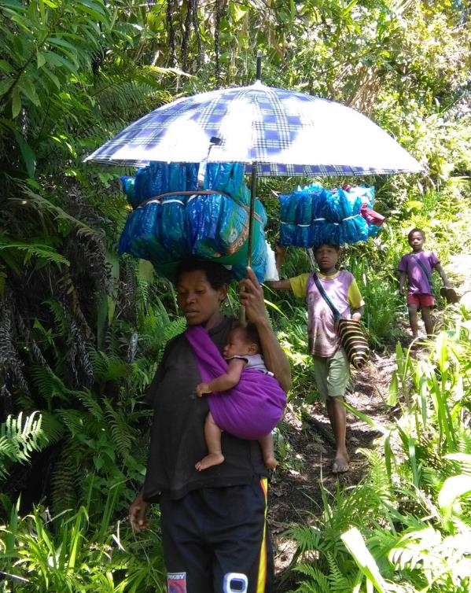
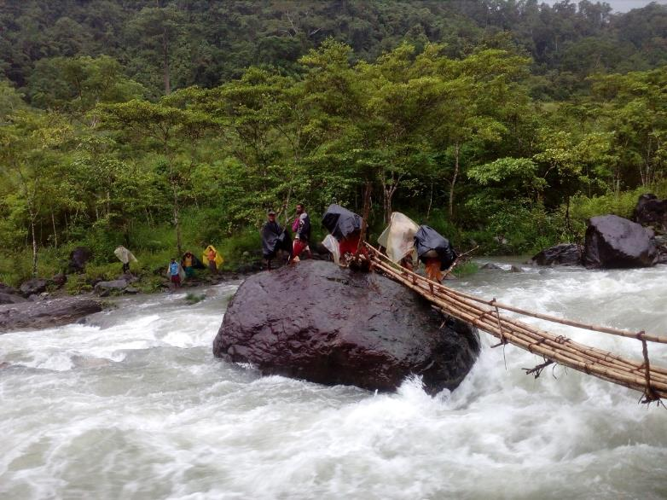
LLIN HOUSEHOLD DISTRIBUTION
Going home with precious nets

Slide 8
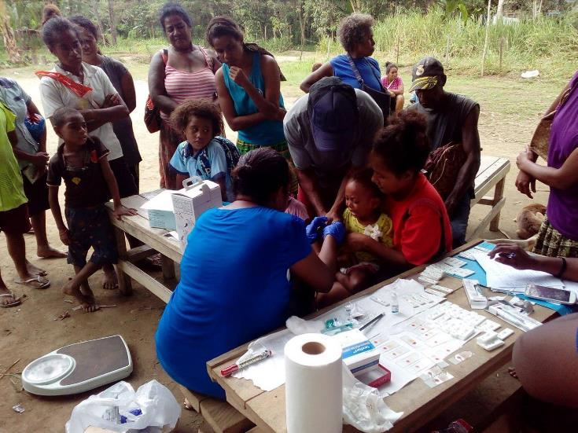
Kuriva School Malaria Club
Chasing Malaria Program
Screening school kids for malaria

Slide 9
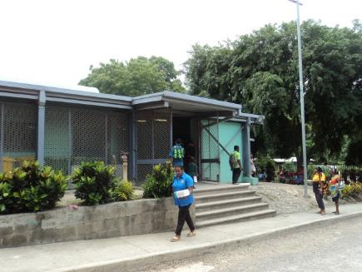
Chasing Malaria staff check RDTs & clinic records all +ve cases get a new LLIN

Slide 10
Tim will report in detail on the RAM PNG programs

Slide 11
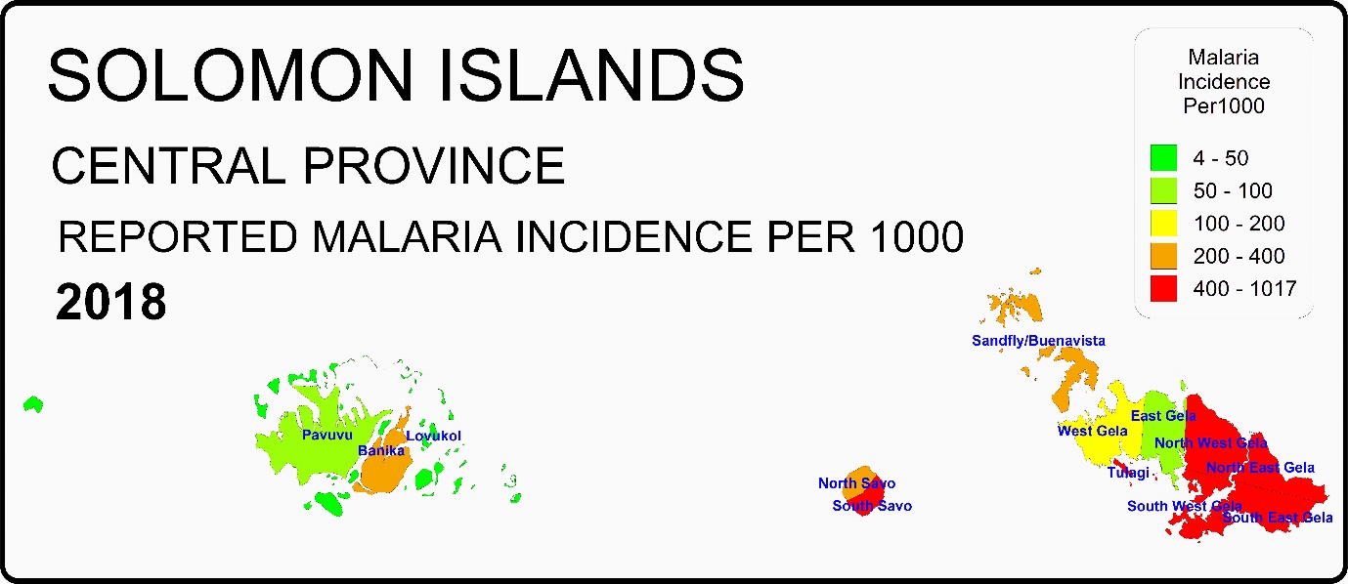
Solomon Islands New project proposed to address resurgent malaria in the eastern islands of Central Islands Province.

Slide 12
Solomon Islands RAM Specialist Consultation team visit
Andrea will report on this significant proposal

Slide 13
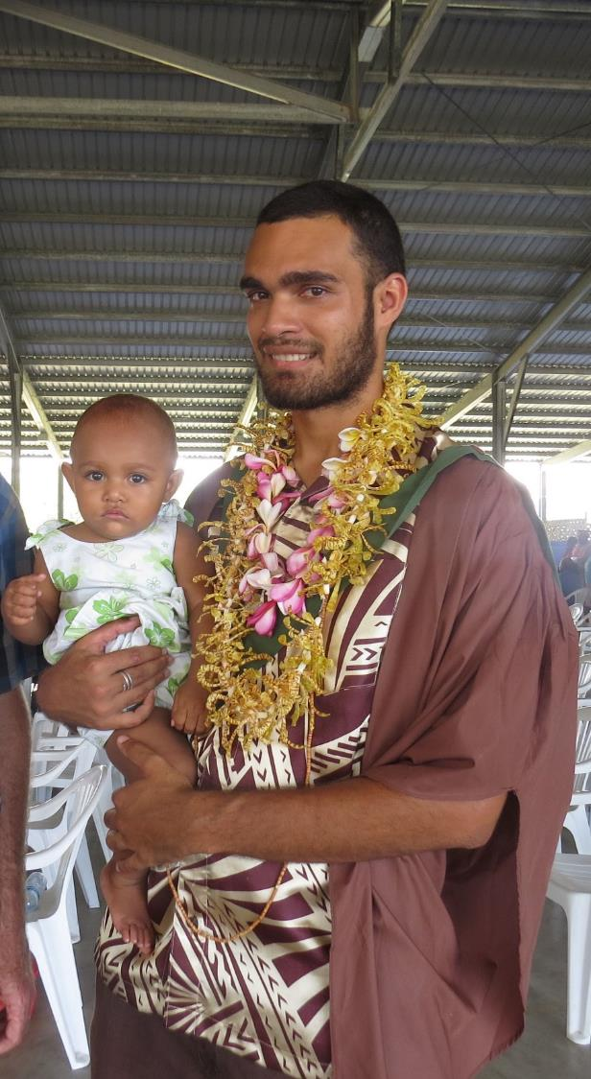
RAM Sponsored PhD student
Edgar Pollard
Is in the final stages of completing his write up and will then return to Honiara.

Slide 14
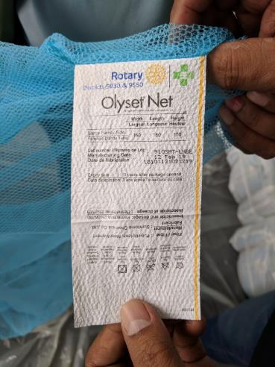
RAM Rotary Foundation Grant to support malaria elimination in Timor Leste
USD$251,000 Global Grant
40,000 LLINs and 80 IRS units delivered

Slide 15
Rotary Foundation Cadre Dr Noel Alidio is enthusiastic!

Slide 16
Timor Leste and Indonesian NTT at RAM Conference 2018
Dr Merita (TL) Dr Theresia (NTT) Dr Manel (TL-WHO)

Slide 17
East Timor meets West Timor to beat malaria together

Slide 18
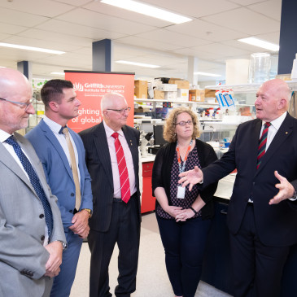
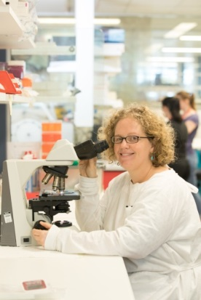
Malaria Vaccine Fund raising project
AUD$500,000 from Federal Government takes funding over $1 million

Slide 19
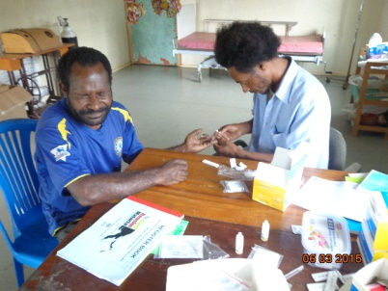
Rotary’s strength is persistence !!
RAM will see the end of malaria !!

