Slide 1
Solomon Islands Needs Assessment & RAM Project Proposal
Dave Pearson / Andrea Grosvenor
RAM Annual Conference 2019

Slide 2
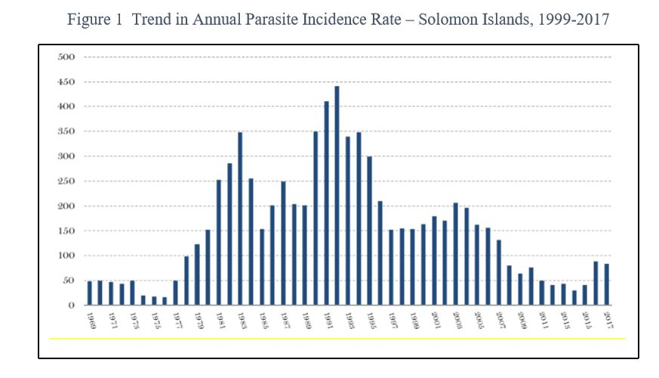
Trend in Annual Parasite Incidence Rate – Solomon Islands 1969-2017
Source: Solomon Islands National Malaria Control Programme – Malaria Programme Review - 2018
Notes:
Solomon Islands’ malaria burden is among the highest in the Western Pacific Region of the World Health Organisation (WHO). In the 1970s Solomon Islands came close to eliminating malaria with fewer than 20 cases per 1000 people. However, premature withdrawal of funding and interventions saw cases soar to 450 per1000 people in 1992 (Solomon Islands Road Map for Malaria Elimination).
Over more than two decades the incidence of malaria has progressively reduced and fluctuated due to unstable investment in malaria interventions coupled with a period of civil unrest resulting in the cessation of most national malaria program activities for several years.
Since 2003, when substantial and sustained financial resources became available over a ten year period, the incidence of malaria continued to trend downwards from an Annual Parasite Incidence (API) of 206 per 1,000 to 40.5 per 1,000 in 2015. However, it increased significantly to 88.8 per 1,000 in 2016 and to 93.2 per 1,000 in 2018. (Solomon Islands Annual Malaria Program Report (2018)).

Slide 3
Source: Ministry of Health and Medical Services (courtesy Tim Freeman)
Notes:
(Solomon Islands Annual Malaria Program Report (2018)). The Report notes that the malaria incidence in Central Islands Province (CIP) remains high relative to other provinces. The API in CIP rose steadily from 56 per 1000 in 2013 to 281 per 1000 in 2016, fell slightly to 220 in 2017, and then rose again to 354 per 1000 in 2018. This is the highest malaria prevalence province in the nation.
The Malaria Situation Review in Central Islands Province states that many factors have contributed to increased malaria cases in CIP from 2016 onwards. The Review specifically cites three observed factors: access to quality diagnostic service, change of information system management and reduced protective coverage of vector control interventions. While this means that some of the reported malaria increase is likely to be due to better diagnosis and reporting, the Review stresses that malaria incidence in CIP has increased. It notes that population protective effects of vector control interventions have reduced. Specifically, indoor residual spraying (IRS) ceased in 2015 and a batch of substandard long-lasting insecticidal nets (LLIN) was distributed and used during 2013 to 2016.
The ongoing increase in malaria cases in CIP from 2016 can be linked to reduced effective vector control including lack of IRS, periodic malaria commodity stock-outs, staggered and incomplete LLIN replacement distributions, low rates of effective use of LLINs and other population behavioural trends such as staying outside longer into the evening. A study by the NVBDCP in 2017, following a local LLIN distribution, showed that of 91 households interviewed only 84% had received new LLINs and only 49% of those were using them. Field surveys by RAM sponsored PhD student Edgar Pollard (AITHM) in CIP and Western Province highlighted the increasing trend of village people to be out socialising during peak biting periods of the principle malaria vector Anopheles Farauti.

Slide 4
RAM Consultations
RAM approached by DFAT re SI collaboration
Ongoing discussions with Solomon Islands National Vector Borne Disease Control Program
Identified Central Islands Province as priority
RAM team scoping visit to Solomon Islands, April 2019
LOTS of meetings to get information, test ideas etc
Notes:
In 2018 staff from the DFAT Indo-Pacific Centre for Health Security contacted RAM to explore the possibility of a RAM – DFAT malaria collaboration. DFAT was impressed with the Rotary Polio Eradication partnerships. This contact led to the proposed Solomon Islands collaboration
developed with significant advice and regular consultation with the Director of the Solomons National Vector Borne Diseases Control Program (NVBDCP) and the Director of the Ministry of Health and Medical Services Health Promotion Division.
RAM was advised by the NVBDCP Director that any new projects targeting Solomon Islands should seek to support the MHMS programs to control resurgent malaria outbreaks in Central Islands and Malaita Provinces. A project outline was developed that will focus on Central Islands Province, in particular the relatively geographically contiguous eastern part of the province. This will cover up to around 25,000 of the province’s approximately 30,000 people.
In April 2019 a RAM delegation to Solomon Islands met with the following officials:
Dr Jimmy Rodgers - Sectary to the Prime Minister; Dr Nemia Bainivalu – Undersec Health Improvement
Mr Alby Bobogare - Director NVBDCP; Mr Charles Butafa – Vector Control Entomologist – NVBDCP
Mr John Leaburi – Program Manager M&E ; Mr William Horoto – Manager – National Medical Store
Mrs Baakai Kamoriki – Chief Medical Statistician; Mr Adrian Leamana – Director Health Promotion
PDG Wayne Morris OBE – RAM Country Coordinator - Rotary Club of Honiara
Ms Fiona Mulhearn – 1st Sec, Health - HC Australia
Dr Lesley Bunabo – Director of Health Central Province
Mr Charles Mau – Provincial Malaria Program Manager
Mr Rolex Havea – Senior Vector Control Officer
Mr John Lodo – Malaria Program Manager Central Province 1972-2010
Ms Jentar Saitoha – Microcopist, Malaria Program

Slide 5
Malaria Program Review Key Findings (that RAM can address)
Health system strengthening
Support for field operations
Procurement and supply chain management
Vector control, e.g. LLINs and IRS
Surveillance
Communication and social mobilisation
Notes:
Malaria program reviews completed by WHO and MHMS in 2018 highlight that malaria resurgence in CIP correlates to:
Distribution of sub-standard LLINs from 2013-2016
Cessation of IRS in 2015
Low levels of community awareness and hence inconsistent and poor preventative behaviours (e.g. low employment of issued LLINs).
Malaria commodity stock-outs in Health Facility inventories
Staggered and incomplete LLIN replacement distributions.
Poor resourcing of Provincial Health activities has led to low rates of visits to Health Facilities by malaria and Health Promotions staﬀ and reporting of malaria diagnostic statistics and other data remains inconsistent.

Slide 6
DFAT Pacific Infectious Disease Prevention Program – RAM Proposal
Provide focussed support to provincial staﬀ
Ensure consistent application of malaria control strategies, e.g. vector control, diagnosis and reporting, case management
Promote community disease awareness and engagement
Seeking $738,000 (DFAT) plus $300,000 RAM Total $1,038,000

Slide 7
Components of PIDP Proposal
Project Manager to be embedded with Provincial health staff to mentor & advise
Reliable transport for supervisory and community visits
Improve reporting practices and data collection, including georeferenced data
Staﬀ training via consultants and courses
Infrastructure enhancement
Notes:
The project will embed a qualiﬁed Project Manager to mentor staﬀ on all aspects of malaria control and will provide targeted assistance to ensure consistent application of best practice malaria control strategies.
The project will provide reliable transport for Health Facility visits and community engagement activities and will reﬁne reporting practices as well as collecting quality georeferenced data capable of supporting future malaria elimination programs.
Highly qualiﬁed malaria control consultants will provide targeted advice.
Staﬀ training opportunities will be identiﬁed and progressed.
Opportunities for infrastructure enhancement (e.g. Health Facility maintenance and improvement and staﬀ housing builds) will be identiﬁed for action by related Rotary Overseas Aid projects.
This approach works and we know how to do it.

Slide 8
Project Outcomes
Increased community engagement
Better management of malaria strategies
Improved surveillance response systems
Increased competencies of provincial staff
Improved administrative systems
More housing availability for provincial staff
Increased capacity of the national malaria response effort as a result of this project
Notes:
The anticipated project outcomes are:
Increased community engagement in malaria control and elimination programs as reflected in: a significant increase in household ownership and use of LLINs; regular IRS of homes in high transmission villages; and increased numbers of villages accredited under the Healthy Village Settings program.
Improved management of malaria control strategies by provincial health staff, including optimising vector control, optimising case detection and management at health facility level, and enhanced quality assurance for intervention commodities.
Improved surveillance systems (e.g. use of GIS) and response systems that result in timely and efficient deployment of targeted resources.
Improved competencies of provincial health staff through consultation, training and mentoring.
Improved administrative systems and capacity of provincial health facilities for malaria case detection, transmission surveillance and response, timely reporting through DHIS2 and MCMR and enhanced procurement and supply management of malaria commodities at all dispensing stations.
Increased availability of housing for provincial malaria staff in order to maximise staff availability.
Increased capacity of the national malaria response effort through the experience and knowledge gained from this project.

Slide 9
Plan B?

