Slide 1
"Overview of Malaria incidence (API) and control in Solomon Islands"
Mr. Albino Bobogare
Director, NVBDCP

Slide 2
Trend of Malaria Incidence Rate in Solomon Islands (1992 – 2017)

Slide 3
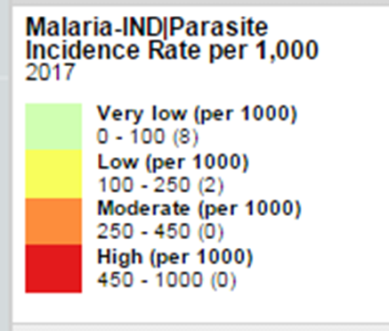
Endemic levels in 2017 using API

Slide 4
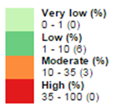
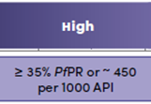
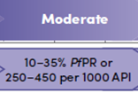
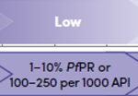
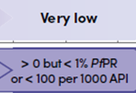
Updated Endemic levels using PfPR and Caseload

Slide 5
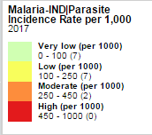
Compared 2017 API by health zones (WP, CIP, and MP)

Slide 6
Main Program Components
Vector control intervention (LLIN)
Case management interventions
Surveillance and program M&E
Management and coordination
Health Promotion and other cross-cutting health systems are very vital for effective performance

Slide 7
Vector Control Intervention
LLIN
A three-year cycle distribution for households and boarding schools
Continued distribution for pregnant mothers through ante-natal clinics
IRS: Ceased in 2015 due to technical, operational and resource constraints

Slide 8
Case Management Intervention
Test, treat, and track
Diagnostic services: RDT or microscopy
Treatment regimen: First line ACTs
Track: record, report through case based format with the “Malaria Case Management Register (MCMR)

Slide 9
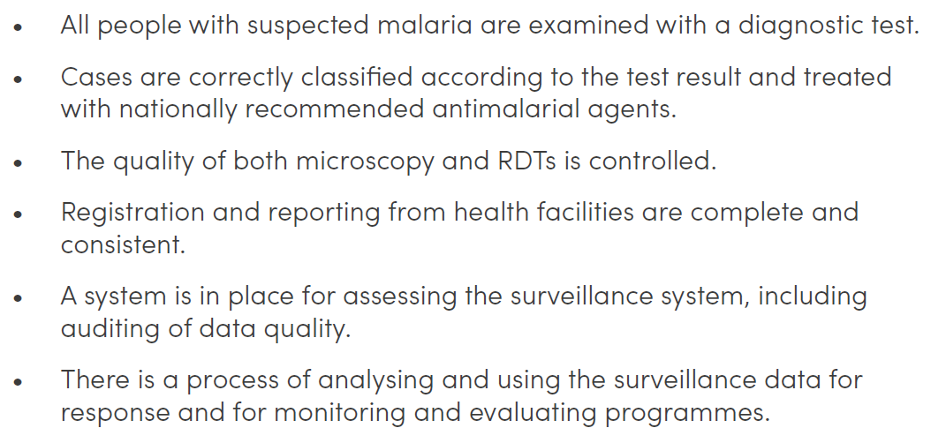
The initial focus will be on ensuring good-quality data, which is based on the following.
These conditions must be in place before countries transition to complex elimination surveillance systems.

Slide 10
Surveillance and M&E
M&E
Programmatic monitoring
Program review and evaluation
Surveillance (and response) – in progress
Information system development – DHIS2
System integration and development (RDP)

Slide 11
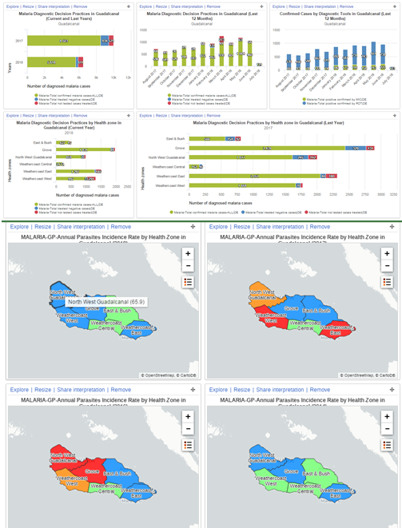
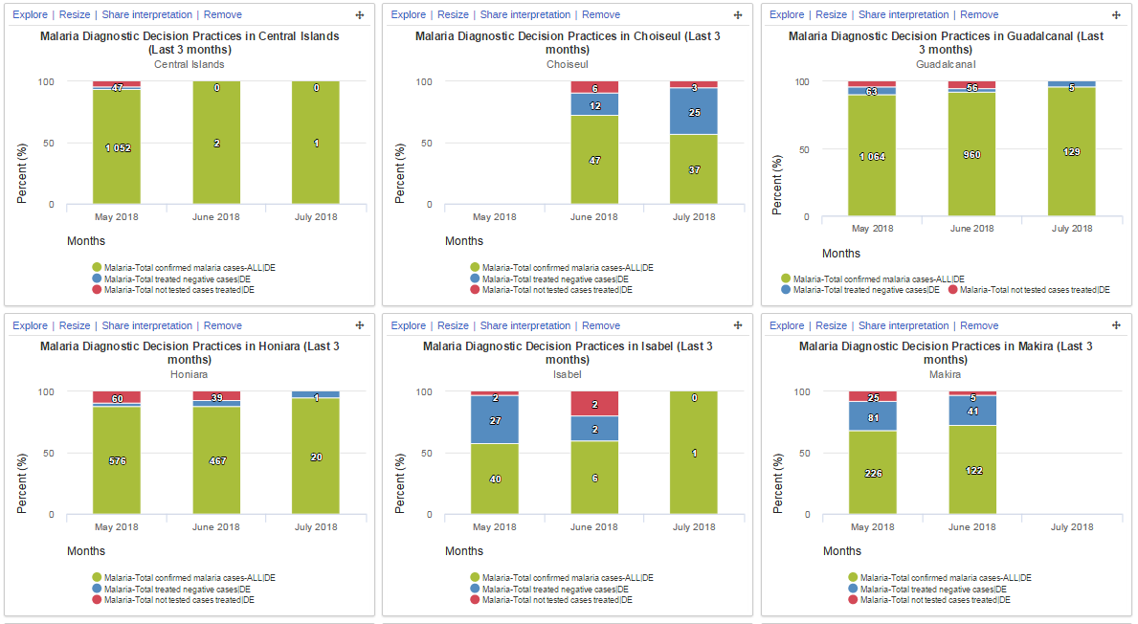
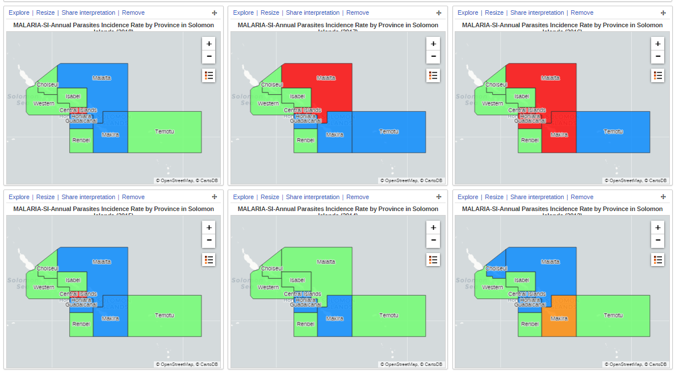
Malaria Information System (in DHIS2)

Slide 12
Health System Reform and Malaria
Health system reform
Decentralization and integration
Roles delineation policy (RDP)
All public health programs including malaria are aligning their operations with the reform process.

Slide 13
Health System and Malaria Elimination
It requires a robust health system in place at all levels including health facility level.
Under the RDP, it will prepare the health system to support malaria elimination.
Investing on malaria at elimination stage means investing on health system to prepare appropriate systems in place to support the elimination interventions in the current country context.

Slide 14
Program Management & Coordination
Advocates and support MHMS on the reform agenda through:
Aligning the operational plans with RDP and health reform principles (decentralized and integration)
Provide strategic intervention and guidance to provinces in line with RDP
Develop information system management and monitor the program performance
Transfer knowledge and skills to provincial level to increase performance and program impact.

Slide 15
Thank you very much

