Slide 1
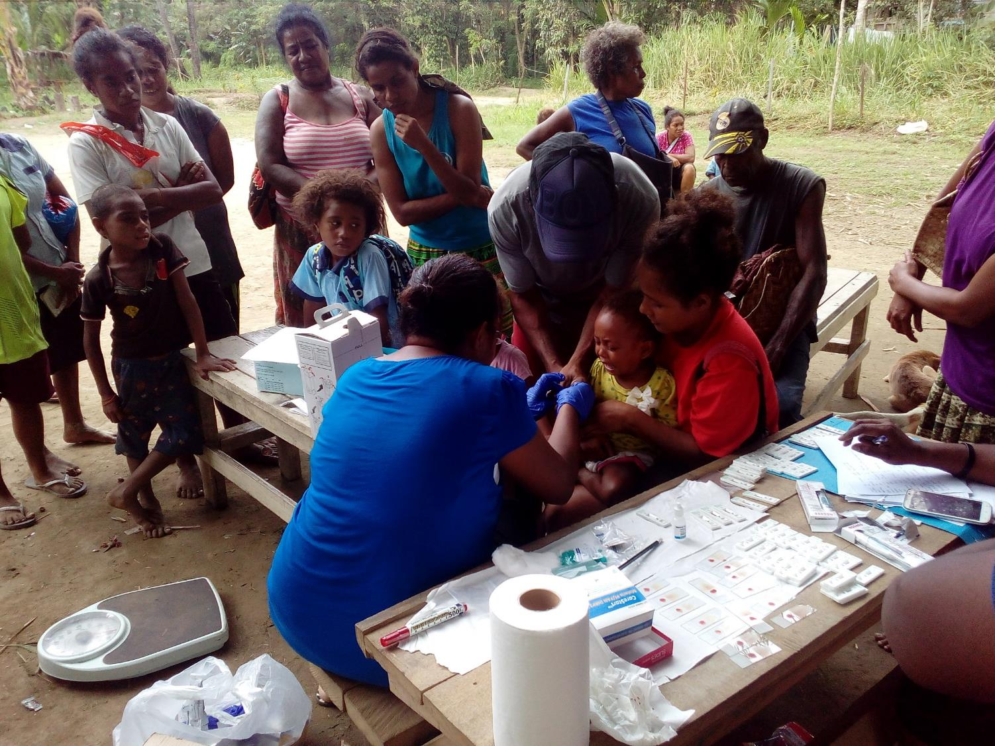


ROTARIANS AGAINST MALARIA
PAPUA NEW GUINEA
Chasing Malaria In PNG
Annual Report
August 2018 Gold Coast Australia
August 2018
Tim Freeman

Slide 2

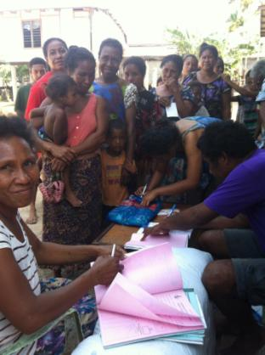
PNG – MALARIA PROGRAMME
RAM PROGRAMME
RAM PROGRAMME
Net Distribution
Drug Distribution
Health Facility Visits
Management Of Finances For IMR and NDOH
Chasing Malaria

Slide 3
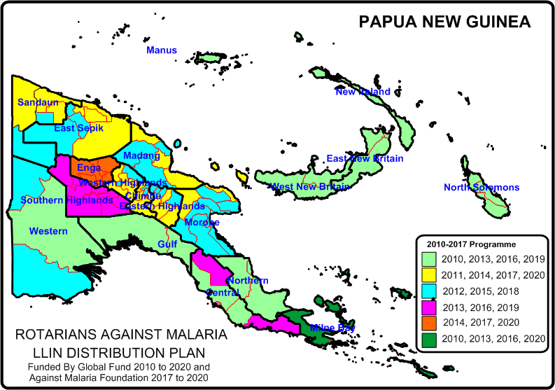
PNG - MALARIA PROGRAMME
LLIN DISTRIBUTION
RAM Distributes LLINs On A Three Year Basis To All Areas Of PNG
Presently in Lae and Madang and moving shortly to East Sepik and Western Provinces

Slide 4
PNG - MALARIA PROGRAMME
LLIN DISTRIBUTION
Distribution Of LLINs To Household Level

Slide 5
PNG - MALARIA PROGRAMME
LLIN DISTRIBUTION
Distribution Of LLINs To Vulnerable Groups

Slide 6
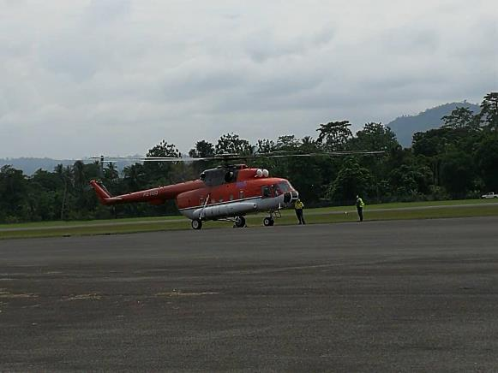
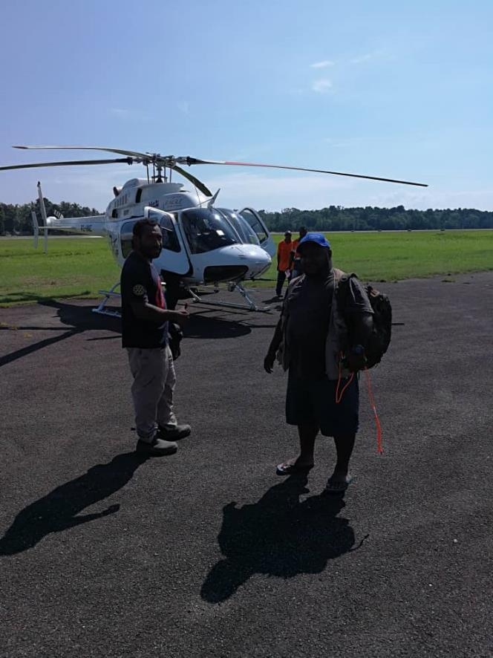
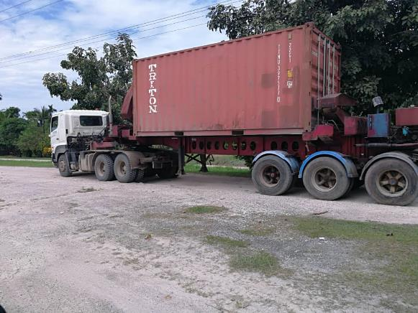
PNG - MALARIA PROGRAMME
LLIN DISTRIBUTION

Slide 7
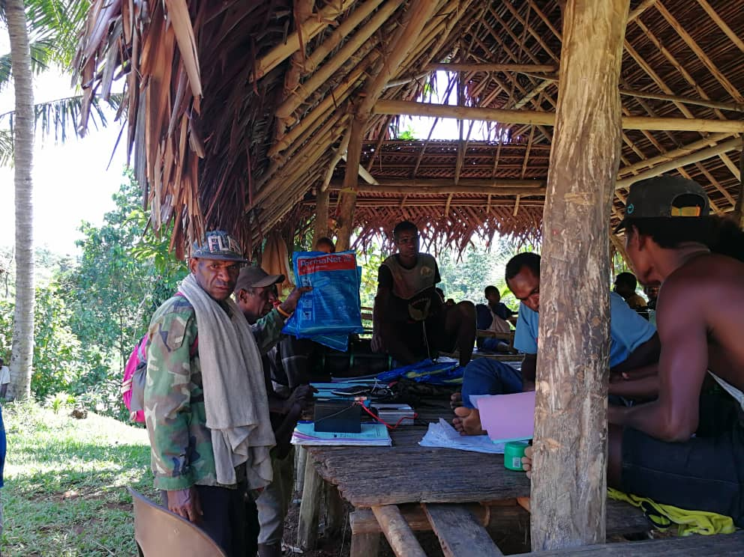
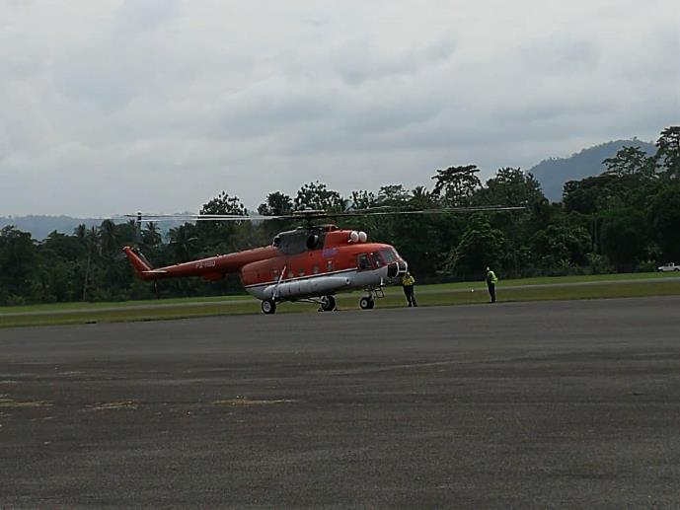

PNG - MALARIA PROGRAMME
LLIN DISTRIBUTION

Slide 8
PNG - MALARIA PROGRAMME
DRUG DISTRIBUTION
RAM programme now employs nine Regional Malaria Coordinators (RMCs) and five Provincial Malaria Supervisors (PMS)
RMCs visit all accessible health facilities (not Aid Posts) on a quarterly basis. At each health facility the RMCs carry out the following:
  Supply RDTs, ACTs and Antenatal LLINs to a predetermined level.
  Ensure that RDTs, ACTS are fully accounted for.
  Monitor testing and treatment of malaria.
  Ensure that all cases of malaria are recorded and data submitted to the NHIS.

Slide 9
PNG - MALARIA PROGRAMME
DRUG DISTRIBUTION

Slide 10
PNG - MALARIA PROGRAMME
DRUG DISTRIBUTION
Since January 2018, RMCs have visited all provinces at least once except for Hela Province which still have security issues following the earthquakes there earlier this year.
16 out of 22 provinces already visited twice.
RAM is working very closely with the National Department of Health Supply Division. RAM is filling in stock shortages of ACTs and RDTs throughout PNG and has distributed both RDTs and ACTs from Global Fund and from government of PNG in a combined distribution.

Slide 11
PNG - MALARIA PROGRAMME
DRUG DISTRIBUTION
RDTs and ACTs stored in Government Store
In total, from January to June 2018, RAM has distributed:
  about 680,000 RDTs (380,000 from GF stocks and about 300,000 from NDoH stocks)
  About 300,000 ACTs (about 230,000 from GF stocks and about 70,000 from NDoH stocks).
Since July 2017 there have been no significant shortages of malaria commodities to this time.
Only problem to date is that one cartoon of drugs has been lost in transit through Air Niugini.

Slide 12
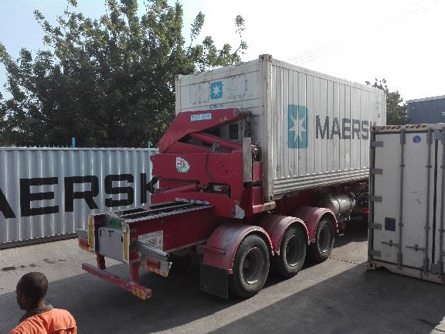
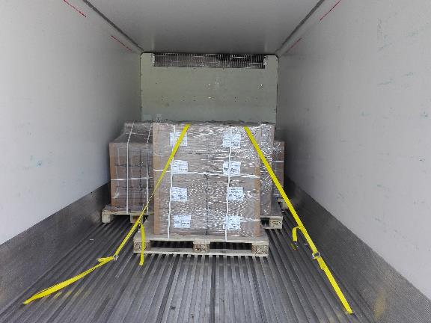
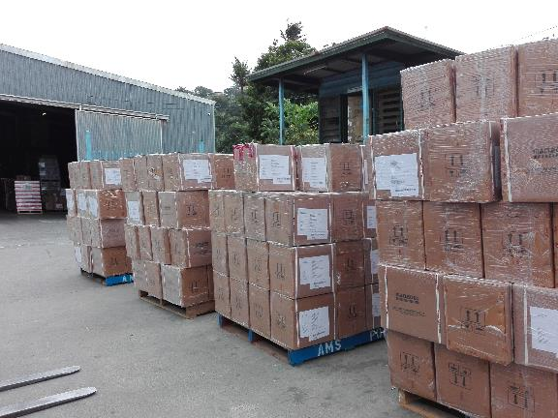
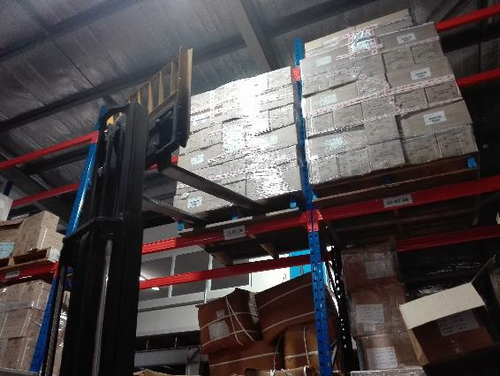
PNG - MALARIA PROGRAMME
DRUG DISTRIBUTION

Slide 13
PNG - MALARIA PROGRAMME
SUPERVISION
  Estimated that 30-40% cases of malaria are not recorded. This has made quantification of ACTs and RDTs very difficult.
  Negative cases are often not recorded.
  Many other malaria cases still not recorded, particularly clinically diagnosed malaria cases. This results in RDTs being better reconciled than ACTs.
  Reporting to the National Health Information System (NHIS) is very slow. For this reason RAM has send two teams to two provinces to resolve problems in reporting.

Slide 14
PNG - MALARIA PROGRAMME
INSTITUTE OF MEDICAL RESEARCH
  RAM is managing finances of IMR in three studies being supported by the Global Fund.
  Stratification of malaria in PNG in 2018.
  Insecticide Resistance in 2018 and 2020.
  Malaria Indicator Survey in 2019 – 2020.

Slide 15
PNG - MALARIA PROGRAMME
INSTITUTE OF MEDICAL RESEARCH
  STRATIFICATION
  It is presently assumed that the stratification of malaria in PNG is as follows:
  0-1200m Malaria is endemic
  1200-1600m Malaria is epidemic
  1600-2000m Only P. vivax is transmitted
  2000m and over No malaria transmission.
  This study is to determine if these limits are still good in the environment of Global Warming

Slide 16
PNG - MALARIA PROGRAMME
INSTITUTE OF MEDICAL RESEARCH
  Malaria Indicator Survey
  This is a national malaria survey which covers all provinces. It looks primarily at three things,
  LLIN Coverage and Usage
  Treatment seeking practices
  National Prevalence
  (Note LLIN Coverage has remained consisten for seven years)

Slide 17
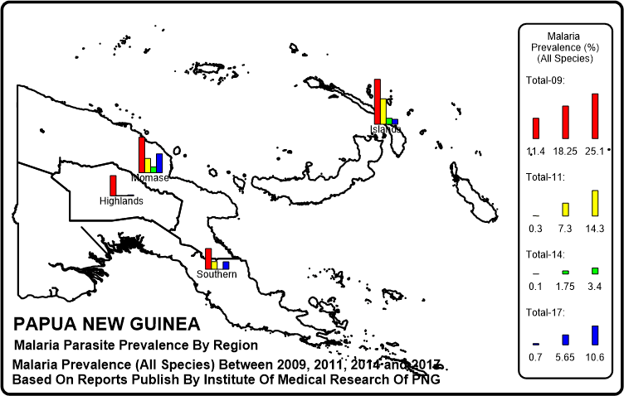
PNG - MALARIA PROGRAMME
INSTITUTE OF MEDICAL RESEARCH
  Malaria Indicator Survey

Slide 18
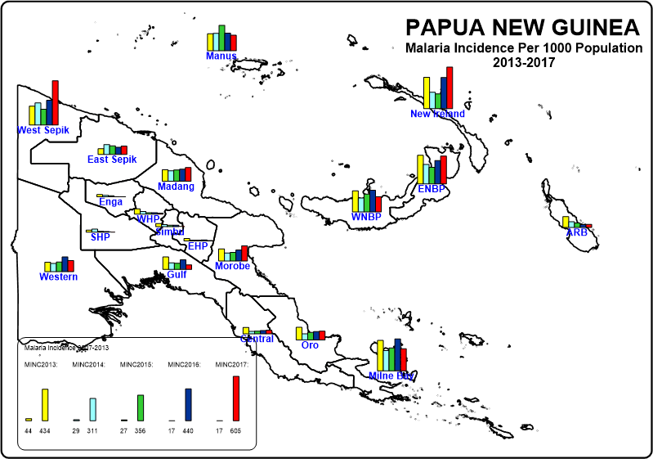
PNG - MALARIA PROGRAMME
MALARIA INCIDECE

Slide 19
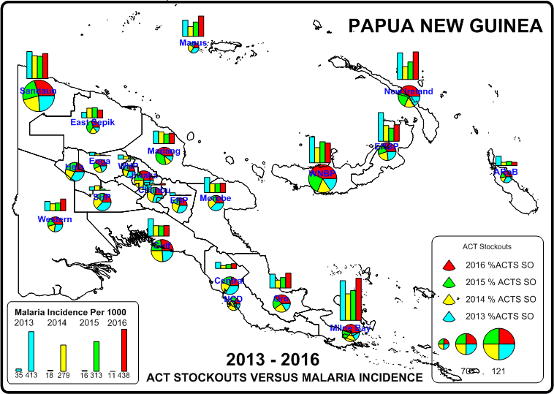
PNG - MALARIA PROGRAMME
MALARIA INCIDECE

Slide 20
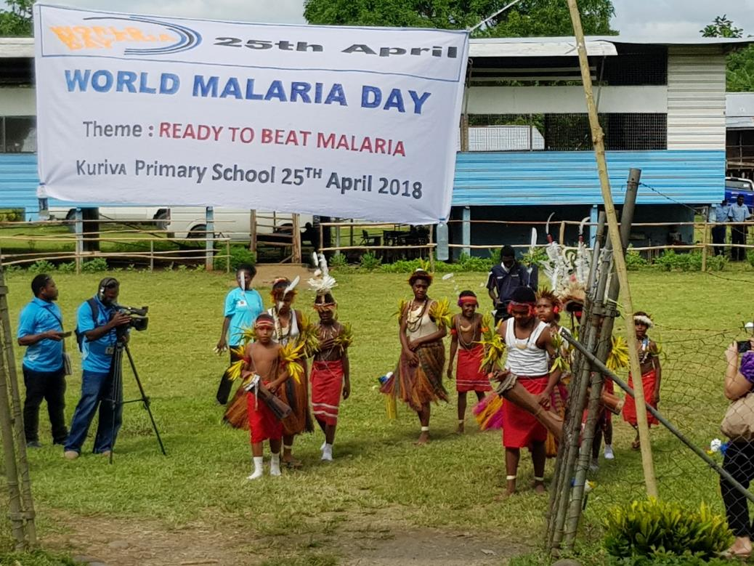
PNG - MALARIA PROGRAMME
CHASING MALARIA
Working now in collaboration with WHO, NDoH Malaria Programme,CPHL and Central Province PHA

Slide 21
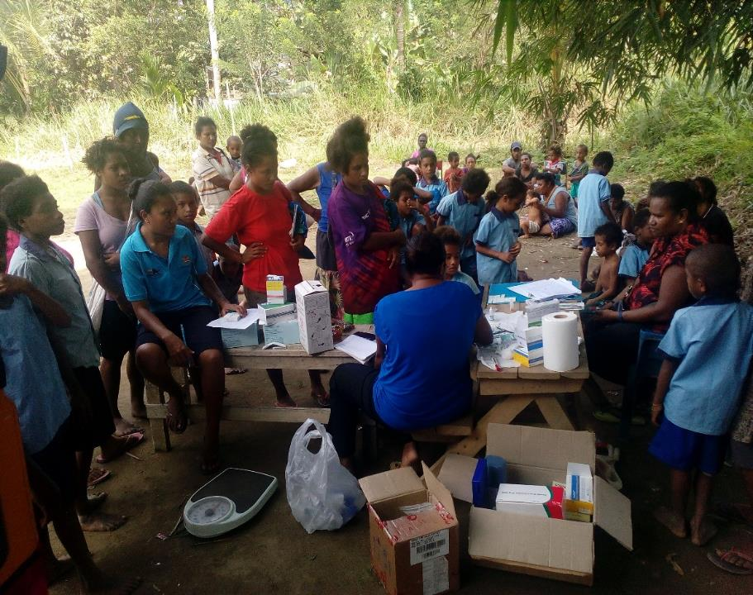
PNG - MALARIA PROGRAMME
CHASING MALARIA
As a result of World Malaria Day it was decided to carry out malaria prevalence surveys in primary schools

Slide 22
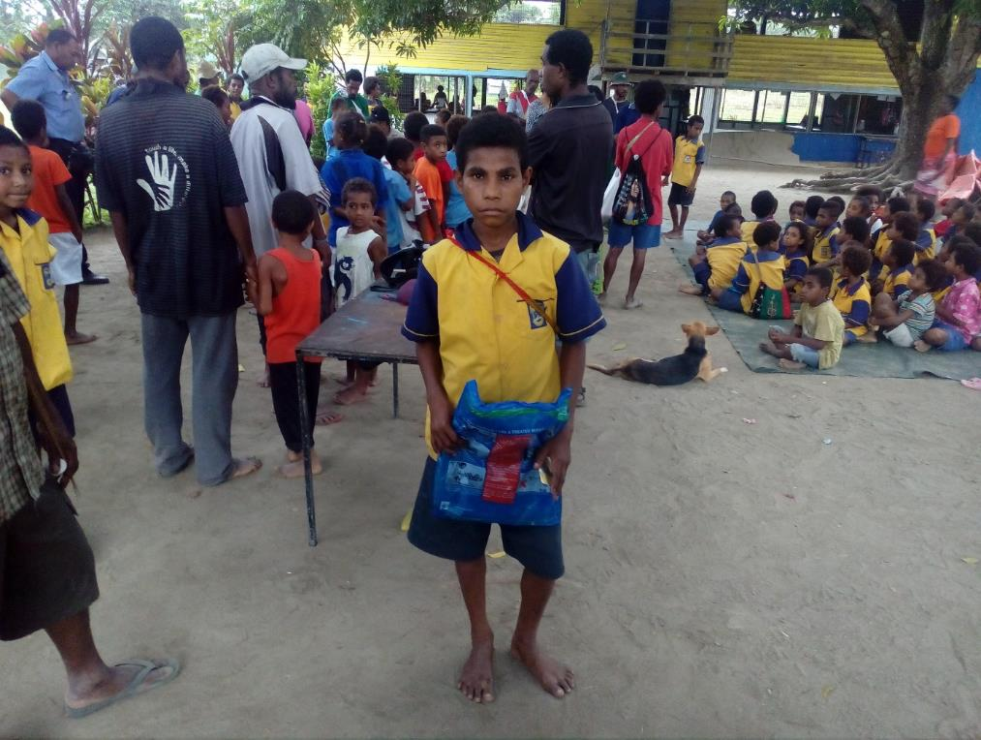
PNG - MALARIA PROGRAMME
CHASING MALARIA
Nets were given to RDT Positive Cases through the Chasing Malaria Programme

Slide 23
PNG - MALARIA PROGRAMME
CHASING MALARIA
Prevalence Rates Carried Out In April/May 2018 In Different Schools IN The Kuriva Area Of Central Province

Slide 24
PNG - MALARIA LLIN PROGRAMME
CHASING MALARIA
MAPPING IN CENTRAL AND NCD PROVINCES
Since late 2014, RAM has been giving nets away for all RDT positive cases. This has encouraged people to get tested while allowing health staff to collect data on malaria cases throughout the two provinces.
We also collect data on the travel history of the patients.

Slide 25
PNG - MALARIA LLIN PROGRAMME
CHASING MALARIA
LLINs Given Out For Positive Cases Of Malaria In Central, NCD and Gulf Provinces

Slide 26
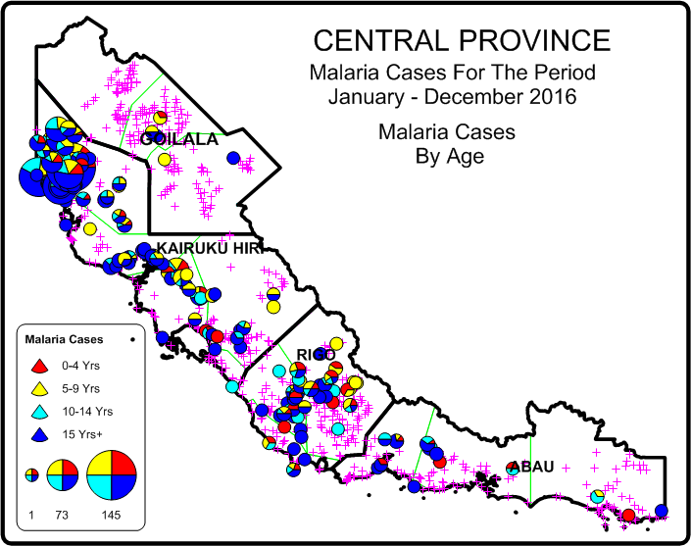
PNG - MALARIA LLIN PROGRAMME
CHASING MALARIA
MAPPING IN CENTRAL PROVINCE
Based on this map, Chasing Malaria has concentrated its activities in the Waima and Bereina areas of Kairuku

Slide 27
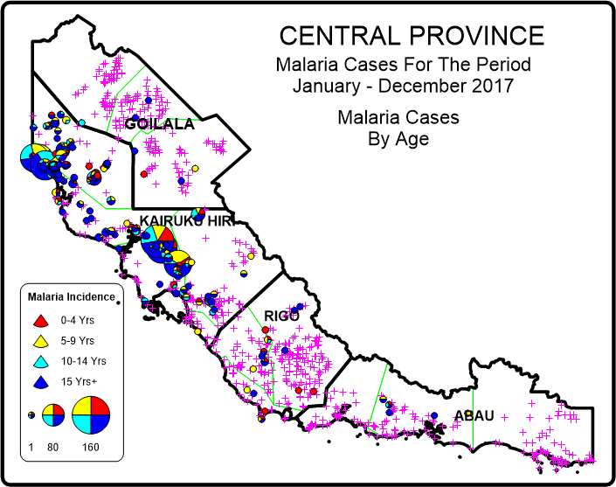
PNG - MALARIA LLIN PROGRAMME
CHASING MALARIA
MAPPING IN CENTRAL PROVINCE
This map shows reduced malaria in Waima and Bereina but increased malaria in the Kuriva area

Slide 28
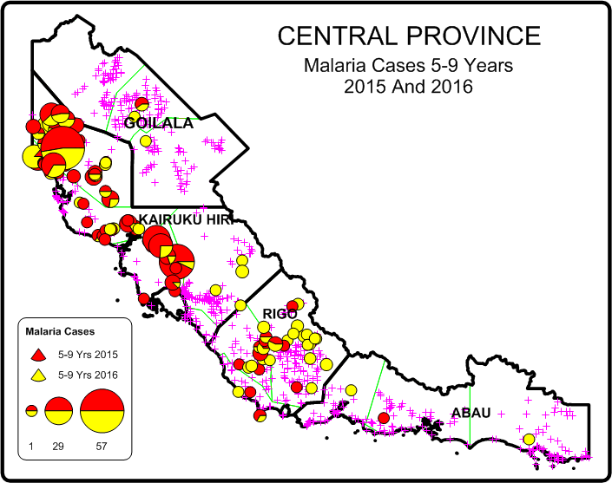
PNG - MALARIA LLIN PROGRAMME
CHASING MALARIA
MAPPING IN CENTRAL AND NCD PROVINCES

Slide 29
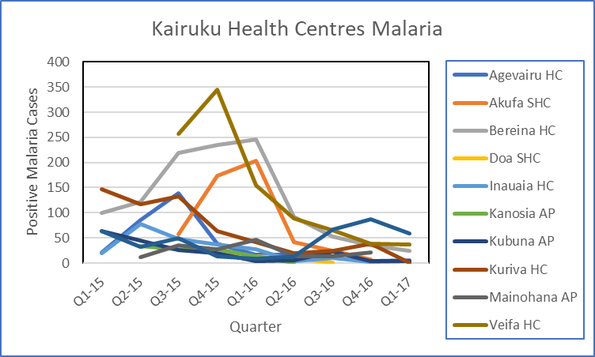
PNG - MALARIA LLIN PROGRAMME
CHASING MALARIA
MAPPING IN CENTRAL AND NCD PROVINCES

Slide 30
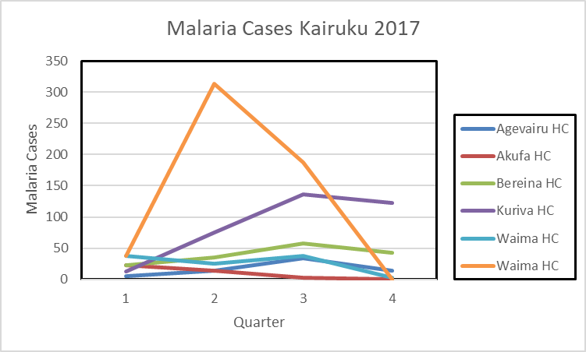
PNG - MALARIA LLIN PROGRAMME
CHASING MALARIA
MAPPING IN CENTRAL AND NCD PROVINCES

Slide 31
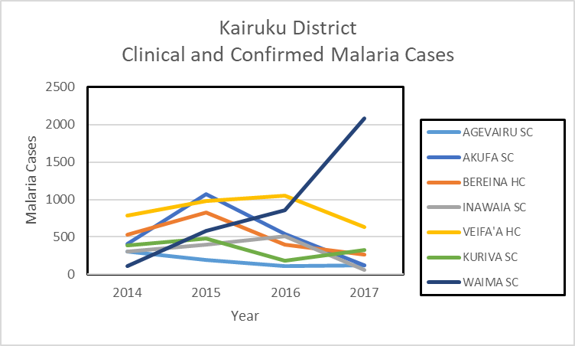
PNG - MALARIA LLIN PROGRAMME
CHASING MALARIA
MAPPING IN CENTRAL AND NCD PROVINCES

Slide 32
PNG - MALARIA LLIN PROGRAMME
POSSIBLE PROBLEMS
POSSIBLE REASONS FOR INCREASES IN MALARIA
Treatment failure
  Drugs resistance
  Substandard medicine
  Non compliance of taking full course or sub optimal doses
  Expired drugs
  Health Staff giving wrong doses
  Diagnostic Test (RDTs) problems
  Treatment seeking behaviour
  Health Staff behaviour
Shortage of antimlaria commodities

Slide 33
PNG - MALARIA LLIN PROGRAMME
POSSIBLE PROBLEMS
POSSIBLE REASONS FOR INCREASES IN MALARIA
People not going for treatment due to access (Kuriva Population spread out)
Human behaviour
  Not sleeping under nets, not repairing nets
Mosquitoes biting earlier so increasing contact with mosquitoes.
People staying up late e.g. watching village cinema
LLINs no longer working
  not treated properly.
  Insecticide resistance
  Nets not being repaired

Slide 34
PNG - MALARIA LLIN PROGRAMME
PARTNER INTERVENTIONS
Verify Cause Of Problems. Carry out the following investigations.
  Therapeutic Efficacy Studies (TES) (NDoH)
  Insecticide Resistance Studies (IMR)
  Test bednets for efficacy (IMR)
  Entomological studies include speciation and when mosquitoes are biting (IMR).
  Study of people night time behaviour (RAM to lead).

Slide 35
PNG - MALARIA LLIN PROGRAMME
INTERVENTIONS
Mapping of area to show villages in relationship to health centres and schools.
Look for other partners or organisations working in the area
Identify any church or other local action groups
Introduce School Health Master and possible Village Volunteers for testing and treatment of malaria in remote locations.
Ensure that health centre does not run out of malaria commodities (RAM).
Health education of schools and villages
School Projects to carry out health education and larval control – this can be extended to villages where volunteers are willing.

Slide 36
PNG - MALARIA LLIN PROGRAMME
FUTURE
RAM will continue to work in Waima but will now concentrate on this new area called Kuriva.
However ownership remains a big problem – communities happy to work when RAM staff are present and but do nothing when RAM staff are away. In this respect trying to identify any strong local groups (e.g. Church or women’s groups) working in the area with whom RAM Chasing Malaria Team can win.

Slide 37
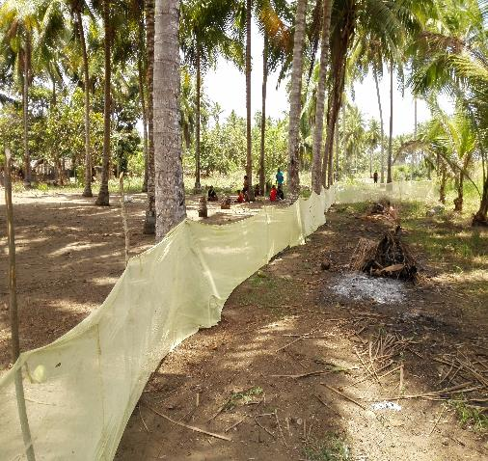
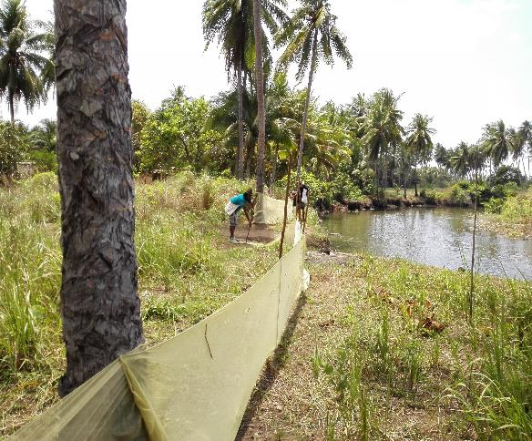
PNG - MALARIA LLIN PROGRAMME
OTHER ACTIVITIES
Intervention Failure
No impact on malaria and continually destroyed by pigs

Slide 38
PNG - MALARIA LLIN PROGRAMME
CHASING MALARIA
Community Involvement
RAM has been working in 2018 with communities in the Kairuku area of Central Province where malaria was the worst and does not appear to have reduced by very much, particularly in the Waima area.
Working closely with four health centres.
Presently working with 15 schools and many communities to encourage looking for breeding sites of malaria on a weekly basis.
School teachers and children are educated in malaria and asked to form school clubs which should look for larvae on a weekly basis.

Slide 39
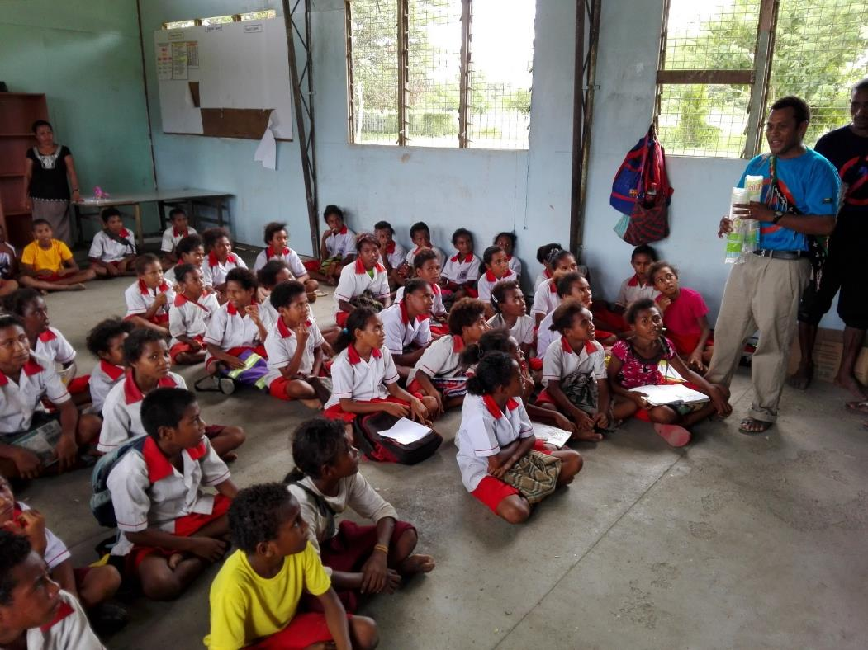
PNG - MALARIA LLIN PROGRAMME
CHASING MALARIA
Community Involvement

Slide 40
PNG - MALARIA LLIN PROGRAMME
CHASING MALARIA
Community Involvement
Ensuring that all health centres are recording malaria on a regular basis.
We work with schools and communities trying to destroy breeding sites through filling in puddles of water, larviciding, covering water places, fish.
Also set up barrier of old mosquito nets to see if this would stop malaria.

Slide 41
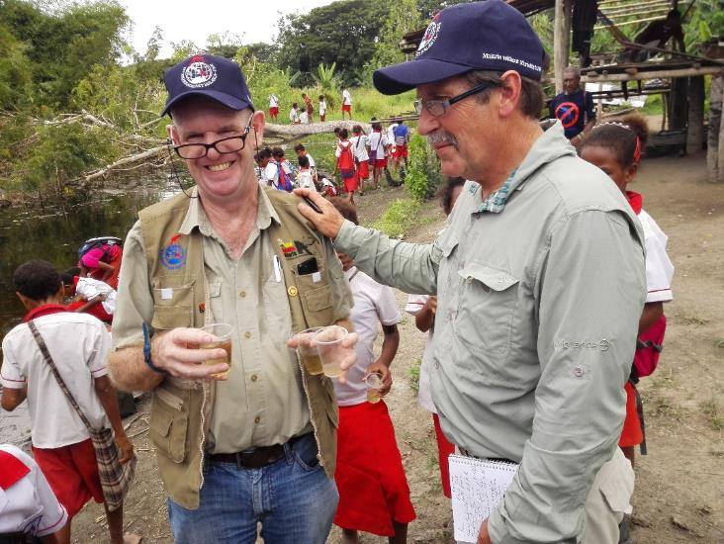
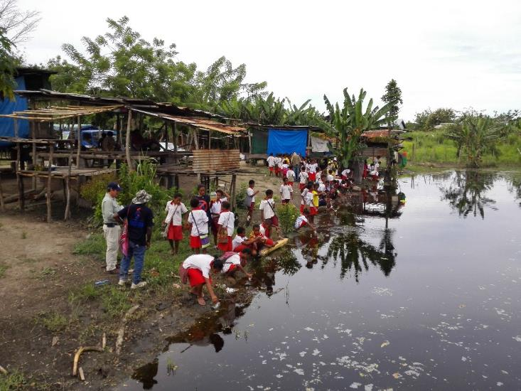
PNG - MALARIA LLIN PROGRAMME
CHASING MALARIA
Community Involvement

Slide 42
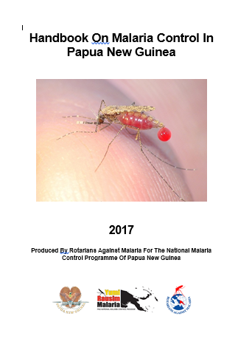
PNG - MALARIA LLIN PROGRAMME
CHASING MALARIA
Manual On Malaria Control
RAM has printed a practical guide to malaria control at national and community level.
5000 copies in A5 size to be distributed to all health centres and schools in the country.
Written by RAM in collaboration with WHO staff and NDoH.

Slide 43
PNG - MALARIA LLIN PROGRAMME
CHASING MALARIA
Private Sector Sale Of Nets
RAM had engaged a salesman in 2014 and 2015 to sell nets around Port Moresby.
Revenue from his sales supported his salary.
Salesman left and nets in supply chain few so this was abandoned.
It is hoped that this will now be resurrected. We would like to have a target of LLINs being sold in every district capital in PNG so that people can replace their nets when there wear out early.

Slide 44
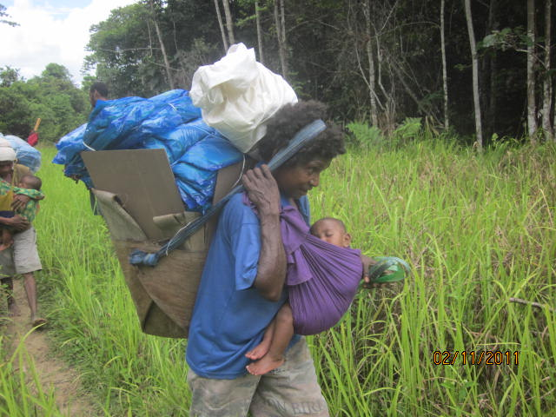
PNG - MALARIA LLIN PROGRAMME
Next Steps (3)
Initial Data From Chasing Malaria Project Showing Malaria Cases Recorded In NCD and Hiri and Kairuku District Of Central Province
The Realities Of Distributing Nets In PMG

Slide 45
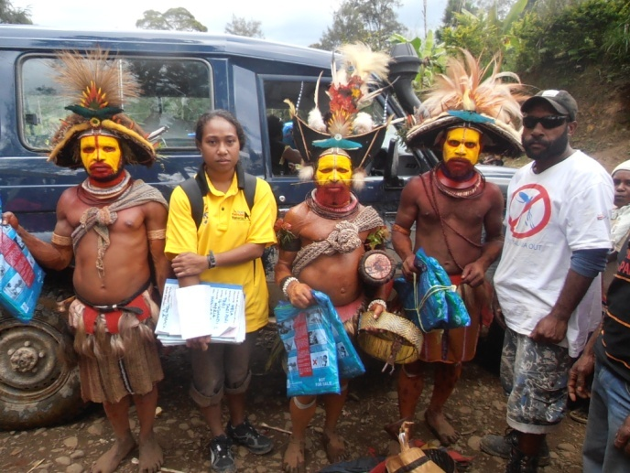
Thank You Very Much
Tenk Yu Tru
Tanikiu Bada Herea
PNG - MALARIA LLIN PROGRAMME

