Slide 1
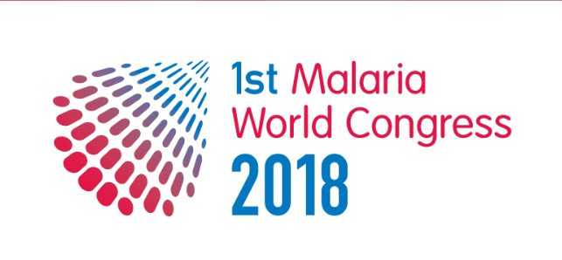
RAM Conference, Griffith University, August 2018
Presenter: Associate Professor Helen Evans
Co-Chair of the 1st MWC

Slide 2
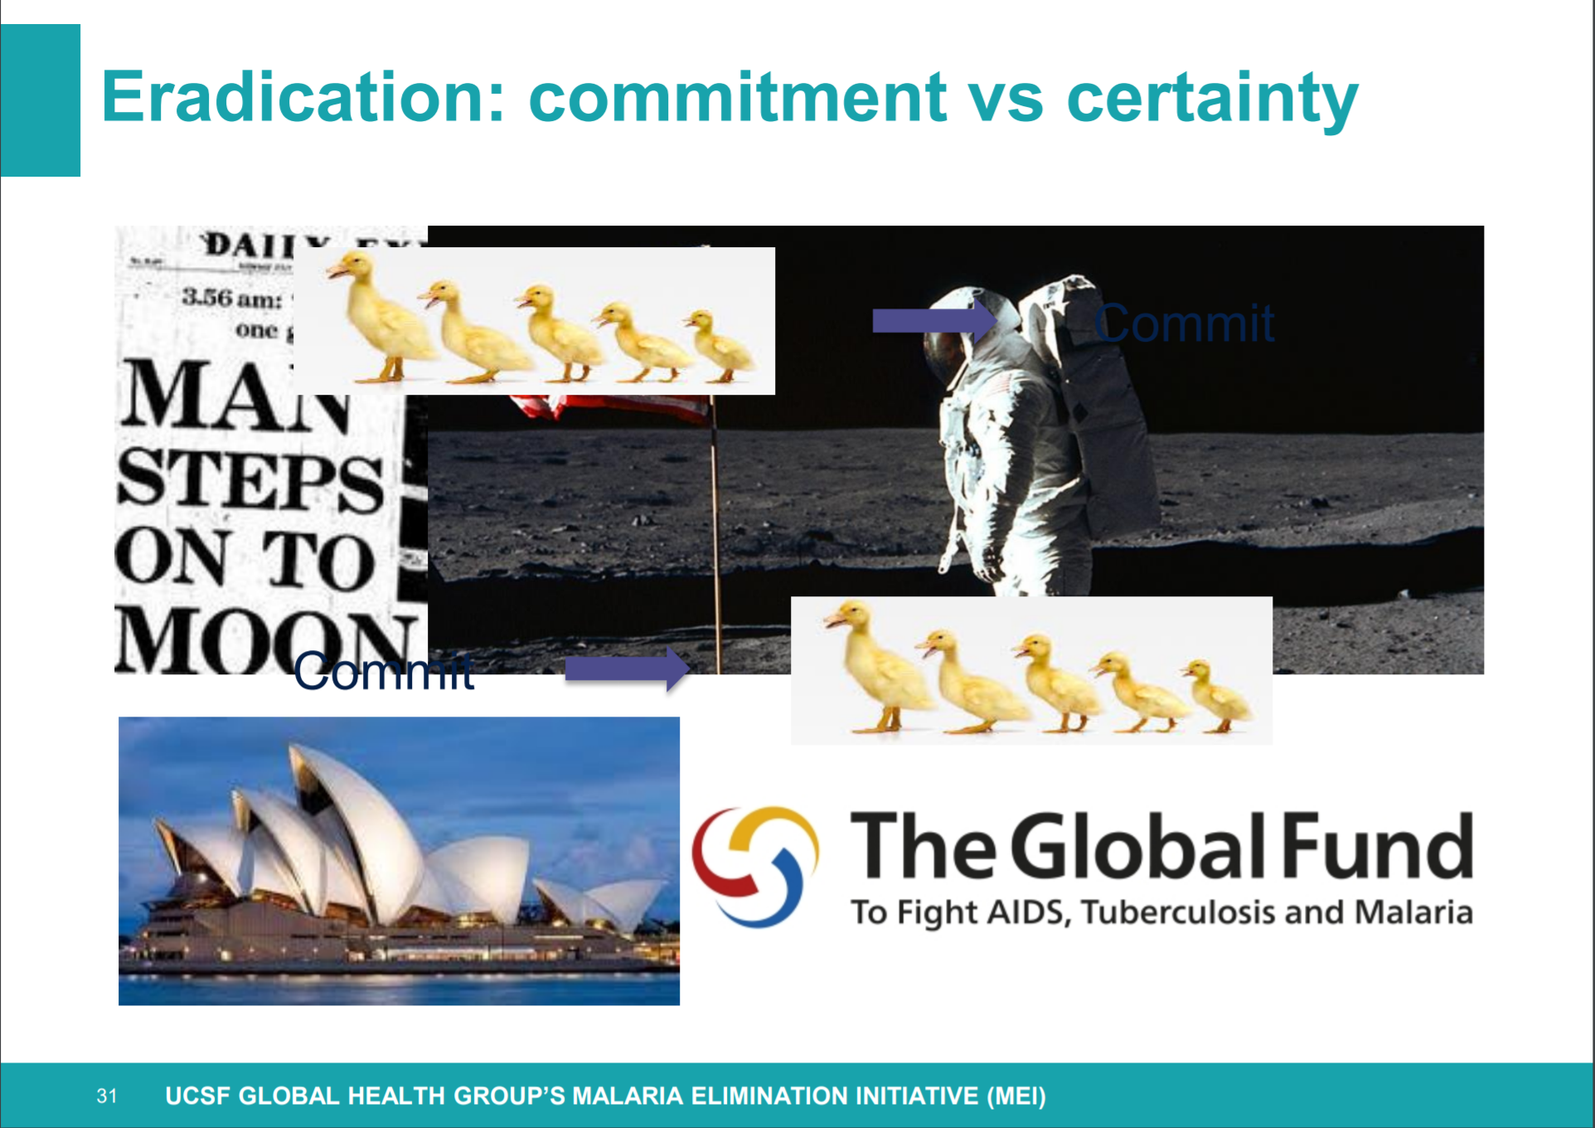

Slide 3
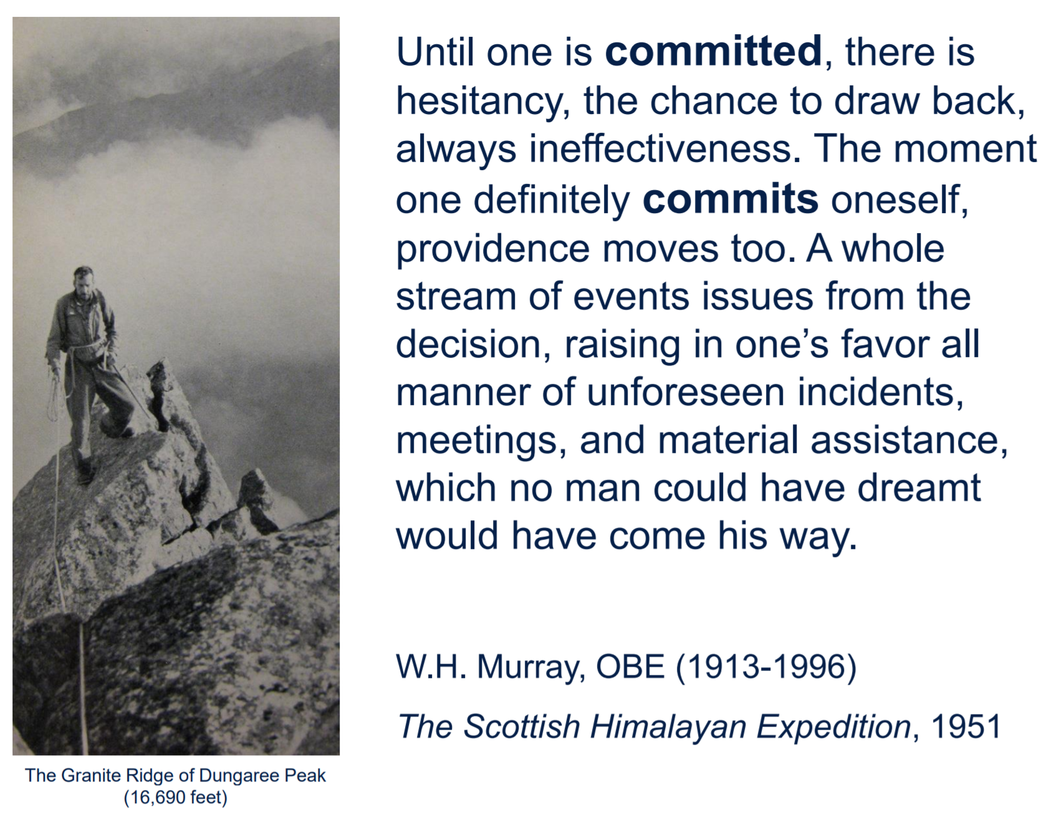

Slide 4
Objectives
Facilitation of collaboration between those directly affected by the disease, implementers, scientists, funders & technical agencies, government representatives & other policy makers, non-government organisations & private sector.
Address gaps in knowledge and communication within and across sectors to meet elimination targets
Position malaria elimination within the Universal Health Coverage and Sustainable Development Goals
Strengthen political commitment and action towards malaria elimination

Slide 5
3 Key Themes
The Congress was structured around 3 key themes:
Malaria Today - The recent history and present of malaria control and elimination efforts
Malaria Elimination in a Global Health Context - how malaria sits within the broader global health context, with focus on the Sustainable Development Goals, Universal Health Care and health security
Meeting the Challenges of Malaria Elimination & Eradication - how we move forward together to enable sustainable impact in malaria endemic countries

Slide 6
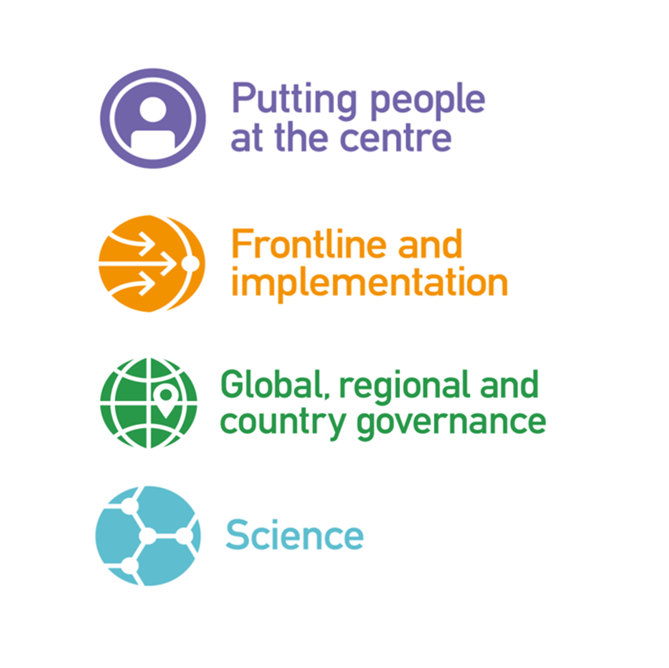
4 Pillars
Notes:
Rationale captured within the 4 pillars.
Putting People at the Centre – the affected communities themselves;
Frontline – implementation of malaria interventions at scale;
Global, Regional & Country Governance – Leadership driving goals;
Science – including applied and socially-focused research;
The Congress aims to bring each of these pillars together and discuss issues and lessons learnt across the sectors. Implementation will be addressed both globally and also in the different countries and regions, including those that are not part of the Commonwealth, linking these firmly with the science agenda.

Slide 7
What is the aspiration for malaria?
Control | Non-specific term for reduction of disease incidence, prevalence, morbidity, and/or mortality to a locally acceptable level as a result of deliberate efforts; continued intervention measures are required to maintain the reduction.
Elimination of transmission | A reduction to zero of the incidence of infection caused by a specific pathogen in a defined geographical area, with minimal risk of reintroduction, as a result of deliberate efforts; continued actions to prevent re-establishment of transmission may be required.
Verification | The process of documenting elimination of transmission.
Elimination as a public health problem | Defined by achievement of measurable global targets set in relation to a specific disease. When reached, continued actions are required to maintain the targets and/or to advance the interruption of transmission.
Validation | The process of documenting elimination as a public health problem.
Eradication | The permanent reduction to zero of a specific pathogen, as a result of deliberate efforts, with no more risk of reintroduction
Certification | The process of documenting eradication
Extinction | Eradication of a specific pathogen so that it no longer exists in nature or the laboratory.
Notes:
3 Essentials for successful eradication
Technical feasibility
Global advocacy
Negotiation amongst political leaders to transform political will into action – often by a consensus
resolution
Polio had a vaccine, easy clinical diagnosis, transmission was mainly poor hygiene and contaminated water, no animal reservoir

Slide 8
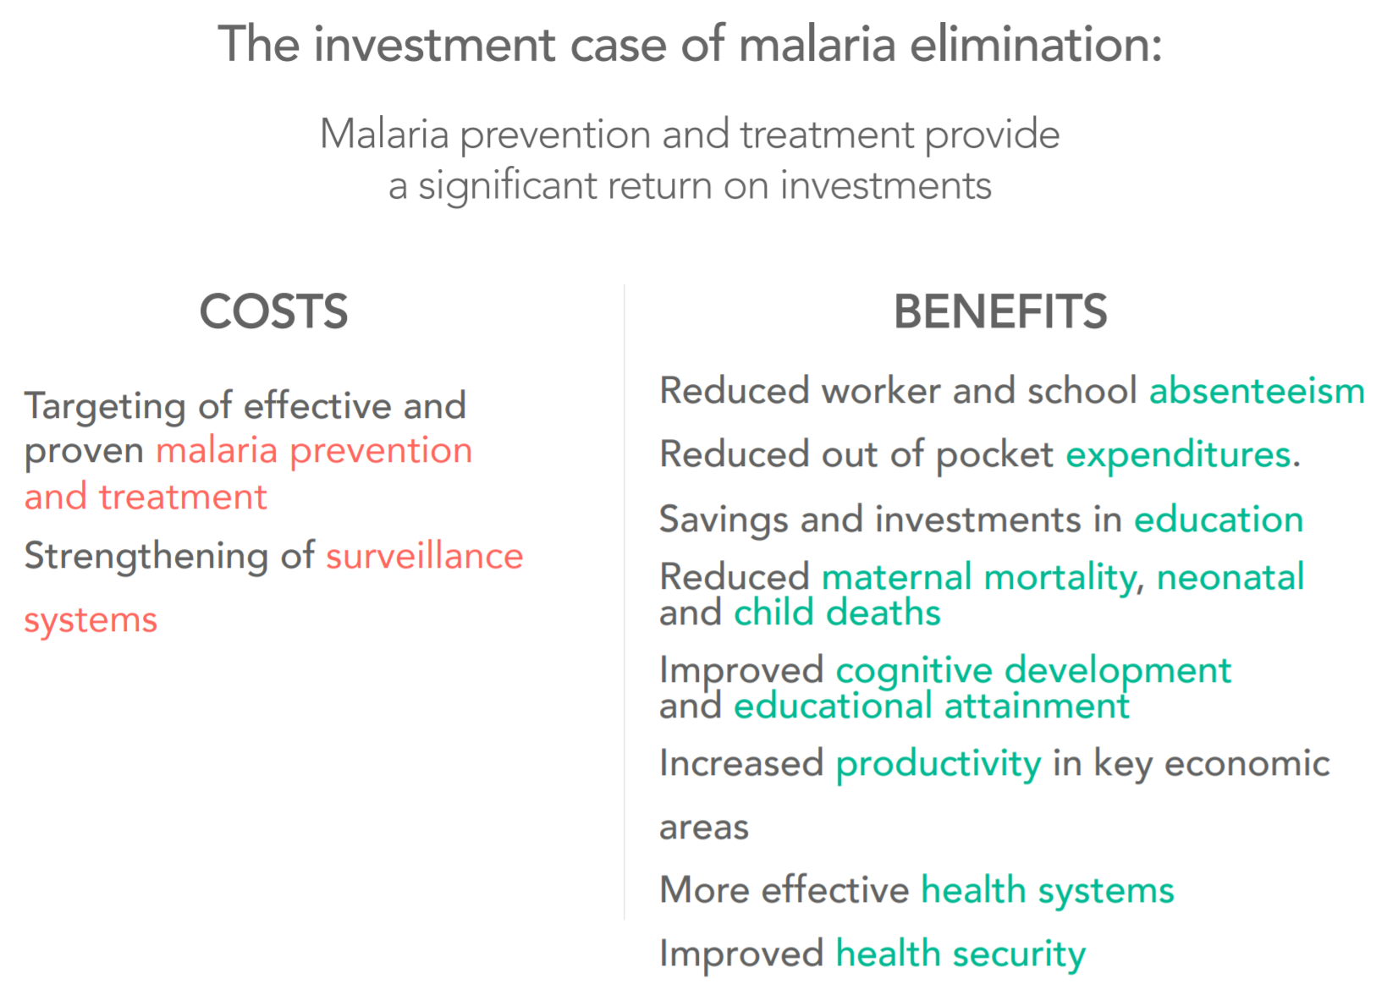

Slide 9
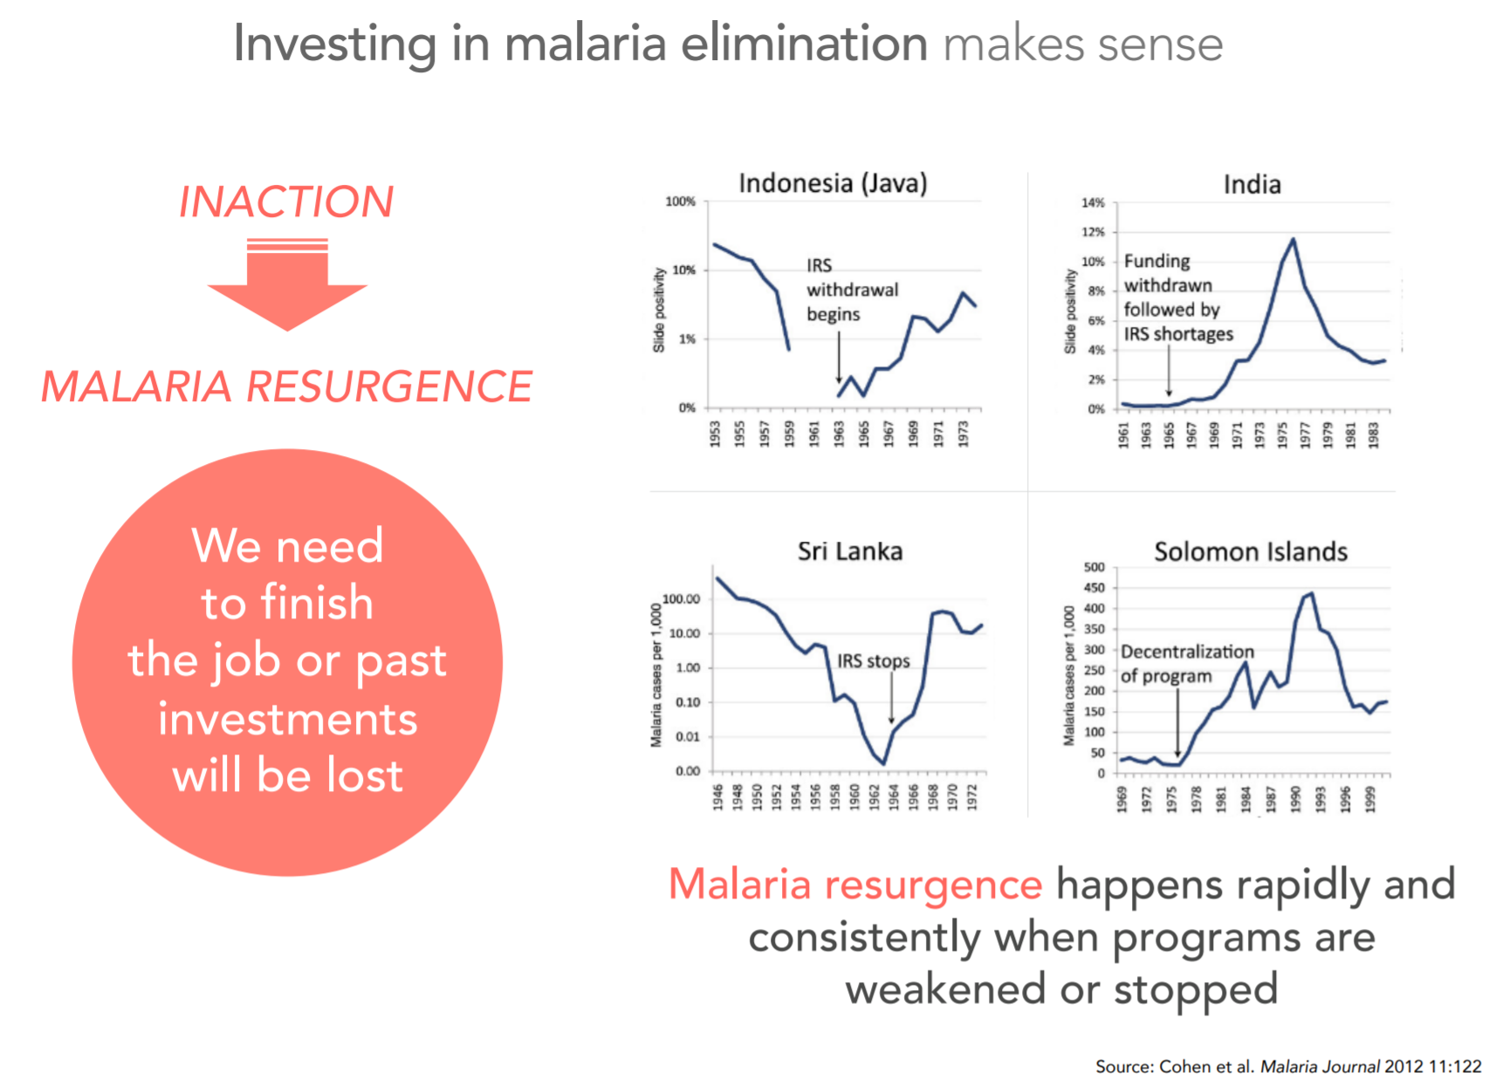

Slide 10
Universal health coverage
For malaria, UHC means that effective preventive measures are in place throughout a country
Those that develop malaria receive appropriate treatment close to their homes
No-one is impoverished in the process of accessing health care.
Notes:
From ‘systems’ to universal health coverage…The specific domain of health systems analysis attempts to link analyses of how humanly devised institutions to promote human health, function as a whole to do so effectively, or not. The idea of Universal Health Coverage requires a level of functionality of these institutions underpinned by political, economic and social domains.

Slide 11
Key Outcomes
Congress Statement of Action : “The Status Quo is not OK”
Think creatively outside existing solutions and promote scientific and social innovation: “create a culture of problem-solving not task-performing”.
Engage vulnerable communities and civil society as equal partners in this fight.
Listen then act collaboratively.
Hold ourselves to account. Facilitate cross-sector conversations and relationships.
Commit to mobilising increased and sustained financing for malaria control and elimination.
  "The status quo is NOT OK” - Outlines principles & priority areas for actions, informed by the wider malaria community
  Supports the agreed Regional and Global Targets & Goals
  Urges all parts of the sector to collaborate towards elimination

Slide 12
Legacy of recurring MWC
  Global governing council for a periodic Malaria World Congress
  Establishment of CS4ME, the Global CSO malaria network

Slide 13
Global Civil Society for Malaria Elimination (CS4ME) Declaration
Frame malaria response in the context of social justice and human rights, and within equitable UHC systems
Make malaria decision making space more inclusive and support malaria civil society mobilisation
Fully meet the funding needs for the malaria response and for health and community systems strengthening
Partner with civil society and community actors for effective malaria surveillance and response systems

Slide 14
THANK YOU

Slide 15
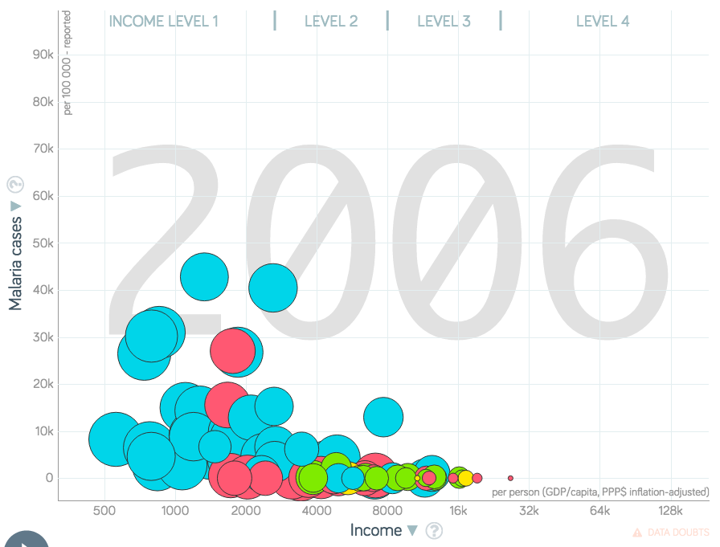
Malaria: a disease of poverty
There’s surprisingly little analysis of the association between malaria incidence and socio-economic status
Another of the Gapminder graphs shows that it occurs in the poorest countries (bubble size now = poverty headcount)
A few analyses confirm that even in poor communities within such countries, the poorest are most at risk (eg. RR malaria incidence 1.23 for poor compared to less poor in western Kenyan rural county: Were et al. 2018)
Malaria is both cause and effect of poverty (llunga-llunga, 2015)
Successful investments in malaria control have been shown to contribute to poverty reduction at the household level and to increases in economic productivity in industry (Purdy et al., 2013)
Notes:
Hence, the SDG perspective – that malaria needs to be addressed as a development issue rather than biomedical problem, can be understood.

Slide 16
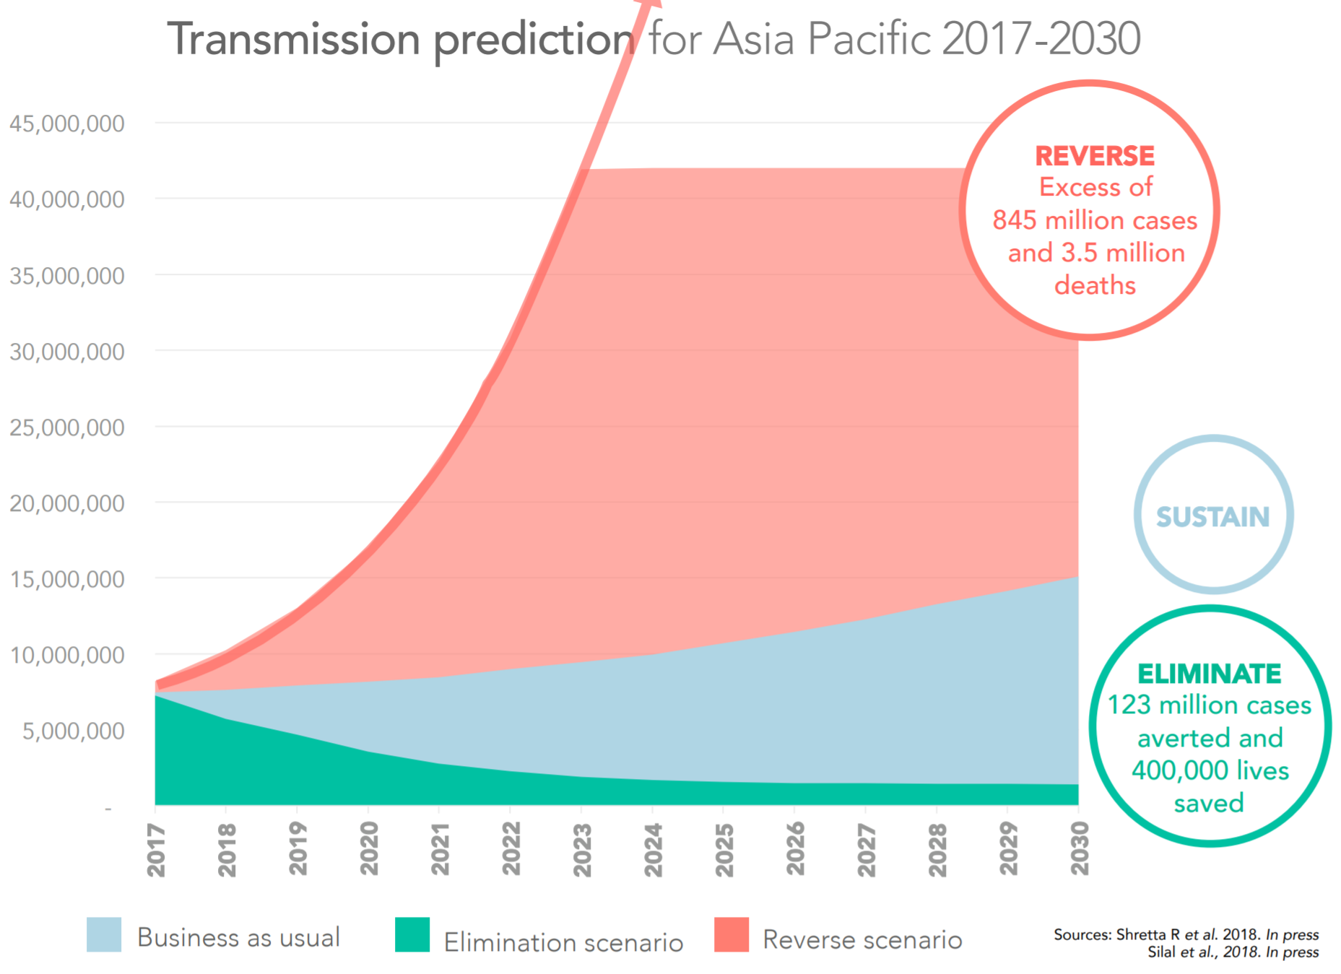
Notes:
Economic benefit of elimination in the period 2017-2030 US$ 90 billion
Return on investment 6 : 1

