Slide 1
Why it will be hard to eliminate malaria
Prof G. Dennis Shanks
COL US Army (retired)
Director, ADF Malaria and Infectious Disease Institute, Brisbane

Slide 2
Malaria Elimination is Different than Control
Elimination means killing the last parasite in a population / area
Leaving a few asymptomatically infected persons risks future epidemics
The hardest part will be getting rid of relapsing (vivax) malaria

Slide 3
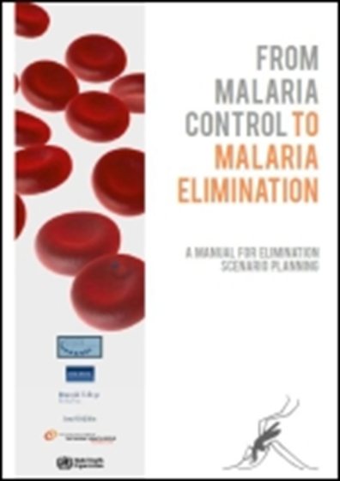
Malaria Elimination in Phases
Reduce death and illness with drugs
Control transmission with bet nets / spray
Eliminate residual parasites in human reservoir

Slide 4
Global Progress Against Malaria
Philippines, Malaysia, Vietnam, Thailand, China, Nepal and Bhutan are all nearing malaria elimination

Slide 5
Progress Against Malaria Indonesia

Slide 6
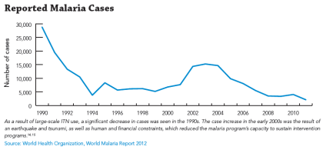
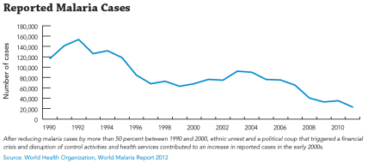
Vanuatu and Solomon Islands
Vanuatu 94 % decline in malaria cases 2000 -2015 from 6,768 to 423 cases
No malaria south of Vila in Vanuatu but still a problem in Santo, Pentecost
Solomon Islands 65% decrease in reported malaria cases 2000-2015 from 68,107 to 23,998
Vanuatu
Solomon Islands

Slide 7
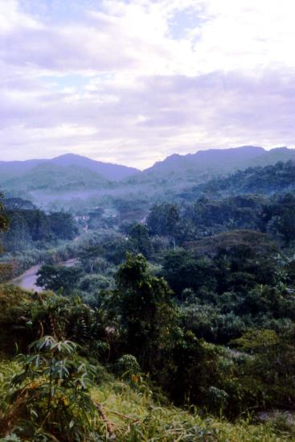
Malaria in Papua New Guinea
Within the past decade PNG has reduced malaria cases by 37% and malaria-attributed deaths by 57%
Multiple problems exist within PNG health system and sustainability of gains is open to question
Other speakers will comment more on PNG

Slide 8
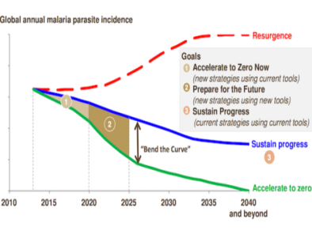
Time Limited Nature of Malaria Elimination
In Sustainable Development Goals everything is a priority; multiple elimination programs exist (AIDS free generation)
Huge use of antimalarial drugs and insecticide impregnated nets cannot be sustained indefinitely
Have to be able to ‘bend the curve’ of malaria elimination to speed up the process and avoid disease resurgence
Bill and Melinda Gates Foundation

Slide 9
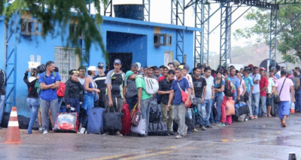
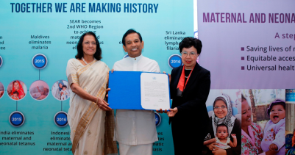
Decreased Cases Means Less Interest in Malaria Elimination
China’s great success was preceded by huge vivax epidemics in 1980-90s
Venezuela is focus of Americas due to financial crisis stopping programs
Sri Lanka had to eliminate malaria twice after failure in 1960s to kill the last parasite
UN Dispatch
WHO

Slide 10
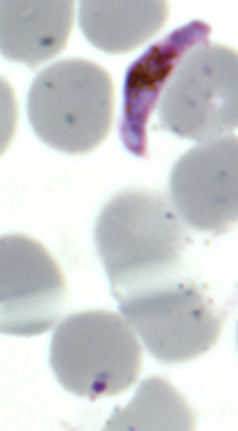
Malaria Responds to Human Stress
P falciparum recrudesces from undetectable levels in people stressed by work and starvation
May be a way parasite arranges to transmit after rains arrive as that is when intense effort required for tropical agriculture (planting season)
P vivax relapses from liver also timed to seasonal changes

Slide 11
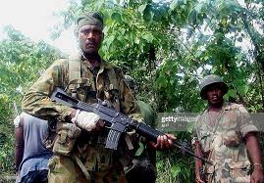
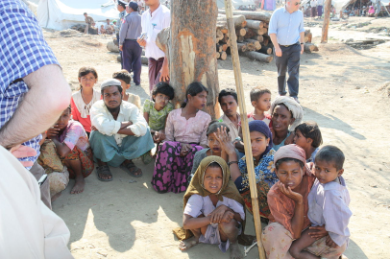
War / Refugee Related Epidemics
East Timor 1999 after population fled into jungle during Indonesian exodus
Solomon Islands 2000 after Malaita Guadalcanal conflict stopped malaria control
Bangladesh 2017 following Rohingya refugee crisis
Getty Images
By Foreign and Commonwealth Office - Flickr, OGL,

Slide 12
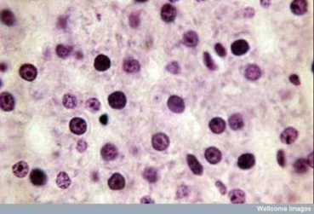
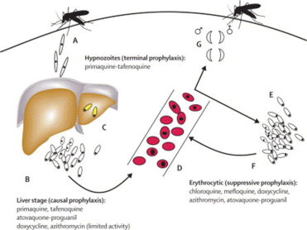
Eliminate Residual Parasites in Humans
Destruction of residual parasites is difficult, time consuming and expensive
Vivax: latent liver parasites called hypnozoites can wait months to years to emerge
Falciparum: dormant stages in blood and gametocytes resist treatment with ordinary drugs

Slide 13
China: No Recent Malaria Transmission
Relapsing malaria now gone from Central China; in 1980s > 1M cases / yr
Used mass drug administration of huge amounts of primaquine
Workers returning from African construction projects with falciparum

Slide 14
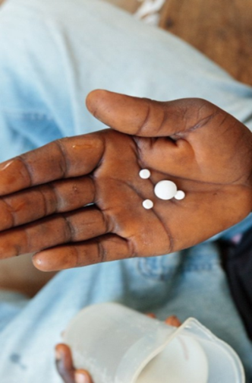
Examples of Successful Mass Drug Usage
Azithromycin: trachoma treatment in children
Ivermectin: filarial elimination
Albendazole: filaria and helminth elimination
Primaquine: relapsing malaria elimination in China (>100M)

Slide 15

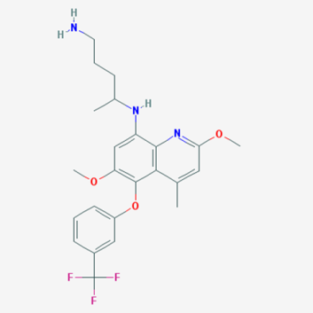
Tafenoquine Newly Approved Drug
It is US FDA approved for both treatment of relapsing malaria and malaria chemoprophylaxis
Hope is that TGA will follow US FDA in registering tafenoquine in Australia soon
Roll out of tafenoquine will still require several years

Slide 16
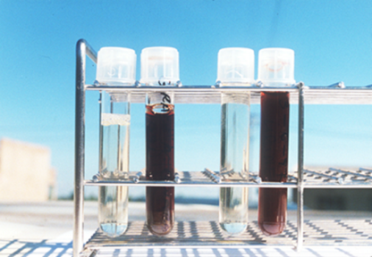
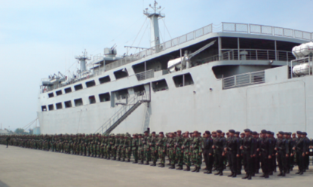
Repeat China’s Primaquine Mass Drug Administration with Tafenoquine?
Tafenoquine single dose (300 mg) kills all residual parasites hiding in liver
Still have to manage G6PD deficiency hemolysis risk
Currently tafenoquine is being tested in Indonesia Army in Java

Slide 17
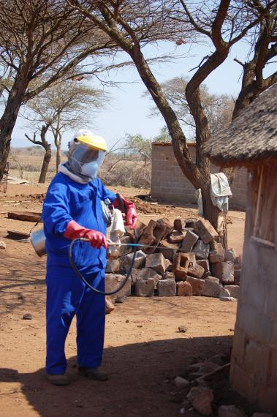
New Insecticides for Mosquitoes
Agriculture market drives introduction of insecticides
Public health use is a tiny market of little commercial significance
New compounds in advanced testing (Sumimoto, BASF, Syngenta, Bayer, others)

Slide 18
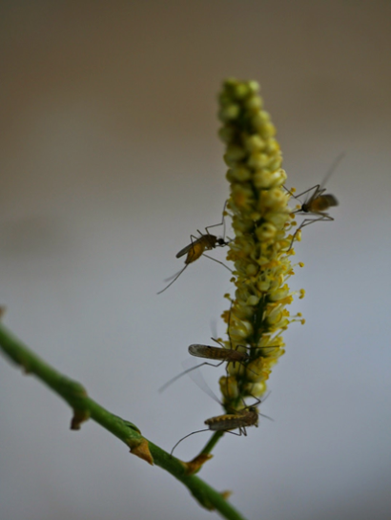
New Anti-Insect Modalities
Attractive sugar baits to kill Anopheles while sparing other insects through selective membrane biting poisoning only mosquitoes
Spatial repellents designed to fill living area over days to weeks that can be placed by the household members without help

Slide 19

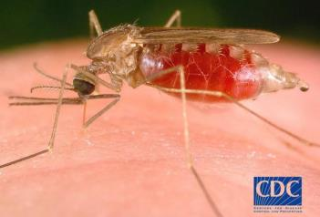
Drugs Against Mosquito Vector?
Ivermectin used in filarial elimination projects given safely to > 1B people in tropics
Mosquito biting someone with ivermectin in their blood has a shortened life-span
Likely have to use longer acting drug to make an impact on malaria transmission

Slide 20
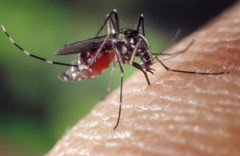
Genetically Modified Mosquitoes
Only a few species of Anopheles transmit malaria which is also a parasite of mosquitoes
Making a vector incompetent to parasite growth in GI tract
Gene drive required to move through population
US CDC

Slide 21
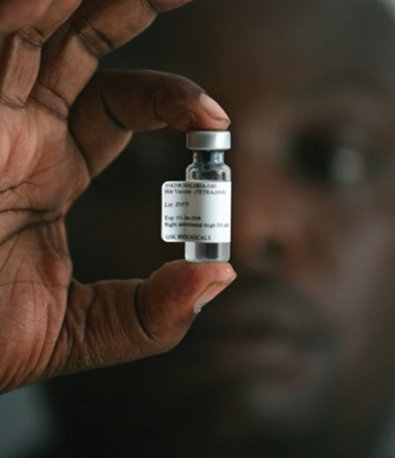
Malaria Vaccines Still in the Future
Anti-disease: minimize impact on vulnerable populations (children)
Anti-parasite: immune system to kill parasites in blood
Anti-transmission: blocking ability of parasite to infect mosquitoes

Slide 22
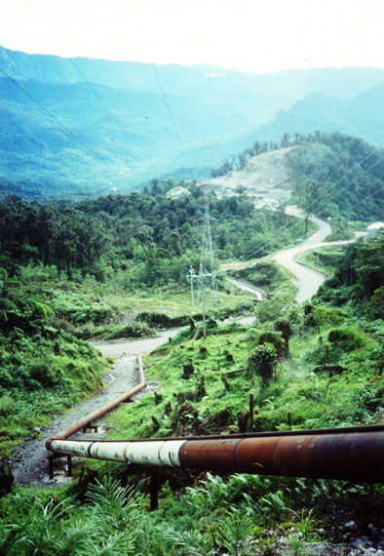
Malaria Contained Within Limits?
Once malaria is eliminated, it is not easily re-established unlike polio
Motivation to finish malaria program in other countries has low priority to national leaders
Another gap in malaria elimination will leave PNG with endemic malaria

Slide 23
Malaria Elimination: 2030 Deadline
Have to maintain sense of progress and success in order to continue
Competition for resources with non-communicable diseases (diabetes)
New tools are needed for high transmission areas, but a great deal can be done with what we have now

Slide 24









Acknowledgements
Malaria Elimination Group, San Francisco USA
Bill and Melinda Gates Foundation, Seattle USA
University of Queensland, School of Public Health, Brisbane, QLD, Australia
Queensland Institute Medical Research Berghofer, Herston, QLD Australia

