Slide 1
MALARIA IN INDONESIA’S
NUSA TENGGARA TIMUR (NTT) PROVINCE
Dr. Theresia Sarlyn Ralo, MPH
Head Division, of Disease Prevention and Control
NTT Provincial Health Office
26 August 2018

Slide 2
Malaria Endemicity Maps of Indonesia 2012 - 2017
No. | Category | Population |  | Distric
 |  | No. | % | No. | %
1. | No malaria | 187.968.543 | 72 | 266 | 52
2. | Low Endemic | 62.888.849 | 24 | 175 | 34
3. | Moderat Endemic | 5.442.232 | 2 | 40 | 8
4. | High Endemic | 4.264.081 | 2 | 33 | 6
5. | TOTAL | 255.881.112 | 100 | 514 | 100

Slide 3
MALARIA ELIMINATION ROAD MAP IN INDONESIA
2027
2018
2019
2025
2030
2020 : no high malaria endemic district
Indonesia achieve Malaria Elimination
100% Province achieve malaria elimination
100% distric achieve malaria elimination
300 distric achieved malaria elimination
300 distric achieve malaria elimination
266 distric achieve malaria elimination
2017
2016
285 distric achieved malaria elimination
265 distric achieved malaria elimination

Slide 4
Total National malaria cases in 2016:
218.450
Total malaria cases in 2017:
195.597
248 Districts in Indonesia endemic for malaria (48%) (MoH 2017)
195. 597 Malaria in Indonesia cases per 1,000 in 2017 (15% from NTT) (MoH 2017)

Slide 5
MALARIA IN
NUSA TENGGARA TIMUR PROVINCE

Slide 6
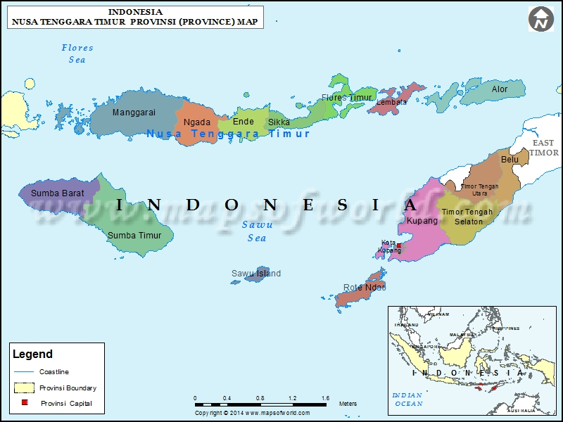
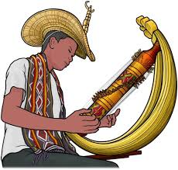
District/Town | 21/1
Sub Districs | 306
village | 3.344
Hospital | 50
Community Health center (Location on Sub-Districts/ Kecamatan) | 402
PUSTU (IN VILLAGE) | 1.039
Health Effort with he community Village Poskesdes, Polindes) | 1.975
Geographical: 8 ⁰-12⁰ SL and 118⁰-125⁰ EL
Climate: 8 months dry & 4 months wet
Areas: ± 49.852,14 km2 Land ± 200.000 km² Ocean
Population: 5.318.543 (BPS NTT 2016)

Slide 7
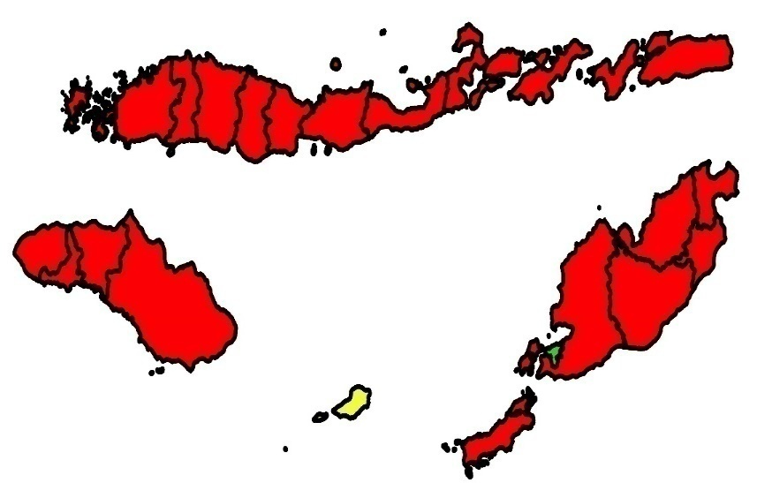
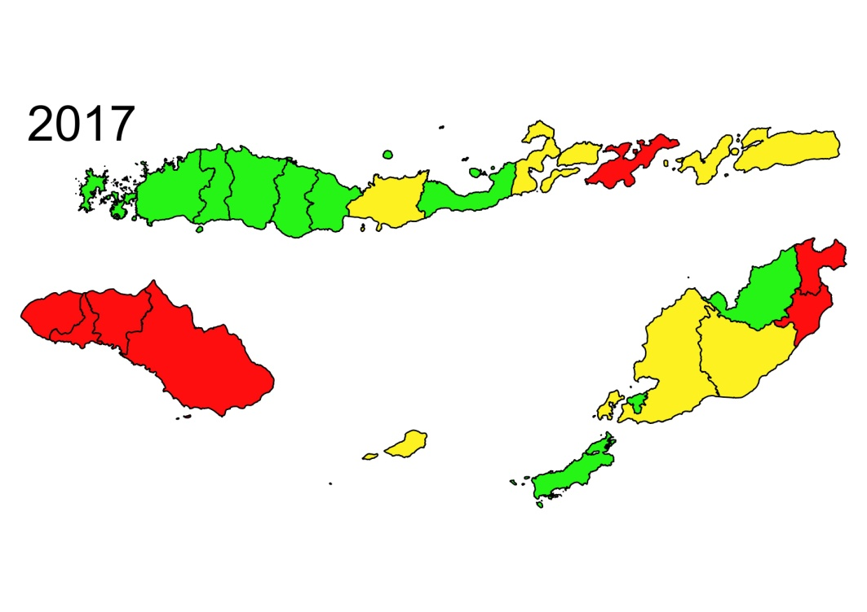
PROGRESS OF NTT MALARIA ELIMINATION 2010 – 2017
2010
Jumlah Kab./Kota Endemis Malaria & Populasi Berisiko Tahun 2017
Stratification | Population | No. Of Distric
No malaria | 0 | 0
LOW Endemic | 2,329,745 (42%) | 9
MODERATE Endemis | 1,930,801 (34%) | 6
HIGH Endemis | 1,348,729 (24%) | 7
Total | 5,609,275 (100%) | 22

Slide 8
Trend of Annual Paracite Incidence Malaria NTT 2010 - 2017
Trend of Deaths From Malaria Cases
in NTT 2010 - 2017
Trend of Malaria Cases in NTT 2010-2017
3 Deaths From MALARIA in 2017
in Alor and TTS

Slide 9
2027
2025
2030
MALARIA ELIMINATION ROAD MAP IN INDONESIA
NTT ELIMINATION MALARIA ROAD MAP 2023
2017 - 2019
2020 - 2021
2022 - 2023
2024 - 2026
10 district
10 district
22 district
100% Province achieve malaria elimination
Indonesia achieve Malaria Elimination
8 district
12 district
2020 : no high malaria endemic district
4 district
10
8
4
100% distric achieve malaria elimination
B
A
S
E
L
I
N
E
2015
Acceleration stage | 10 district : Lembata, Sumba Timur, Sumba Barat Daya, Sumba Tengah, Sumba Barat, Belu (2022/2023), Alor ,Ende, Sabu Raijua dan Malaka (2022/2023)
Intensifikation Stage | 8 district : Timor Tengah Selatan, Flores Timur, Manggarai Barat, Kab. Kupang, Nagekeo, Sikka, Rote Ndao, dan Ngada
Elimination Stage | 4 district : Kota Kupang, Manggarai, Manggarai Timur dan Timur Tengah Utara (2019),
Maintenance Stage | -

Slide 10
GOVERNOR’S REGULATION NO.11, 2017 about MALARIA ELIMINATION IN NTT
Pasal (2) ayat (2)
Tujuan dari Peraturan Gubernur ini adalah terwujudnya eliminasi malaria di Provinsi Nusa Tenggara Timur Tahun 2023
Article (2) paragraph (2)
The aim of this Governor Regulation is the realization of malaria elimination in East Nusa Tenggara Province by 2023

Slide 11
NUMBER OF MALARIA CASES IN PREGNANT WOMEN by DISTRICT 2017
0,6% (347 pregnant women) screened are
MALARIA POSITIVE !
(total 57.756)
Data Source: integrated program MNH & MALARIA PHO NTT 2017

Slide 12
DISTRIBUTION OF (LLIN) NTT by DISTRICT 2014, 2016 & 2017
LLIN 2014 | 1,897,062
LLIN 2016 | 984,900
LLIN 2017 | 1,124,000

Slide 13
Annual Paracite Incidence & Slide Positive Rate Malaria Situation in NTT Before And After Mass Bed Net Distribution in 15 Districs 2014
No | Districs | API (%) |  |  | TREND | SPR (%) |  |  | TREND
 |  | 2013 | 2014 | 2015 |  | 2013 | 2014 | 2015
1. | Lembata | 132.09 | 102.74 | 72.82 | TURUN | 42 | 35 | 29 | TURUN
2. | Sumba Tengah | 76.95 | 81.84 | 46.25 | TURUN | 32 | 35 | 28 | TURUN
3. | Belu | 23.68 | 12.87 | 15.65 | NAIK | 12 | 8.5 | 10.14 | NAIK
4. | Sumba Barat Daya | 28.1 | 45.75 | 14.24 | TURUN | 41 | 40 | 12.39 | TURUN
5. | Ende | 27.60 | 21.85 | 12.26 | TURUN | 30 | 20 | 9.70 | TURUN
6. | Sumba Barat | 37.6 | 23.71 | 8.92 | TURUN | 27 | 21 | 12.39 | TURUN
7. | Alor | 19.55 | 8.46 | 8.39 | TURUN | 44 | 44 | 33.33 | TURUN
8. | Sumba Timur | 36.16 | 46.33 | 7.25 | TURUN | 38 | 37 | 16.06 | TURUN
9. | Sikka | 24.72 | 9.45 | 1.90 | TURUN | 20 | 10 | 3.19 | TURUN
10. | Flores Timur | 10.43 | 9.54 | 4.36 | TURUN | 11 | 10 | 8.01 | TURUN
11. | Nagekeo | 24.66 | 5.07 | 2.67 | TURUN | 18 | 5.4 | 4.18 | TURUN
12. | Manggarai Barat | 26.75 | 6.00 | 3.51 | TURUN | 39 | 15 | 10.09 | TURUN
13. | Sabu Raidjua | 20.16 | 20.86 | 5.93 | TURUN | 51 | 37 | 15.78 | TURUN
14 | RoteNdao | 5.81 | 1.96 | 1.18 | TURUN | 14 | 5.1 | 4.38 | TURUN
15 | Malaka |  | 11.58 | 5.12 | TURUN |  | 15 | 7.2 | Turun

Slide 14
MICROSCOPIC FOR MALARIA
IN Community Health Center by DISTRICT, 2017
Lack of microscopic in 8 districs
Sumber data: Laporan Malaria, Dinkes Kab./Kota Jan-Des 2017
433 microscopic work in 387 PHC (total 402 PHC).

Slide 15
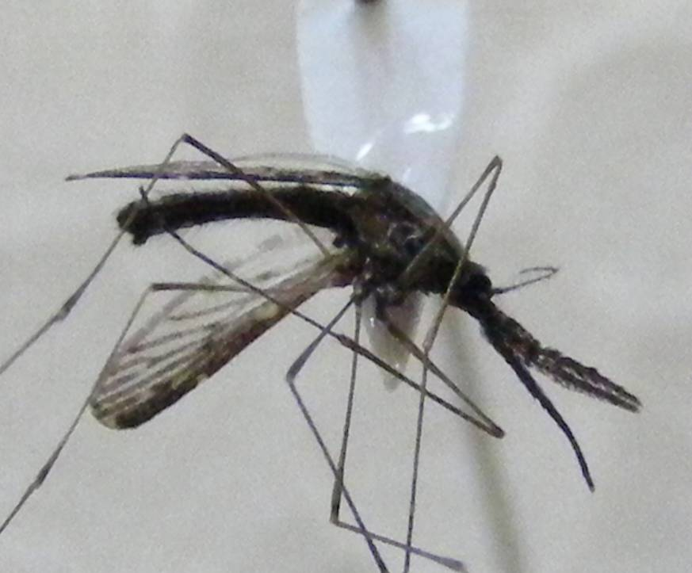
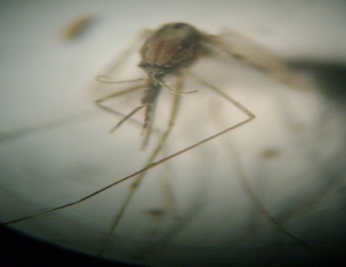
Common Malaria Vectors in NTT
Anopheles, 13 species
Subpictus,
Aconitus,
Vagus,
Barbirostris,
Maculatus,
Annularis,
Mansonia,
Sundaicus,
Indefinitus,
Minimus,
Tessalatus,
Kochi,
Umbrosus
An. barbirostris
An. subpictus

Slide 16
Malaria Network in NTT
PERDHAKI locate in private health facility in 22 districts and own 72 health service unit
UNICEF, in Sumba Barat Daya, Lembata, Sikka dan Province
No More Malaria (Jepang) in Sikka
YASPEM, local NGO, in Sikka, Manggarai Barat, Lembata (focus on Participatory Learning and Action (PLA) Training for village people)
Sumba Foundation, in Sumba Barat (focus on microscopic training since 2011)
Asia Pacific Leaders’ Malaria Alliance (APLMA), Malaria advocacy workshop with NTT Governor, 2017

Slide 17
Statistics | Belu |  | Malaka |  | TTU
Population (2017) | 221.734 |  | 177.425 |  | 263.922
ViIllage | 81 |  | 127 |  | 174
Primary Health Care | 17 |  | 20 |  | 26
Laboratory Analis at PHC | 18 (6/12) |  | 17 (9/8) |  | 25
Hospital (public & Privat) | 2 /3 |  | 1/0 |  | 1/1
Laboratory Analis at Hospital | Not Training Malaria |  | Not Training Malaria |  | Not Training Malaria
Posyandu | 2018 |  | 426 |  | 505
Kader | 2.105 |  | 2.130 |  | 2.531
MALARIA ENDEMIC VILLAGE | 37 (46%) |  | 16 (13%) |  | 46 (23%)
Malaria cases | 1.688 (2016) | 1.348 (2017) | (2016) | 908 (2017) | 146 (2016) | 144 (2017)
API | 7,6 | 6.08 | 3,0 | 5,1 | 0,55 | 0,5
ABER | 10,1% | 11,49% | 4,95% | 4,99% | 3,33% | 3,84%
SPR | 7,6% | 5,29% | 5,96% | 10,26% | 1,66% | 5,29%
Type Paracite | PF: 70/ PV:1.618 | PF:77/ PV:65/ MIX:4 | PF:426/ PV:135 | PF:759/ PV:139 | PF:77/ PV:65 | PF:104/ PV:40/ MIX:3
LLIN Distribution 2016-2017 | 49.000 |  | 93.400 |  | 93.700
Statistic at Border line

Slide 18
NTT ELIMINATION MALARIA ROAD MAP 2023
2017 - 2019
2020 - 2021
2022 - 2023
2024 - 2026
10 district
22 district
10 district
12 district
8 district
4 district
10
8
4
Acceleration stage | 10 district : Lembata, Sumba Timur, Sumba Barat Daya, Sumba Tengah, Sumba Barat, Belu, Alor ,Ende, Sabu Raijua dan Malaka
Intensifikation Stage | 8 district : Timor Tengah Selatan, Flores Timur, Manggarai Barat, Kab. Kupang, Nagekeo, Sikka, Rote Ndao, dan Ngada
Elimination Stage | 4 district : Kota Kupang, Manggarai, Manggarai Timur dan Timur Tengah Utara,
Maintenance Stage | -
Prepare 4 districs for malaria assessment process (TTU, Manggarai , Kupang City, East Manggarai) 2018
2. Acceleration of the malaria reduction malaria cases in 10 districts including Malaka and Belu in 2018-2020

Slide 19
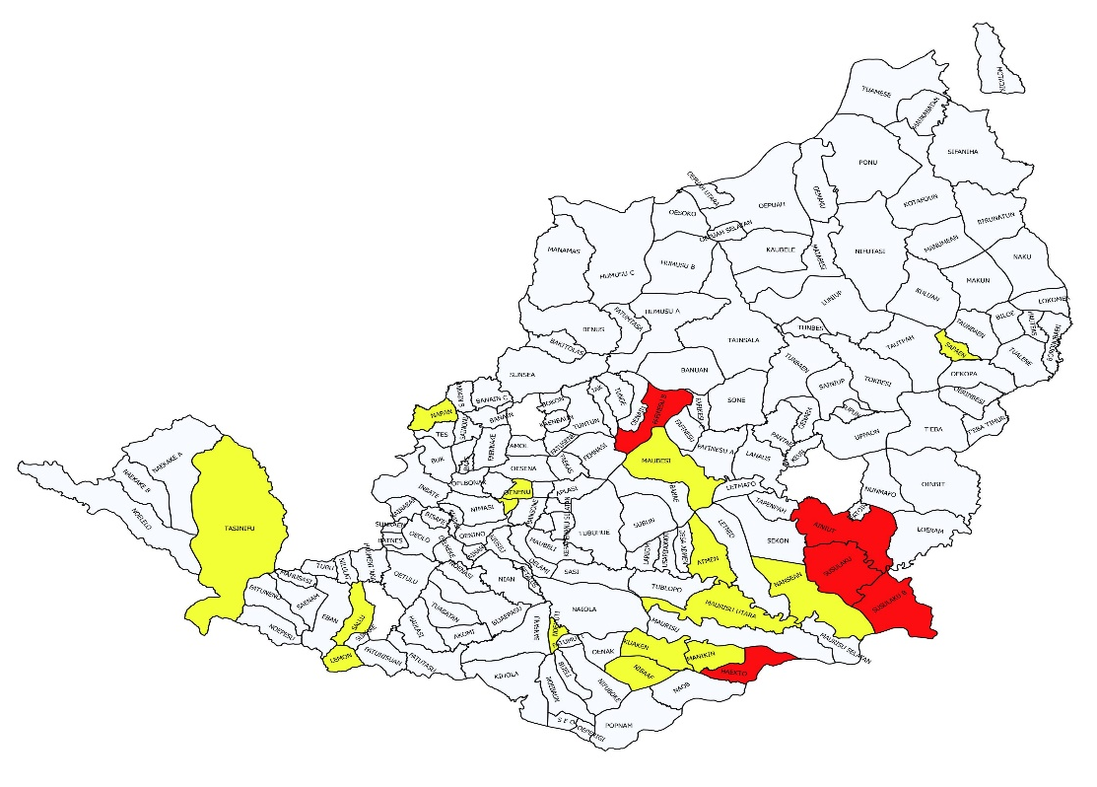
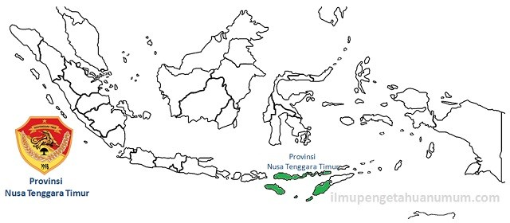
MAP ENDEMICITY MALARIA PER VILLAGE IN BORDER LINE, 2017
46 of 197 Villages (23%) in TTU Endemic Malaria
Name of Villages in Border Areas:
Napan
Humusu C
Haumeni
Inbate
Nilulat
Belu
RDTL
Malaka
Kupang
TTS

Slide 20
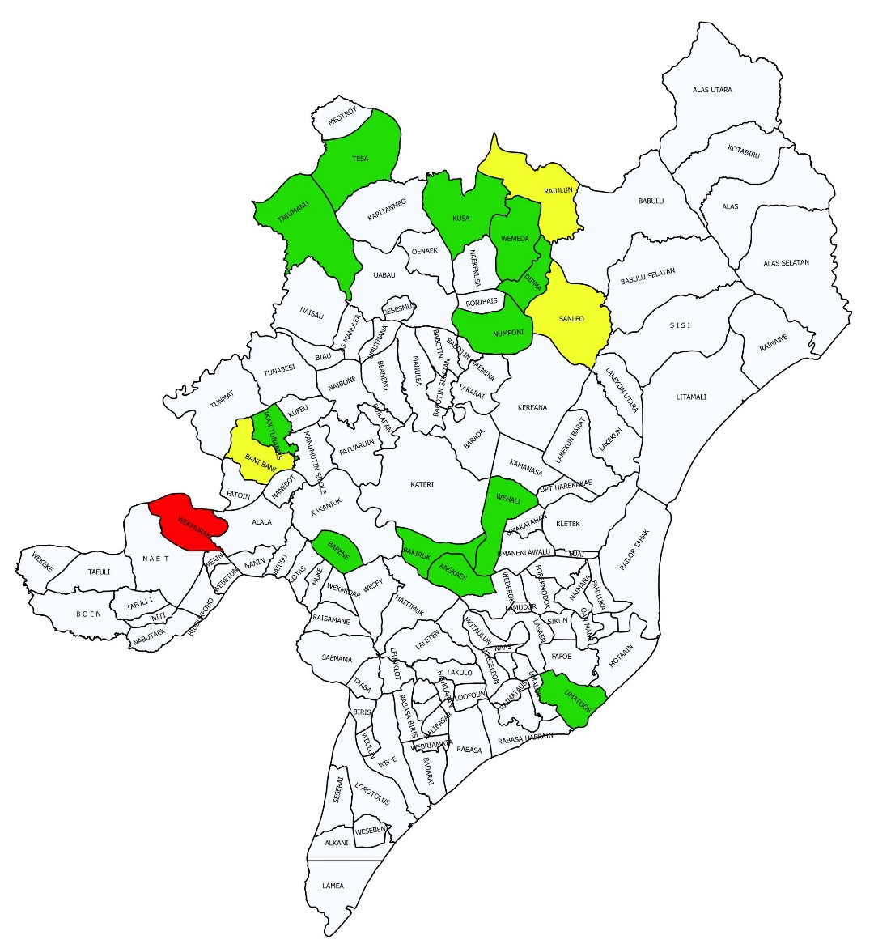
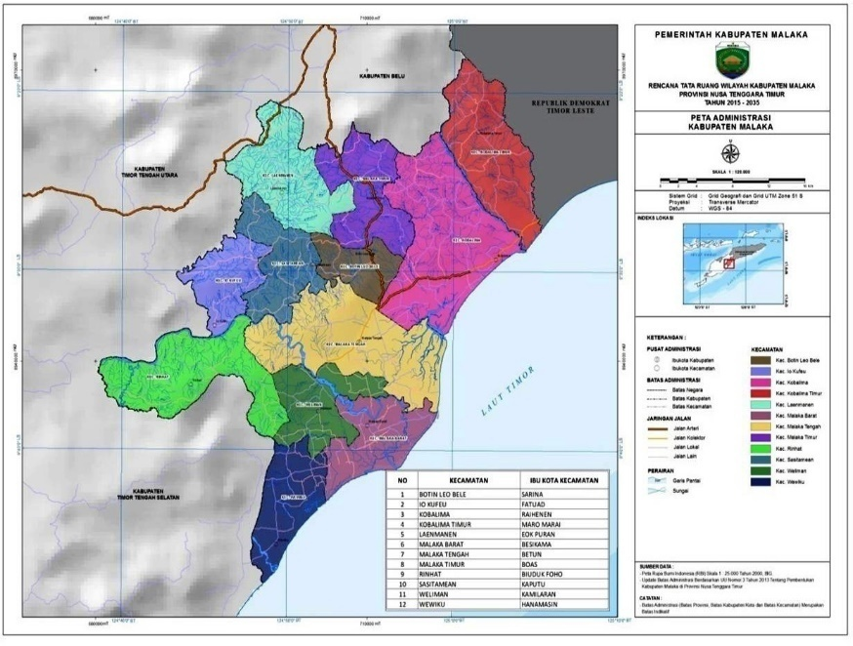
MAP of ENDEMICITY MALARIA PER VILLAGE IN BORDER LINE, 2017
16 of 127 Villages (13%) in MALAKA
Endemic Malaria
Belu
RDTL
Name of Villages in Border Areas:
Alas
South Alas
North Alas
Rainawe
TTU
TTS

Slide 21
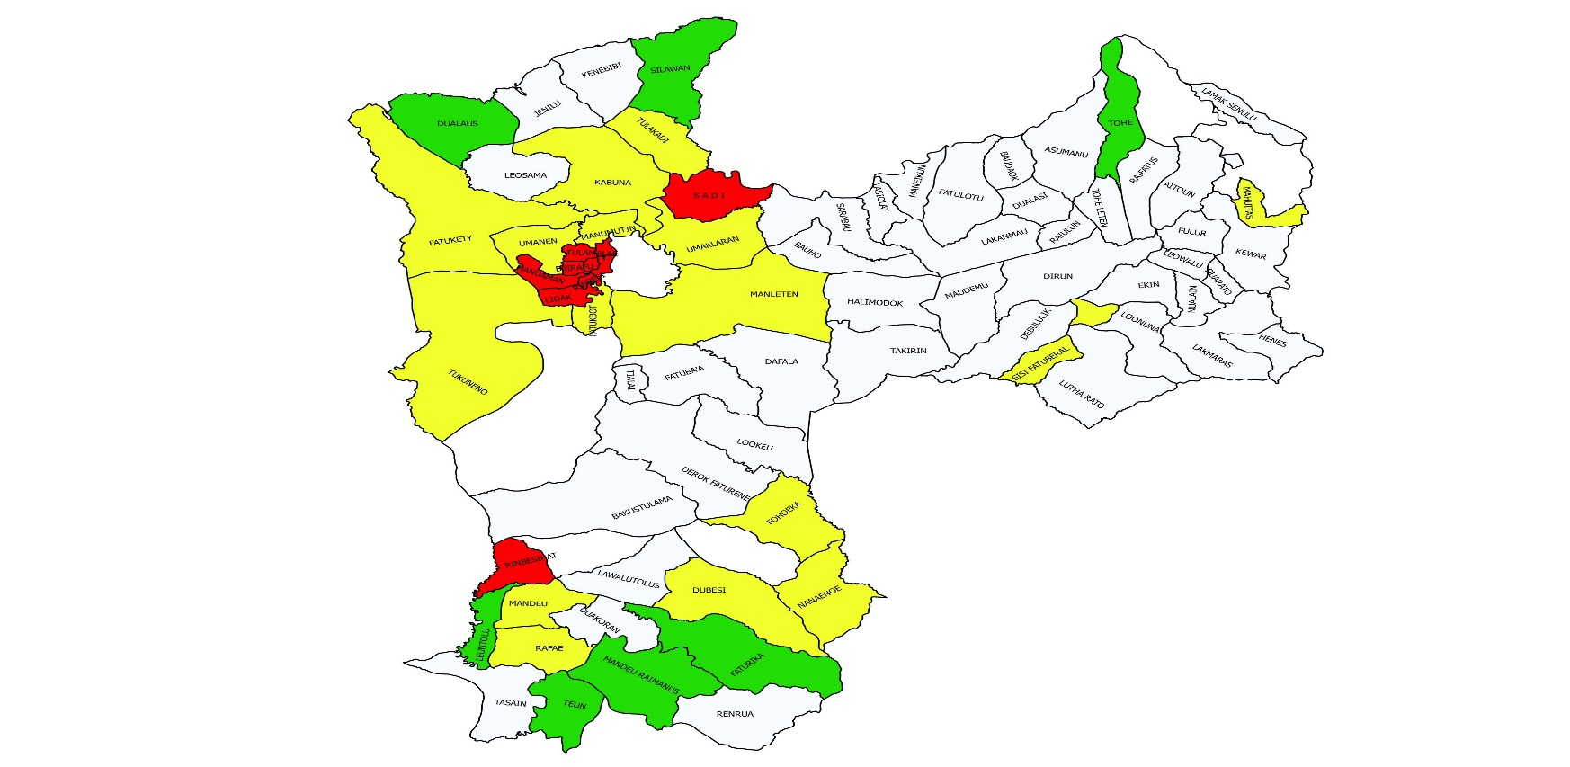
MAP of ENDEMICITY MALARIA PER VILLAGE IN BORDER LINE, 2017
RDTL
RDTL
37 of 81 Villages (46%) in BELU
Endemic Malaria
RDTL
Villages in Border Areas:
Baudaok
Dafala
Debululik
Derok Faturene
Duarato
Fatulotu
Faturika
Fohoeka
Fulur
Halimodok
Henes
Kewar
Lakmaras
Lamak Senulu
Lookeu
Loonuna
Lutha Rato
Maudemu
Manumutin
Nanaenoe
Nanaet
Sadi
Sarabau
Silawan
Takirin
Tulakadi
RDTL
RDTL
TTU
TTS

Slide 22
SUCCESSES: Controlling malaria
L A U T F L O R E S
P.ADONARA
P. SOLOR
S E L A T O M B A I
DILLI
S E L A T S U M B A
L A U T S A W U
L A U T S U M B A
P. SAWU
P. ROTE
S E L A T R O T I
L A U T T I M O R
U
Inovation and Best Practice in Sikka Distric in Flores Island

Slide 23
Malaria Best Practice
Malaria Cases decrease
up to 75% in Sikka 2015-2016

Slide 24
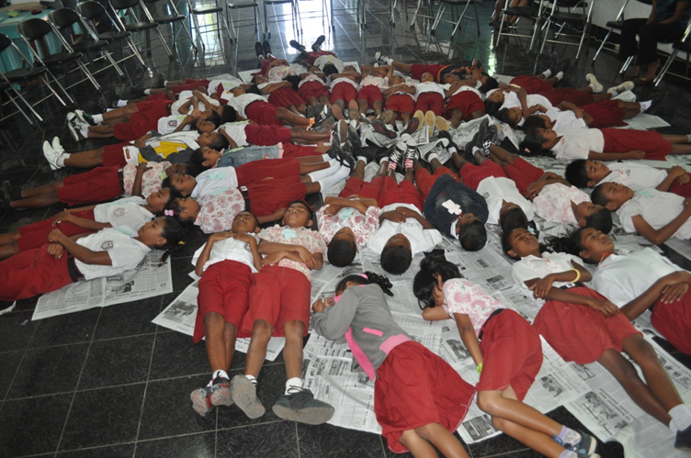
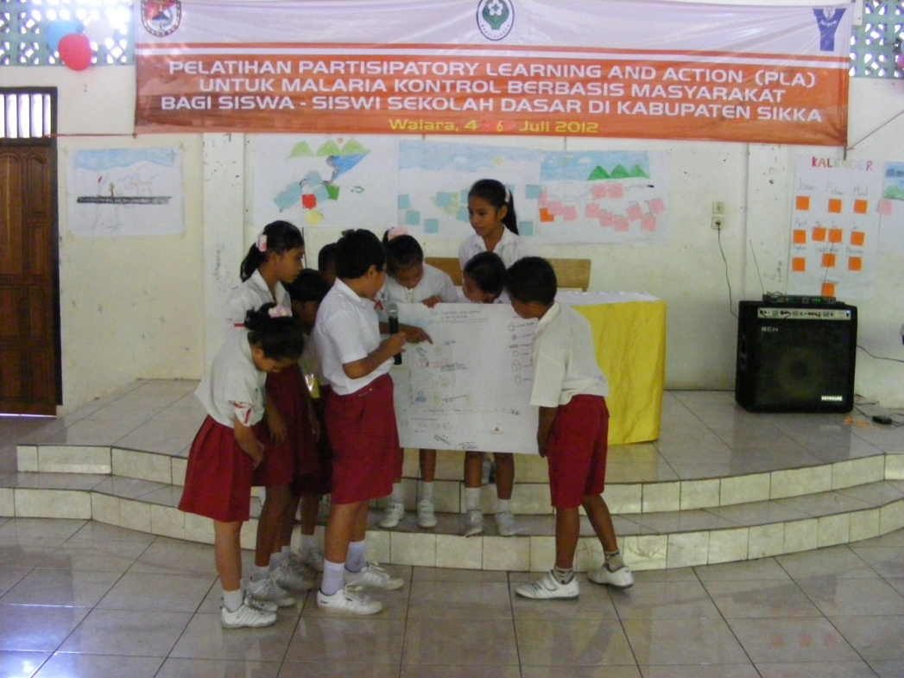
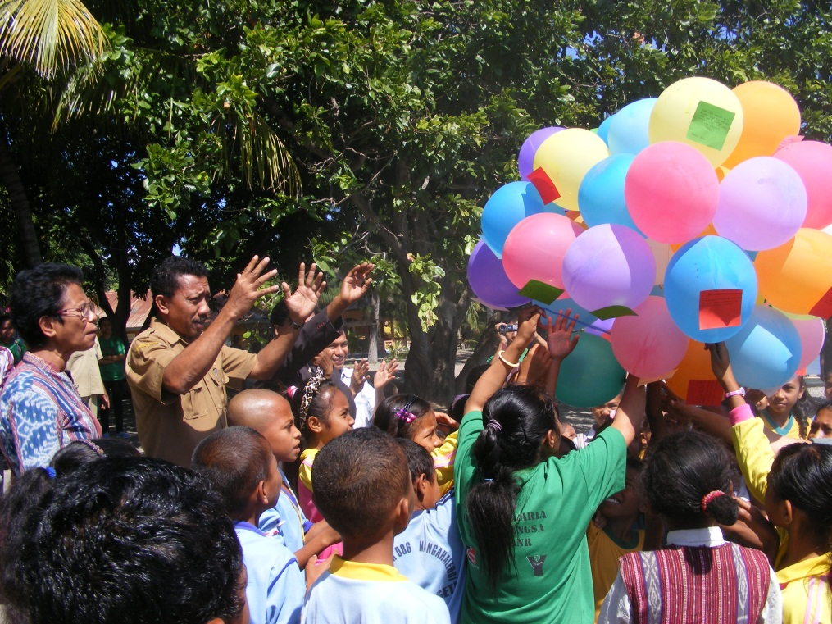
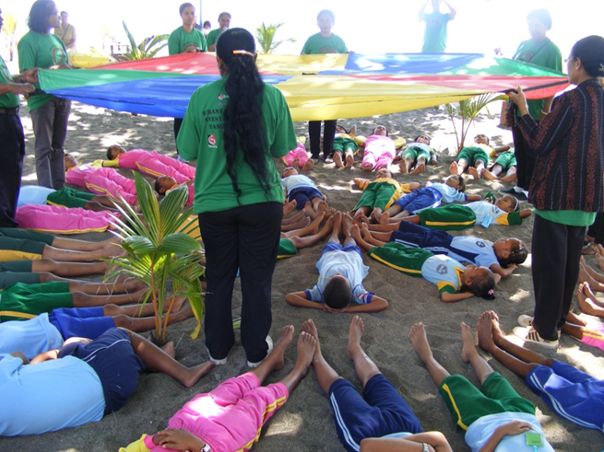
“LASKAR-LASKAR JENTIK”
(1000 student trained for Larvae Control)

Slide 25
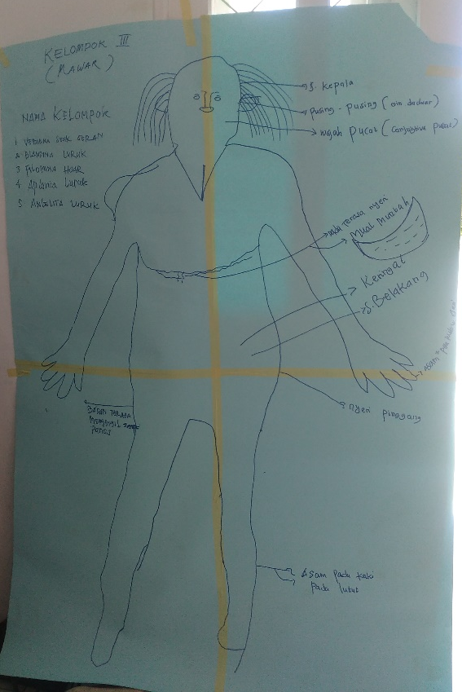
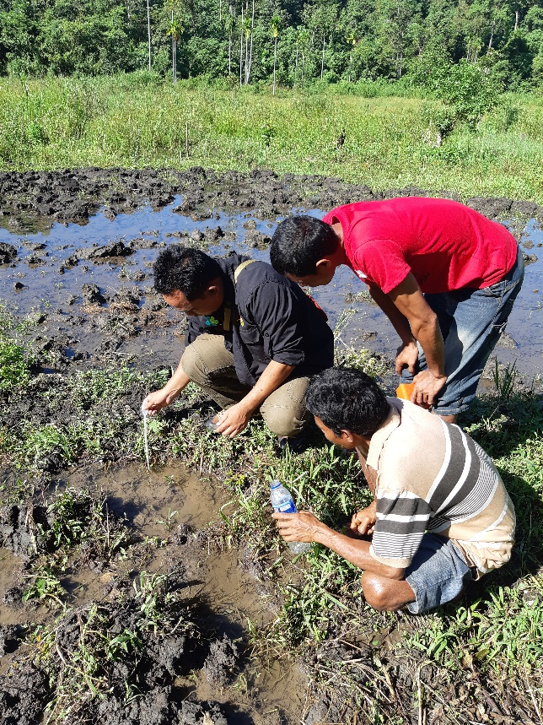
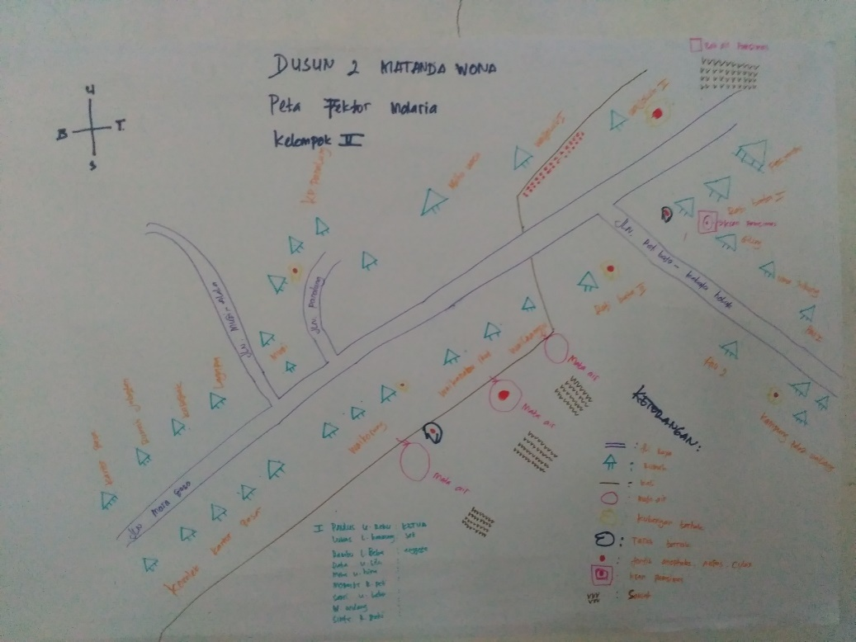
Body Mapping Malaria
(Malaka, April 2018)
Transect Walk to mapping
Breeding Places around Village
(Sumba, April 2018)
PLA Training
for 25 keyperson
in Village
to FIGHT MALARIA

Slide 26
CHALLENGES: Controlling and eliminating malaria
Accelerate the decline of indigenous malaria cases in high endemic island/ district/ village by 2020
Community empowerment for vector control and health seeking + prevention behavior
Improve quality assurance of diagnosis and treatment of non-trained worker in Community Health Center
Border-cross malaria control Indonesia – RDTL : technical implementation
Awarness of local goverment to support accelaration of malaria elimination

Slide 27
Recommendation CROSS-BORDER WORK WITH TIMOR LESTE
Early diagnose and treatment of malaria, follow up theray of malaria, community empowerment by PLA Trainning
Improve Resources, Technical assistant, capacity building, revitalization of POSMALDES, survaillance migration, set-up public privat mix, revitalization of referral system

Slide 28
Conclusion
NTT Province has 2nd highest malaria cases in Indonesia 2017
Malaria strategy in NTT is malaria elimination per island through coordination between districs
Malaria is endemic in NTT (low,moderate, high)
NTT Province border areas with RDTL need specific intervention

