Slide 1
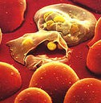
Development of a Whole Parasite Blood-Stage Malaria Vaccine
Dr Danielle Stanisic
Laboratory of Vaccines for the Developing World
Institute for Glycomics, Griffith University

Slide 2
Evaluation and testing of vaccines
In most countries, the evaluation and testing of vaccine follow a set of standard steps:
Pre-clinical laboratory and animal studies
Human Clinical studies
  -Phase I
  -Phase II
  -Phase III
3. Approval and licensing

Slide 3
Human Clinical Studies
Phase I:
-Assess safety, tolerability and immunogenicity of vaccine in a small group of adults (20-100 individuals) who have not been naturally exposed to the target pathogen.
-Identify short-term side-effects and immune responses.
-If a human challenge system exists, vaccine efficacy can be evaluated in vaccinated vs unvaccinated individuals (Phase Ib)
-If safe and immunogenic, proceed to Phase II
Phase II:
-Expanded safety and immunogenicity studies in a larger group of adults (>100).
-These groups may include intended targets of the test vaccine.
-If a human challenge system exists, vaccine efficacy can be evaluated in vaccinated vs unvaccinated individuals.
-These studies may also contain a placebo group (receive saline solution, a vaccine against another disease or another vaccine against the same disease).
-If successful, proceed to Phase III

Slide 4
Human Clinical Studies
Phase III:
-Thousands of individuals over multiple sites.
-Carried out in conditions similar to those under which vaccine will ultimately be used.
-Studies are randomised, double blind(neither participant or doctor knows that treatment has been given) and involve comparing the effectiveness of vaccine against a placebo.
-With more people involved, rarer side effects may be observed.
-Evaluating vaccine efficacy and other endpoints eg prevention of re-infection vs prevention of disease/death.
Approval and licensing
-If Phase III successful, the vaccine developer will submit an application to regulatory authorities to license the vaccine (eg FDA).
-After a vaccine is licensed, there is continued monitoring of vaccine production and side effects in vaccinees.

Slide 5
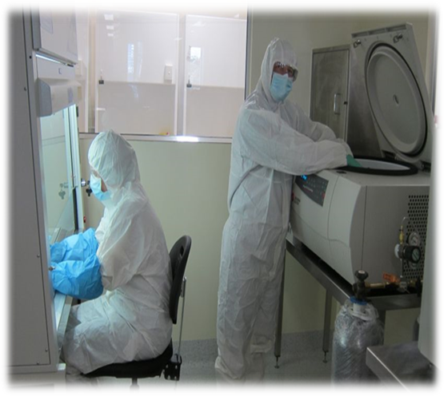
Clinical Vaccine Development
Development of Plasmodium falciparum
cell banks
Required:
To make the vaccine
For challenge to examine if the vaccine protects
P. falciparum parasites expanded in transfusion-grade red blood cells in the cleanroom at Griffith University and then cryopreserved.
Characterized according to specific release criteria eg sterility, viability of parasites, drug sensitivity, viral testing.
Suitable for administration to humans in early phase clinical studies.
DI Stanisic et al 2015 Malaria J 14: 143.

Slide 6
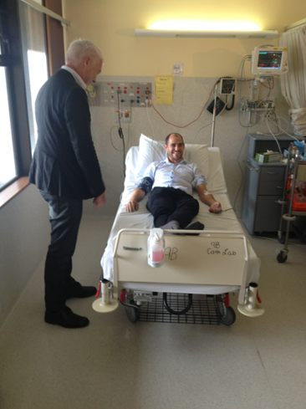
Infectivity of a Plasmodium falciparum cell bank in malaria-naïve volunteers
n=2 male volunteers
initiation of Drug treatment
DI Stanisic et al 2016 Infect Immun 84: 2689

Slide 7
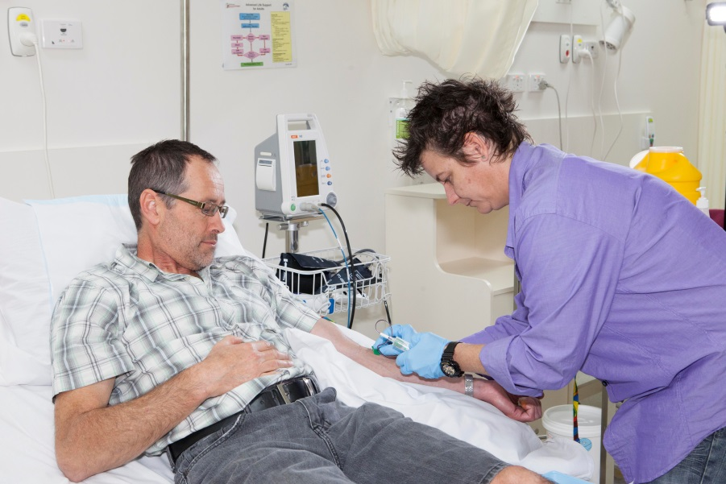
Pilot clinical study: Malaria Vaccine
Pilot Study
Identify correct dose of chemical to completely attenuate parasite
Examine safety and tolerability
Does it induce an immune response?
Study participants screened according to inclusion/exclusion criteria
-Healthy males 18-60 years of age
-No history of clinical malaria or travel/residence
(>2 weeks) in malaria endemic area within last
12 months

Slide 8
Pilot clinical study: Malaria Vaccine
Study Schedule
-----PCR to monitor parasite growth every 2 days----
-Day 21 // 0 2 4 6 8 10 12 14 16 18 20 22 24 26 28 // 90
Î ÎÎ Î Î ÎÎÎ ÎÎ
Î Screening Î Immunology Î Vaccine Î Safety Assessment
Î Drug Treatment
If parasitemia >11,550 parasites/ml or participants are symptomatic, then drug treatment is initiated.

Slide 9
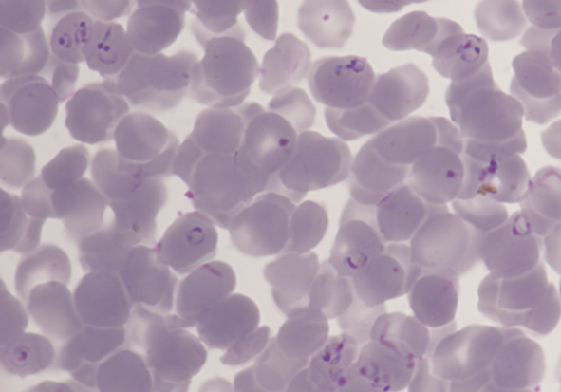
Vaccine Preparation
1. P. falciparum 7G8 cell bank parasites thawed and cultured in transfusion grade red blood cells in cleanroom at Griffith University.
2. Ring stage parasites harvested.
3. Parasites incubated in vitro with chemical (Tafuramycin-A).
4. Parasites washed.
5. Chemically treated parasites injected
intravenously.

Slide 10


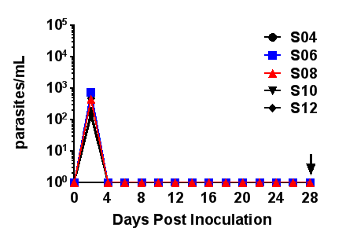


Clinical study: Malaria Vaccine
Study Group A:
3 x 10⁷ parasites treated with dose 1 of Tafuramycin-A
Study Group B:
3 x 10⁷ parasites treated with dose 2 Tafuramycin-A
Parasite Growth Y Y Y N N N N N
Well tolerated Y Y Y Y Y Y Y Y
Antibodies N N N N N N N N
T cells Y Y Y Y Y Y Y Y

Slide 11
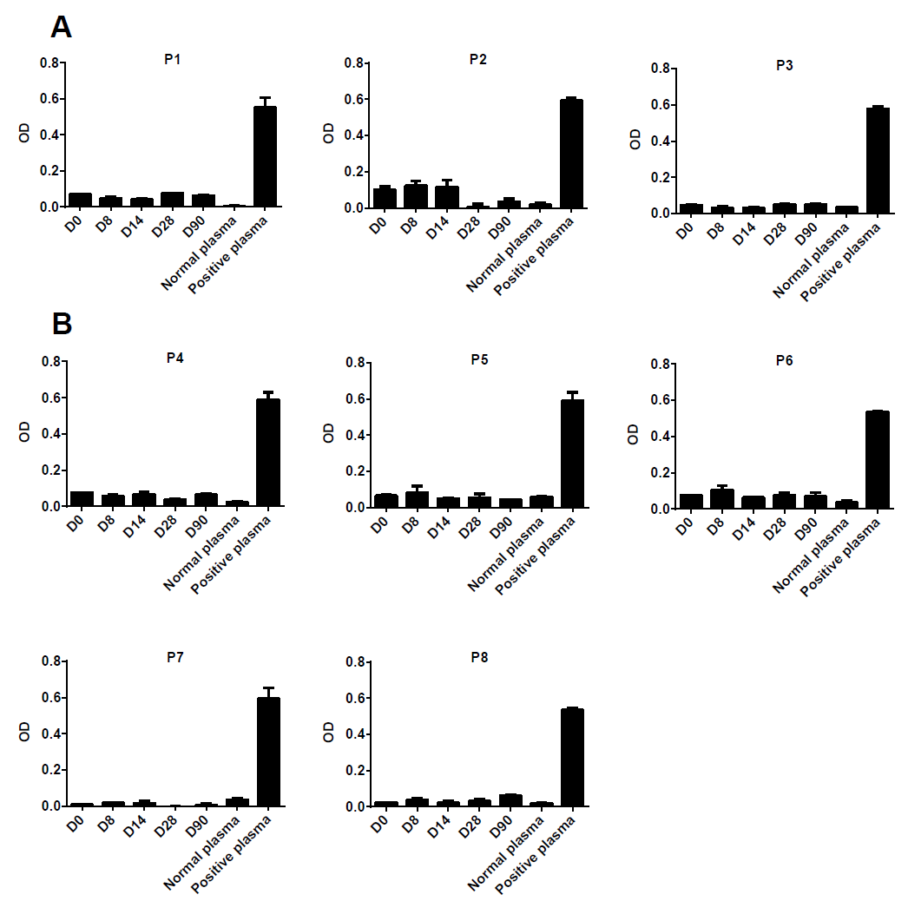
Antibody responses post vaccination-IgG
Group
Group

Slide 12
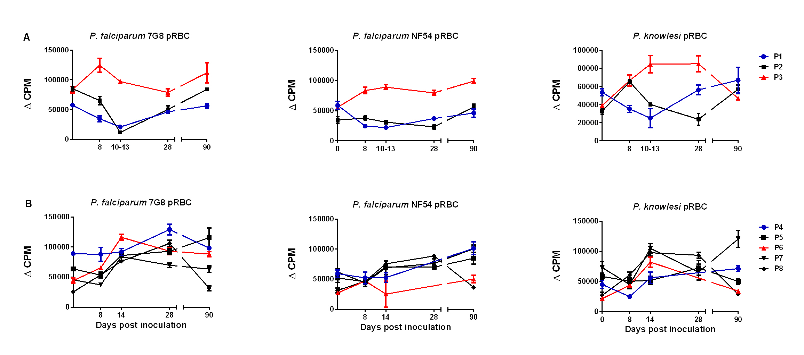
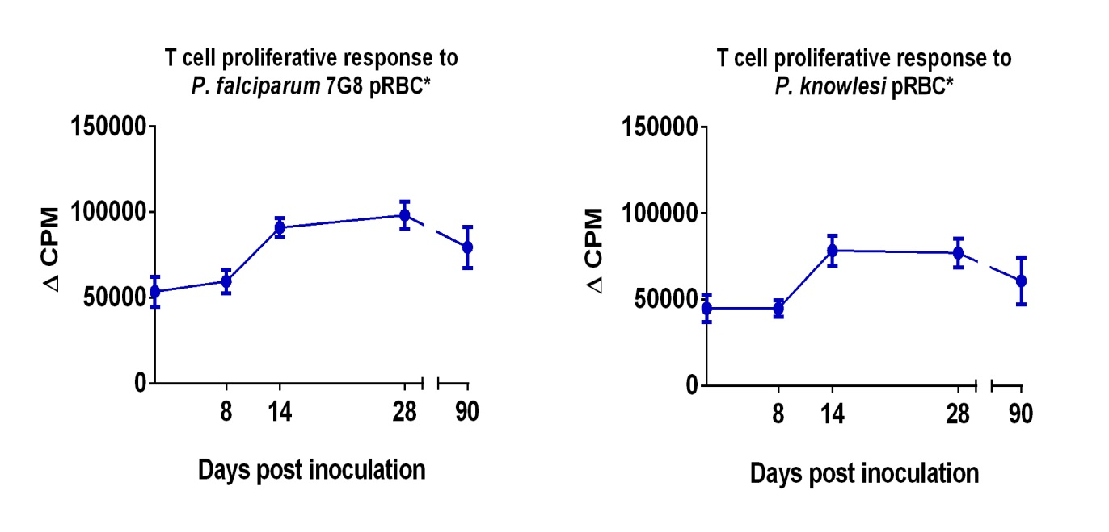
T cell responses post vaccination

Slide 13
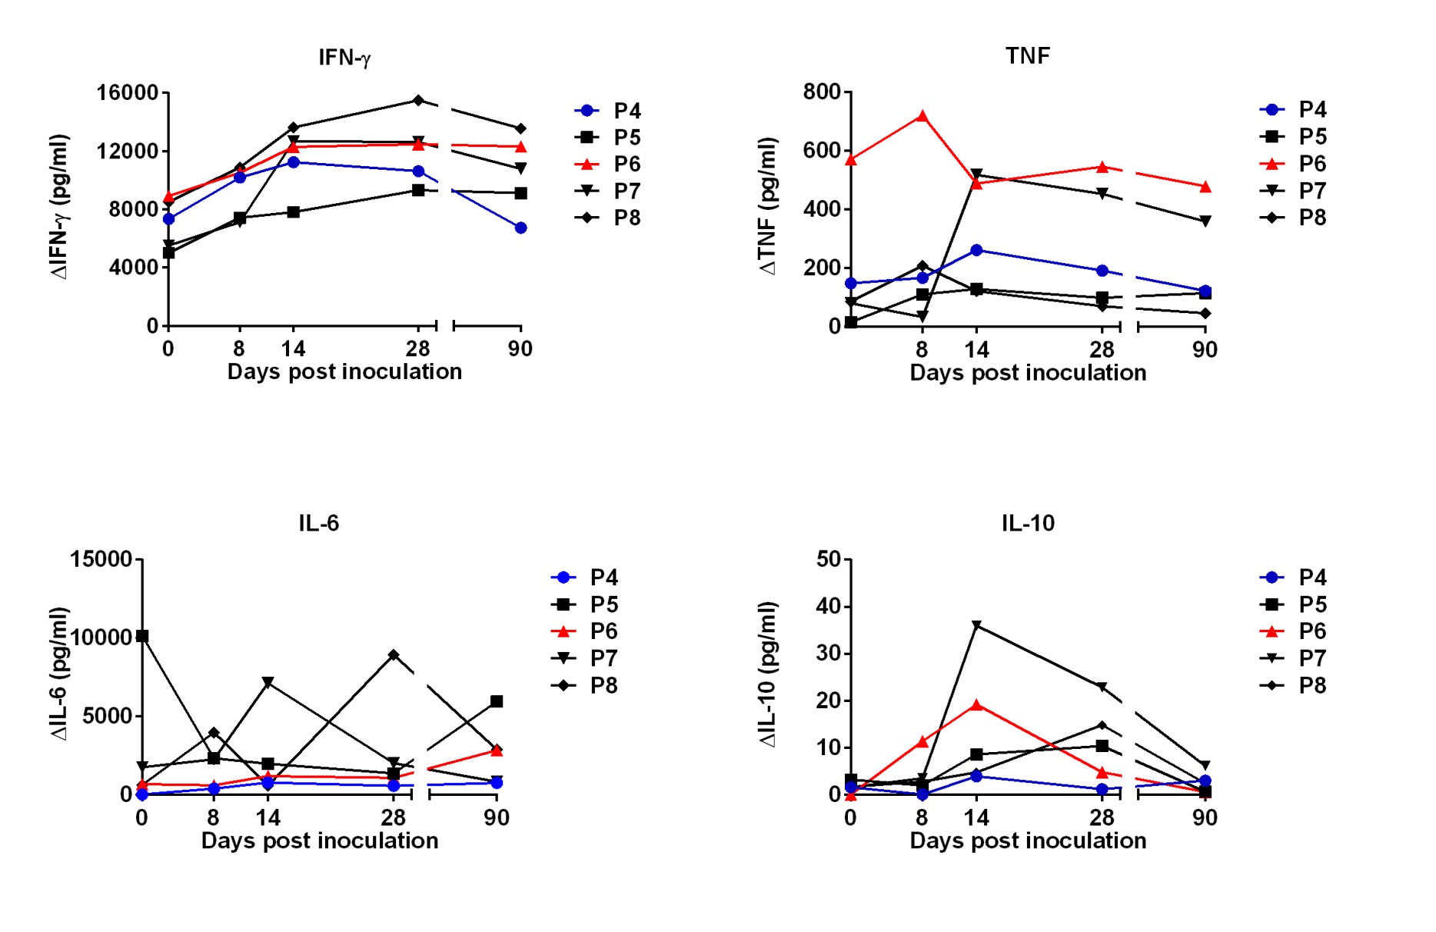
Group B: cytokine responses post vaccination

Slide 14
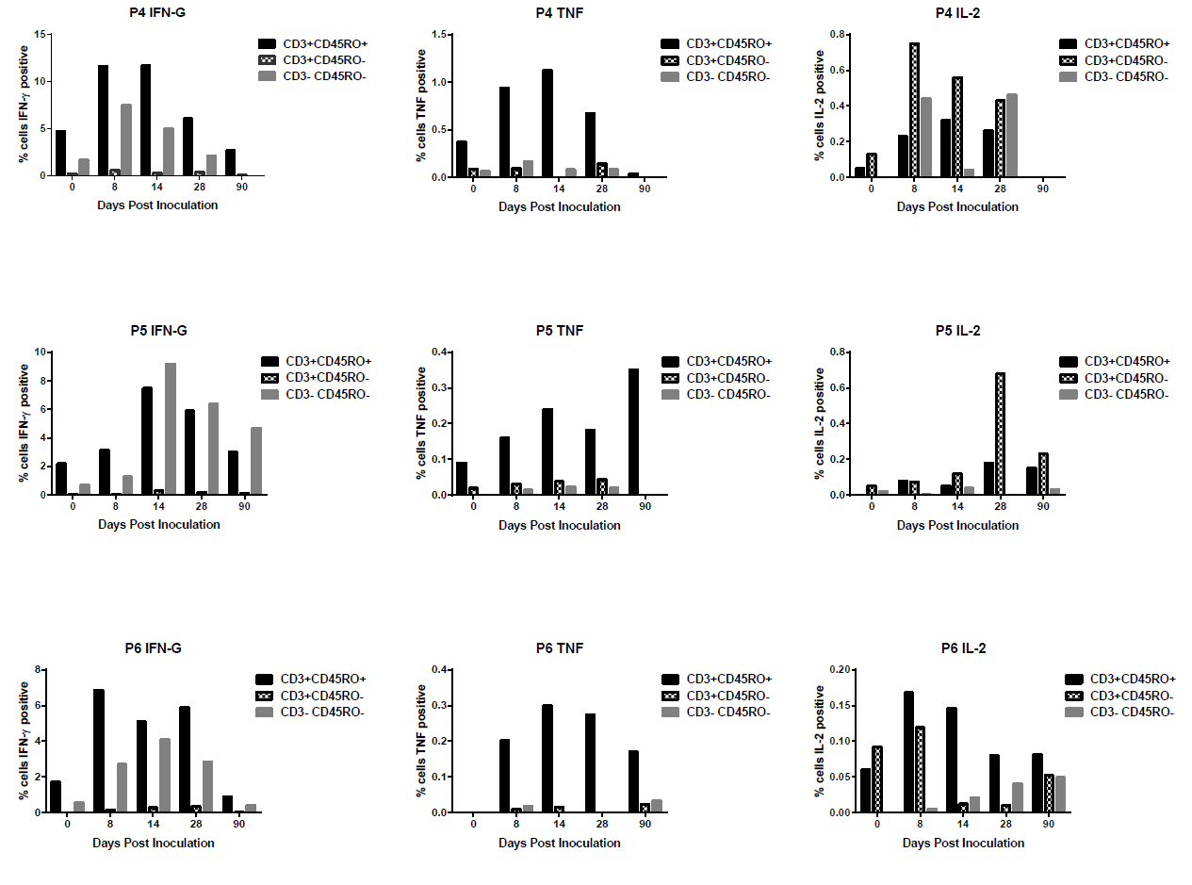
Group B: Cytokine production in memory T cells

Slide 15
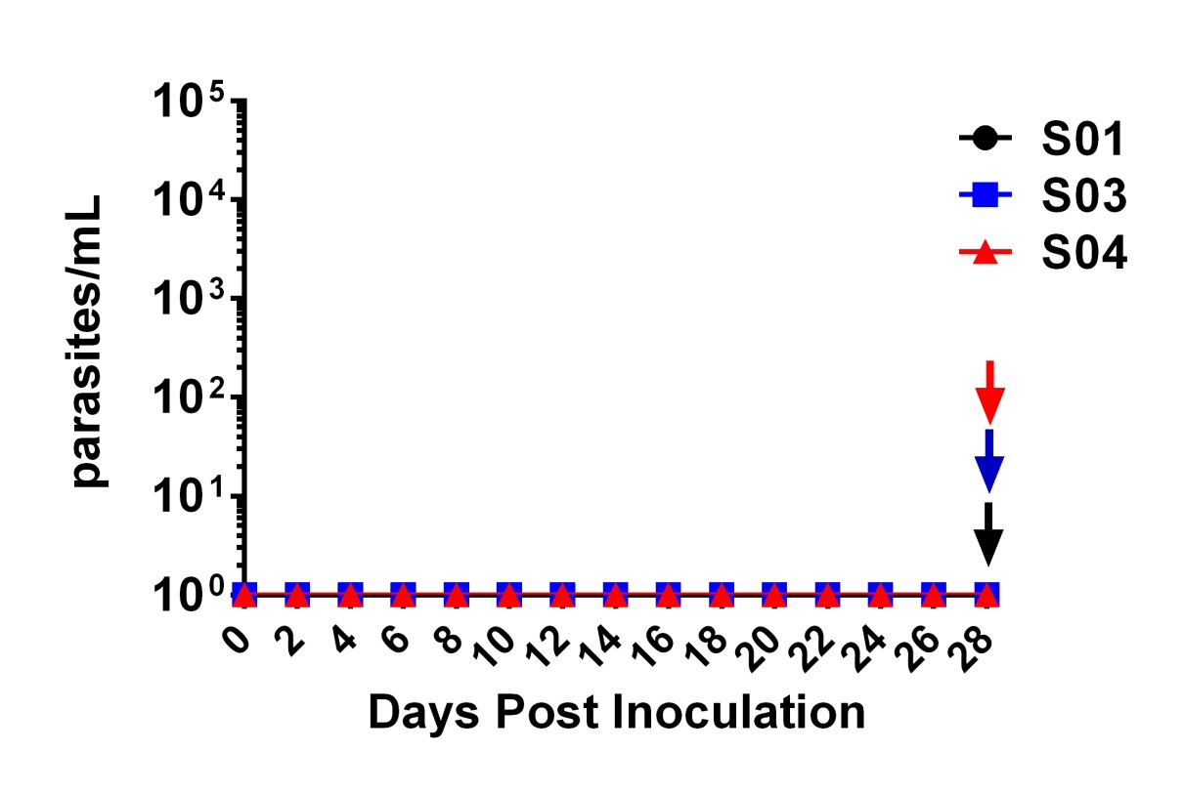

Purified chemically attenuated P. falciparum blood-stage vaccine
Reformulation of vaccine to allow purification of parasitised red blood cells
Small study to examine safety and immunogenicity of fresh, purified form of the vaccine
Initiation of drug treatment

Slide 16
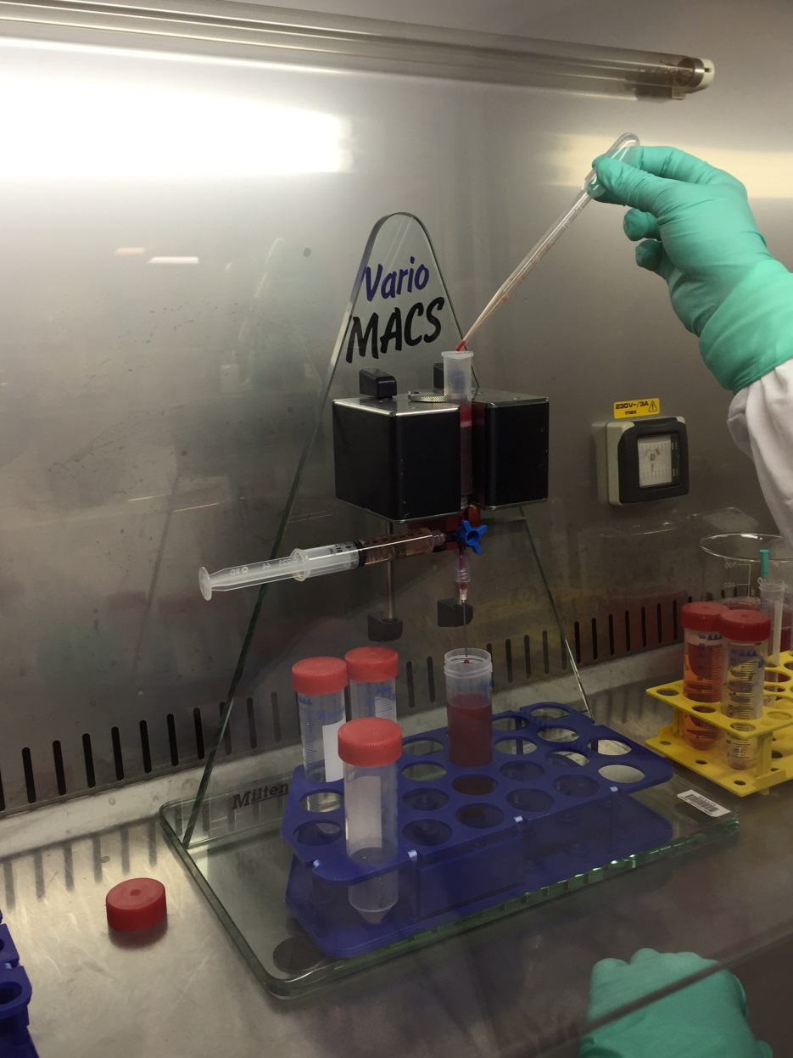
ROTARY PARTNERSHIP
ROTARY DISTRICT 9640
-Rotary Clubs of Southport, Broadbeach, Hope Island, Satellite Club of Southport-Griffith University
-fundraising project to support further development of the vaccine (clinical trial)
-registered by Rotary Australia Benevolent Society and endorsed by the National Committee of Rotarians Against Malaria

Slide 17
Purified chemically attenuated P. falciparum blood-stage vaccine
Phase Ib Efficacy Study
Aims
-Safety, immunogenicity and protective efficacy following blood-stage challenge
3 study groups receiving different doses of parasite (n=10) run sequentially
2 infectivity controls per study group
3 doses of the vaccine on Day 0, 28 and 56
Challenge on Day 84 with P. falciparum blood-stage parasites
Four volunteers in the first group have received their first vaccine dose
Funding: Rotary and Zarraffa’s

Slide 18
Acknowledgements
Institute for Glycomics Gold Coast Hospital Sanaria
Michael Good John Gerrard Steve Hoffman
Xue Liu James Fink Kim Lee Sim
Bibiana Rodriguez Johanna Mayer Tao Li
Jolien Pingnet Lana Sundac
Jessica Powell Letitia Gore Burnet Institute
Mei-Fong Ho Sarah Coghill James Beeson
Nicole Willemsen Kylie Alcorn Jo-Anne Chan
Ibrahim El-Deeb
Tanya Forbes Mater Hospital
Nicola Cocroft Paul Griffin
Chris Davis
Michael Batzloff
Silvana Sekuloski Australian Army Malaria Institute
Judy Coote Dennis Shanks; Qin Cheng
Maryna Martin Marina Chavchich THE VOLUNTEERS
QIMR Berghofer Institute Bio21 ROTARY
for Medical Research Eric Hansen NFMRI
James McCarthy ZARRAFFA’S Georgia State University
Moses Lee

