Slide 1
RAM Conference 2018 Malaria Vaccine Project
Graham Jones: Chairman & Project Manager

Slide 2
Support Vaccine Development

Slide 3
Governor-General Launch: 27 March 2017

Slide 4
How are we stacking up?
TARGET: $500, 000
LAUNCH DAY: $50,000
AUGUST 17: $470,000

Slide 5
Rotary leads the Way!
Notes:
Rotary 310,000

Slide 6
Key Districts & Clubs
Queensland | NSW & ACT | Victoria | SA | Other
9640 | 9710 | 9800 | 9500 | RAM National
9630 | 9670 | 9810 | 9520 | RAM PNG
9600 | 9675 | 9790
9570 | 9685
9550 | 9790

Slide 7
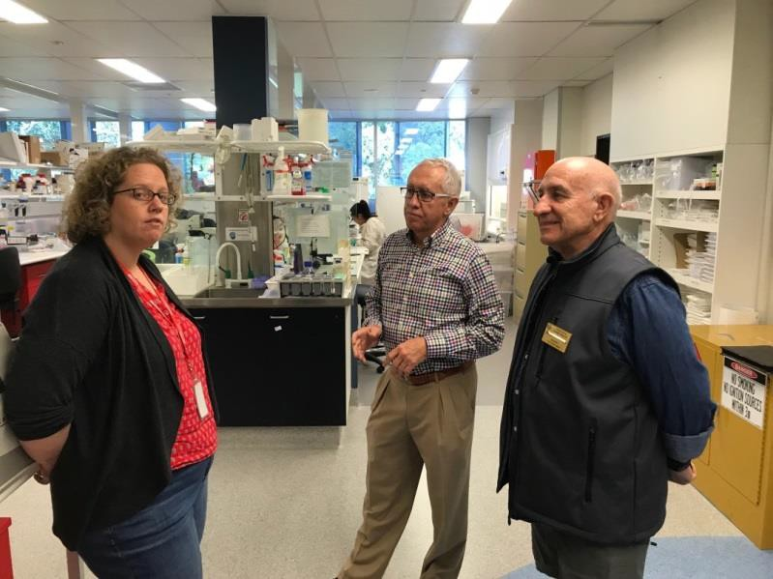
District Strategy: Ambassadors
DG
Contact person for
each District
One ambassador
per cluster [6 clubs]
Link with Assistant Governors

Slide 8
Making a Difference

Slide 9
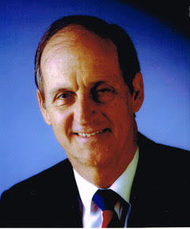
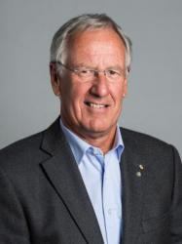
Patrons
PRIP Glen Kinross AO Hon Lawrence Springborg MP RID Noel Trevaskis OAM

Slide 10
A Corporate Sponsor: Kenton & Rachel

Slide 11
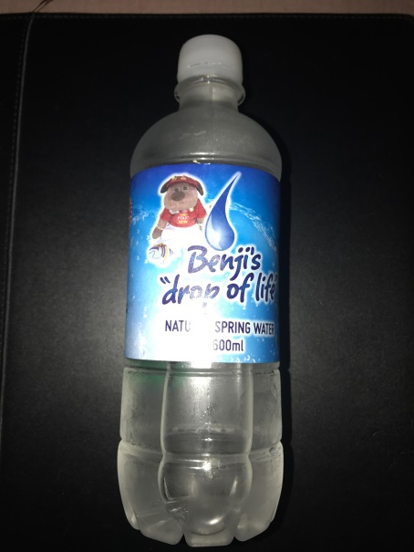
BENJI adds water to the mix!

Slide 12
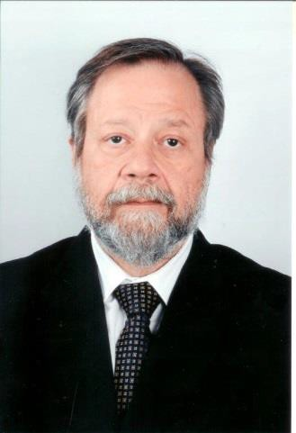
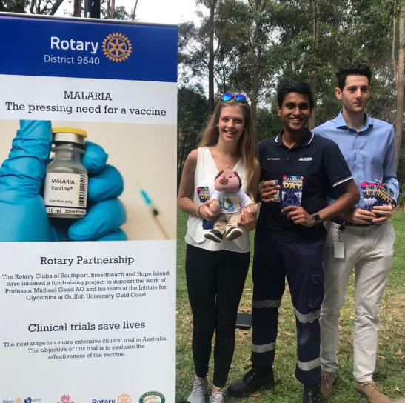
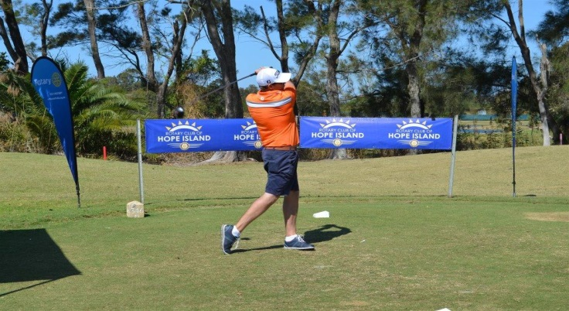
A Plethora of Innovative Fund Raising

Slide 13
The Challenge
Goal: Fund the clinical trials in a non-endemic country (Australia)
Reset our target: $1,000,000
Completion Date: December 2019

Slide 14
We need to change the equation!
Notes:
Rotary 310,000

Slide 15
Making IMaking It All Happen!

