Slide 1
Insecticide Impregnated Outdoor Screens
Lessons from Barrier Screens
Edgar Pollard
PhD Candidate

Slide 2
What is the barrier screen?
Notes:
A method for collecting resting mosquitoes
No insecticide – monitoring tool
Moquitoes encounter the screen as they fly along and rest and are then collected

Slide 3
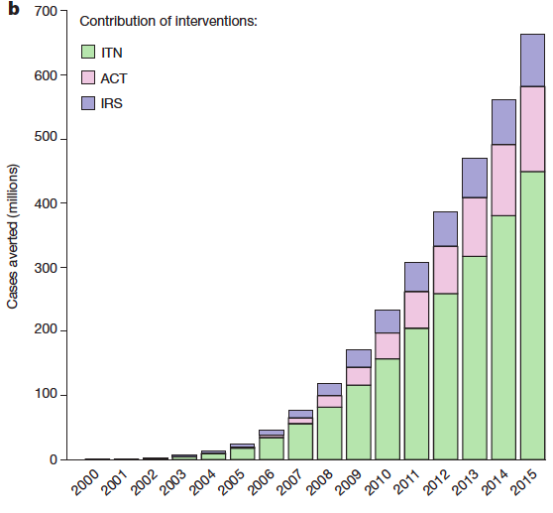
The success of the bed-net story
Indoor Residual Spraying
Artemisinin Comb. Therapy
Insecticide Treated Nets
Cases Averted (millions)
0 200 400 600
2000 2005 2010 2015
Notes:
Importance of bednets in global gains against Malaria
The success of the bednet is due to the basic understanding of the mosquito biology

Slide 4
The need for outdoor vector control tools
6pm
12am
6am
Notes:
Where is biting happening
Currently no protection during this time and space

Slide 5
What we did
Used barrier screens over 80 nights in the Solomons and Cairns to determine best practice in relation to;
Colour
Screen thickness
Height
Placement within villages

Slide 6
What to use
Darker colours such as Black
Allow/permit airflow thickness such as 70% shading
Minimum Height at least 1.2m
Notes:
(Black and Green over White)
Medium to light thickness is better, medium also gives a bit of strength
80% of anophelines were found resting below 1.2m

Slide 7
Where to place
Jack Harbour
5.9
0.5
0.1
Houses
Village
Larval sites
Haleta
0.2
1.0
1.6
Notes:
Barrier to intercept flying mosquito routes
Around houses and larval sites
Village hotspots
Understanding that village contexts are also different
Also understanding Temporal and Spatial hotspots

Slide 8
Practicalities for insecticide treated screens
People are mostly located veranda/kitchen
Double impact (Same as insecticide bednet), protect and kill
Possibility of windows & eaves
Notes:
So knowing this how does it help us with
During peak biting

Slide 9
What else do we need to know
Entomological efficacy and how to measure impact
UV/ weather exposure
Community acceptability and uptake

Slide 10
Conclusions
A possible new tool
We now know the vector behavior a little better so possible to trial a proof of concept
We know that mosquitoes do rest on screens and we know where they are most like to rest
Notes:
That targets early outdoor biting mosquitoes

Slide 11
Tagio tumas

