Slide 1
Malaria Elimination Programme
Timor Leste
National Malaria Programme
Department of CDC
Ministry of Health
Timor Leste
19/08/2017

Slide 2
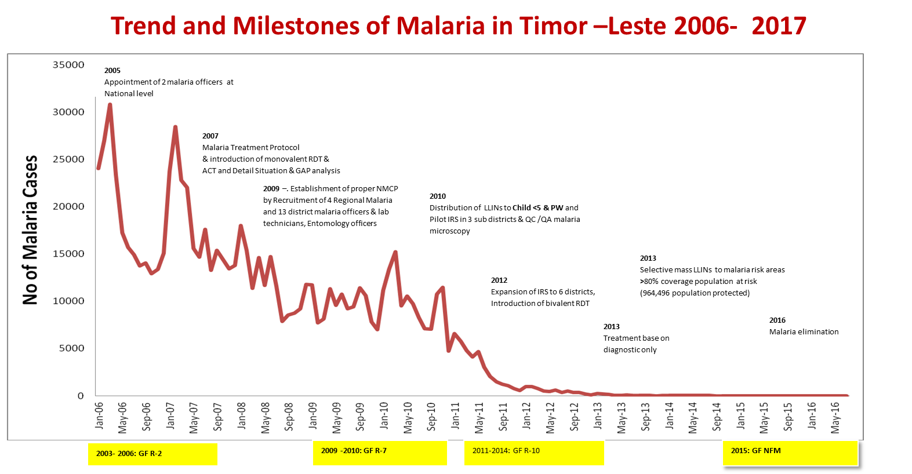
National Malaria Programme Success Story: Control to Elimination Phase in 10 years

Slide 3

Number of Malaria Cases Reported and Annual Parasitic Incidence (API)
Year | No exam. slide | No exam. RDT | Clinical malaria | Conferm Malaria | Pf | Pv | Mix | Total | death | API (/1000)
2009 | 85,538 | 34,152 | 85,799 | 40,999 | 34517 | 12,246 | 567 | 133,129 | 56 | 37
2010 | 110,494 | 85,751 | 78,882 | 40,250 | 28,350 | 11,432 | 154 | 119,072 | 58 | 35
2011 | 81,172 | 127,272 | 16,418 | 19,740 | 14,261 | 3,759 | 1720 | 36,153 | 16 | 18
2012 | 64,318 | 117,180 | 940 | 5,208 | 1,962 | 2,288 | 958 | 6,148 | 4 | 5
2013 | 56,251 | 121,991 | 17 | 1,028 | 373 | 512 | 140 | 1,042 | 3 | 0.9
2014 | 25,421 | 70,618 | 5 | 342 | 118 | 139 | 85 | 347 | 1 | 0.3
2015 | 30,253 | 90,818 | 0 | 80 | 33 | 24 | 23 | 80 | 0 | 0.07
2016 | 34,016 | 108,397 | 1 | 94 | 51 | 11 | 32 | 95 | 0 | 0.08

Slide 4
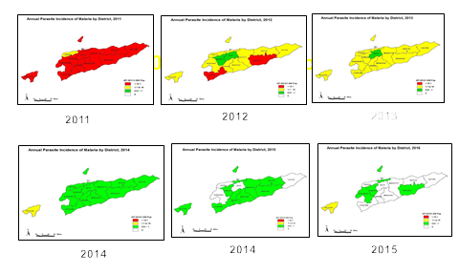
Malaria Incidence per 1000 population from 2011 to 2016 according to municipalities

Slide 6
Malaria Cases 2016 reported in the East & West Timor Border 2016
District | Sub District
 |  | <5 | >5 | M | F | Border | other
Oecusse | Nitibe | 4 | 20 | 15 | 9 | 24
 | Pante Makasar | 5 | 59 | 40 | 24 | 64
 | Passabe |  | 1 |  | 1 | 1
 |  | 9 | 80 | 55 | 34 | 89
Bobonaro | Malina |  | 2 | 1 | 1 | 2
Dili | Atauru |  | 1 |  | 1 |  | 1
 | Don Alexio |  | 1 | 1 |  |  | 1
Eremera | Hatolia |  | 1 | 1 |  |  | 1
Viqueque | Vatu Carabau | 1 |  | 1 |  |  | 1
TOTAL |  | 10 | 85 | 59 | 36 | 91 | 4

Slide 7
Factors that contributed to success
Political and financial support and commitment from the Government,
Major financial support mainly from the Global Fund starting from 2002 and Rotarian Against Malaria, Australia staring from 2010
Strong Long Term Technical Support from WHO
Implementation of evidence based prompt and effective diagnosis and treatment (QC malaria microscopy and RDT, training of clinicians, Therapeutic efficacy study )
Implementation of evidence based vector control programme base on Entomological surveillance findings
Community based diagnosis and treatment by the community health Workers in hard to reach areas (30% of the confirmed cases from Community Health Volunteers)
High coverage with Long Lasting Insecticide treated nets (> 90% of the risk population) and good quality Indoor Residual Spraying with >90% coverage
Strong surveillance, and monitoring and evaluation system
Intersectoral collaboration
Strong leadership at the central level and a young highly trained and motivated staff

Slide 8
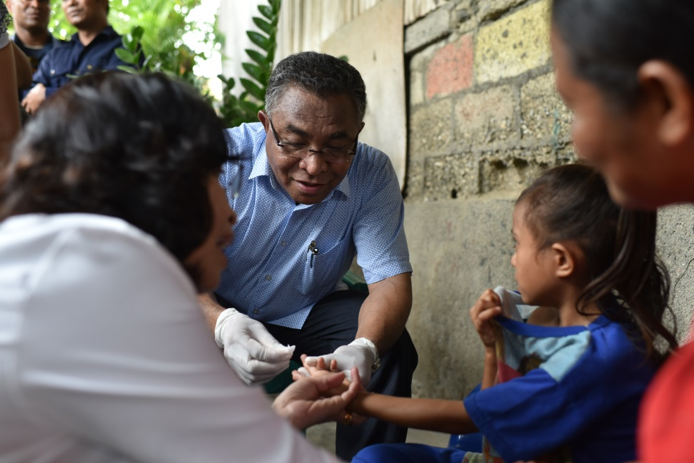
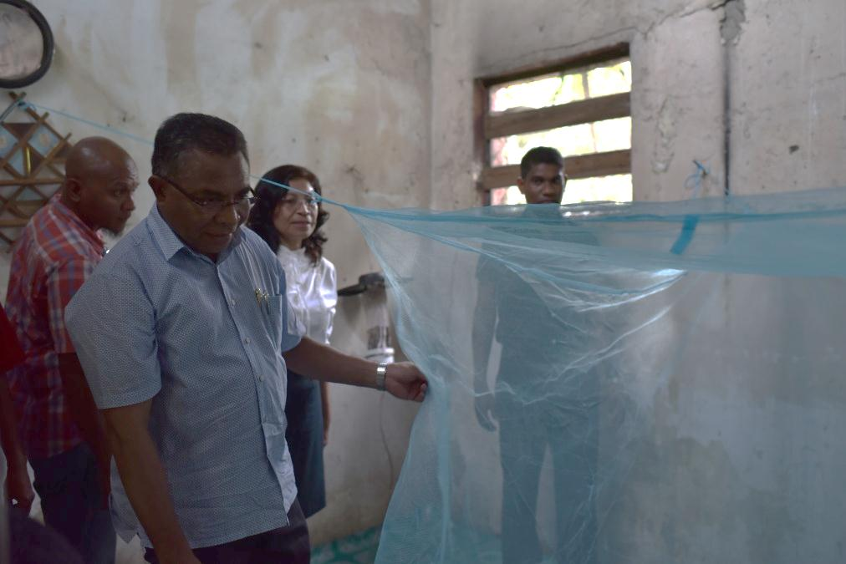
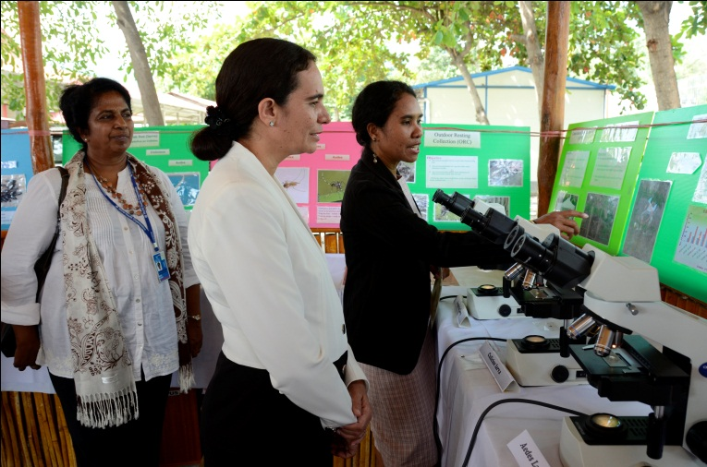
Strong Political Commitment
HE Prime Minister, Dr Rui Maria de Araujo, participating in a field visit for active case detection among the vulnerable population
HE Prime Minister, Dr Rui Maria de Araujo and Vice Minister of Health, Dr Ana Isabel de Fatima S. Soares visiting a community member house in Hera.
Honorable Minister of Health, Dr Maria do Ceu Sarmento Pina da Costa at an event that showcased the national malaria programme focusing on diagnosis of malaria parasites using microscopy.
Notes:
Strong

Slide 9
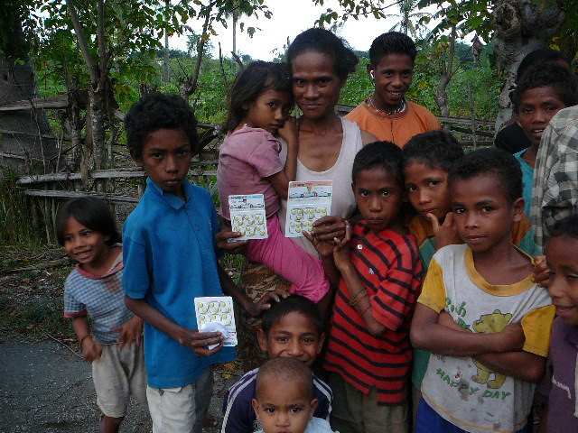
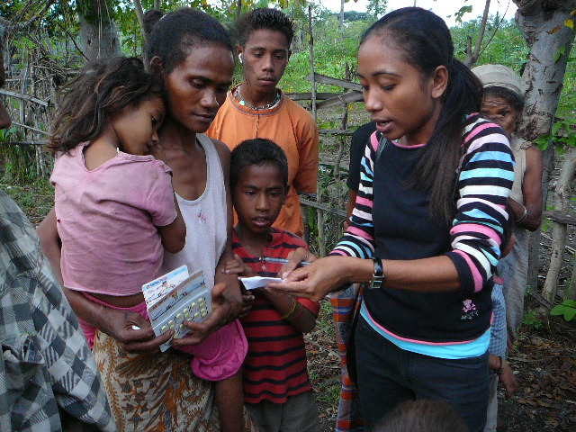
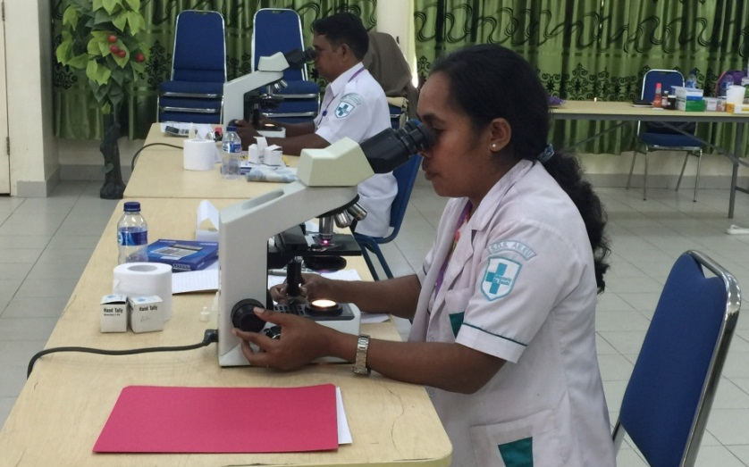
Universal access to free diagnosis and treatment for malaria
Treatment for malaria is free. Health care workers interacting with community informing them about malaria, its diagnosis and treatment
Diagnosis of malaria using malaria microscopy

Slide 10
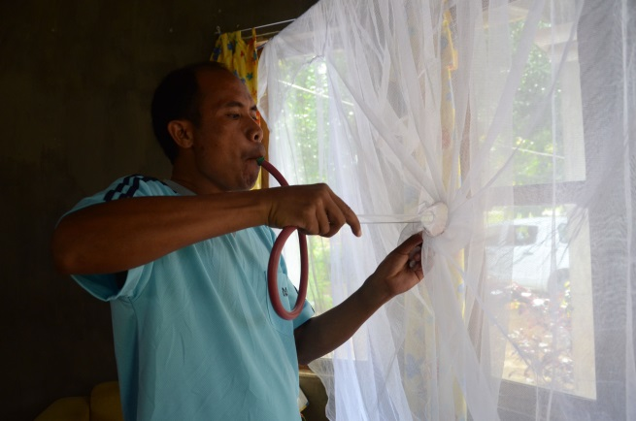
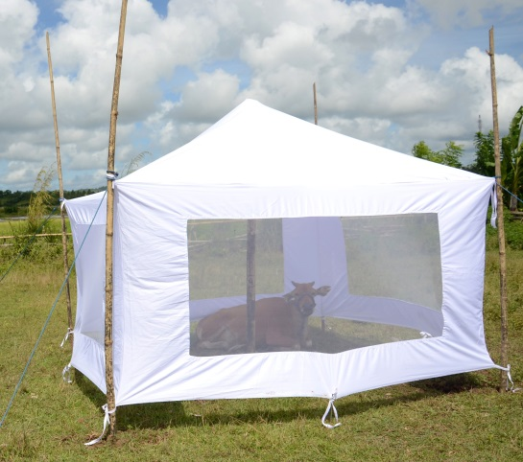
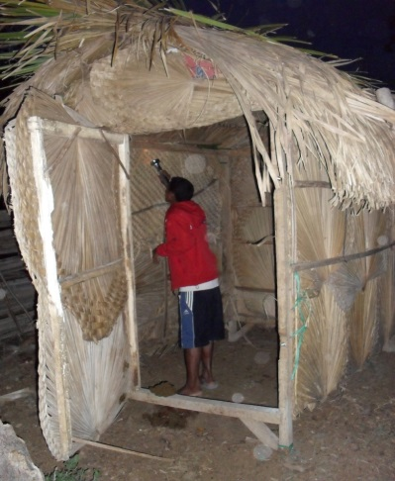
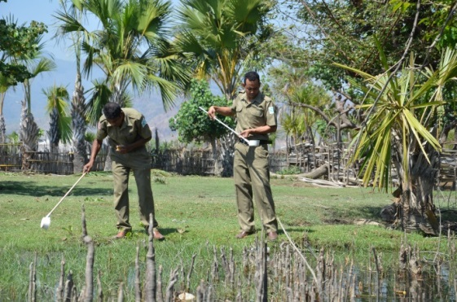
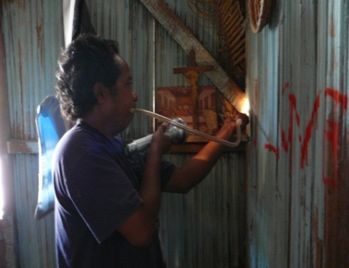
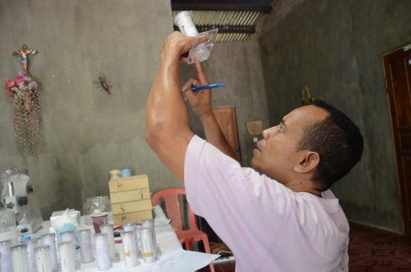
Implementation of evidence based malaria vector control based on entomological surveillance
Monitoring the persistence of the insecticide impregnated to the fibers of the nets and mortality rate of the malaria vectors.
Entomological surveillance for monitoring of the bionomics of malaria vectors using different entomological techniques for implementation of evidence based vector control.
Insecticide resistance monitoring for selection of suitable susceptible insecticide for indoor residual spraying.
Notes:
Monitoring the persistence of the insecticide impregnated to the fibres of the nets and mortality rate of the malaria vectors

Slide 11
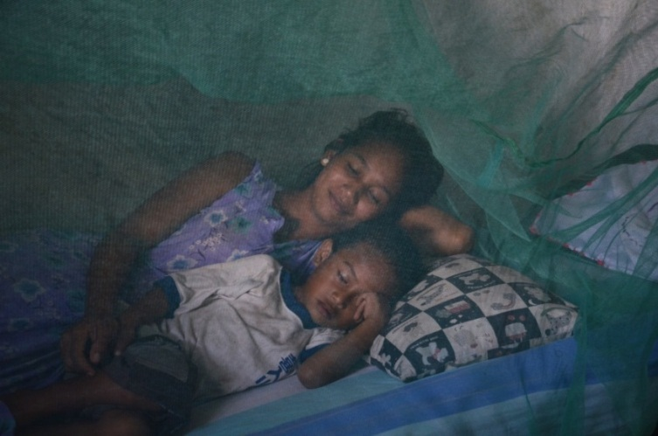
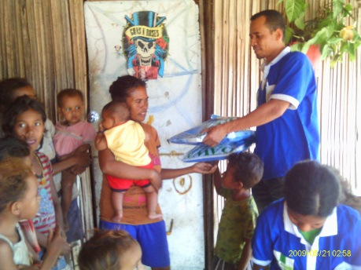
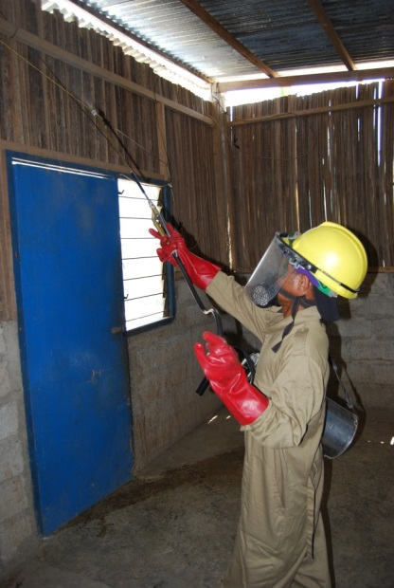
Use of Long Lasting Insecticide treated Nets (LLIN) and Indoor Residual Spraying (IRS) in malaria risk areas
>80% people in risk areas sleep under a LLIN.
LLIN being distributed in the community.
IRS : >80% houses fully sprayed with susceptible insecticide in risk areas.

Slide 12
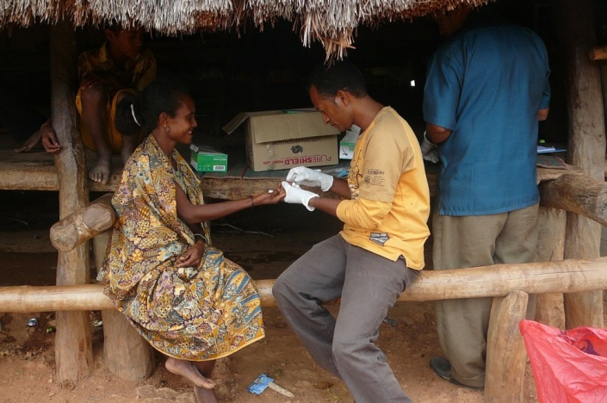
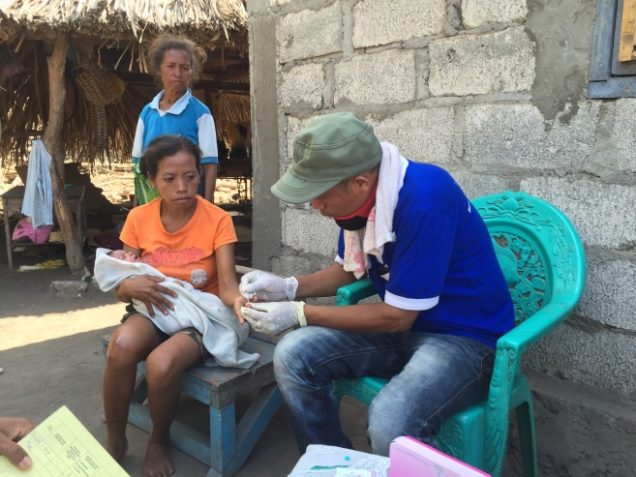
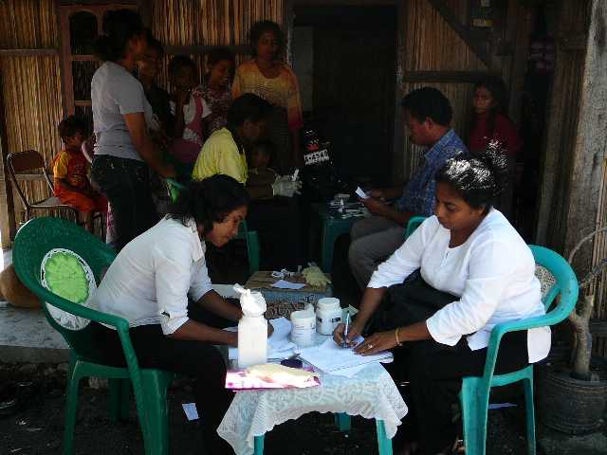
Community based malaria diagnosis and treatment
Active case detection in the community
Mobile Malaria Clinic

Slide 13
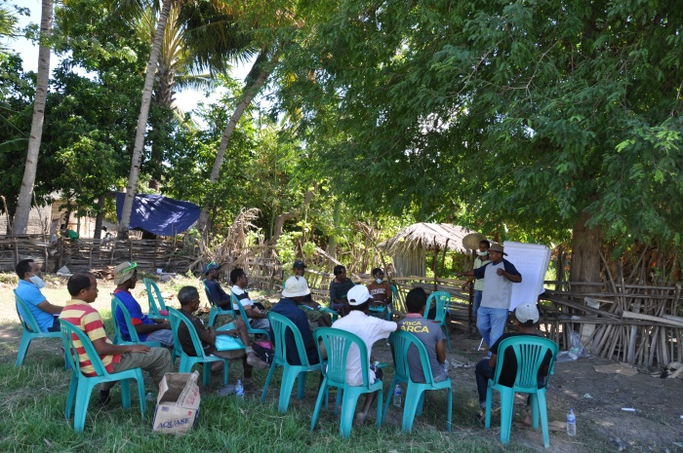
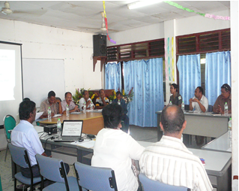
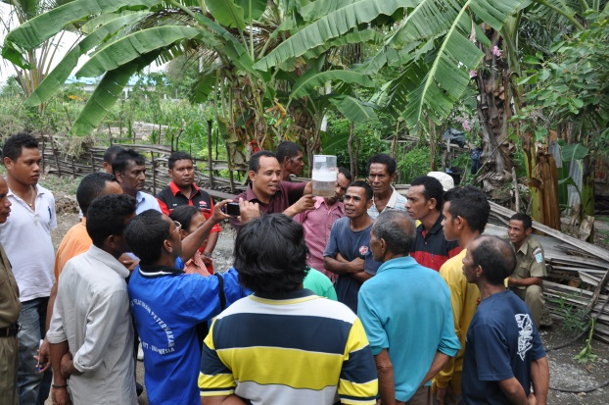
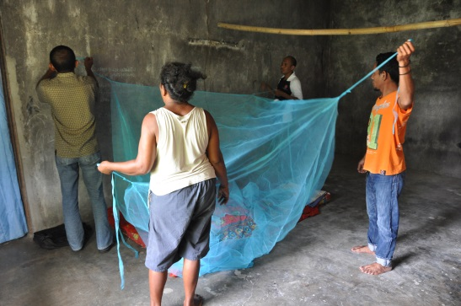
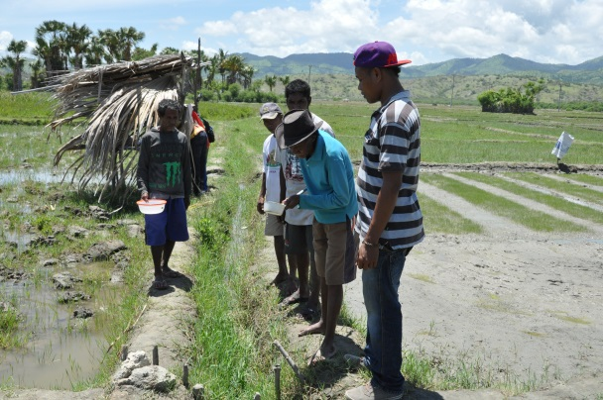
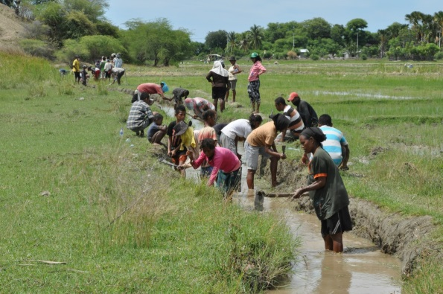
Intersectoral collaboration and community participation
Empowering the farmers by providing hands-on training by sensitizing them about various aspects of malaria and pest also which helps them protect against the diseases holistically
Intersectoral collaboration meeting with MoH , Ministry of Agriculture and administration.
Farmer school-learning by doing.
Larval source reduction with farmer community participation.
Community using LLIN as awareness about malaria and its prevention increases.
Monitoring larval density and pest density by farmers.

Slide 14
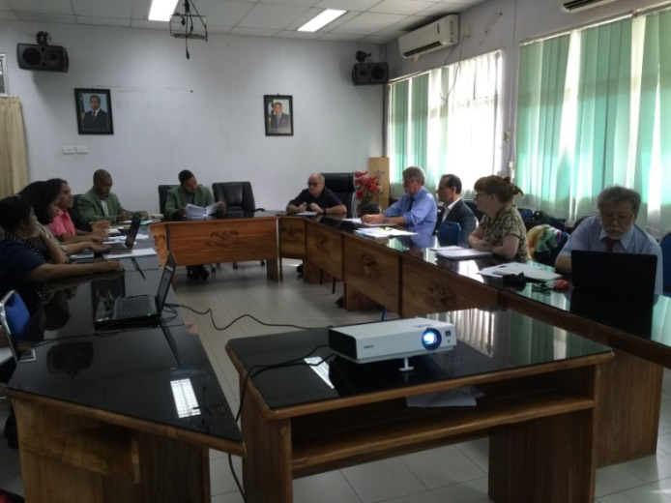
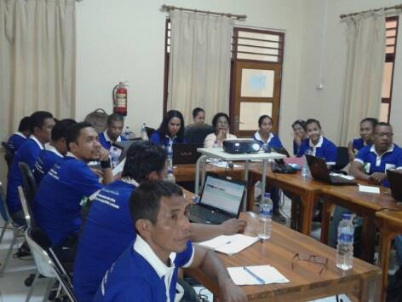
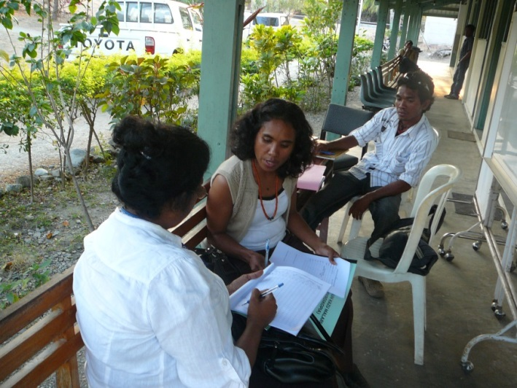
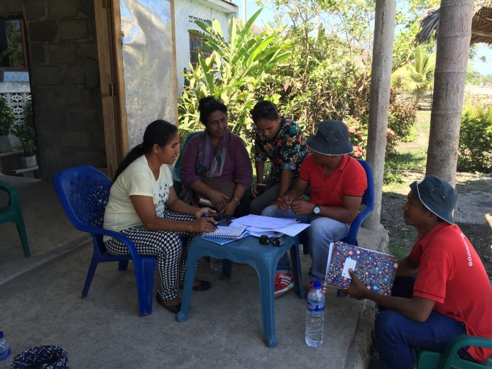
Strong Monitoring and Evaluation
External review of the malaria national programme.
Quarterly monitoring and evaluation meeting with municipality malaria officers to assess the progress and learn from others experiences.
Monitoring and Evaluation malaria data in the field and at health institutions.

Slide 15
Way forward
Cross border collaboration with West Timor as 98% cases reported from the border
Rapid response to the reported malaria cases to reduce indigenous malaria transmission
Multi sectoral collaboration to reduce malaria transmission due to migrant mobile population and involvement of private health sector
Active case detection through Family Health Programme (Saude na Familia) for finding malaria cases

Slide 16
Funding Gaps
Procurement of Long Lasting Insecticides treated nets to Pregnant Mothers live in Risk areas
Distribution of Long Lasting Insecticides treated nets to the population in malaria risk areas
Procurement of spray machines and spare parts to carry

Slide 17
Funds needed, 2018-2020
activity | No of LLINs /Nets & Sprayers |  |  |  | Estimated budget US$
 | 2018 | 2019 | 2020 | Total | 2018 | 2019 | 2020 | Total
LLINs distribution to Pregnant women live in high risk areas only -Procurement | 13022 | 13245 | 13497 | 39773 | 51,373 | 52,170 | 53,004 | 156,547
Procurement of Hudson Compression sprayers for IRS | 80 |  |  |  | 31,300 |  |  | 31,300
 |  |  |  |  | 82,673 | 239,392 | 182,512 | 509,577

Slide 18





Slide 19
Thank you

