Slide 1
Understanding human behavior in Malaria hotspots
Edgar J M Pollard
PhD Candidate
James Cook University

Slide 2
My project
Halfway through my PhD, on schedule
Completed all fieldwork back in the Solomons
Data analysis, Lab analysis and writing left to do.

Slide 3
Current malaria picture in the Solomon Islands
WHO recommended control strategies of LLINs and IRS
These methods require the mosquito to go indoors
Only 13% of exposure occurring indoors [3]
Need new tools to control mosquitoes outdoors
Better understand the biology and behavior of the mosquitoes and also of humans
Russell, TL. 2016

Slide 4
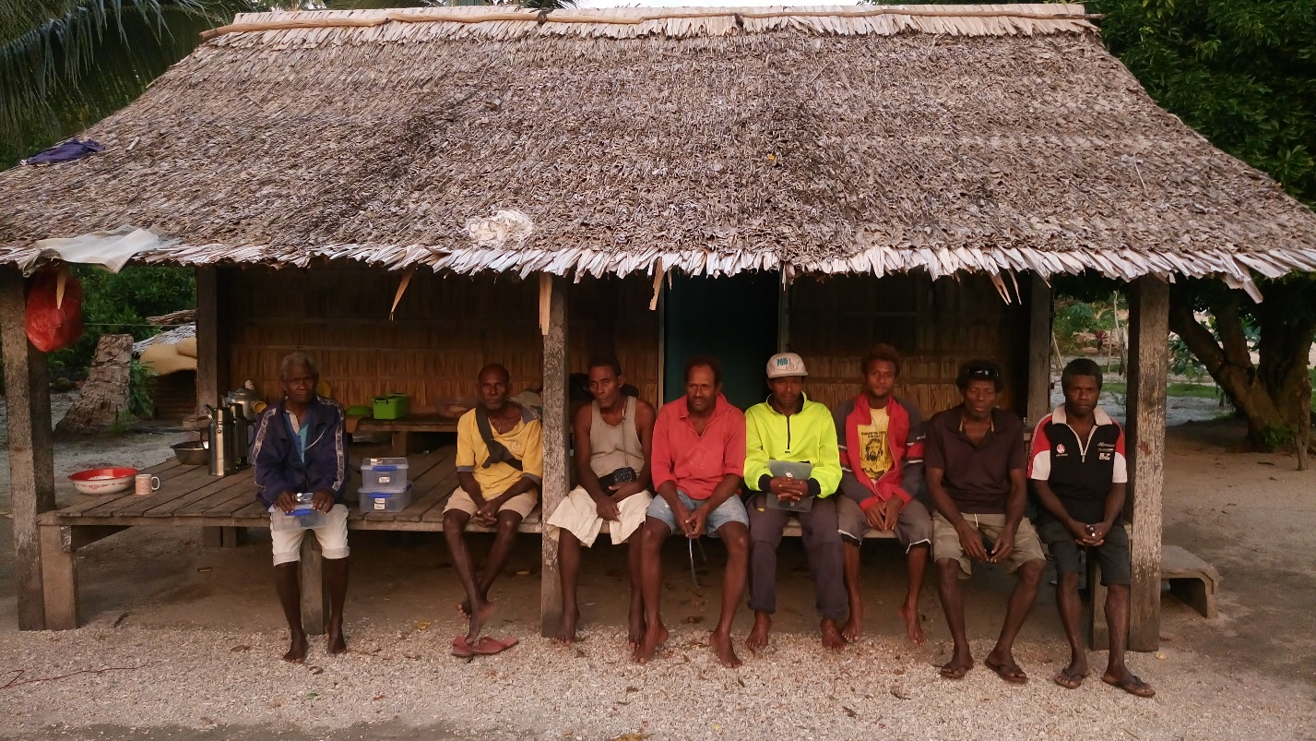
Why is human behavior important
Malaria ultimately is a human problem and it is therefore also useful to understand the human behaviour patterns in the places where malaria is endemic [5]
So to better understanding the intersection of human and mosquito populations [4]

Slide 5
Methods
Looking at human movements with 8 households around a village over a 2 week time period
18 hour macro scale to understand context of daily village movement
6 hour micro scale to understand locations and behavior during peak mosquito biting time
Time (pm) | John | Mary | Kulagu | Machu
6-7
7-8
8-9
9-10
10-11
11-12

Slide 6
Baseline Data of Haleta village
More than 90% of houses are unscreened
All houses had at least 1 bednet with an average of 3.4 bednets per household of which 2.9 are used of which 0.3 have holes
Average household size of 4.6 members
14% under 5 and 41% under 18

Slide 7
A typical village Home

Slide 8
The village home – where people are
Veranda
Inside house
Room
Outside
Kitchen
Under house

Slide 9
6-8 pm
Veranda
Inside house
Room
23%
13%
5%
Outside
Kitchen
Under house
32%
27%
4%

Slide 10
8-10 pm
Veranda
Inside house
Room
36%
12%
13%
Outside
Kitchen
Under house
28%
10%
1%

Slide 11
10-12 pm
Veranda
Inside house
Room
10%
23%
49%
Outside
Kitchen
Under house
14%
2%
2%

Slide 12
People sleep locations
86% sleep under a bednet
Veranda
Inside house
Room
1%
7
%
90%
Outside
Kitchen
Under house
2
%
0
%
0
%

Slide 13
Questions & Possible Answers
Why are people mostly outside during peak biting times?
Why are most homes not mosquito proof?
Why are not all people sleeping under mosquito nets?
Social reasons, house is only for sleeping, cooler with sea breeze outside
Access to building materials, screens, use of traditional materials
Access, some households only have 1 so children are prioritised and also individual preference

Slide 14
Possible solutions
Insect or spatial repellent or trapping
Mosquito proofing veranda or kitchen
Education and Awareness

Slide 15
Conclusion
Human Population
Mosquito Population
Current infrastructure and human behavior are adding challenges to malaria elimination
Better understanding of mosquito and human behavior will help us focus our efforts to minimize the overlap

Slide 16
Tagio tumas

