Slide 1
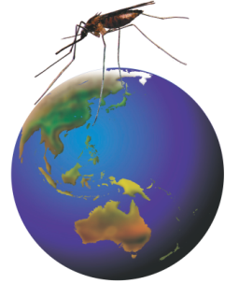
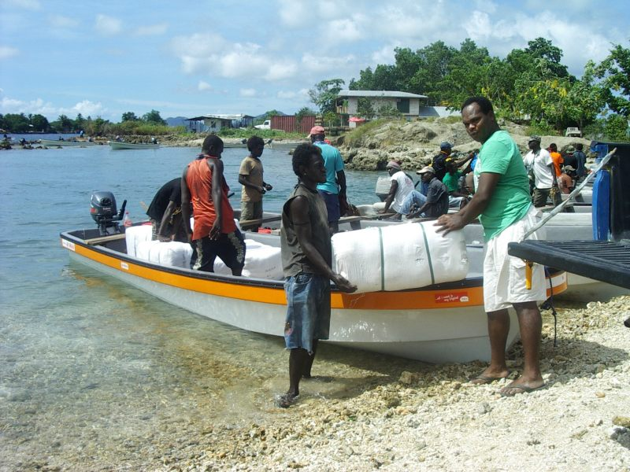
RAM Programs in Solomon Islands

Slide 2
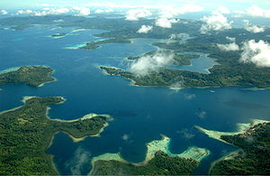
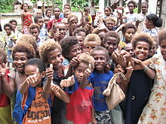
Overview – Solomon Islands
674,000 population
Archipelago covers 28,400 sq kms
922 islands
9 Administrative Provinces
356 health facilities
200 NVBDCP Staff
68 indigenous languages
Infant mortality – 16 deaths/1000
live births
Slide from Alby Bobogare 2015

Slide 3
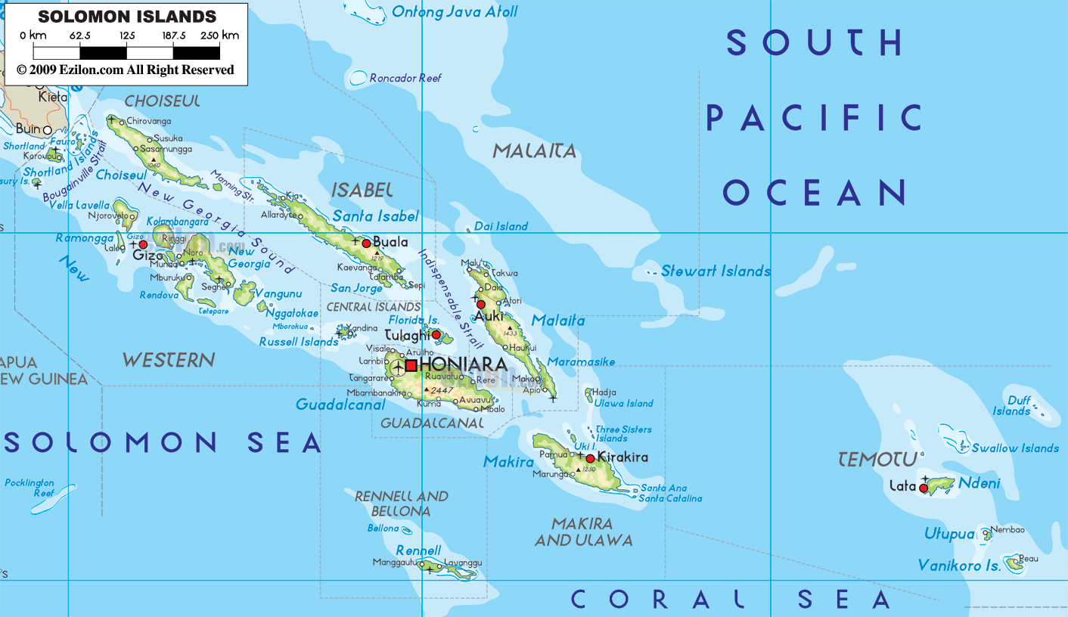
map of Solomon Islands

Slide 4

Recent History of Malaria
RAM
launched
Original MEP
DDT spraying
Intensified control & elimination program
Malaria in the Solomon Islands
Incidence of confirmed cases per 1000 population (MHMS, Solomon Islands)
Notes:
Nets require humans to sleep inside them. IRS is less behaviour dependent but the mosquitoes still need to enter the houses to contact the insecticide and be killed. We are presently at the same level of control as when DDT was used in indoor residual spraying in the 1970s in the Solomon Islands

Slide 5
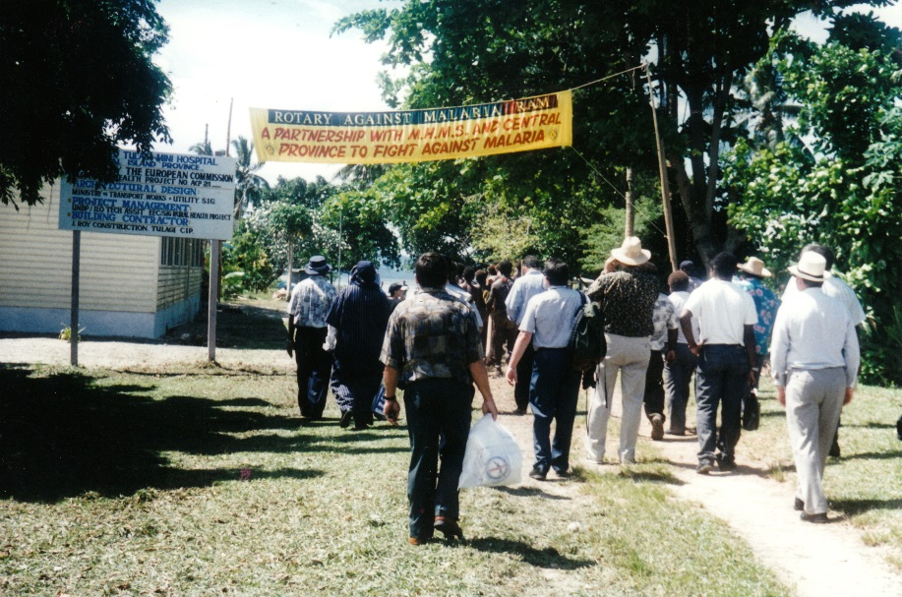
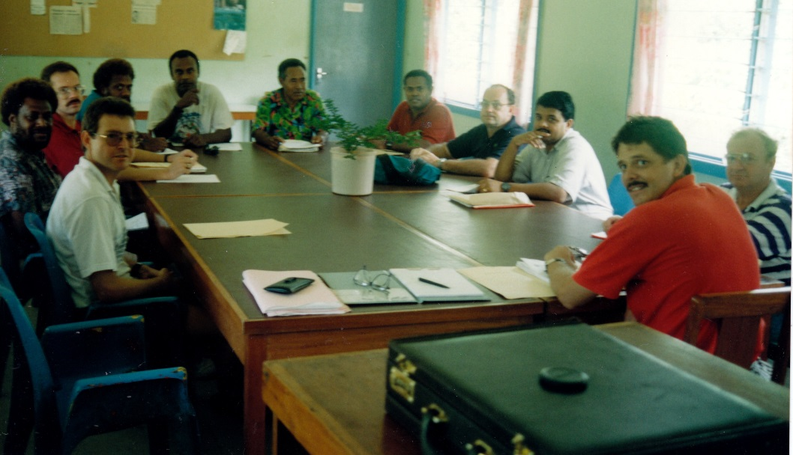
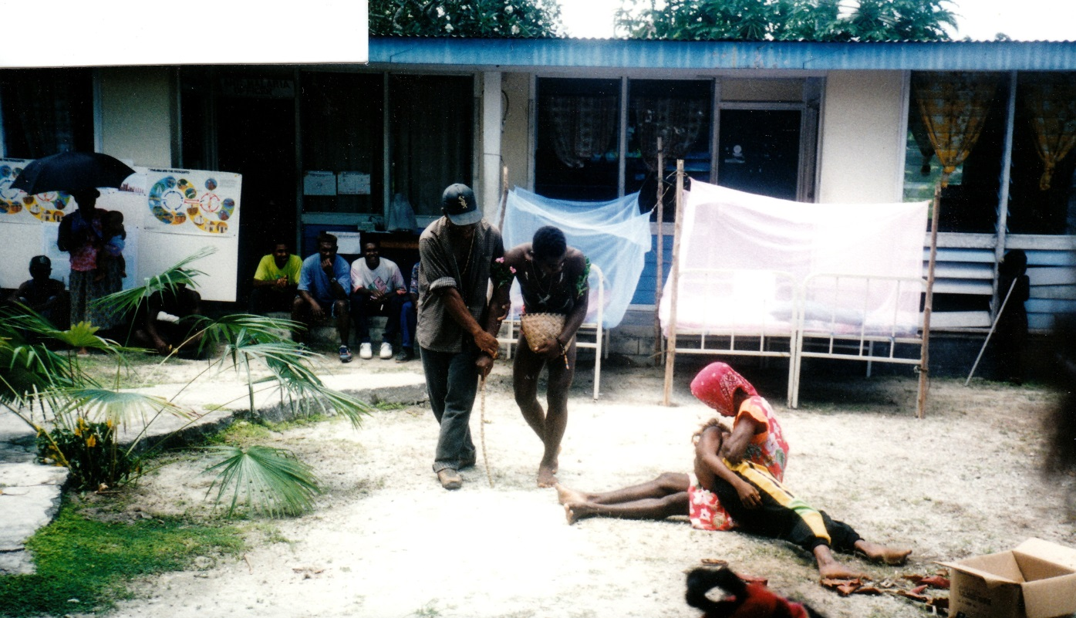
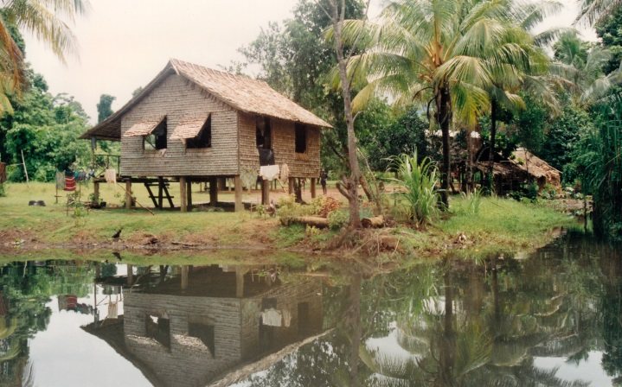
RAM Beginnings 1995
Tulaghi Solomon Islands

Slide 6
RAM Record of Service: Solomons
>200,000 Bed nets, Flip charts and brochures, larvacide & IRS.
LLIN procurement for the Global fund.
21 Houses constructed for MoH malaria staff and microscope diagnosis.
13 Storage sheds for LLINs.
20 boats and several vehicles to assist LLIN distribution.
160 villages provided with tools.

Slide 7
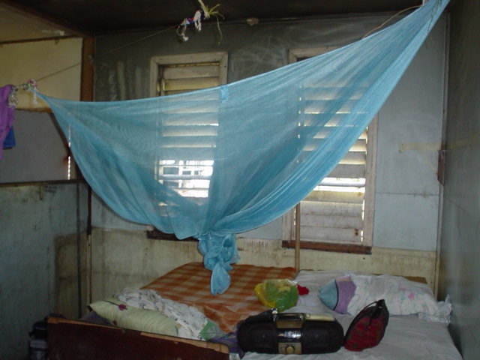
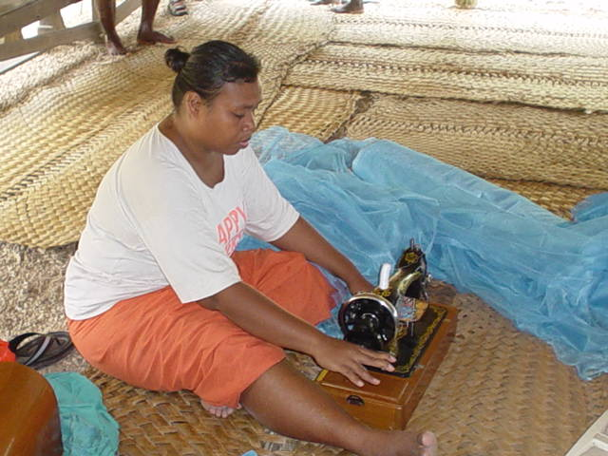
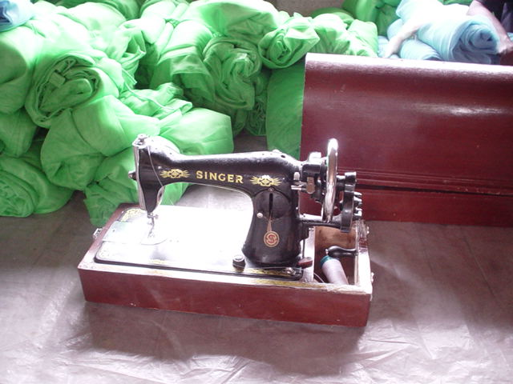
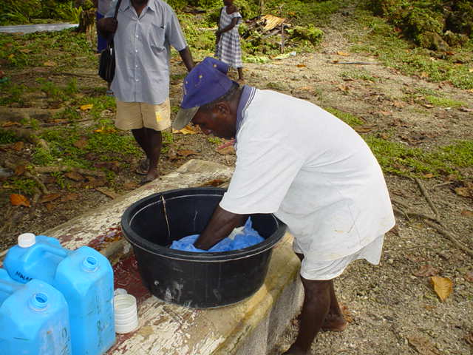
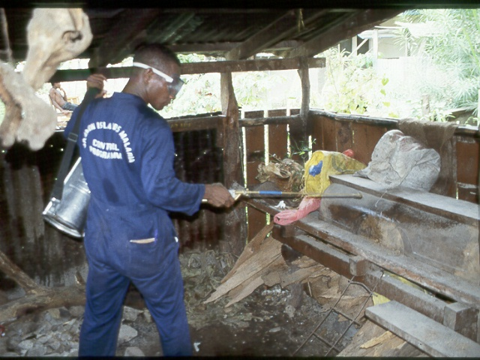
Early RAM Programs - Bed nets and Chemicals

Slide 8
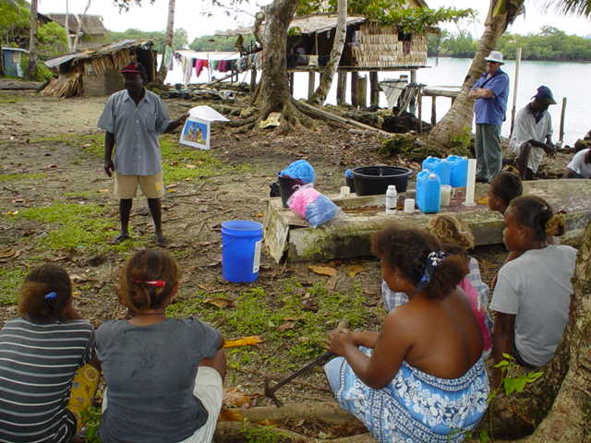
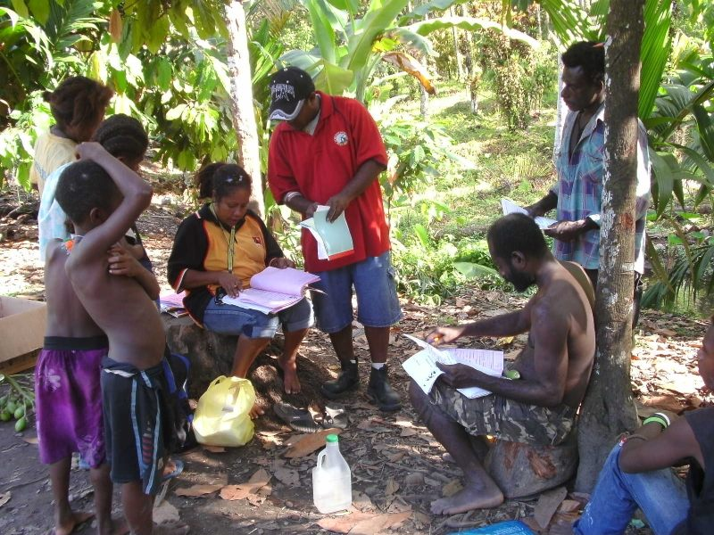
Malaria education
Accurate distribution

Slide 9
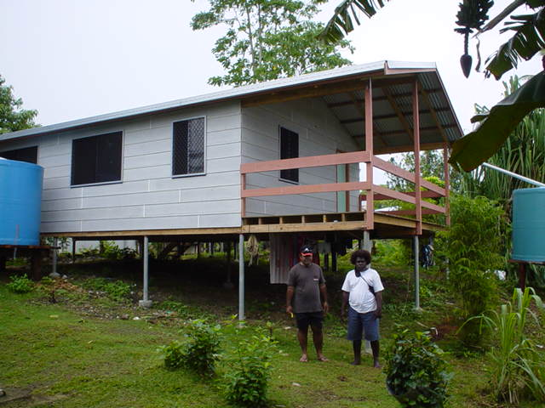
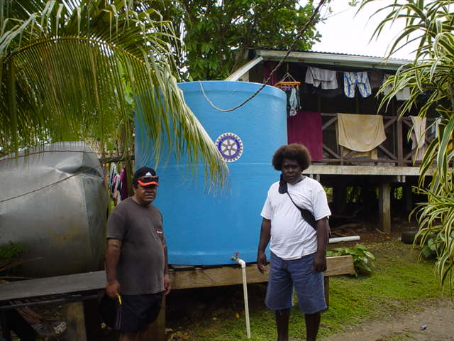
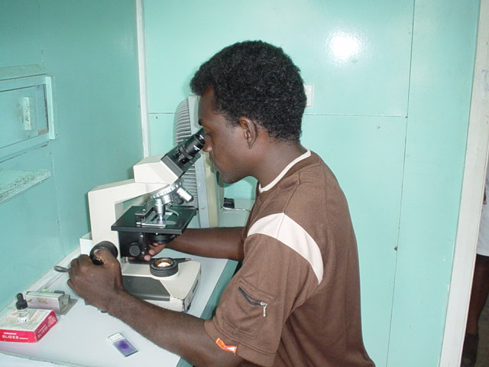
Staff & Microscopist Houses
21 Houses built by RAM assisted by TRF and AusAid

Slide 10
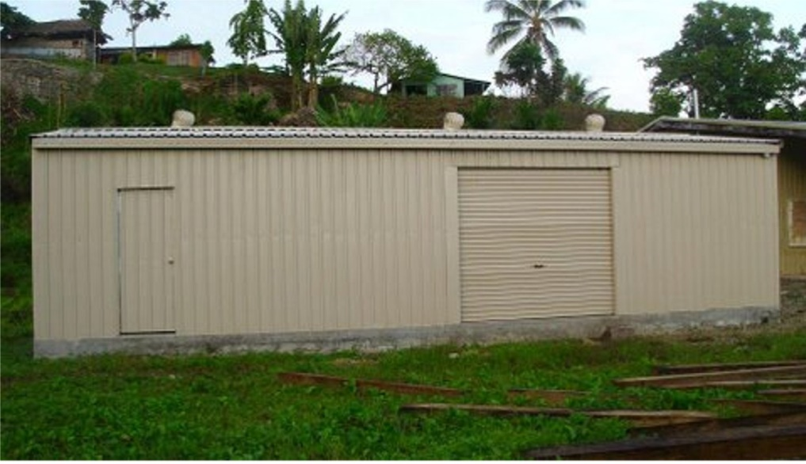
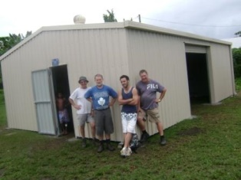
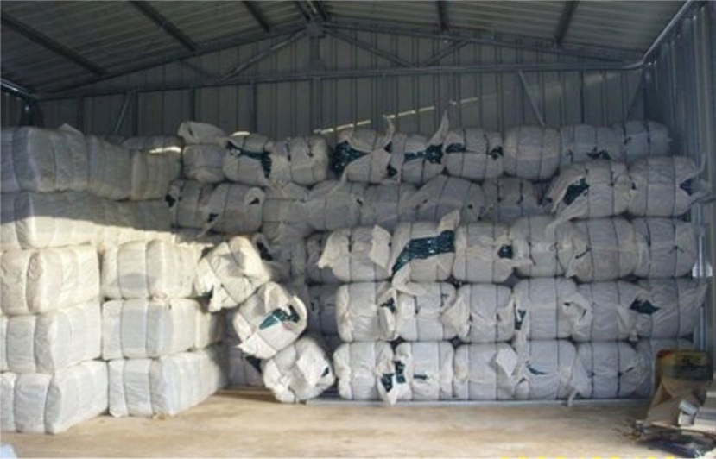
Bed Net Storage Warehouses
13 Sheds constructed by RAM Rotary Volunteers.

Slide 11
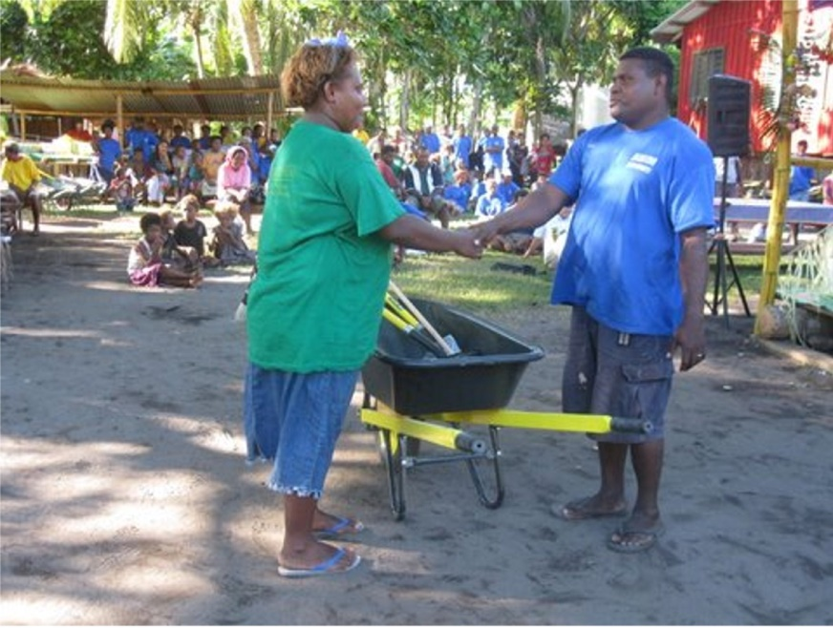
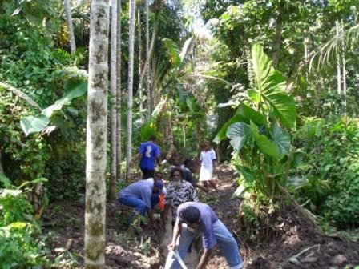
Solomon Islands Healthy Villages program
RAM has supplied tools for 160 Villages
Tools handed over by MoH Health Promotion Dept.
Drainage works
Notes:
Some of the tools lined up for distribution. Clubs and individuals supply the funds, RAM acquires the tools and Ministry of Health workers arrange distribution.

Slide 12
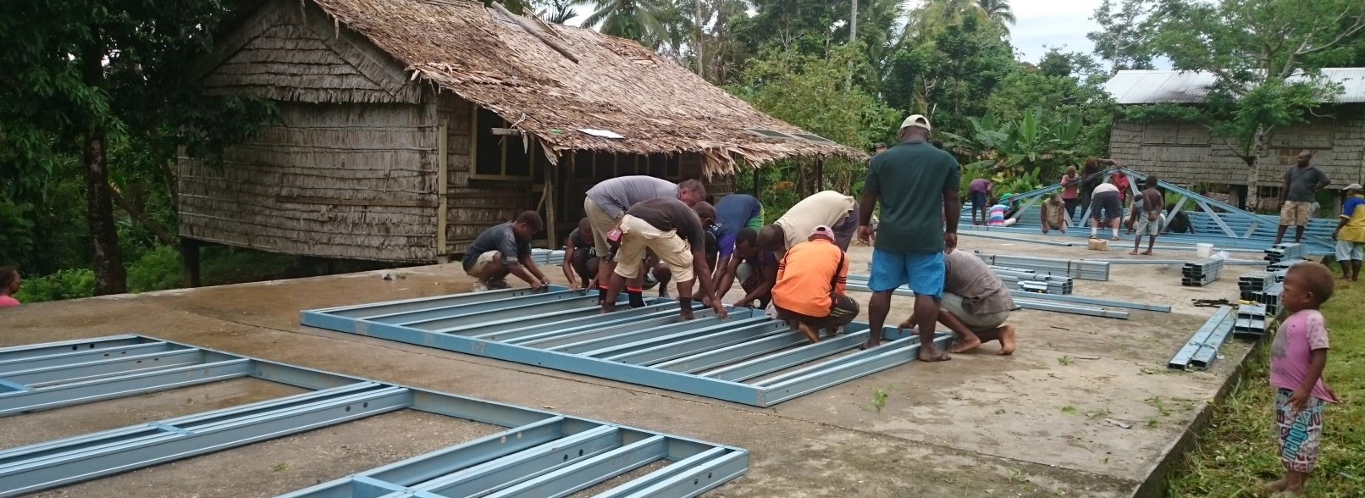
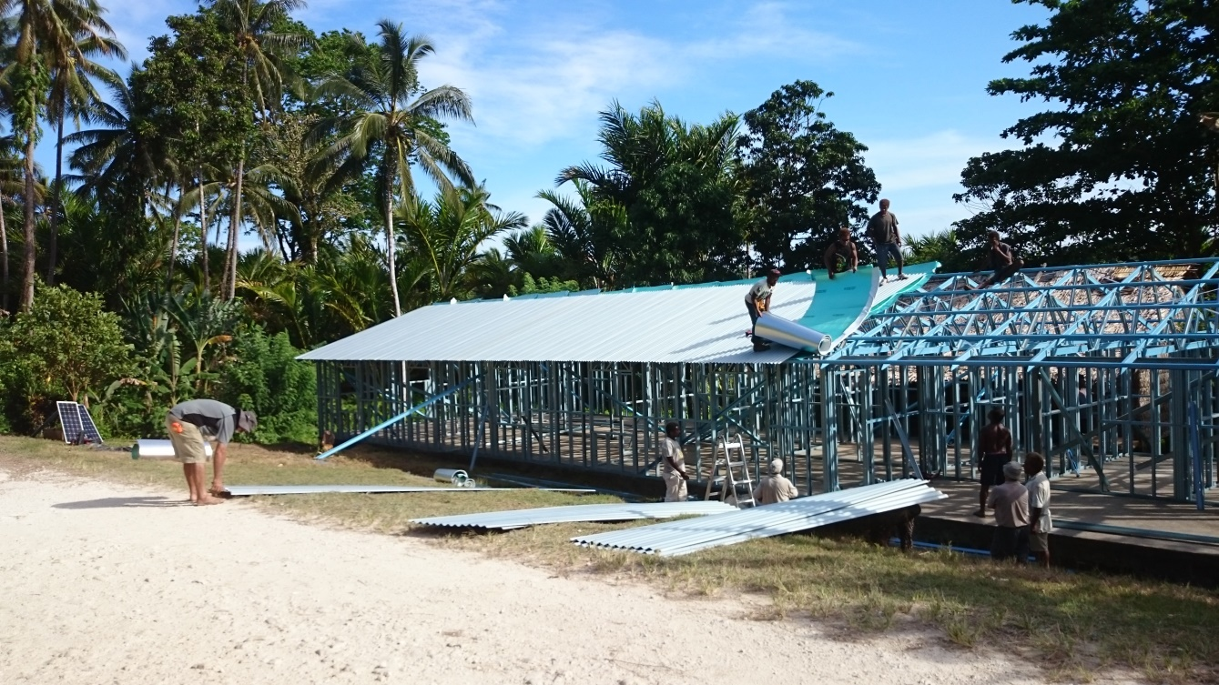
Molotabi Clinic

Slide 13
Acknowledgements
Project manager: Wayne Morris OBE
Former SI Malariologist: Dr Nathan K Kere
Solomon Forest Association $16,000 PA, 3 years

