Slide 1
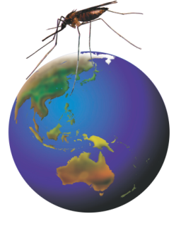

Rotarians Against Malaria
A volunteer run organisation working to eliminate malaria

Slide 2
Guest Speakers – Welcome!
Mr Tim Freeman RAM PNG
Mr Ben Rickie Kiokimo SI MoH
Mr Edgar Pollard AITHM
Dr Merita Monteiro Timor Leste MoH
Prof Denis Shanks Army Malaria Inst.
Assoc Prof Harin Kuranajeewa WEHI
Assoc Prof Bayden Wood Monash Uni
Dr Danielle Stanisic Inst. for Glycomics

Slide 3
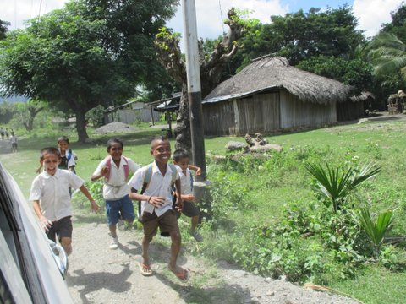
An important goal of RAM
Happy healthy kids eager to get an education

Slide 4

Recent History of Malaria
RAM
launched
Original MEP
DDT spraying
Intensified control & elimination program
Malaria in the Solomon Islands
Incidence of confirmed cases per 1000 population (MHMS, Solomon Islands)
Notes:
Nets require humans to sleep inside them. IRS is less behaviour dependent but the mosquitoes still need to enter the houses to contact the insecticide and be killed. We are presently at the same level of control as when DDT was used in indoor residual spraying in the 1970s in the Solomon Islands

Slide 5
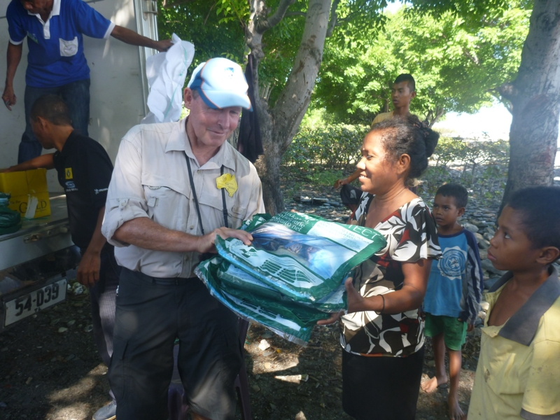
RAM Focus Countries
PNG 65% (to 90%) reduction; elimination programs planned.
Solomon Islands 87% reduction, 2 provinces at pre-elimination stage.
Timor Leste 99% reduction 5 of 13 Health Districts at pre-elimination stage.
PP Rod Browne RC Gunnedah
Distributing nets at Morai, Timor Leste 2014

Slide 6
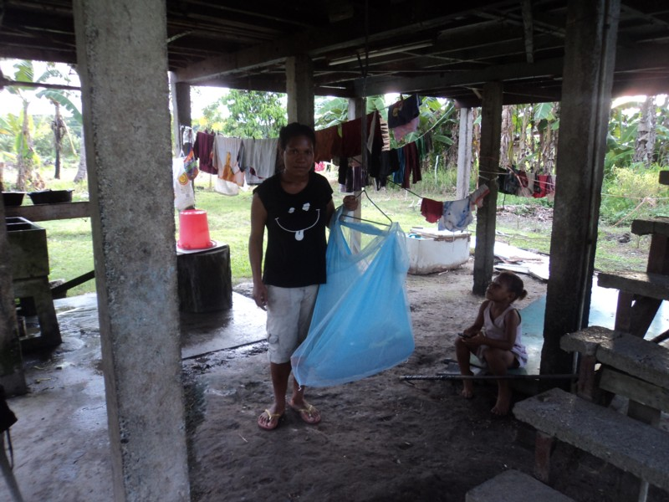
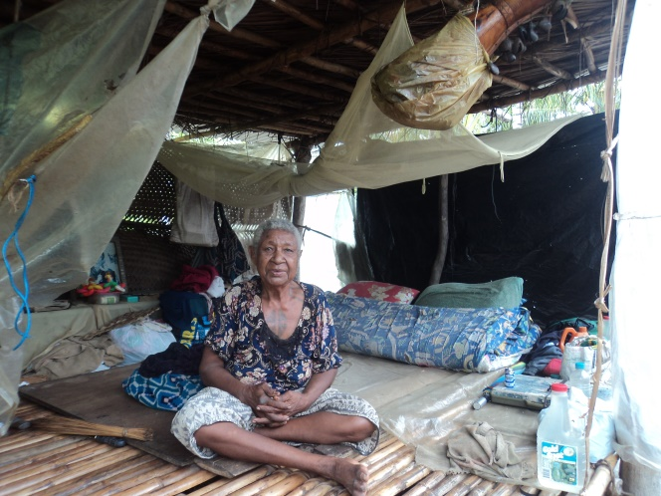
Two generations appreciate the protection of RAM bed nets

Slide 7
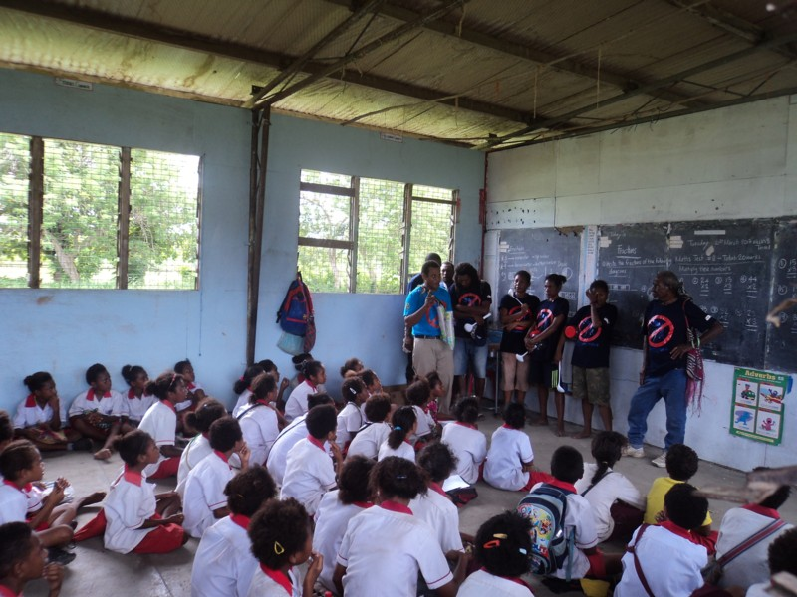
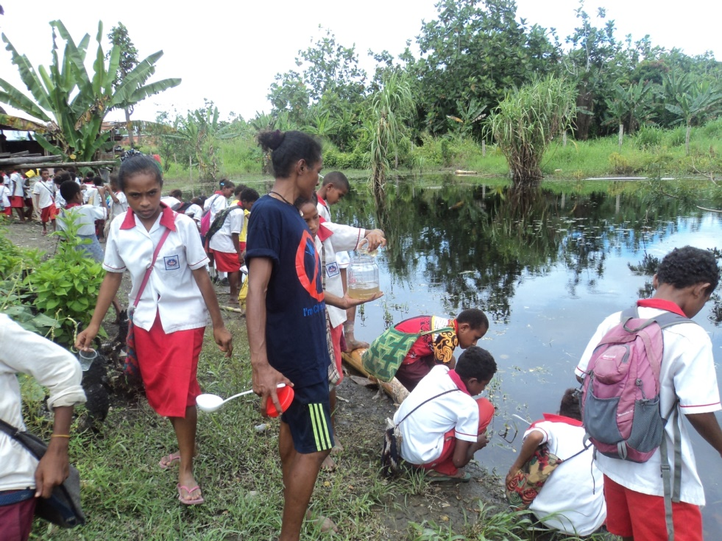
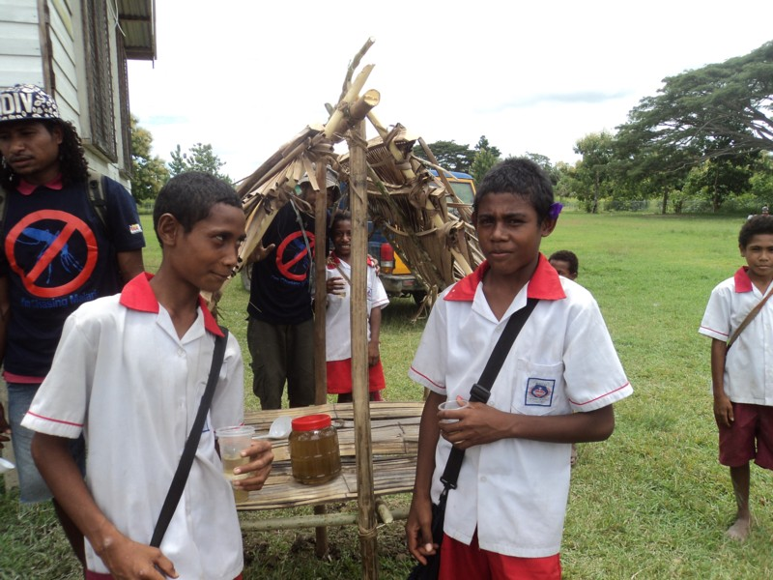
Chasing Malaria volunteers and local school surveillance recruits

Slide 8
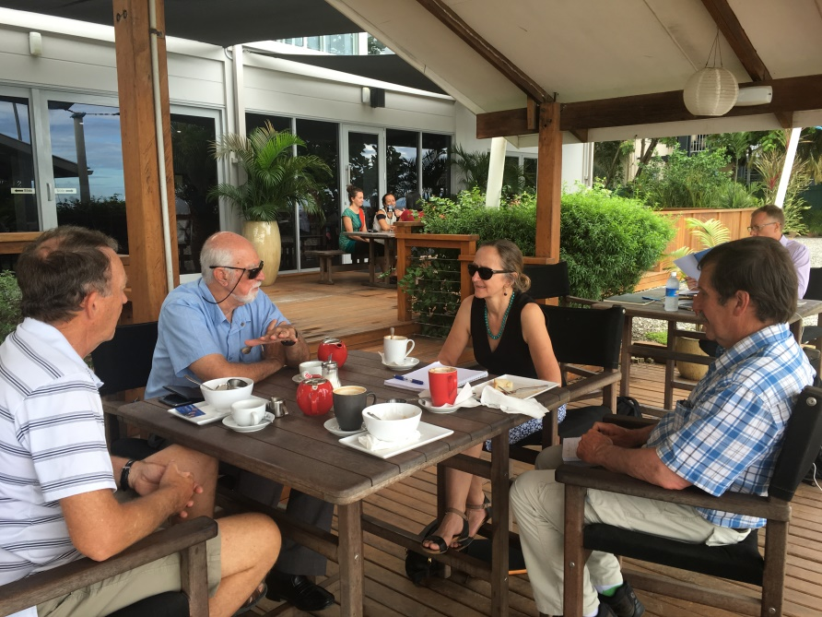
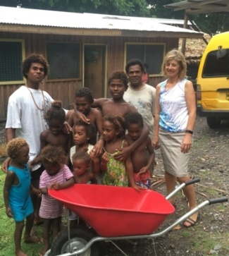
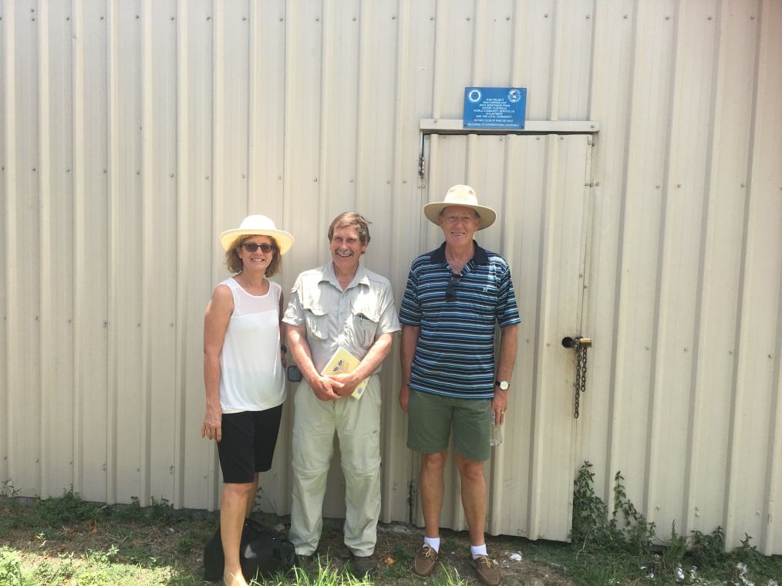
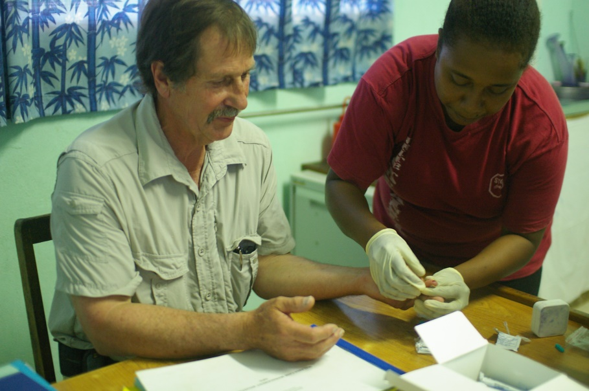

Slide 9
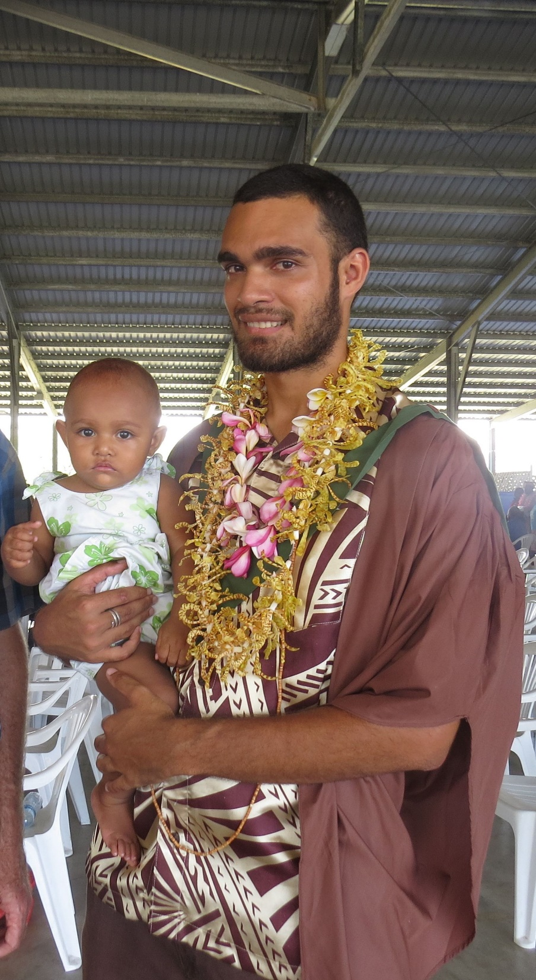
Successful first Recipient of the RAM Scholarship:
Edgar Pollard MSc
Research Topic:
Understanding mosquito flight to maximize malaria and dengue control by insecticide impregnated barriers.

Slide 10
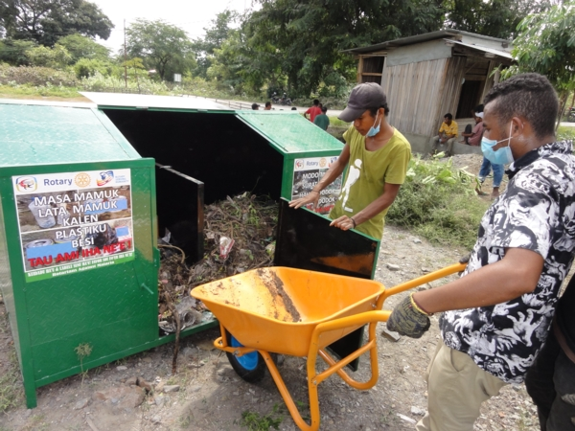
RAM and Rotary Club of Dili Lafaek
Healthy village project in Timor Leste

Slide 11
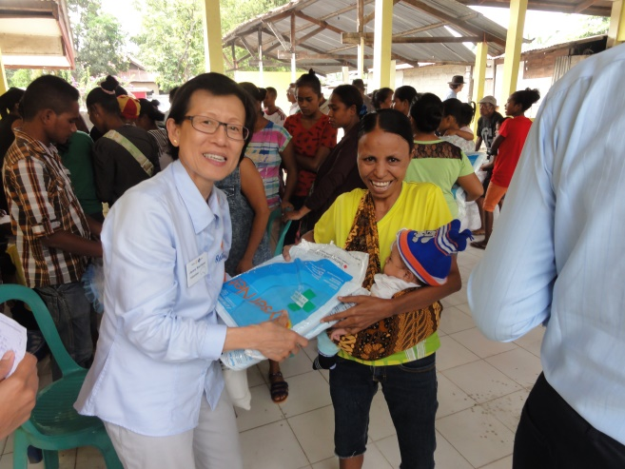
RAM Rotary Volunteers 2017

Slide 12
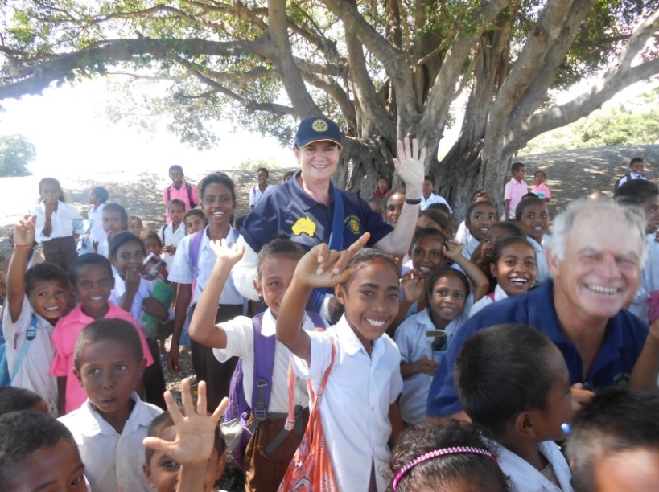
RAM Vision Elimination
‘STRATEGIC’ provision of bed nets.
Rapid Diagnostic kits, Educational flip charts.
Convince RI that Malaria should be next after Polio.
RAM Healthy Villages.
Expand ‘Chasing Malaria’ program.
Seek to work with Rotary Indonesia.
PhD in Vector Bourne disease.
More Volunteer teams.

Slide 13

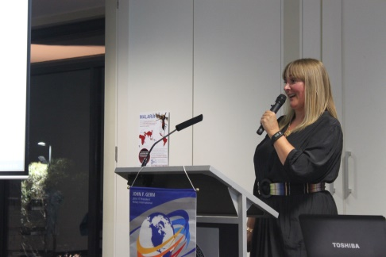
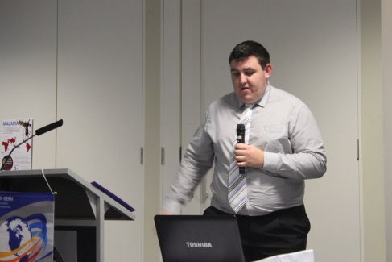
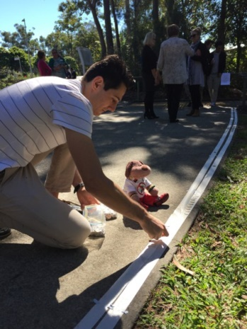
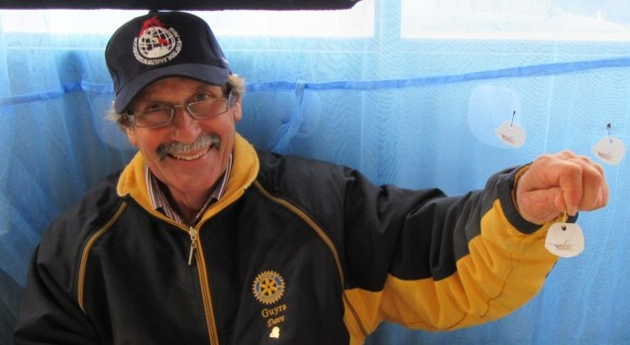
Awareness Raising
Malaria Awareness Day April 30

Slide 14

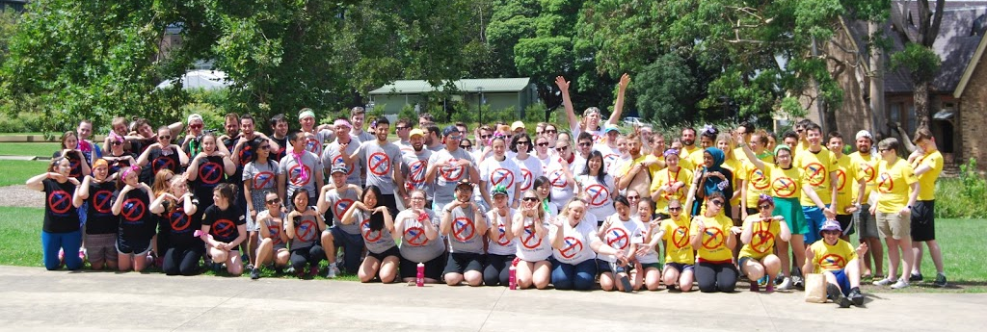

Slide 15
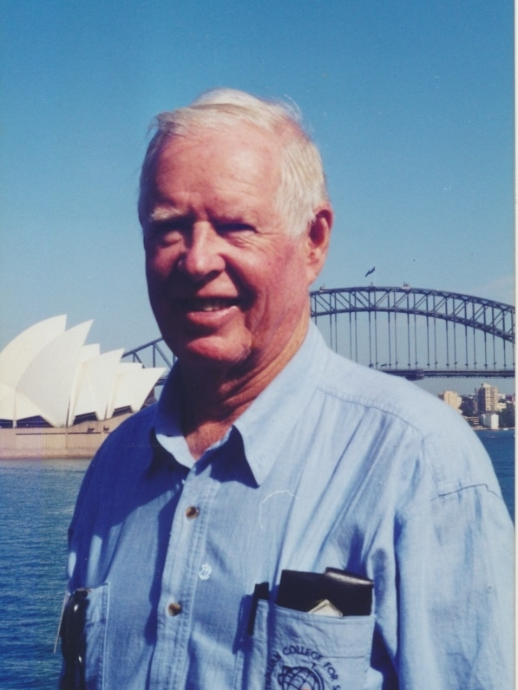
Vale PDG Richmond Manyweathers OAM
Paul Harris Fellow (Ruby level)
Australian Rotary Health – Gold Companion
Rotary International “Service Above Self” Award – 2003
Rotary Centennial Community Volunteer Award – 2005
RAWCS Humanitarian Service Award - 2015
A tireless worker for Rotary and RAM

Slide 16
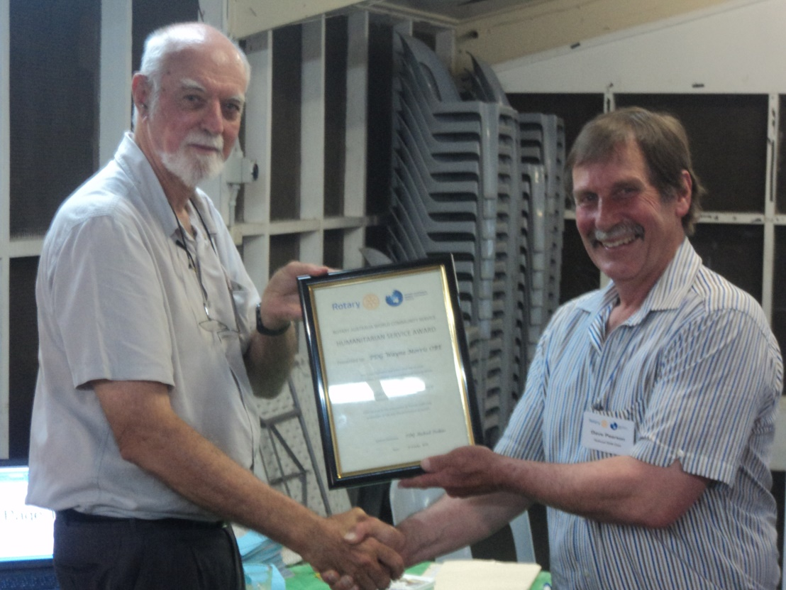
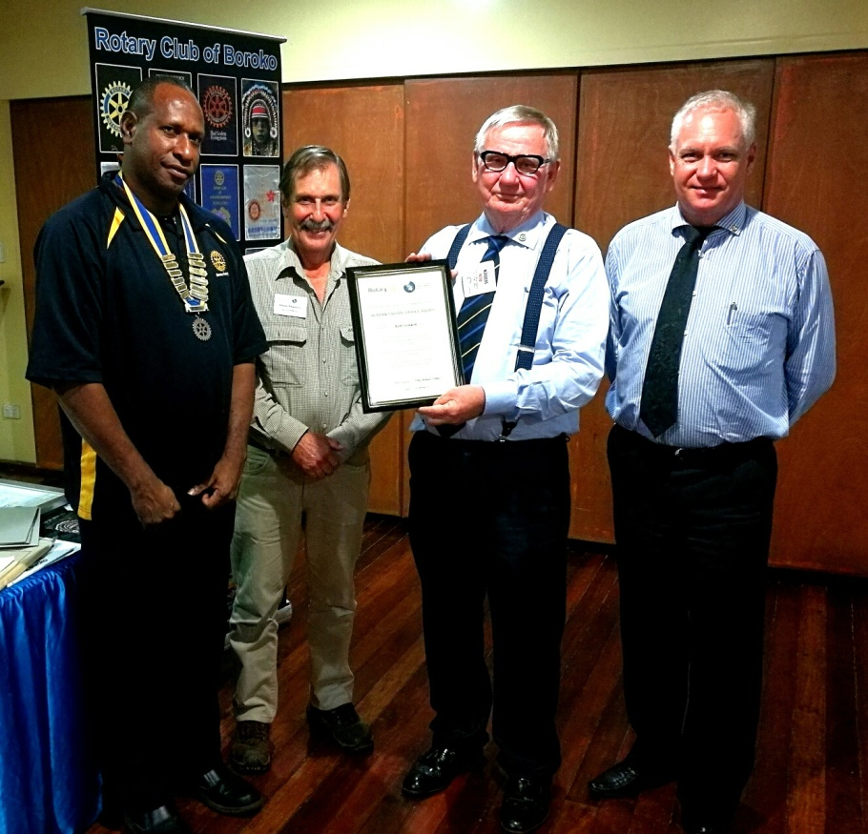
Humanitarian Service Awards
Wayne Morris RAM Solomon Islands
Ron Seddon RAM PNG

Slide 17
Elimination will require:-
Accurate surveillance and mapping
Maintenance of control measures
A reliable field test for asymptomatic carriers
New affordable drug as a reliable treatment
Multi valent vaccine

Slide 18
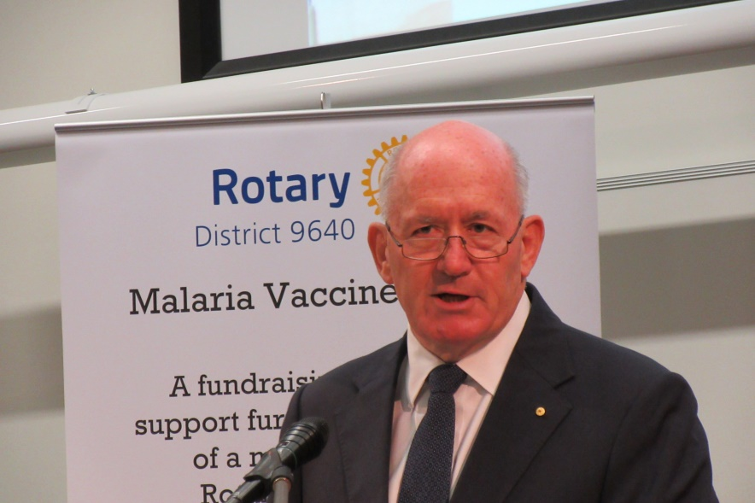
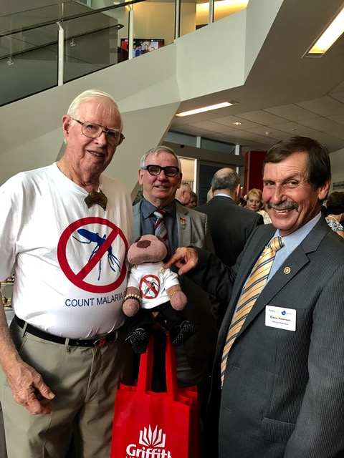
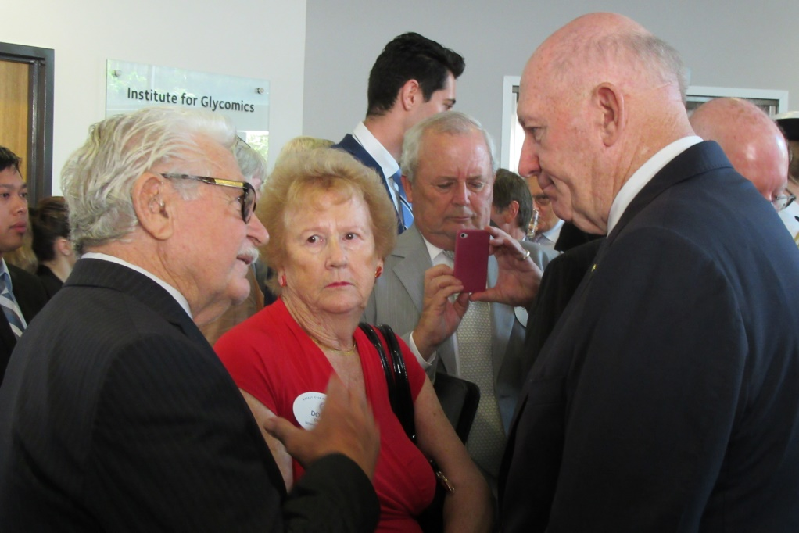
Malaria Vaccine
Fund raising project
Launch:-
Vaccine candidate: PlasProtecT®

Slide 19


