Slide 1
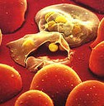
Development of a Whole Parasite Blood-Stage Malaria Vaccine
Dr Danielle Stanisic
Laboratory of Vaccines for the Developing World
Institute for Glycomics, Griffith University

Slide 2
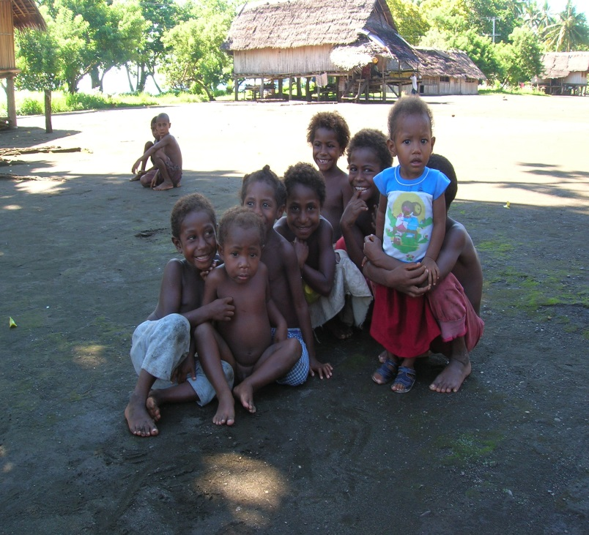
Why do we need a malaria vaccine?
Up to 500, 000 deaths in 2015
-mostly children <5 years and pregnant women
214 million cases of malaria in 2015
90% of malaria in sub-Saharan Africa
40% of world’s population at risk
Becoming more difficult to treat malaria
-insecticides and anti-malarial drugs are increasingly less effective due to development of resistance

Slide 3
Evaluation and testing of vaccines
In most countries, the evaluation and testing of vaccine follow a set of standard steps:
Pre-clinical laboratory and animal studies
Human Clinical studies
  -Phase I
  -Phase II
  -Phase III
3. Approval and licensing

Slide 4
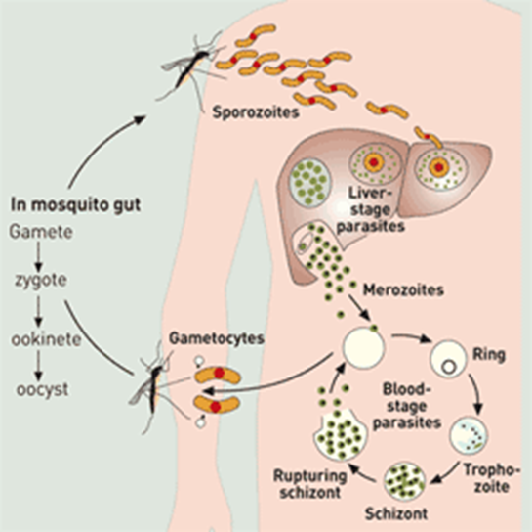
Considerations for a malaria vaccine
Which Plasmodium species should a vaccine target?
There are 6 species of malaria that infect humans: Plasmodium falciparum and Plasmodium vivax are dominant.
What Plasmodium stage should be targeted?
What do we want a malaria vaccine to do?
-eliminate infection?
-reduce disease?
-prevent transmission?
Requirements: affordable, capable of inducing long-term immunity, well tolerated and non-toxic

Slide 5
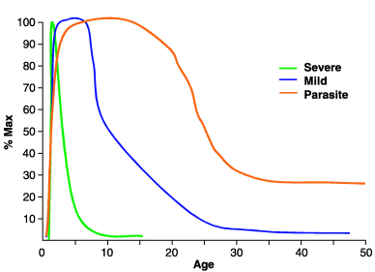
Immunity to the malaria parasite
Is acquired gradually and is related to exposure.
Is not sterilising and people living in endemic areas are continually re-infected.
In areas of high malaria endemicity, adults with no symptoms may have low levels of parasites in their blood.
Associated with a reduction in clinical symptoms and parasite levels.

Slide 6
Immune response to the malaria parasite

Slide 7
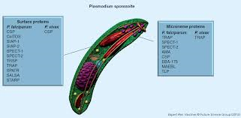
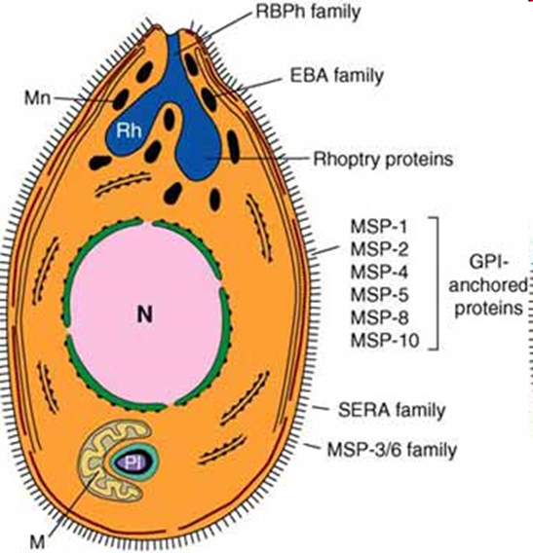
2 Broad Vaccine Approaches
Sub-unit vaccines
Contain a small part of the parasite eg a single protein
Require adjuvants (substance that enhances immune response)
Proteins that are targeted are often variable between different parasite strains
Immune responses often not long-lived
Low and variable protection

Slide 8
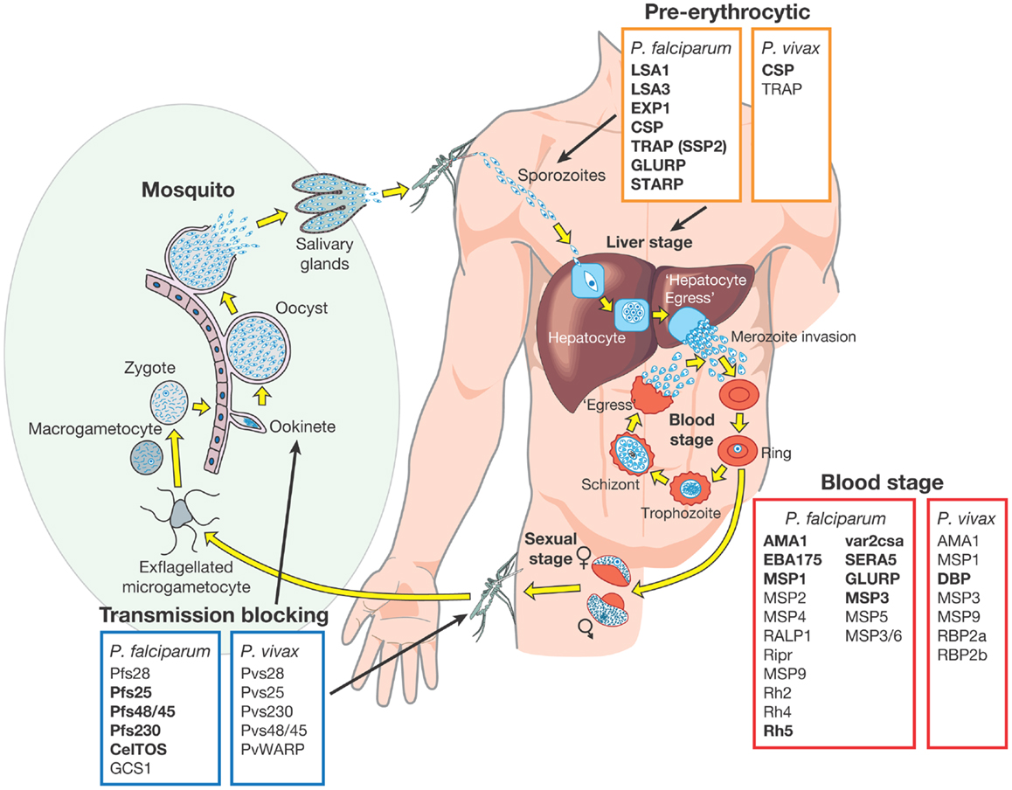
Sub-unit vaccine
candidates
Barry et al 2014 Front Immunol 5: 359

Slide 9
RTS,S (Mosquirix)
-Only vaccine to successfully complete Phase III testing in >15,000 infants and young children in 7 countries in Sub-Saharan Africa (2009-2014). Partial protection against episodes of clinical malaria observed.
-Very low efficacy in infants who received 3 doses of the malaria vaccine at 6,10 and 14 weeks of age (27% at 20 mths to 18.3% at 48mths of follow-up).
-In children who received their first (of 3) vaccinations at 5-17mths of age, efficacy was 45.1% at 20mths, falling to 28.3% at 48 mths.
-A fourth dose administered 18mths after primary series improved efficacy (36.3% at 48mths).
-Over a period of 7 years, vaccine efficacy was 4.4%.
Strain specificity of the immune response: Vaccine efficacy against matched strains (10% of all strains) was 50.3% and 33.4% against non-matched strains over 48mths.
The World Health Organization Regional Office for Africa (WHO/AFRO) announced on April 24, 2017, that Ghana, Kenya, and Malawi will partner with WHO in the Malaria Vaccine Implementation Program (MVIP) that will make the RTS,S vaccine available in selected areas of the three countries, beginning in 2018.

Slide 10
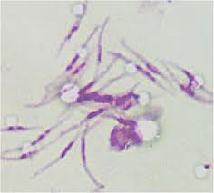
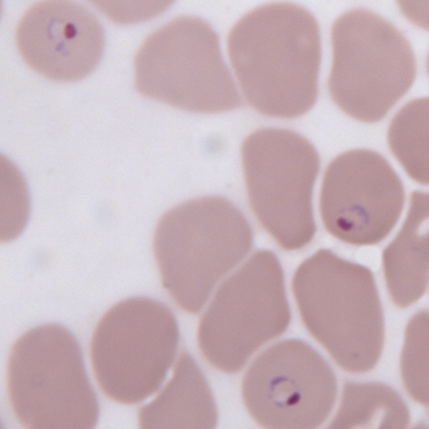
Whole Parasite Vaccines
Many different protein targets including proteins that are the same (conserved) between parasite strains
Approaches:
-Irradiated parasite vaccine
-Genetically attenuated parasite vaccine
-Chemically attenuated parasite vaccine

Slide 11
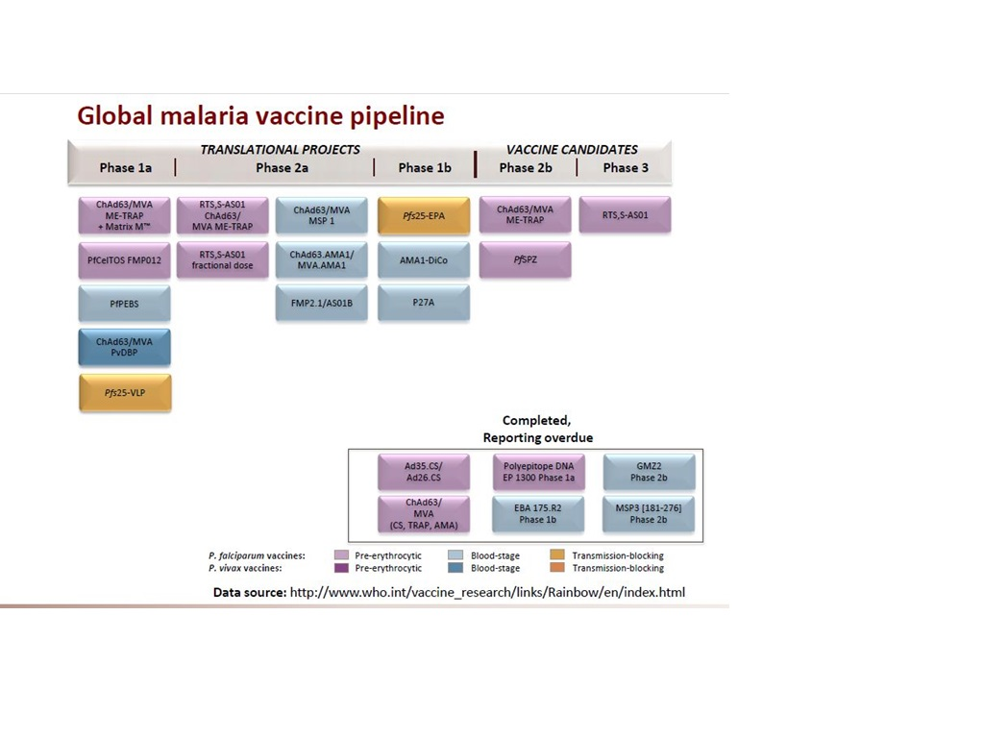

Slide 12
Development of a chemically attenuated whole parasite blood-stage vaccine (PlasProtect)
Chemical used to treat malaria parasite:
Tafuramycin-A binds to malaria parasite DNA and this stops the parasite replicating
In rodent model, chemically treated parasites could protect mice from challenge
Immune response induced by vaccine:
X Antibodies √ CD4+ and CD8+ T cells
Tafuramycin-A

Slide 13
Pre-clinical Vaccine Development
Chemically treated parasites
induce protection against challenge
Mice challenged with same malaria parasite as in vaccine
Mice challenged with different malaria parasite

Slide 14
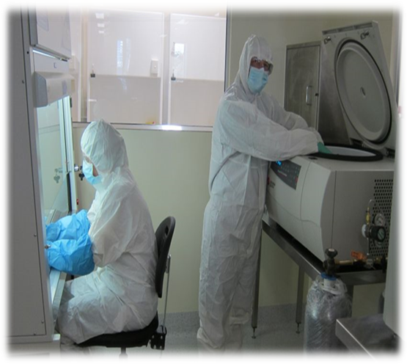
Clinical Vaccine Development
Development of Plasmodium falciparum
cell banks
Required:
To make the vaccine
For challenge to examine if the vaccine protects
P. falciparum parasites expanded in transfusion-grade Blood Group O Rh negative red blood cells in the cleanroom at Griffith University and then frozen.
Tested according to specific criteria to allow use in humans.
DI Stanisic et al 2015 Malaria J 14: 143.

Slide 15
ROTARY PARTNERSHIP
ROTARY DISTRICT 9640
-Rotary Clubs of Southport, Broadbeach, Hope Island, Satellite Club of Southport-Griffith University
-fundraising project to support further development of the vaccine (clinical trial)
-registered by Rotary Australia Benevolent Society and endorsed by the National Committee of Rotarians Against Malaria

Slide 16
Acknowledgements
Institute for Glycomics Gold Coast Hospital Sanaria
Michael Good John Gerrard Steve Hoffman
Xue Liu James Fink Kim Lee Sim
Bibiana Rodriguez Johanna Mayer Tao Li
Jolien Pingnet Lana Sundac
Jessica Powell Letitia Gore
Mei-Fong Ho Sarah Coghill
Nicole Willemsen
Ibrahim El-Deeb Burnet Institute Mater Hospital
Tanya Forbes James Beeson Paul Griffin
Nicola Cocroft Jo-Anne Chan
Chris Davis Christine Langer
Michael Batzloff
Silvana Sekuloski Australian Army Malaria Institute
Judy Coote Dennis Shanks; Qin Cheng
Maryna Martin Marina Chavchich THE VOLUNTEERS
QIMR Berghofer Institute Bio21 ROTARY
for Medical Research Eric Hansen
James McCarthy
Silvana Sekuloski Georgia State University
Katharine Trenholme Moses Lee
Wendy Chung

