Slide 1
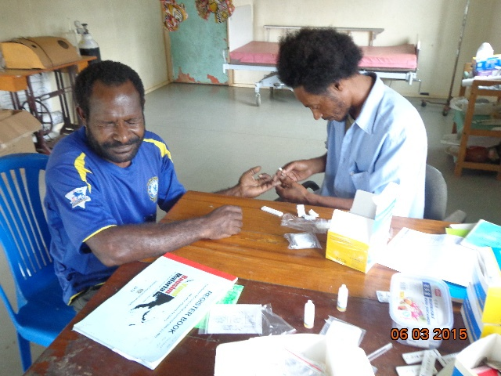


ROTARIANS AGAINST MALARIA
PAPUA NEW GUINEA
Chasing Malaria In PNG
Annual Report
August 2017 Sydney Australia
August 2017
Tim Freeman

Slide 2

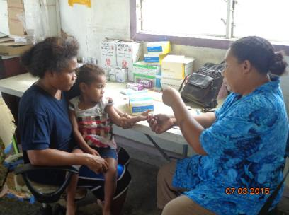
PNG – MALARIA PROGRAMME
BACKGROUND
Historically Papua New Guinea has one of the highest burdens of malaria outside of Africa.
PNG has annually been reporting about 1.7 million cases annually plus about 600 deaths. Annual incidence rates about 300 per thousand people
One of the first published works on the efficacy of treated nets was published by IMR (Institute of Medical Research) in 1987 from Madang together with a paper from Tanzania.

Slide 3
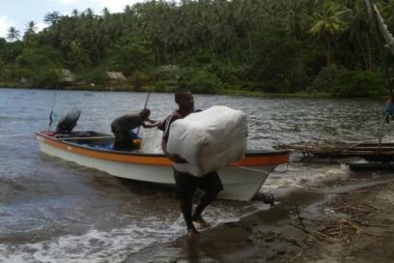
PNG - MALARIA PROGRAMME
BACKGROUND (2)
With Global Fund support:
From 2005 to 2009 about 2.3 million LLINs were distributed by National Department of Health (NDoH.
Under RAM coordination, in the last seven years a total of about 9.4 million LLINs have been distributed (8.2 million LLINs to Household Level and 1.2 million LLINs to Vulnerable Groups).
This give a total of about 11.7 million nets distributed in PNG.
Nets have been distributed to all 89 districts in all 22 provinces.

Slide 4
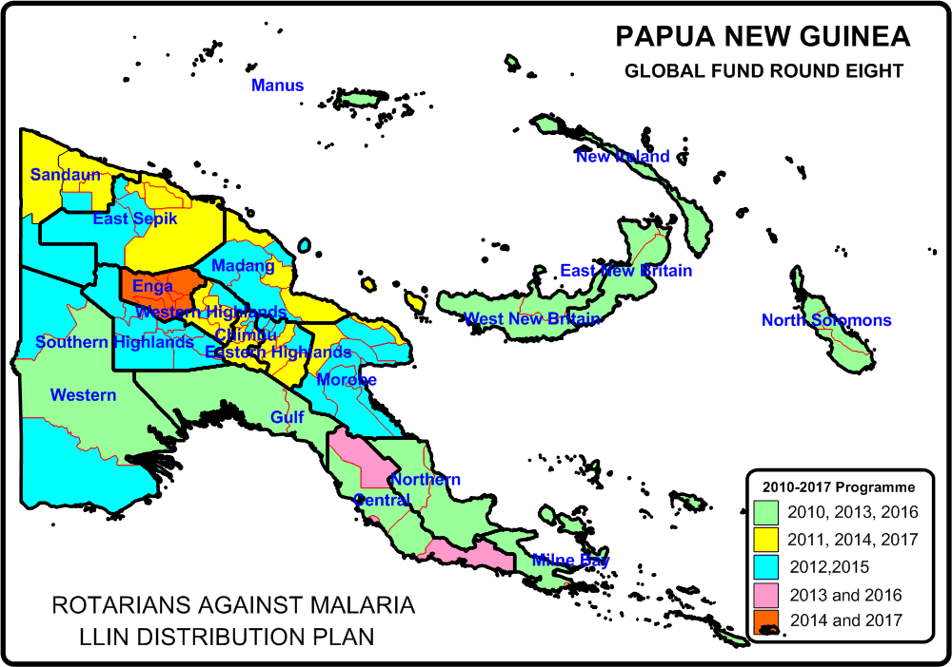
PNG - MALARIA PROGRAMME
RESULTS
RAM Distributes LLINs On A Three Year Basis To All Areas Of PNG

Slide 5
PNG - MALARIA PROGRAMME
RESULTS (2)
Distribution Of LLINs To Household Level
Period | Dates | Districts | Provinces | Nets Delivered
Phase One (2010-2011) | Nov 09 - Oct 11 | 50 Districts | 18 Provinces | 1,890,448
Year 3 (2012) | Nov 11 - Sep 12 | 27 Districts | 10 Provinces | 832,671
Year 4 (2013) | Oct 12 - Sep 13 | 28 Districts | 12 Provinces | 1,210,391
Year 5 (2014) | Oct 13 - Sep 14 | 23 Districts | 11 Provinces | 1,374,791
Year 5 (2014) No Cost Extension | Oct 14 - Dec 14 | Okapa, Lufa, Madang, Angoram, Maprik, Yangoru Saussi, Wewak, Aitape Lumi, Nuku and Vanimo Green | EHP, Madang, East Sepik and Sandaun | 454,806
Year 6 (2015) |  | 29 Districts | 11 Provinces | 932,822
Year 7 (2016) |  | 27 Districts | 13 Provinces | 805,597
Year 8 (2017) | Jan - Mar 2017 | Kokopo, Rabaul, Gazelle, Kimbe, Alotau, Samarai Nurua , Esa'ala, Kiriwina Goodenough | East New Britain, West New Britain, Milne Bay | 335,330
 | Apr - Jun 2017 | Kompiam, Wabag, Wapenamanda, Lagaip Porgera, Tambul Nebliya, Mul Bayer, Dei, Anglimp South Waghi and North Waghi | Enga, West New Britain and Jiwaka | 396,997
New Funding Model |  |  |  | 2,470,746
Round Eight |  |  |  | 5,763,107
Overall Total Phase One and Phase Two And NFM |  |  |  | 8,233,853

Slide 6
PNG - MALARIA PROGRAMME
RESULTS (3)
Distribution Of LLINs To Vulnerable Groups

Slide 7
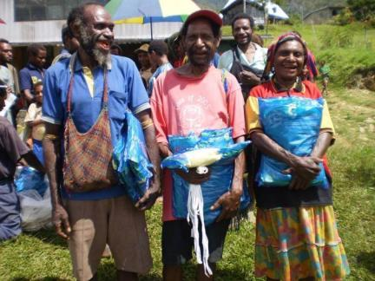
PNG - MALARIA PROGRAMME
RESULTS (4)
Impact on malaria has been massive. By 2011:
Clinical malaria incidence has fallen by as much as 70% following a distribution by nets in a district.
Prevalence of malaria has fallen by 75% in some regions.
People have been generally very happy with the programme.

Slide 8
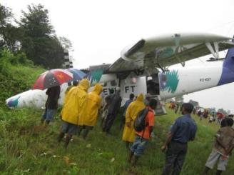
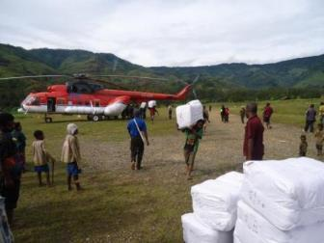
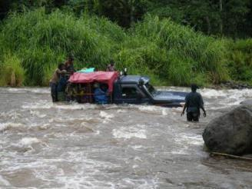
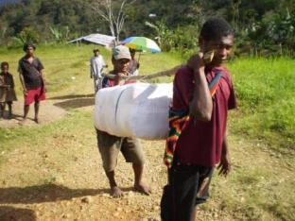
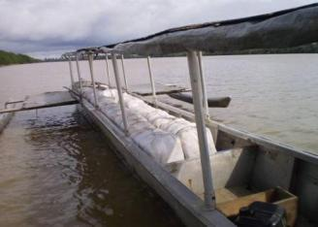
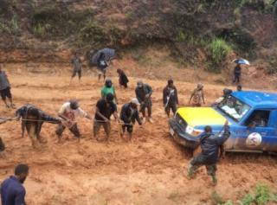
PNG - MALARIA PROGRAMME
SOME DIFFICULTIES

Slide 9
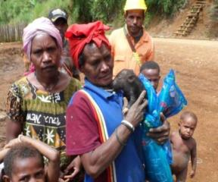
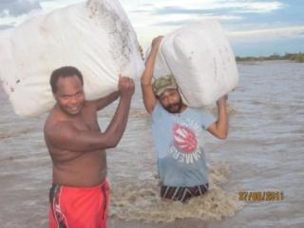
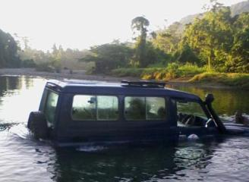
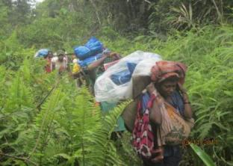
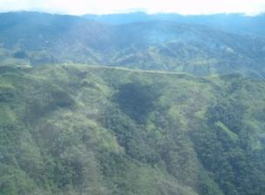
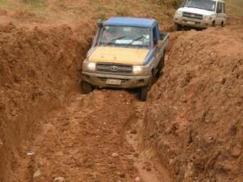
PNG - MALARIA PROGRAMME
Other Pictures

Slide 10
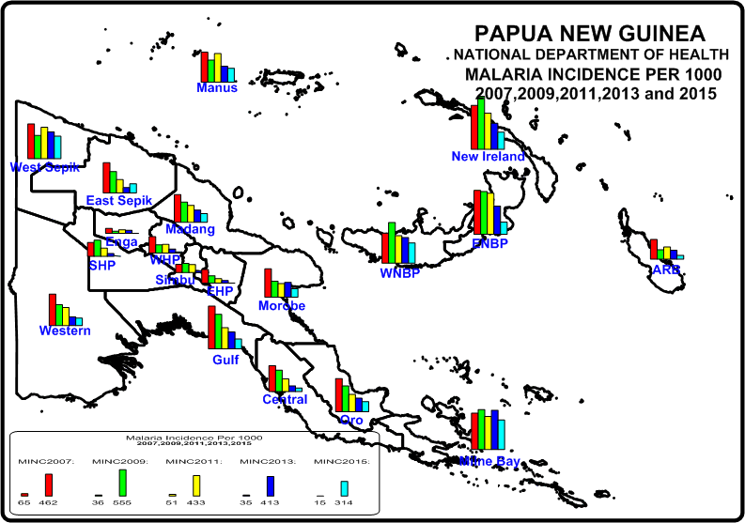
PNG - MALARIA PROGRAMME
Impact Of The Programme
Malaria is reducing in many places where nets have been distributed. Also indicated an impact against filariasis.

Slide 11
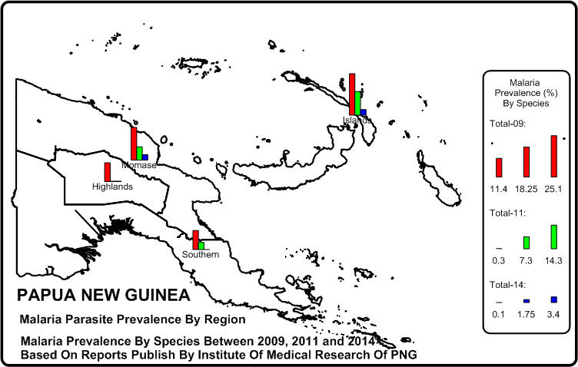
PNG - MALARIA LLIN PROGRAMME
Impact Of The Programme
Malaria Prevalence Reduced From 2009 To 2014 By More Than 90% In Highlands And Southern Region and 80% In Momase And Niugini Islands

Slide 12
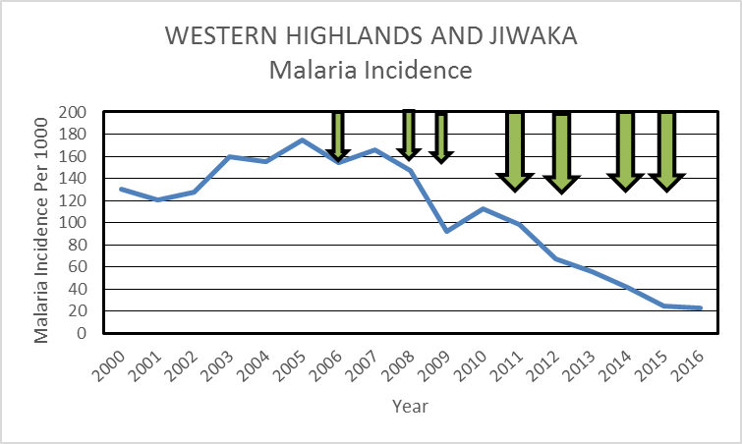
PNG - MALARIA PROGRAMME
Impact Of The LLIN Programme
THE PERFECT PICTURE

Slide 13
PNG - MALARIA PROGRAMME
CHALLENGES
Funding from Global Fund continues to decrease for LLINs:
  US$10 million a year from 2010 to 2014
  US$6 million a year 2015 to 2017
  US$4.5 million a year 2018 to 2020
Increases in malaria seen in many provinces in the last two years.
LLINs not seemingly having the same impact
Drug shortages experiences in many parts of the country
RAM has been made Sole PR for Global Fund

Slide 14

PNG - MALARIA PROGRAMME
NEW FUNDING
Against Malaria Foundation
Following a meeting in Geneva last year, RAM has managed to get support from a British Organisation called Against Malaria Foundation.
In 2017 they have donated 1,159,400 extra large nets to cover all areas targeted for nets in 2017. Only areas left out are those above 2000m where malaria is not thought to be transmitted.
Against Malaria Foundation gives the nets and Global Fund pays for everything else.
This donation has been a life saver.

Slide 15
PNG - MALARIA PROGRAMME
NEW FUNDING
Against Malaria Foundation
Against Malaria Foundation (AMF) has also committed to give nets for the next three years. At present we are looking at
  2018 – 973,707
  2019 – 1,039,429
  2020 – 1,215,041
Despite this, we are still short of funds as funds available from the Global Fund cannot fund the distribution of any more nets.
We are still short of nets for pregnant women an all areas above 1600 m.

Slide 16
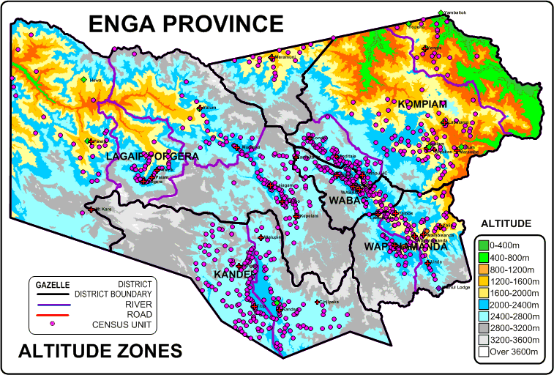
PNG - MALARIA PROGRAMME
LLINs Will Not Be Distributed In Areas Above 1600m
At present, Enga Province will receive very few nets in future

Slide 17
PNG - MALARIA PROGRAMME
NEW FUNDING
We are still hoping that Global Fund will still find extra funds to cover antenatal nets as well as household distribution in areas above 1600m.
In part, we hope to cover some of these costs through donations of private sector and Ron Seddon (Chairman of RAM) now has the role to petition the private sector for funds. For example we received funds from Oil Search in 2016 for their impact areas.

Slide 18
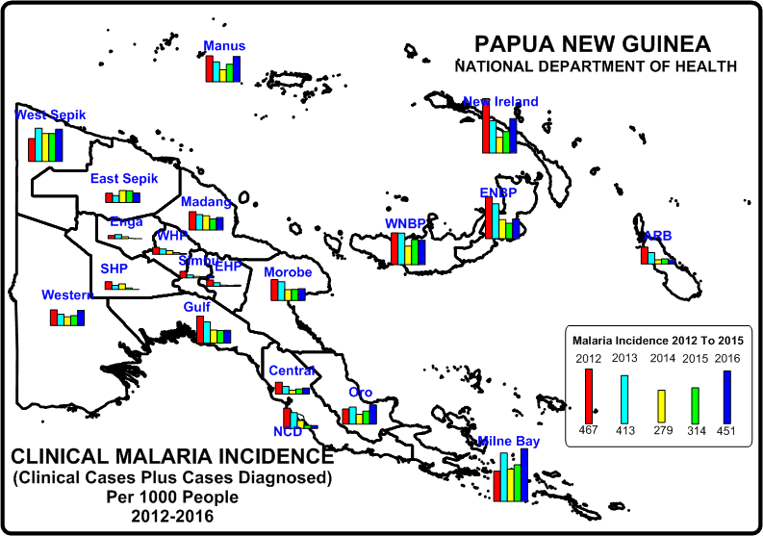
PNG - MALARIA PROGRAMME
Increases In Malaria
Results have been mixed in the last two years when the country has been facing intermittent drug shortages in some places.

Slide 19
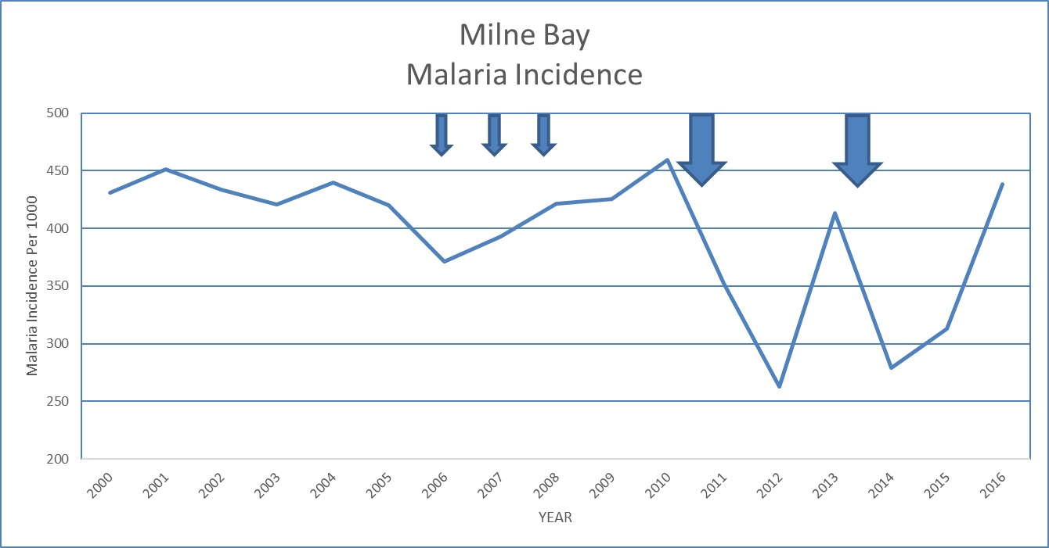
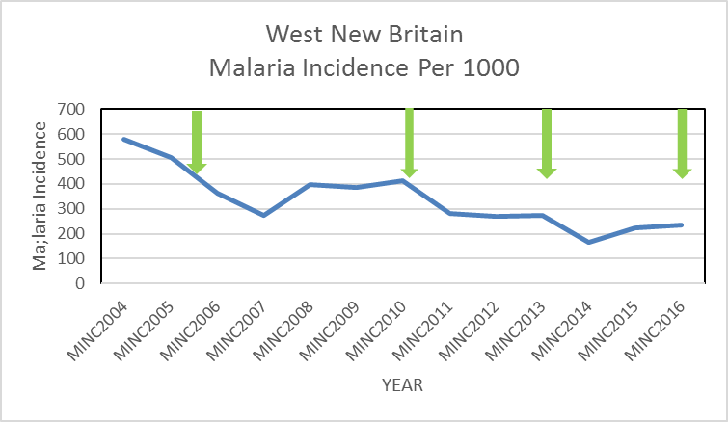
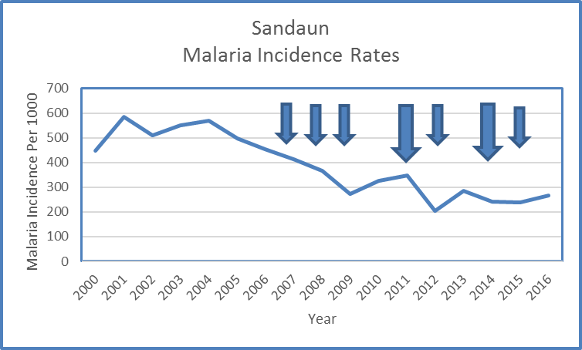
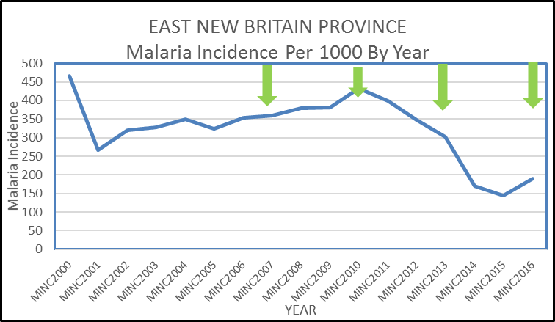
PNG - MALARIA LLIN PROGRAMME
ARE LLINS STILL WORKING

Slide 20
PNG - MALARIA LLIN PROGRAMME
ARE LLINS STILL WORKING
Distribution of LLINs normally gives rise to massive reductions in malaria which last two years.
Indications are that the effect of LLINs are now less and lasting only a year in many cases.
Theories include:
  Insecticide resistance but not yet recorded in PNG.
  People not using nets as biting densities reduce.
  Mosquitoes biting earlier
  People staying out later – village cinemas.
  Drug shortages.

Slide 21
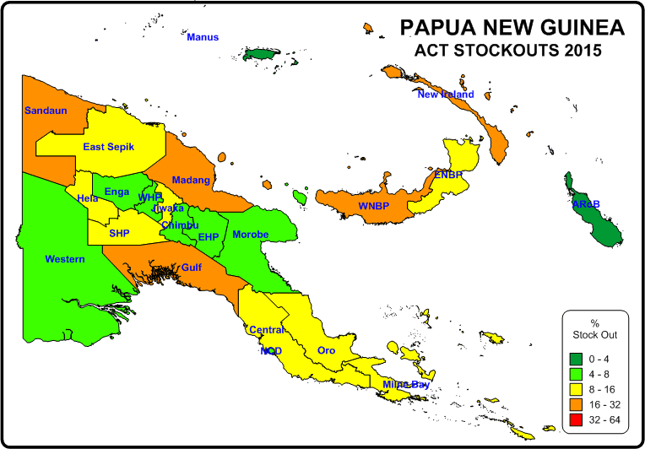
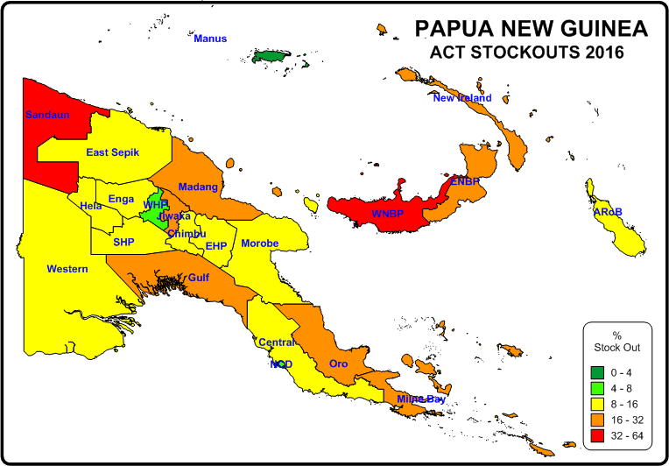
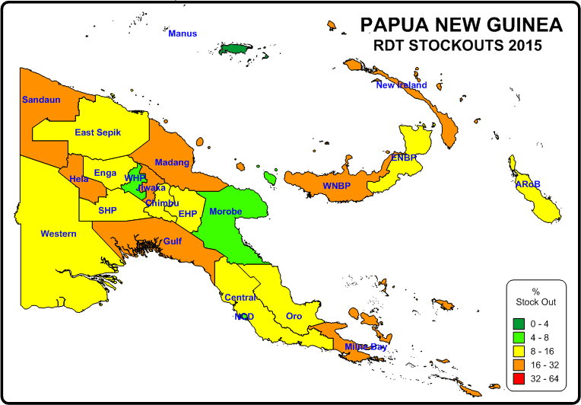
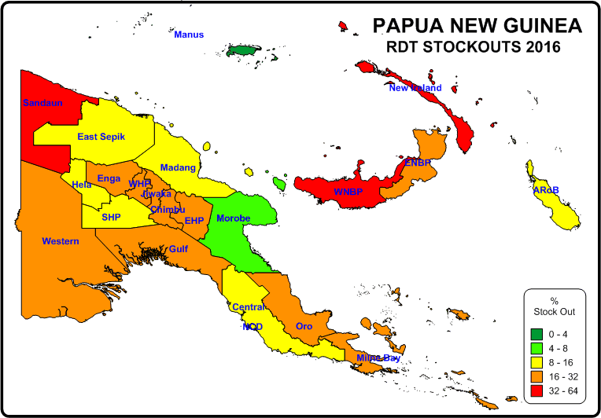
PNG - MALARIA PROGRAMME
ACT AND RDT SHORTAGES 2015 - 2016
ACT AND RDT STOCK OUT VARY FROM 2.7% To 44.8%

Slide 22
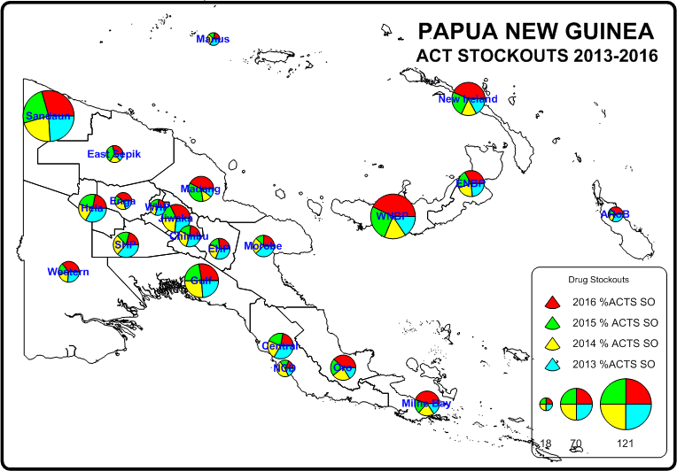
PNG - MALARIA PROGRAMME
ACT SHORTAGES 2013 - 2016

Slide 23
PNG - MALARIA PROGRAMME
ACT AND RDT SHORTAGES 2013 - 2016
Map shows that at a provincial level,
High malaria seems to be associated with stock outs – particularly Sandaun
Malaria commodity stock outs are not new.
Provinces with Area Medical Stores have less stock outs that those without.
Some provinces appear to have perennial stock out problems such as Sandaun, West New Britain, New Ireland and Gulf.

Slide 24
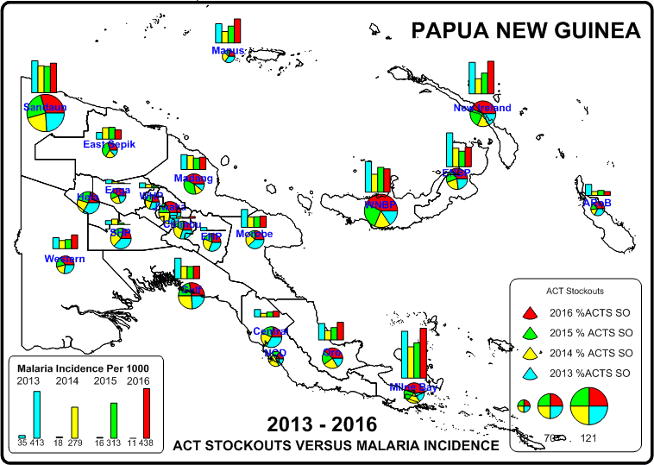
PNG - MALARIA PROGRAMME
SHORTAGES VERSUS MALARIA 2013 - 2016

Slide 25
PNG - MALARIA PROGRAMME
RAM WILL BE SOLE PRINCIPAL RECIPIENT FOR MALARIA IN PNG
Global Fund has given only US$21 million for PNG for malaria for 2018-2020 which is down from US$35 million in the period 2015-2017.
There are not enough funds to support two Principal Recipients so Population Services International (PSI) will no longer be supported at the end of 2017.
With this will also disappear NGO supported Home Based Management of Malaria (HMM).

Slide 26
PNG - MALARIA PROGRAMME
RAM WILL BE SOLE PRINCIPAL RECIPIENT FOR MALARIA IN PNG
Of the US$21 million, only US$13.5 will go to LLINs and US$3.5 million to drugs as a result of the apparent drug shortages.
The remaining funds will support the Institute of Medical Research and the National Malaria Control Programme (NMCP).

Slide 27
PNG - MALARIA PROGRAMME
RAM WILL BE SOLE PRINCIPAL RECIPIENT FOR MALARIA IN PNG
In addition to distributing nets, RAM will be responsible for the following:
  Recruitment of about 15 people within NDoH.
  Payment of per diems and other payments for both NDoH and IMR who both have a no cash policy with the Global Fund.
  Procure and distribute drugs if necessary.

Slide 28
PNG - MALARIA PROGRAMME
RAM WILL BE SOLE PRINCIPAL RECIPIENT FOR MALARIA IN PNG
The new programme will see the following changes:
  It is hoped that the NDoH will procure enough drugs so that the money can be used for other issues.
  RAM will employ a person to work within the NMCP to assist with capacity building and management.
  NDoH has agreed to carry out the following:
    Carry out a national prevalence surveys each year in schools,
    Finalise a home based management policy and work with provinces to implement with provincial health services rather than through NGOs.
    Continue with other activities related to improving diagnosis, treatment and reporting.

Slide 29
PNG - MALARIA PROGRAMME
RAMS CONTRIBUTION TO MALARIA CONTROL - CHASING MALARIA
Many challenges still remain apart from drugs shortages, early biting mosquitoes etc.
The biggest challenge is knowing where malaria is and dealing with it on a community basis.
Many areas in PNG will not be supplied with mosquito nets and cheap LLINs nets are not generally available in shops.
RAM PNG has an approach to all these three issues and is known by the name CHASING MALARIA.

Slide 30
PNG - MALARIA LLIN PROGRAMME
CHASING MALARIA
MAPPING MALARIA
Two years ago RAM sponsored the improvement of a Rapid Diagnostic Tool Register. Formally this form was a single form and only recorded where the name, age and sex of the patient being tested. This form was inevitably thrown away at the end of each month.
RAM improved this form, included where the patient came from, and made the forms into a register with duplicates. It is now possible to visit any health centre in PNG and know where the malaria positive patients are coming from.

Slide 31
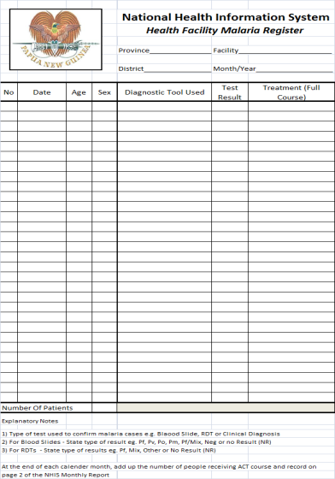
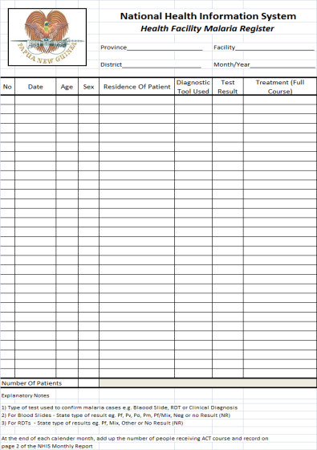
PNG - MALARIA LLIN PROGRAMME
CHASING MALARIA
Old Form New Form Being Distributed
Countrywide

Slide 32
PNG - MALARIA LLIN PROGRAMME
CHASING MALARIA
RAM pays for all the registers which can be found in nearly all the health centres in the country.
Where time and funds allow, RAM is able to map this data. Below is the preliminary results of data collected in Oro Province which shows all the negative and positive cases by village throughout the province.
The data clearly also shows where malaria cases are not being tested.

Slide 33
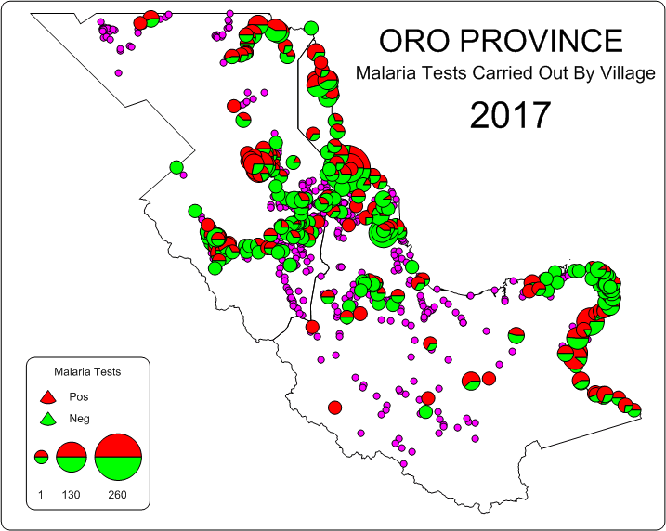
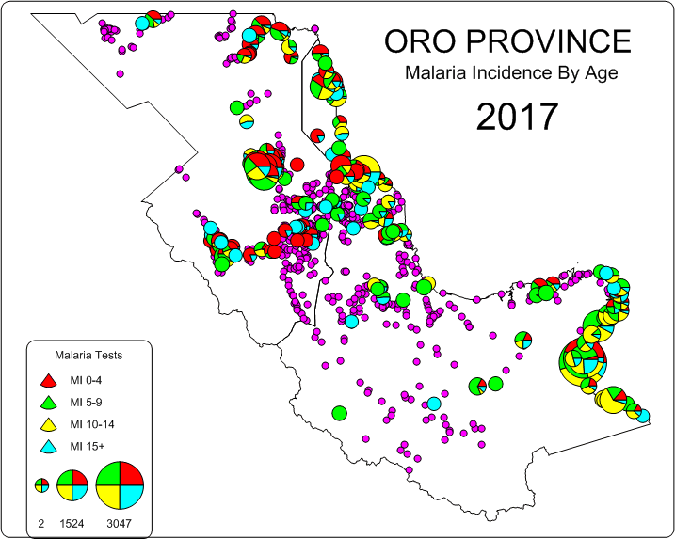
PNG - MALARIA LLIN PROGRAMME
CHASING MALARIA
Data Collected From Oro Province In 2017

Slide 34
PNG - MALARIA LLIN PROGRAMME
CHASING MALARIA
MAPPING IN CENTRAL AND NCD PROVINCES
Since late 2014, RAM has been giving nets away for all RDT positive cases. This has encouraged people to get tested while allowing health staff to collect data on malaria cases throughout the two provinces.
We also collect data on the travel history of the patients.

Slide 35
PNG - MALARIA LLIN PROGRAMME
CHASING MALARIA
LLINs Given Out For Positive Cases Of Malaria In Central, NCD and Gulf Provinces

Slide 36
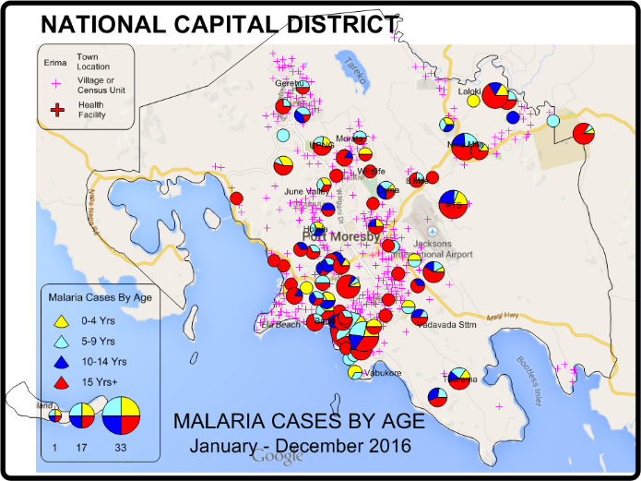
PNG - MALARIA LLIN PROGRAMME
Chasing Malaria Results
Data From Chasing Malaria Project Showing Malaria Incidence By Age In Port Moresby IN 2016

Slide 37
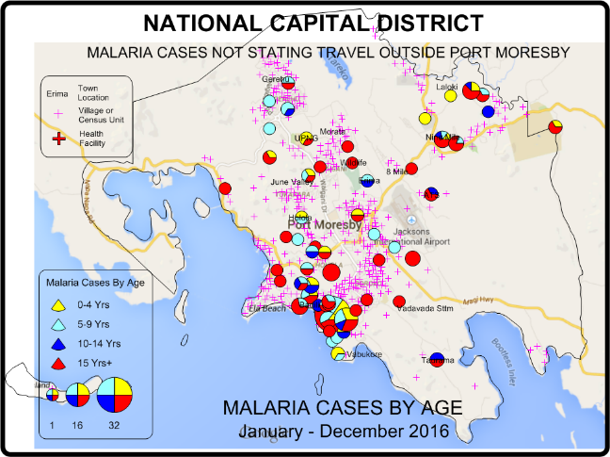
PNG - MALARIA LLIN PROGRAMME
Chasing Malaria Results
Data From Chasing Malaria Project Showing Malaria Incidence By Age In Port Moresby IN 2016 But Only Cases Which Do Not Report Travel Outside Of Port Moresby

Slide 38
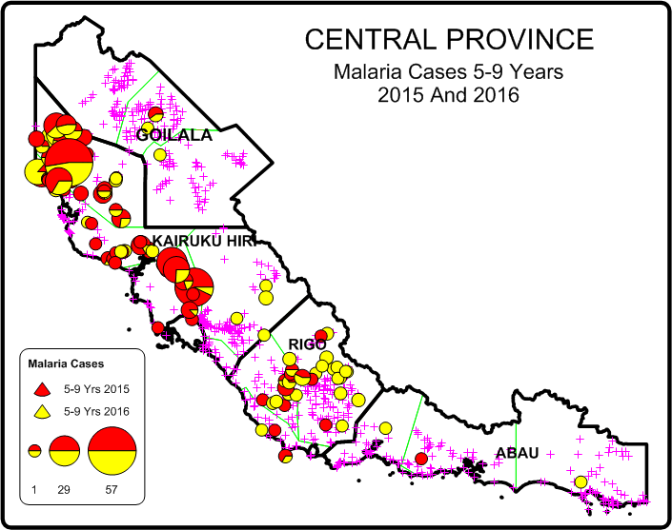
PNG - MALARIA LLIN PROGRAMME
CHASING MALARIA
MAPPING IN CENTRAL AND NCD PROVINCES

Slide 39
PNG - MALARIA LLIN PROGRAMME
CHASING MALARIA
WORKINNG WITH THE NEW ELECTRONIC NHIS
PNG has a National Health Information System that uses tablets to collect data. This system is live and data is collected everyday through data transfers.
At present, this system is operating in five provinces of Bougainville, West New Britain, Milne Bay and Enga.

Slide 40
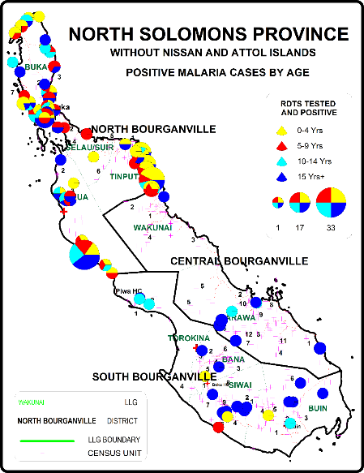
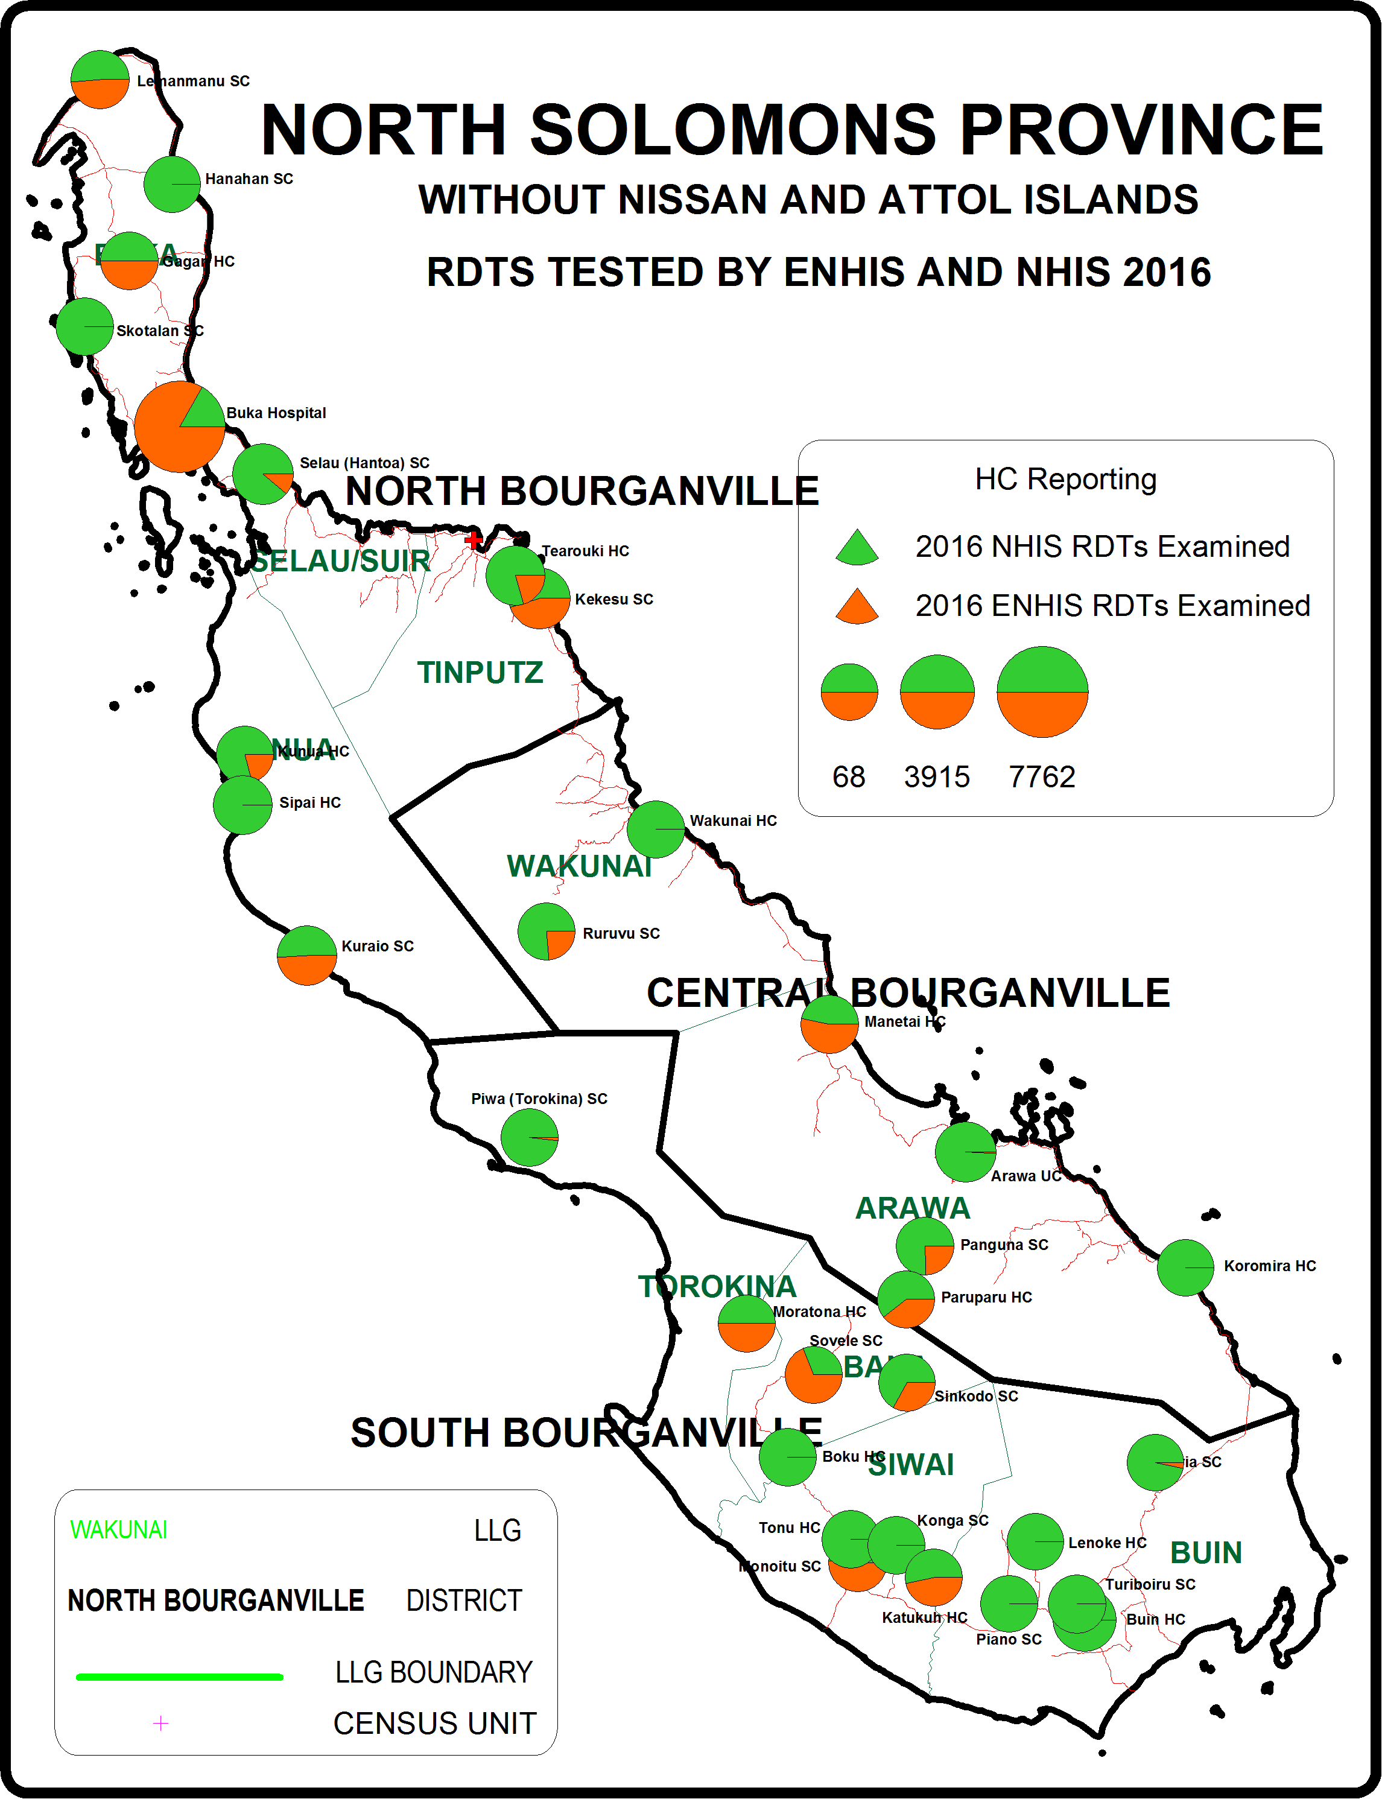
PNG - MALARIA LLIN PROGRAMME
CHASING MALARIA

Slide 41
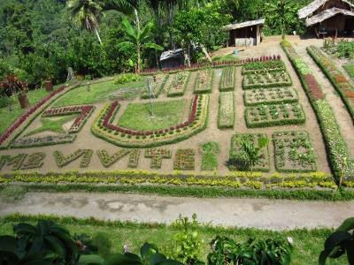
PNG - MALARIA LLIN PROGRAMME
CHASING MALARIA
Bougainville
Reduction of malaria appears associated with a health Island Project which started in 2006 in the south of Bougainville.
We visited the Health Islands Community Project. What we learnt is that community involvement takes a very long time. 25 exhibition villages in 10 years.

Slide 42
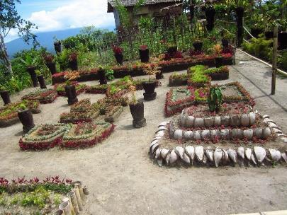
PNG - MALARIA LLIN PROGRAMME
CHASING MALARIA
Bougainville
Programme was very surprised to see the malaria hotspots.
We shared many ideas about community involvement.
Question is how to go forward.
RAM can help with mapping malaria but not sure if we can expand into Bougainville as this would be expensive.

Slide 43
PNG - MALARIA LLIN PROGRAMME
CHASING MALARIA
Community Involvement
RAM has been working with communities in the Kairuku area of Central Province where malaria is the worst and does not appear to have reduced by very much, particularly in the Waima area.
Working closely with four health centres.
Presently working with 15 schools and many communities to encourage looking for breeding sites of malaria on a weekly basis.
School teachers and children are educated in malaria and asked to form school clubs which should look for larvae on a weekly basis.

Slide 44
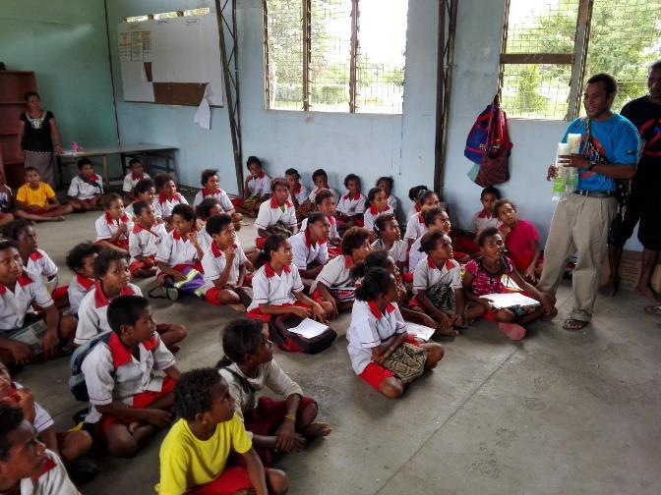
PNG - MALARIA LLIN PROGRAMME
CHASING MALARIA
Community Involvement

Slide 45
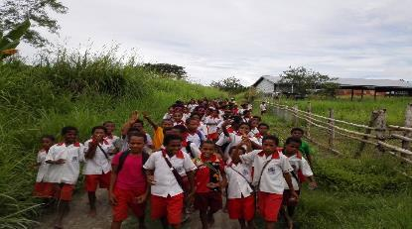
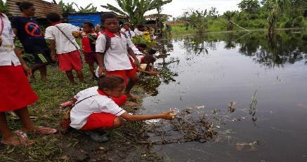
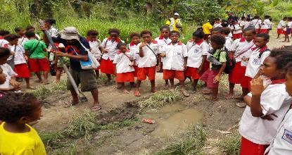
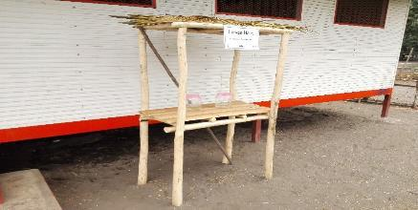
PNG - MALARIA LLIN PROGRAMME
CHASING MALARIA
Community Involvement
Picture 1. Sacred Heart Primary School Students going to Collect Larvae
Picture 2. Students Collecting Larvae at Barina Village, Bereina Station.
Picture 3. Students Participating in Land Filling Activity
Picture 4. Larvae House for Storing Larvae for Observation

Slide 46
PNG - MALARIA LLIN PROGRAMME
CHASING MALARIA
Community Involvement
Ensuring that all health centres are recording malaria on a regular basis.
We work with schools and communities trying to destroy breeding sites through filling in puddles of water, larviciding, covering water places, fish.
Also now working to set up barrier of old mosquito nets to see if this will stop malaria.
In December 2016 has the Institute of Medical Research (IMR) to carry out entomological work.

Slide 47
PNG - MALARIA LLIN PROGRAMME
CHASING MALARIA
Community Involvement

Slide 48
PNG - MALARIA LLIN PROGRAMME
CHASING MALARIA
Community Involvement

Slide 49
PNG - MALARIA LLIN PROGRAMME
Chasing Malaria Results - 5
Data From Chasing Malaria Project Showing Relative Malaria Cases By Age And Sex In Bereina Central Province

Slide 50
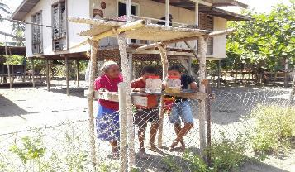
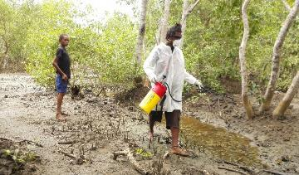


PNG - MALARIA LLIN PROGRAMME
CHASING MALARIA
Community Involvement

Slide 51


PNG - MALARIA LLIN PROGRAMME
CHASING MALARIA
Community Involvement

Slide 52


PNG - MALARIA LLIN PROGRAMME
CHASING MALARIA
Community Involvement

Slide 53
PNG - MALARIA LLIN PROGRAMME
CHASING MALARIA
Community Involvement
CHALLENGES
Community involvement a problem unless there is someone to personally supervise. Still trying to find ways to wean schools and communities to act without full project involvement.
LLIN Distribution brought malaria down in January 2016. Waima however proving a problem, particularly in two major villages of Kivori Poe and Kivori Kui.
Difficult to prove impact on malaria when malaria cases are already low.
Employed an entomologist to help the programme but she has now got another job.

Slide 54
PNG - MALARIA LLIN PROGRAMME
CHASING MALARIA
Community Involvement
RESULTS AND FUTURE
So far malaria in Bereina has remained the lowest levels it has been for some years. We hope that the project is contributing to these low figures.
We still need to prove that schools and communities can take ownership of the programme. Bougainville has shown that this takes time.
Use of old nets is important and now being experimented with in Kivori Poe.
Use of Mosbar also needs to be clarified.

Slide 55

PNG - MALARIA LLIN PROGRAMME
CHASING MALARIA
MAPPING IN CENTRAL AND NCD PROVINCES
Net Distribution

Slide 56

PNG - MALARIA LLIN PROGRAMME
CHASING MALARIA
MAPPING IN CENTRAL AND NCD PROVINCES
Net Distribution

Slide 57

PNG - MALARIA LLIN PROGRAMME
CHASING MALARIA
Manual On Malaria Control
RAM is presently printing a practical guide to malaria control at national and community level.
Will print 5000 copies in A4 size to be distributed to all health centres and schools in the country.
Written by RAM in collaboration with WHO staff and NDoH.

Slide 58
PNG - MALARIA LLIN PROGRAMME
Chasing Malaria Results - 4
Data From Chasing Malaria Project Showing Relative Malaria Cases By Age And Sex In Central Province And NCD

Slide 59
PNG - MALARIA LLIN PROGRAMME
Chasing Malaria Results - 6
Data From Chasing Malaria Project Showing Relative Malaria Cases By Age And Sex In Adio Central Province. Worst Malaria Village In Central.

Slide 60
PNG - MALARIA LLIN PROGRAMME
Private Sector Initiate
There were 33 outlets selling nets in Port Moresby in 2015 but most of them were centrally located.
Total revenues were 77,000 Kina with about 57 bales of nets sold and almost 2,000 Mosbar .
The project was raising enough revenue to cover the costs of the project including salaries.
Mosbar was targeted at rural villages with malaria problems as identified by the Chasing Malaria Programme. Follow up surveys showed that the Mosbar was very popular with the villagers and works well.
Adverts now developed to advertise nets and Mosbar throughout the country.
The programme has been presently abandoned as the Inland Revenue wanted to start charging GST including nets for household distribution.

Slide 61
PNG - MALARIA LLIN PROGRAMME
Private Sector Initiate
Problems have now been sorted out with IRC who have told us that we cannot use the same tax registration for selling nets and giving them away.
We are now in the process of setting up a company to sell nets. This is important as places such as Port Moresby will not receive nets in the future and RAM can supply nets at a much lower price that other commercial operators.
We hope that we can sell nets in every province of PNG.

Slide 62

PNG - MALARIA LLIN PROGRAMME
Next Steps (3)
Initial Data From Chasing Malaria Project Showing Malaria Cases Recorded In NCD and Hiri and Kairuku District Of Central Province
The Realities Of Distributing Nets In PMG

Slide 63

Thank You Very Much
Tenk Yu Tru
Tanikiu Bada Herea
PNG - MALARIA LLIN PROGRAMME

